Slide 1
North East Energy sector careers
Electrification
Notes:
The resources have been designed to be used as starter/plenary sessions for subject lessons, connecting to relevant topics within the scheme of work or related subject specific skills. There are links to additional resources or optional extension activities which could support a full careers lesson if desired.
Please read accompanying teacher guide for information on how they can be used and links to the curriculum.

Slide 2
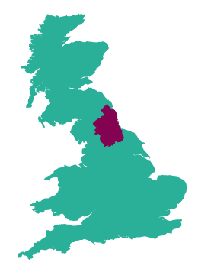
The Energy sector in the North East
The Energy sector in the North East grew by 28% between 2010 and 2021, with 3,780 related companies in the region employing over 45,000 people.
The North East is the leading location in England in the wind energy, oil and gas sectors with a thriving cluster of supply chain businesses to the subsea industry, supporting 15,000 jobs,
More than 20% of English hydro electricity generation and more than 14% of onshore wind electricity generation takes place in the North East LEP area.
The North East was home to the first electric vehicle battery production facility in Europe, with 2 more facilities currently under development
Pioneering heat network projects
79 research projects funded with £46.2m
Notes:
Facts on the sector in the NE to give context – very large employment sector already and it is growing

Slide 3
What is Electrification?
Answer the following questions whilst watching the video:
What is meant by Electrification?
Why is electric vehicle production so important to the North East?
What is the name of the electric car produced in Sunderland?
What are the 2 different routes the young people at the end of the video have taken into working for Advanced Electric Machines?
What could be the benefits of a career in Electrification?
Notes:
Students watch video and answer questions to share in class discussion
Link to video:
https://www.youtube.com/watch?v=_fu-5AYPenA

Slide 4
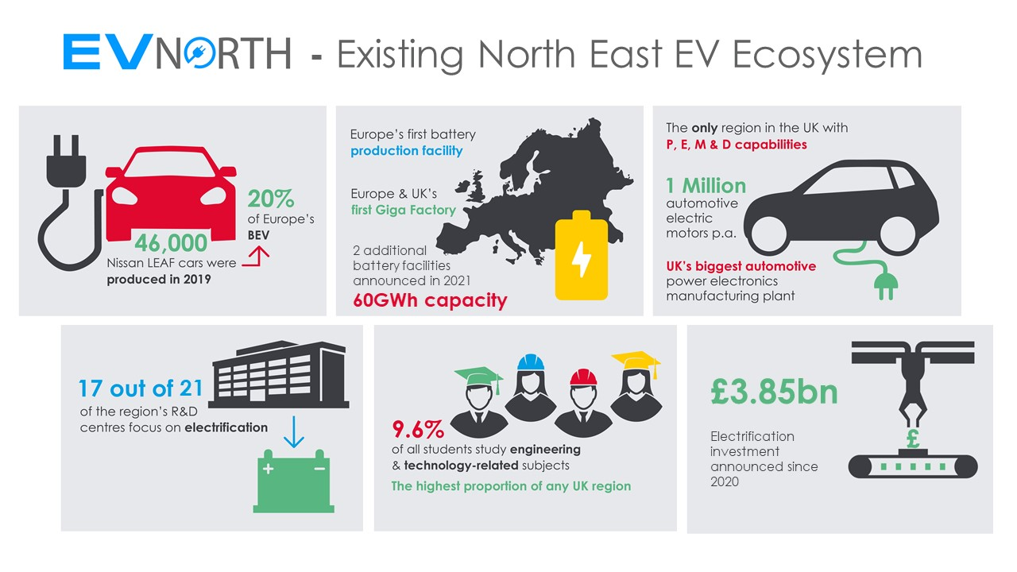
Notes:
Facts about our NE strengths in electrification from the industry organisation EV North
– website link: https://www.northeastautomotivealliance.com/neaa-membership-services/ev-north/
In summary:
The region is home to Europe’s most successful Electric Vehicle (EV), the Nissan LEAF, Europe’s first giga battery manufacturing facility, and has full Power Electronics, Motors and Drives (PEMD) capability.
The unveiling of Nissan's EV36Zero and the investment by British Volt to build a battery manufacturing plant near Blyth in Northumberland will create thousands of new jobs in the industry.

Slide 5
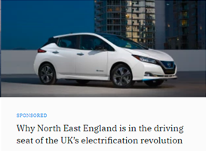
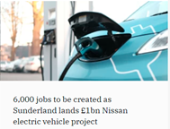
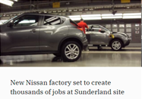
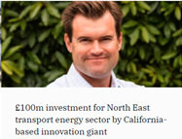
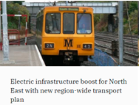
There is lots happening!
Notes:
Optional additional info:
More good news stories about the growing industry in our region including the British Volt battery manufacturing site, Nissan investments and successful NE businesses

Slide 6
Jobs in the Electrification industry
Watch the videos of people working in the Electrification industry in the North East and answer the questions below:
Envision AESC
Avid Technology
Nissan
Questions:
What does the company do?
What job does the speaker have and what types of things do they do in the role?
What qualifications do you need to get the job?
What skills are important to the job?
How can you find out more about jobs such as these?
Notes:
Students watch videos (teacher can select one which is most relevant to their students if preferred) and answer questions.
Envision video link:
https://www.youtube.com/watch?app=desktop&v=yYLgS-IuXwk
Avid tech video link:
https://www.youtube.com/watch?app=desktop&v=58lK75vBkac
Nissan video link:
https://www.youtube.com/watch?app=desktop&v=8oEplrjLvPc

Slide 7
What jobs are available in Electrification?
Here are some examples of jobs which are available in Electrification:
Pick one of the jobs listed and research the following:
What is the job, what types of things would you do in the role?
How many hours would you work a week? Is it a typical 9-5 or varied hours? Can you work part-time or freelance?
What qualifications do you need to get the job?
What is the starting salary?
What jobs could you progress to in the future?
Can you find any local companies currently advertising this job role?
Supply Chain Manager
Systems Analyst
Production Supervisor
Mechanical Design Engineer
Head of Operations
Maintenance Technician
Motor Vehicle Fitter
Process Engineer
Finance / Tax Controller
R&D Programme Manager
Senior Buyer
Research Associate
HR Controller
Notes:
Slide 1 of optional extension task – only use this if prefer to turn this into a whole careers lesson rather than starter/plenary or can be set as home learning.
Activity – ask students to pick one of the jobs from the slide and then use the guiding questions on the slide to find out more about it. Websites such as the National Careers Service can be a helpful place to start but links to more detailed information on roles in electrification can be found on the next slide.

Slide 8
Useful links for research task on job roles
Routes into the industry
Home Page – GoCareer
https://nationalcareers.service.gov.uk/
Overview of the UK's energy and utilities sector | Prospects.ac.uk
https://amazingapprenticeships.com/
https://www.gov.uk/apply-apprenticeship
Dept for Education – post-16 choices
Careers and Education - IMechE
Careers Advice in Manufacturing & Industry (successatschool.org)
How to make a career in the Electric Vehicle Industry • Evreporter
Local employers
EV North – NE industry association
Life at Nissan Sunderland - Careers at Nissan
Careers - Britishvolt
Careers - AVID Technology | Join Our World Class Engineering Company! (avidtp.com)
https://advancedelectricmachines.com/careers
https://turntide.com/culture-careers/
https://www.peakresources.com.au/uk/
https://www.envision-aesc.com/en/aboutus.html
Notes:
Slide 2 of optional extension task - research links

Slide 9
Skills for careers in Electrification
In today’s lesson we will learn about:
Text
Text
Text
We will develop skills such as:
Text
Text
Text
These are important for the Electrification industry because:
Text
Text
Text
Notes:
[Teacher to choose curriculum links most appropriate for the topic currently being studied and how this links to electrification]
See accompanying teacher guide for suggested curriculum links

Slide 10
Review
How does what we have learned today link to the Electrification sector?
Want to find out more?
Here are some links to more information on the industry in the North East and careers in Electrification
Electric Vehicle North
Home Page - GoCareer
https://www.der-ic.org.uk/about-us
What We Do - Britishvolt
https://nationalcareers.service.gov.uk/
https://www.lmiforall.org.uk/
Notes:
Optional plenary task to follow subject lesson and link to starter activity.

