Slide 1
North East Energy sector careers
Low Carbon Heat
Notes:
Please read accompanying teacher guide before delivering these lesson resources

Slide 2
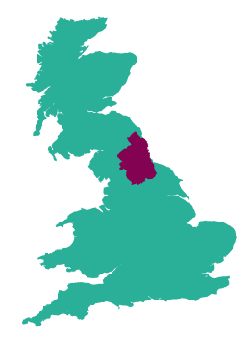
The Energy sector in the North East
The Energy sector in the North East grew by 28% between 2010 and 2021, with 3,780 related companies in the region employing over 45,000 people.
The North East is the leading location in England in the wind energy, oil and gas sectors with a thriving cluster of supply chain businesses to the subsea industry, supporting 15,000 jobs,
More than 20% of English hydro electricity generation and more than 14% of onshore wind electricity generation takes place in the North East LEP area.
The North East was home to the first electric vehicle battery production facility in Europe, with 2 more facilities currently under development
Pioneering heat network projects
79 research projects funded with £46.2m
Notes:
Facts on the sector in the NE to give context – very large employment sector already and it is growing

Slide 3
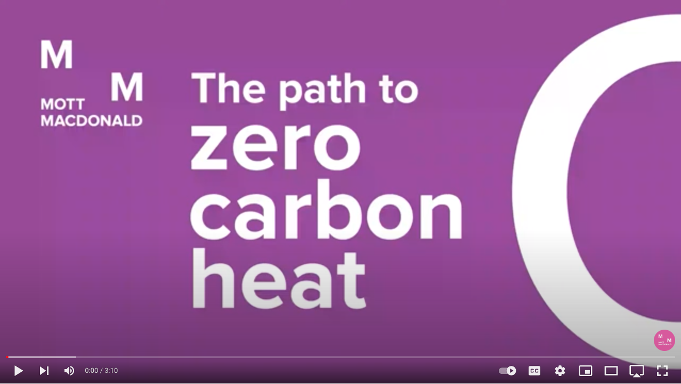
What is Low Carbon Heat?
Watch the video and answer the questions below
Why is low carbon heat important?
What will be the most difficult part of the economy to decarbonise?
How many homes currently use natural gas for their heating?
What are the three pathways to get to decarbonisation and how will these change homes?
What changes are needed to infrastructure to enable people to swap to low carbon heating sources in their homes?
Notes:
Students watch video and answer questions to share in class discussion
Video link (3:10)
https://www.youtube.com/watch?app=desktop&v=BEc3GdtAjSM

Slide 4
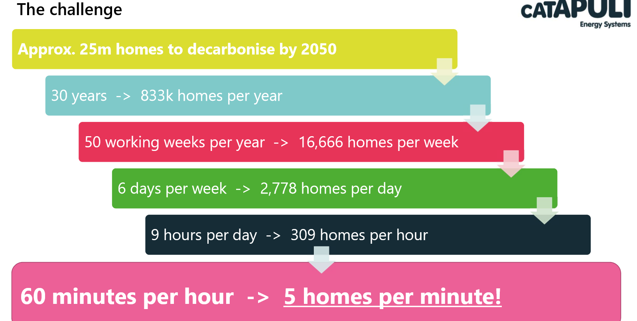
Source: ESC 2020
Notes:
Context to the scale of skills required to deliver government ambitions:
Moving to low carbon heat for all domestic homes in the UK will be a challenge to complete by 2050 and involve a lot of work

Slide 5
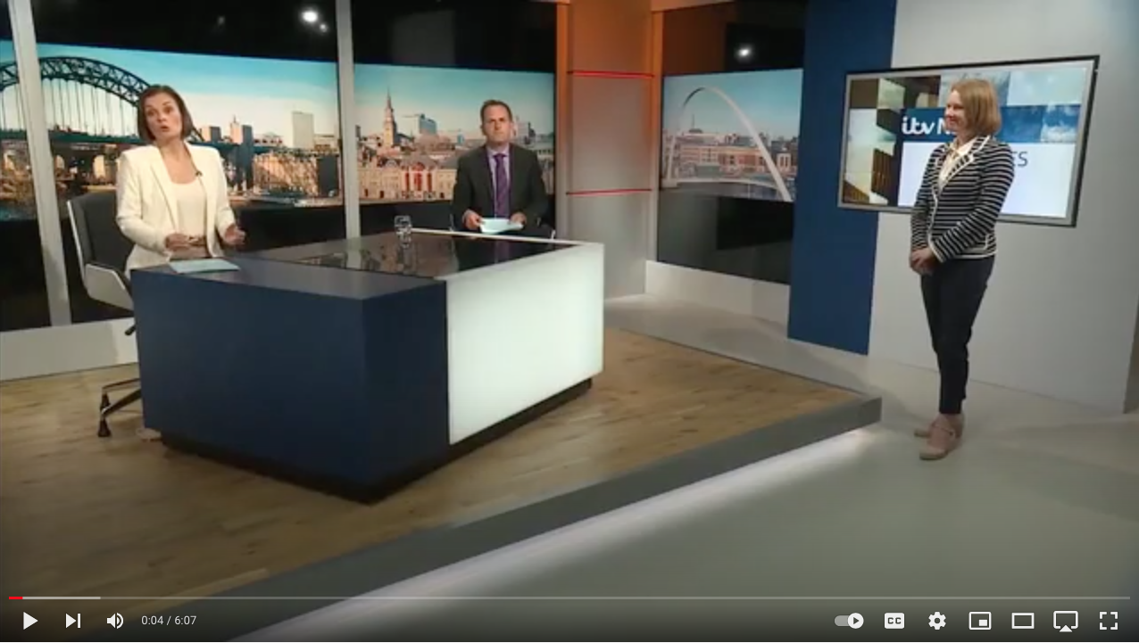
What is the North East doing to introduce Low Carbon Heat?
Watch the video and answer the questions below
Why do we need an alternative to gas for our homes and businesses?
How is the North East leading the way in developing alternatives to gas for heating homes and businesses?
How does geothermal energy work and why is it a good option for the North East?
Which company in the North East is already using old mine workings to heat their warehouse and how long have they done this for?
Notes:
This video will help students to understand how low carbon initiatives are being introduced in the North East.
Students watch video and answer questions.
ITV news video link (6:07):
https://www.youtube.com/watch?app=desktop&v=9t-H9H_yErc
For information: Hydrogen produces only water vapour when it is combusted rather than carbon dioxide which natural gas produces, so can help reduce the carbon footprint of domestic heating.

Slide 6
Jobs in Low Carbon Heat
Questions
Which company do they work for and what does the company do?
What job does the speaker have and what types of things do they do in the role?
What qualifications do you need to get the job?
Which skills are important to the job?
How can you find out more about jobs such as these?
Watch the videos of people working the low carbon heat industry in the North East and answer the questions
Northern Gas Network
Gateshead Council
North East LEP
Durham University
Notes:
Students watch videos (teacher can select one which is most relevant to their students if preferred) and answer questions
See accompanying teacher guide for overview of video content
Video links:
Northern Gas Network 2 roles(2:48)
https://youtu.be/30Bl_L0cLEo
Gateshead Council apprentice (1:51)
https://youtu.be/_oy7f0wFJ9o
North East LEP – graduate civil engineer (5:02)
https://youtu.be/GaDIgO4-do4
Durham Uni – Geology PhD student (5:01)
https://youtu.be/u8N8puzJFEQ

Slide 7
What careers are available in Low Carbon Heat?
Here are some examples of jobs which are available in Low Carbon Heat:
Pick one of the jobs listed and research the following:
What is the job, what types of things would you do in the role?
How many hours would you work a week? Is it a typical 9-5 or varied hours? Can you work part-time or freelance?
What qualifications do you need to get the job?
What is the starting salary?
What jobs could you progress to in the future?
Can you find any local companies currently advertising this job role?
Retrofit Coordinator
Domestic Energy Assessor
Electrical Engineer
Insulation Engineer
Roofer
Supply Chain Engagement Managers
Energy Operations Manager
Project Manager – District heating
Gas Service Technician
Building Surveyor
Energy Technician
Local Planning Controller
Heating and Ventilation Engineer
Retrofit Adviser
Geologist
Hydrogen Engineer
Notes:
Slide 1 of optional extension task – only use this if want a turn this into a whole careers lesson rather than starter/plenary. Alternatively can be set as home learning.
Activity – ask students to pick one of the jobs from the slide and then use the guiding questions on the slide to find out more about it. Websites such as the National Careers Service can be a helpful place to start but links to more detailed information on roles in the low carbon heat industry can be found on the next slide.

Slide 8
Useful links for research task on job roles
Routes into the industry
https://nationalcareers.service.gov.uk/
https://amazingapprenticeships.com/
https://www.gov.uk/apply-apprenticeship
Dept for Education – post-16 choices
https://www.instituteforapprenticeships.org/occupational-maps/
https://www.retrofitacademy.org/
Local employers
https://regen-group.co.uk/
https://thriftenergy.co.uk/
https://www.karbonhomes.co.uk/
https://www.believehousing.co.uk/
https://www.sgsheating.com/
Gateshead Council
Northern Gas Networks
https://www.geowarmth.co.uk/
https://www.solarcapturetechnologies.com/solar-capture/
https://www.dlawcontractors.co.uk/about-us/
https://powerroll.solar/
Notes:
Slide 2 of optional extension task - research links

Slide 9
Skills for careers in Low Carbon Heat
In today’s lesson we will learn about:
Text
Text
Text
We will develop skills such as:
Text
Text
Text
These are important for the low carbon heat sector because:
Text
Text
Text
Notes:
[Teacher to choose curriculum links most appropriate for the topic currently being studied and how this links to the low carbon heat sectors]
See accompanying teacher briefing guide for suggested curriculum links

Slide 10
Review
How does what we have learned today link to the Low Carbon Heat sector?
Want to find out more?
Here are some links to more information on the industry in the North East and careers in low carbon heat
greenjobs.co.uk
Hydrogen heating pilot in Winlaton, Gateshead
EEA:Energy Efficiency Association
H21 North of England
What is Hydrogen | Equinor
Axon Systems
https://nationalcareers.service.gov.uk/
https://www.instituteforapprenticeships.org/occupational-maps/
Notes:
Optional plenary task to follow subject lesson and link to starter activity.

