Slide 1
North East Energy sector careers
Offshore Energy and Subsea Technology
Notes:
Please read accompanying teacher guide before delivering these lesson resources

Slide 2
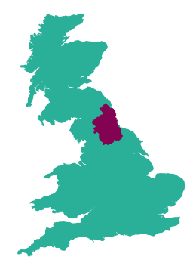
The Energy sector in the North East
The Energy sector in the North East grew by 28% between 2010 and 2021, with 3,780 related companies in the region employing over 45,000 people.
The North East is the leading location in England in the wind energy, oil and gas sectors with a thriving cluster of supply chain businesses to the subsea industry, supporting 15,000 jobs,
More than 20% of English hydro electricity generation and more than 14% of onshore wind electricity generation takes place in the North East LEP area.
The North East was home to the first electric vehicle battery production facility in Europe, with 2 more facilities currently under development
Pioneering heat network projects
79 research projects funded with £46.2m
Notes:
Facts on the sector in the NE to give context – very large employment sector already and it is growing

Slide 3
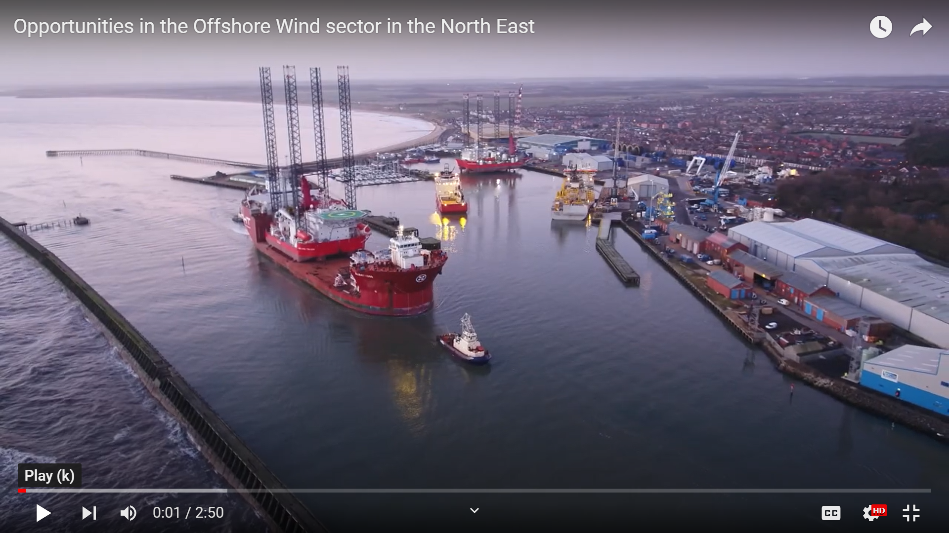
What is Offshore Energy and Subsea Technology?
Watch the video and answer the questions below
What is the offshore energy and subsea technology sector and why is it important to the North East?
Why does offshore wind offer a huge opportunity for the North East?
What are the strengths of the offshore energy and subsea sector in the North East
What does the future hold for the offshore energy and subsea sector in the North East?
What might be the benefits of a career in the industry?
Notes:
Students watch video and answer questions to share in class discussion
Overview of offshore energy and subsea sector and opportunities in the North East (2:50):
https://youtu.be/plNVQV-toQw

Slide 4
Jobs in Offshore Energy and Subsea Technology
Questions
Which company do they work for and what does the company do?
What job does the speaker have and what types of things do they do in the role?
What qualifications do you need to get the job?
Which skills are important to the job?
How can you find out more about jobs such as these?
Watch the videos of people working the offshore energy and subsea industry in the North East and answer the questions
Osbit (6:40)
Offshore renewable energy catapult (2:57)
Port of Blyth (5:54)
Notes:
Students watch videos (teacher can select one which is most relevant to their students if preferred) and answer questions
See accompanying teacher guide for overview of video content
Osbit graduate video link (6:40):
https://www.youtube.com/watch?app=desktop&v=jDyTm7Kbfo8&feature=youtu.be
ORE catapult (2:57):
https://www.youtube.com/watch?v=yWwRU-toABs
Port of Blyth apprenticeships (5:54):
https://www.youtube.com/watch?app=desktop&v=oQyDpIBJwd0

Slide 5
What careers are available in Offshore Energy and Subsea Technology?
Here are some examples of jobs which are available in this sector:
Pick one of the jobs listed and research the following:
What is the job, what types of things would you do in the role?
How many hours would you work a week? Is it a typical 9-5 or varied hours? Can you work part-time or freelance?
What qualifications do you need to get the job?
What is the starting salary?
What jobs could you progress to in the future?
Can you find any local companies currently advertising this job role?
Operations and Maintenance Technician
Project Manager
Geologist
Design Engineer
Development Officer
Site Assessment Specialist
Environmental Modeller
Electrical Engineer
Civil Engineer Project Planner
Wind Turbine Technician
Technical Analyst
Control and Instrumentation Engineer
Mechanical Engineer
Notes:
Slide 1 of optional extension task – only use this if want a turn this into a whole careers lesson rather than starter/plenary. Alternatively can be set as home learning.
Activity – ask students to pick one of the jobs from the slide and then use the guiding questions on the slide to find out more about it. Websites such as the National Careers Service can be a helpful place to start but links to more detailed information on roles in the offshore energy and subsea and renewable energy technology industry can be found on the next slide.

Slide 6
Useful links for research task on job roles
Routes into the industry
https://www.renewableuk.com/page/Careers
https://nationalcareers.service.gov.uk/
Overview of the UK renewable energy careers | Prospects.ac.uk
Geology Careers in Energy sector
Careers in Energy OPITO
https://amazingapprenticeships.com/
https://www.gov.uk/apply-apprenticeship
https://www.instituteforapprenticeships.org/occupational-maps/
Dept for Education – post-16 choices
Local employers
https://regen-group.co.uk/
Energi Coast (NE Offshore wind cluster)
Dogger Bank Wind Farm careers (North Sea offshore wind farm)
Equinor careers (Port of Tyne)
ORE Catapult careers (Northumberland)
GE Renewables careers (Newcastle and Teesside)
Sofia Wind Farm careers (North Sea offshore wind farm)
Port of Blyth careers
Port Training Services (port of Blyth)
Royal IHC careers (Northumberland)
Osbit careers (Northumberland)
Osprey Group careers (Northumberland)
SMD careers (Newcastle/North Tyneside)
JDR Cables (Co Durham/ Newcastle)
Tekmar (Co Durham)
Technip (Newcastle)
Baker Hughes careers (Newcastle)
MPI Offshore (Teesside)
Jobs In Renewable Energy (successatschool.org)
I-could careers videos for Energy sector (23 videos)
Notes:
Slide 2 of optional extension task - research links

Slide 7
Skills for careers in offshore energy and subsea technology
In today’s lesson we will learn about:
Text
Text
Text
We will develop skills such as:
Text
Text
Text
These are important for the Subsea and Offshore Energy sector because:
Text
Text
Text
Notes:
[Teacher to choose curriculum links most appropriate for the topic currently being studied and how this links to the Subsea and Offshore Wind Energy sectors]
See accompanying teacher briefing guide for suggested curriculum links

Slide 8
Review
How does what we have learned today link to the Offshore Energy and Subsea Technology industry?
Want to find out more?
Here are some links to more information on the industry in the North East and careers in the offshore energy and subsea technology industry:
Renewables UK careers map
Energi Coast - NE offshore energy cluster
Port of Blyth - You Tube channel
JDR Cables – NE company
https://nationalcareers.service.gov.uk/
LMI For All – LMI For All
https://www.instituteforapprenticeships.org/occupational-maps/
Notes:
Optional plenary task to follow subject lesson and link to starter activity.

