Slide 1
Year 6 Transition:
Understanding Personality and Career Choices

Slide 2
Teacher’s notes
Summary:
This activity has been developed to support Y6 Transition into KS3 with a focus on careers and aspirations.
This activity introduces ‘personality’ to KS2 pupils and allows them to identify their personality strengths and their shadow personality.
This includes a small group follow-up activity linked to identifying a career that would suit their personality animal group.
Programme linked to:
Homepage - North East Ambition
Expected duration:
1-2 hours
Resources Needed:
How I am at School Resource Sheet (1 per pupil)
All About Me Resource Sheet (1 per pupil)
Primary Animal Profiles (1 of each animal placed around the classroom – 16 in total)
Optional - Personality Type Jobs (1 of each animal trimmed and given to corresponding pupils
© D. Hodgson, 2025. Copyrighted material, permission granted for use in schools and colleges in North East CA only for educational purposes.

Slide 3
Session Aims
To use the Buzz Quiz to identify your animal guide and key personal strengths.
To identify your 'shadow (opposite) animal' with skills to develop in Year 6 and 7.
To learn how personality can impact on your career journey and future choices.
Notes:
Introduce the topic and the objectives of the lesson.
Explain that the lesson will help pupils understand their personality strengths and how these can influence their future career choices.

Slide 4

What does personality mean to you?
Personality is our underlying strengths that guide us through school and life.
Everyone has unique strengths and preferences.
Notes:
Discuss the concept of personality and its importance.
Emphasise that everyone has unique strengths and preferences – explored through the following activity.

Slide 5

Activity - Signing Your Name
Sign your name with your dominant hand (the one you usually write with).
Now sign your name with your non-dominant hand.
How did it feel to use your non-dominant hand?
Notes:
Ask pupils to sign their name with their dominant hand.
Then ask them to sign their name with their non-dominant hand.
Explain that this activity demonstrates how we have a preferred way of doing things, similar to our personality preferences.
Seek feedback from pupils about how it felt to use their non-dominant hand.
Reinforce that there is no right or wrong preference, just like there is no right or wrong personality.

Slide 6
Personality Types
These are the balancing skill sets
Communicating:
Talking/Listening
Problem Solving:
Fact-Finding/Imagination
Leading:
Team Focus/Task Focus
Achieve Results:
Planning/Adapting
Four key parts of personality that we can explore and develop.
Each has two balancing skill sets, a natural strength and an opposite shadow strength, both can be practised.
Together they allow us to choose the right behaviour in any situation we face.
Notes:
Explain the four key aspects of personality and how they are developed.
Discuss the balancing skill sets for each aspect and how most people have a mixture of both but a preference for one or the other.
Emphasise that these can be developed and are not fixed.
Ask pupils to reflect on examples of how they use some of these skill sets in their daily lives.

Slide 7
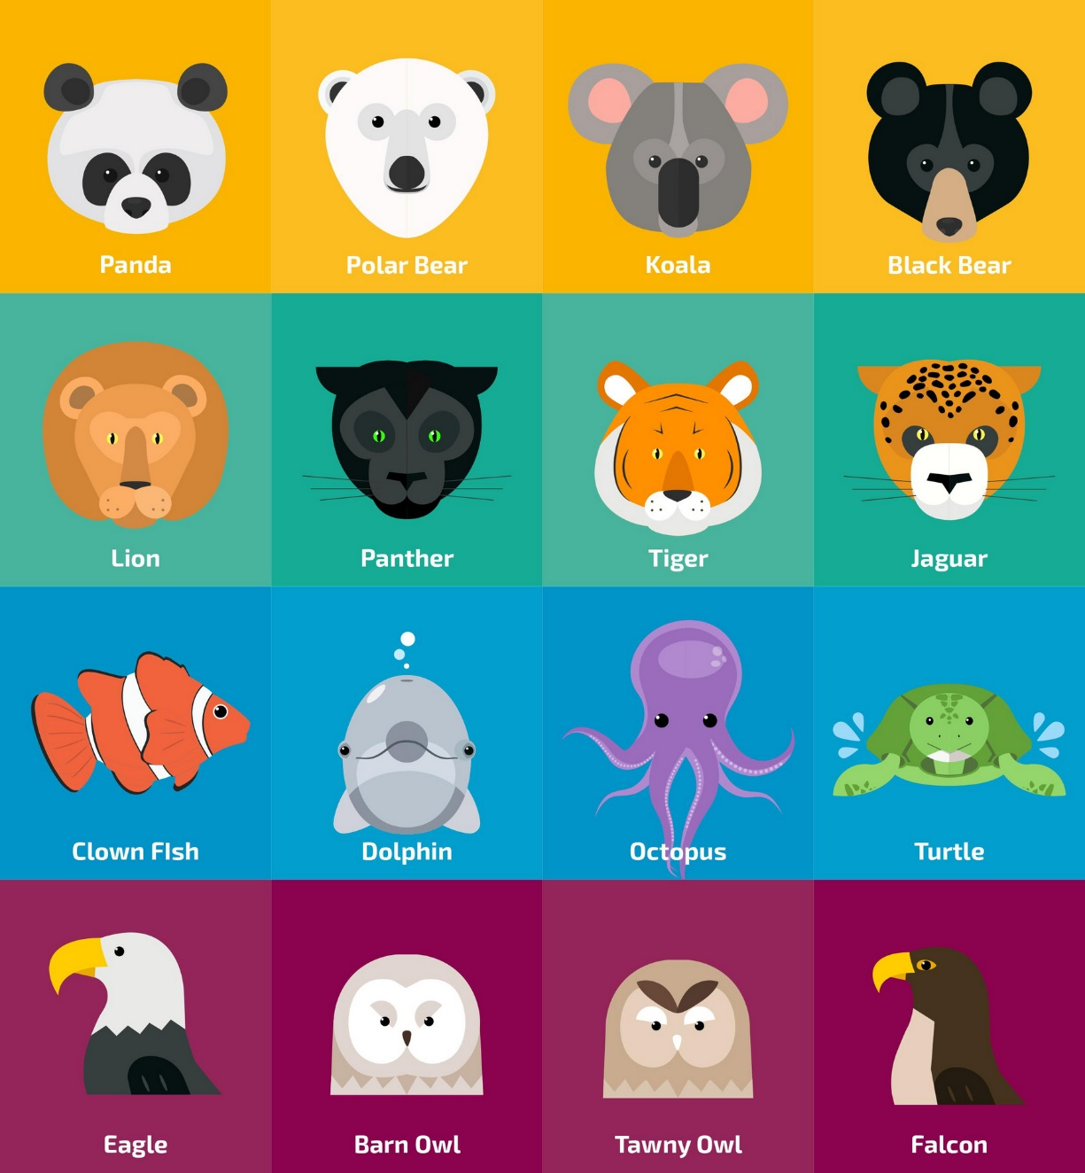
Identifying Your Animal Guide
The Buzz Quiz helps us to look at each pair of skill sets to identify our strengths.
We can represent this as an animal guide!
It also helps us to recognise our shadow animal (the opposite) which shows us the things that we can improve.
Notes:
Introduce the idea of a quiz to help pupils to reflect on and identify their strengths.
It is important that they focus on themselves and answer as honestly as possible.

Slide 8
Identifying Your Animal Guide and Shadow Animal
We will now look at each pair together. You should decide which letter is your preference and note it down.
Communicating: Talking/Listening
Problem Solving: Fact-Finding/Imagination
Leading: Team Focus/Task Focus
Achieving Results: Planning/Adapting
Notes:
Guide pupils through the process of identifying their animal type using the "How I am at School" worksheet.
Explain the four pairs of preferences in the following slides (E or I, S or N, F or T, J or P) and how to choose the one that best describes them.
Provide examples to help pupils understand each preference.

Slide 9
Communicating
Talking (E)
I think out loud
I prefer variety and action
I like to act quickly
I’m a good talker
I like to give my opinion
Listening (I)
I think before I speak
I prefer quiet
I like to be careful
I’m a good listener
I keep my thoughts to myself
Notes:
Discuss each pair of characteristics, giving examples, and ask pupils to reflect on which best applies to them. E.g Do you prefer to think out loud or think before you speak?
They will likely end up with some from each column but should decide whether E or I overall fits them best.
They can follow along and tick these off on their worksheet as they go.

Slide 10
Problem Solving
Fact-Finding (S)
I like to learn to do something step-by-step
I look for the facts or details
I focus on what works now
I prefer using what I’ve learned
I’m more practical and sensible
Imagination (N)
I like to work out what it means or change it
I look for patterns
I focus on how to make it different
I prefer learning new skills
I’m more of a dreamer and imaginative
Notes:
Discuss each pair of characteristics, giving examples, and ask pupils to reflect on which best applies to them.
They will likely end up with some from each column but should decide whether S or N overall fits them best.
They can follow along and tick these off on their worksheet as they go.

Slide 11
Leading
Team Focus (F)
I think of people then the task
I like pleasing people
I tend to be careful to avoid saying things that could upset someone
Task Focus (T)
I think of the task then people
I like sticking to the rules
I tend to give and take criticism quite easily
Notes:
Discuss each pair of characteristics, giving examples, and ask pupils to reflect on which best applies to them.
They will likely end up with some from each column but should decide whether F or T overall fits them best.
They can follow along and tick these off on their worksheet as they go.

Slide 12
Achieving Results
Planning (J)
I like to plan and organise things
I like to make decisions
I prefer finishing tasks
I quite like using lists
I like things tidy
Adapting (P)
I like to see how things turn out
I like to keep my options open
I prefer starting tasks
I’d rather not use lists
I don’t mind things untidy
Notes:
Discuss each pair of characteristics, giving examples, and ask pupils to reflect on which best applies to them.
They will likely end up with some from each column but should decide whether J or P overall fits them best.
They can follow along and tick these off on their worksheet as they go.

Slide 13
















Use the information below to identify your animal guide and your shadow animal:
Panda
ESFJ
Tawny Owl
INTP
Koala
ISFJ
Falcon
ENTP
Barn Owl
INTJ
Lion
ESFP
Jaguar
ISFP
Eagle
ENTJ
Clownfish
ENFP
Polar Bear ISTJ
Sea Turtle
INFJ
Panther
ESTP
Octopus
INFP
Black Bear ESTJ
Tiger
ISTP
Dolphin
ENFJ
Notes:
Explain how to convert their preferences to their animal type using the four letters they wrote down e.g. if they chose E, N, T and J on the previous slides, their animal is Eagle.
Introduce the concept of the shadow animal, which is the opposite of their animal type.
They should find this by writing down the opposite of each letter E/I, S/N, F/T, J/P
Explain the importance of understanding both their strengths (animal) and areas for development (shadow animal).

Slide 14
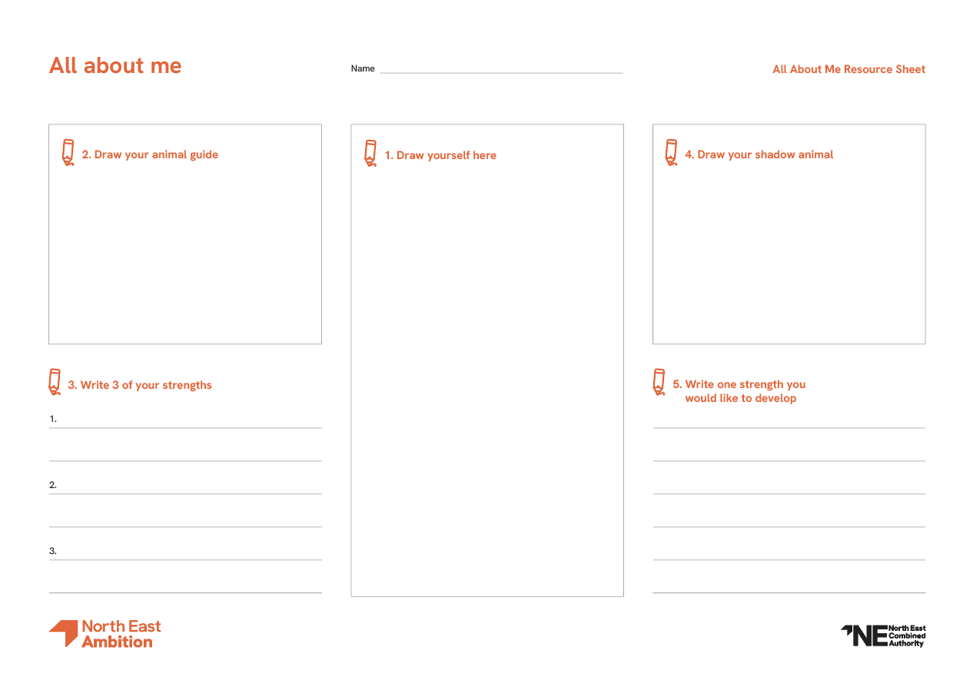

Activity – All About Me
Draw a picture of yourself in middle circle.
Draw your animal guide and write 3 strengths you feel match your animal from the profile page.
Draw your shadow animal and choose a strength you’d like to develop from that animal. How can you develop this strength as a skill?
20 Mins
Notes:
Provide descriptions of each animal type and their strengths around the classroom – see resources provided.
Encourage pupils to move to their animal guide, draw their animal and write three strengths that match their animal type.
Ask pupils to then move to their shadow animal, draw their shadow animal and choose a strength they would like to develop from that animal.
Suggest working in pairs to discuss how they can develop this strength as a skill.

Slide 15

Activity – Animal Groups
Split into four groups based on your animal type: Bears, Sea Animals, Birds, and Cats.
In your groups, identify strengths that you all share.
Prepare to feedback to the class!
15 Mins
15 Mins
Notes:
Split pupils into four groups based on their animal types: Bears, Sea Animals, Birds, and Cats.
Ask each group to stand in a different corner of the room.
Have each group identify positive qualities they all share.
Note that the groups may not be evenly split and provide examples of qualities for each group (e.g., Birds are imaginative and determined, Cats are flexible and playful, Sea Animals are creative and caring, Bears are organized and practical).
Have each group choose one or two pupils to share their findings with the class.

Slide 16
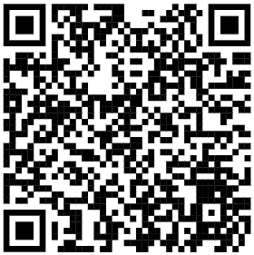

Activity – Explore Careers
As a group with similar animal guides, think of a job or career that would suit your strengths
Search for it on the Explore Careers website
Discuss – which parts of the job would suit your strengths and which parts might be challenging?
Explore careers | National Careers Service
15 Mins
Notes:
Arrange pupils into tables of 4 to 6 based on their animal groups with a device to access the internet.
Ask each group to identify a career that would suit their personality strengths – you may wish to provide a list of careers they have learned about.
Guide pupils to analyse which parts of the career would suit their strengths and which parts might be challenging.
Explain that this activity helps them understand how to choose their options moving through education and assess career suitability.
Provide printed copies of job descriptions (e.g., Lawyer and Paramedic) if pupils do not have access to the internet.
GROUPS MAY NOT BE EQUAL NUMBERS USUALLY 50% BEARS, 25% CATS, 15% SEA ANIMALS 10% BIRDS.

Slide 17
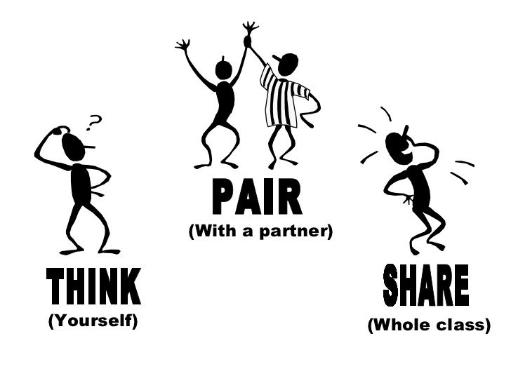
Reflection and Discussion
Reflect on what you have learned about your personality and career choices.
Discuss your thoughts with a partner.
Questions:
  What did you learn about your strengths?
  How can understanding your personality help you in the future?
  What does this mean for you as you move into Year 7?
Notes:
Encourage pupils to reflect on what they have learned about their personality and career choices.
Facilitate a class discussion where pupils can share their thoughts and insights.
Ask questions such as "What did you learn about your strengths?" and "How can understanding your personality help you in the future?“
Address misconception that strengths/areas for development are fixed if this emerges.

Slide 18
How I am at School
Instruction: circle one letter from each pair (E or I, S or N, F or T, J or P)
Communicating | Problem Solving | Leading | Achieving Results
E | S | F | J
I think out loud I prefer variety and action I like to act quickly I’m a good talker I like to give my opinion | I like to learn to do something step-by-step I look for the facts or details I focus on what works now I prefer using what I’ve learned I’m more practical and sensible | I think of people then the task I like pleasing people I tend to be careful to avoid saying things that could upset someone | I like to plan and organise things I like to make decisions I prefer finishing tasks I quite like using lists I like things tidy
I | N | T | P
I think before I speak I prefer quiet I like to be careful I’m a good listener I keep my thoughts to myself | I like to work out what it means or change it I look for patterns I focus on how to make it different I prefer learning new skills I’m more of a dreamer and imaginative | I think of the task then people I like sticking to the rules I tend to give and take criticism quite easily | I like to see how things turn out I like to keep my options open I prefer starting tasks I’d rather not use lists I don’t mind things untidy
How I am at School Resource Sheet
Notes:
How I am at School Resource Sheet

Slide 19
All About Me
Name:
2. Draw your animal guide
4. Draw your shadow animal
1. Draw yourself here
5. Write one strength you would like to develop
3. Write three of your strengths
All About Me Resource Sheet
Notes:
All About Me Resource Sheet

