Slide 1
KS4 Buzz Activity
Decision Making

Slide 2
Teacher’s Guide
Summary:
This activity has been developed to support KS4 pupils at the end of year 10.
This activity identifies personality animal as a framework for considering learning approaches and research techniques to support future career choices.
Programme linked to:
North-East Ambition’s Career Benchmarks:
(to insert)
Expected duration:
1-2 hours
Learning objectives:
To complete Buzz Quiz and identify their animal type and key personal strengths.
To learn how personality can impact on career journey and future choices.
© D. Hodgson, 2025. Copyrighted material, permission granted for use in schools and colleges in North East CA only for educational purposes.

Slide 3
Session Aims
To complete Buzz Quiz and identify your animal type and key personal strengths.
To learn how personality can impact on career journey and future choices.
Notes:
Introduce the topic and the objectives of the lesson.
Explain that the lesson will help pupils understand their personality strengths and how these can influence their future career choices.

Slide 4

What does personality mean to you?
Personality is our underlying strengths that guide us through school and life. Everyone has unique strengths and preferences.
Think of three positive words that describe your personality.
What advice would you send back to yourself at start of Year 9?
Notes:
Discuss the concept of personality and its importance.
Emphasise that everyone has unique strengths and preferences – explored through the following activity.

Slide 5
Personality Types
These are the balancing skill sets
Communicating:
Talking/Listening
Problem Solving:
Fact-Finding/Imagination
Leading:
Team Focus/Task Focus
Achieve Results:
Planning/Adapting
Four key parts of personality that we can explore and develop.
Each has two balancing skill sets, a natural strength and an opposite shadow strength, both can be practised.
Together they allow us to choose the right behaviour in any situation we face.
Notes:
Explain the four key aspects of personality and how they are developed.
Discuss the balancing skill sets for each aspect and how most people have a mixture of both but a preference for one or the other.
Emphasise that these can be developed and are not fixed.
Ask pupils to reflect on examples of how they use some of these skill sets in their daily lives.

Slide 6
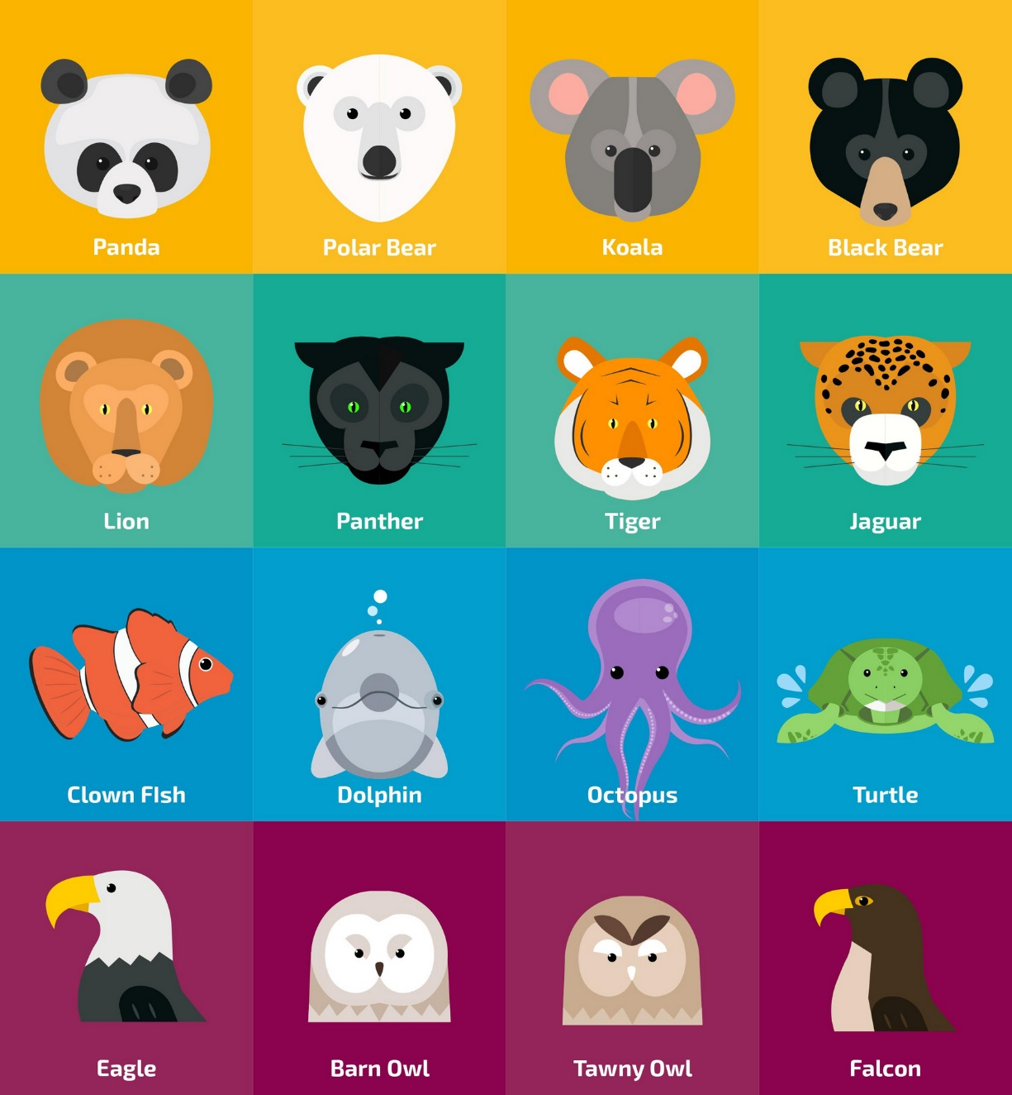
Identifying Your Animal Guide
The Buzz Quiz helps us to look at each pair of skill sets to identify our strengths.
We can represent this as an animal guide!
It also helps us to recognise our shadow animal (the opposite) which shows us the things that we can improve.
Notes:
Introduce the idea of a quiz to help pupils to reflect on and identify their strengths.
It is important that they focus on themselves and answer as honestly as possible.

Slide 7
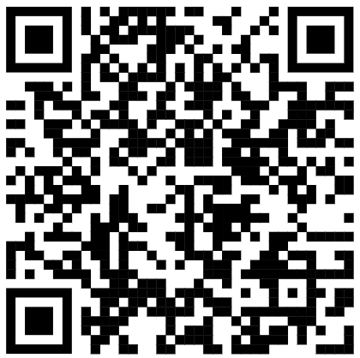
Identifying Your Animal Guide
We will now complete the Buzz Quiz to find out our animal guide.
The Buzz Quiz - North East Ambition
Notes:
Guide pupils through the process of identifying their animal type using the online Buzz Quiz.
Pupils take note their four letters and consider how their subject/course choices will match their natural learning preferences.

Slide 8
How do you make big decisions?
When you need to make important decisions, your natural strengths probably mean you can:
E | S | F | J
Gather the opinions of others and can ask for support when it could be helpful. | Concentrate on the details, the steps required to achieve your goals. | Gather the opinions and advice of friends, family, and experts. | Work steadily to complete all steps on schedule. You are comforted rather than stressed by deadlines.
I | N | T | P
Focus and consider detailed research without rushing to conclusions. | Consider imaginative and unusual options, looking beyond the obvious. | Take onboard advice from friends, family, and experts without being upset. | Change direction, avoid sticking to a schedule or plan.
Notes:
Questions for pupils
Do you agree with the suggestions?
Do different types of learning best suit you: apprenticeships, A levels, FE courses.
When have you made good and bad decisions in the past?

Slide 9
How do you make big decisions?
When you need to make important decisions, your Achilles heel could be:
E | S | F | J
Making decisions too quickly. | Concentrate on the details, the steps required to achieve your goals. | Gather the opinions and advice of friends, family, and experts. | Work steadily to complete all steps on schedule. You are comforted rather than stressed by deadlines.
I | N | T | P
Overthinking, avoid deciding. | Consider imaginative and unusual options, looking beyond the obvious. | Take onboard advice from friends, family, and experts without being upset. | Change direction, avoid sticking to a schedule or plan.
Notes:
Questions for pupils
Do you agree with the suggestions?
Do different types of learning best suit you: apprenticeships, A levels, FE courses.
When have you made good and bad decisions in the past?

Slide 10
Top 10 Employability Skills
(e) communication (face to face)
(s) can identify problems
(f) respect views & contributions of team/customers
(j) punctual, manage own time
(-) learn from mistakes
(i) communication (in writing)
(n) can think creatively
(t) can solve problems logically, task focused
(p) adaptable, can change plans
(+) have a positive outlook
Notes:
Additional Activity Top 10 employability skills Slide Identify at least one example of how you can demonstrate you have this skill at an interview, work in pairs to select and hone answers.

