Slide 1
KS3 Buzz Activity
Building Aspiration

Slide 2
Teacher’s Guide
Summary:
This activity has been developed to support KS3 pupils with a focus on subject, careers and aspirations.
This activity identifies personality animal as a framework for considering GCSE subject and future career choices.
Programme linked to:
North-East Ambition’s Career Benchmarks:
(to insert)
Expected duration:
1-2 hours
Learning objectives:
To complete Buzz Quiz and identify their animal type and key personal strengths.
To learn how personality can impact on career journey and future choices.
© D. Hodgson, 2025. Copyrighted material, permission granted for use in schools and colleges in North East CA only for educational purposes.

Slide 3
Session Aims
To complete Buzz Quiz and identify your animal type and key personal strengths.
To learn how personality can impact on career journey and future choices.
Notes:
Introduce the topic and the objectives of the lesson.
Explain that the lesson will help pupils understand their personality strengths and how these can influence their future career choices.

Slide 4

What does personality mean to you?
Personality is our underlying strengths that guide us through school and life.
Everyone has unique strengths and preferences.
Notes:
Discuss the concept of personality and its importance.
Emphasise that everyone has unique strengths and preferences – explored through the following activity.

Slide 5

Activity - Signing Your Name
Sign your name with your dominant hand
(the one you usually write with).
Now sign your name with your non-dominant hand.
How did it feel to use your non-dominant hand?
We can use both hands, but we have a preference. Identifying our preferences, and developing our non-preferred (shadow) leads to success in school and life.
Notes:
Ask pupils to sign their name with their dominant hand.
Then ask them to sign their name with their non-dominant hand.
Explain that this activity demonstrates how we have a preferred way of doing things, similar to our personality preferences.
Seek feedback from pupils about how it felt to use their non-dominant hand.
Reinforce that there is no right or wrong preference, just like there is no right or wrong personality.

Slide 6
Personality Types
These are the balancing skill sets
Communicating:
Talking/Listening
Problem Solving:
Fact-Finding/Imagination
Leading:
Team Focus/Task Focus
Achieve Results:
Planning/Adapting
Four key parts of personality that we can explore and develop.
Each has two balancing skill sets, a natural strength and an opposite shadow strength, both can be practised.
Together they allow us to choose the right behaviour in any situation we face.
Notes:
Explain the four key aspects of personality and how they are developed.
Discuss the balancing skill sets for each aspect and how most people have a mixture of both but a preference for one or the other.
Emphasise that these can be developed and are not fixed.
Ask pupils to reflect on examples of how they use some of these skill sets in their daily lives.

Slide 7
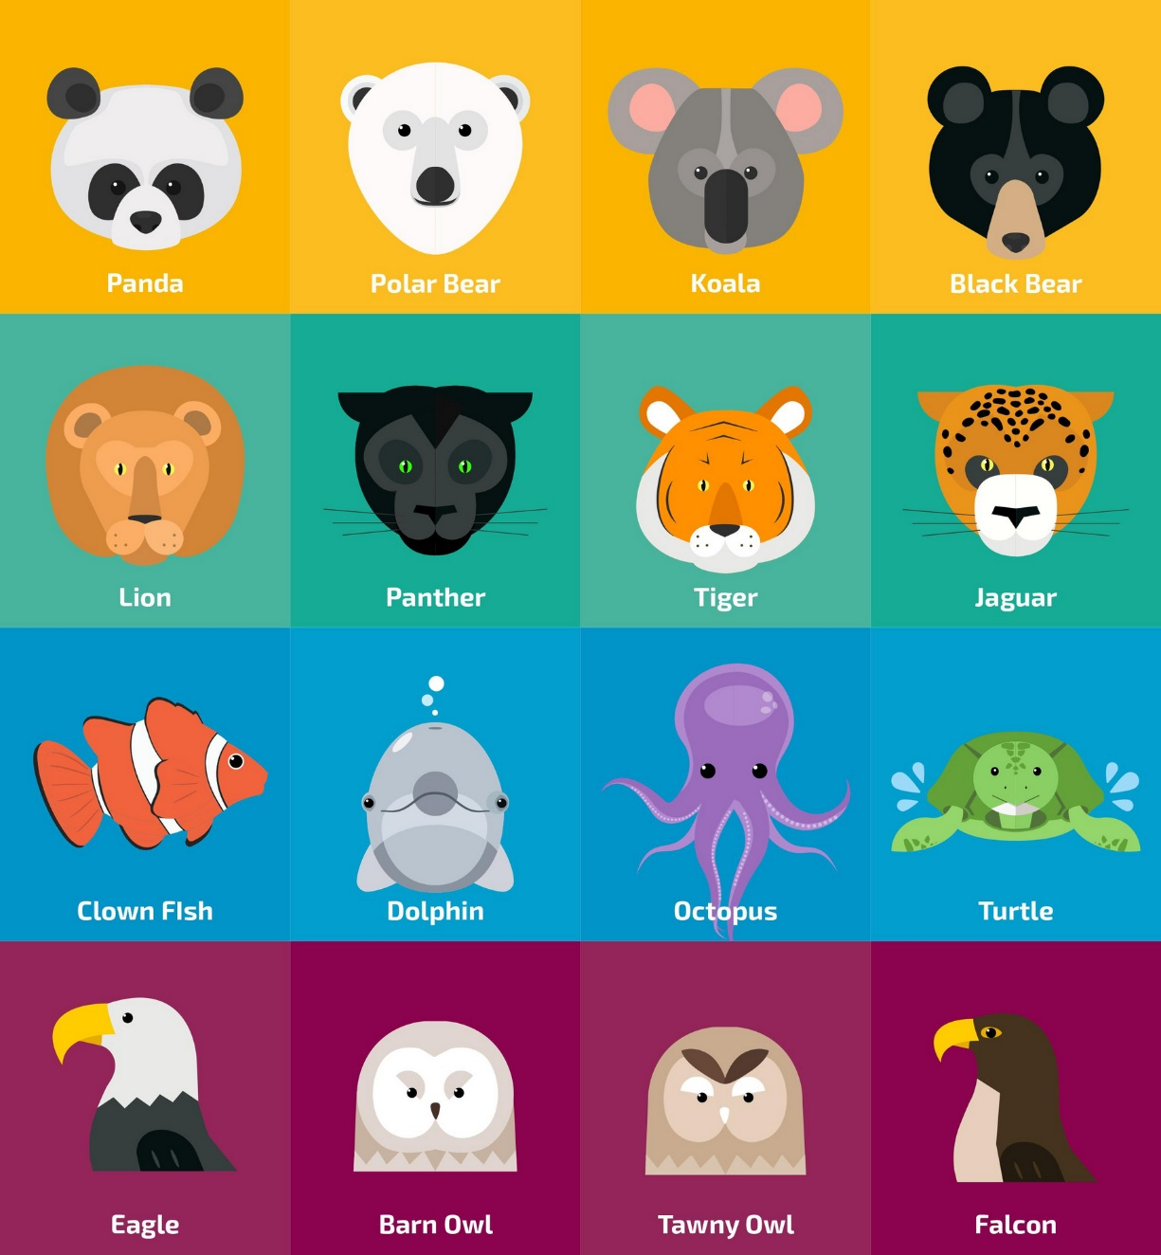
Identifying Your Animal Guide
The Buzz Quiz helps us to look at each pair of skill sets to identify our strengths.
We can represent this as an animal guide!
It also helps us to recognise our shadow animal (the opposite) which shows us the things that we can improve.
Notes:
Introduce the idea of a quiz to help pupils to reflect on and identify their strengths.
It is important that they focus on themselves and answer as honestly as possible.

Slide 8
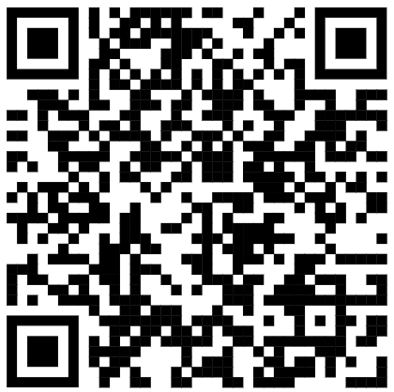
Identifying Your Animal Guide
We will now complete the Buzz Quiz to find out our animal guide.
The Buzz Quiz - North East Ambition
Notes:
Guide pupils through the process of identifying their animal type using the online Buzz Quiz.
Pupils take note their four letters and consider how their subject/course choices will match their natural learning preferences.

Slide 9
I Enjoy Learning When…
E | S | F | J
Working in groups and talking about the topic. | I know why I am learning a topic and learning the steps involved. | I am encouraged and in a supportive atmosphere. | There’s a clear structure, routine and finish times.
I | N | T | P
I can concentrate and work quietly, without interruptions. | I can use my imagination and creativity to explore a topic. | The focus is on the task, and with a competitive edge. | There is variety in the place and time to study.
Notes:
Questions for pupils
Do you agree with the suggestions?
Which are most important?
Which subjects best match your preferences?
How can you enjoy all subjects more by applying your preferences?
Do different types of learning best suit you: apprenticeships, A levels, FE courses.

Slide 10


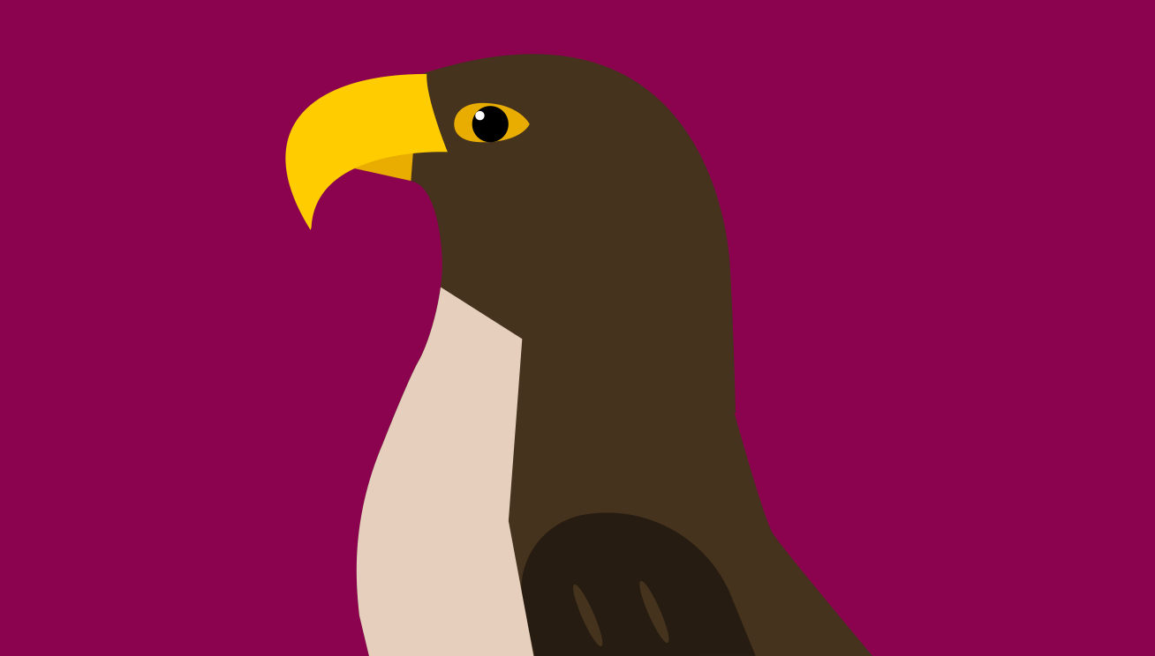













Do you agree with your Animal Group?
(This is based on feedback from hundreds of teenagers)
Bears
Like: clear instructions, checklists, like observation followed by activity, specific answers.
Strengths: Diligent, hard-working, determined and focused.
Stressed when their plans are disrupted, coping with change and uncertainty.
Birds
Like: reasoning, theories, evaluation, analysis, logic, ideas, playing devil’s advocate, puzzles, asking why? debate, research.
Strengths: Curious, competitive, lift everyone, ingenious.
Stressed when not feeling good enough or feeling disrespected.
Cats
Like: up and doing, investigation, independence, risks, choice, visits, open-ended tasks, challenges.
Strengths: Flexible, spontaneous, adaptable.
Stressed when boredom and containment are imposed.
Sea animals
Like: imagination, belonging, discussion, peer groups, humour, games, stories, emotions, own timetable, collaboration.
Strengths: Co-operative, caring and creative.
Stressed when there’s negativity, a lack of positive solutions.

Slide 11
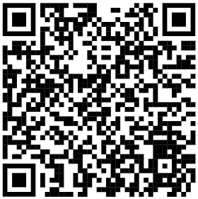
Career Options
Look at your animal profile on the Buzz Quiz and focus on the job and course ideas.
Do they match your current ideas?
Research some of the jobs to see how they fit or do not fit your strengths and aims.
Job and course ideas
For career happiness Pandas like to clearly understand their role and responsibilities. They gain satisfaction from doing their job well, being acknowledged and thanked by their bosses and colleagues and providing a useful service to people. This means they are an asset to most organisations.
Courses and careers including business, hospitality, tourism, advice and advocacy work, and law are a natural fit for Pandas.
Explore careers | National Careers Service
Notes:
Pupils identify their animal online.
Students consider the job recommendations.
Do they match your current ideas?
Research some of the jobs to see how they fit or do not fit your strengths and aims.

Slide 12
Your Worst Job?
(This is a job your animal is unlikely to be doing, statistically speaking, for example, Clownfish are 6% UK population but fewer than 1% of Air Traffic Controllers)
Bears
Polar Bear: Stage Actor
Black Bear: Social Worker
Koala: Door to Door Sales
Panda: Laboratory Technician
Birds
Barn Owl: Reflexologist
Tawny Owl: Counsellor
Eagle: Dog Walker
Falcon: Administrator
Cats
Panther: Archivist
Lion: Accountant
Tiger: Barista
Jaguar: Librarian
Sea animals
Clownfish: Air Traffic Controller
Dolphin: Lorry Driver
Octopus: Police Officer
Turtle: Security Guard
Notes:
Can you identify your worst job?
Look at the suggestion on the slide and look it up online.
Discussion Points
No job or career is bad for everyone
Happiness and success is found when we apply our strengths, skills and values.
Why do some people do jobs they don’t like?
Invite pupils to now find their best job?

