Slide 1
FE Buzz Activity
Confidence and Resilience

Slide 2
Teacher’s Guide
Summary:
This activity has been developed to support FE students with a focus on resilience and self-confidence.
This activity shares ‘personality’ to students and links personality strengths to resilience.
This includes a small group follow-up activity linked to identifying a career that would suit their personality animal group.
Programme linked to:
North-East Ambition’s Career Benchmarks:
(to insert)
Expected duration:
1-2 hours
Learning objectives:
To complete Buzz Quiz and identify their animal type and key personal strengths.
To identify key animal strengths and link these to core values and beliefs which underpin resilience.
To learn how personality can positively impact on career journey and future happiness and success.
© D. Hodgson, 2025. Copyrighted material, permission granted for use in schools and colleges in North East CA only for educational purposes.

Slide 3
Session Aims
To complete Buzz Quiz and identify their animal type and key personal strengths.
To identify key animal strengths and link these to core values and beliefs which underpin resilience.
To learn how personality can positively impact on career journey and future happiness and success.
Notes:
Introduce the topic and the objectives of the lesson.
Explain that the lesson will help pupils understand their personality strengths and how these can influence their future career choices.

Slide 4
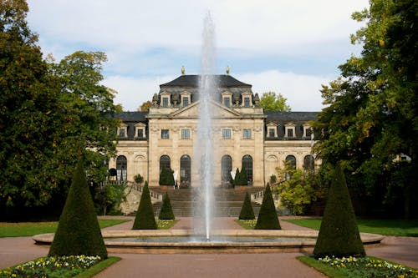

Who is happier one year later?
A lottery jackpot winner
A survivor of a Road Traffic Accident resulting in a permanent spinal injury
A:
Notes:
QUESTION: Who is happier a year later, a jackpot lottery winner or someone seriously injured in an accident?
Discussion with reasons.
ANSWER 'Road Traffic Accident Victims report higher levels of happiness a year later, because they assess their life and build meaning, purpose and connection. After a year, Lottery winners return to the level of happiness they were at prior to their lottery win. They slip back to their original miserable or happy life. Money is most useful when it builds the three elements of happiness.’ (Source: Lottery Winners and accident victims: is happiness relative? P, Brickman et al, Journal Personality & Social Psychology, 1978, 36/8)

Slide 5
The 3 Ingredients of Happiness
Many researchers (including Martin Seligman, Henry Stewart, and Robert Waldinger) have found that the happiest and healthiest people build a life rich in three things:
Purpose-Meaning-Connection
Purpose
Purpose results from finding a career in which you can fully develop and apply your skills and personality strengths. Identifying your personality animal with buzz quiz can set you on the path. This is what we do as we work.
Meaning
Meaning is choosing a career that has a positive impact in the world. You will see some suggestions after you reveal your personality animal. This is why we work.
Connection
Involves building relationships with networks of people and groups, in the real, not the virtual, world, to ensure you become a resilient adult with qualities such as kindness, compassion, courage, and curiosity, attracting positive friends and mentors. This is how we live well. Where you live and work is also important for connection. Do you want to live close to your family, in a city or a rural location
Notes:
How are they going to build a life rich in these three things?
Discuss with students before completing Buzz Quiz.

Slide 6
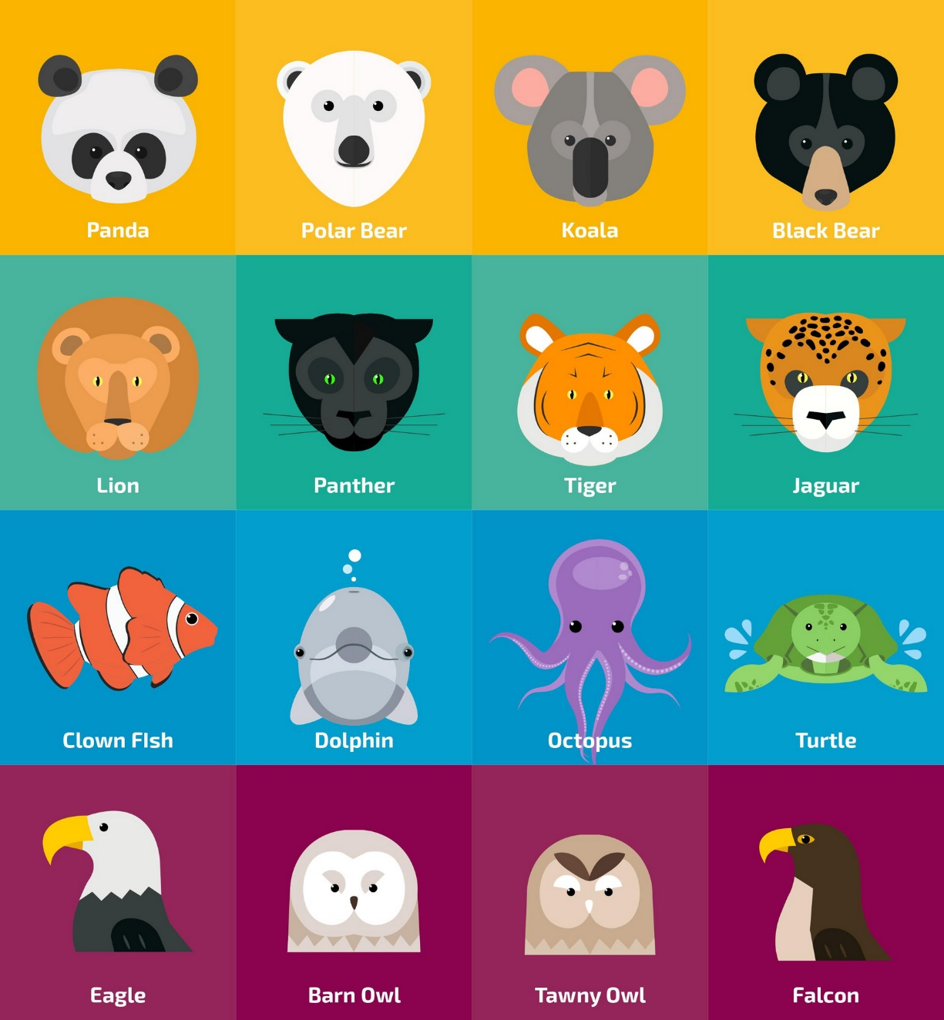
Identifying Your Animal Guide
The Buzz Quiz helps us to look at each pair of skill sets to identify our strengths.
We can represent this as an animal guide!
It also helps us to recognise our shadow animal (the opposite) which shows us the things that we can improve.
Notes:
Introduce the idea of a quiz to help pupils to reflect on and identify their strengths.
It is important that they focus on themselves and answer as honestly as possible.

Slide 7
Your Animal Guide
Look for clues in your animal description to identify how to build three ingredients of happiness.
These create resilience from the foundations upwards.
They are an unseen compass that guides us.
Notes:
Students look for clues in their animal description to identify how to build three ingredients of happiness.

Slide 8
















How will you build meaning, connection and purpose?
What’s Your Core Motivation?
Bears
Belonging, hard work, membership through responsibility, duty and building on past success.
Birds
Mastery, self-control, through competence and Knowledge.
Cats
Impulse, freedom to act through ability to make an impact.
Sea animals
Meaning and significance for people through my unique creative contribution.
(Ref: David Keirsey, Please Understand Me, 1984)
Notes:
Students work in same animal groups to identify core motivators, of same
Then show Core Motivation table to see if they match

Slide 9
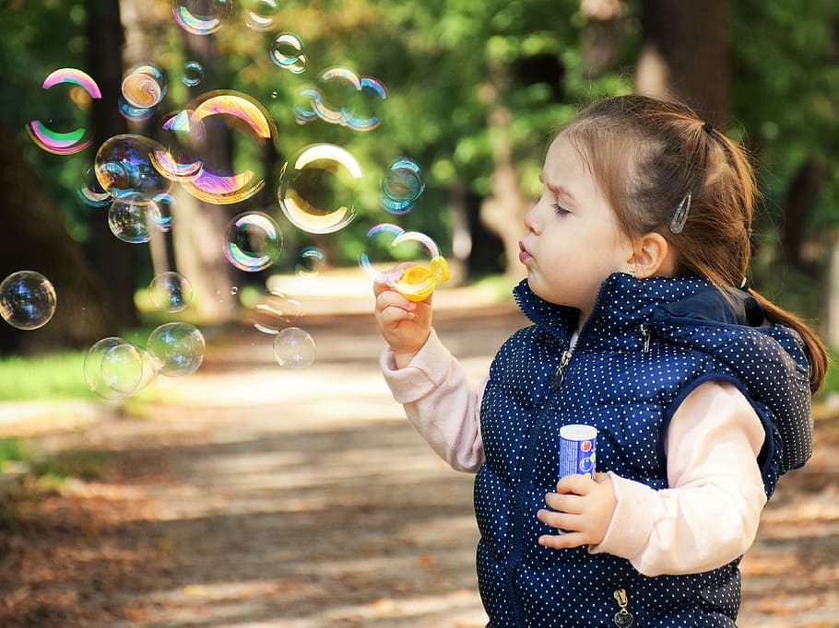
Building Resilience in the Present
Which of these work for you? Can you add more ideas?
1. Look for the Positive
In people, relationships, organisations, events.
2. Seek silver linings/ what you have learned
Don’t laugh about it ten years from now (and be miserable for 10 years) learn from it now and move forward.
3. Relax and Recharge in the present
With Breathing, a walk, listening to music, dancing…
Building Resilience Vanessa King ,Head of Psychology, Action for Happiness (Youtube, July 2024)
Notes:
Share, practice some of the methods such as breathing, share examples of looking for the positive in course and career contexts.

