Slide 1
North East construction sector careers
Infrastructure
Notes:
Please read accompanying teacher guide before delivering these lesson resources

Slide 2
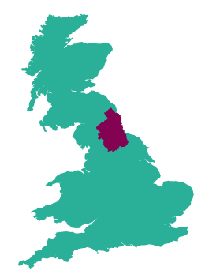
The construction sector in the North East
Construction is a key part of the North East economy, a driver of jobs and growth. The quality of our buildings, whether that be schools, offices, hospitals or housing, has a lasting impact on the wellbeing of businesses and communities across the region.
The construction sector is important to the North East and enables the growth of other key sectors the North East economy.
In 2020 there were over 50,000 people employed in 8,125 businesses in our region and more skilled people are needed in this sector. The CITB estimate a further 7,000* new workers are needed between the end of 2020 and 2025 to meet the recruitment needs of the industry in the North East.
Investment in infrastructure and sustainable housing is driving growth in the construction sector.
The UK, Welsh and Scottish governments have underpinned climate change commitments with a legally-binding target to reduce greenhouse gas emissions to net zero by 2050.
This presents a huge opportunity for construction businesses to meet new demands through a new set of skills and services which will help to make homes and buildings more sustainable.
Notes:
*CITB –Construction Skills Network NE LMI report 2021-2025
https://www.citb.co.uk/media/rikcy33j/north_east.pdf
For the most recent economic and employment data visit:
https://evidencehub.northeastlep.co.uk/datapage

Slide 3
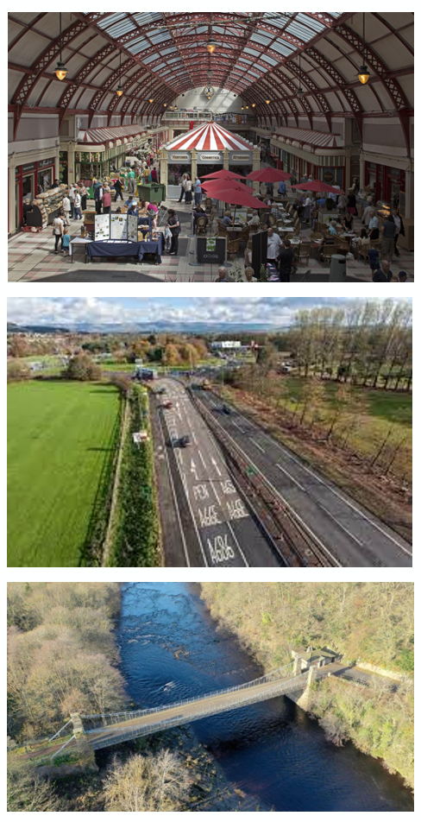
Construction of infrastructure in the North East
Infrastructure construction activity accounts for around 14% of NE construction *
In 2021 the Chancellor announced £4.8 billion “Levelling Up” funding for infrastructure projects across the country. In the North East this funding will be used for projects such as the restoration of the Grainger Market in Newcastle, building a state-of-the-art sports facility in West Denton, and reopening the Whorlton Bridge near Barnard Castle.
Other large infrastructure construction projects in our region include the upgrade of the A66 and the roll out of gigabit-capable broadband to homes and businesses across the region.
Investment in infrastructure projects such as these leads to an increased demand for skilled people
Notes:
*CITB –Construction Skills Network NE LMI report 2021-2025
https://www.citb.co.uk/media/rikcy33j/north_east.pdf
Info on Newcastle Grainger market restoration and West Denton leisure centre:
https://www.newcastle.gov.uk/citylife-news/employment/major-investment-city-centre-and-new-leisure-centre-west-denton
Info on Whorlton bridge project
https://www.durham.gov.uk/article/25171/Whorlton-Bridge-current-programme

Slide 4
What is the construction of infrastructure?
Using the information on the previous slide and video to answer the questions below
Why is construction important to the North East economy?
Can you name some infrastructure projects planned for construction in the North East?
What are the benefits of a career in the construction industry?
What types of roles are available in the construction industry?
Why is demand for skilled people increasing in the construction industry?
CITB -Careers in construction
Notes:
Students watch video and use facts from slide 3 to answer questions to share in class discussion
Please read accompanying teacher briefing guide
CITB careers in construction video (5:13)
https://www.youtube.com/watch?v=xTiqFF9MjLA

Slide 5
Jobs in the construction industry - infrastructure
Questions
Which company do they work for and what does the company do?
What job does the speaker have and what types of things do they do in the role?
What qualifications do you need to get the job?
Which skills are important to the job?
How can you find out more about jobs such as these?
Watch the videos of people working in the construction industry in the North East and answer the questions
Danielle, Quantity surveyor
Ben, BIM Coordinator
Jessica, Drainage Engineer
Caitlin, Structural Engineer
Sean, Groundworker
Notes:
Students watch videos (teacher can select one which is most relevant to their students if preferred) and answer questions
See accompanying teacher guide for overview of video content
Danielle Quantity surveyor (5:48)
https://www.youtube.com/watch?v=br9uxMVIEoA
Ben, BIM Coordinator (4:18)
https://www.youtube.com/watch?v=TERR4tBBJjI&feature=youtu.be
Jessica, Drainage Engineer(1:26)
https://www.thewowshow.org/day-in-the-life-jessica/
Caitlin, Structural Engineer (4:16)
https://www.youtube.com/watch?v=Vs9APrPZ0y8
Sean, Groundworker (2:31)
https://www.youtube.com/watch?v=jBnwjtW9mSw

Slide 6
What careers are available in infrastructure construction?
Here are some examples of jobs which are available in this sector:
Pick one of the jobs listed and research the following:
What is the job, what types of things would you do in the role?
How many hours would you work a week? Is it a typical 9-5 or varied hours? Can you work part-time or freelance?
What qualifications do you need to get the job?
What is the starting salary?
What jobs could you progress to in the future?
Can you find any local companies currently advertising this job role?
Supply Chain Manager
Quantity Surveyor
Ground worker
Civil Engineer
Structural Engineer
Site Manager
Commercial and Risk management
Design Manager
BIM Coordinator
Business Development Manager
Social Value Manager
Health & Safety Officer
Environmental Officer
Estimator
Notes:
Slide 1 of optional extension task – only use this if want a turn this into a whole careers lesson rather than starter/plenary. Alternatively can be set as home learning.
Activity – ask students to pick one of the jobs from the slide and then use the guiding questions on the slide to find out more about it. Websites such as the National Careers Service can be a helpful place to start but links to more detailed information on roles in the low carbon heat industry can be found on the next slide.

Slide 7
Useful links for research task on job roles
Routes into the industry
National careers service
Construction Is A Career Like No Other | Go Construct
Routes into our Industry - CECA
Property and construction | Prospects.ac.uk
Start profile | careers in construction
Building People | Creating connection across the built environment.
Construction and Architecture – icould
Construction Industry Training Board (CITB)
Amazing apprenticeships
Find an apprenticeship
Institute for apprenticeships occupational maps
Dept for Education – post-16 choices
Local employers
J Murphy & Sons
Story Construction
Balfour Beatty
McAlpine
Mott MacDonald
Jacobs
Costain
Kier
Bowmer + Kirkland
Cundall
Turner and Townsend
Caterpillar
Tilbury Douglas
MGL Group
Arup
Galliford Try
Howard Russell
ISG
Northumbrian Water
Esh Group
Meldrum Group
NG Bailey
Construction Excellence North East
Notes:
Slide 2 of optional extension task - research links

Slide 8
Skills for careers in construction
In today’s lesson we will learn about:
Text
Text
Text
We will develop skills such as:
Text
Text
Text
These skills are important for the construction sector because:
Text
Text
Text
Notes:
[Teacher to choose curriculum links most appropriate for the topic currently being studied and how this links to the construction industry]
See accompanying teacher briefing guide for suggested curriculum links

Slide 9
Review
How does what we have learned today link to the construction industry?
Want to find out more?
Here are some links to more information on careers in the North East construction industry:
National careers service
Construction Is A Career Like No Other | Go Construct
Property and construction | Prospects.ac.uk
Start profile | careers in construction
Building People | Creating connection across the built environment.
Construction Industry Training Board (CITB)
Construction Excellence North East
Amazing apprenticeships
Find an apprenticeship
Institute for apprenticeships occupational maps
Dept for Education – post-16 choices
LMI For All – LMI For All
Notes:
Optional plenary task to follow subject lesson and link to starter activity.

Slide 10
Thank you
Find out more about the North East LEP

