Slide 1
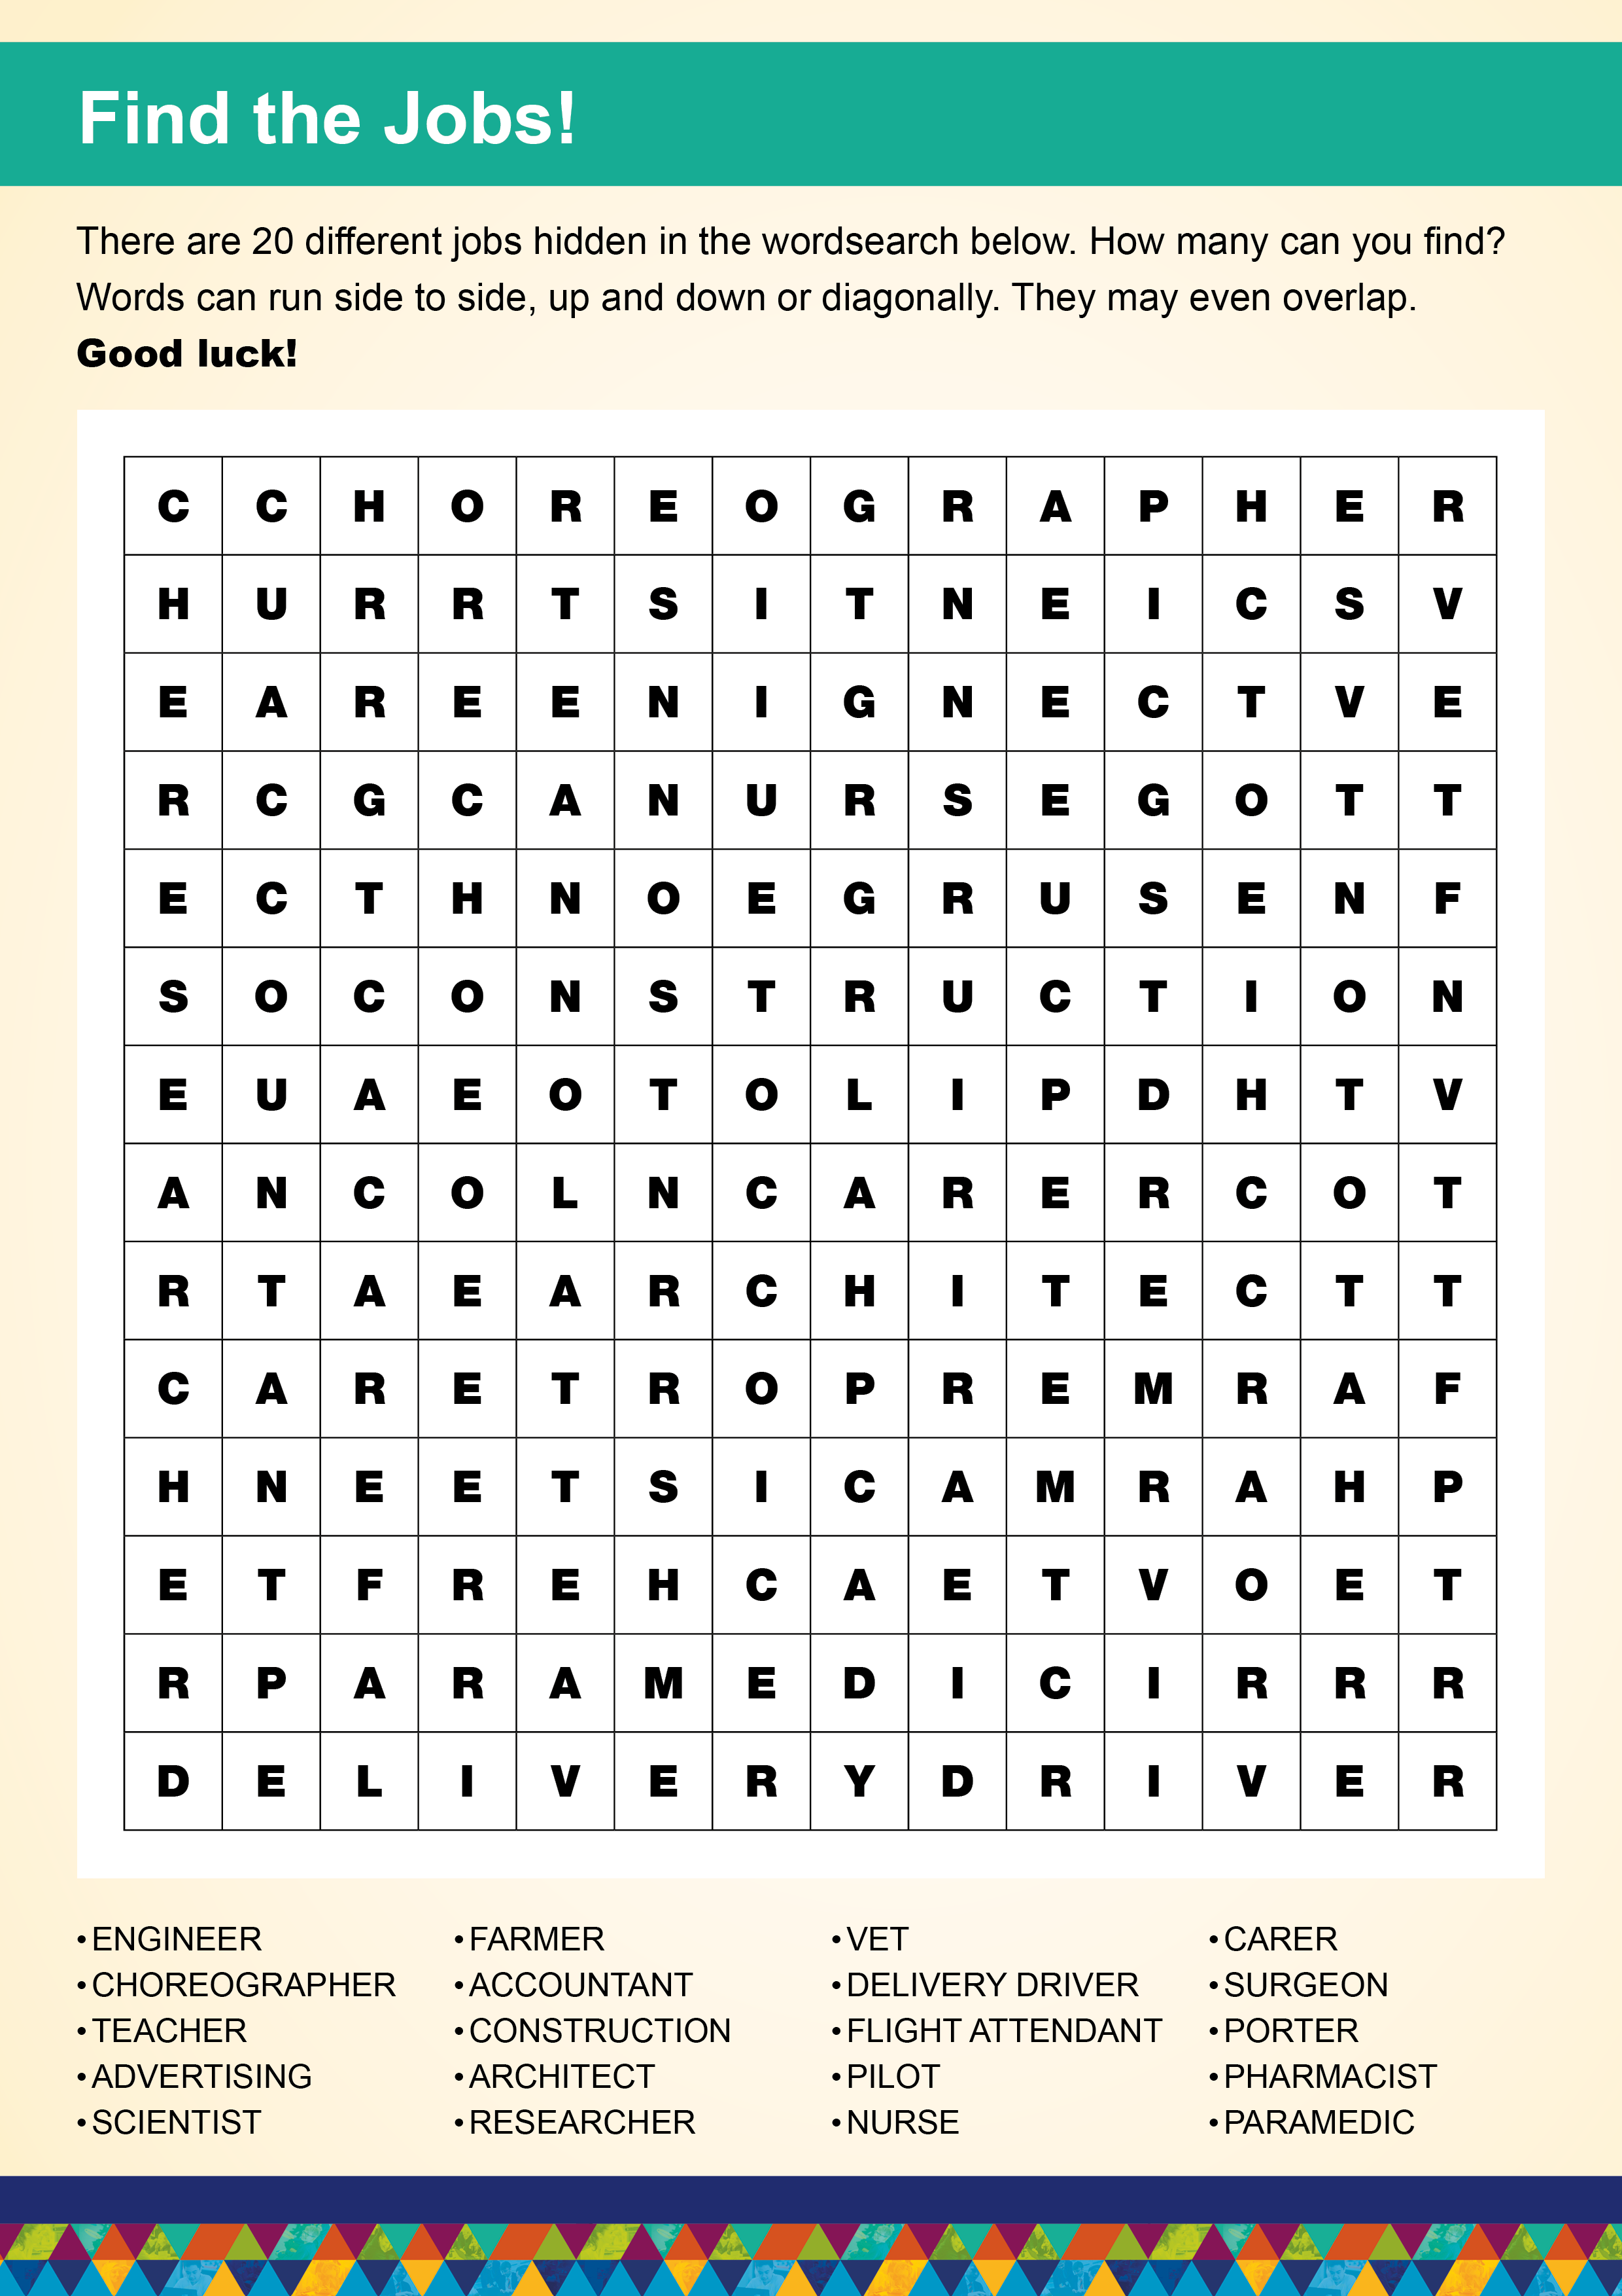

Slide 2

Dear Parents and Carers,
We hope you and your family are safe and well.
We have been learning about a wide range of different jobs to inspire our children and to broaden their horizons for the future.
Research shows that children as young as five have views about the jobs people do, based on their gender, ethnicity and social background. Starting early with career-related learning brings many benefits for primary children including a better understanding of the importance of what they learn at school and how this links to their future. It also helps reduce stereotypes such as increasing children’s understanding that boys and girls can do the same job.
Parental support in nurturing children’s aspirations, alongside structured career related learning in schools, provides a foundation for capturing children’s aspirations and influences the learning and work decisions they make in the future.
There are 20 different jobs hidden in the wordsearch overleaf. Why not take this opportunity to talk to your child about the different jobs that they may enjoy doing in the future?
Get Involved
Would you like to volunteer to be a career role model at our school?
We are looking for a diversity of voices so that our children can see and hear themselves in the volunteers they speak to. By sharing your career story, you can open children’s eyes to a world they might never have imagined for themselves. You will be surprised what an impact sharing your story will make! Please contact xxxxxx to volunteer to be a career volunteer.
We really appreciate your engagement in our work to inspire our children to aim high.
Many thanks and best wishes

