Slide 1
Introducing Career Related Learning
Name

Slide 2
Session Overview
Why Career Related Learning?
Explore approaches to careers in the curriculum (Benchmark 4)

Slide 3
North East Employment
North East regional labour market data (Oct-Dec 23): Key points
According to the latest data, in the Oct-Dec 2023 three-month period, the North East region was estimated to have had:
The lowest working age employment rate
(71.6%, Eng. 75.4%)
The joint second highest unemployment rate
(4.3% of economically active adults, Eng. 3.8%)
The highest working age economic inactivity rate
(25.4%, Eng. 21.5%)
Notes:
Start by introducing why this work is particularly important for children and young people in our region. You may wish to focus on another metric or ensure that this is up to date by visiting Employment and Skills - North East Evidence Hub (northeastlep.co.uk)

Slide 4
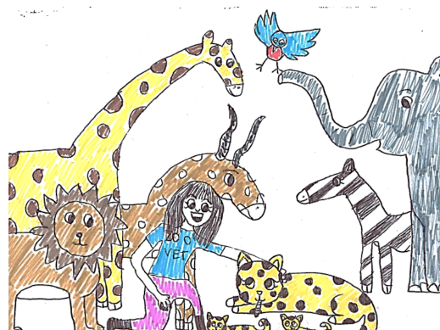
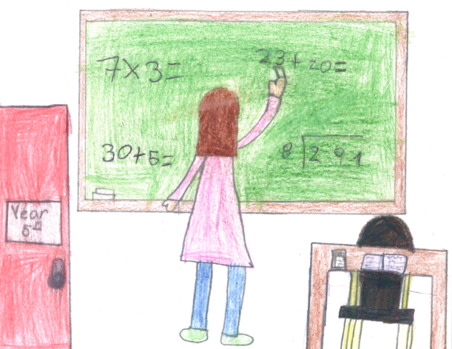
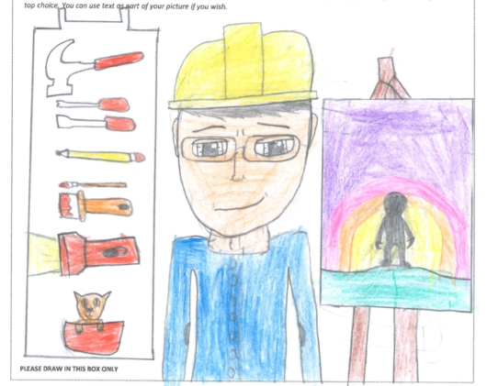
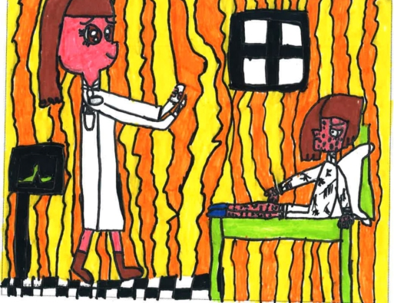
The research: Drawing the Future
Reflection
1.
What stereotypes do our pupils hold that could limit their aspirations?
2.
How do we currently challenge those stereotypes?
A survey of 20,000 primary school children with significant implications for social mobility and gender equality.
The report revealed that the difference between children’s career aspirations from age 7 to 17 are marginal, and too often based on gender stereotypes, socio-economic backgrounds and by TV, film and radio.
It also shows that some sectors vital for economic health look set to be badly resourced in the future.
Notes:
See full study here: Drawing the Future - Education and Employers
The report suggests two key reason to start early with career-related learning:
- Career-limiting decisions can be made by age 7 based on a range of factors (listed above)
- There is a disconnect between the jobs young people aspire to and the areas of opportunity for them when they grow up

Slide 5
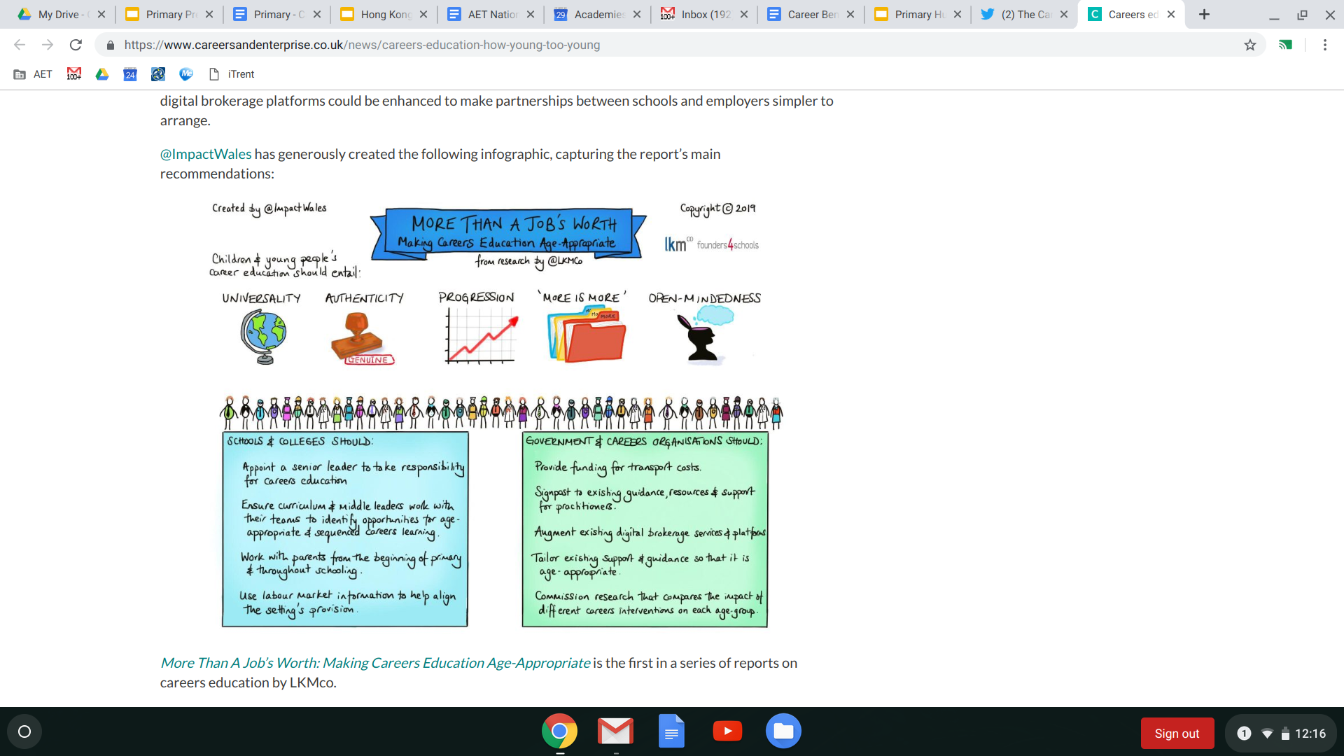
The research: Drawing the Future
Reflection
Reflection
The report argues the need for careers education to start as soon as children begin their education.
It suggests that young people’s careers education should then build cumulatively throughout their time in school.
It explores the challenges of delivering careers education in primary schools including curriculum pressures and their understanding about how to build a cumulative careers curriculum.
1.
What could careers education look like at Early Years, KS1 and KS2?
2.
What does progression look like?
LKMCo and Founders for Schools (2019)
More than a Job’s Worth: Making Careers Education Age-Appropriate
Notes:
See the full report here: (PDF) More than a Job's Worth: Making Careers Education Age-Appropriate (researchgate.net)
Bullet points:
Ensure curriculum leaders identify opportunities for CRL in their subject
Work with parents
Use labour market information to inform school’s approach

Slide 6
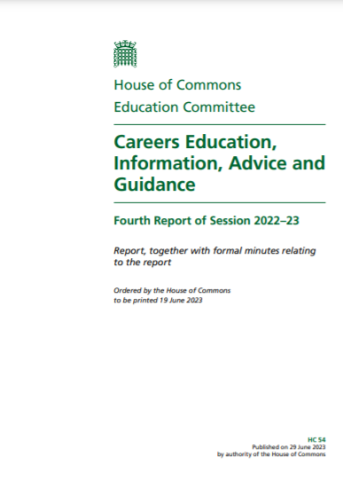
National update
The report focusses on four areas:
Primary Schools
Careers in the curriculum
Employer links with schools
Supporting specific groups of pupils
Primary schools:
Starting careers provision at an early age is essential
DfE’s recently announced pilot is a positive step forward
There is a need to move to a universal approach – with the DfE encouraged to work with Gatsby on an adapted set of Benchmarks for primary schools
Notes:
The government has responded to recommendations from the Education Select Committee to set out its plans for Careers education from 2024 onwards.

Slide 7

The Good Career Guidance Primary Benchmarks
1. A stable careers programme
Every school has an embedded programme of careers and personal development that seeks to raise aspirations, broaden horizons and is age appropriate. This programme shows progression through the key stages and is known and understood by pupils, parents/carers, teachers, governors and other key stakeholders.
2. Learning from career and Labour market information
Every pupil, and their parents/carers, should have access to basic labour market information to help expand their awareness of future possibilities and opportunities.
3. Addressing the needs of each pupil
Pupils will have different needs and so opportunities for support should be tailored to the requirements of each pupil. A school's careers and personal. development programme should embed equality and diversity throughout and actively challenge stereotypical thinking.
4. Linking curriculum learning to careers
All teachers should link curriculum learning with careers and future learning possibilities. The importance of literacy, numeracy and digital awareness should be emphasised and pupils should have the chance to explore STEM related opportunities and understand the skills they will need for the future.
5. Encounters with employers and employees
Every pupil should have the opportunity to have meaningful and age appropriate encounters with a range of different employers and understand the importance of skills in the workplace. This can be through a range of different activities including visiting speakers and/or enterprise schemes.
6. Experiences of workplaces
Every pupil should have the opportunity to experience a variety of workplaces. These experiences of the world of work could be either direct and indirect and might include role plays, challenge days or visits to local employers.
7. Encounters with further and higher education
All pupils should understand the full range of learning opportunities that will be available to them. This includes both academic and vocational technical routes and learning in schools, sixth forms, colleges, training providers, universities and in the workplace.
8. Personal guidance
Every pupil should have the opportunity to have ‘careers conversations’. Their aspirations and personal development progress should be recorded and shared with parents/carers, as well as the transition leaders of the next place of education.
Notes:
The Good Career Guidance Primary Benchmarks are a strategic framework to guide primary on how to deliver effective careers education.
All 8 Benchmarks are interconnected, and equally important, but for the purposes of today’s CPD session we are going to concentrate on one of these in particular –
Benchmark 4 which explicitly asks schools to make connections to careers within their existing curriculum
Benchmark 2 which asks schools to base their careers learning on a sounds understanding of the existing and future labour market

Slide 8
But what does this mean?
Reflection
Incorporating careers education at the heart of learning. Making meaningful links to the world of work within curriculum lessons.
Providing pupils with opportunities to learn from real world contexts, interact with employers and experience workplaces.
Enabling pupils to make links between what they are learning in the classroom and the practical application of that knowledge (and skills).
Ensuring that pupils begin to understand the skills required in the workplace and have opportunities to develop these.
Helping pupils understand the opportunities available to them in the local and regional labour market, and variety of pathways into these roles, including through FE and HE.
1.
Which elements do we already do?
2.
Where are the opportunities to develop further?
Notes:
What does this framework actually mean in practice?

Slide 9
Linking Curriculum to Careers

Slide 10
Benchmark 4: Linking Curriculum Learning to Careers
4. Linking curriculum learning to careers
All teachers should link curriculum learning with careers and future learning possibilities. The importance of literacy, numeracy and digital awareness should be emphasised and pupils should have the chance to explore STEM related opportunities and understand the skills they will need for the future.
Notes:
This section explores ways in which curriculum can be linked to careers in line with Benchmark 4.

Slide 11
Why curriculum led?
Authenticity for teachers and students
True links to career and future opportunities
More impactful than standalone activity
Excitement into planning and teaching
Parental engagement – showcase events
Self-sustaining - manageable workload after initial delivery
Relationship building
Embedding self/ school within community
Experiences & insight outside of the classroom

Slide 12
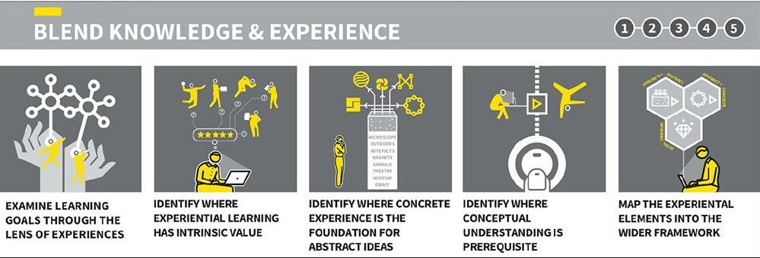
Tom Sherrington Perspective
Ambition
The search for richness, quality, challenge – runs through all.
Weaving together
A curriculum bigger than the sum of parts; not just teaching one thing after another. We’re weaving our stories and ideas together, building secure but expansive schema, helping students make sense of the world in its interconnected glory.
Choices with a balance of breadth and depth
There’s too much to teach! We need to make a selection the best we can, based on some shared principles, looking for a balance of breadth, selecting a core and sign-posting the hinterland.
Notes:
Embedding careers in the primary curriculum supports the more general theory of building an effective school curriculum.
Tom Sherrington outlines these key elements of building a curriculum – we can see that including careers in the curriculum can support all of these outcomes.

Slide 13
Tom Sherrington Perspective
Curriculum+ Pedagogy
The idea that a curriculum is always enacted; how we teach matters.
Diversity
Why it matters so much and the fact that the possibilities are everywhere.
Long-term process
Curriculum design isn’t an event; there’s no finished, polished product. It’s an ongoing process and it’s better if schools and leaders regard it as such, setting things up so that process is happening continually.
Notes:
Embedding careers in the primary curriculum supports the more general theory of building an effective school curriculum.
Tom Sherrington outlines these key elements of building a curriculum – we can see that including careers in the curriculum can support all of these outcomes.

Slide 14
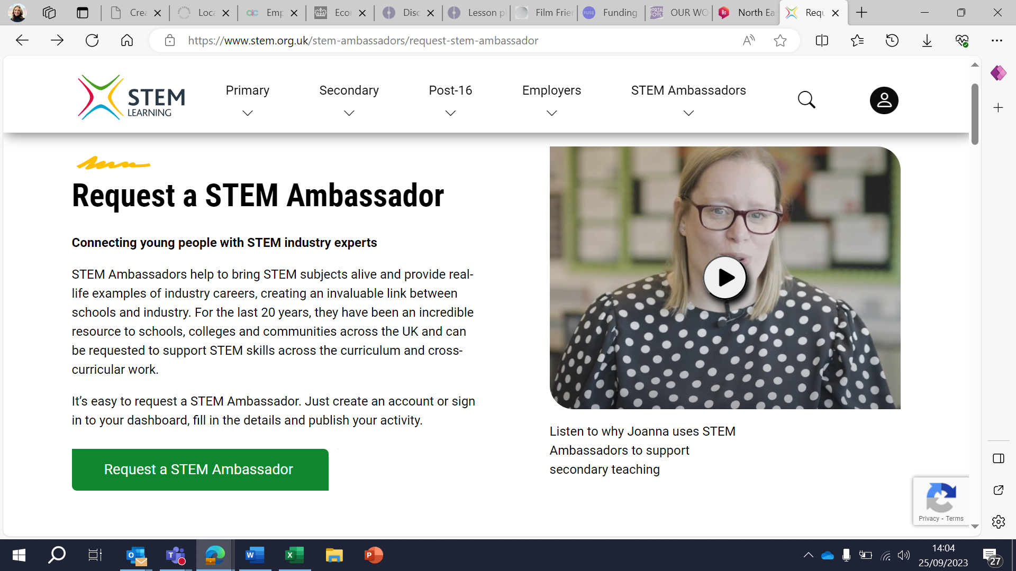

Approaches to Benchmark 4
1. Guest speakers in subject lessons
From platforms such as Primary Futures or the STEM Ambassador Network.
You can also use staff, parents and governors to build your own network.
2. Ready-made Resources or Activities
North East STEM Hub Loan Kits
iCould Careers Videos
BBC Bitesize Careers
Online resources enabling exploration of careers linked to subjects with supporting videos and guides.
Notes:
There are varying levels of incorporating careers related learning into curriculum and an approach to suit the experiences and capacity of all careers leaders and teachers, from light touch to truly embedded across curriculum.
Including guest speakers in lesson time (pre-recorded videos, live in-person or virtual guest speakers in lesson time to interact with students). By using networks such as Primary Futures and STEM Ambassador Network we can grow our own contact base. Invite employers to talk about their career pathway, role, company they work for and highlight how the key areas of their role or their company work links to the curriculum content
Guest speakers in subject lessons
Light touch encounters linked to curriculum topics/ subjects
Build a network of contacts that can contribute annually to the curriculum
Opportunity for pupils to ask questions
Existing local and national networks e.g. Primary Futures, STEM Ambassador Network
2. Existing resources highlighting the relevance of subjects to careers, opportunities and pathways e.g. iCould/BBC Bitesize
Ready made resources/ activities
Highlight relevance of subjects to careers, opportunities and pathways through existing activity
Opportunity to trial approaches such as projects
Minimal time required for planning

Slide 15





What is Primary Futures?
Connects primary schools with tens of thousands of inspirational volunteers from the world of world of work virtually or face to face
Suite of pre-recorded video resources – curated volunteer talks with cross-curricular learning activities
Used by over 4,000 primary schools to support career-related learning
Notes:
Primary Futures is a free to use platform which includes resources, lesson plans, activity structures and a platform enabling teachers to connect to industry.

Slide 16
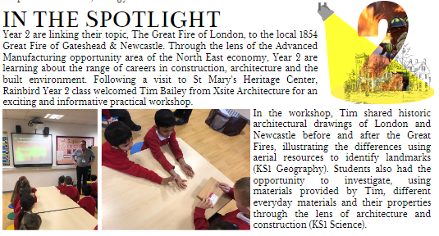
Approaches to Benchmark 4
3. Codeveloped curriculum linked/ led projects with employers
Most amount of time required for developing and delivering
More sustainable and likely to be more embedded
Strong application of subject/ topic content to careers and future opportunities
Opportunity to focus on numeracy and literacy and key skill development
Notes:
3. The most embedded approach where we see codevelop curriculum linked and curriculum led projects with employers – embedding careers in curriculum teaching and learning and encouraging sustainable relationships with employers.
The next slide shares an example from work with Excelsior Academy’s primary, Rainbird, where they focused on the Great Fires topic in Year 2 and developed partnerships with a local architect and St Mary’s Heritage centre.

Slide 17
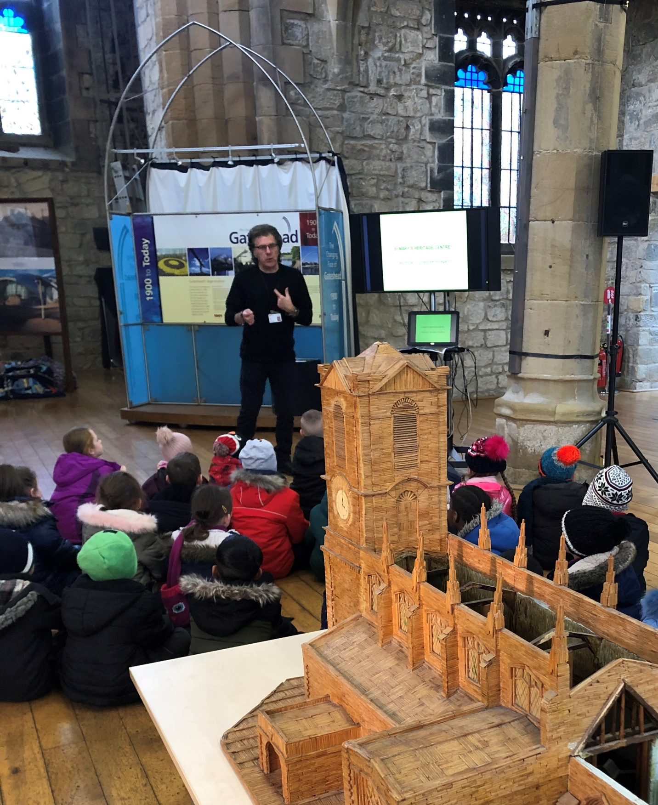
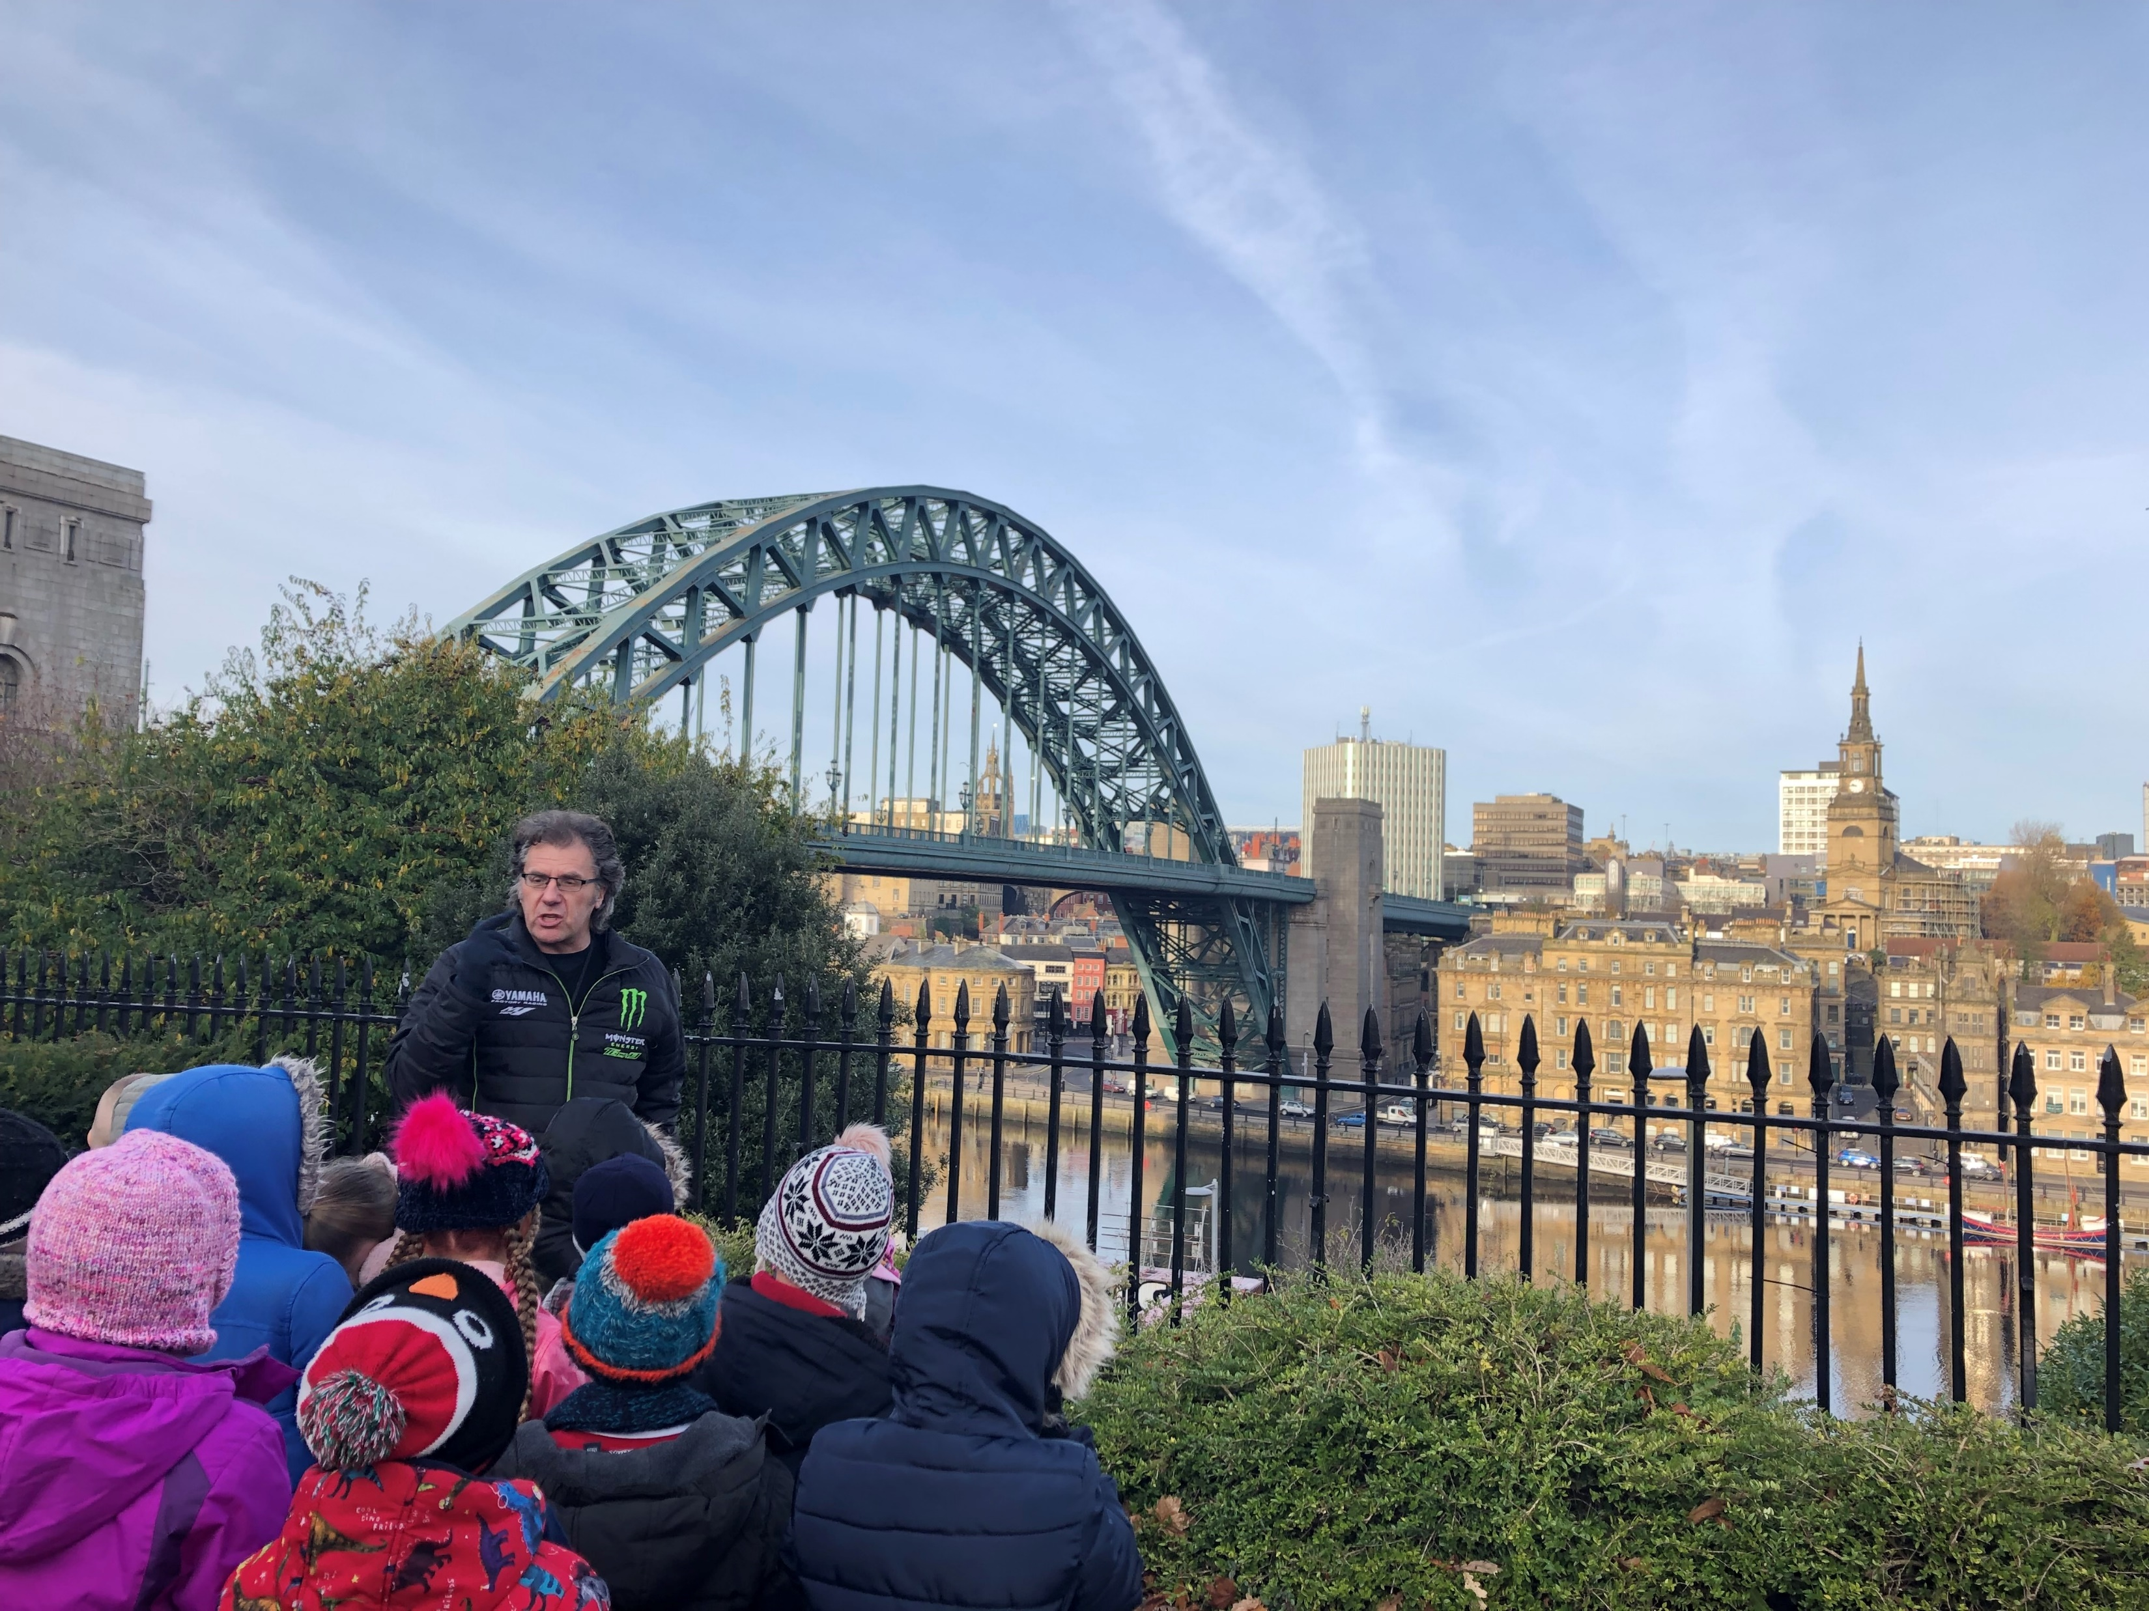
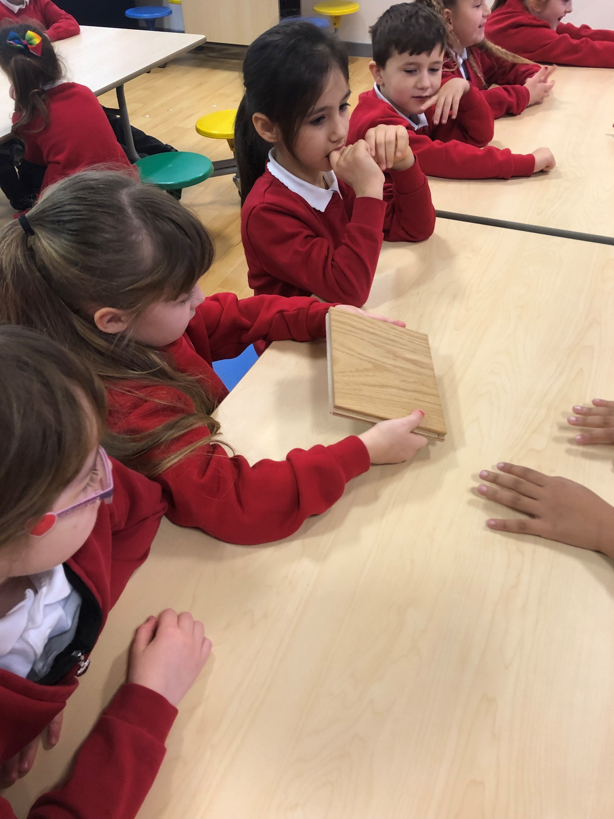
Year 2: Great Fires Project
Notes:
Great Fires Project involved a pre-learn in classroom lesson looking at the history of the Great Fire of London and that of Newcastle and Gateshead.
Pupils then visited St Mary’s Heritage Centre on the Quayside (history and context learning), before an in classroom practical session with Architect Tim from XSite Architecture who investigated local aerial shots of the quayside, properties of everyday materials and careers related learning linked to relevant sectors and pathways.
Pupils showcased their learning to peers, parents and project partners and demonstrated an awareness of architecture, how to get into the sector.
Pupils were also able to articulate the impact the Great Fires had on construction and points of importance from the historical timeline and the aerial geographical shots of locations.

Slide 18

Embedding employer encounters into curriculum
Dentist/ Nurse/ Doctor
Mountain Rescue
Theatre Usher
Construction Worker
Offshore Divers
Film & Television Production
Police Officer
Notes:
Where can we start and how can we make the process for identifying an opportunity to embed careers into the curriculum easier?
Props! Think of a torch. Now think of as many careers you can think of that link to a torch.

Slide 19

Embedding employer encounters into curriculum
List of careers linked to chosen object
Notes:
You could repeat the activity with a physical object and develop your own list of potential careers.
Now, here is a ***, can you do the same and think of all of the careers that might link to this item?

Slide 20

Activity
Put out a big sheet of paper for each year group with subjects/topics for the year.
Add all the career related learning that is currently happening including curriculum links, visits or visitors
Use post-its to add suggestions of how to enhance this further (your wish list)
Move around and add ideas to other year groups

Slide 21
Next steps
Audit opportunities for career links within each year group curriculum e.g., do we start with STEM or DT or History? May be easier for everyone to focus on one particular subject?
Rather than thinking in terms of 'one off' days such as Dream Job day, how can we begin to build relationships with people who can come in and support learning in specific topics?
What CPD/support might staff need going forward? Staff suggestions
Notes:
Discuss school year priorities and next steps for all/ some colleagues

