Slide 1
Labour Market Information
The What, the Why and the How

Slide 2
Session Overview
Background
The Future of Work
Job Awareness
Labour Market Information (LMI) in school
Putting it into Practice

Slide 3
Background

Slide 4
Our Ambition:
Every young person in the North East should be able to identify routes into a successful working life
Notes:
This statement underlines our ambition for the region. It is widely acknowledge that increased knowledge and understanding of the local labour market helps a young person to identify routes into a successful working life and this sits at the heart of our work. This demonstrates the need for accurate and up to date information about the labour market so that children and young people can make informed choices.

Slide 5
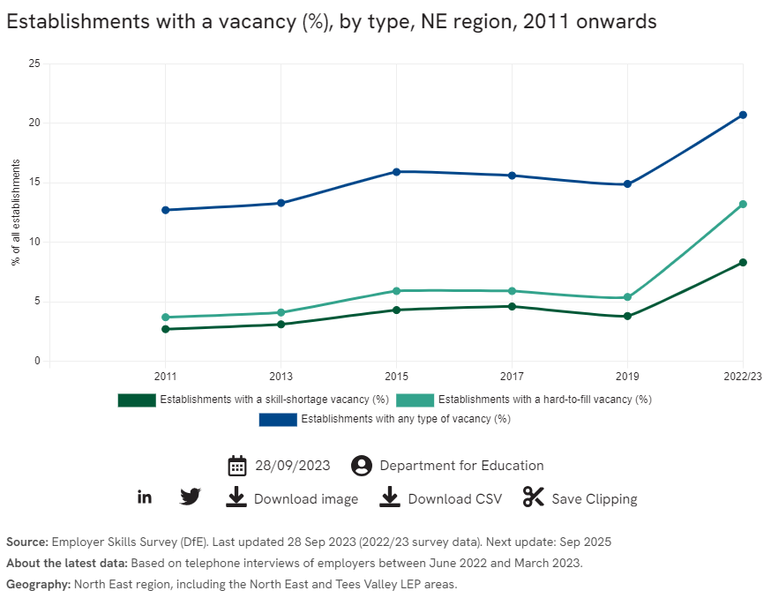
The number of jobs is in the North East is increasing
Please note – check Education, inclusion and skills - North East Evidence Hub (northeast-ca.gov.uk) for up to date information.
Notes:
Please note – check Education, inclusion and skills - North East Evidence Hub (northeast-ca.gov.uk) for up to date information.
Here we can see a steady increase in job vacancies over time with a significant increase post-covid.
What is also interesting is that jobs with skills shortages or those ‘hard to fill’ are increasing. This tells us that we need to have an awareness of what these jobs are, and the skills needed to prepare our pupils for their future careers.

Slide 6
What is LMI?
Data about the workplace
Statistics about the workplace
Research into the workplace
Also about pathways and progression
Notes:
LMI is information, data and statistics that describe the labour or employment market. The North East Evidence Hub website is a great source of information to find statistics about our region.
LMI also provides young people with a better understanding of the pathways into jobs including the qualifications needed.

Slide 7
Why does it matter?
Access to up-to-date career and labour market information is important for social mobility
Information about pay, how many available jobs and previous pupils in the school who have had ‘successful transitions’ helps to connect pupils to a different future
Giving information, different routes and employers allows pupils to make more informed choices and transitions:
“If you can see it, you can be it.”
Notes:
This could be from Y6 deciding on a high school to a route into further/higher education at the end of high school.

Slide 8
What do the Benchmarks say about LMI?
Throughout their time in school every pupil has had multiple opportunities to explore a range of different careers and job roles including the routes into them. This may include the use of careers websites and other online resources.
Throughout their time in school (by the end of Y6 or by the end of Y4 in a first school) all pupils have explored basic labour market information to expand their awareness of future opportunities and possibilities.
Labour Market Information is used to tackle stereotypical thinking, raise aspirations and broaden horizons, ensuring each pupil understands the full range of options open to them.
Parents/carers are encouraged to explore accurate and up to date labour market information related to different careers and job roles, and the routes into them, with their children.
Notes:
This is an outline of how we should be using LMI as part of our careers programme.
Which of these are we already doing? Where are the gaps?

Slide 9
The Future of Work

Slide 10



A minute to discuss…
What are the key sectors in the North East?
A sector is an area of the economy where businesses share the same or related activities, products or services, for example the Digital sector
Notes:
Individually or in small groups discuss what you think are the key sectors in the North East where we may see significant growth or job creation now and in years to come?

Slide 11

Tourism
Conservator, events manager, museum attendant, resort representative
Notes:
A major leisure and tourism sector in the region - including urban and rural assets, two World Heritage Sites, a National Park and the Gateshead Quays development; with over 48 million visitors per year to the region.
To consider - which tourist attractions are close to your school? Is this a place you could visit and find out about what job roles are available?

Slide 12
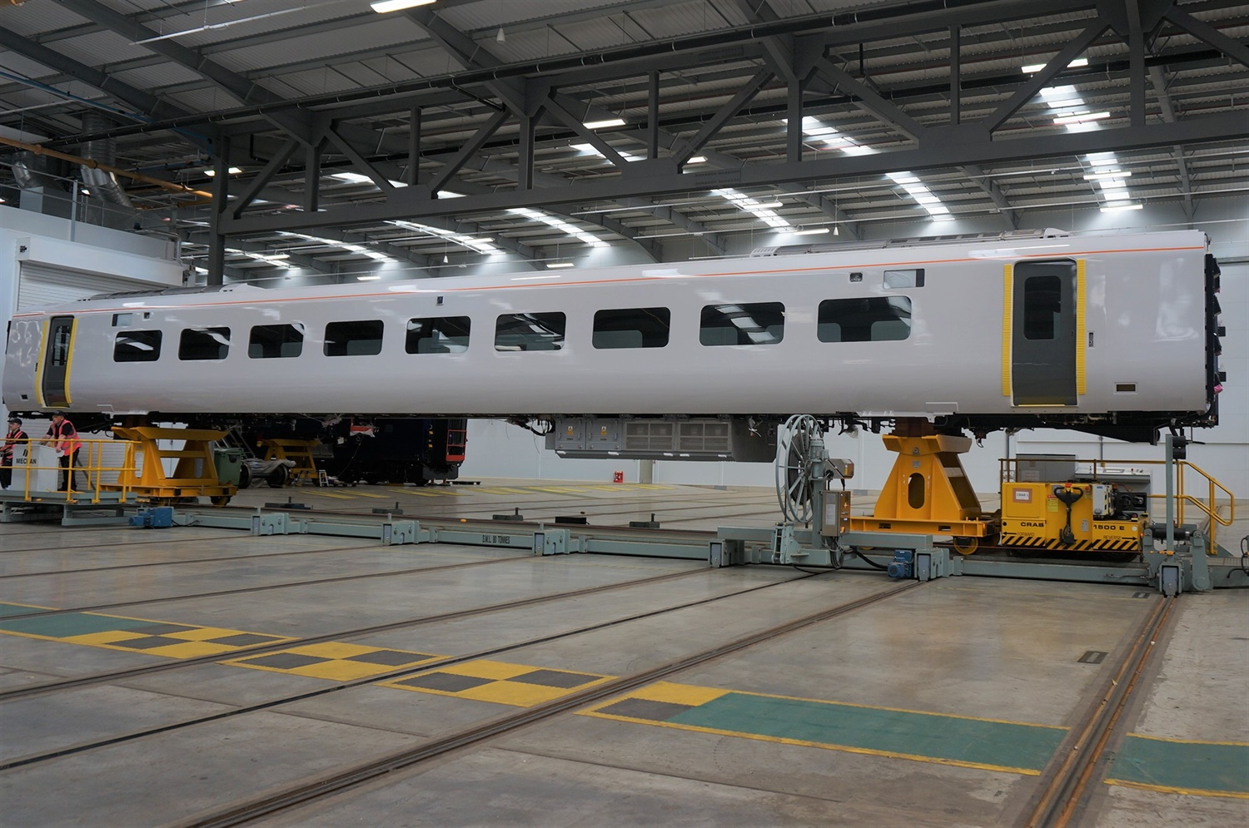
Advanced Manufacturing
Production worker/manager, engineer, toolmaker, welder, fabricator
Notes:
The North East is one of the most established and productive manufacturing sectors in Europe, home to Nissan and an abundance of other thriving manufacturing giants including Hitachi, Cummins, Komatsu, Caterpillar and Liebherr.

Slide 13
Digital
Software engineer, data scientist, robotics engineer, cybersecurity officer
Notes:
A thriving tech sector - including Sage, Atom Bank, consultancy, games etc – and growing opportunities around screen industries did you know that major films are being produced here in the North East like the recent Danny Boyce film 28 Years later starring actress Jodie Comer North East Screen - The North East's Screen Agency
How many of students are interested in gaming or technology did you know that major video games including game of thrones have been produced in the North East?

Slide 14

Energy
Heat pump engineer, drone pilot, wind turbine technician, pipe fitter
Notes:
An increasingly important low-carbon economy, including offshore wind technologies, electrification/batteries and onshore wind and geothermal. The North East is the leading location in England in the wind energy, oil, and gas sectors with a thriving cluster of supply chain businesses to the offshore energy and subsea industry, supporting 15,000 jobs. The North East of England was home to the first Offshore Wind Farm in Blyth and we are now home to what will be the worlds largest Offshore Wind Farm, Dogger Bank Wind Farm.
Check out - Equinor: Dogger Bank Wind Farm - North East Ambition (northeast-ca.gov.uk)

Slide 15

Health and Life Sciences
Clinical psychologist, dietitian, art therapist, medical physicist, geneticist
Notes:
North East England is a major centre for pharmaceutical manufacturing with companies across our region making a vital contribution to the supply of essential medicines across the world and responding in the global effort to diagnose, treat, and prevent COVID 19. A leading region in health research and treatment.

Slide 16

Construction
Architect, bricklayer, civil engineer, quantity surveyor, roofer, town planner
Notes:
The construction sector is a substantial part of the North East economy, representing 9,750 businesses and 95,000 employees, as well as generating £2.3 billion for the regions economy. The North East construction sector is forecast to require an extra 7,900 workers by 2027 did you know that a total of 19 providers offer education programmes with construction elements, at various qualification levels, including Durham University, Gateshead College and their PlanBEE programme, Northumbria University’s digital built environment work.
Companies such as ESH Group offer education programmes aimed to inspire the next generation of STEM workers. - Constructing Local | Esh Group

Slide 17

Creative and Cultural
Animator, choreographer, journalist, musician, photographer, TV producer,
Notes:
The North East of England is emerging as a dynamic hub for the cultural and creative sectors, renowned for its rich heritage, thriving arts scene, and growing media presence. The region boasts a diverse range of creative industries, including visual arts, music, theatre, digital media, and film production.
A major development is the upcoming Crown Works Studios in Sunderland. This state-of-the-art film and television production facility aims to establish the North East as a key player in the UK’s screen industry. Crown Works is expected to attract major international productions, provide local employment, and further boost the region's creative economy, positioning it as a destination for global talent in film and TV.

Slide 18

Transport and Logistics
Air traffic controller, HGV driver, railway signaller, transport planner
Notes:
A sustainable Transport and logistics sector is essential to the North’s economy – evidence suggests the sector could be worth more than £30billion by 2050 and employ more than 500,000 people.

Slide 19

Professional Services
Accountant, advertising executive, human resources manager, consultant
Notes:
The professional services sector in North East England is a vital component of the region's economy, encompassing a wide range of industries such as legal, financial, accounting, consultancy, and IT services. The North East has become a thriving hub for professional services with roles in companies across all sectors.
Major cities like Newcastle and Sunderland serve as key centers for these industries, attracting national and international businesses due to the region's strategic location, cost-effectiveness, and strong infrastructure.

Slide 20




Key sectors in action
Careers in electrification 4.24
NHS Apprenticeships 2.17
Why not pick a job and find out about it using the National Careers Service website
Careers in health and life sciences - Sterling Pharma Solutions 3.07
Opportunities in North East offshore wind 2.56
Explore careers
Notes:
Feel free to watch one or all videos now or later.
Take time to look at the explore careers website and encourage all staff to use this with pupils when talking about specific jobs.
Careers in electrification - https://www.youtube.com/watch?v=_fu-5AYPenA
NHS Apprenticeship - https://www.youtube.com/watch?v=I5KyXKre9So
Careers in health and life science - https://www.youtube.com/watch?v=wH2O2d28a7c
Opportunities in North East offshore wind - https://www.youtube.com/watch?v=ckd0mAuDscs

Slide 21
Key Trends
Changing demographics
Greater emphasis on work-life balance
Changing work environments and business ecosystems
Increasing insecurity of employment and income
Technological change
Impact of globalisation
Environmental considerations
Notes:
There are a range of key trends which are influencing changes in the labour market over the next decade.
Changing demographics – in the North East we have an ageing population and we can therefore predict there will be a need for more jobs in health/social care but also that this will cause a skills gap in some of our other key industries as people retire.
The rise of hybrid/flexible working practices will continue to have a big impact on jobs in the future.
We continue to see a rise in the average number of jobs a person may work in with the fall of the ‘job for life’.
Tech and the rise of AI will transform ways of working but also the rising need of batteries for electric vehicles is an opportunity for the region.
The rising green economy is a massive area of opportunity for jobs in this region.

Slide 22




North East: where we're heading (medium-term)
A number of significant investments across the region that are expected to create strong pipeline of jobs over the next 5-10 years, including:
  Investment zones - Blyth, NETPark, IAMP
  Space and defence - development and supply of software and materials
  Film and TV – Crownworks and BBC
  Gateshead Quays Conference Centre
  Offshore wind along the coasts and through the ports
  Northumberland data centre
  Visitor economy anticipated to double in value
Notes:
The North East continues to attract investment which opens the door to new jobs and opportunities. Over the next 10 years it is expected there will be jobs created across sectors including digital and tech, screen industries and space.
Are pupils aware of the opportunities available to them here in the region? Are any of these developments near our school?

Slide 23
North East: where we're heading (longer-term)
A future trends analysis identified 17 markets where the North East is well positioned to capture significant growth over the next 10-15 years. This included E.V. manufacture, offshore wind, biopharmaceuticals and immersive technologies
The North East region has a projected net employment requirement of about half a million jobs in the 15 years to 2035 – mainly reflecting replacement demand
Replacement jobs not like-for-like: over half of the employment requirement will be in roles requiring a qualification at degree level or higher
Around a third of the requirement will be in health, education and public administration
Significant requirements around high skilled private services, while an ageing manufacturing workforce faces short-medium term challenges
Notes:
Over the next 10-15 years there will be an increase in jobs including replacement demand due to an aging workforce as well as new jobs.
It is important to note that over half of these jobs will be higher level and require qualifications at degree level.

Slide 24
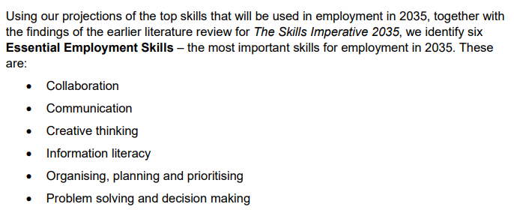

Are these the top 6 skills needed in 2035?
Notes:
What skills do you think will be important for future jobs?

Slide 25
A minute to discuss…
How can we highlight those six skills through our careers programme?

Slide 26
Job Awareness

Slide 27
What jobs are pupils aware of?
Aware
Jobs of family and friends
Jobs that are visible in their daily lives: shop assistant, bus driver
People who help us: police officer, firefighter, paramedic
Doctors and dentists
Jobs in the media: sports, gamer, youtuber
Jobs in school
Jobs they have seen on trips
Less Aware
Breadth of hidden jobs within certain sectors e.g. healthcare
Jobs that surround their ‘fantasy’ job e.g. football
More professional roles e.g. lawyers, accountants, civil servants
Support roles e.g. customer service assistant
Office based jobs e.g. comms, marketing, data analysis
Notes:
An important consideration when using LMI is building on the knowledge that pupils already have of jobs and the labour market – linked to BM3 (addressing the needs of each child). This would be a useful activity to do with staff to relate to your context as a school to give you a platform to build on. Ask the question and gather responses before revealing the rest of the slide. The point is that we don’t want our careers programme to just consist of jobs that our pupils are ALREADY aware of.
Here are some jobs that children are most commonly aware of.
Here are some that we think they are likely to be less aware of:
Hidden jobs in healthcare – beyond the obvious doctors and nurses all the people involved from porters to radiographers to finance managers
Many children gravitate to jobs such as premier league footballer but aren’t aware of the other jobs available in that industry e.g. coach, translator, marketing, associated charity work – this can add a positive spin rather than just saying it is unlikely they can become a Premier League footballer.
A lot of young people may be aware of politicians but are they aware of the huge number of jobs in the civil service that sit alongside?
There are a huge number of call centres in the North East and lots of opportunities for employment
They may also be unaware of the more operational roles that exist in most offices and businesses to make them run.
You may wish to use this slide alongside the national careers service website to give teachers an opportunity to then explore some of these jobs in more detail.

Slide 28
LMI in School

Slide 29
How can you build LMI into lessons or extra-curricular activities?
Information
Tasks and activities
Publications
Notes:
When we develop tasks and activities, we should have an underlying understanding of internal information that we have in school as well as external publications.
Basically – how can we utilise existing resources and structures in school rather than creating new work!

Slide 30

Information
Posters
Displays
School website
Social media
Slideshows around school/TV screens
Banner stands
Careers area (in class or whole school)
Notes:
Internal information are things we can incorporate into the classroom or school environment.
Examples of these might include:
Posters from sources such as NUSTEM of a range of hidden careers and role models
Displays linked to subjects or topics that challenge stereotypes
Website and social media are excellent tools for sharing that information with parents
Some schools have set up a designated careers area to allow pupils to research jobs by themselves using books and the internet
Visitors to the school may also have branded posters or banners with facts and information that they can bring and share

Slide 31

Publications
School planner
Careers books for the library e.g. ‘Bonkers Book of Jobs’ / ‘Careers using maths’
School options booklets around transition
Marketing leaflets
Secondary school/college prospectus and other destinations
Employer database
Local press
Notes:
We’re starting to see schools include dedicated primary careers books and games that can be purchased but this could also include documents from local schools, colleges or universities.
There may even be news stories or information about jobs in our area as a stimulus for discussion – this may be more reactive than planned.

Slide 32

Tasks and Activities
Careers fairs
Assemblies/registration time tasks
Teacher CPD
PSHE Lessons
Suspended timetable days
Employer and employee encounters (including preparation and debrief)
Notes:
Using these sources of information (LMI) can help to ensure tasks and activites are planned effectively and can be as meaningful as possible.
Here are some examples of the types of activities these may support you to develop.

Slide 33
Putting it into Practice
Notes:
The following slides explore how we can use LMI to enhance our careers programme through the lens of Intent, Implementation and Impact.

Slide 34

Intent
Scope out where you need LMI in your long-term career programme
Ensure staff understand LMI, how to access current information and the school’s career programme
Check that you are making good use of resources and the networks you’re involved in
Review your website and resources to ensure you cover different pathways into work and engage the interests of pupils and parents
Notes:
When planning a careers programme you should consider these points.

Slide 35

Implementation
Start early so that children (and their parents) have lots of opportunities to explore today’s workplaces
Ensure school events and parents’ evenings explain and promote pathways in an impartial way
Train older pupils to support younger children to make use of key careers information resources in your school
Make use of a wide range of media to encourage pupils in their career exploration including social media, posters, websites and physical resources
Develop a careers assembly plan that identifies careers information topics appropriately for each Key Stage.
Notes:
When delivering your careers programme you should consider these points.

Slide 36

Impact
Plan regular monitoring of the programme to evaluate coverage of key sectors and LMI
Evaluate the programme alongside pupil voice/aspiration data to ensure that it meets the needs of your pupils and opens their eyes to the jobs they aren’t aware of
Include all stakeholders in that evaluation – parents, governors, teachers as well as pupils
Notes:
When evaluating your careers programme you should consider these points.

Slide 37
LMI at Home

Slide 38
Encouraging the conversation to continue
Adapt and deliver LMI session to parents/carers
Deliver in school sessions to staff and pupils
Adapt and deliver LMI Quiz to parents/ carers
Notes:
It is well known that parents and carers of children are their biggest influence and main source of information and often inspiration. It is therefore important to encourage the conversation you have started in school with children about the labour market to continue at home.
Now that you have explored the North East Labour Market and shared insight with colleagues and pupils in school, hopefully you feel confident to adapt the resources and deliver an information session to your parent/ carer community to encourage conversations to continue at home. Why not adapt and deliver the Quiz resource to make the session with parents and carers more interactive and include them in their child’s learning and your wider careers programme.

Slide 39
Any Questions?

