Slide 1

The Journey

Slide 2
Session Aims:
Learn about passenger transport and freight transport
Learn about some of the hidden jobs in transport
Learn new vocabulary linked to transport

Slide 3




What is Transport?
Transport is to take people or goods from one place to another.
There are lots of different types of transport.
Transport methods can include a vehicle, aircraft or ship.

Slide 4

Why do we need transport?
With the person next to you, think of 3 reasons why we need transport.

Slide 5
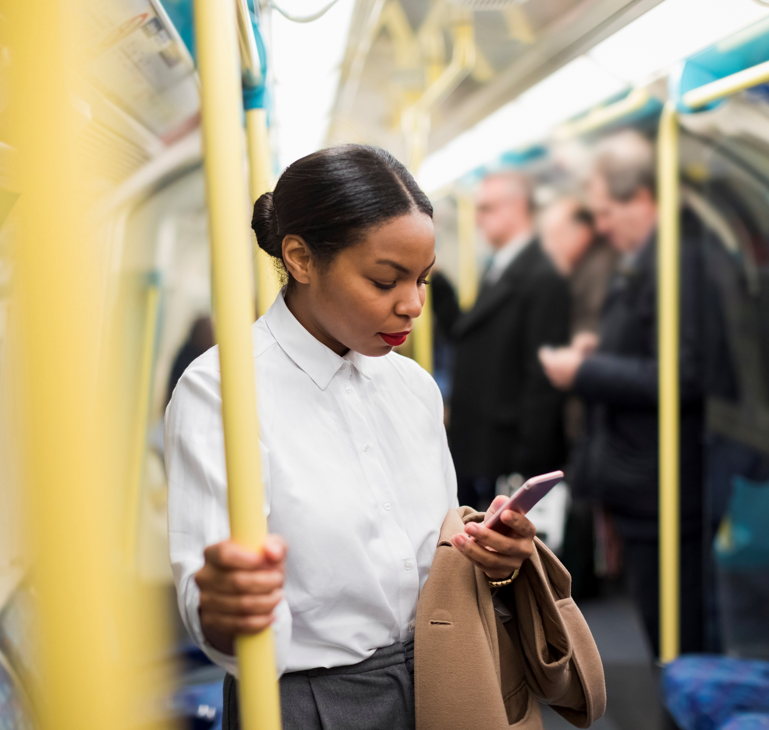
Passenger Transport
A person who travels on a vehicle to get from one
place to another is called
a passenger.
How many types of passenger transport can you think of?

Slide 6

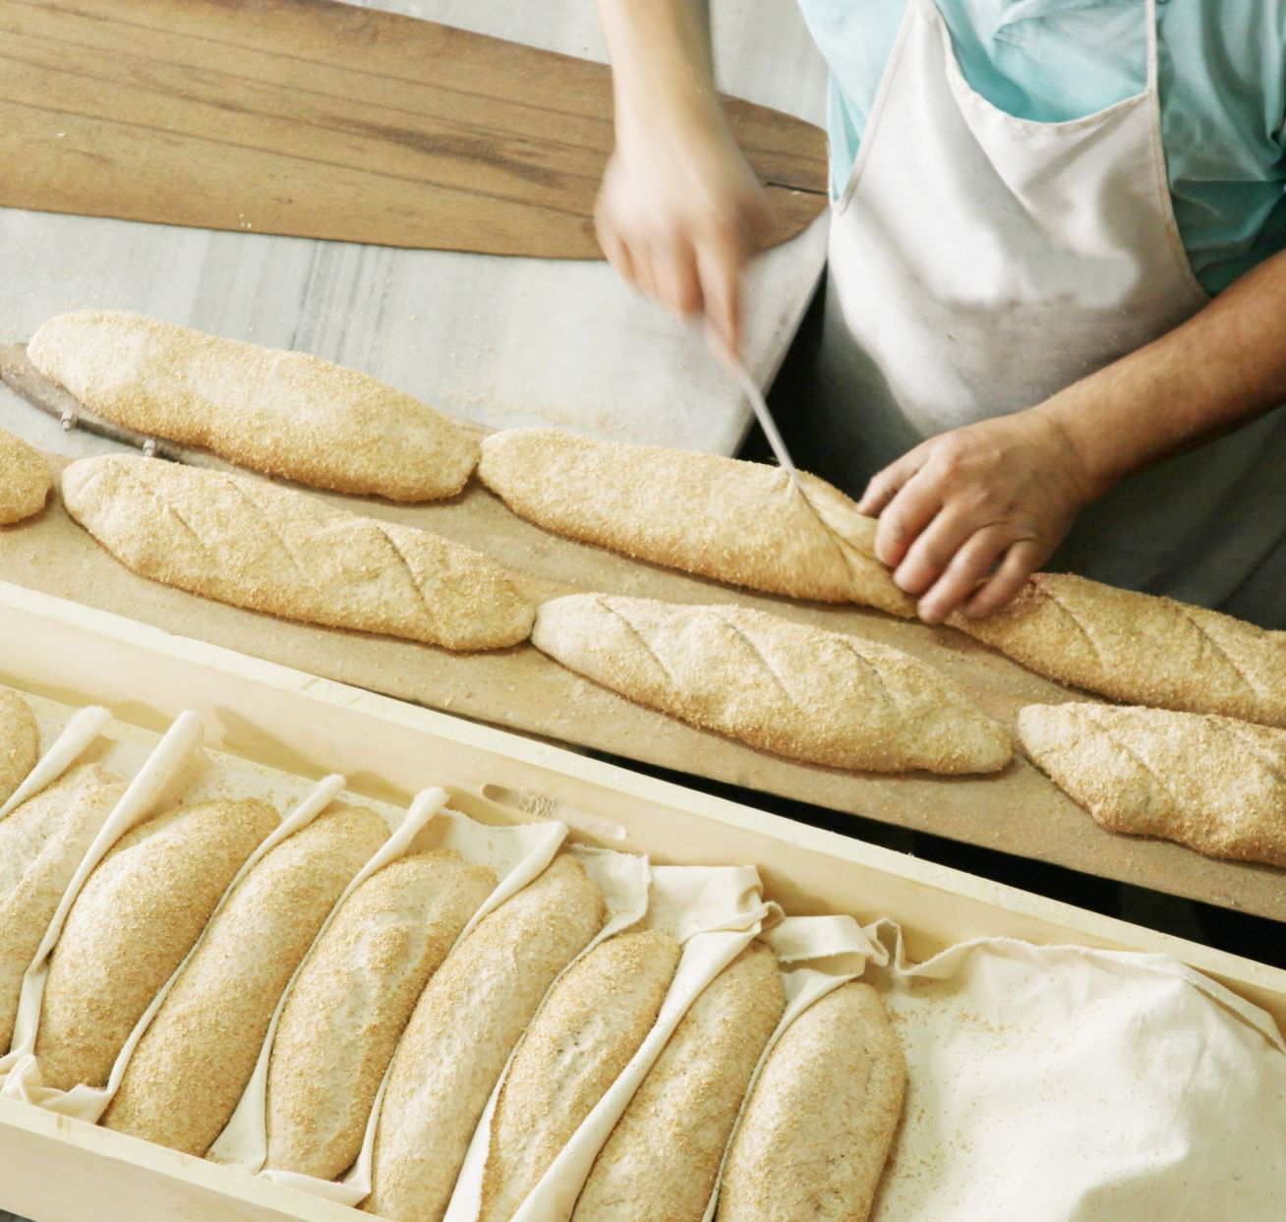
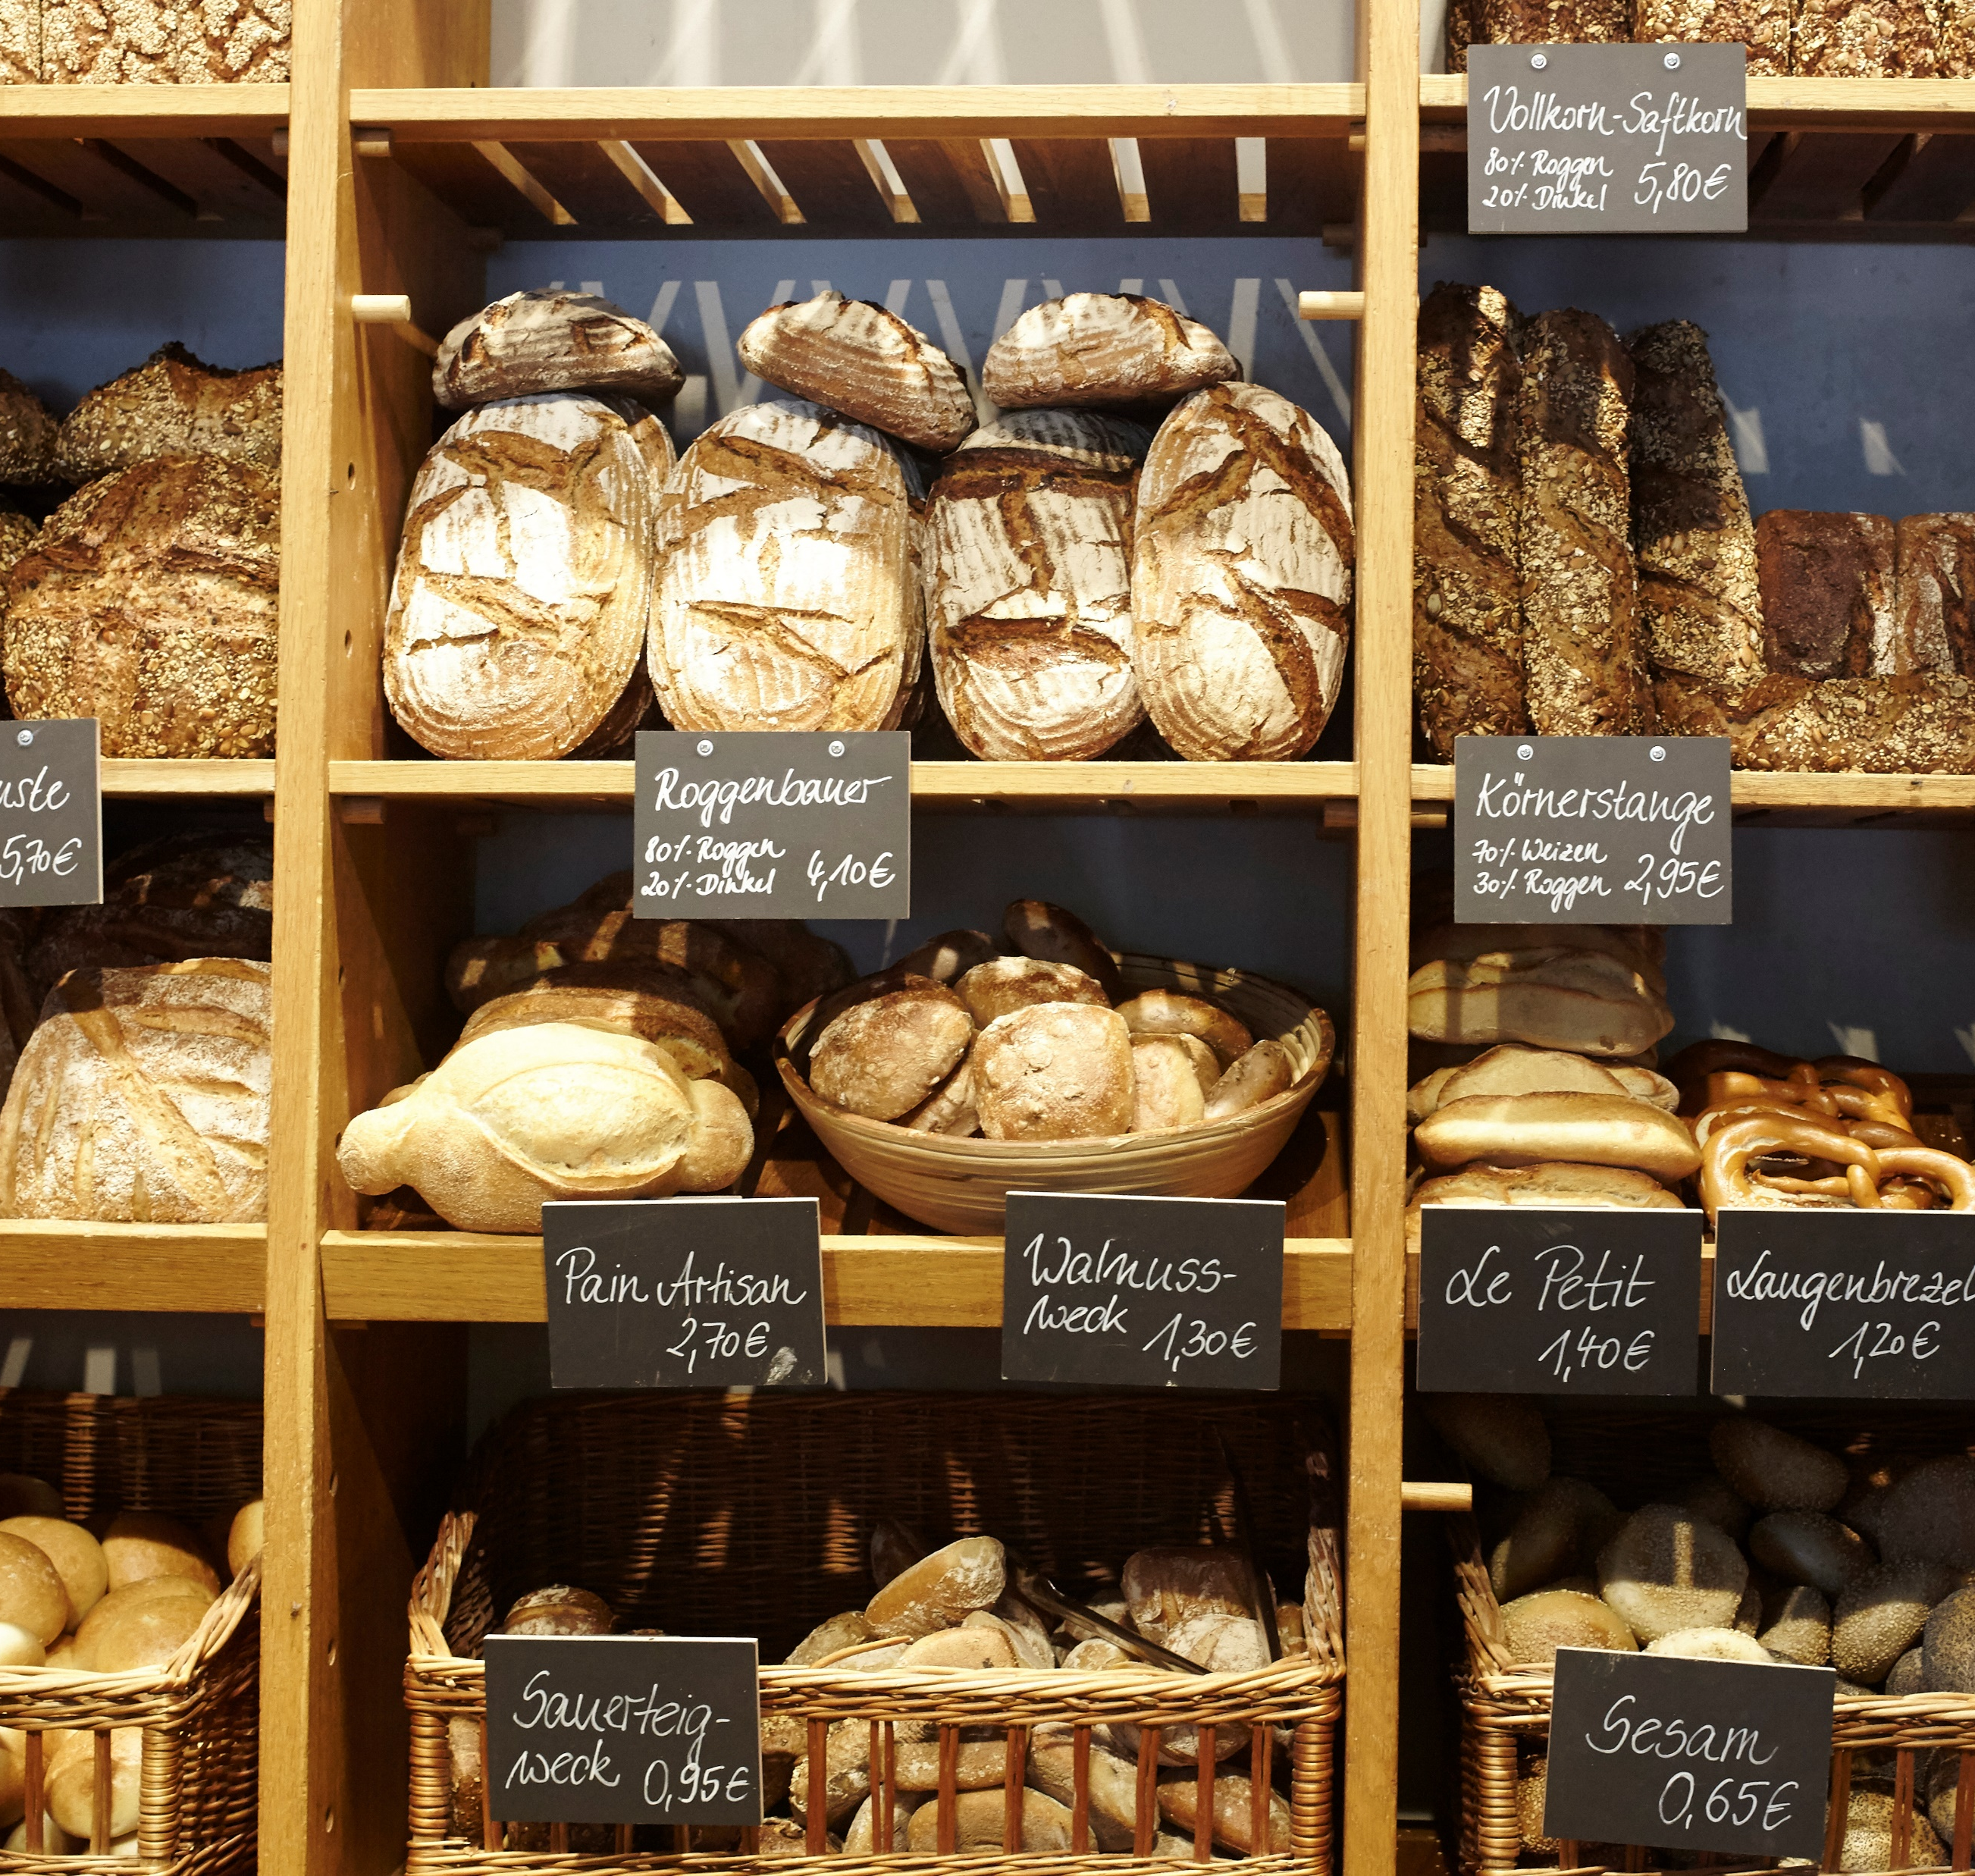

Freight Transport
Lots of things need to be moved from where they are made to where they are needed.
For example food needs to be moved from the farm, to the factory and then to the supermarket. This is called freight.
How many types of freight transport can you think of?

Slide 7






Do you know what these words linked to transport mean?
Notes:
Before watching the video: introduce some of the vocabulary featured in the video

Slide 8
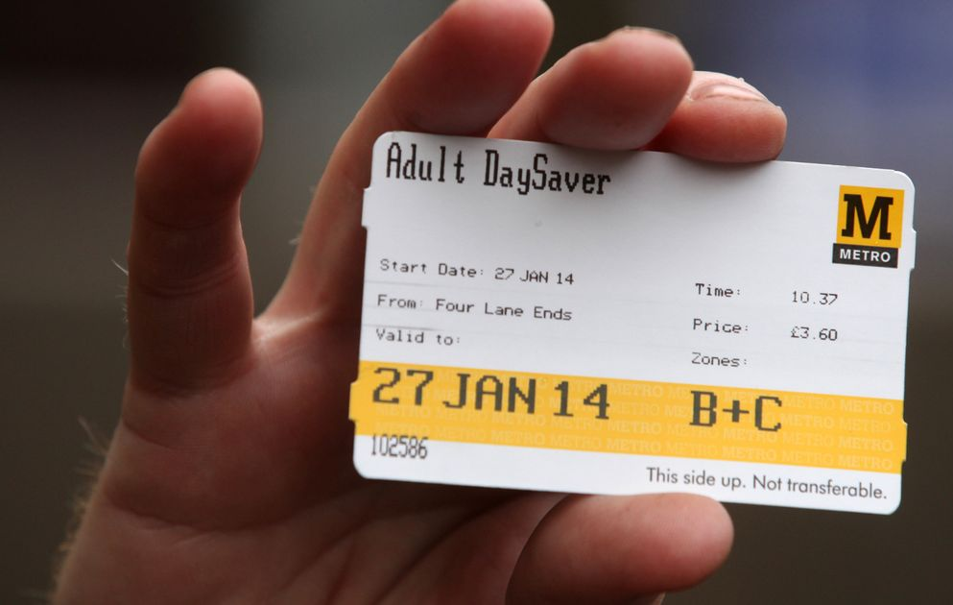
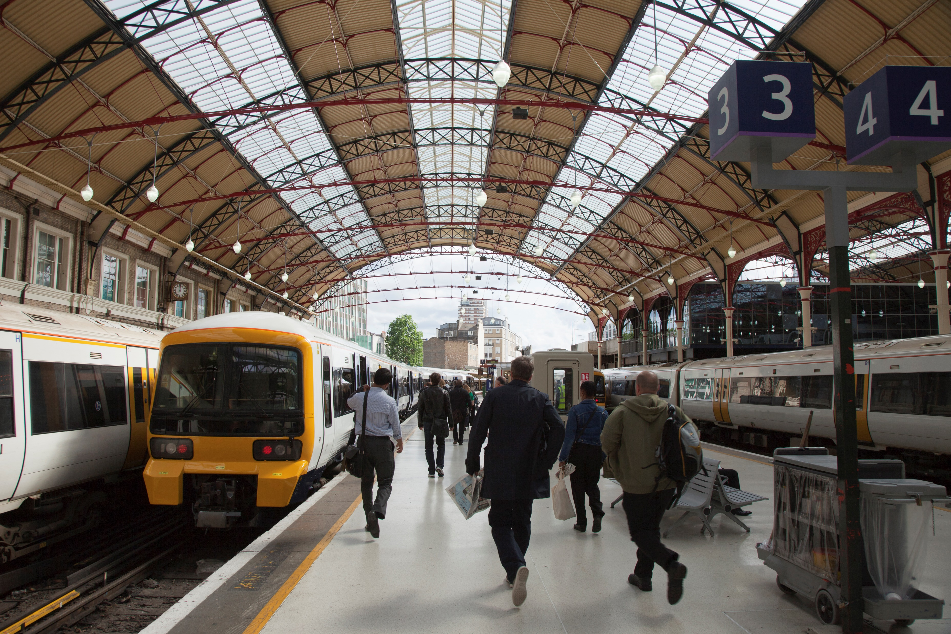
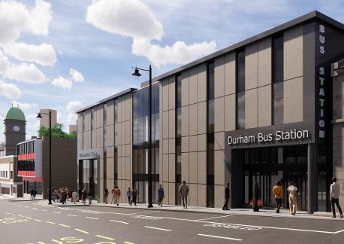
What is a ticket?
A paper or card showing that you have paid for your trip.
What is a station?
A place where people get on or off a bus or train.
Notes:
Before watching the video: introduce some of the vocabulary featured in the video

Slide 9


What is a tunnel?
An underground passage.
What is a signal?
An action used to send information.
Can be used to send a message,
warning, or command.
Notes:
Before watching the video: introduce some of the vocabulary featured in the video

Slide 10
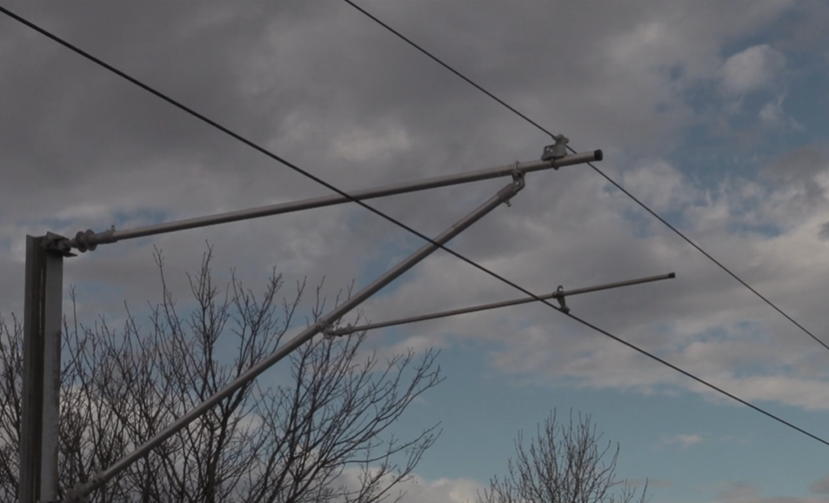
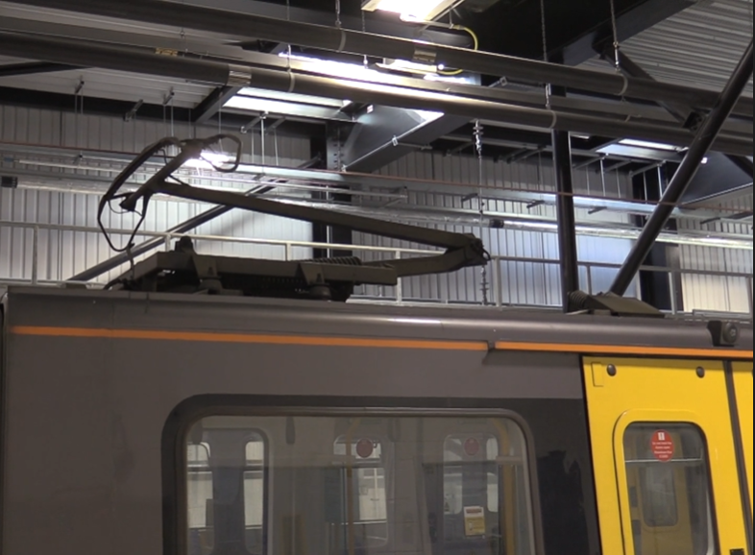
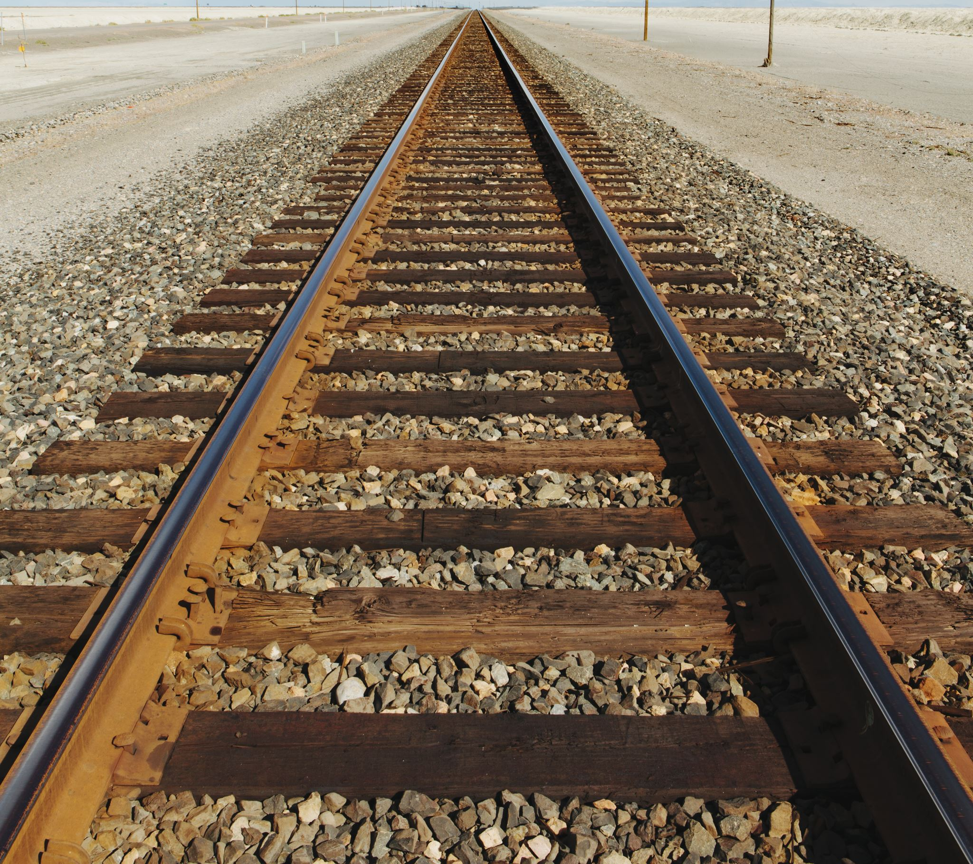
What is a train track?
A set of two parallel rows of long pieces of steel that a train travels along.
What is a power cable?
An electrical cable providing electricity.
Notes:
Before watching the video: introduce some of the vocabulary featured in the video

Slide 11
We need lots of people to work in transport jobs.
Let’s take a look at Nexus to see how they make transport safe and reliable for thousands of people every day.
VIDEO LINK

Slide 12

What do we know now?
Let’s do a quiz to see what we’ve remembered!

Slide 13

Question 1
What is the Metro?
A. School
B. Underground Train
C. Airport

Slide 14
Question 2
What does a Ferry travel on?
A. Road
B. Water
C. Track

Slide 15
Question 3
How many people live in the North East
A. 2 thousand
1 million
2 million

Slide 16
Question 4
Can you remember 2 school subjects mentioned in the video as being useful for a job in transport?

Slide 17
Question 1
What is the Metro?
B. Underground Train
A. School
B. Underground Train
C. Airport

Slide 18
Question 2
What does a Ferry travel on?
A. Road
B. Water
C. Track
B. Water

Slide 19
Question 3
How many people live in the North East
2 million
A. 2 thousand
1 million
2 million

Slide 20
Question 4
Can you remember 2 school subjects mentioned in the video as being useful for a job in transport?
Art
Drama
Geography
Maths
Science

Slide 21
Challenge1: Route Planning
Can you plan where to build a railway across to get from once city to another?
Notes:
There is printable pupil worksheets called ‘Challenge 1_Feature Cards’ and ‘Challenge 1_Map’ available for this activity.

Slide 22
Challenge 2: Transport Manager
Can be you a Transport Manager and make sure people are doing
their job correctly?
Notes:
There is a printable pupil worksheets called ‘Challenge 2_Transport Manager’ available for this activity.

Slide 23
Challenge 3: Health and Safety Officer
Can you design a health & safety poster for passengers in a busy train station?
Notes:
There is a printable pupil worksheets called ‘Challenge 3_Health and Safety Officer’ available for this activity.

Slide 24
Challenge 4: Head of Customer Experience
Can you design some on board entertainment for a long train journey?
Notes:
There is a printable pupil worksheets called ‘Challenge 4_Head of Customer Experience’ available for this activity.

Slide 25
Final Challenge: What job would you enjoy?
Can you choose one of the jobs you have just learnt about and draw a picture of yourself doing this job?
Notes:
There is a printable pupil worksheet called ‘I could be...’ available for this activity.
Additional question on the sheet are:
List the skills you think you would need to do the job.
What would you enjoy most about doing this job?

Slide 26
Goodbye from Bingo!

