Slide 1

MOLECULE TO MEDICINE

Slide 2
Session Aims:
Learn more about ‘medicines’ and why we need them.
Explore how science links with making medicines.
Find out about the job roles of people working in Health and Life Sciences in the North East

Slide 3
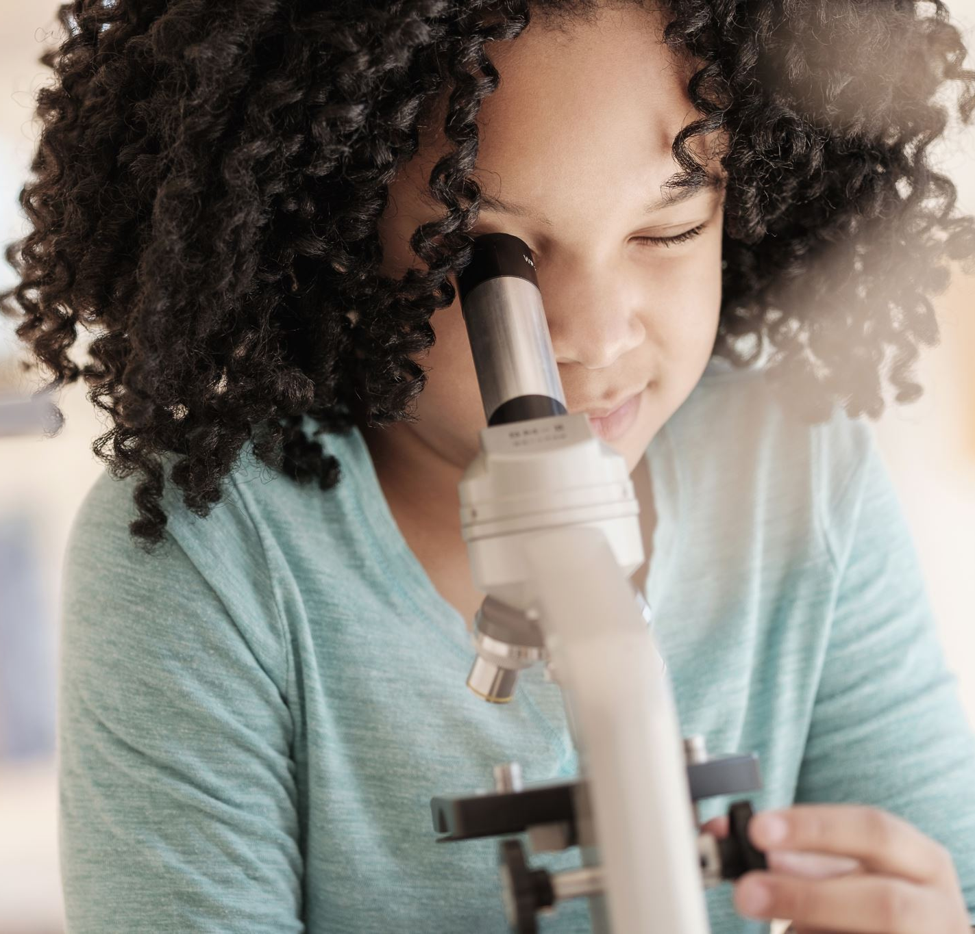
Linking Science to Health
There is a type of science called Biology and this is the science of life and living things, including humans.
By learning about the human body, we can learn how to keep people healthy and how to treat them when they are unwell.

Slide 4
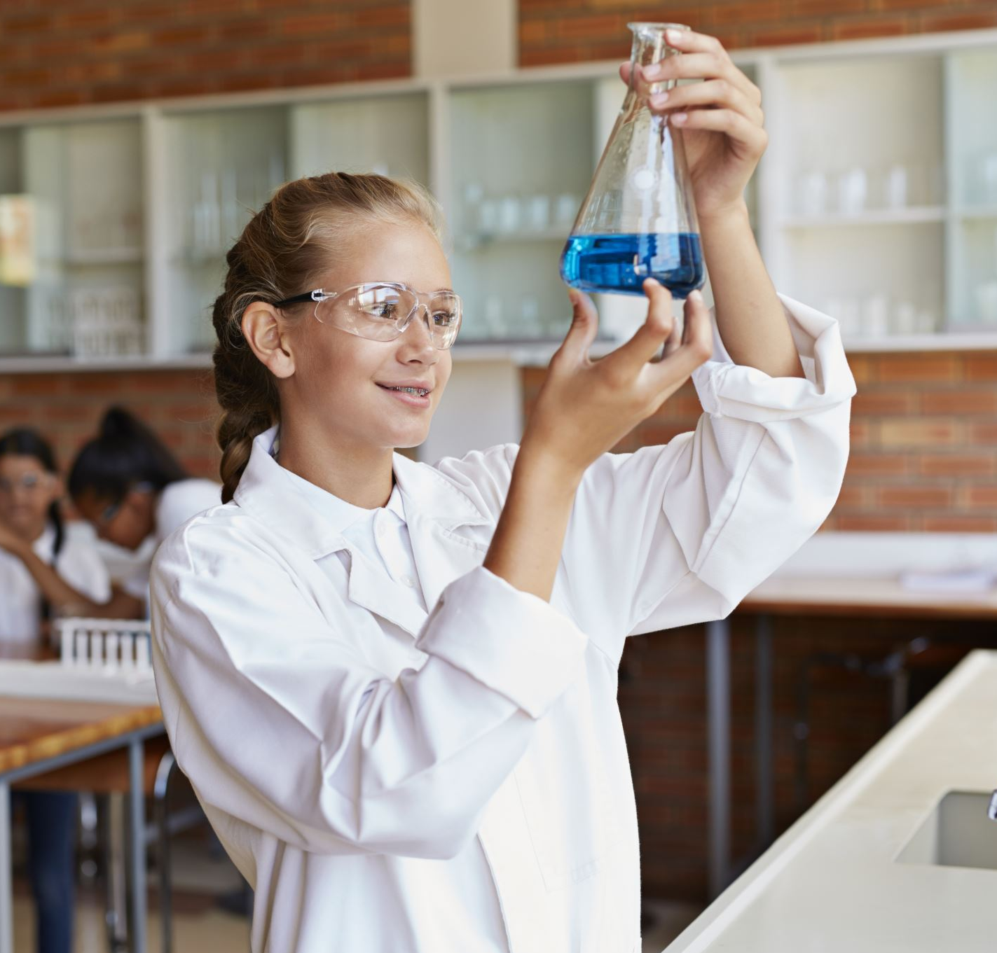
Linking Science to Health
There is a type of science called Chemistry that studies what everything is made of and how these things work together.
Scientists who specialise in chemistry are called chemists.

Slide 5




What is Medicine?
Medicine can help you feel better when you are ill.
Medicine can help save lives and control illness.
Medicines are made by Chemists.

Slide 6

With the person next to you, can you think of times that you might need medicine?
Why do we need medicine?

Slide 7
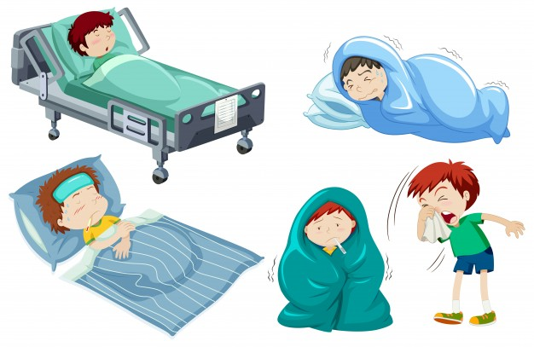
Did you think of any of these?:
Cough
Sore throat
Fever
Tummy ache
Headache
Image courtesy of freepik

Slide 8
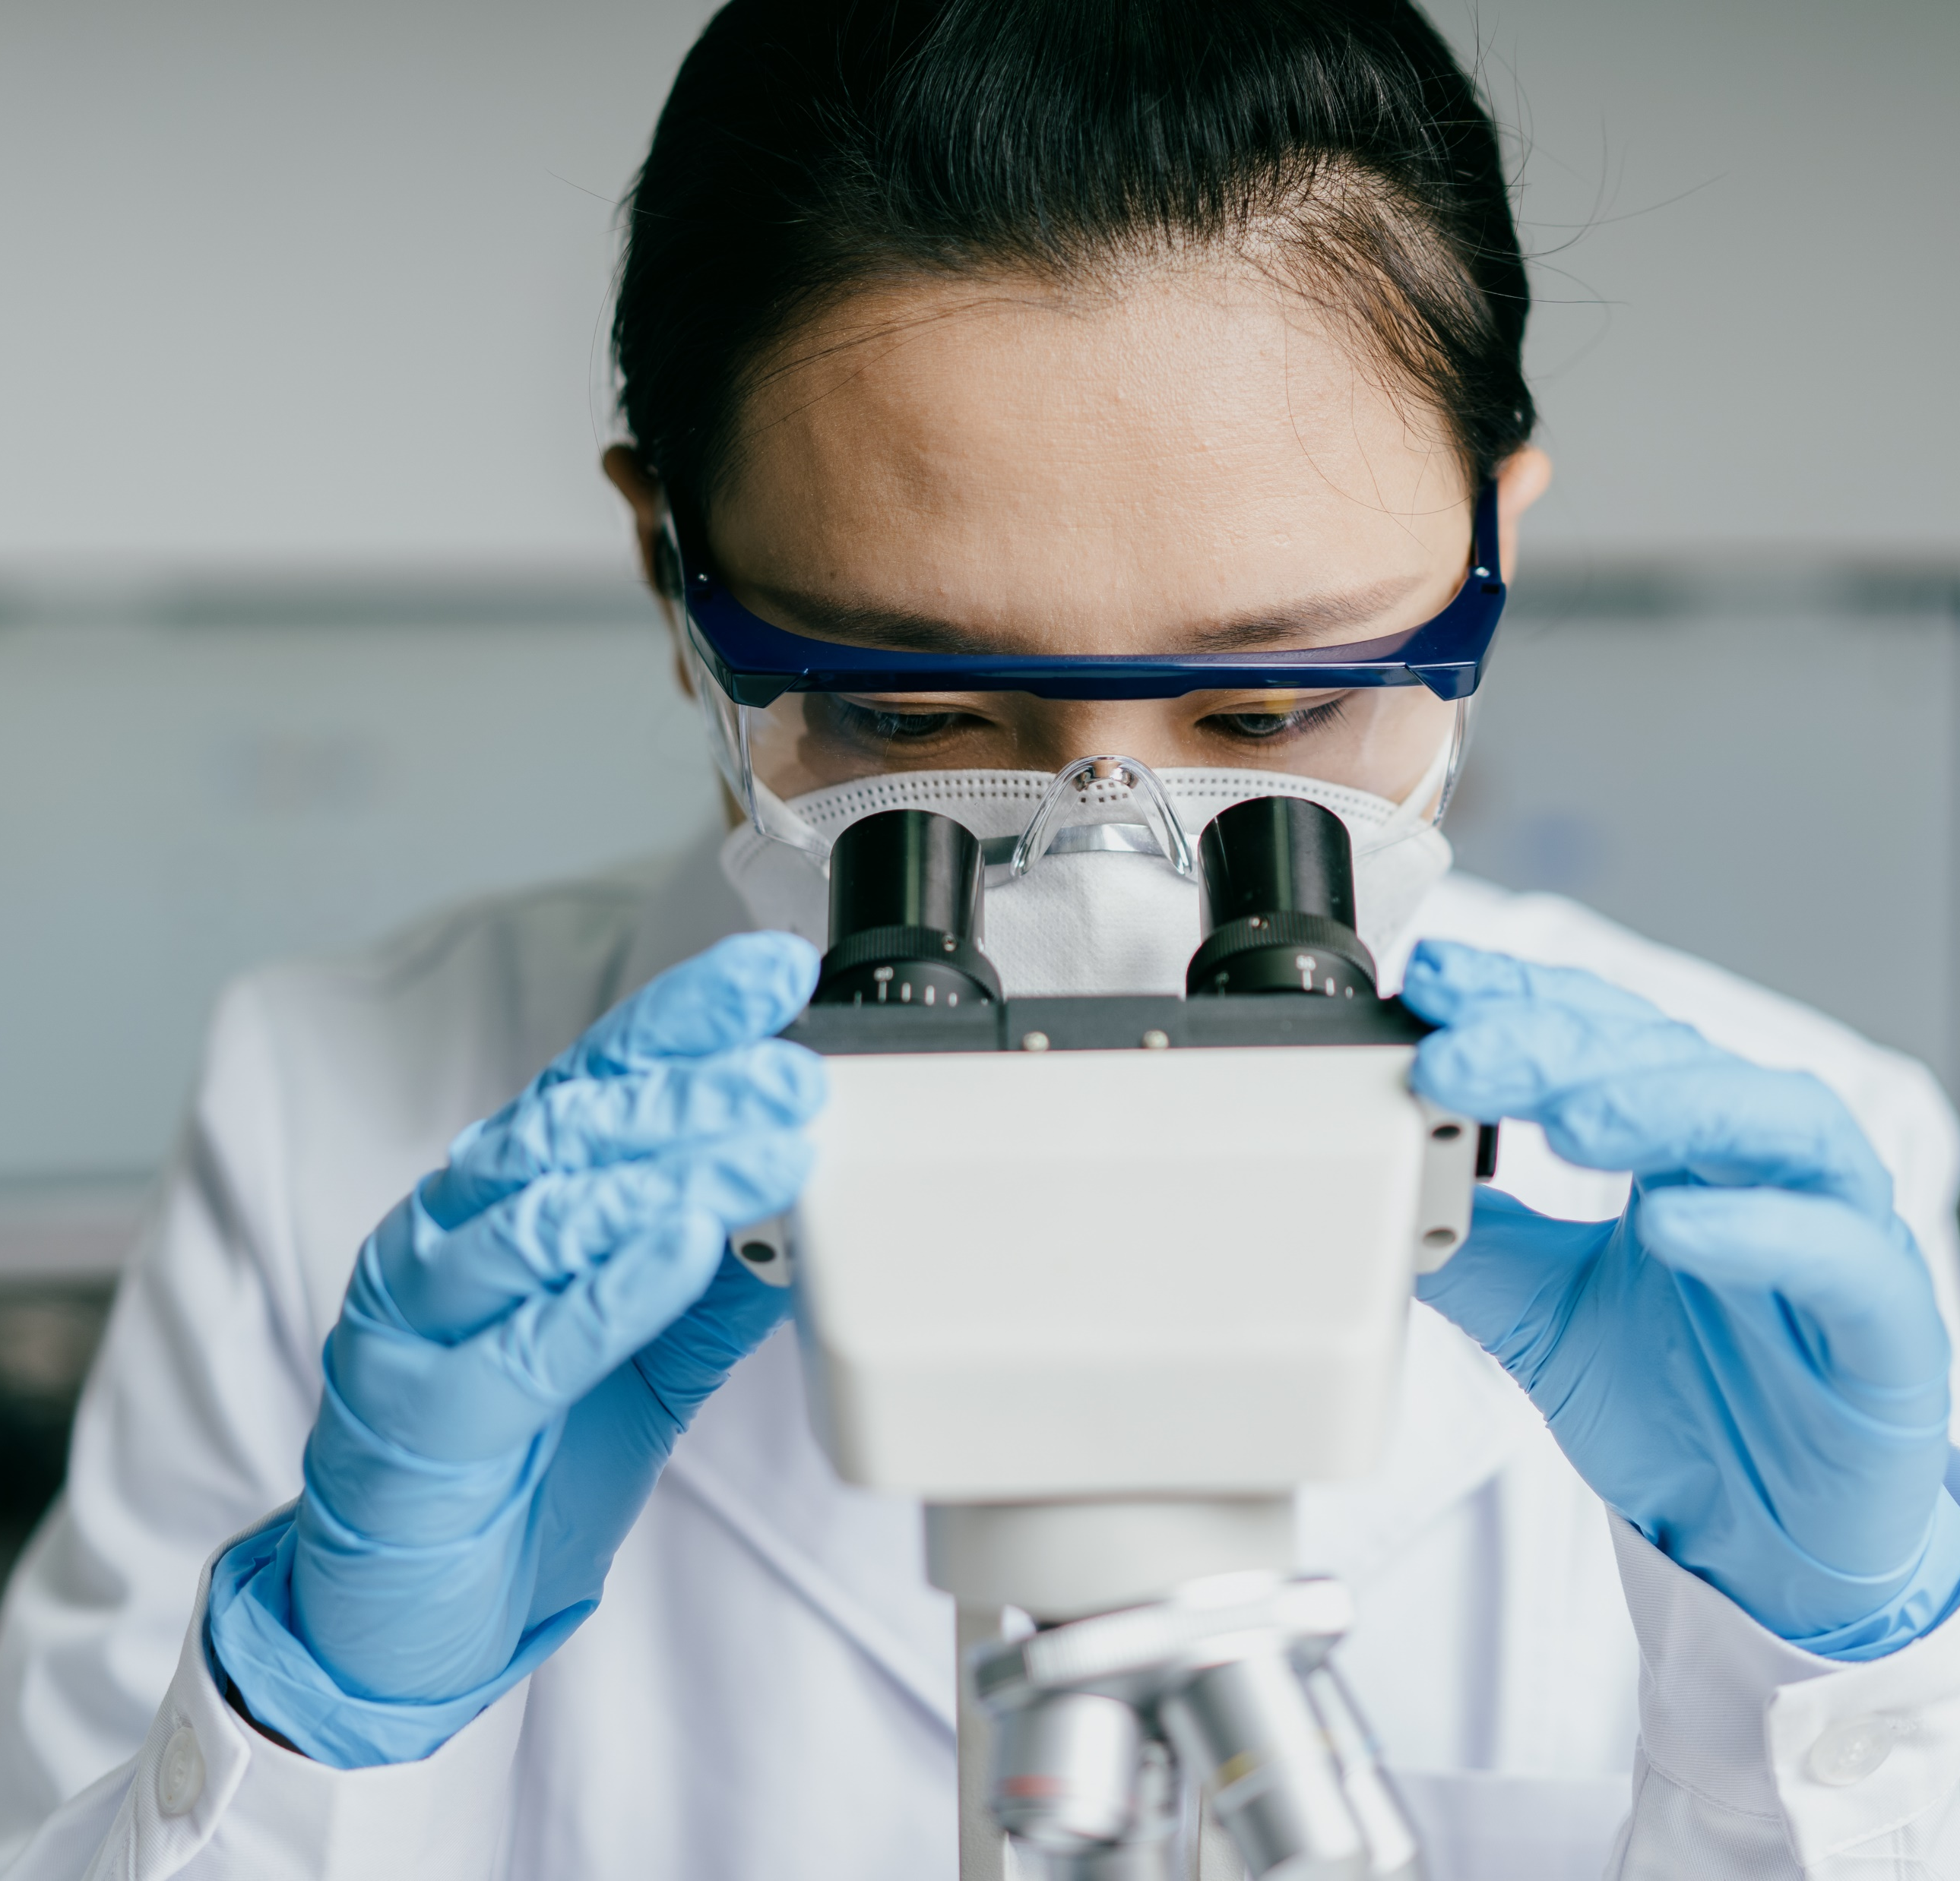
What is Heath and Life Sciences?
We use this term for the group of people and companies that use science and technology to improve the health of human beings.

Slide 9
Do you know what these words linked to Health and Life Sciences mean?
Before we watch a Newshound video....
Notes:
Before watching the video: introduce some of the vocabulary featured in the video

Slide 10
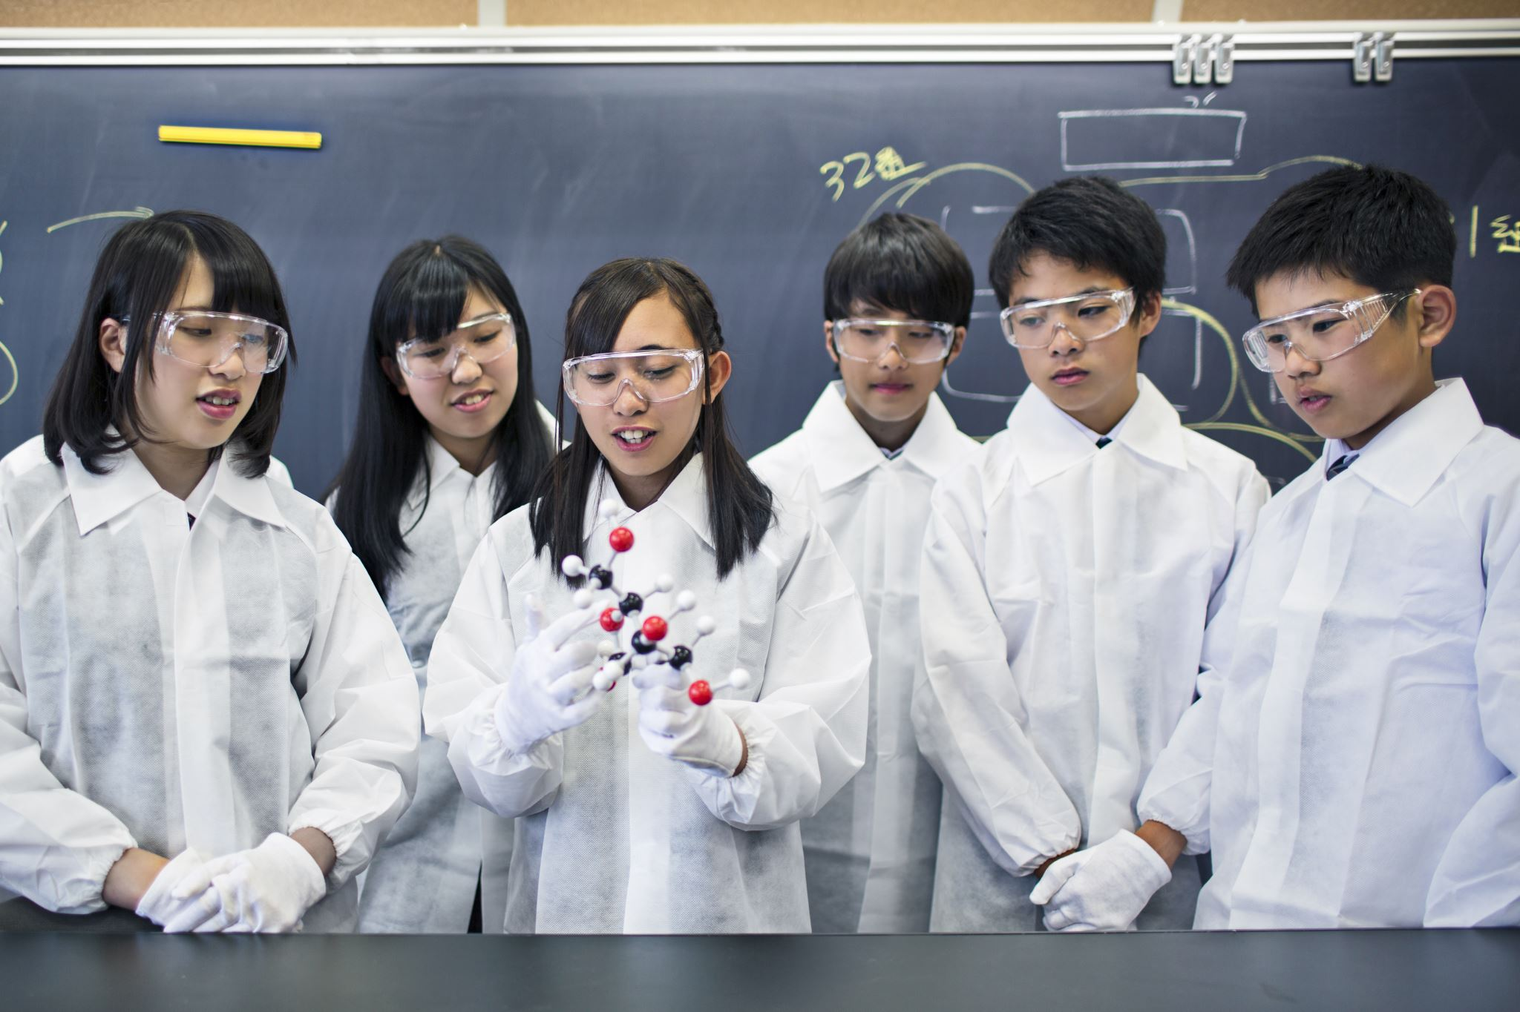
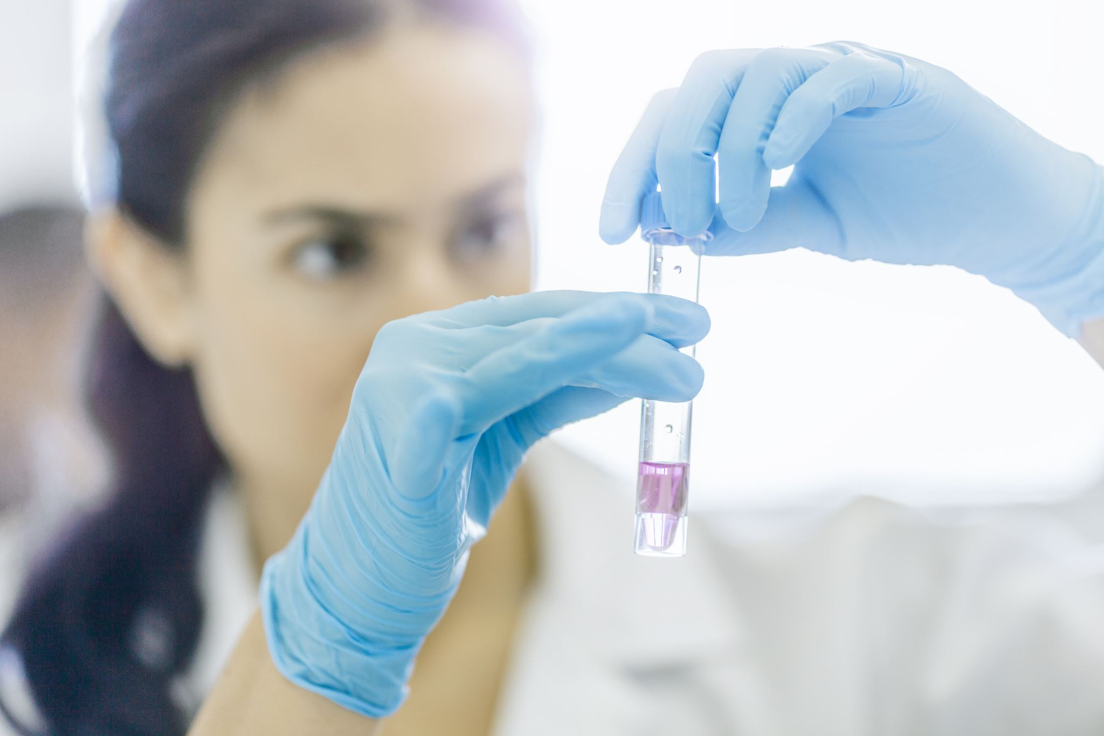
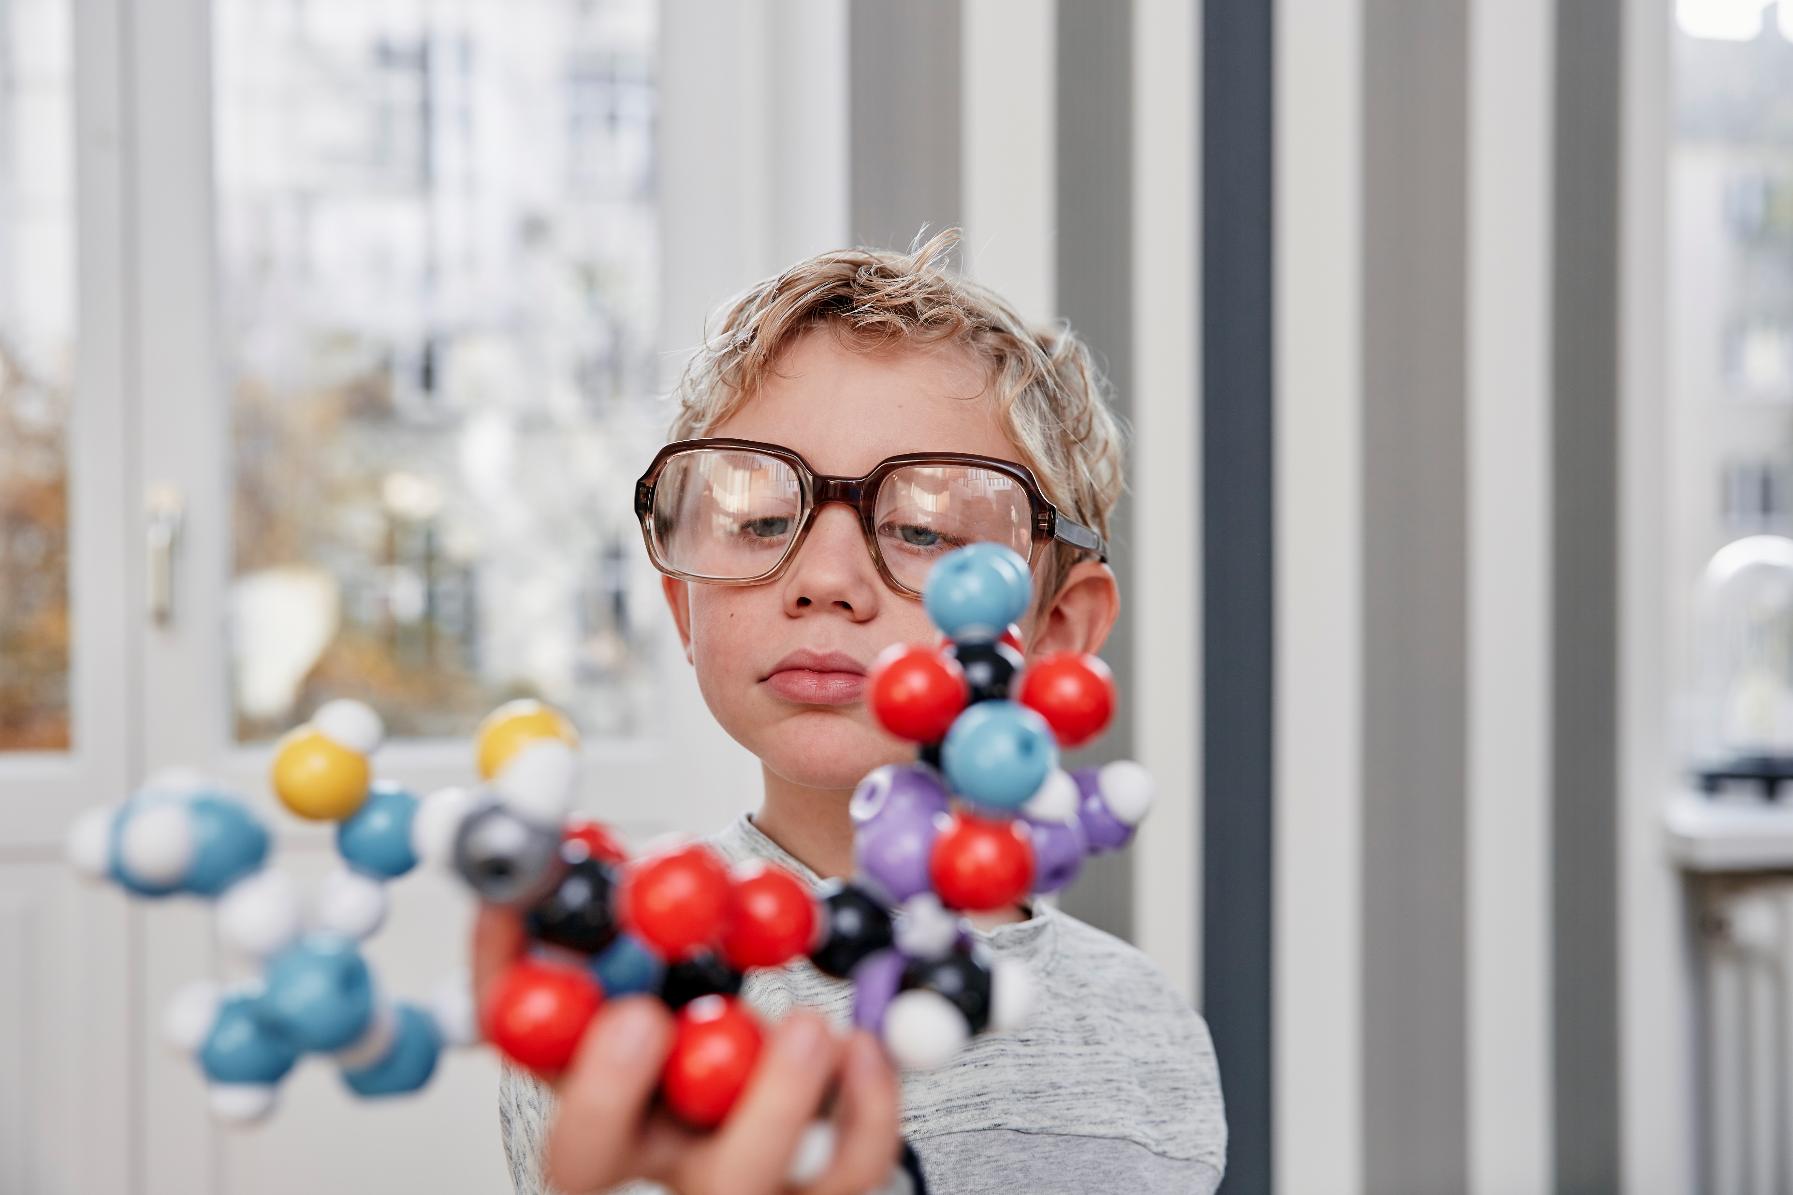

What does science mean?
A way of discovering what is in the world and how things work.
What is a scientist?
A person who is an expert in science.
Notes:
Before watching the video: introduce some of the vocabulary featured in the video

Slide 11
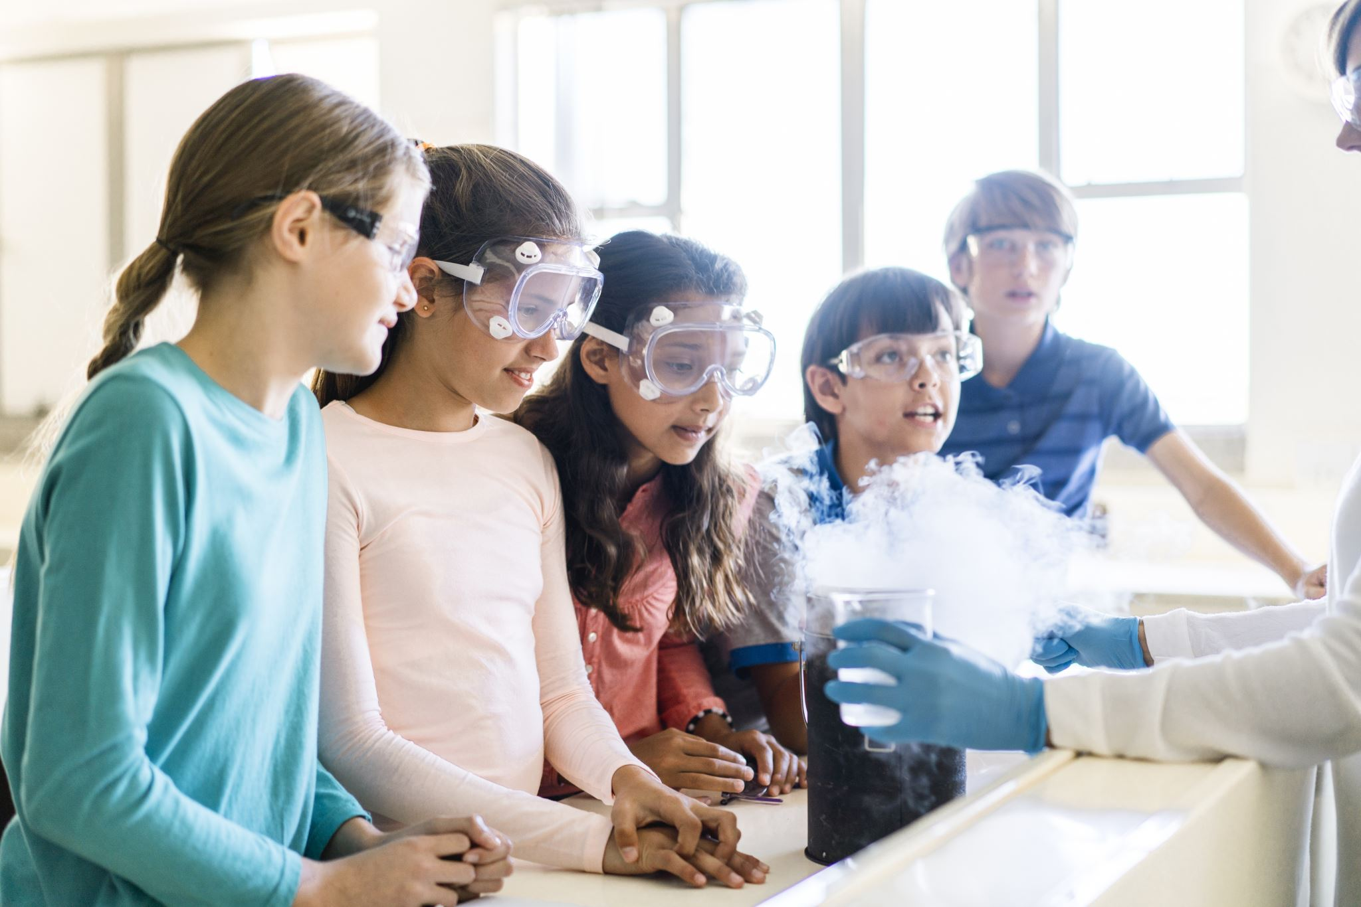
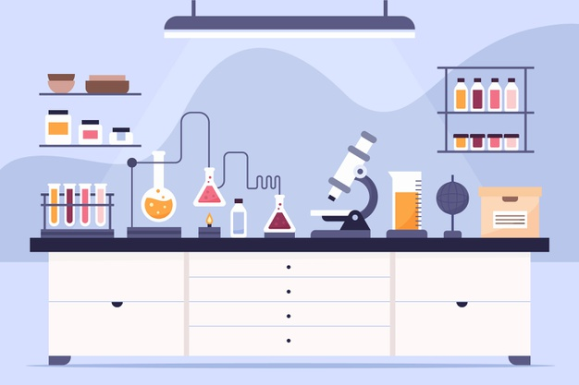
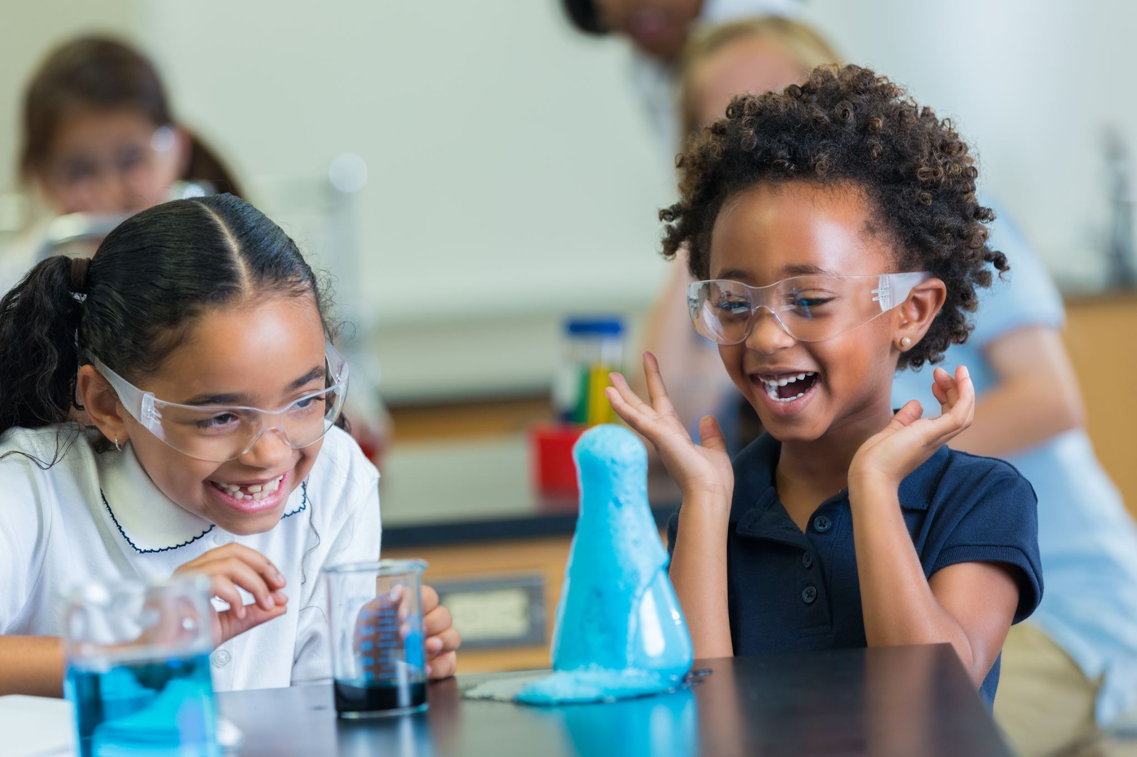
What is a laboratory?
A room for science experiments. Sometimes called a ‘lab’.
What does experiment mean?
A test to study something.
Image courtesy of freepik
Notes:
Before watching the video: introduce some of the vocabulary featured in the video

Slide 12
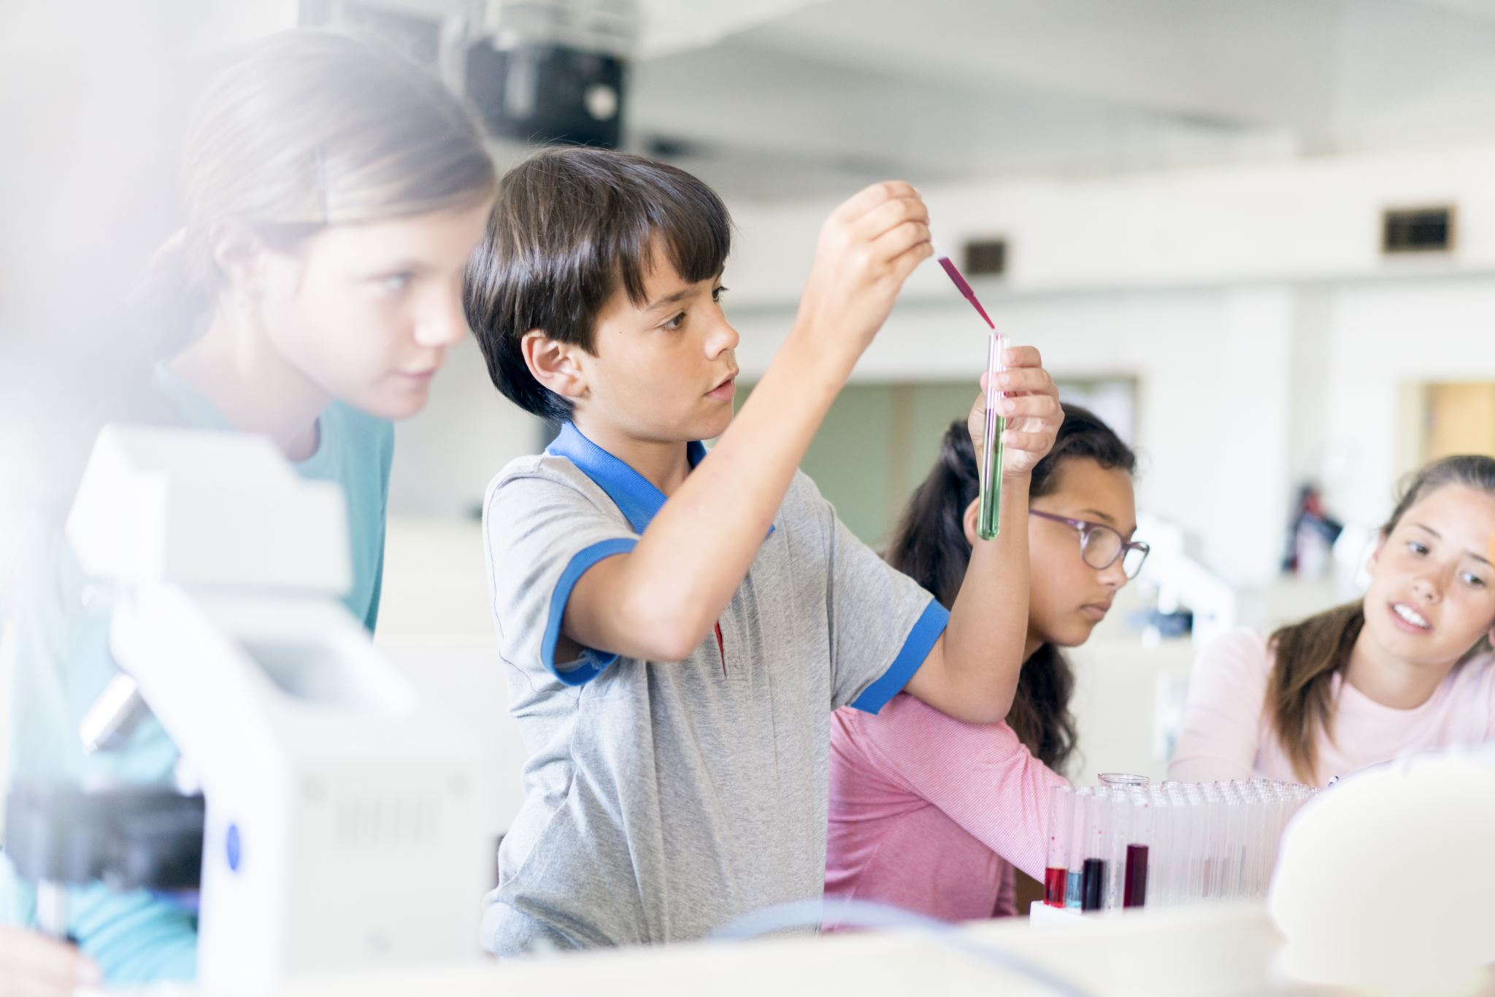
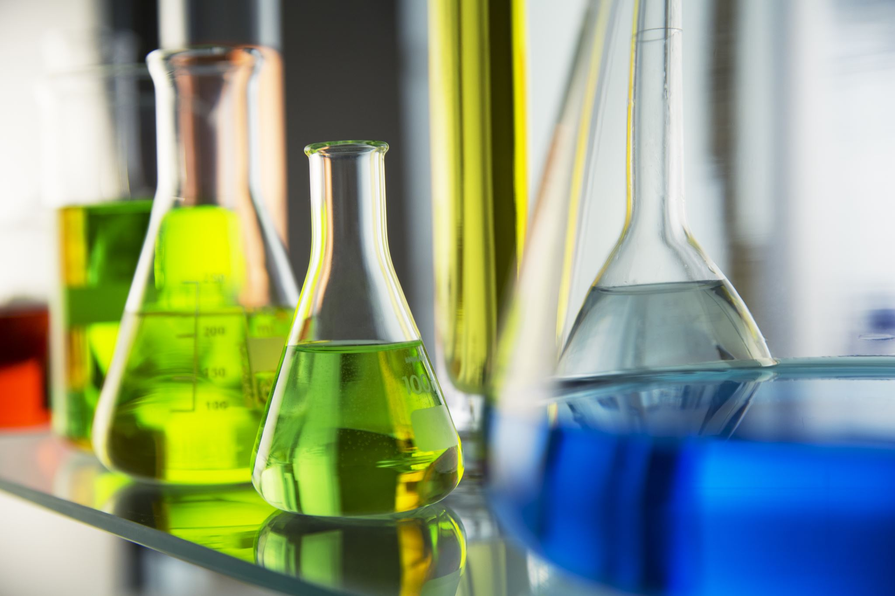
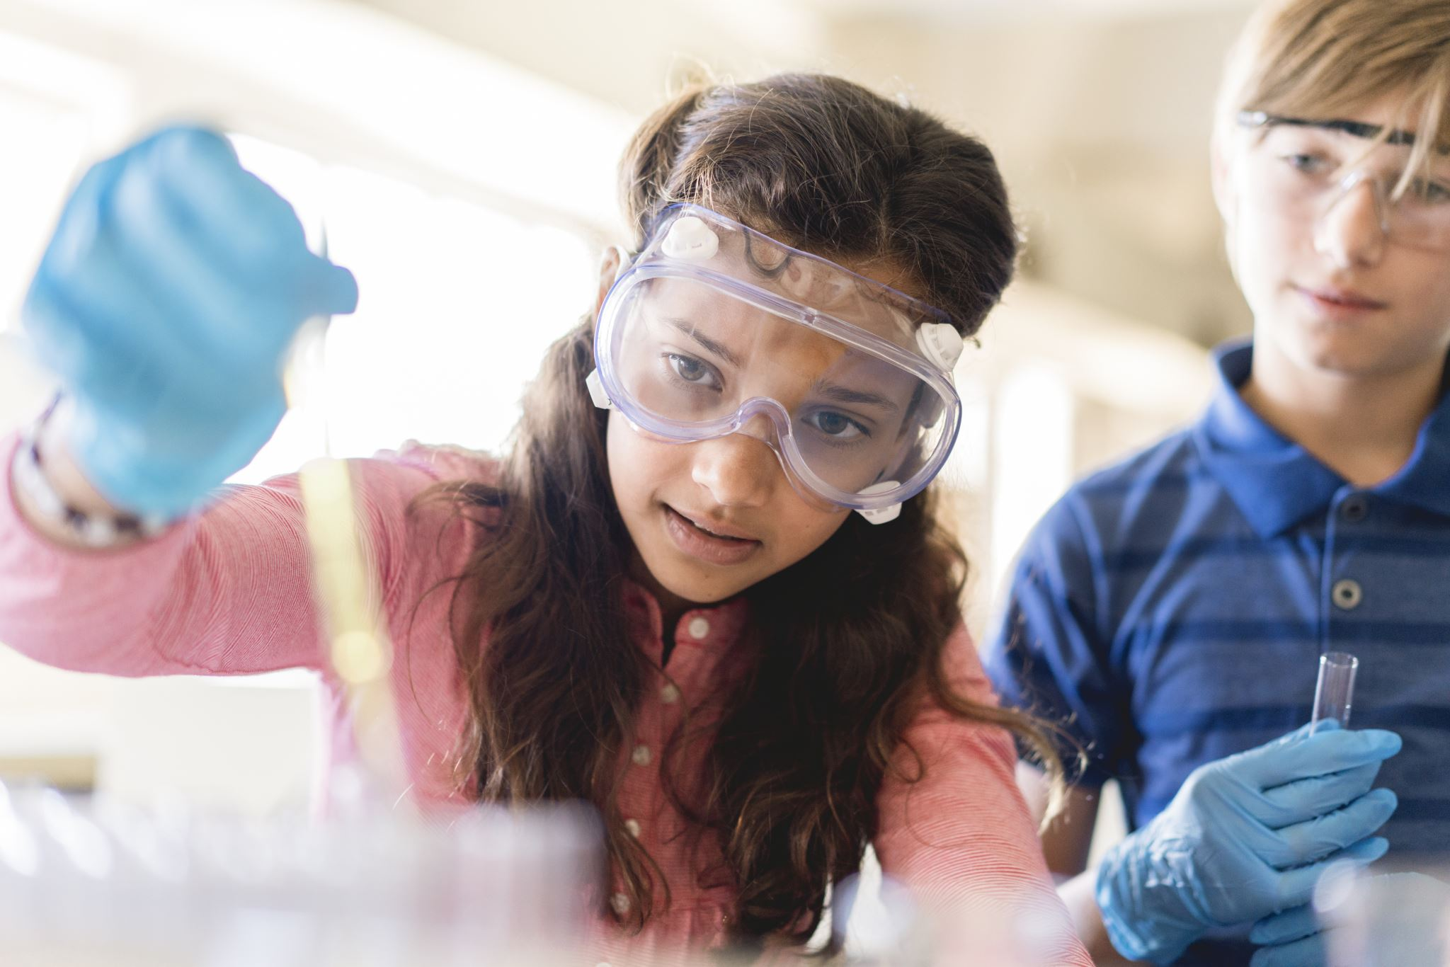
What does chemistry mean?
The science of substances which change when mixed together.
Notes:
Before watching the video: introduce some of the vocabulary featured in the video

Slide 13


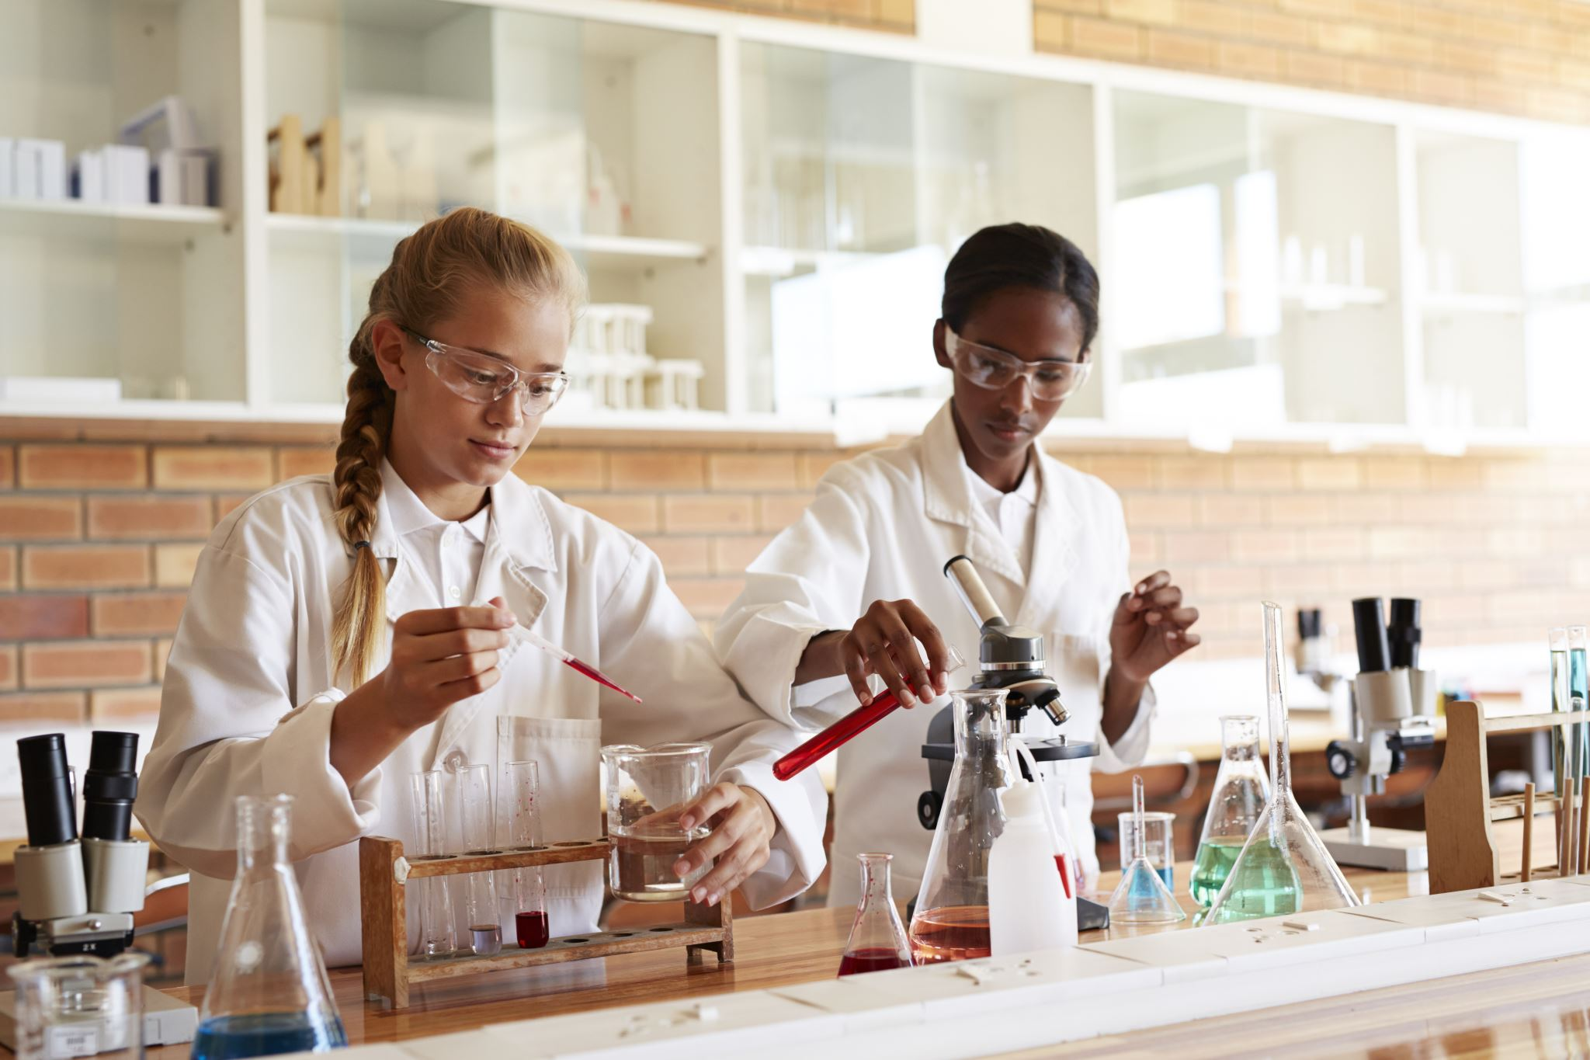
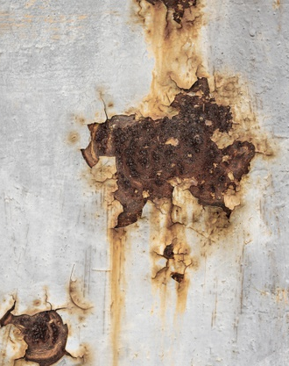
What is a chemical reaction?
When two different substances are mixed together and then undergo a change to become a different substance altogether.
Fireworks are the result of chemical reactions. So is rust.
Image courtesy of freepik
Notes:
Another example is baking a cake
The wet mixture rises in the oven and turns into sponge.

Slide 14
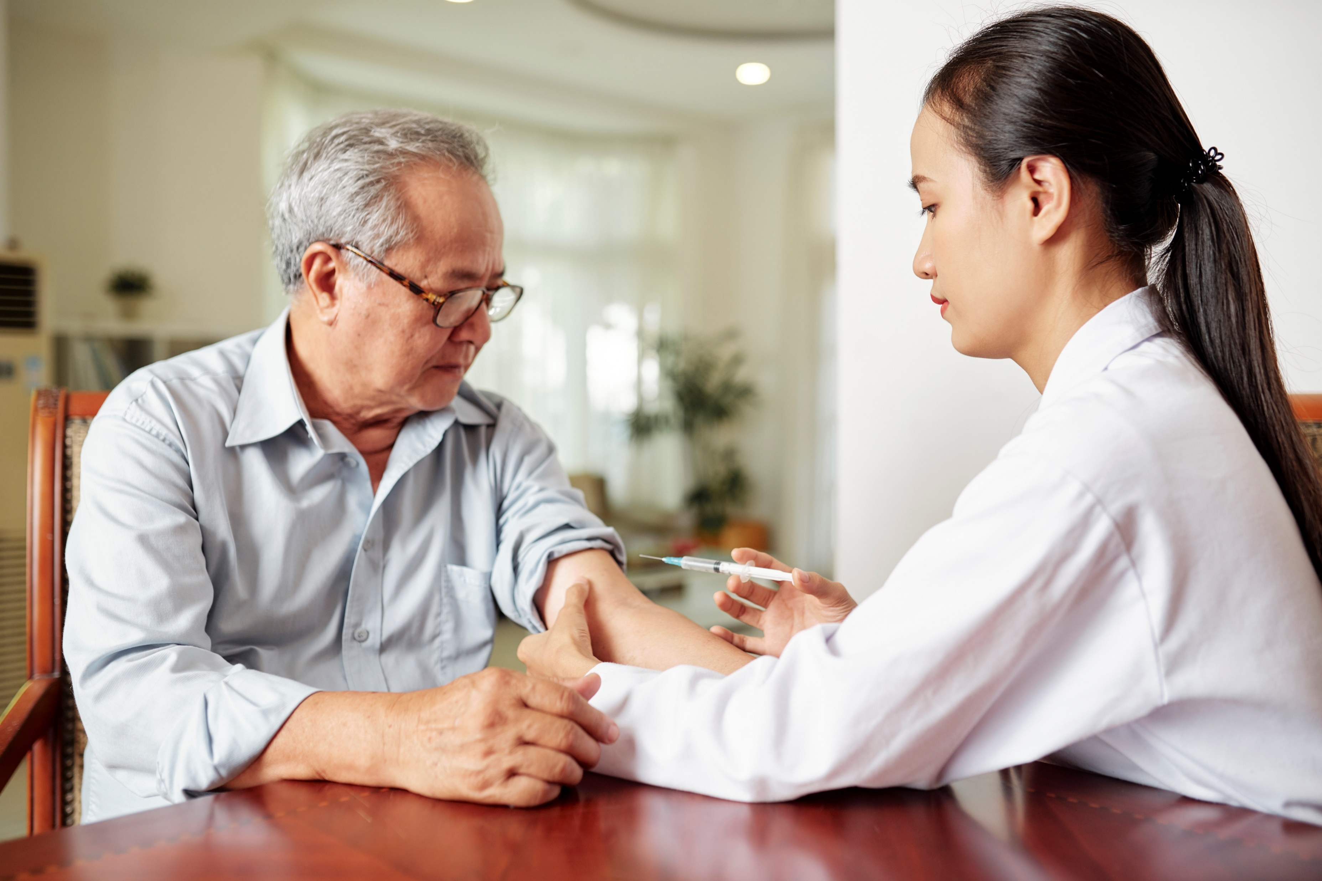
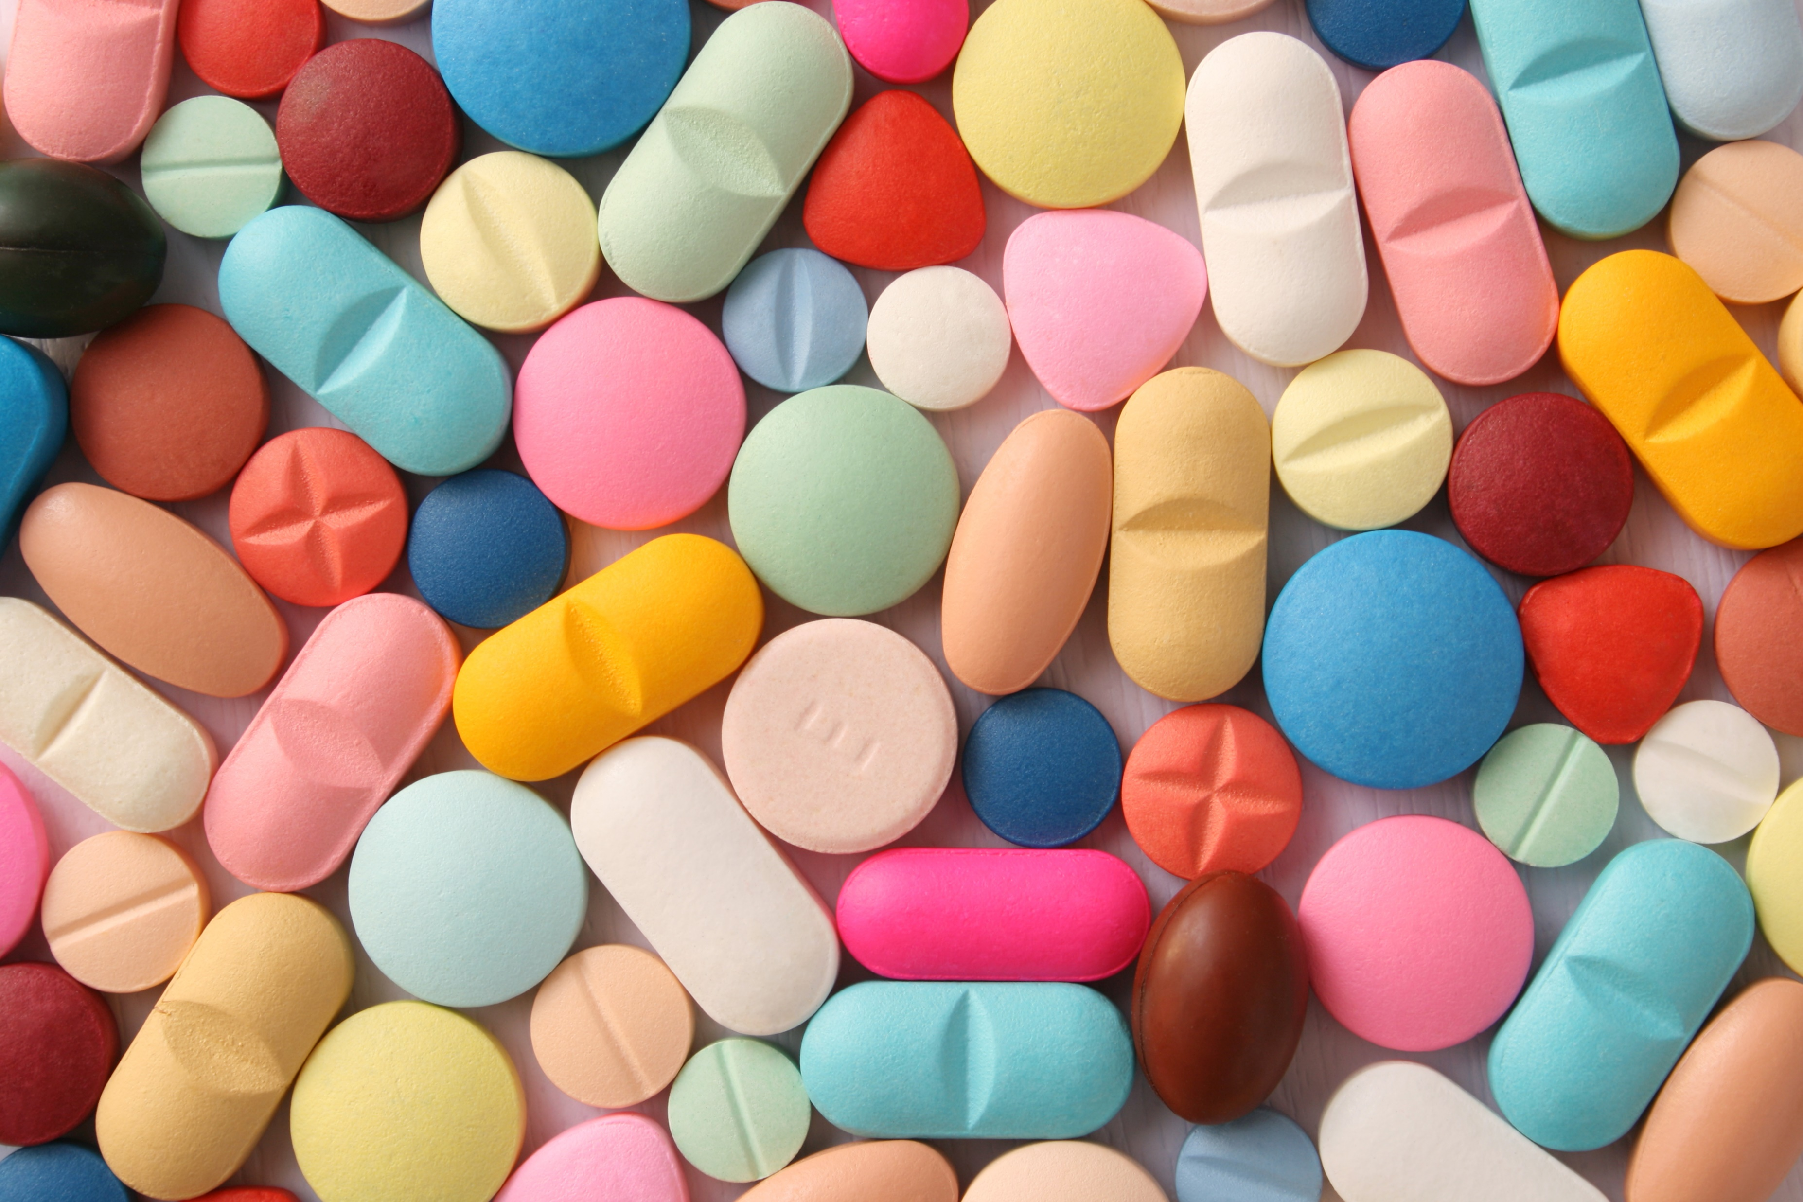
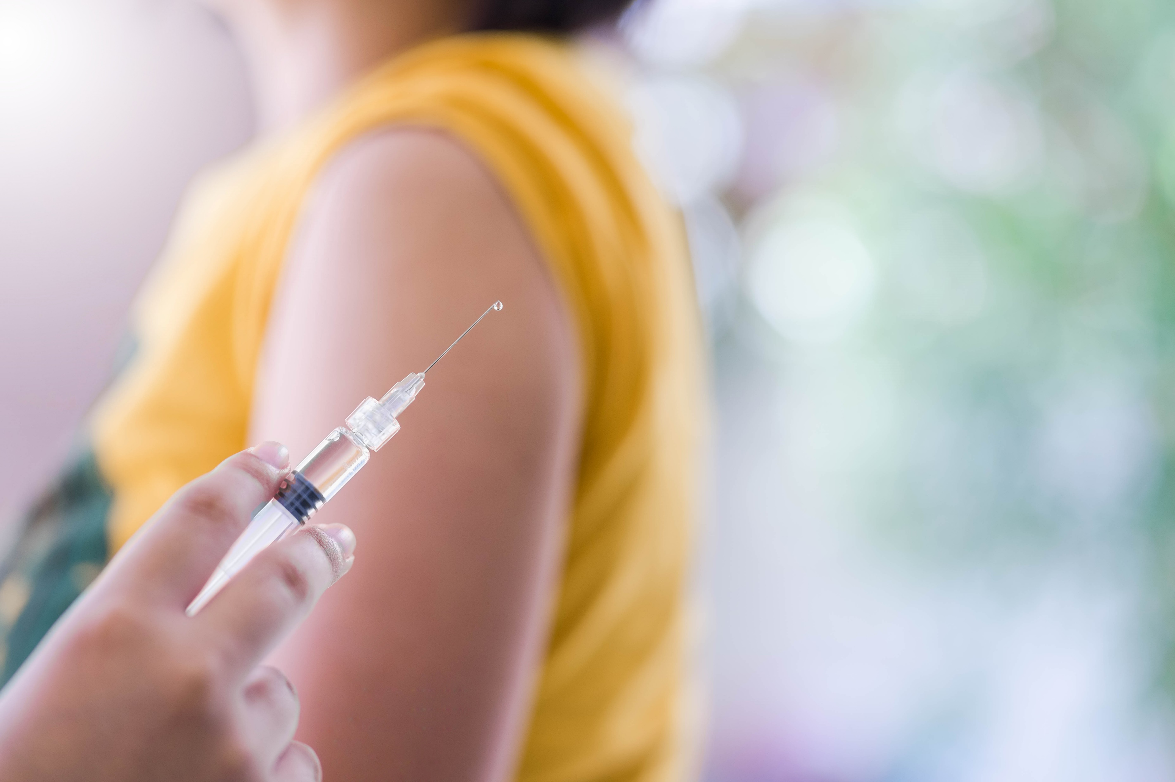
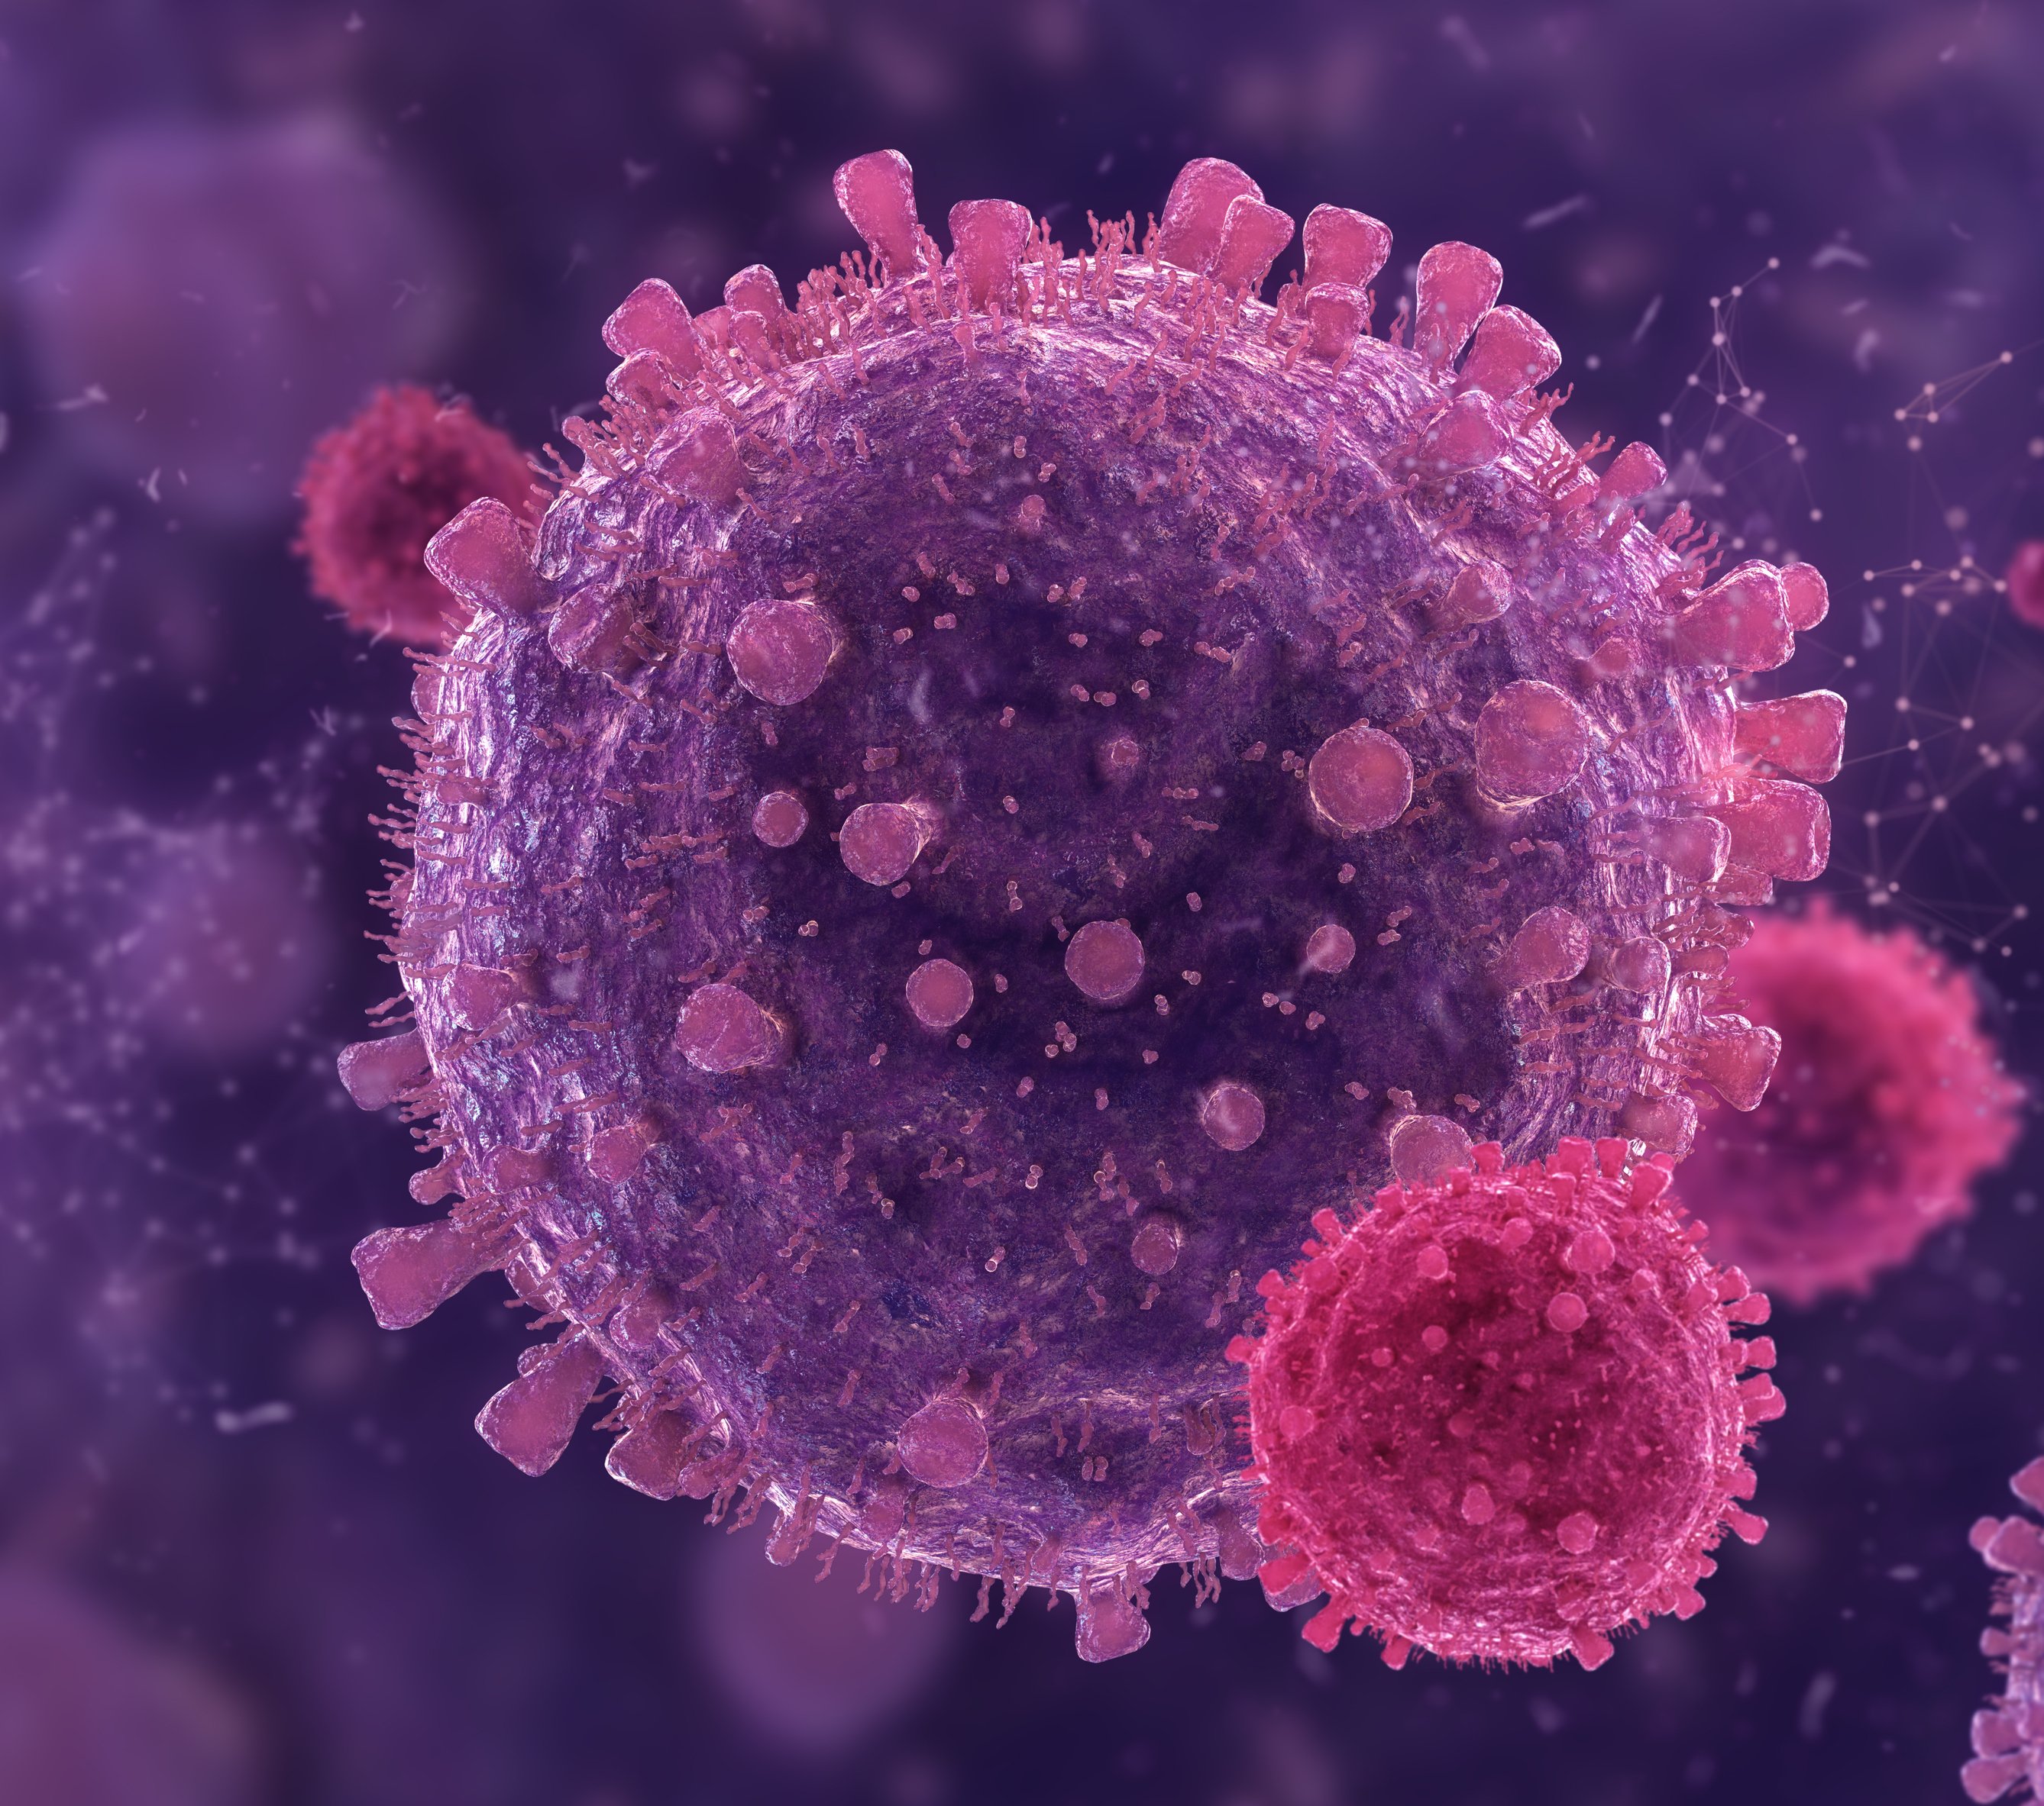
What does disease mean?
Where something unhealthy happens to the body or mind.
What does pharmaceutical mean?
This is an area of health and life sciences all about making and selling medicines.
Notes:
Before watching the video: introduce some of the vocabulary featured in the video

Slide 15
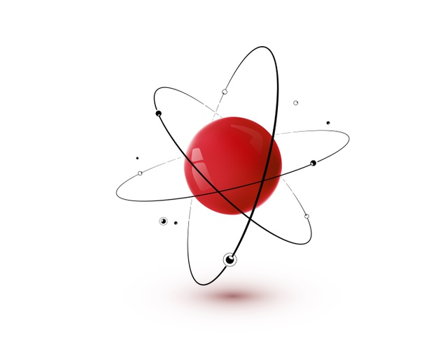
What is an atom?
Everything you can see is made up of atoms – even you!
Atoms are much too small to see and are even too small for a microscope.
They are the basic building block
that makes up the universe,
the smallest part.
Image courtesy of freepik
Notes:
Before watching the video: introduce some of the vocabulary featured in the video

Slide 16
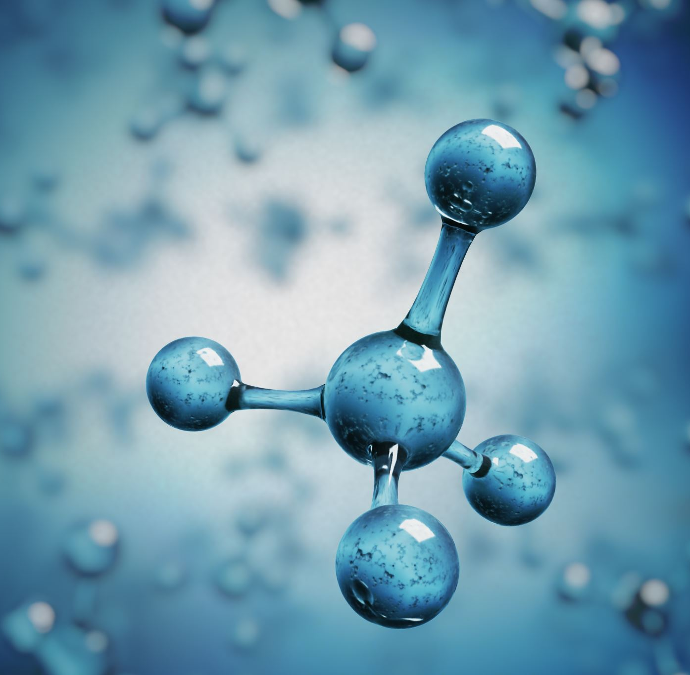
What is a molecule?
Two or more atoms joined together.
Water is an example of a molecules.
Medicines are made from molecules.
Notes:
Before watching the video: introduce some of the vocabulary featured in the video

Slide 17

What do we mean by industry or sector?
A group of businesses that make or sell similar products or perform similar services.
We are going to watch a video about a company called Sterling Pharma Solutions who are part of the Health and Life Sciences Industry or Sector
Notes:
Before watching the video: introduce some of the vocabulary featured in the video

Slide 18
Let’s watch Newshound to see where medicines come from and discover the jobs in Health and Life Sciences.
VIDEO LINK HERE
Notes:
Explain that when watching the video, learners should try and complete the active listening sheet by circling any jobs they hear mentioned.

Slide 19
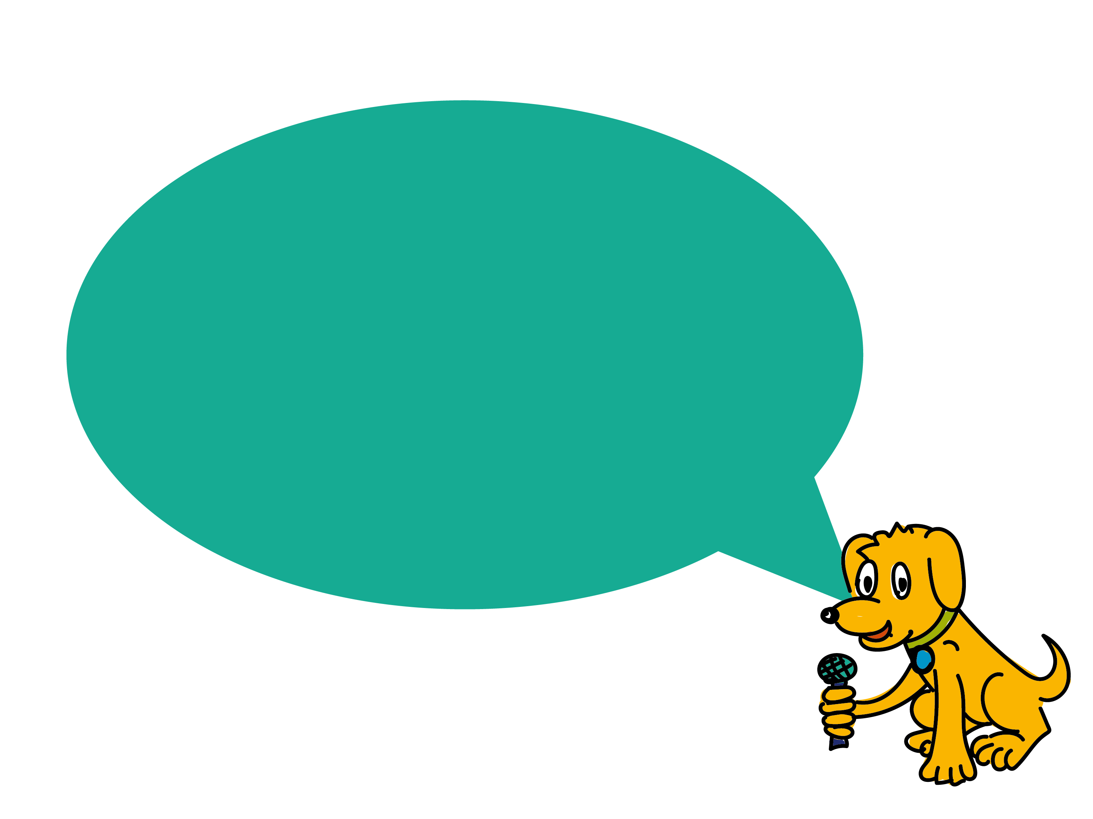
What do we know now?
Let’s do a quiz to see what we’ve remembered!

Slide 20
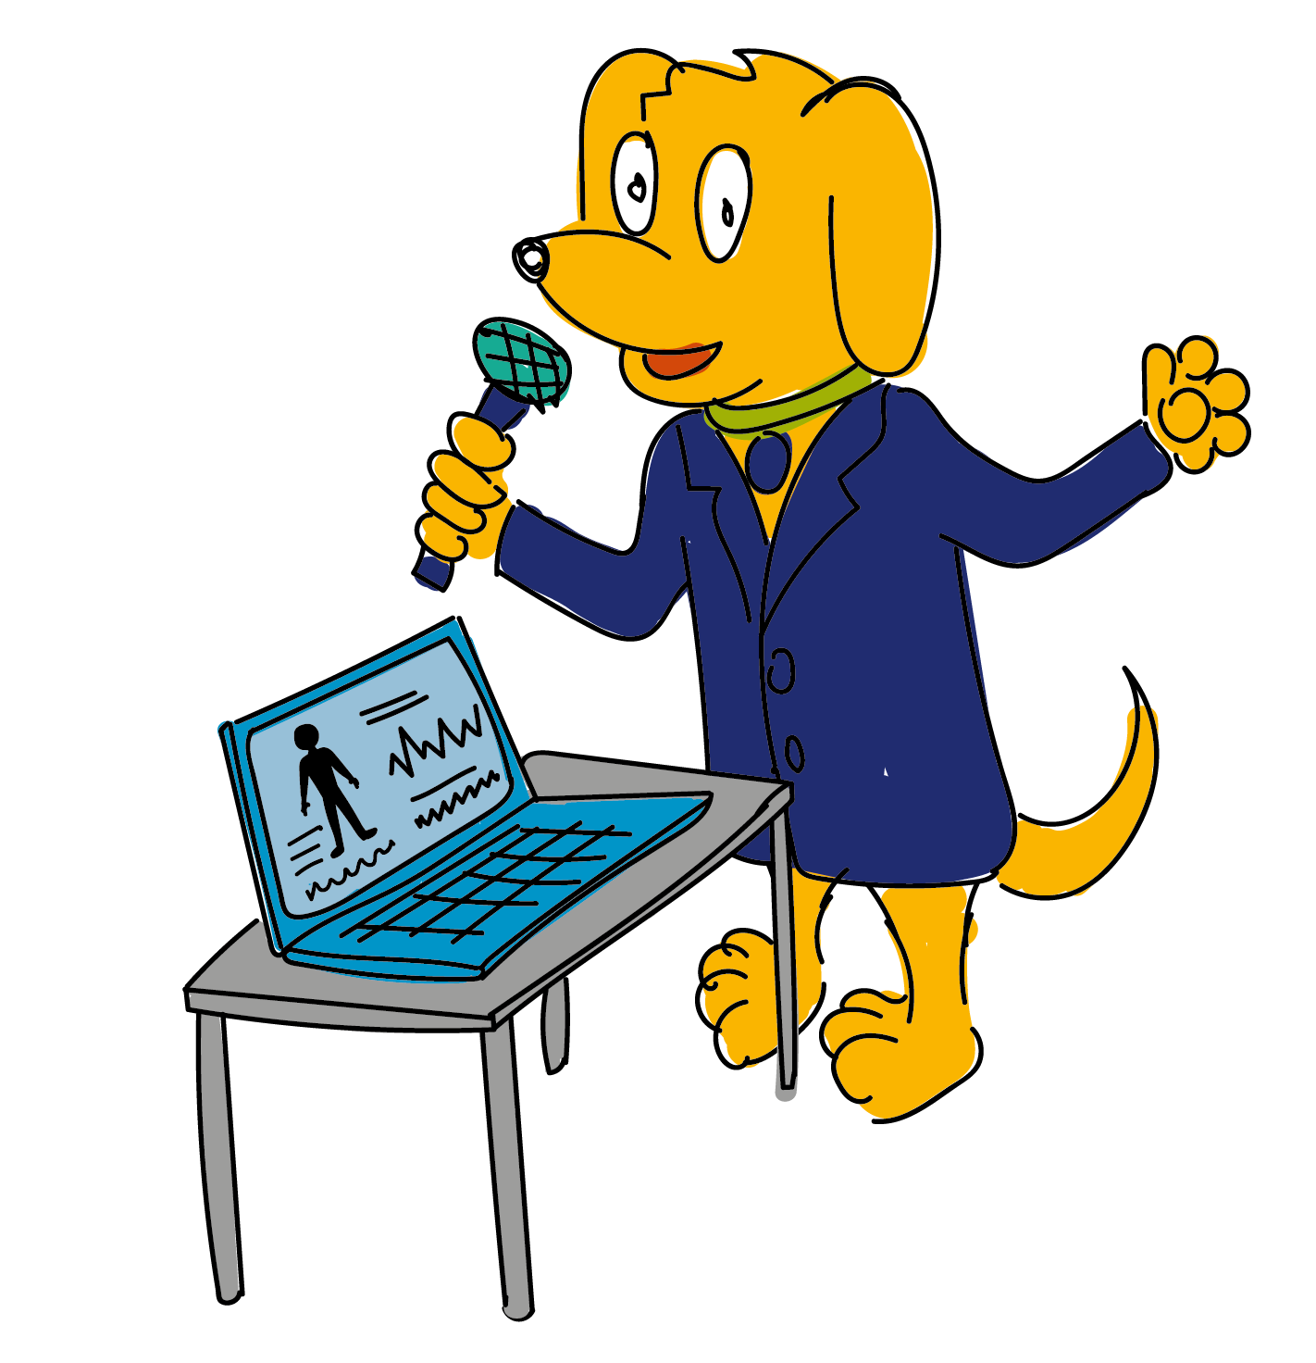
Question 1
What are medicines used for?
A. Growing plants.
B. Treating poorly people and curing disease.
C. Creating energy.
Notes:
What are medicines used for?

Slide 21
Question 2
What is a laboratory?
A. A room for chemical experiments
B. A room for baking
C. A room for exercise
Notes:
What are medicines used for?

Slide 22
Question 3
True or False?
A test to study something is called an experiment.
Notes:
What are medicines used for?

Slide 23
Question 4
How many different job roles were there at Sterling Pharma Solutions?
A. 18
B. 83
C. 183
Notes:
What are medicines used for?

Slide 24
Question 5
Which are the two main subjects for jobs in health and life sciences?
A. Maths
B. Art
C. Science
P.E.
History
Notes:
What are medicines used for?

Slide 25
Question 6
Can you remember any important skills for working at Sterling that were mentioned in the video?
Notes:
What are medicines used for?

Slide 26
Question 1
What are medicines used for?
A. Growing plants.
B. Treating poorly people and curing disease.
C. Creating energy.
B. Treating poorly people and curing disease.
Notes:
What are medicines used for?

Slide 27
Question 2
What is a laboratory?
A. A room for chemical experiments
B. A room for baking
C. A room for exercise
A room for chemical experiments
Notes:
What are medicines used for?

Slide 28

Question 3
True or False?
A test to study something is called an experiment.
True
Notes:
What are medicines used for?

Slide 29
Question 4
How many different job roles were there at Sterling Pharma Solutions?
A. 18
B. 83
C. 183
C. 183
Notes:
What are medicines used for?

Slide 30
Question 5
Which are the two main subjects for jobs in health and life sciences?
A. Maths
B. Art
C. Science
P.E.
History
A. Maths
C. Science
Notes:
What are medicines used for?

Slide 31
Question 6
Can you remember any important skills for working at Sterling that were mentioned in the video?
Teamwork
Working Independently
Problem Solving
Notes:
What are medicines used for?

Slide 32
Challenge: Design a New Medicine
Can you design a new medicine?
Draw a picture of the medicine helping someone.
Notes:
There is a printable pupil worksheet called ‘Design a New Medicine’ available for this activity.
This worksheet asks pupils to
Design a new medicine and come up with a name for it.
Draw a picture of the medicine.
Draw a picture of the medicine helping someone.
Describe what the medicine does.

Slide 33
Challenge: The Journey of Medicine
Can you cut out the 10 stages of making a medicine and stick them into the correct order on the flow chart.
Notes:
There is a printable pupil worksheet called ‘The Journey of Medicine’ available for this activity.

Slide 34
Challenge: What job would you enjoy?
Can you choose one of the jobs you have just learnt about and draw a picture of yourself doing this job?
Notes:
There is a printable pupil worksheet called ‘I could be...’ available for this activity.
Additional question on the sheet are:
List the skills you think you would need to do the job.
What would you enjoy most about doing this job?

Slide 35
Goodbye from Bingo!

