Slide 1

ENERGY: POWERING UP

Slide 2
Session Aims:
Learn more about ‘energy’ and why we need it.
Understand the difference between renewable and non-renewable energy, and the importance of greener cleaner energy.
Explore renewable energy technologies.
Find out about the job roles of people working in Renewable Energy in the North East.

Slide 3



What is Energy?
Energy is what makes things move or change
There are lots of different types of energy
We can even store energy and use it at a time that suits us

Slide 4

Why do we need energy?
With the person next to you, name 3 items you can see that need energy to power them and make them work.
Notes:
Explain sustainability.

Slide 5

Electricity is a type of Energy
We use electricity to power our school and our homes
But first we need to make it!

Slide 6


How do we generate Electricity?
We burn coal, oil and natural gas to generate electricity.
Are there any problems with doing this?
Non – Renewable Energy
Notes:
Discuss: Non-renewable energy resources (e.g. coal and oil) are still commonly used, but will eventually run out, and are releasing lots of pollution as they are burnt.
Additional Info:
Non – Renewable Energy
Fossil fuels (oil, gas and coal) are burnt and converted into energy.
When fossil fuels burn, they release carbon dioxide into the atmosphere. Research shows that a major contributor to the green-house effect and global warming is our overuse and burning of fossil fuels.
Coal and gas also release sulphur dioxide gas when they are burned. Sulphur dioxide can cause breathing problems for living creatures and is also a major part of acid rain.
The source is limited. Oil and gas will be the first to run out and then coal.

Slide 7



How do we generate Electricity?
…Rather than burning coal, oil or natural gas, which will eventually run out, we do have some alternatives…
We can use renewable technologies, such as wind turbines and solar panels, to generate electricity. These will not run out and are better for our planet.
Renewable Energy
Notes:
Discuss: Renewable energy resources (e.g. solar panels and wind turbines) are not going to run out, as they don’t ‘use up’ all of their source materials.
Renewable energy is also called ‘Clean Energy’ because it does not harm the environment by causing pollution. Renewables release far less pollution than non-renewables, so avoid contributing further to climate change.

Slide 8
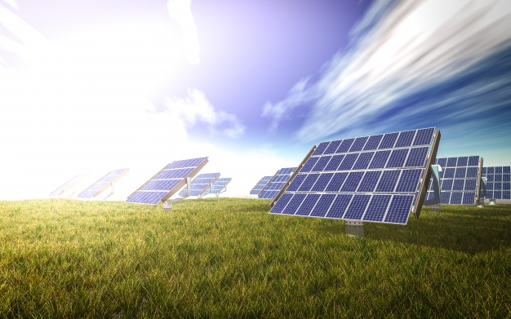
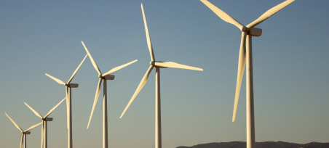
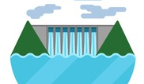
Renewable Energy – Finish these sentences
To convert the light energy from the sun we have…
To convert the wind energy we have…
To convert the water and wave energy we have…
Solar Panels!
Wind turbines!
Water turbines!
Notes:
Discuss: Renewable Energy is obtained from natural resources that will not run out: sun, wind and water. These sources are converted into electricity to power homes, school, hospitals and more.

Slide 9

On a really windy day, wind turbines can generate up to 40% of the UK’s energy!
As the blades move, the wind's kinetic (movement) energy is converted into electrical energy.
But how are wind turbines made?
There are hundreds of different job roles involved in making renewable energy technology.
Notes:
Press play to see the turbine blades turn!
Extra info: Wind-turbine technicians and solar panel installers are amongst the fastest-growing jobs in the country!

Slide 10
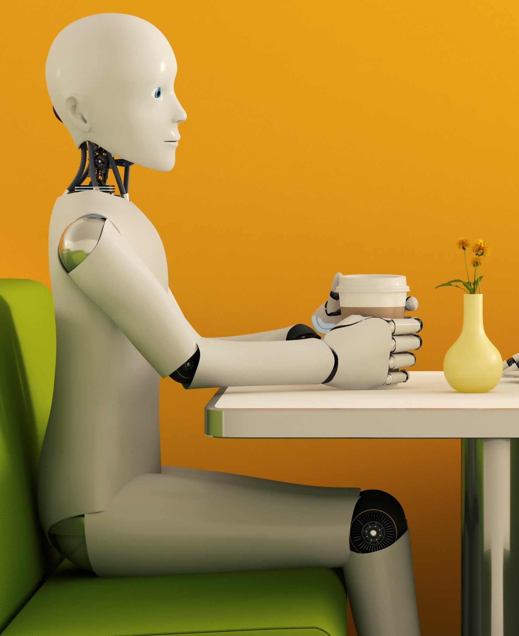
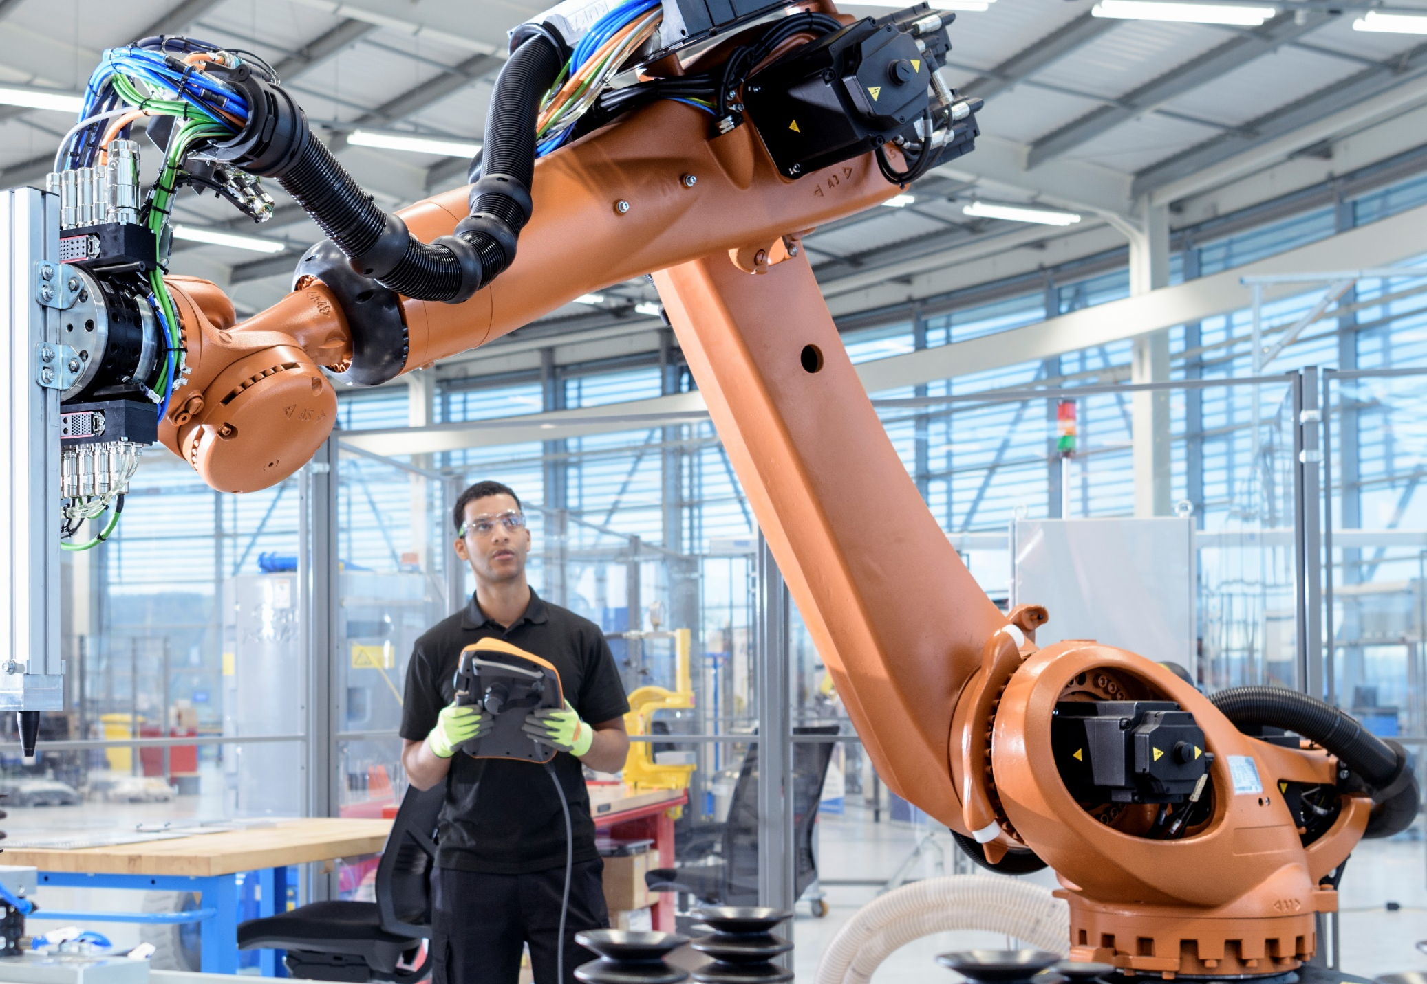
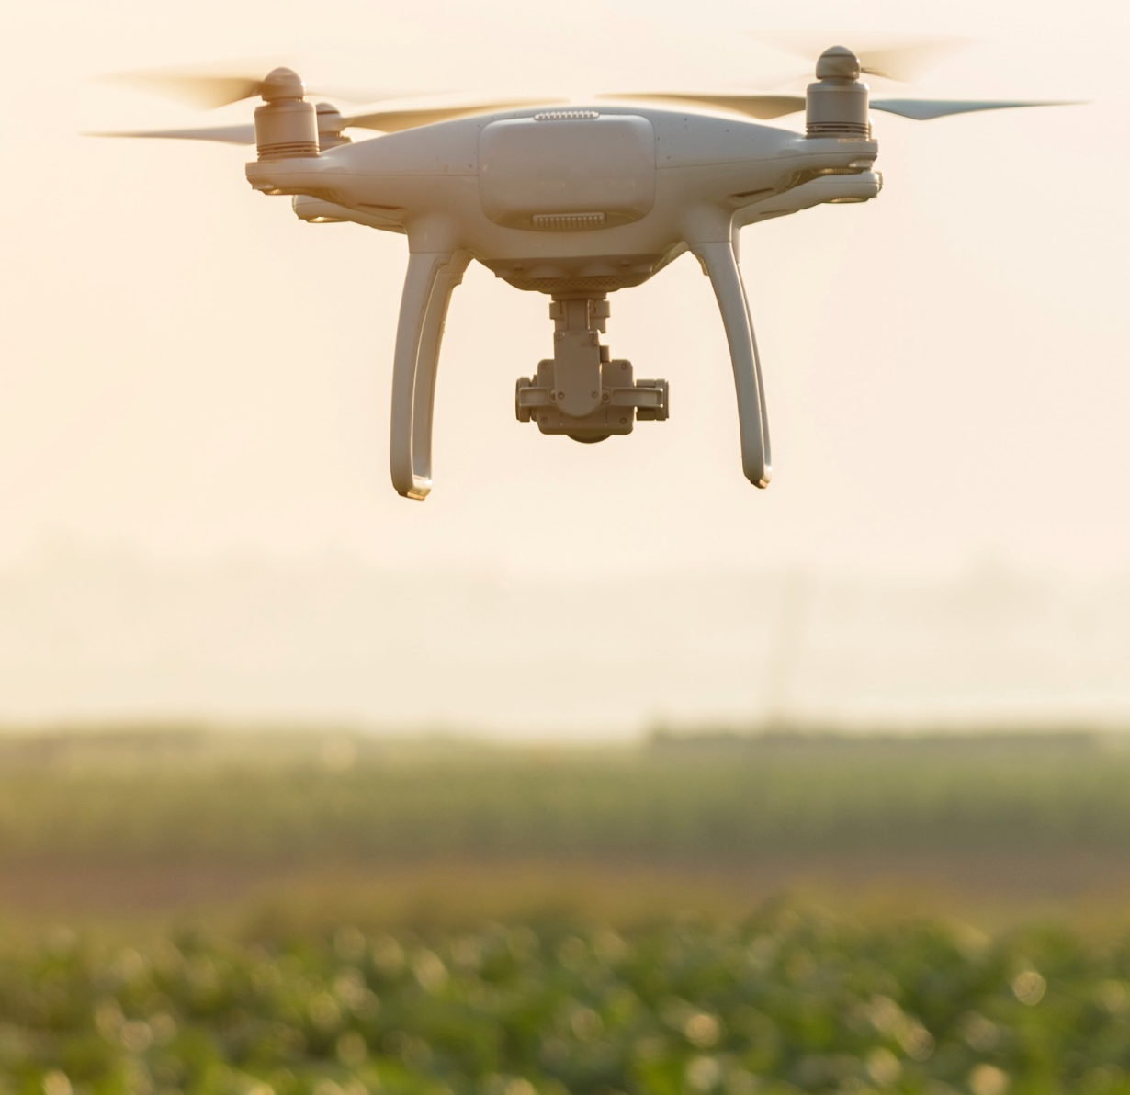
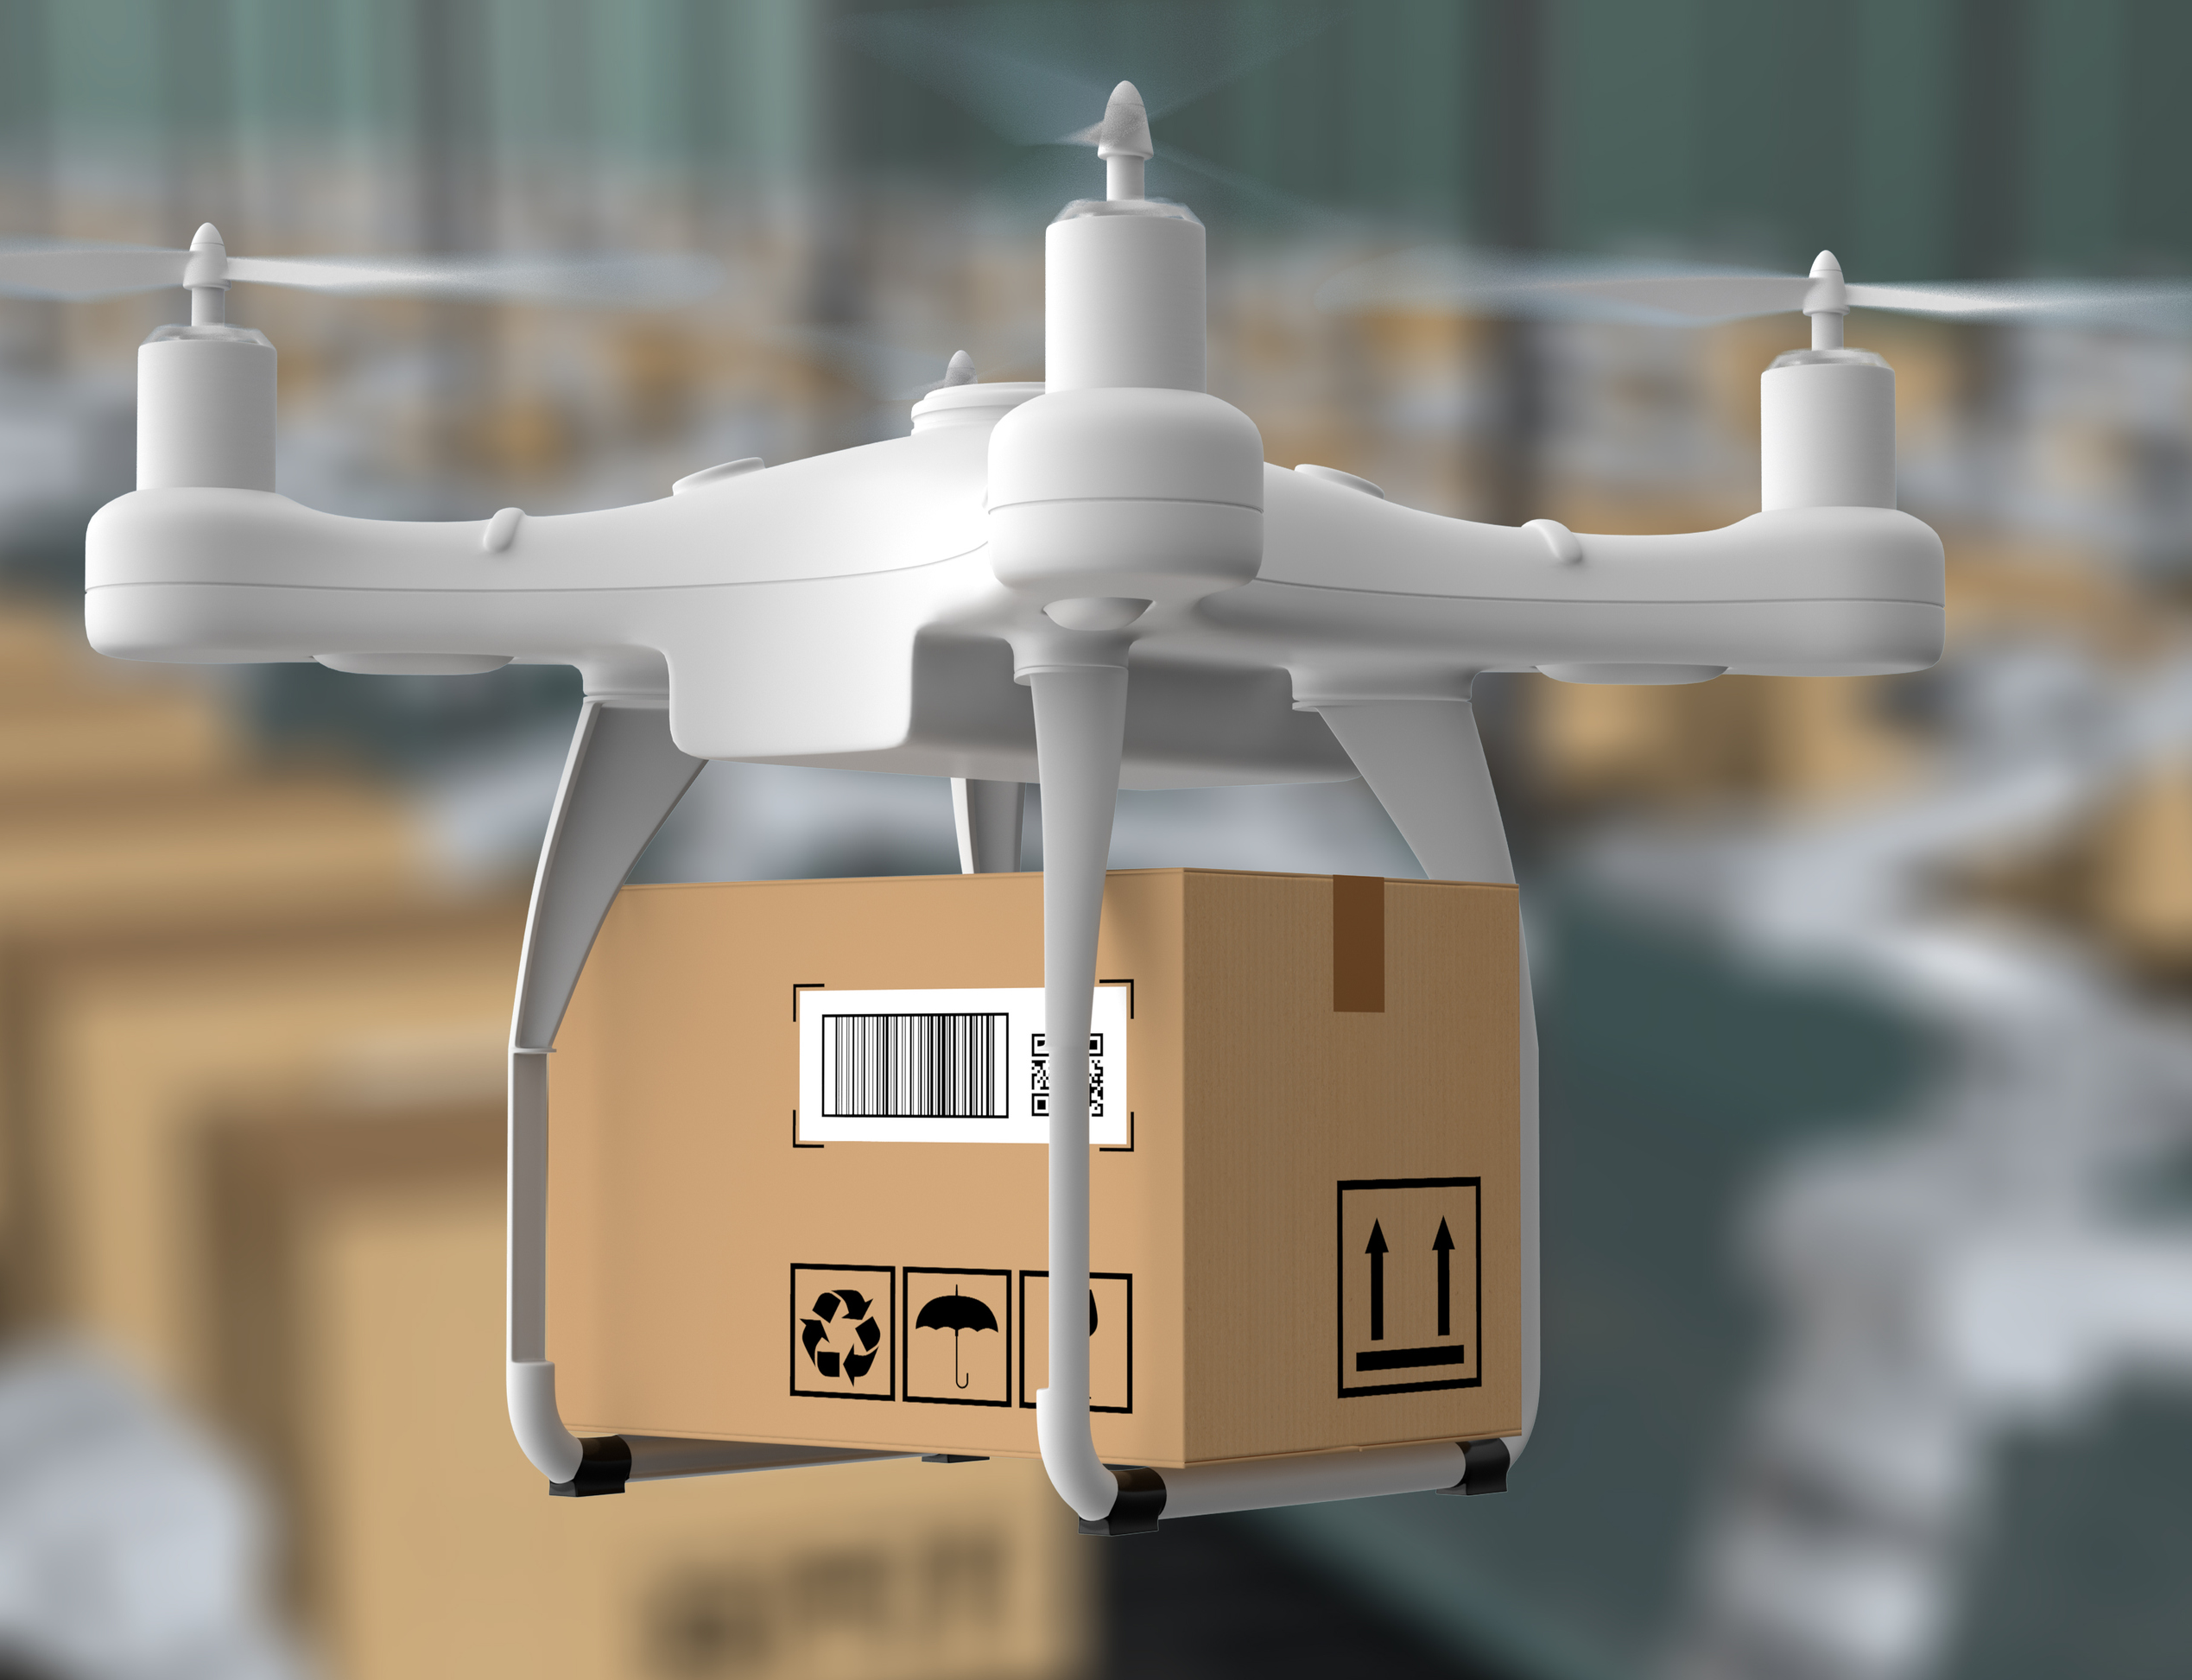
What is a robot?
A machine acting like a human being.
What is a drone?
A robot in the sky
Notes:
Before watching the video: introduce some of the vocabulary featured in the video

Slide 11

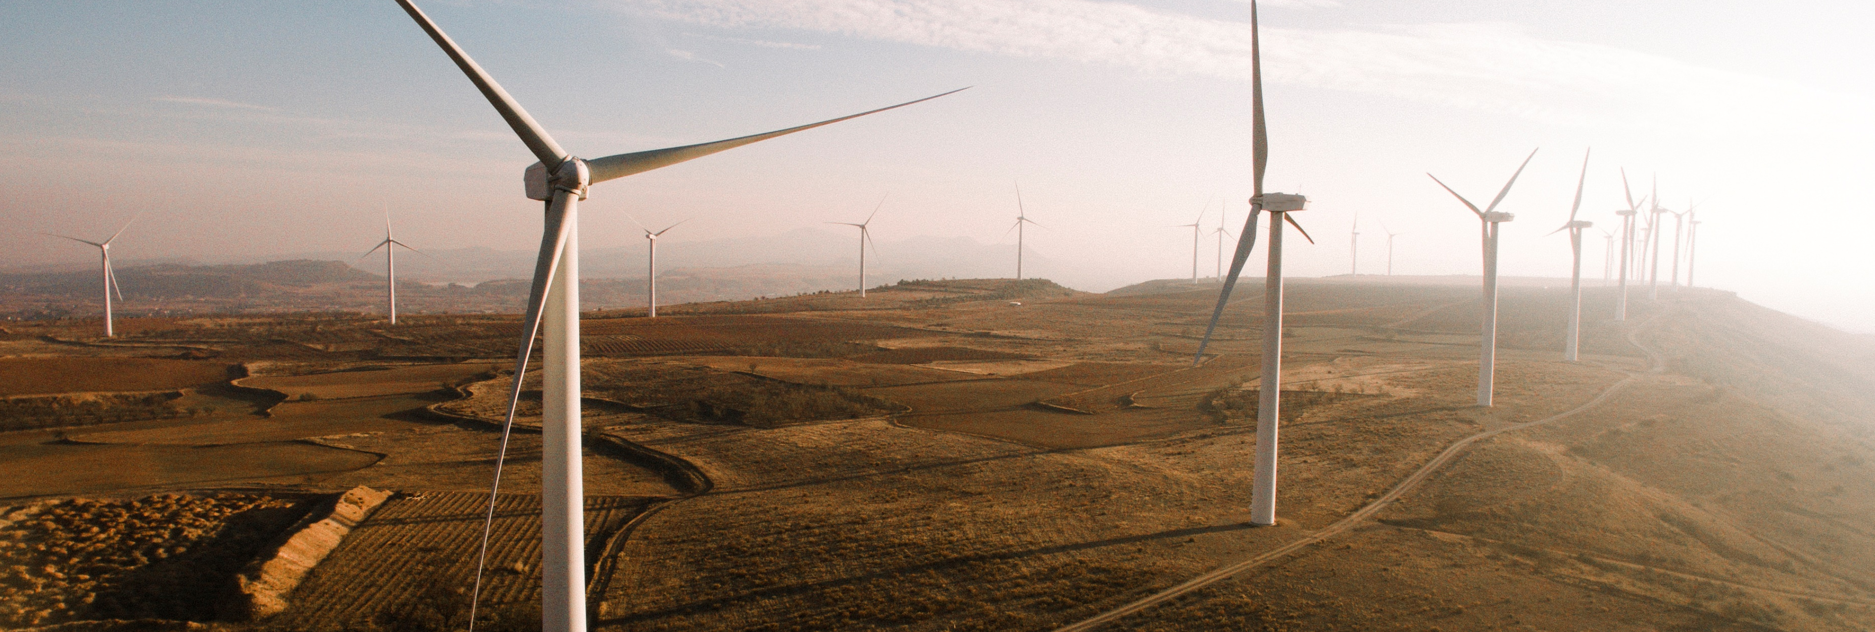
What does offshore mean?
Located at sea some distance from the shore.
What does wind farm mean?
An area where a group of wind turbines produce energy.
Notes:
Before watching the video: introduce some of the vocabulary featured in the video

Slide 12
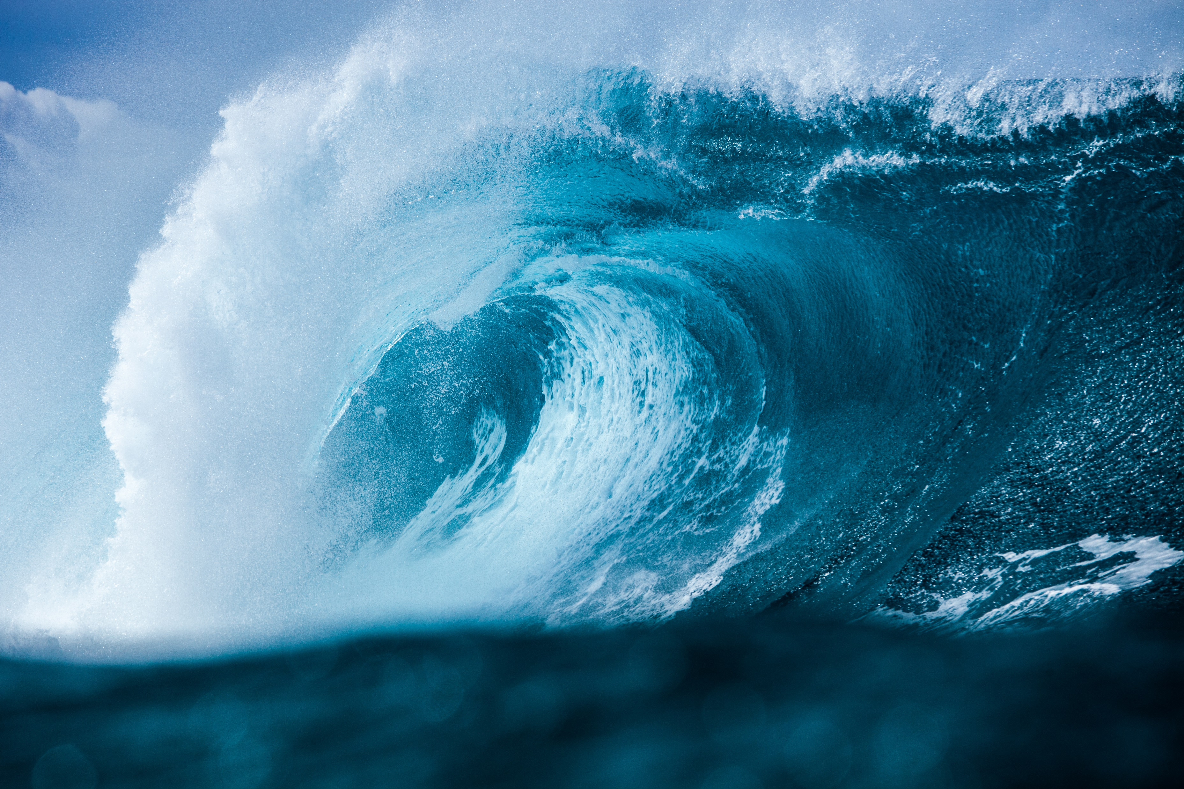
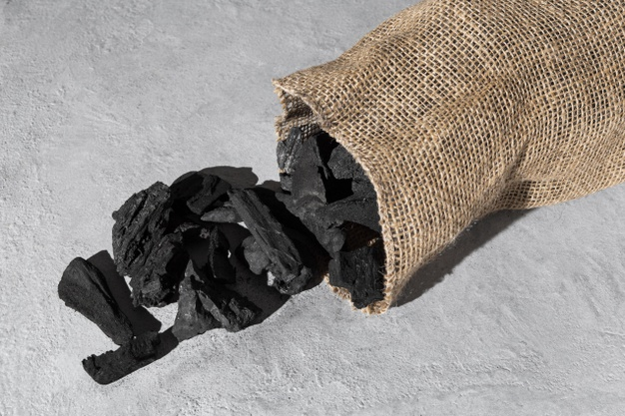

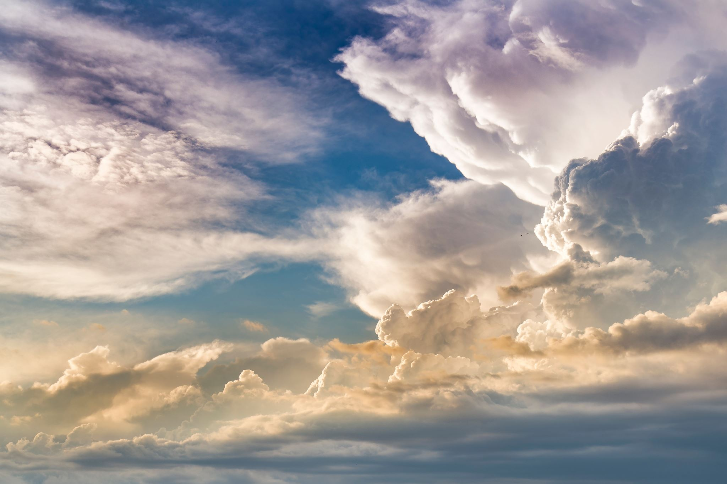
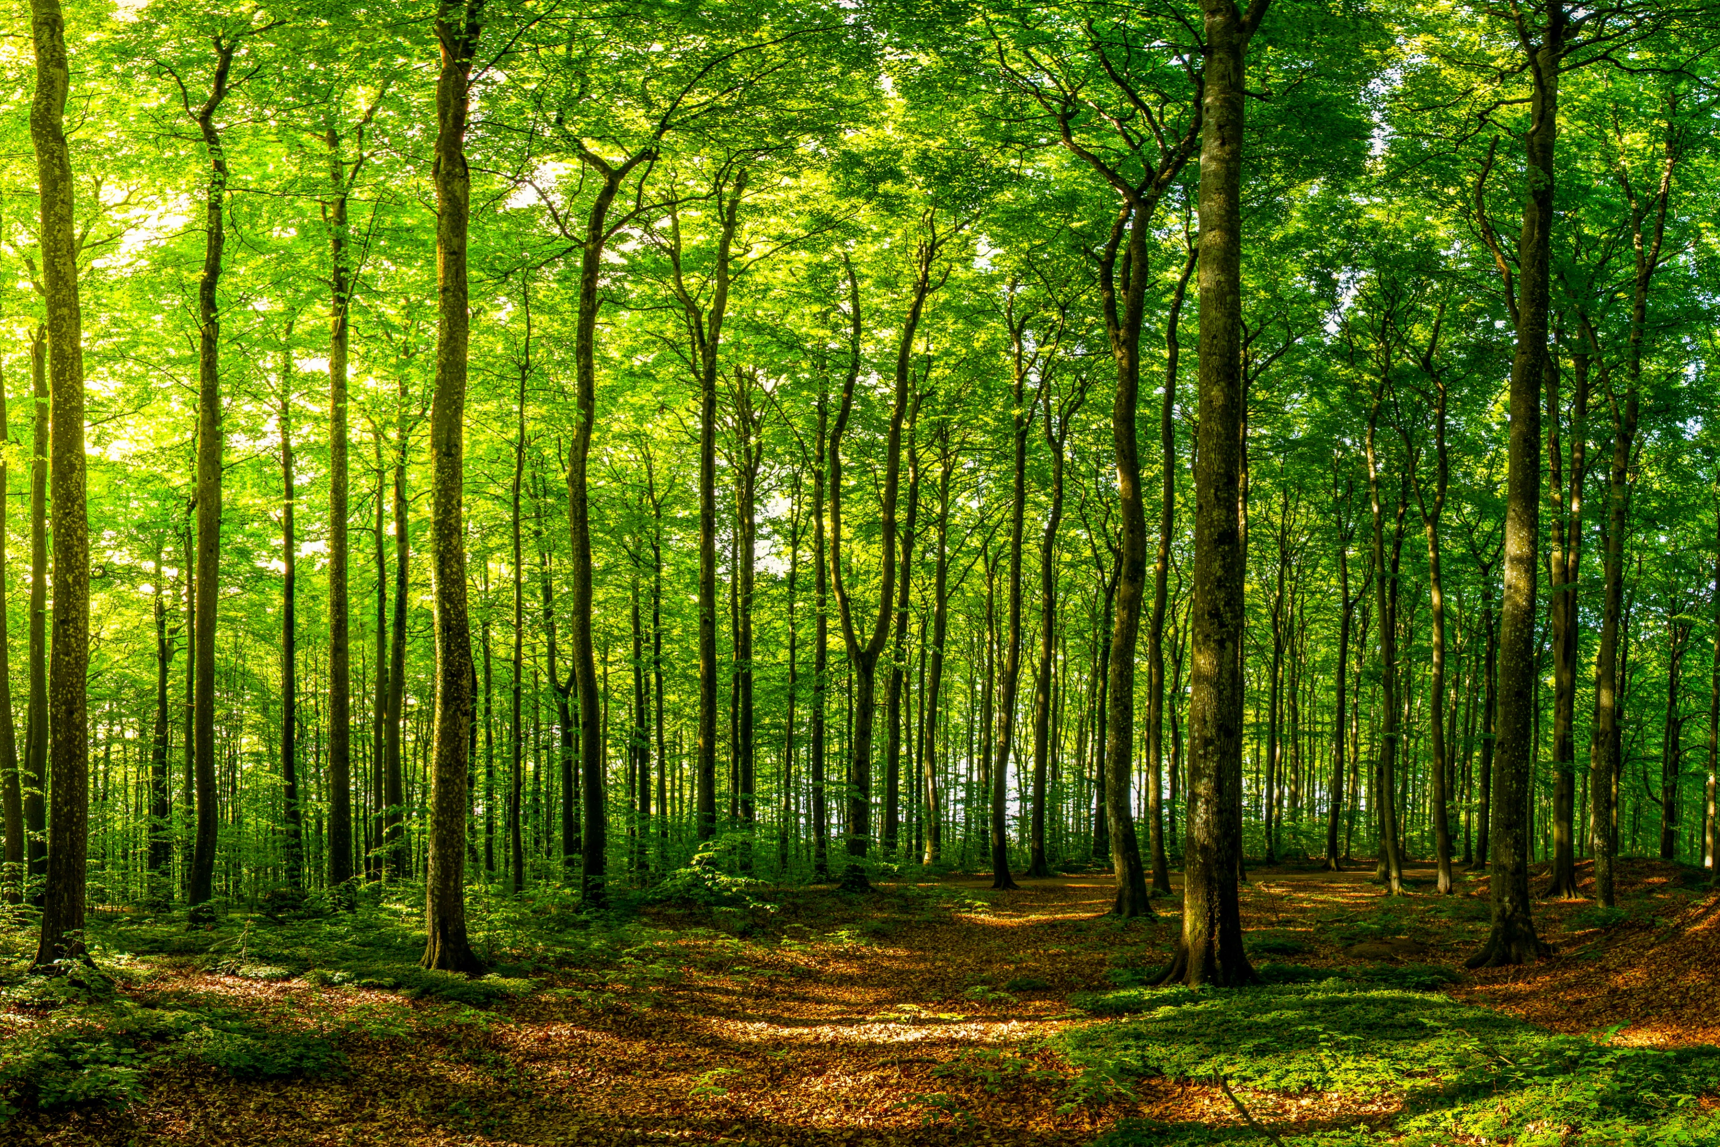
What are natural resources?
Things in nature that humans use like.....
Air
Water
Wood
Oil
Wind energy
Natural gas
Iron
Coal
Images courtesy of freepix.com
Notes:
Before watching the video: introduce some of the vocabulary featured in the video

Slide 13
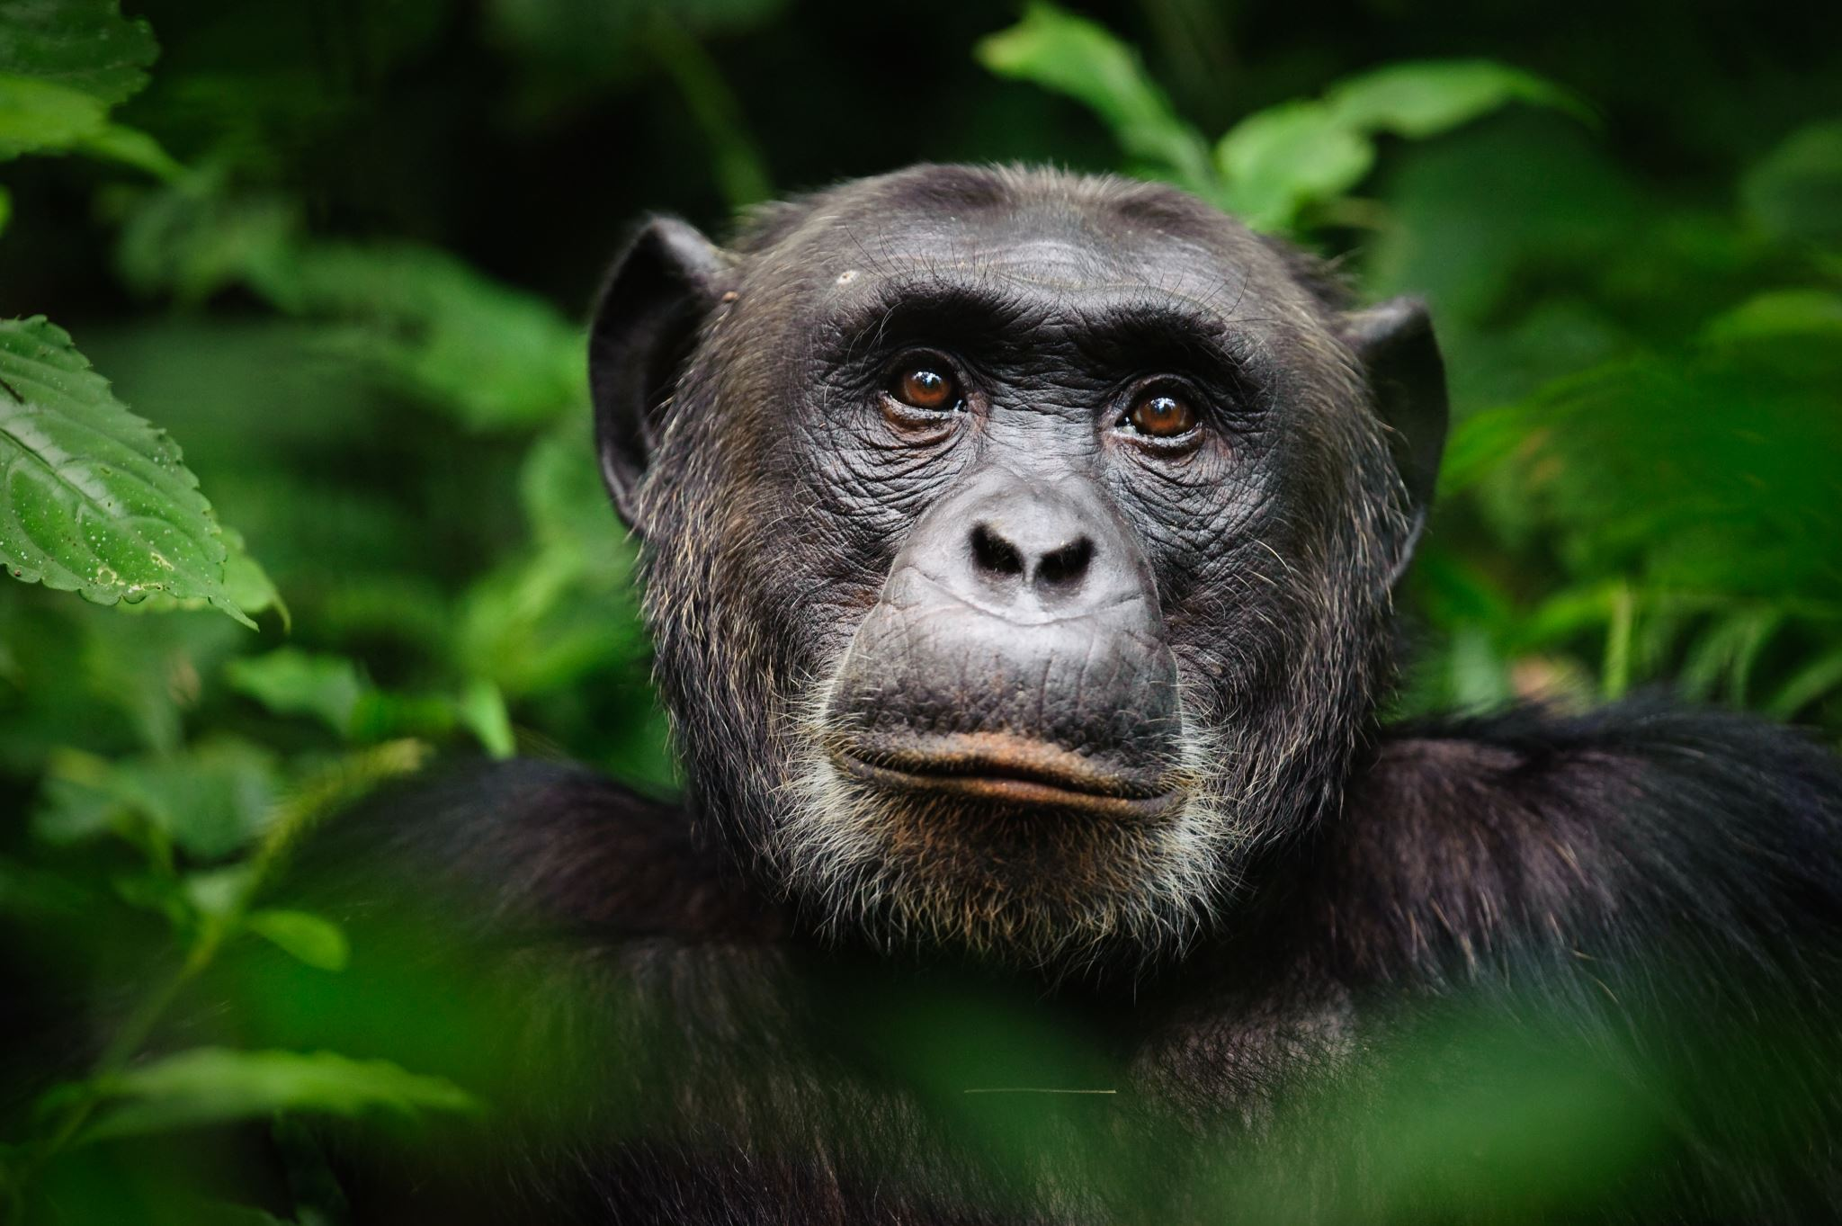
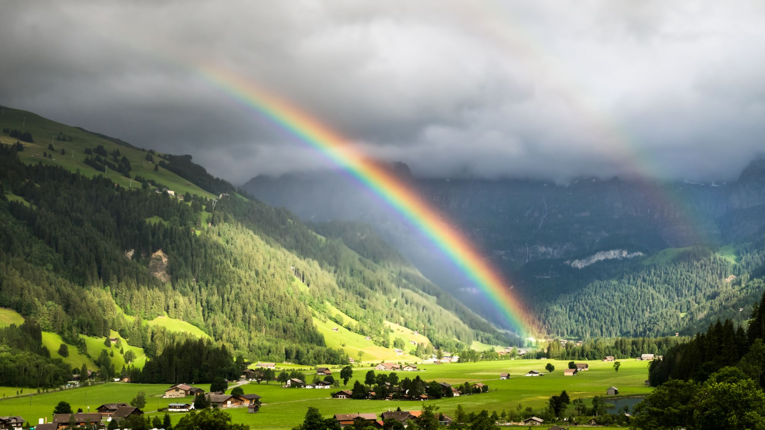
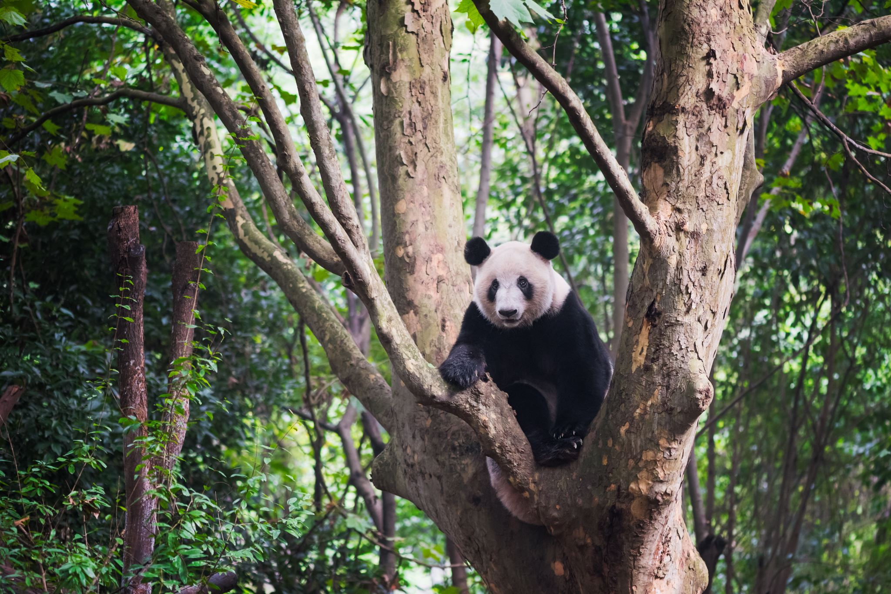
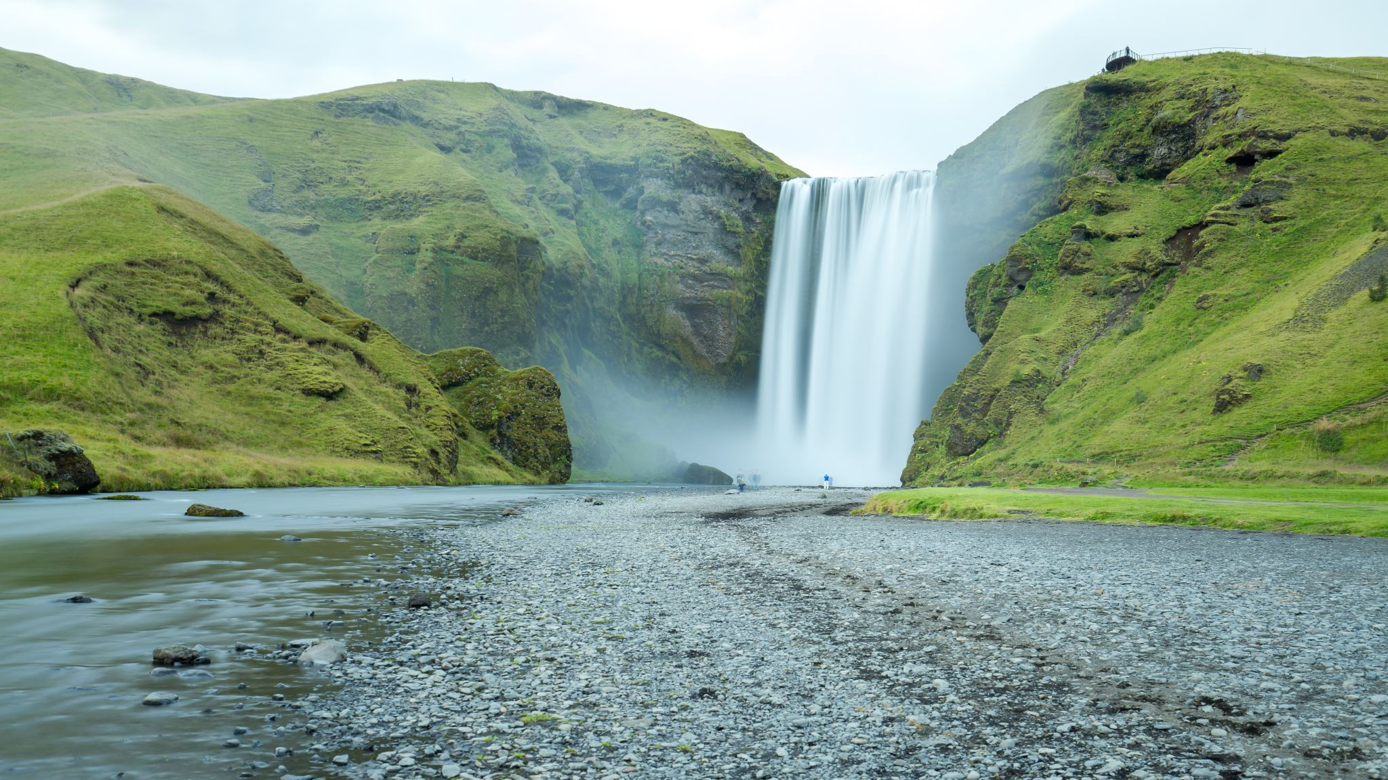
What does sustainable mean?
We use the term ‘sustainable’ to describe the way we use natural resources when this use is kept at a steady level that is not likely to damage the environment.
Notes:
Before watching the video: introduce some of the vocabulary featured in the video

Slide 14
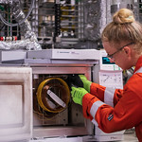
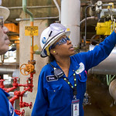
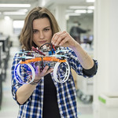
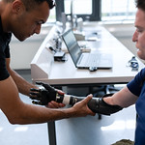
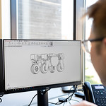
What is an Engineer?
A person who designs, builds, or repairs engines, machines, or structures
Images courtesy of This Is Engineering
Notes:
Before watching the video: introduce some of the vocabulary featured in the video

Slide 15
Images courtesy of This Is Engineering
Look around the room…
Can you see 3 things that engineers might have made or might be responsible for?
Notes:
Ask children to look around the room and come up with 3 things that engineers might have made or might be responsible for.
The answer is that everything apart from the living things in the room will most likely have needed an engineer to help create them.

Slide 16

Let’s take a look at GE Renewable Energy to see how they make wind turbines and help save the planet.
VIDEO LINK HERE
Notes:
Explain that when watching the video, learners should try and complete the active listening sheet by circling any jobs they hear mentioned.

Slide 17

What do we know now?
Let’s do a quiz to see what we’ve remembered!

Slide 18
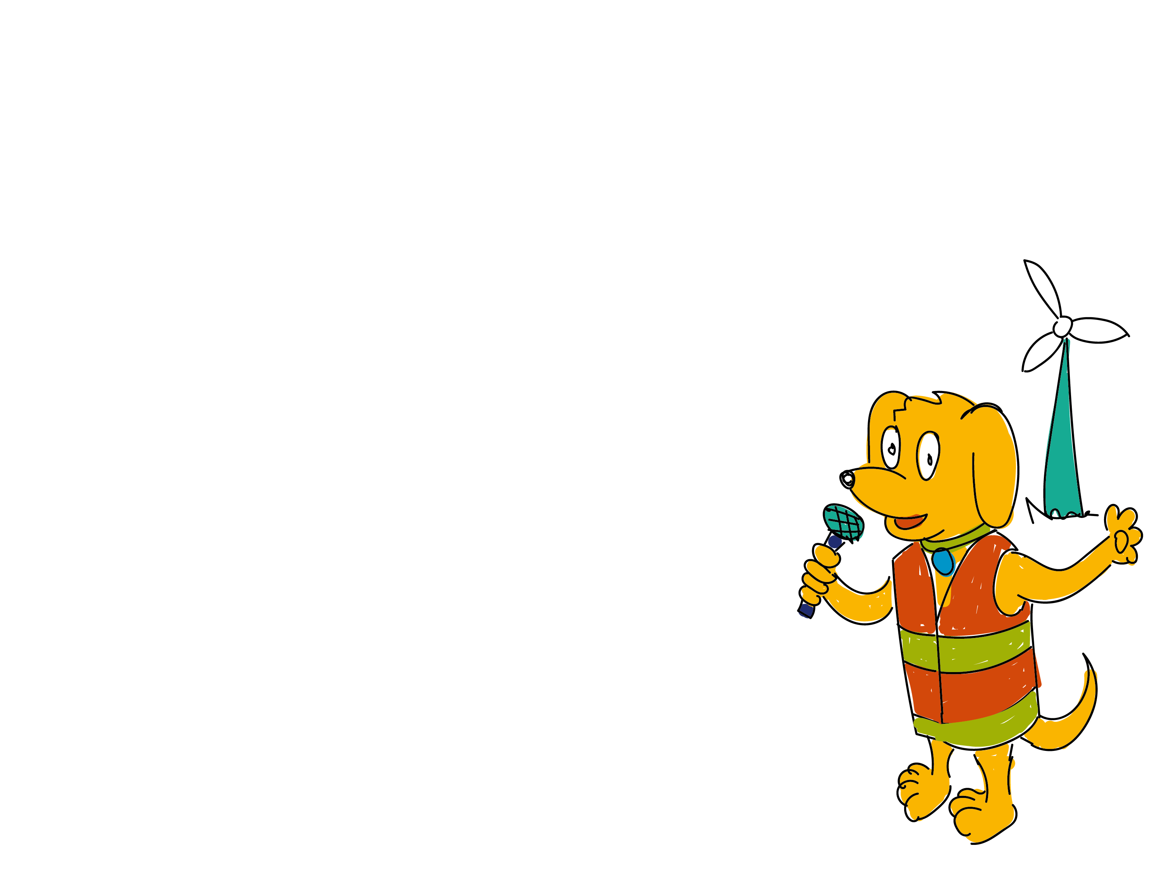
Question 1
What is being built offshore here in the Northeast to provide green energy?
A. Solar panels
B. Wind turbines
C. Wave turbines
Notes:
Answer: Wind turbines

Slide 19
Question 2
What do wind turbines make?
A. Heat
B. Light
C. Electricity

Slide 20
Question 3
How long can one turn of a wind turbine power a home for?
A. 2 minutes
B. 2 hours
C. 2 days

Slide 21
Question 4
How many blades are there on the wind turbines in the video?
A. 5
B. 3
C. 7
Notes:
Answer: 3

Slide 22
Question 5
Which 3 subjects did Anthony say he needed to study to become an engineer?
A. English
B. Maths
C. Science
D. PE
Notes:
Answer: English, Maths and Science

Slide 23
Question 1
What is being built offshore here in the Northeast to provide green energy?
Wind turbines
A. Solar panels
B. Wind turbines
C. Wave turbines
Notes:
Answer: Wind turbines

Slide 24
Question 2
What do wind turbines make?
C. Electricity
A. Heat
B. Light
C. Electricity

Slide 25
Question 3
How long can one turn of a wind turbine power a home for?
C. 2 days
A. 2 minutes
B. 2 hours
C. 2 days

Slide 26
Question 4
How many blades are there on the wind turbines in the video?
A. 5
B. 3
C. 7
3
Notes:
Answer: 3

Slide 27
Question 5
Which 3 subjects did Anthony say he needed to study to become an engineer?
A. English
B. Maths
C. Science
D. PE
A. English
B. Maths
C. Science
Notes:
Answer: English, Maths and Science

Slide 28
Can you draw a robot that the engineers can use to climb up the turbine and mend one of the broken blades?
Challenge: Design a Robot
Label your robot to explain what each part does.
Notes:
There is a printable pupil worksheet available for this activity.

Slide 29
Challenge: What job would you enjoy?
Can you choose one of the jobs you have just learnt about and draw a picture of yourself doing this job?
Notes:
There is a printable pupil worksheet called ‘I could be...’ available for this activity.
Additional question on the sheet are:
List the skills you think you would need to do the job.
What would you enjoy most about doing this job?

Slide 30
Goodbye from Bingo!

