Slide 1

HOW DO WE FEED 7.8 BILLION PEOPLE EVERYDAY?

Slide 2
Session Aims:
Learn about how technology is helping to get food from the farm to our table.
Learn what the term Agri-tech means and how people working in Agri-tech can help feed the world.

Slide 3
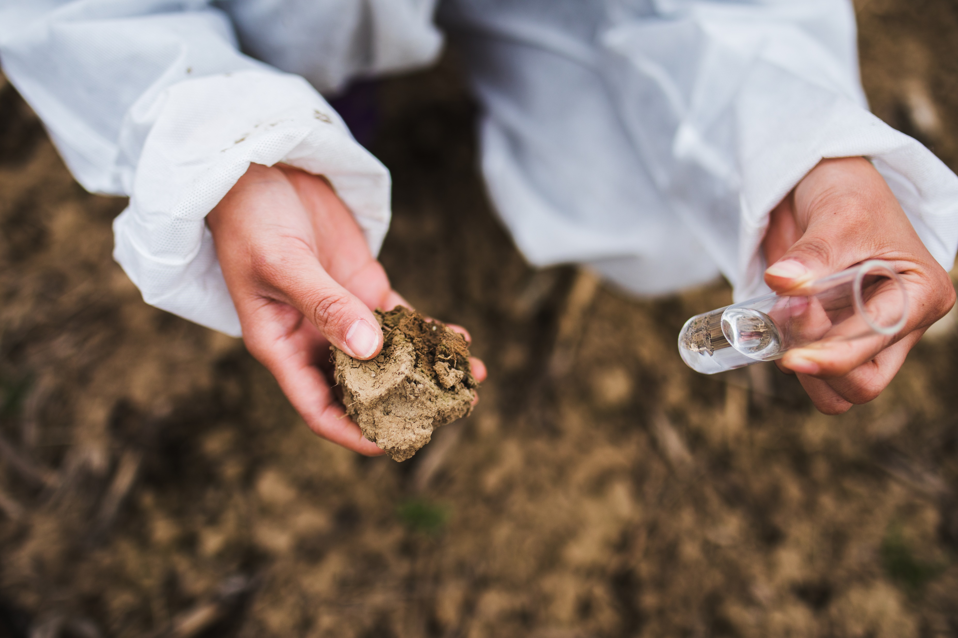
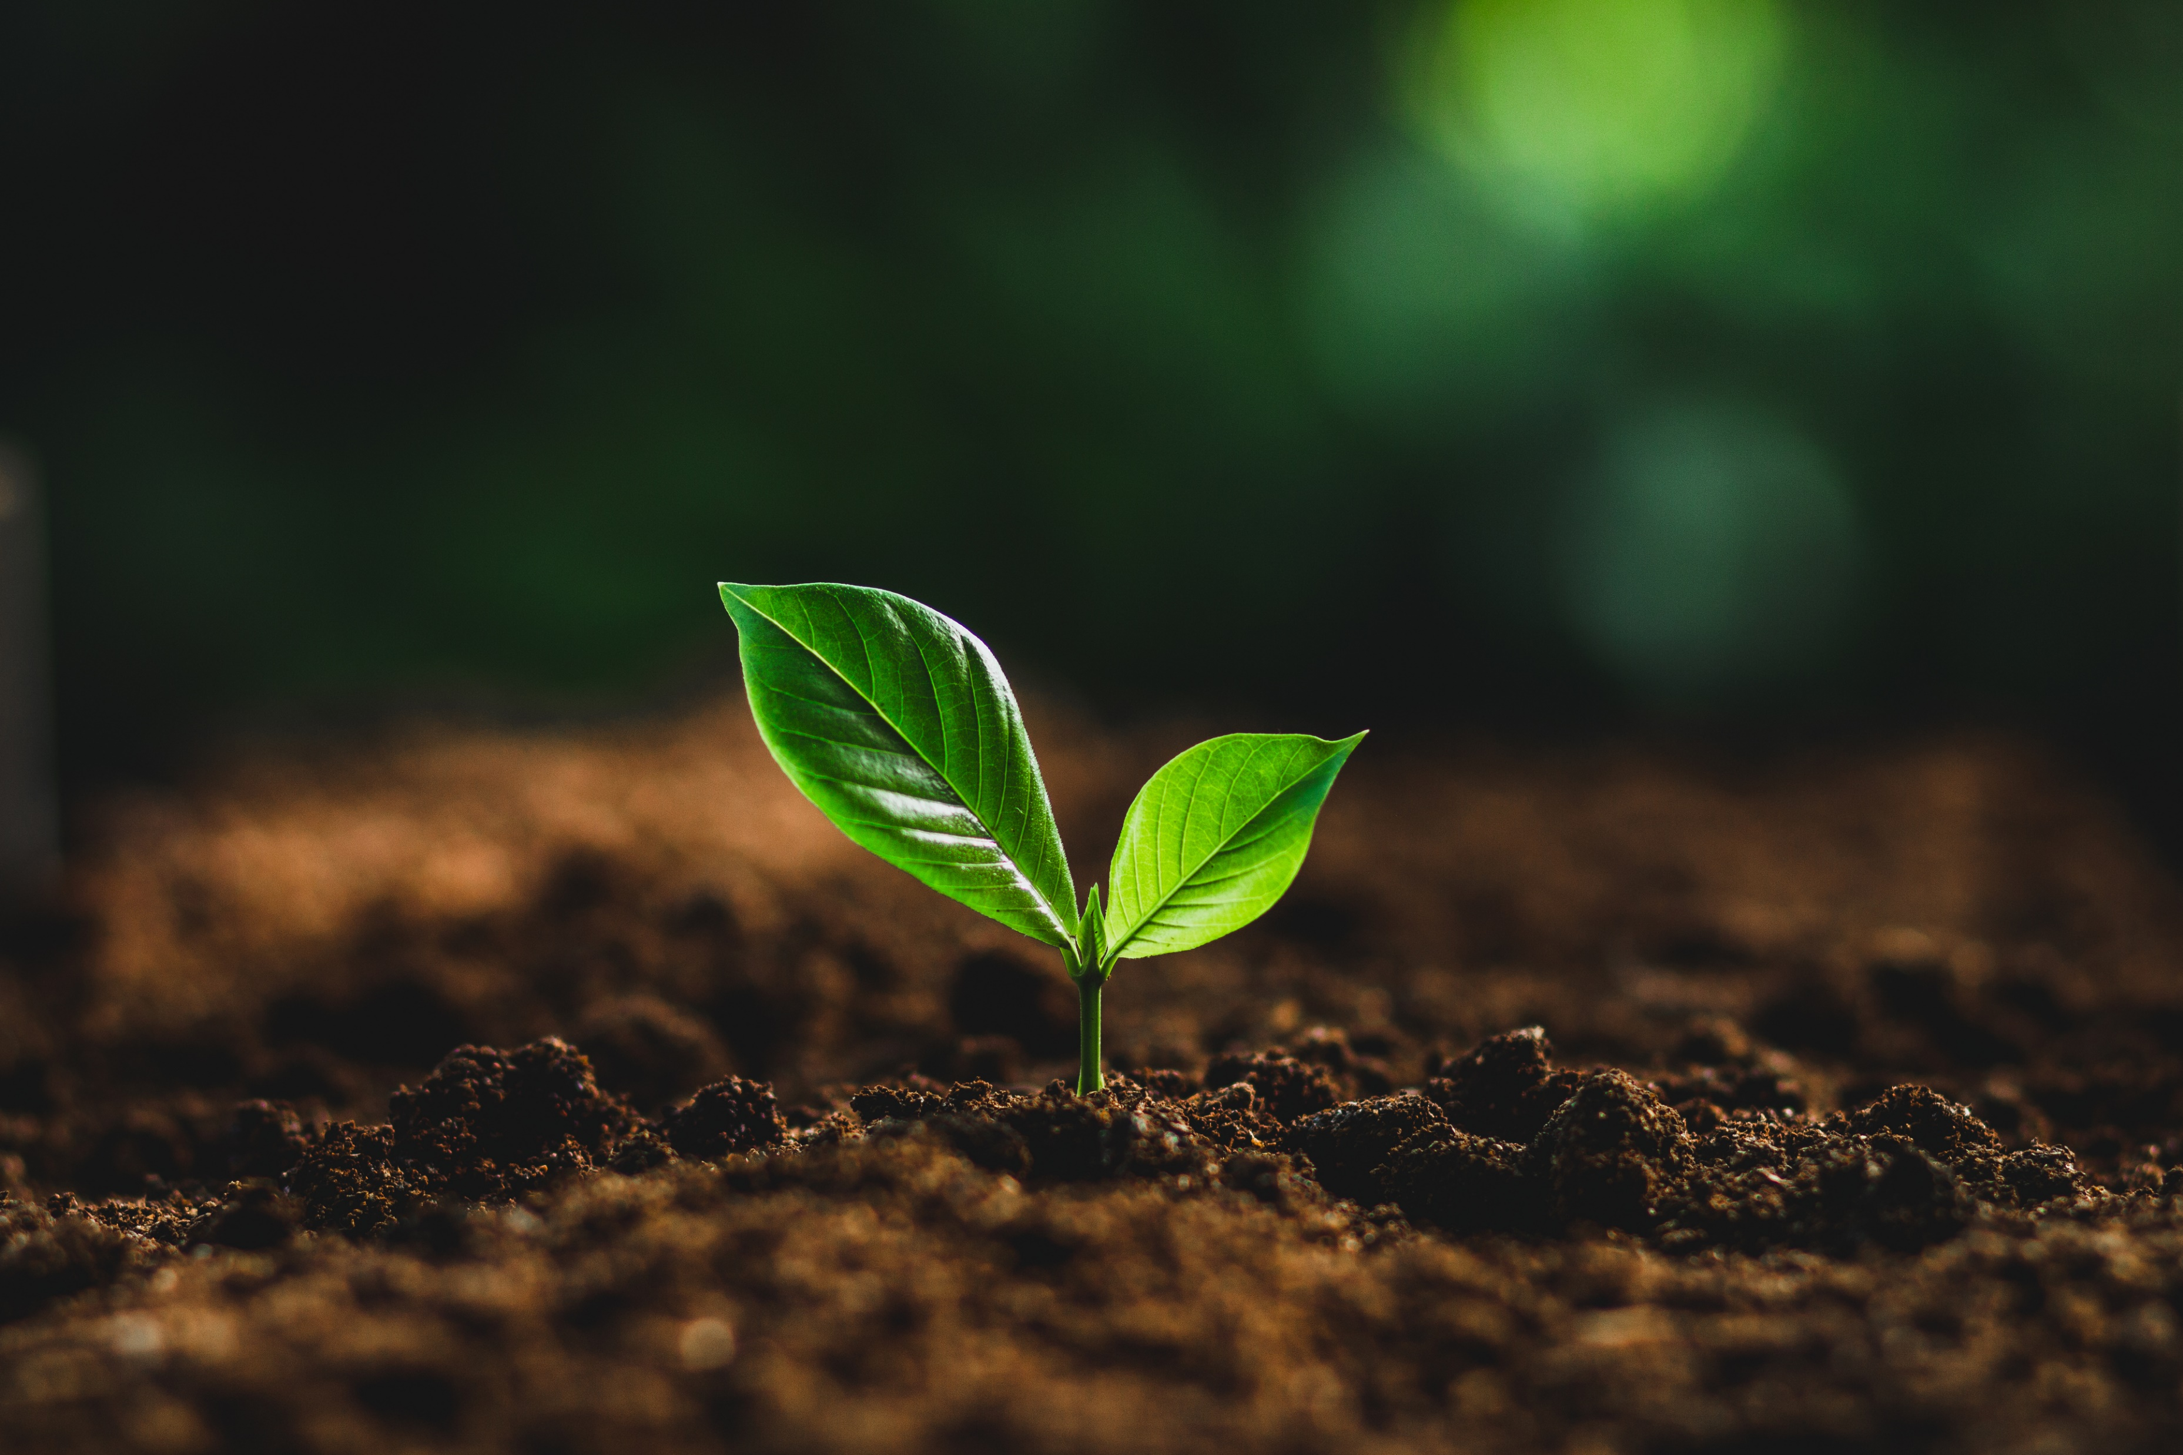
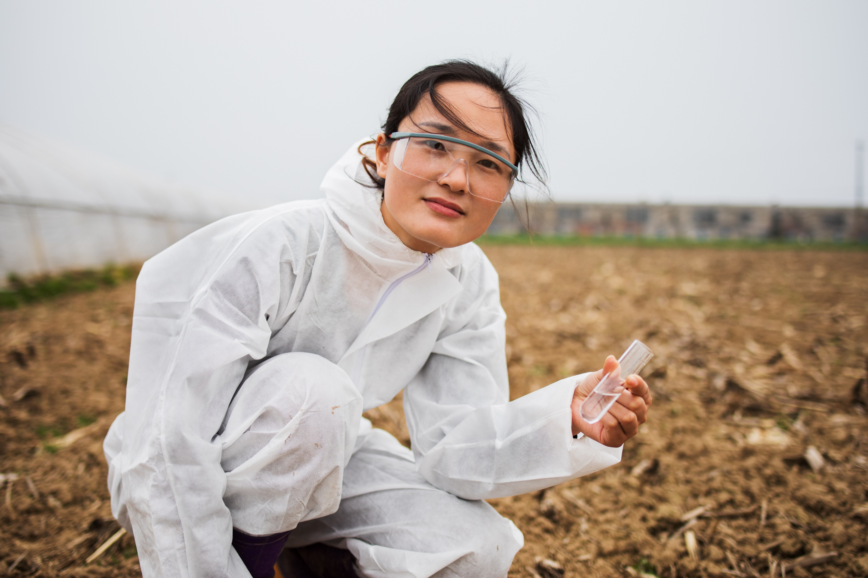
What is Agriculture?
There are three parts to farming:
1. Looking after the soil
Notes:
Another word for agriculture is farming
Discuss why soil health is really important.
Healthy soil enables us to grow plants.

Slide 4
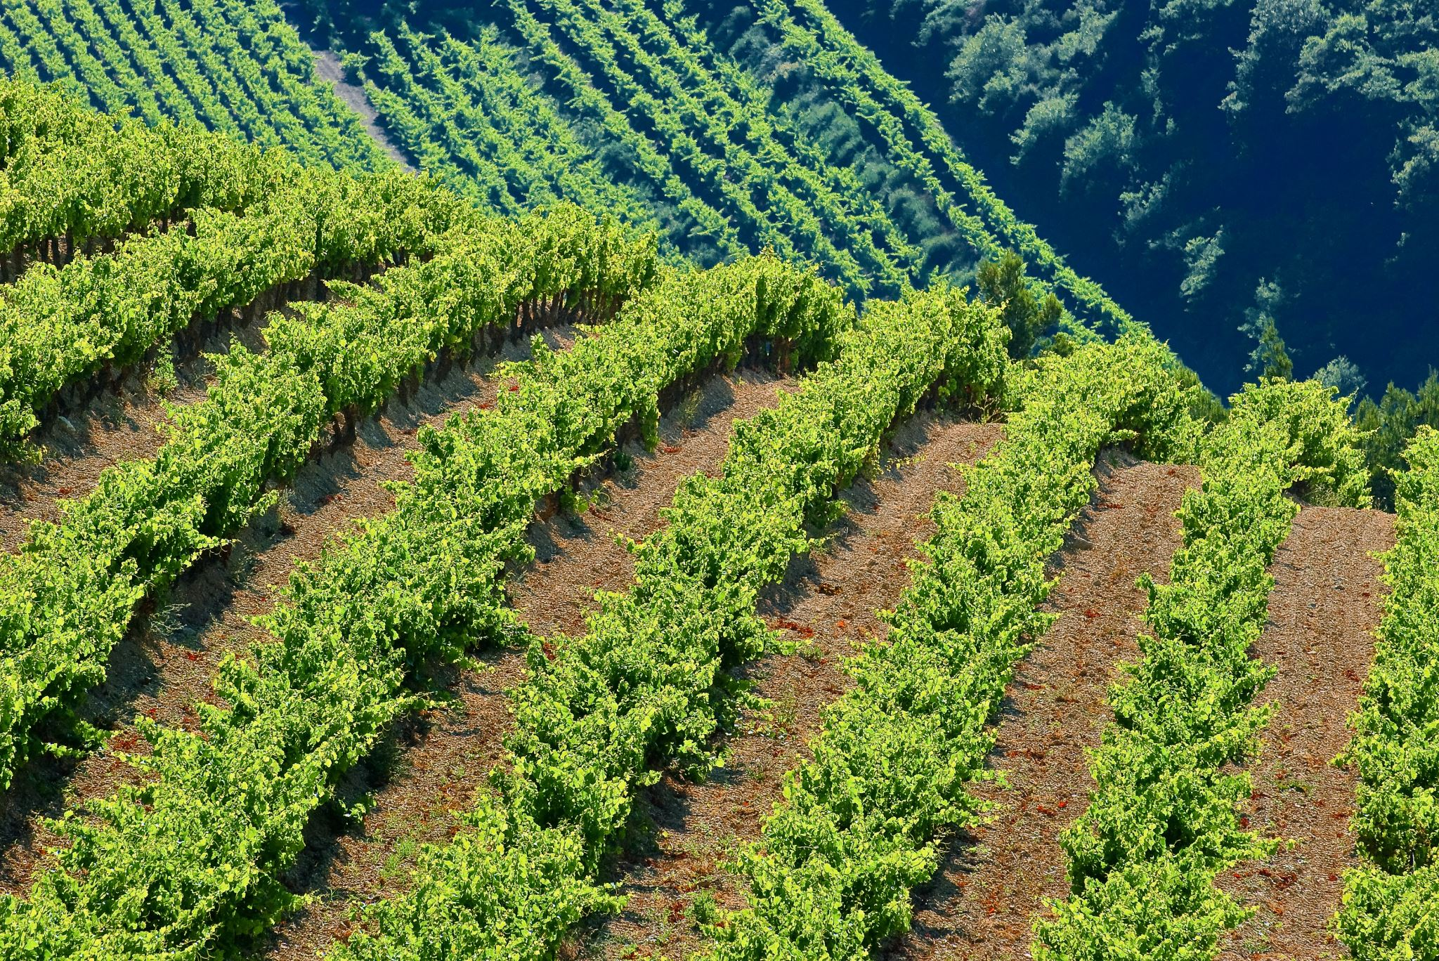
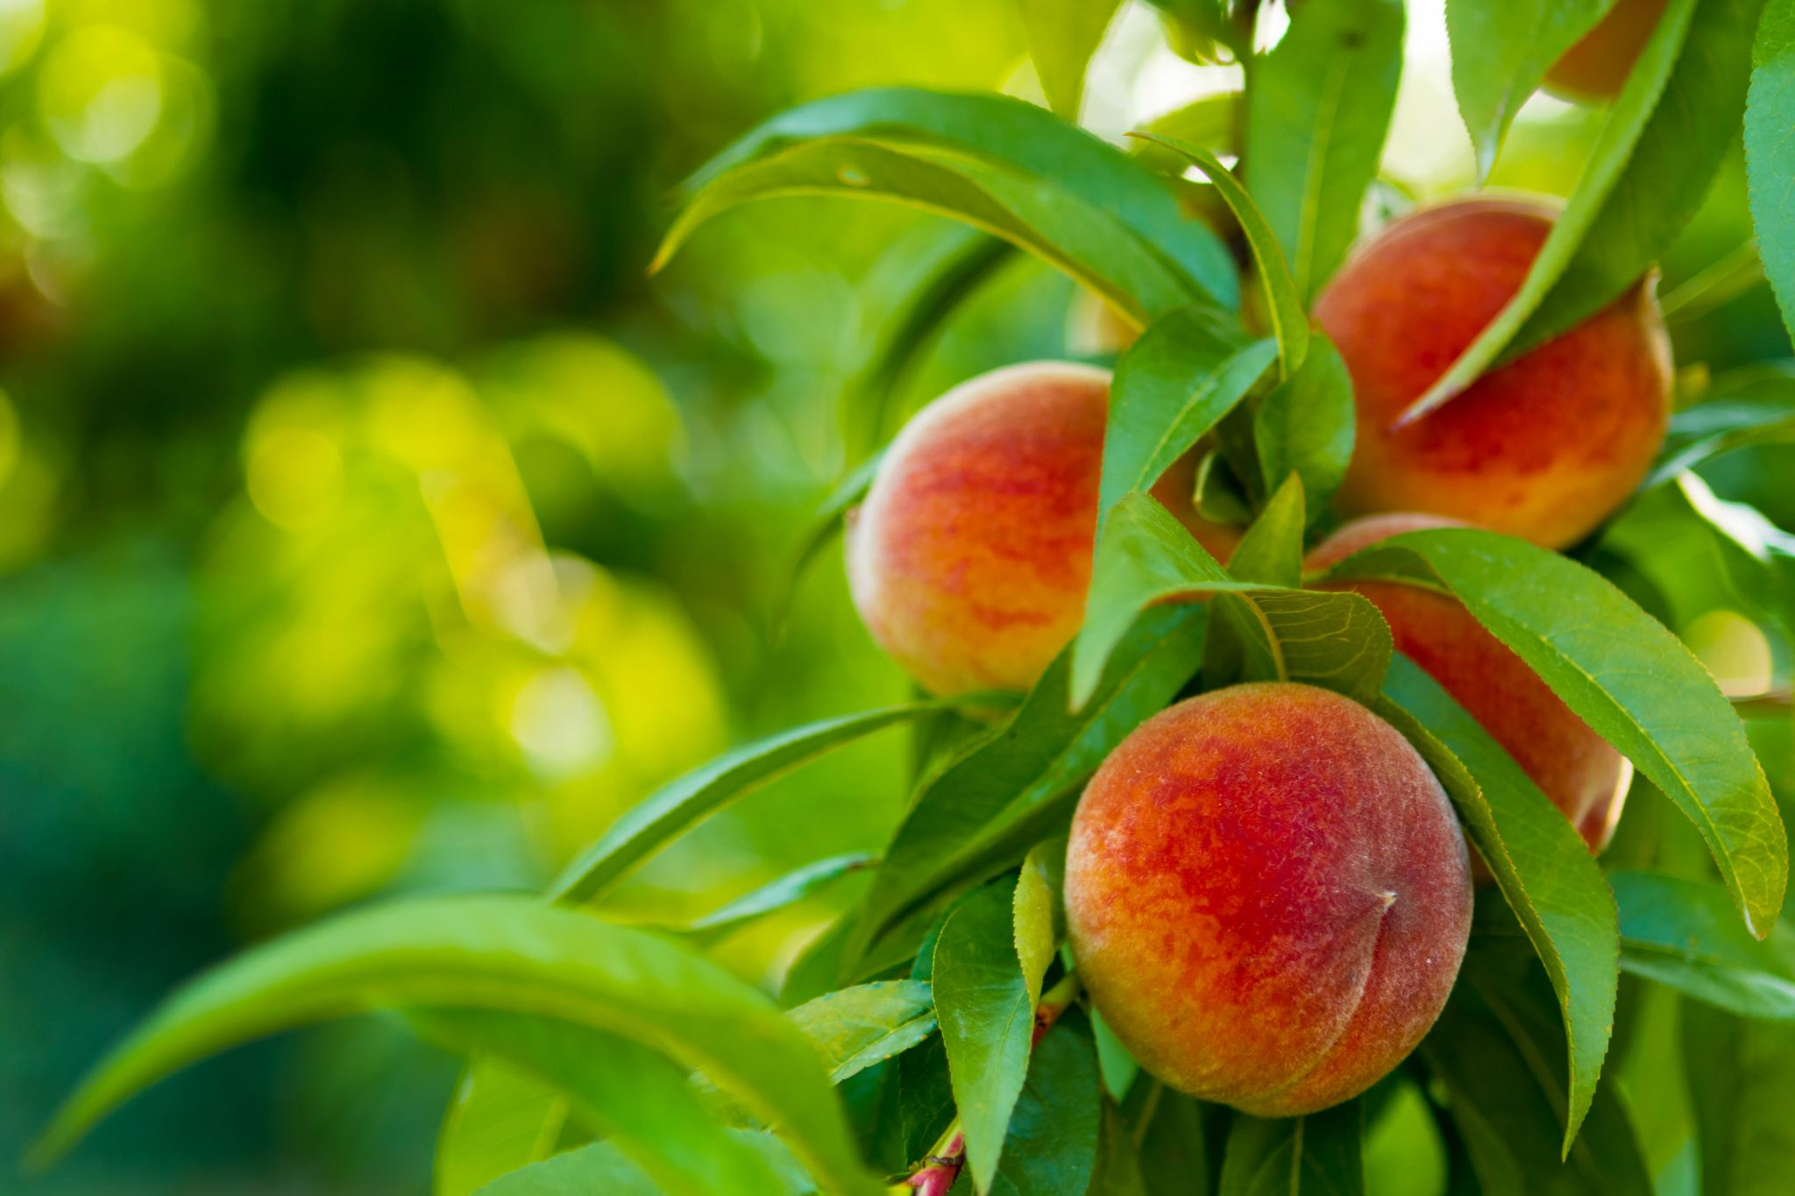
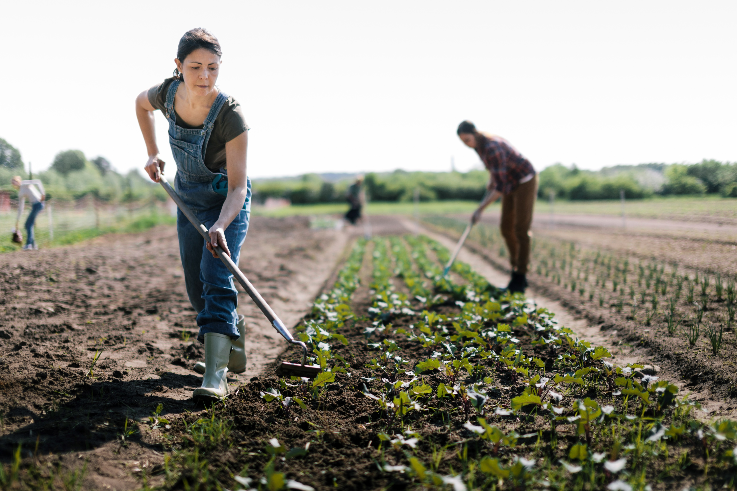
What is Agriculture?
There are three parts to farming:
2. Growing crops
Notes:
Discuss what a crop is.
Crops are living plants grown by farmers. Most crops are foods such as grain, vegetables, or fruit. Some crops are for medicines or fibers such as cotton, or other materials such as rubber or wood.

Slide 5
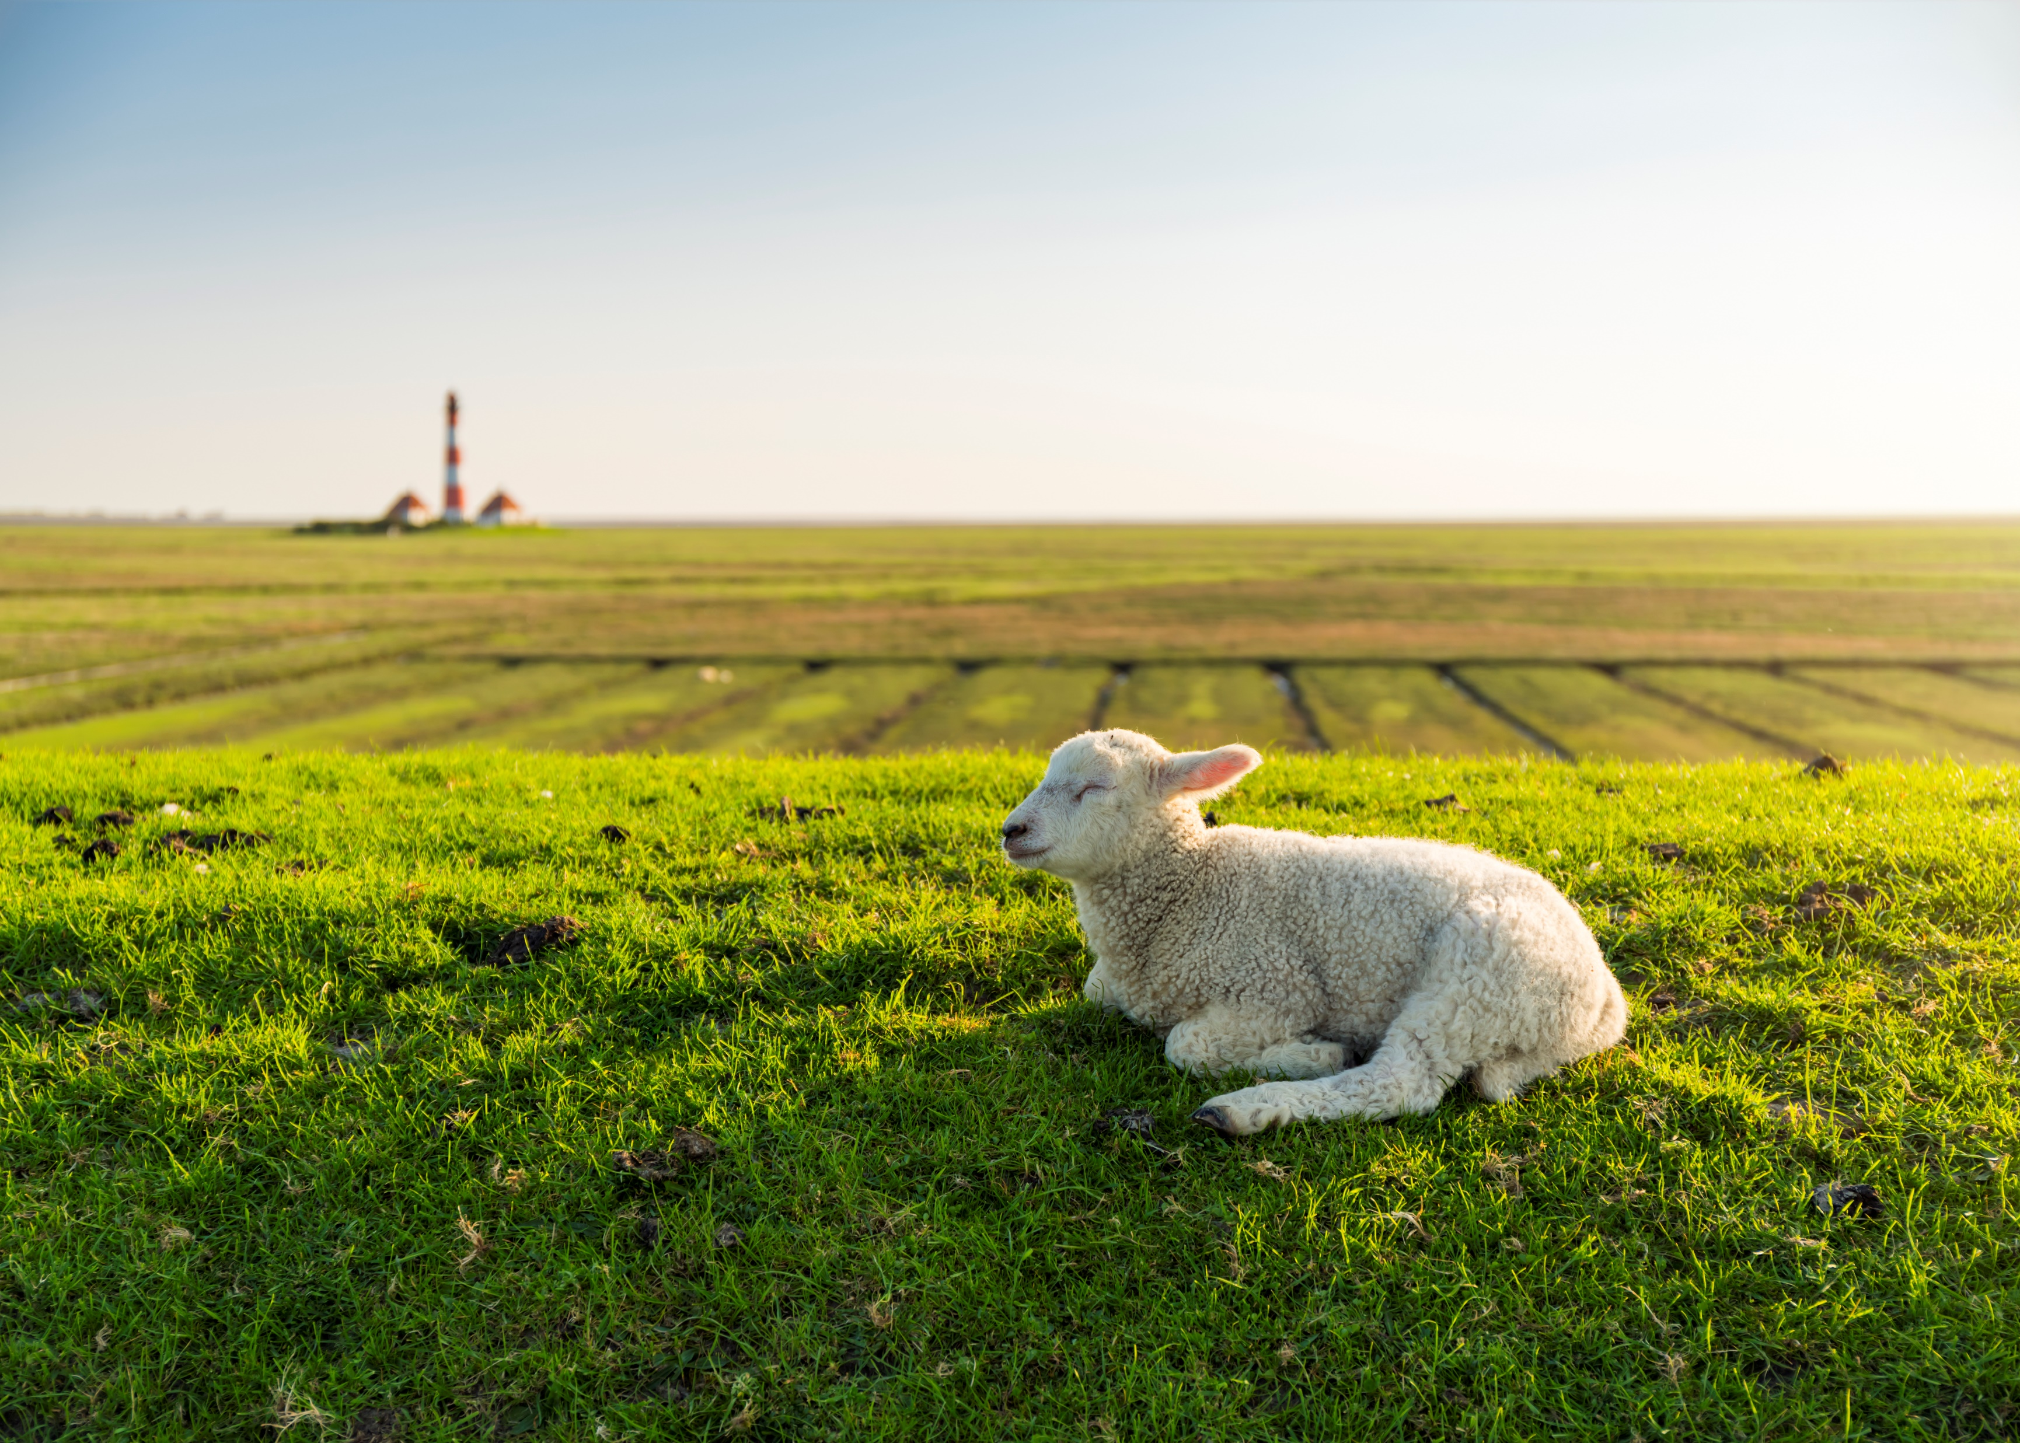
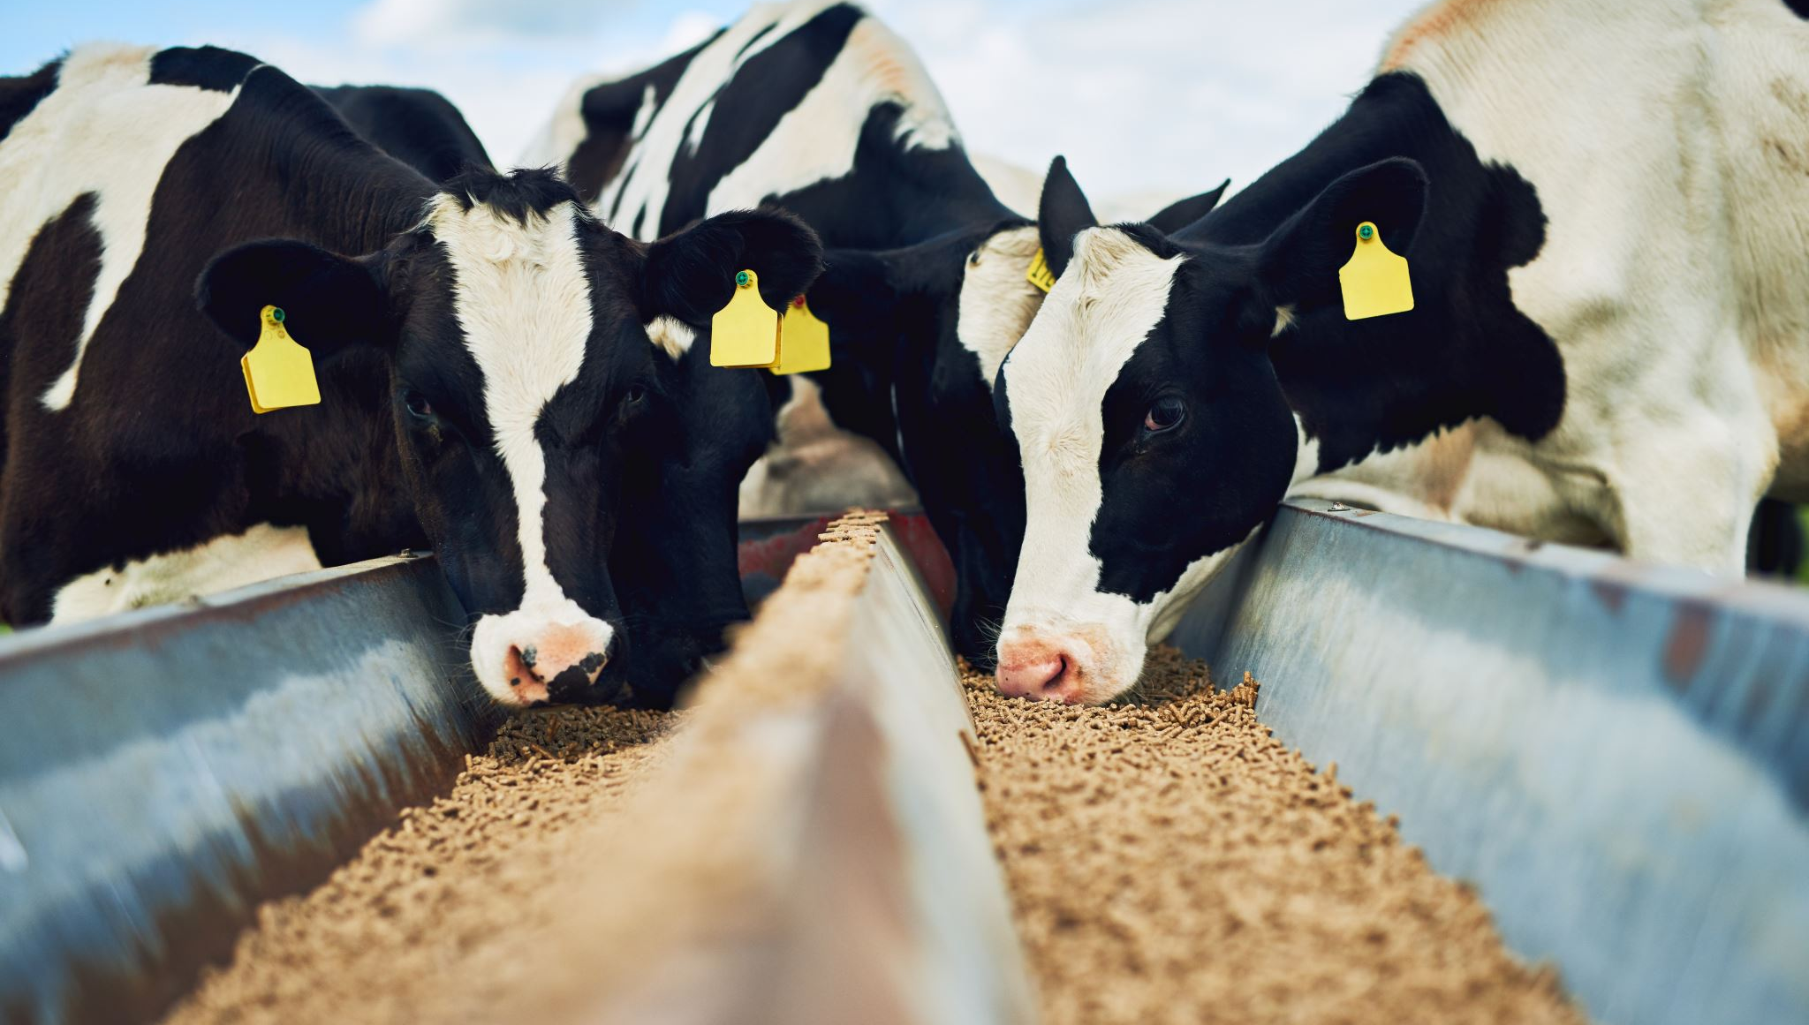
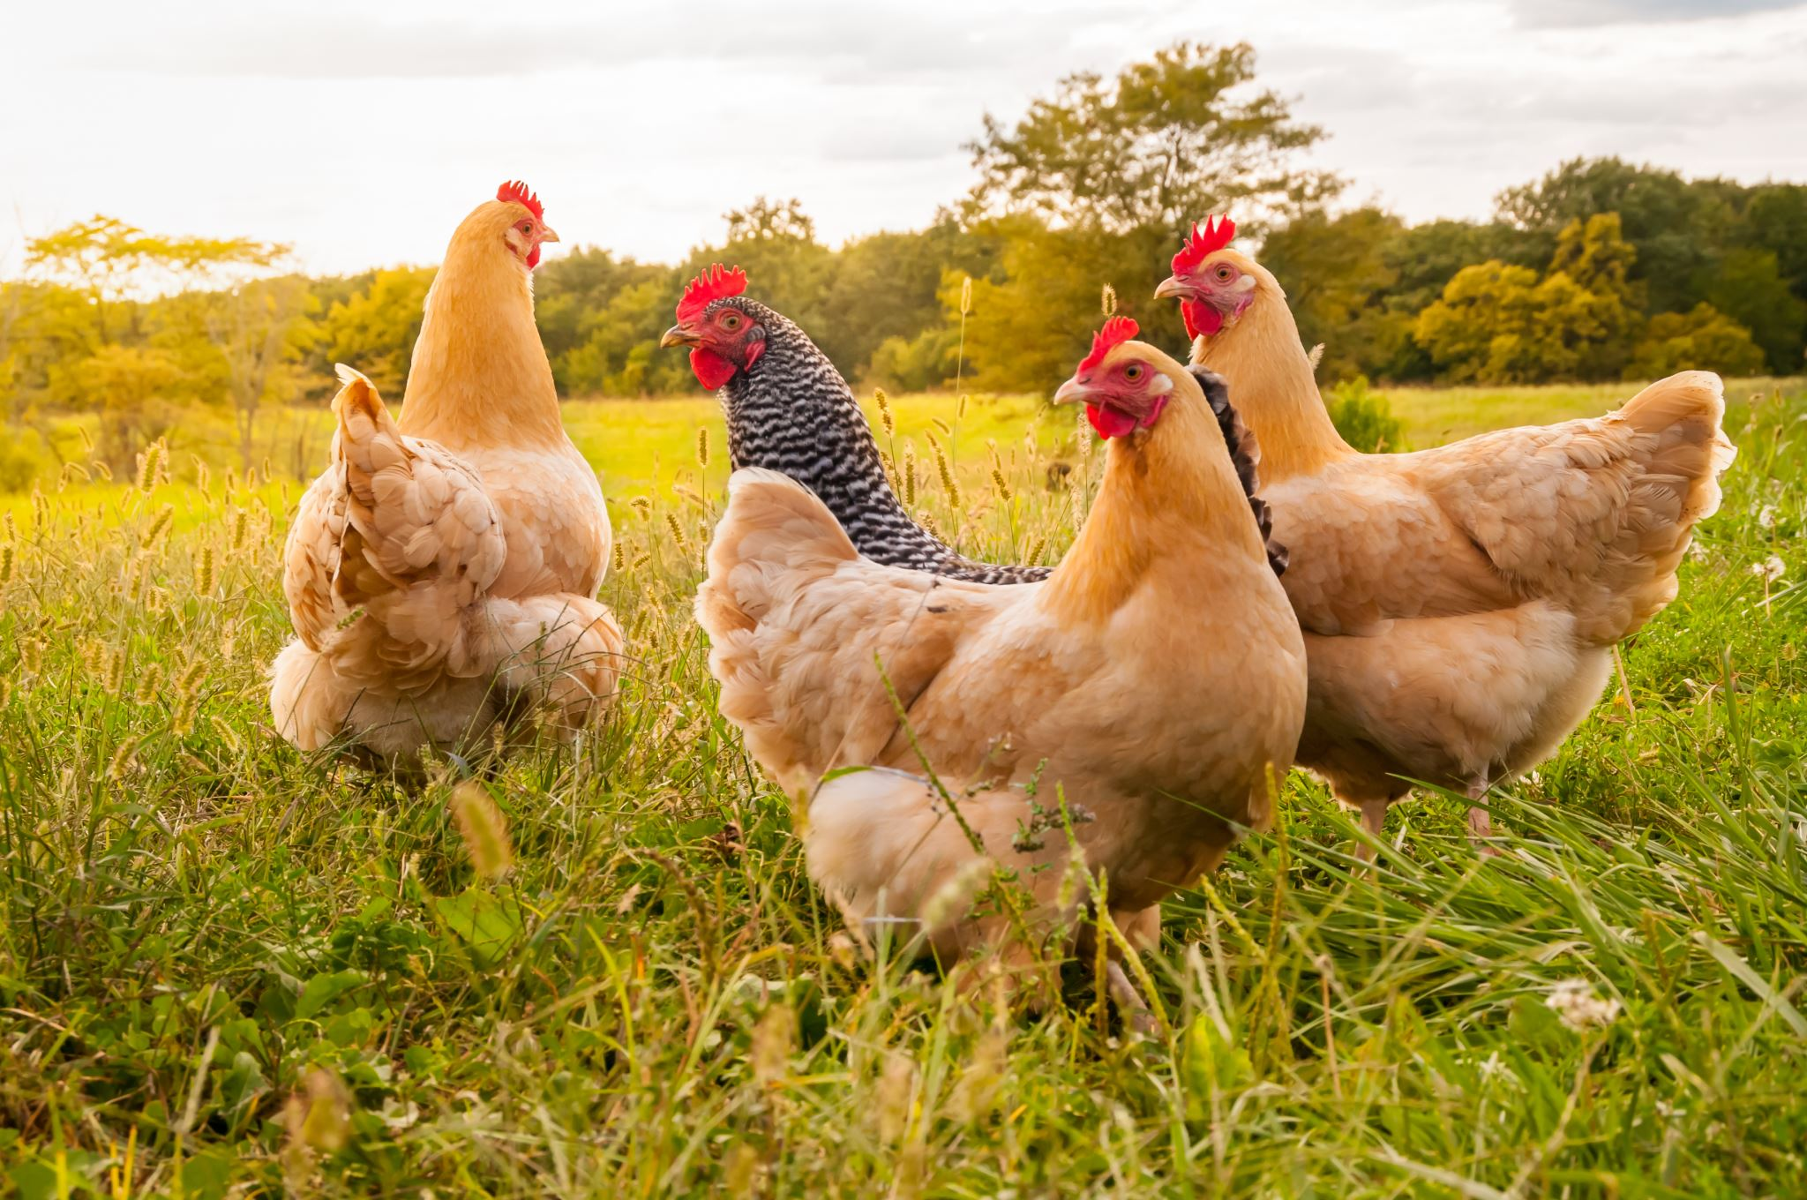
What is Agriculture?
There are three parts to farming:
3. Raising livestock
Notes:
Discuss what livestock is.
Livestock are domestic animals that are kept by people for purposes including meat, milking, wool, leather, or labor.
Taking care of livestock is animal husbandry.
Some types of livestock are: cattle, pigs, sheep, goats, and chickens. Chickens produce eggs; pigs produce meat; cattle, goats and sheep create milk, and sheep also create wool. Horses, cattle, and other large animals do work for people, such as pulling wagons and other vehicles.

Slide 6
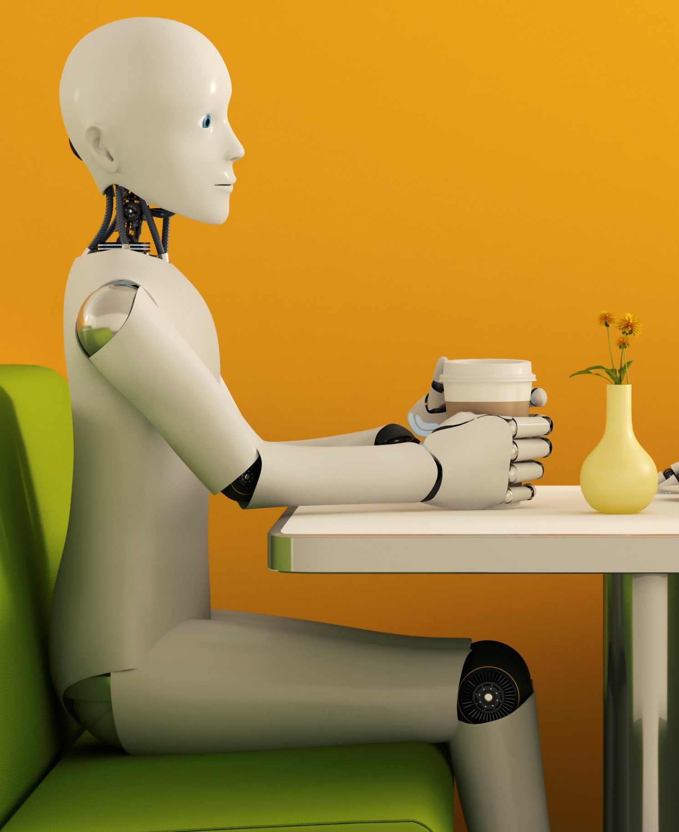
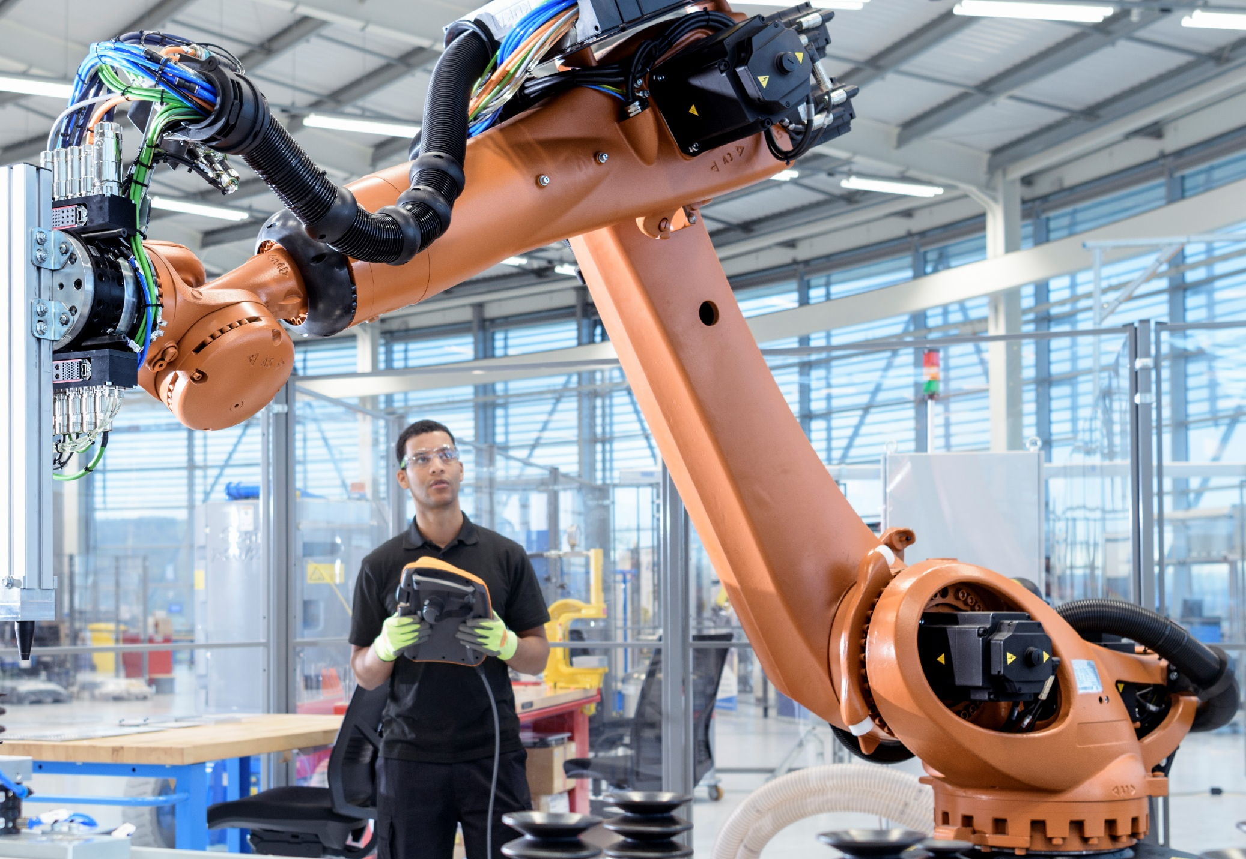
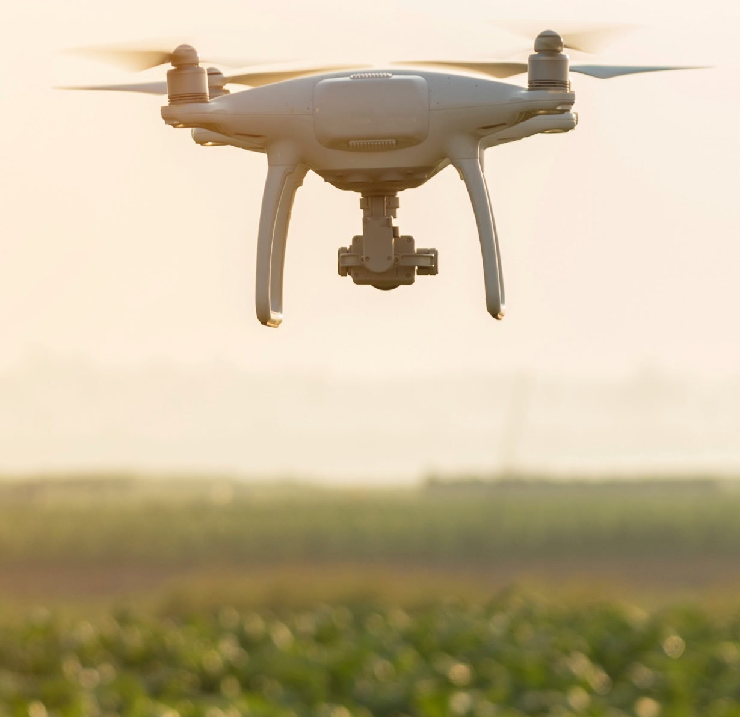

What is Technology?
Using knowledge to invent new devices or tools
What is Artificial Intelligence (AI)?
Computer systems able to perform tasks that humans normally do
Notes:
Before watching the video: introduce some of the vocabulary featured in the video

Slide 7
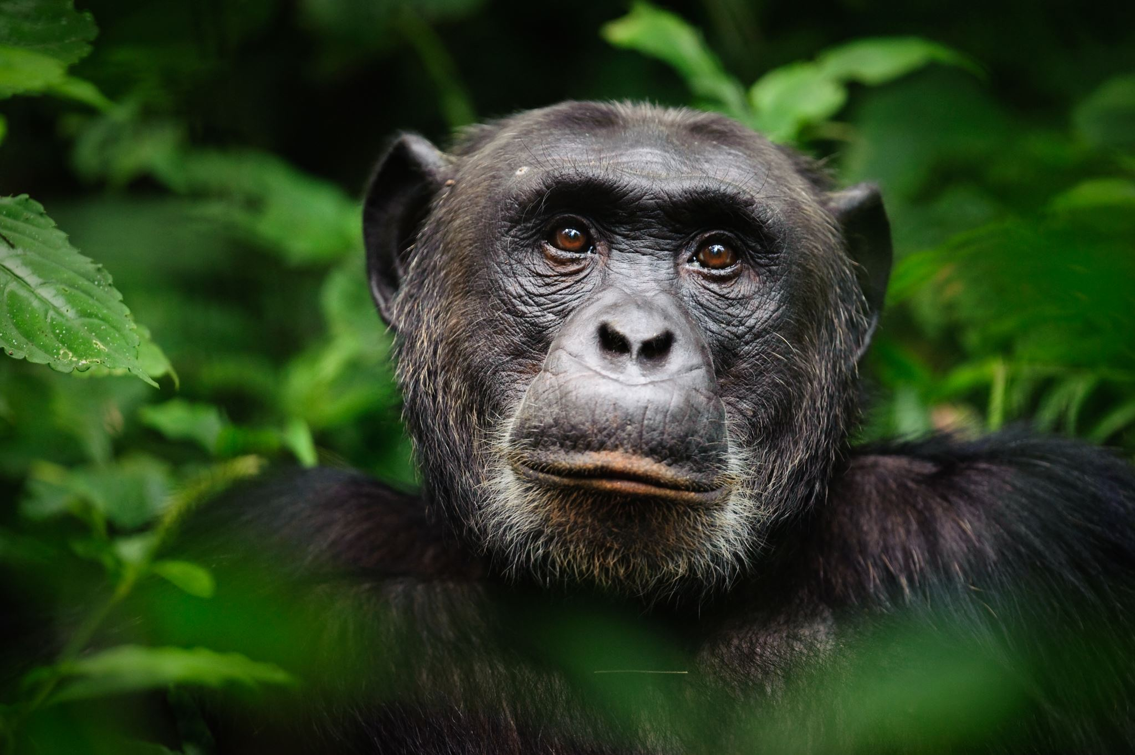
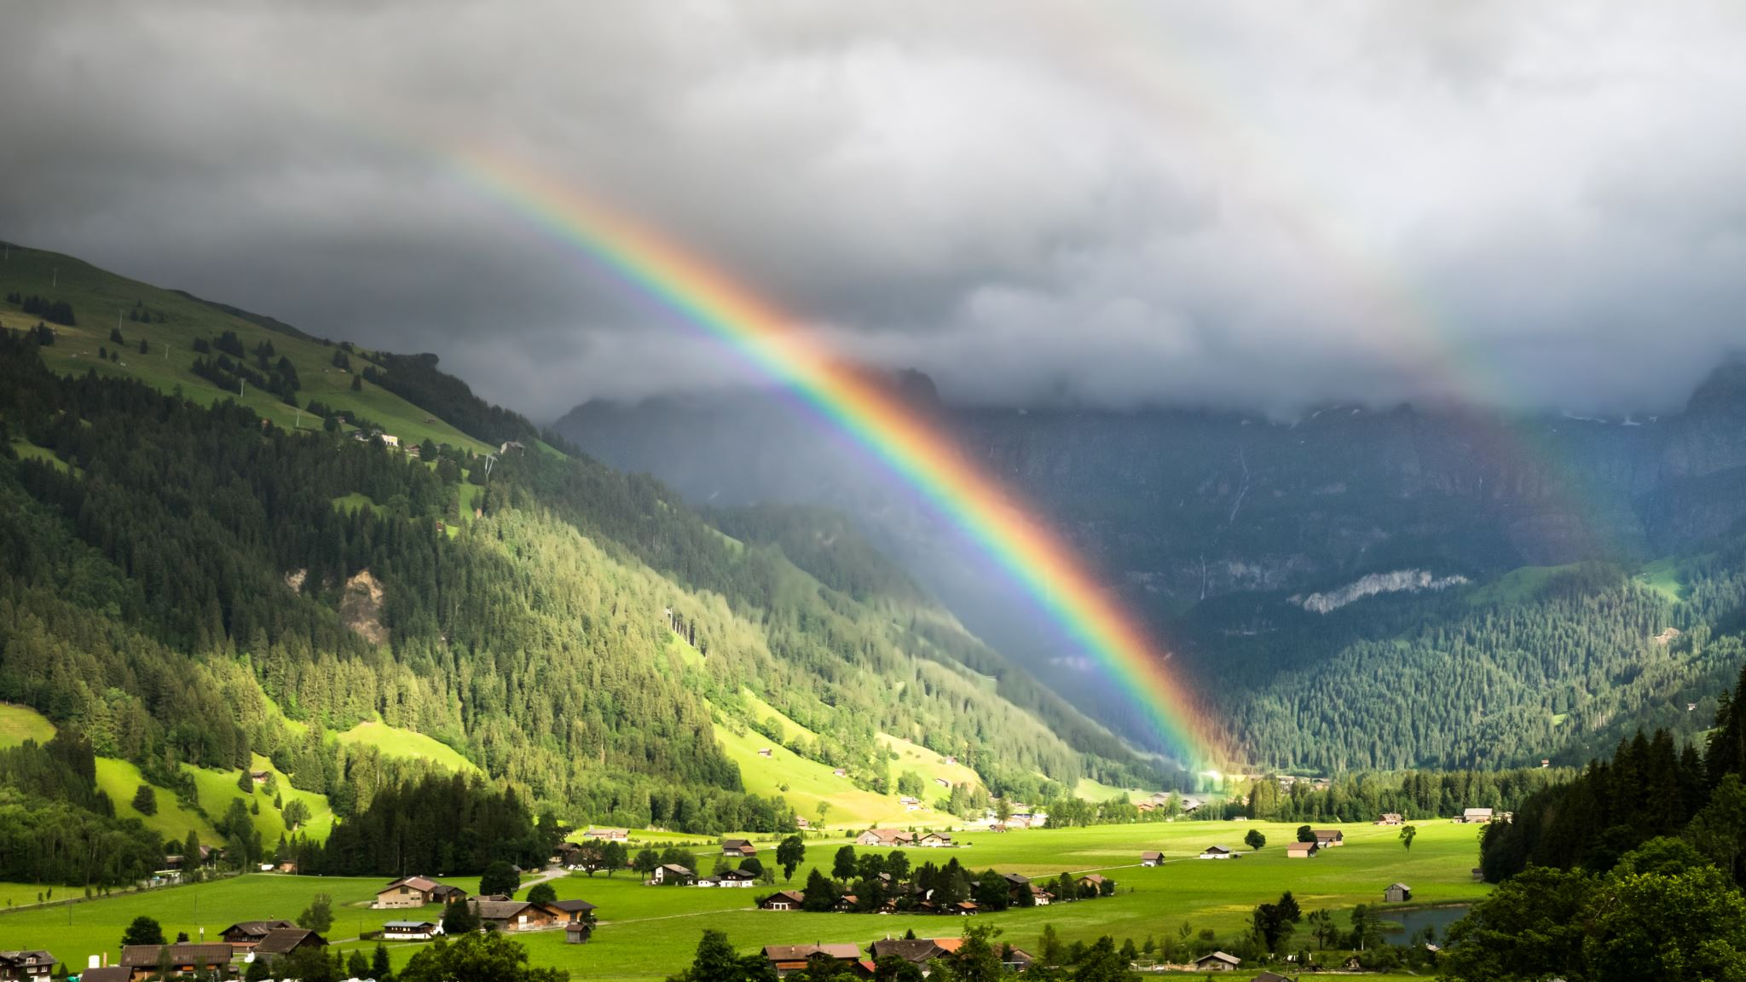
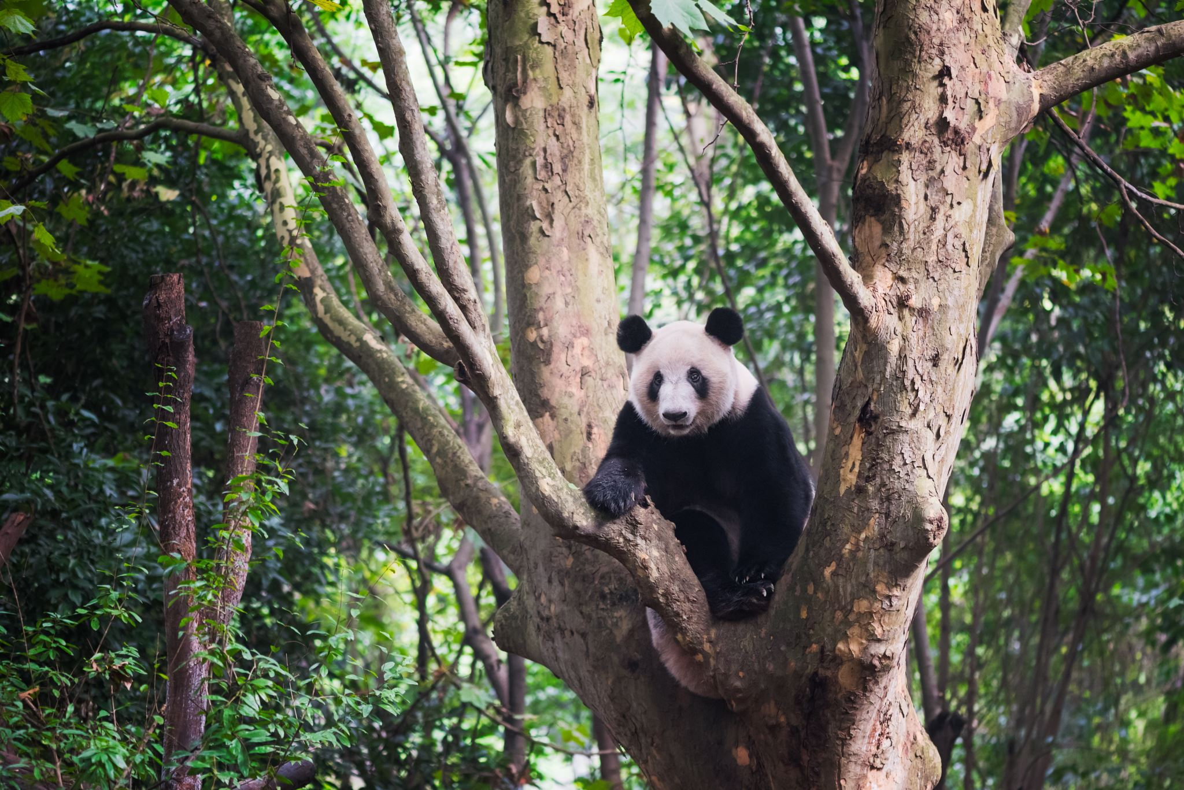
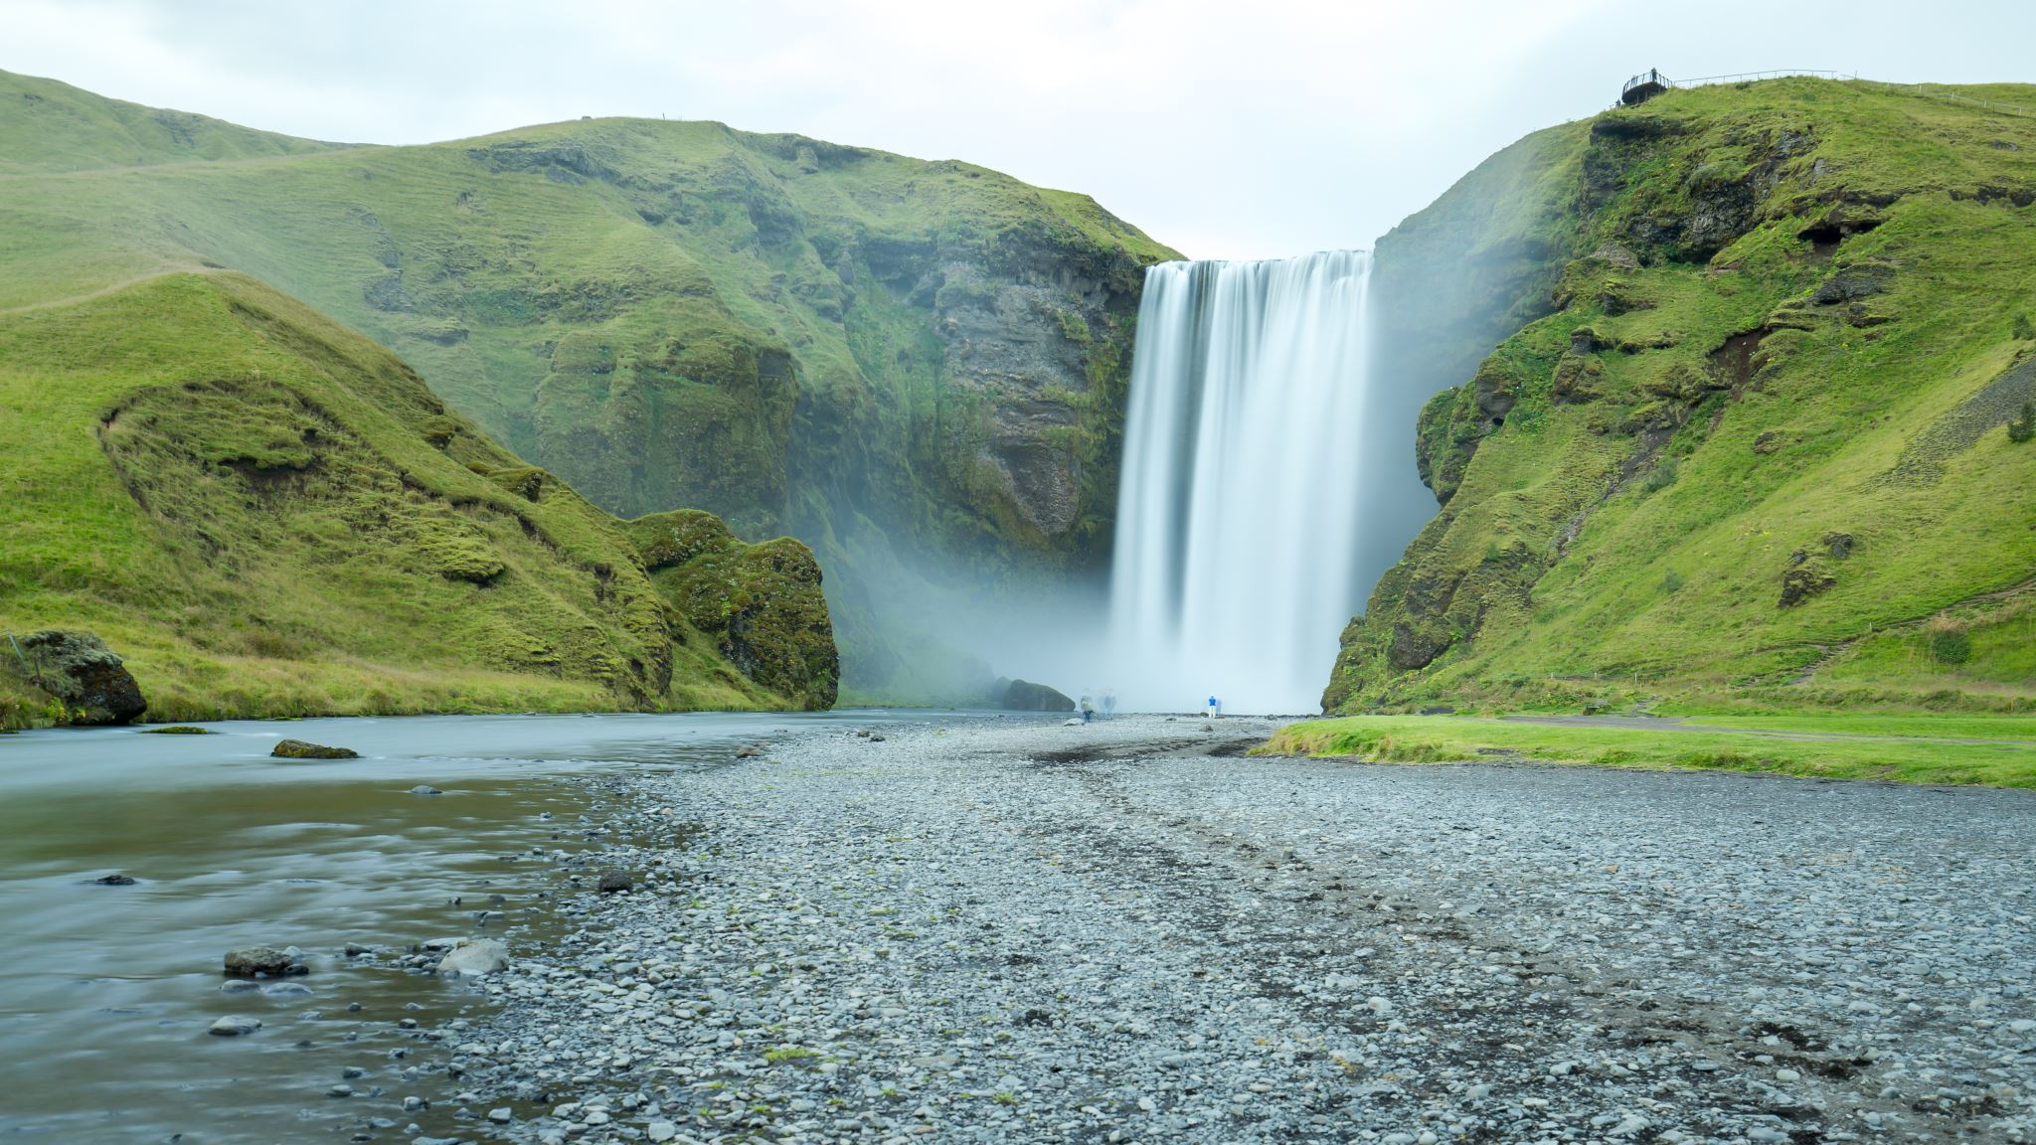
What does sustainable mean?
We use the term ‘sustainable’ to describe the way we use natural resources when this use is kept at a steady level that is not likely to damage the environment.
Notes:
Before watching the video: introduce some of the vocabulary featured in the video

Slide 8
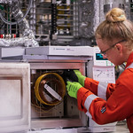
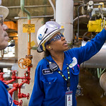

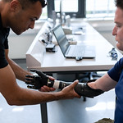
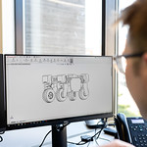
What is an Engineer?
A person who designs, builds, or repairs engines, machines, or structures
Images courtesy of This Is Engineering
Notes:
Before watching the video: introduce some of the vocabulary featured in the video

Slide 9
Look around the room…..
Images courtesy of This Is Engineering
Can you see 3 things that engineers might have made or might be responsible for?
Notes:
Ask children to look around the room and come up with 3 things that engineers might have made or might be responsible for.
The answer is that everything apart from the living things in the room will most likely have needed an engineer to help create them.

Slide 10
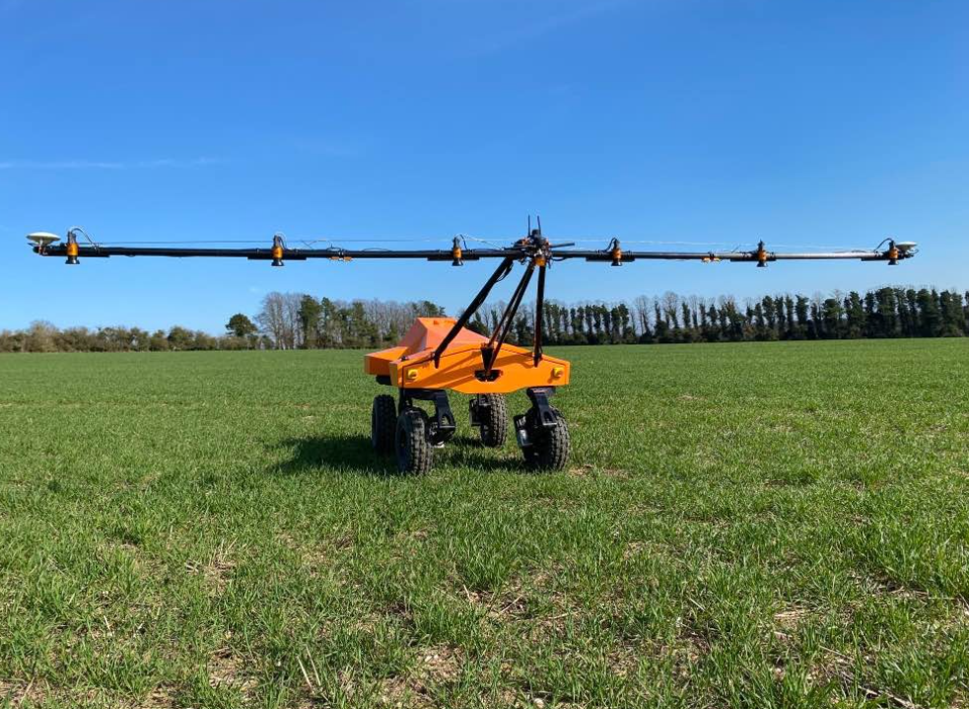

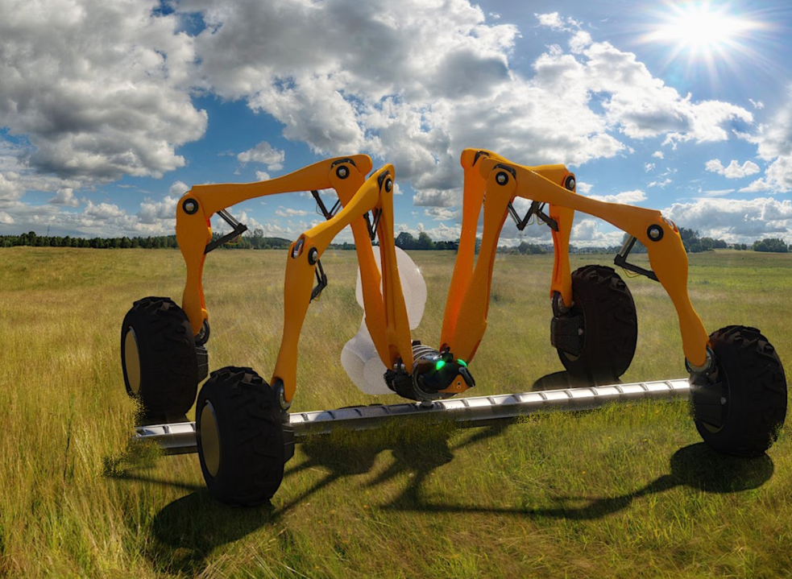
What is Agri-tech?
Agri-tech is using technology for farming to increase the amount of food we are able to produce.
Notes:
We will find out more about Agri-tech in the video

Slide 11
What is a billion?
A very large number with 9 zeros.
1,000,000,000
It is one thousand million.
Notes:
Before watching the video: introduce some of the vocabulary featured in the video

Slide 12
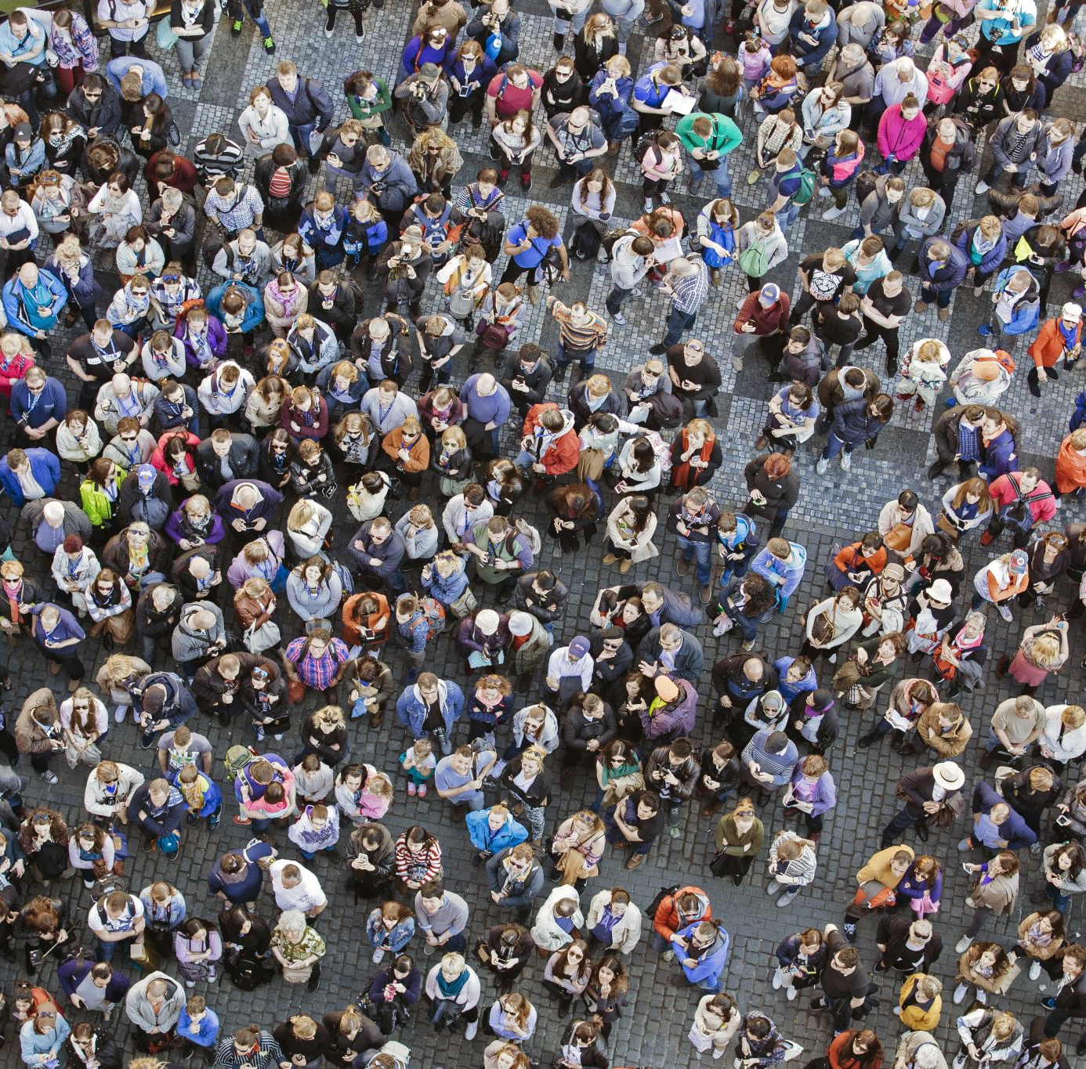
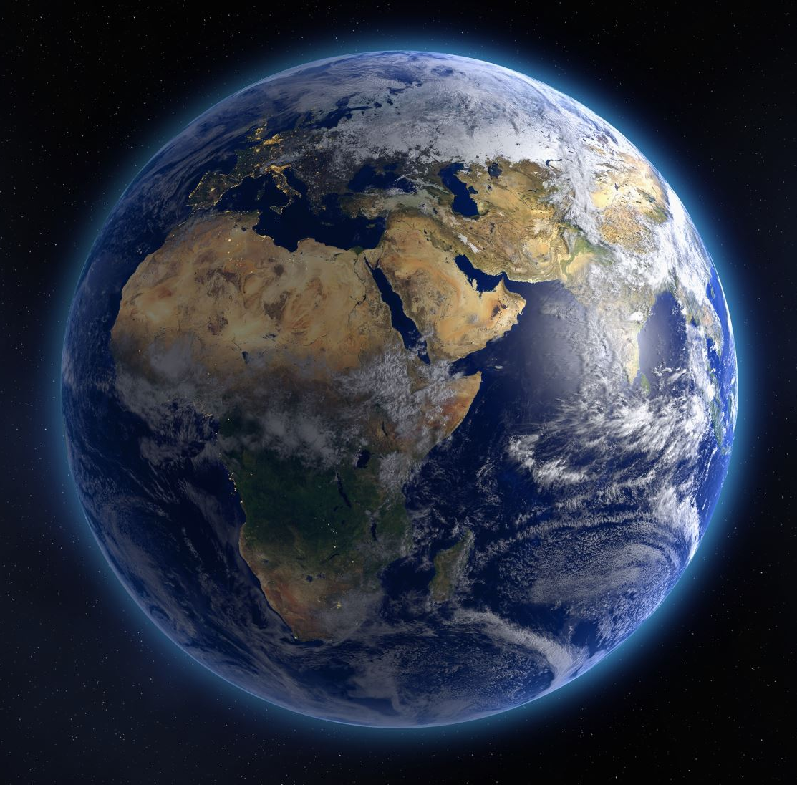

There are 7.8 billion people on our planet
7,800,000,000
Notes:
Before watching the video: introduce some of the vocabulary featured in the video

Slide 13
Let’s take a look and see how people who work in Agri-tech are helping farmer’s to feed 7.8 BILLION PEOPLE EVERYDAY !
VIDEO
Notes:
St

Slide 14

What do we know now?
Let’s do a quiz to see what we’ve remembered!

Slide 15



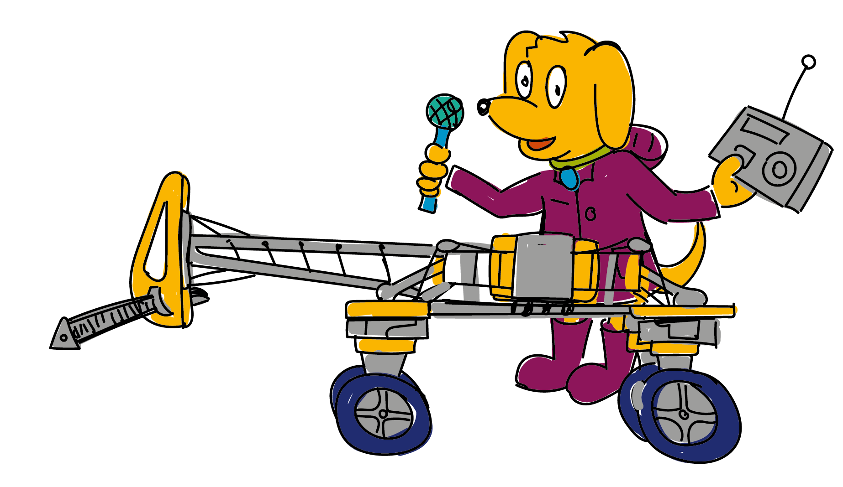
Question 1
Which animal is important for the health of the soil?
Worm
Ladybird
C. Mouse

Slide 16



Question 2
How can small robots kill weeds in the field?
Cut them down
Zap them with electricity
C. Spray them with a chemical

Slide 17
Question 3
How many people need feeding in the world every day?
100 million
5 billion
C. 7.8 billion

Slide 18


Question 4
Technology is helping farming become kinder to the environment?
True
False
Notes:
Answer: Wind turbines

Slide 19
Question 5
With help from small robots how much less energy is used to grow a crop?
10%
50%
C. 90%

Slide 20
Question 1
Which animal is important for the health of the soil?
Worm
Worm
Ladybird
C. Mouse

Slide 21
Question 2
How can small robots kill weeds in the field?
B. Zap them with electricity
Cut them down
Zap them with electricity
C. Spray them with a chemical

Slide 22
Question 3
How many people need feeding in the world every day?
7,800,000,000
C. 7.8 billion
100 million
5 billion
C. 7.8 billion

Slide 23
Question 4
Technology is helping farming become kinder to the environment?
True
True
False
Notes:
Answer: Wind turbines

Slide 24
Question 5
With help from small robots how much less energy is used to grow a crop?
C.90%
10%
50%
C. 90%

Slide 25

Challenge: Design a farming robot
Can you draw a robot to help with the animals on a farm?

Slide 26
Challenge: What job would you enjoy?
Can you choose one of the jobs you have just learnt about and draw a picture of yourself doing this job?
Notes:
There is a printable pupil worksheet called ‘I could be...’ available for this activity.
Additional question on the sheet are:
List the skills you think you would need to do the job.
What would you enjoy most about doing this job?

Slide 27
Goodbye from Bingo!

