Slide 1

HOW DO WE FEED 7.8 BILLION PEOPLE EVERYDAY?

Slide 2
Session Aims:
Learn about how technology is helping to get food from the farm to our table.
Learn what the term Agri-tech means and how people working in Agri-tech can help feed the world.

Slide 3
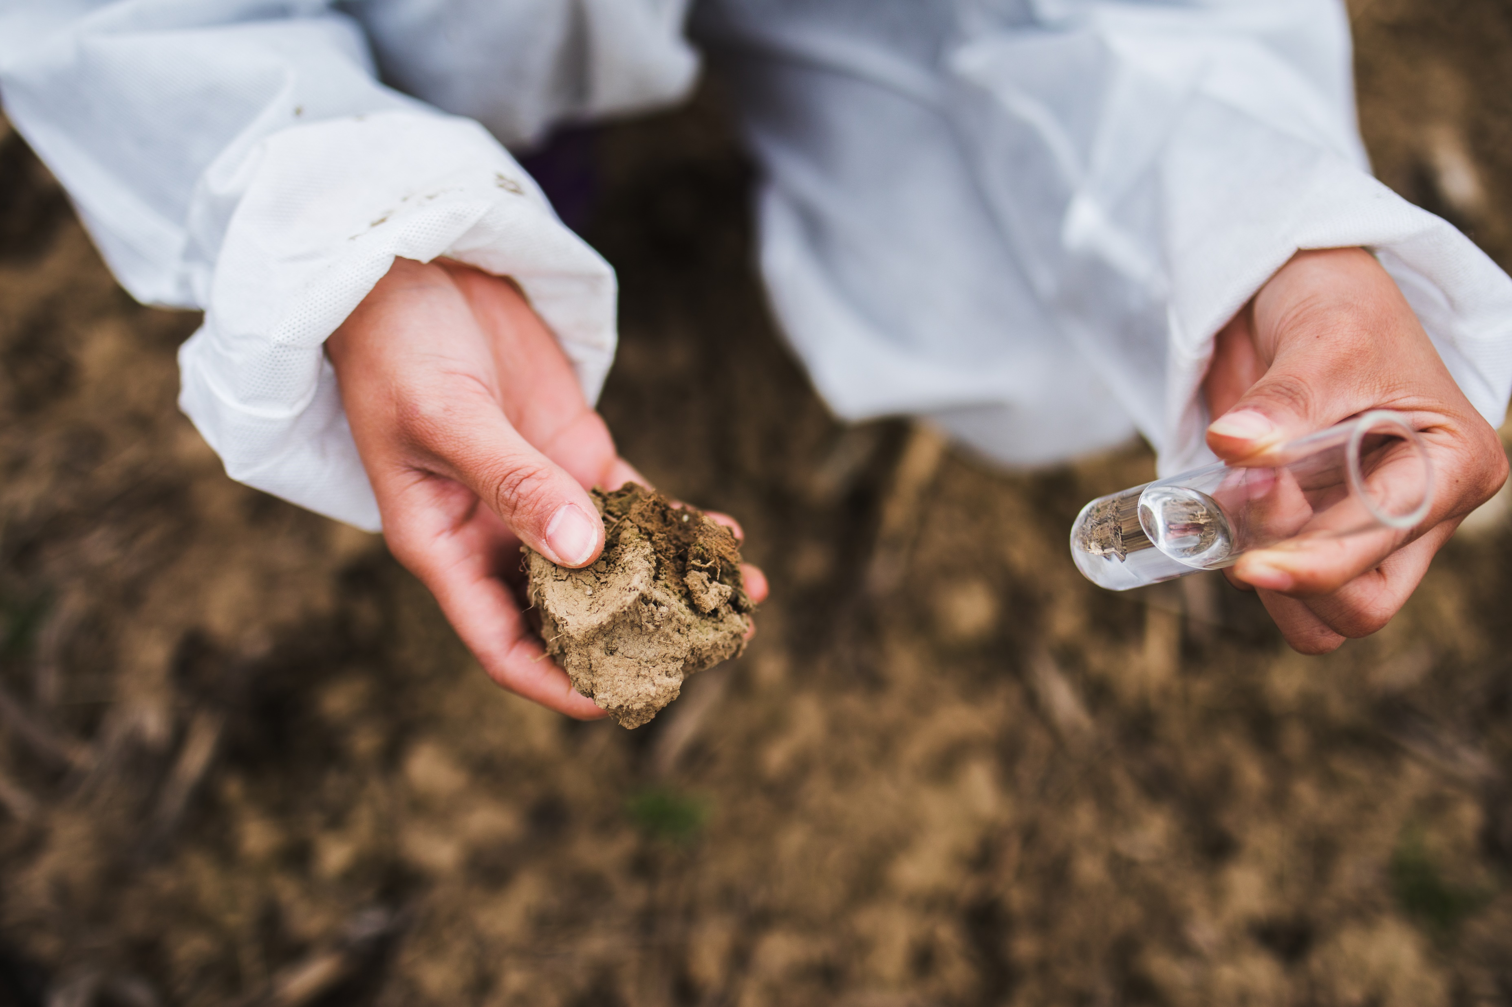
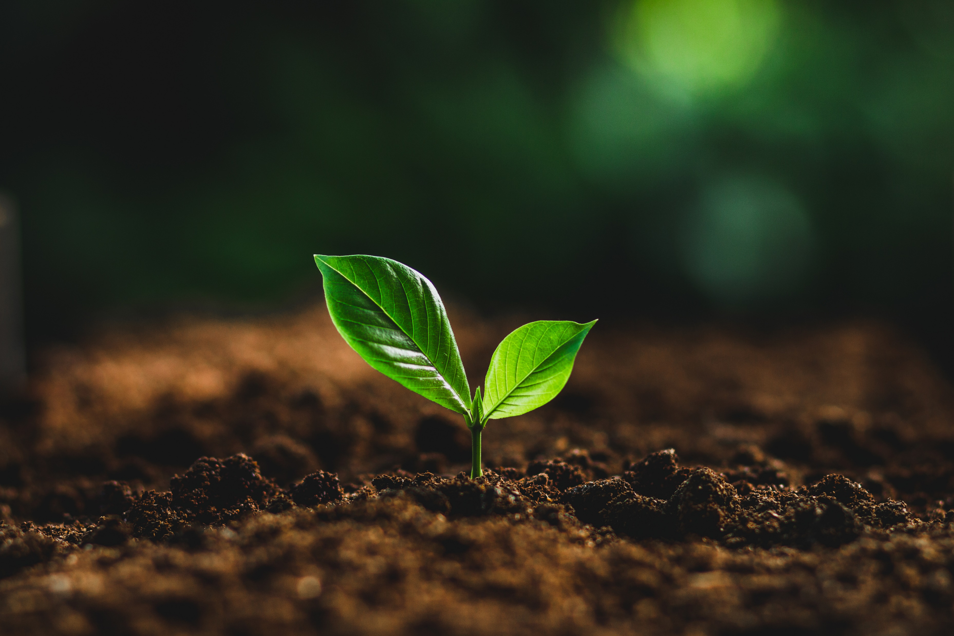
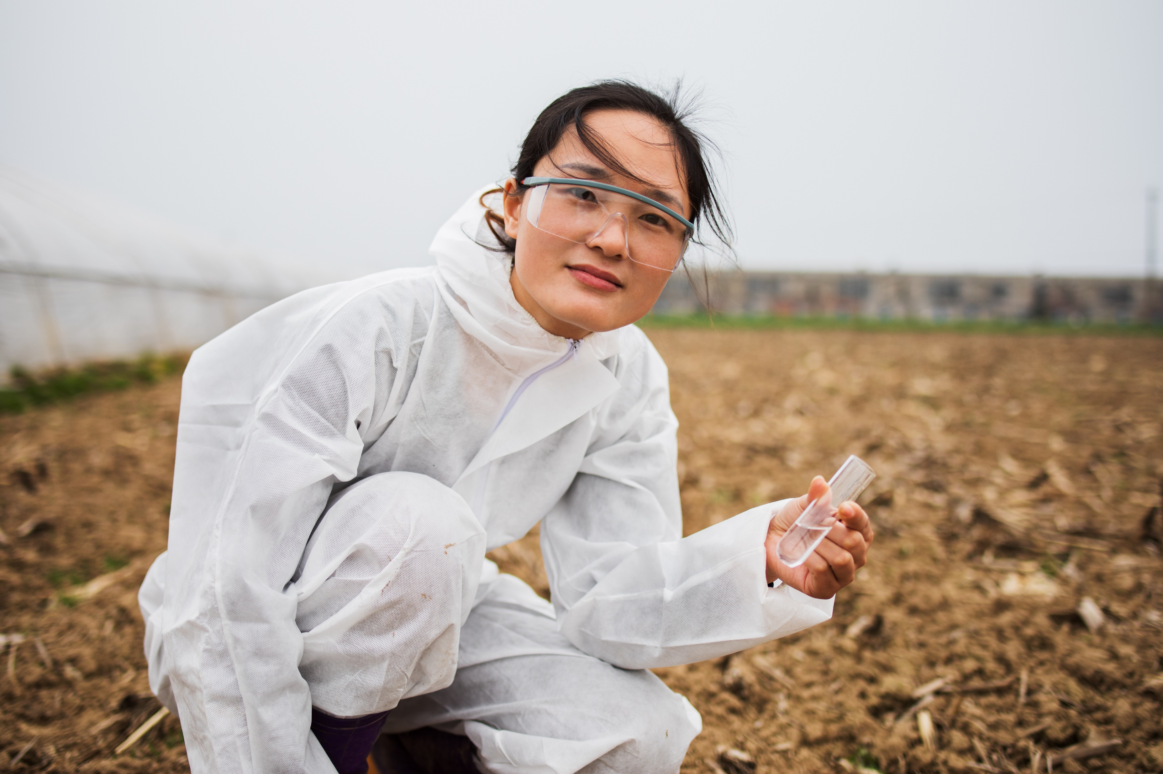
What is Agriculture?
There are three parts to farming:
1. Looking after the soil
Notes:
Another word for agriculture is farming
Discuss why soil health is really important.
Healthy soil enables us to grow plants.

Slide 4
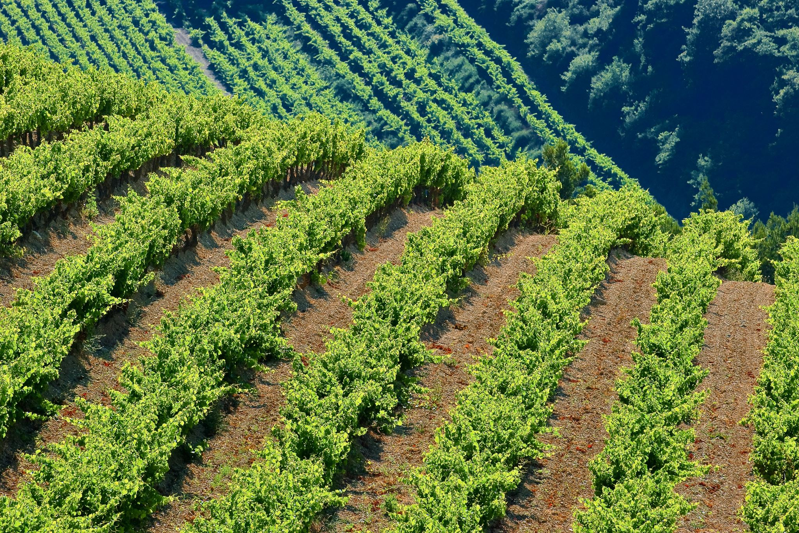
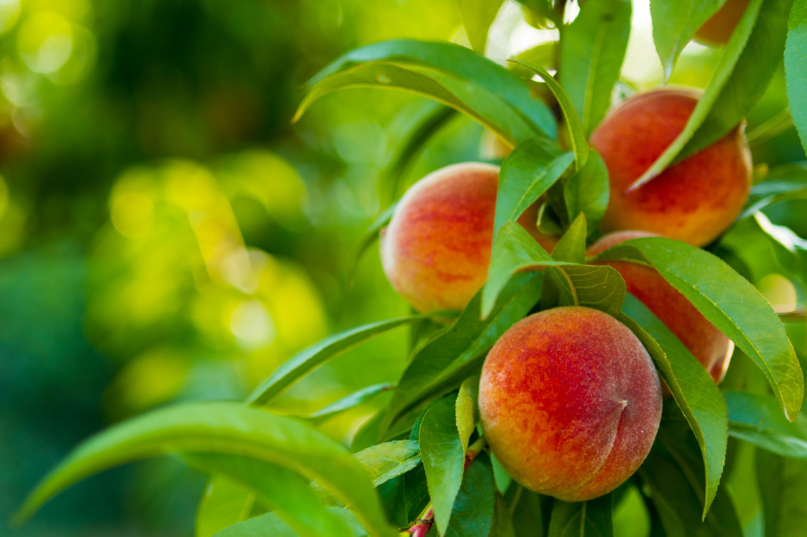
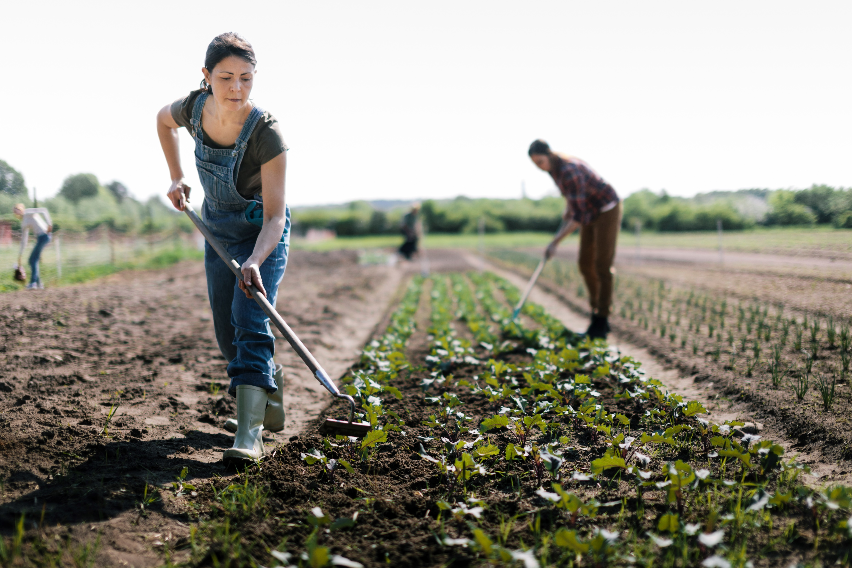
What is Agriculture?
There are three parts to farming:
2. Growing crops
Notes:
Discuss what a crop is.
Crops are living plants grown by farmers. Most crops are foods such as grain, vegetables, or fruit. Some crops are for medicines or fibers such as cotton, or other materials such as rubber or wood.

Slide 5
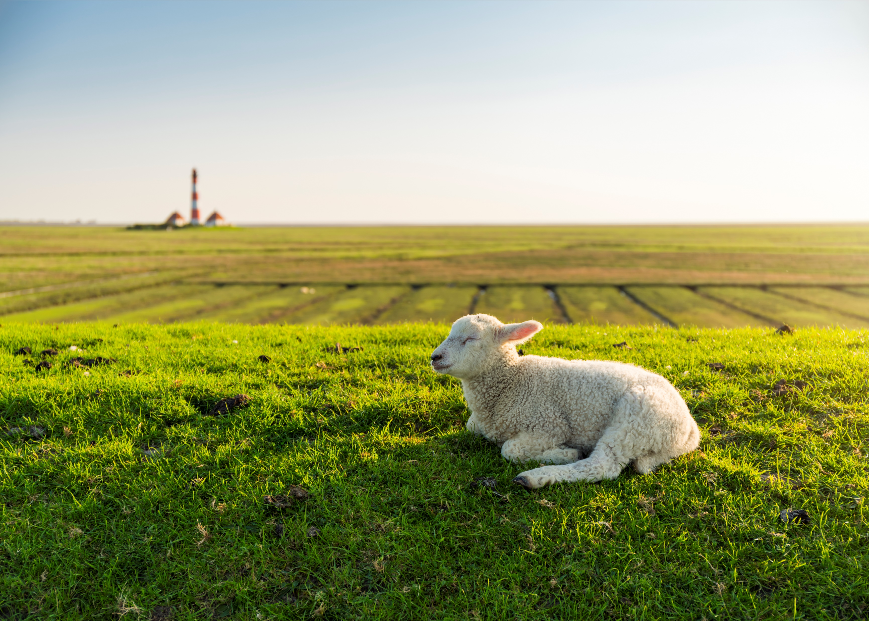
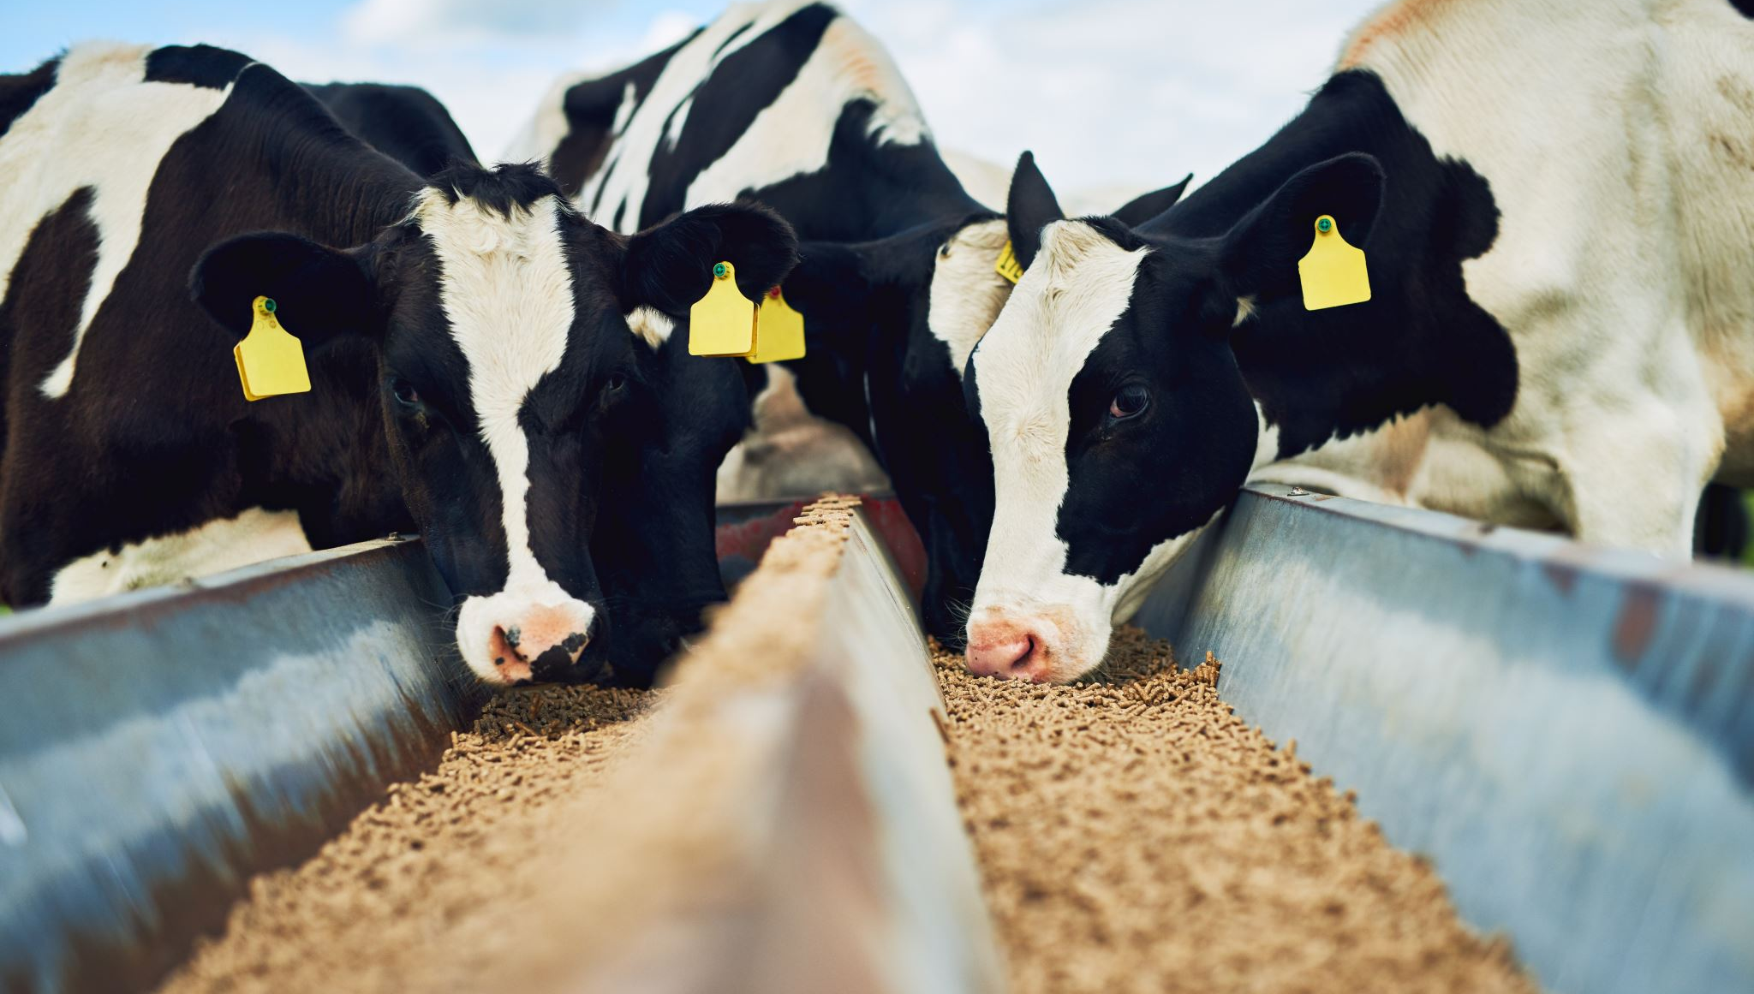
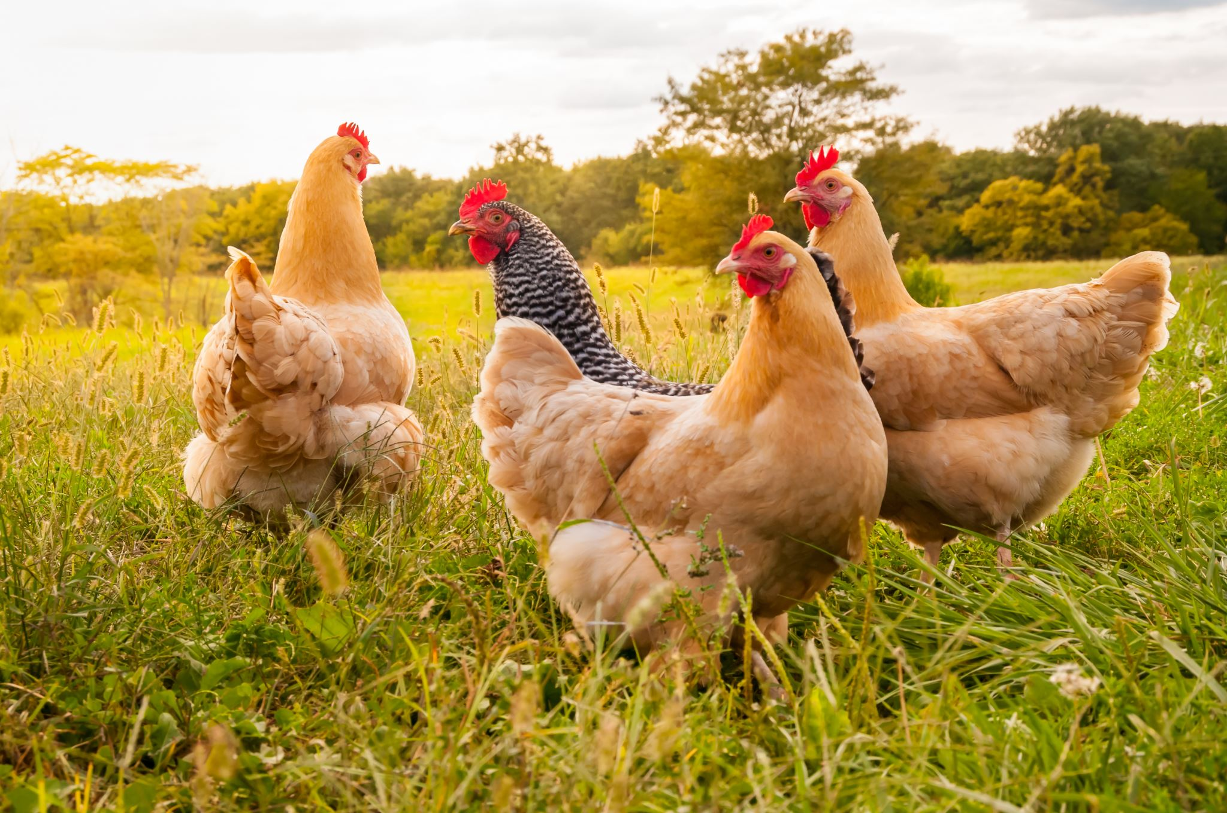
What is Agriculture?
There are three parts to farming:
3. Raising livestock
Notes:
Discuss what livestock is.
Livestock are domestic animals that are kept by people for purposes including meat, milking, wool, leather, or labor.
Taking care of livestock is animal husbandry.
Some types of livestock are: cattle, pigs, sheep, goats, and chickens. Chickens produce eggs; pigs produce meat; cattle, goats and sheep create milk, and sheep also create wool. Horses, cattle, and other large animals do work for people, such as pulling wagons and other vehicles.

Slide 6
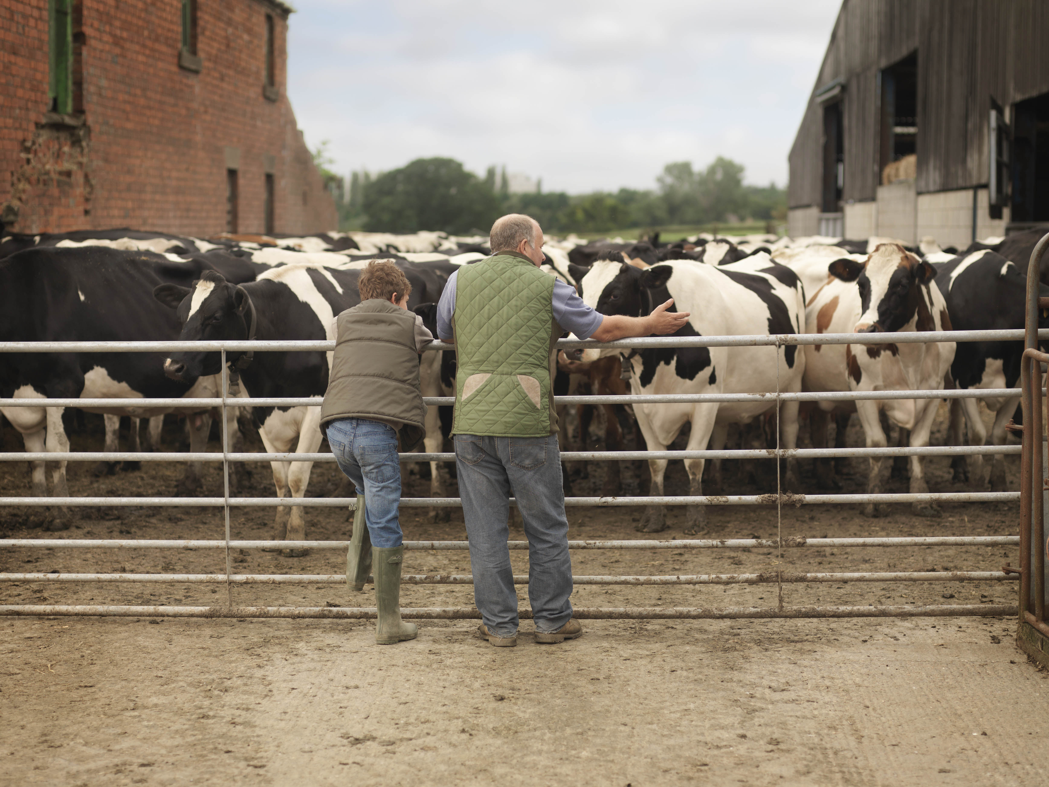
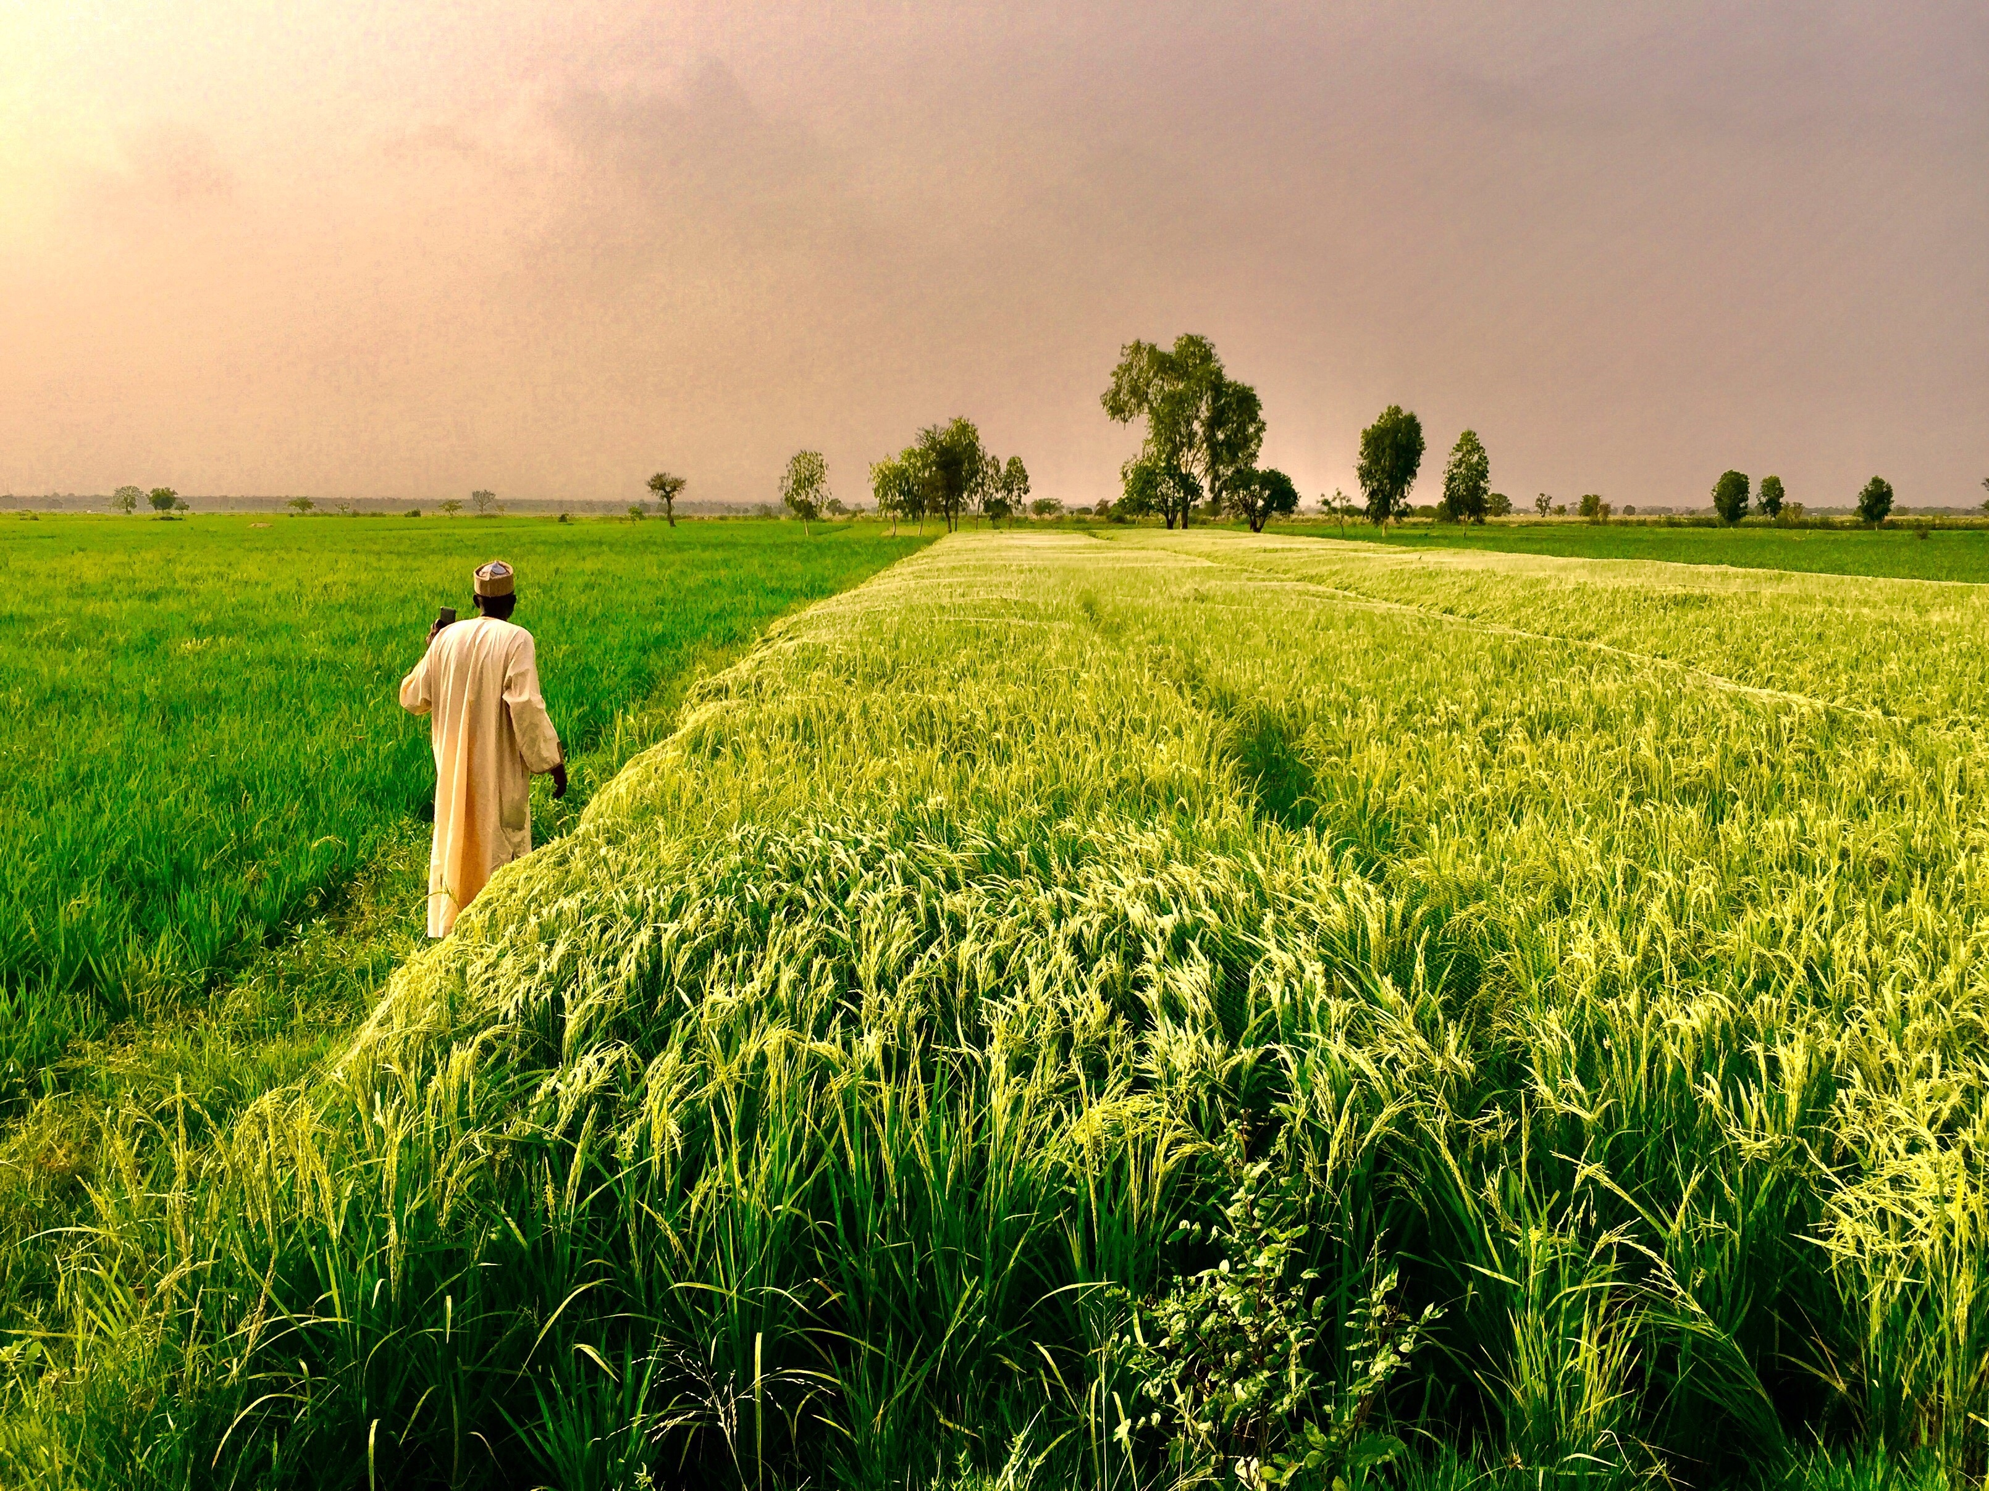

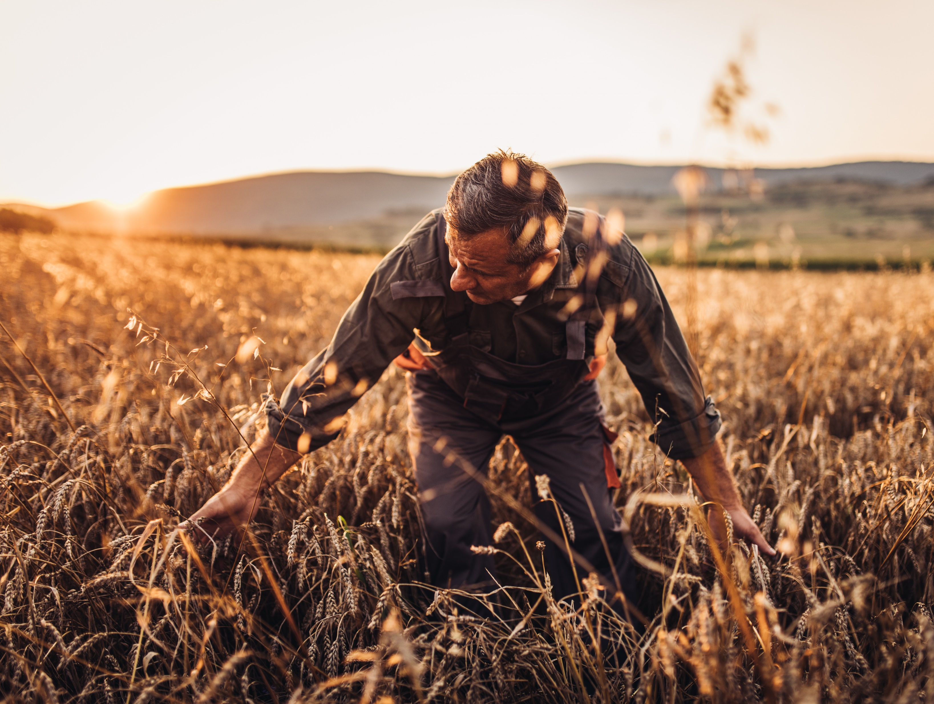
What is a farmer?
A person who works on the land to grows crops and keep animals.
Notes:
Before watching the video: introduce some of the vocabulary featured in the video

Slide 7
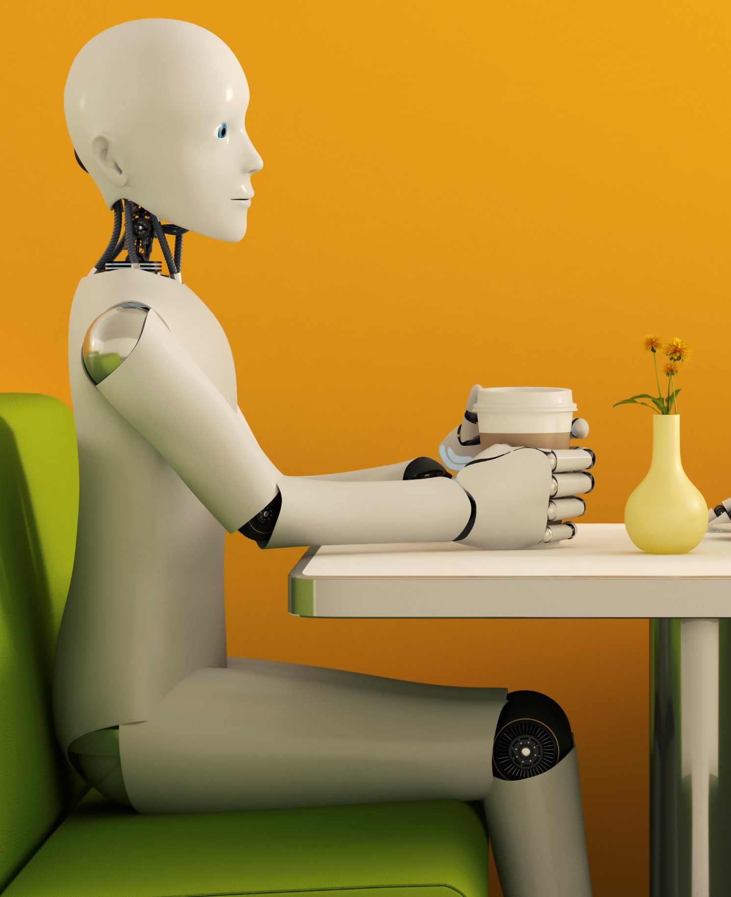
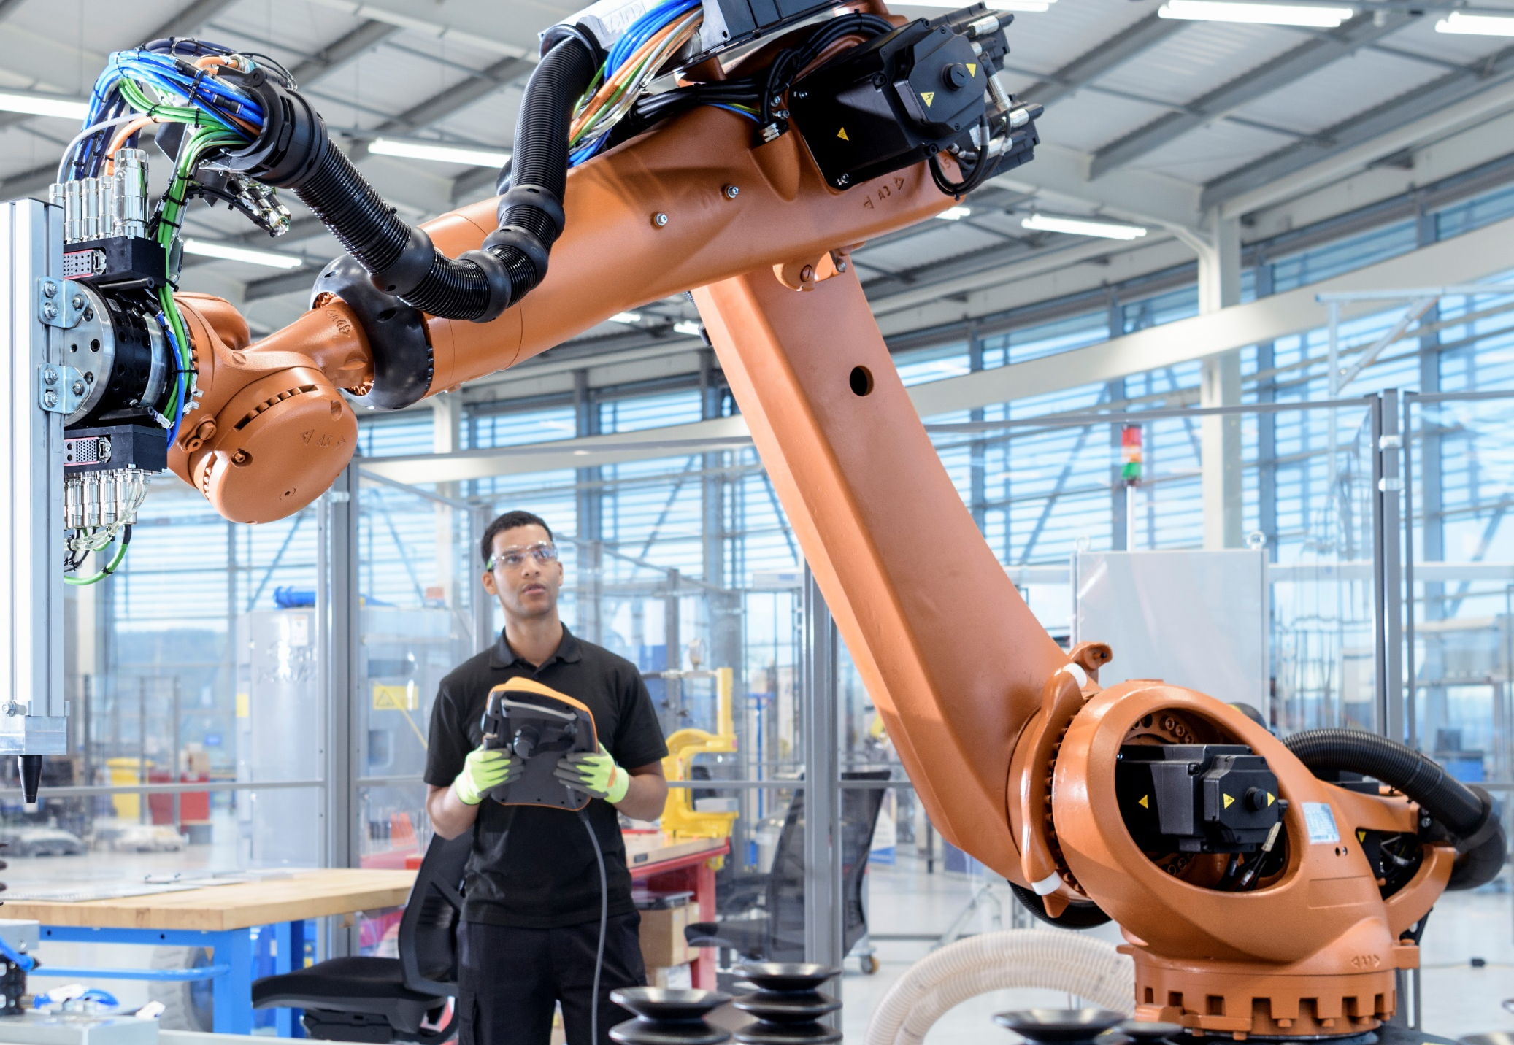
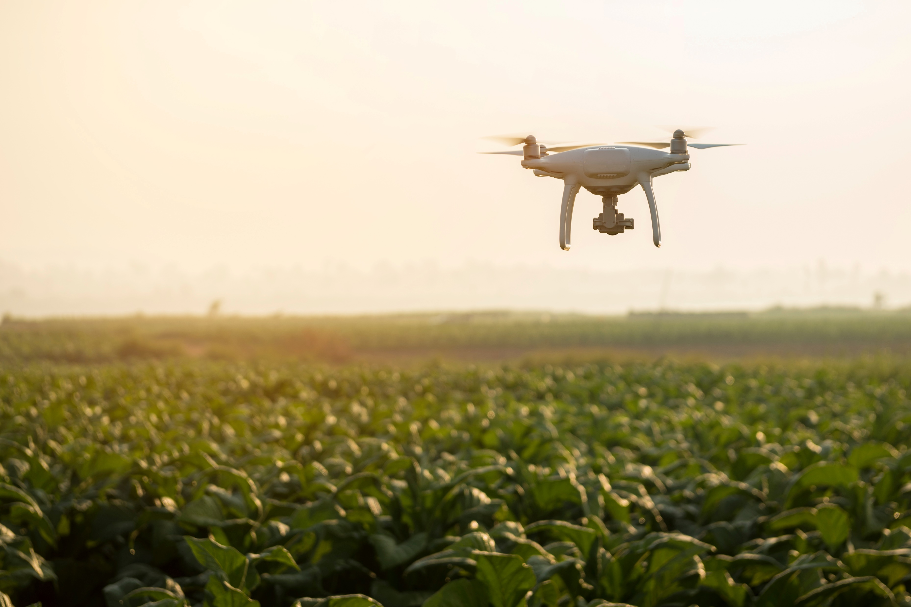

What is a robot?
A machine acting like a human being.
What is a remote control?
A machine that operates another machine from a distance.
Notes:
Before watching the video: introduce some of the vocabulary featured in the video

Slide 8
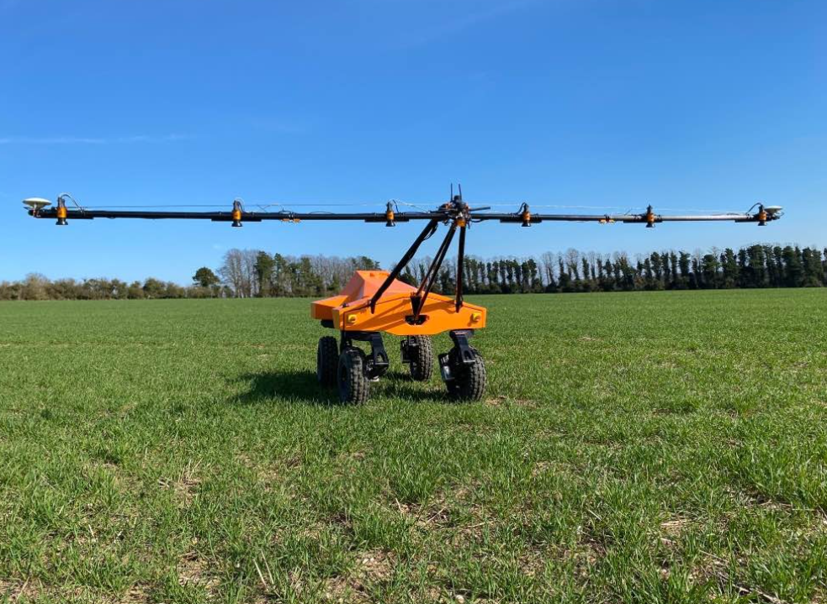
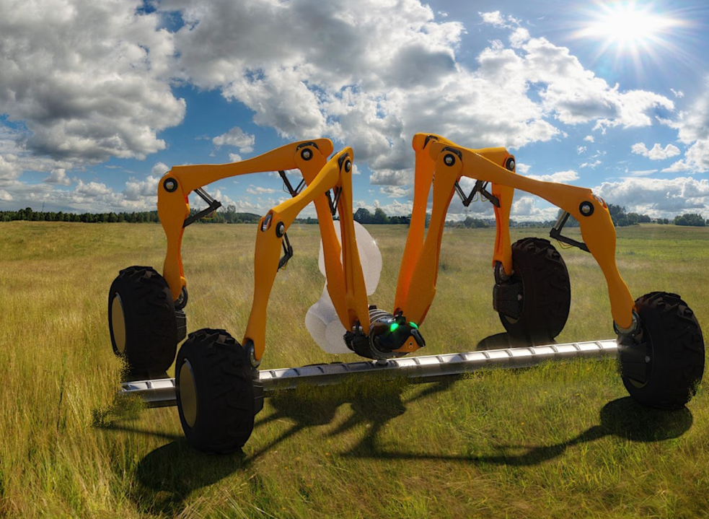
What is Agri-tech?
Agri-tech is using technology for farming to increase the amount of food we are able to produce.
Notes:
We will find out more about Agritech in the video

Slide 9
What is a billion?
A very large number with 9 zeros.
1,000,000,000
It is one thousand million.
Notes:
Before watching the video: introduce some of the vocabulary featured in the video

Slide 10
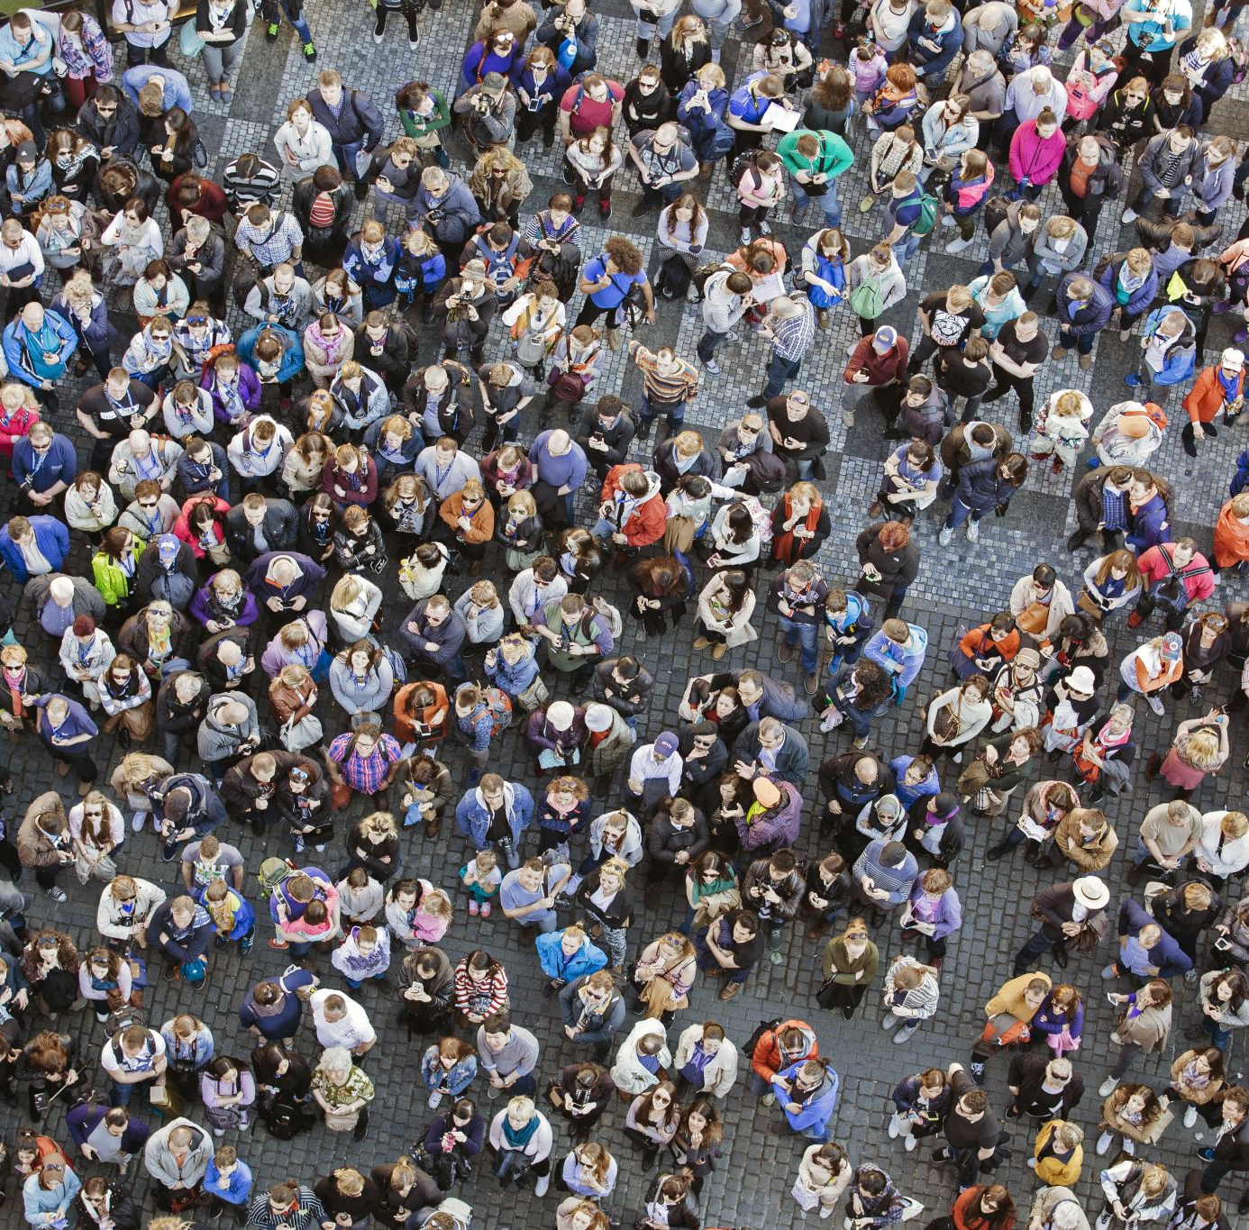
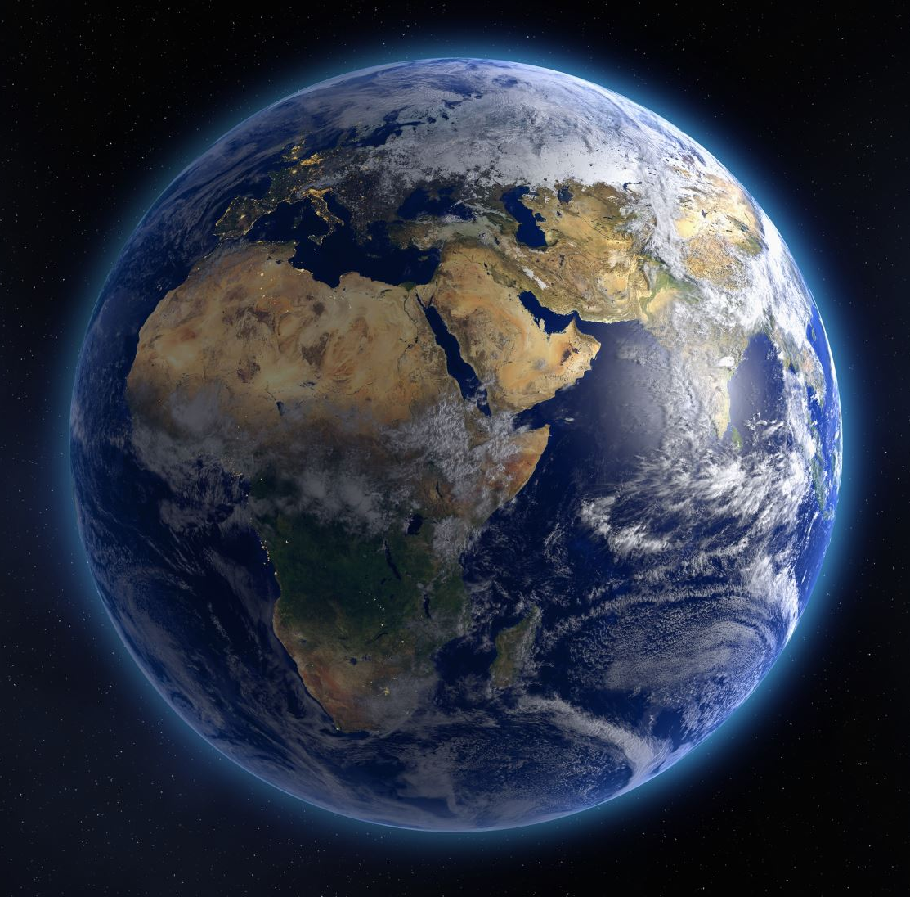

There are 7.8 billion people on our planet
7,800,000,000
Notes:
Before watching the video: introduce some of the vocabulary featured in the video

Slide 11
Let’s take a look and see how people who work in Agri-tech are helping farmer’s to feed 7.8 BILLION PEOPLE EVERYDAY !
VIDEO
Notes:
St

Slide 12

What do we know now?
Let’s do a quiz to see what we’ve remembered!

Slide 13



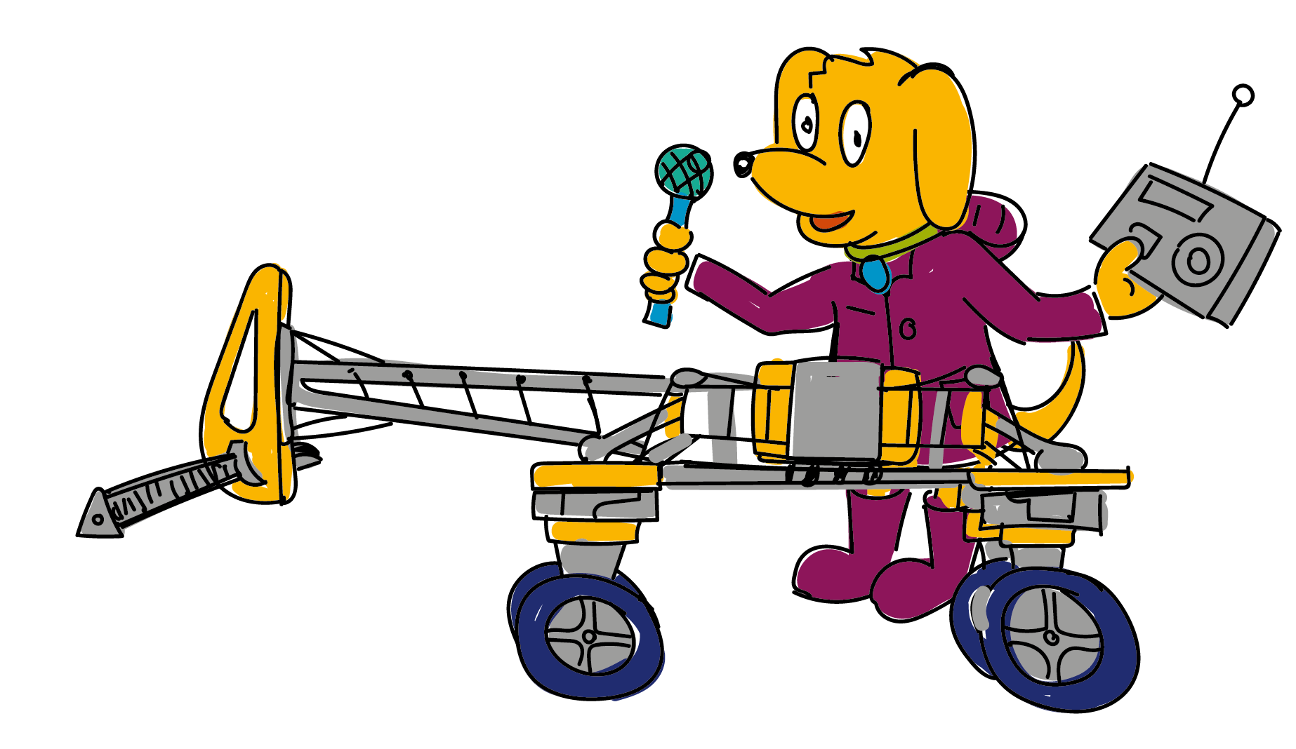
Question 1
Which animal is important for the health of the soil?
Worm
Ladybird
C. Mouse

Slide 14



Question 2
How can small robots kill weeds in the field?
Cut them down
Zap them with electricity
C. Spray them with a chemical

Slide 15



Question 3
What things are being used on farms to help grow more food?
Sheep Dogs
Hand tools
C. Robots

Slide 16


Question 4
Technology is helping farming become kinder to the environment?
True
False

Slide 17
Question 1
Which animal is important for the health of the soil?
Worm
Worm
Ladybird
C. Mouse

Slide 18
Question 2
How can small robots kill weeds in the field?
B. Zap them with electricity
Cut them down
Zap them with electricity
C. Spray them with a chemical

Slide 19
Question 3
What things are being used on farms to help grow more food?
C. Robots
Sheep Dogs
Hand tools
C. Robots

Slide 20
Question 4
Technology is helping farming become kinder to the environment?
True
True
False

Slide 21

Challenge: Design a farming robot
Can you draw a robot to help with the animals on a farm?

Slide 22
Challenge: What job would you enjoy?
Can you choose one of the jobs you have just learnt about and draw a picture of yourself doing this job?
Notes:
There is a printable pupil worksheet called ‘I could be...’ available for this activity.
Additional question on the sheet are:
List the skills you think you would need to do the job.
What would you enjoy most about doing this job?

Slide 23
Goodbye from Bingo!

