Slide 1
Science T Level Pathway
A guide for students
Notes:
This presentation is designed to support secondary school students to understand the Science T level pathway. It has been developedbased upon information available in January 2022.
There are accompanying teacher CPD resources available on:
https://www.northeastambition.co.uk/post16-options-t-levels

Slide 2

What is a T Level?
T levels are new 2-year qualifications which you can study after your GCSEs as an alternative to A Levels, an apprenticeship or other post-16 courses
T Levels offer a mix of classroom learning and on-the-job experience and include a 45-day industry placement
T Levels are equivalent to 3 A Levels and can help you progress to university, a higher-level apprenticeship, or a skilled job
T Levels are available across a range of subject areas from agriculture to catering and engineering to science. They were first launched in September 2020
Notes:
Link to optional video (6:09) to introduce T levels embedded in image slide:
https://www.youtube.com/watch?app=desktop&v=7rua65bHjMw

Slide 3
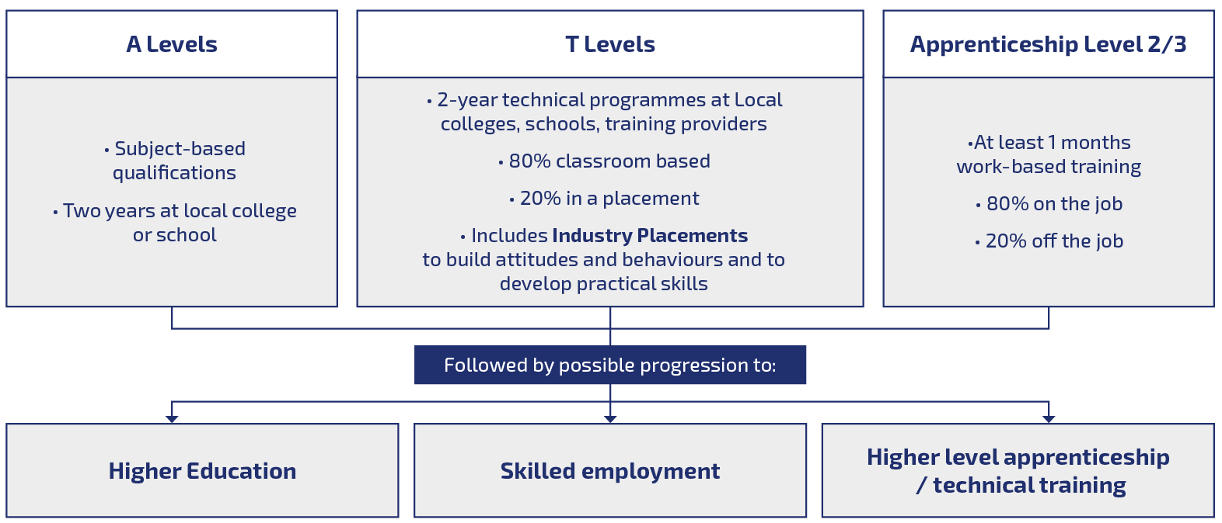
How do T Levels fit with other post-GCSE options?
Notes:
T levels are different to A levels and apprenticeships. They are focussed around technical courses and combine 80% classroom-based study with 20% on-the-job training.
They can lead to a range of opportunities including apprenticeships, skilled work or further study.
Recommended link to short summary video embedded in infographic (2:11):
https://www.youtube.com/watch?app=desktop&v=7rua65bHjMw

Slide 4

Science T Level
The science T Level is suitable for anyone interested in a career in science and could provide a route into jobs in health and science such as:
Food manufacturing inspector
Lab technician
Metrologist
The science T Level can also be a pathway into a higher level apprenticeship or university

Slide 5

What do you learn on a science T level course?
The science T level includes core content on the health and science sector including:
Working within the health and science sector
Good scientific and clinical practice
Core scientific concepts including cell biology, genetics and immunology
In addition to the core content there is a choice of one of 3 specialisms
Laboratory sciences
Food sciences
Metrology sciences

Slide 6
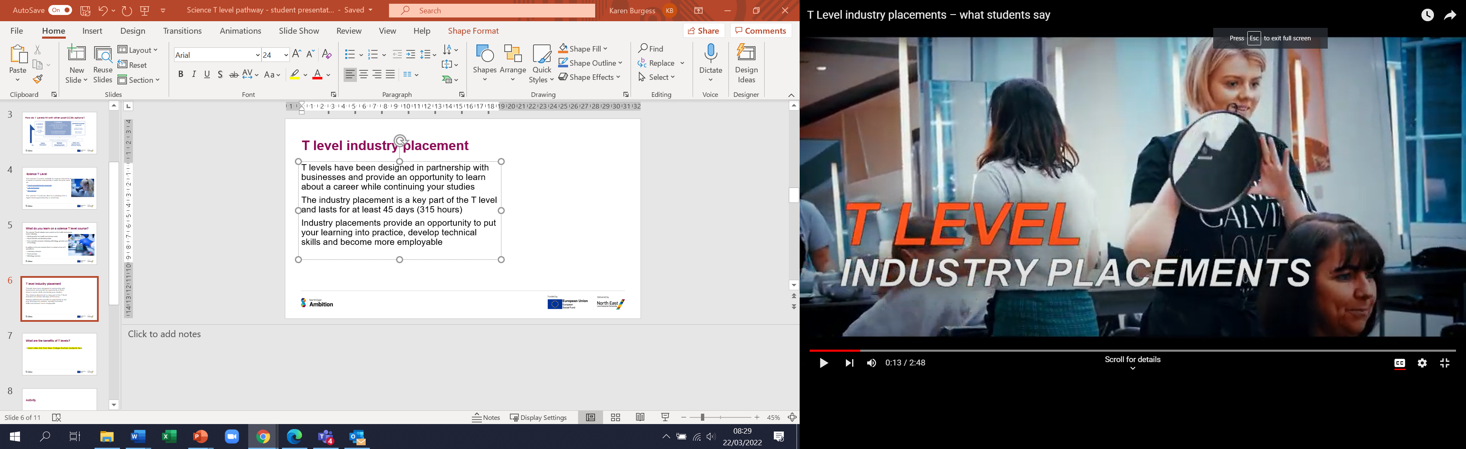
T level industry placement
T levels have been designed in partnership with businesses and provide an opportunity to learn about a career while continuing your studies
The industry placement is a key part of the T level and lasts for at least 45 days (315 hours)
Industry placements provide an opportunity to put your learning into practice, develop technical skills and become more employable
Notes:
Optional short video (2:48) of T levels students giving their perspective on industry placements:
https://www.youtube.com/watch?v=J4hdOsUbYF0

Slide 7
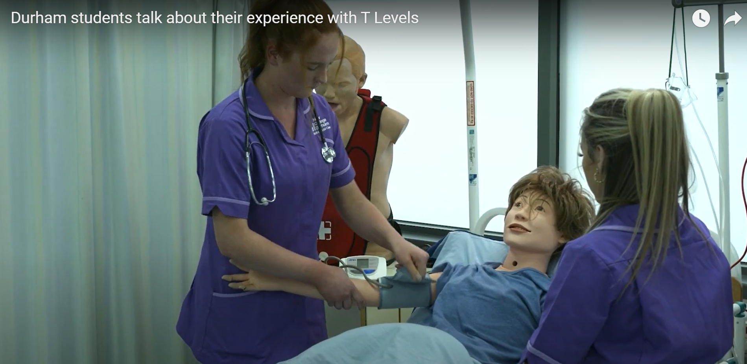

What are the benefits of T levels?
In this video T levels students from New College Durham explain why T levels have been a positive choice for them
You can access further information on T levels and other post-16 options via the North East Ambition website:
https://www.northeastambition.co.uk/options-for-young-people-aged-16
Watch video: T Level students, New College Durham
Notes:
Video of students currently studying for a T level in health at New College Durham
https://www.youtube.com/watch?v=ku4D_gntr48

Slide 8

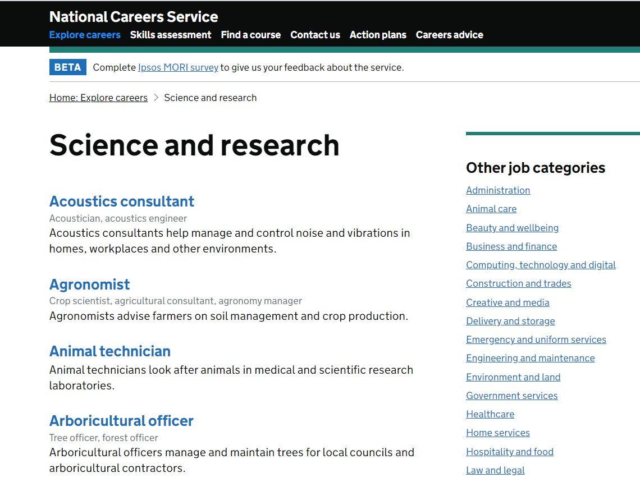
Activity
Notes:
Optional student activities:
A student activity pack to further build knowledge and understanding of T levels is available online:
https://www.gov.uk/government/publications/t-levels-resources-for-teachers-and-careers-advisers
Students can find out more about careers in science via the National Careers Service website
https://nationalcareers.service.gov.uk/

Slide 9



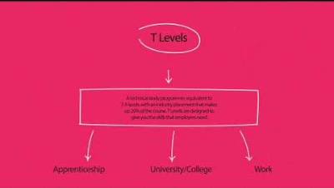
Want to find out more
NCFE Health and Science T Level student video explaining health and science route pathways
https://www.youtube.com/watch?v=08D_q59grxg
NCFE Parents and learners information
https://www.ncfe.org.uk/technical-education/t-levels/parents-and-learners/
Find a local T Level provider
https://www.tlevels.gov.uk/students/find
DfE post 16 choices animation
https://www.youtube.com/watch?app=desktop&v=f_xAQNNi4pA
Notes:
The teacher guide to T levels has an excellent summary to support further understanding of T levels, testimonials and possible destinations

Slide 10
Health and Science T Level providers
The following North East providers currently offer Health and Science T level pathways*
City of Sunderland College
Health (Sept 21)
Gateshead College
Health (Sept 21)
Durham Sixth Form Centre
Health (Sept 21)
New College Durham
Health (Sept 21)
Healthcare Science (Sept 22)
Science (Sept 22)
East Durham College
Health (Sept 22)
Science (Sept 22)
* Based on available data Jan 2022
Notes:
More information can be accessed by following the links to the provider websites

Slide 11

Notes:
https://www.northeastlep.co.uk/

