Slide 1
Science T level pathway
Information for teachers

Slide 2

Content
These resources are designed to be used to support secondary school teachers, in the North East LEP area, to understand the Science T level pathway as a post-16 option for their students.
This presentation covers the following:
Overview of T Levels
Overview of Health and Science Route and occupational specialisms
Content and assessment of Health and Science T Level pathway
Further information and North East providers

Slide 3

What is a T Level?
T levels are new courses which follow GCSEs and are equivalent to 3 A levels
T levels are 2 year level 3 courses which have been developed in collaboration with employers and businesses
T levels offer students a mix of classroom learning and ‘on-the-job’ experience during an industry placement of at least 315 hours
T levels are available across a range of subjects areas, the first were launched in September 2020
Notes:
Full list of planned T level subject areas available here:
https://www.gov.uk/government/publications/introduction-of-t-levels/introduction-of-t-levels

Slide 4


Why are T Levels being introduced?
More Info?
T Level Development Panel Memberships
T Level UCAS Points

Slide 5
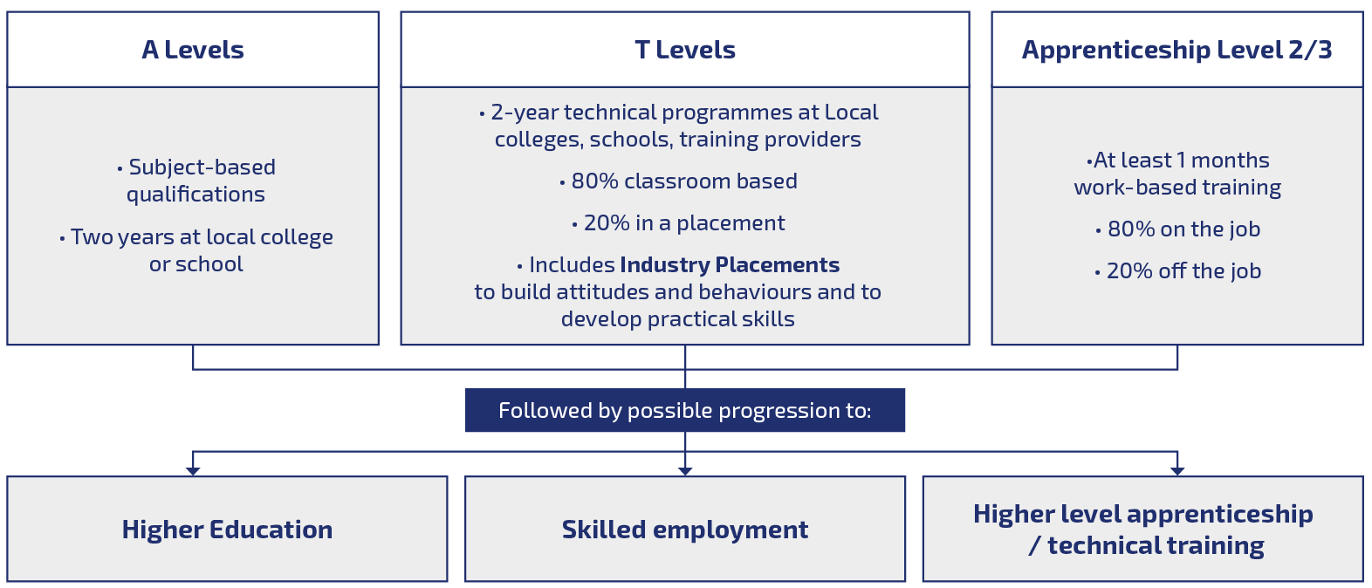
How do T Levels fit with other post-GCSE options?

Slide 6

T level overview
2 Year Programme
Aimed at 16-19 year olds
Equivalent in size, rigour and depth as 3 A-levels
Managed by the Institute for Apprenticeships and Technical Education (IfATE)
Design and content created by employer panels
Designed for students to have the minimum threshold competencies for an occupational role
UCAS Points
Route(s) to paid employment / HE / Higher level Apprenticeships

Slide 7
T level programme structure
T Level courses include the following compulsory elements:
a technical qualification, which includes:
  core theory, concepts and skills for an industry area
  specialist skills and knowledge for an occupation or career
an industry placement with an employer
Students who complete their T Level will receive an overall grade of pass, merit, distinction or distinction*. They will get a nationally recognised certificate which will show their overall grade and a breakdown of what they have achieved

Slide 8
T level programme structure
Core
(20% - 50% of the total learning time)
Knowledge and understanding of the concepts, theories and principles relevant to the T Level and the broader route
Core skills relevant to the T Level route
Occupational Specialism
(50% - 80% of the total learning time)
Knowledge, skills and behaviours required to achieve threshold competency in an occupational role
Industry placement
External employer(s)
Minimum of 315 hours
Students develop technical skills and apply their knowledge in a workplace environment

Slide 9
Health and Science T Level Route
The qualification is split into 2 component parts, delivered through a combination of classroom learning, practical training and industry placements:
Core component which includes
  Route core component
  Pathway component
Occupational specialism components
Within the health and science T level route there are 3 pathways to choose from:
  Health
  Healthcare Science
  Science
Within each of these pathways there are a range of occupational specialisms which can be offered to students. Students choose one specialism.

Slide 10
Specification overview
Core Content
Section A: The health and science sector
Route content is:
Working within the health and science sector
  Health, safety and environmental regulations in the health and science sector
Good scientific and clinical practice
  Managing information and data within the health and science sector
Section B: Science concepts
Core science concepts (route)
Further science concepts (pathway varies)
Core skills (pathway varies) e.g.
Communication
Researching
Science
Laboratory sciences
Food sciences
Metrology sciences
Healthcare science
Assisting with healthcare science
Optical care services (expected 2022)
Pharmacy services (TBC)
Health
Supporting healthcare core +
Supporting the Adult Nursing Team
Supporting the Midwifery Team
Supporting the Mental Health Team
Supporting the care of children and young people
Supporting the Therapy Team
Dental Nursing (expected 2022)
*Information correct in January 2022- current information can be accessed at
www.ncfe.org.uk/technical-education/t-levels/health-and-science/
Notes:
Occupational specialisms listed by relevant pathway
*Information correct in January 2022- current information can be accessed at
www.ncfe.org.uk/technical-education/t-levels/health-and-science/

Slide 11
Assessment
​ | Content ​ | Assessment method​ | Grading ​ | Planned hours​
Core ​ Section A: health and science sector Section B: science concepts | Knowledge and understanding of context, concepts, theories and principles​ ​ Ability to apply core knowledge and skills​ ​ | 2 x externally assessed exams ​ ​ Employer set project​ | A* - E​ | 20-50% of qualification time​
Occupational Specialism​ | Knowledge and skills needed for threshold competence in an industrial specialism ​ ​ | Synoptic assessments​ Practical assessment ​ Professional discussion ​ ​ | Distinction​ Merit​ Pass​ ​ | 50-80% of qualification time​

Slide 12

Core content
Section A: Health & Science sector:
All pathways within the health and science T level route cover:
Working within the Health and Science sector
Health, Safety and Environmental regulations in the Health and Science sector
Managing information and data within the Health and Science sector
Good Scientific and Clinical Practice
Core Science concepts

Slide 13
Core Content
Section B:Science concepts
B1 content is the same across all 3 pathways and includes:
Cell biology
  including structure and function of organelles such as Golgi apparatus and Golgi vesicles.
Biological molecules
  Including proteins, lipids, and carbohydrates. Structure and function nucleic acids (DNA and RNA) is also covered within genetics sub-topic.
Microbiology
  including uses of differential staining techniques
Immunology
  including the actions of T cells and B Cells, pathogens, and their methods of transmission.
Materials and chemical properties, acids/bases and chemical changes, rates of reaction, energy changes and chemical analysis of substances
Electricity, magnetism and electromagnetism, waves, particles and radiation, units
Notes:
Please note this is summary overview of the course content, more information is available online in the qualification specification

Slide 14
Core Content
Section B:Science concepts
  Within B2 of each pathway, known as ‘Further science concepts’, advanced content is tailored for each pathway. For the science pathway:
  Science:
  Classification and molecular structure of biological molecules
  Enzyme and protein structure
  Cell cycle
  Cellular respiration
  Pathogens
  Formulae and equations
  Analytical techniques
  Gas laws, pressure/fluid/viscosity
More information is available in the Science T Level qualification specification

Slide 15
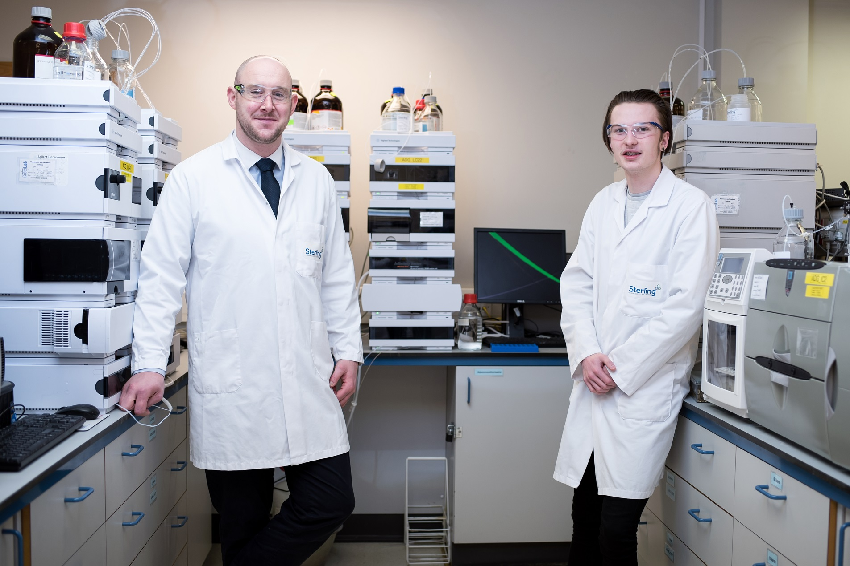
Industry work placements
Mandatory part of T Level programme
Provider led
Give students a valuable opportunity to put their learning into practice, develop their technical skills and become more employable
Minimum of 315 hours with an external employer(s)
Can be outside of the academic timetable

Slide 16
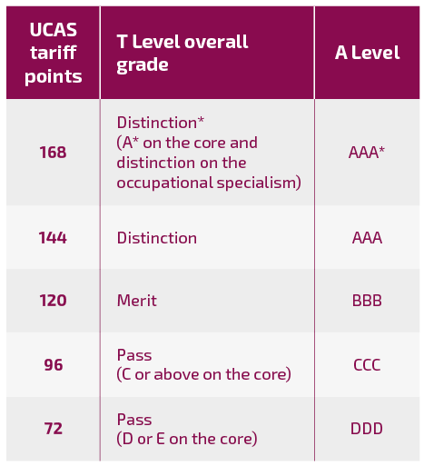
Grading and Assessment
The T Level certificate will include:
  an overall grade for the T Level, shown as pass, merit, distinction or distinction*
  a separate grade for the core component, using A* to E
  a separate grade for each occupational specialism, shown as pass, merit or distinction
It will also confirm that the student has:
  completed the industry placement
  met any additional mandatory requirements
A student’s overall T Level grade will be worked out from the grades they achieved on the core component and the occupational specialism(s). For students looking to progress to higher education UCAS tariff points will be allocated to T levels as outlined in the table shown
Source: Dept for Education Guidance to introduction of T Levels 22 Nov 2021

Slide 17


T levels – a teacher’s perspective
This video gives a teacher perspective on the benefits of the science T level pathway, potential progression routes and this new qualification.
You can access further information on T levels and other post-16 options via the North East Ambition website:
https://www.northeastambition.co.uk/options-for-young-people-aged-16
Watch video: Callum Brown, Science teacher, Gateshead College

Slide 18

Health and Science T Level providers * Based on available data Jan 2022
The following North East providers currently offer Health and Science T level pathways*
Durham Sixth Form Centre
  Health (Sept 21)
East Durham College
  Health (Sept 22)
  Science (Sept 22)
Education Partnership NE
  Health (Sept 21)
  Science (Sept 22)
Gateshead College
  Health (Sept 21)
New College Durham
  Health (Sept 21)
  Healthcare Science (Sept 22)
  Science (Sept 22)
Notes:
More information can be accessed by following the links to the provider websites

Slide 19

Useful links
NCFE Health and Science T Level student video explaining health and science route pathways
https://www.youtube.com/watch?v=08D_q59grxg
ESFA T level resources for teachers and T level providers
https://www.gov.uk/government/publications/t-levels-resources-for-teachers-and-careers-advisers
NCFE T Level overview page
https://www.ncfe.org.uk/technical-education/t-levels/health-and-science/
NCFE Science T level assessment and specification
https://www.qualhub.co.uk/qualification-search/qualification-detail/t-level-technical-qualification-in-science-level-3-delivered-by-ncfe-5041
NCFE Parents and learners information
https://www.ncfe.org.uk/technical-education/t-levels/parents-and-learners/
DfE post 16 choices animation
https://www.youtube.com/watch?app=desktop&v=f_xAQNNi4pA
Notes:
The teacher guide to T levels has an excellent summary to support further understanding of T levels, testimonials and possible destinations

Slide 20

Your Next Steps
Access the T level Professional Development Platform via: pdp.etfoundation.co.uk/
Notes:
Understanding T Levels: in house or live online (new staff within W1&2, and recommended for all W3 providers: develop your knowledge of T Levels to prepare for delivery and provide learners with high quality advice and guidance.
Professional Development for Leaders: (W1,2&3) helping all staff in leadership roles to shape the strategic direction of their organisation.
T Level Role and Route Specific Training (W1,2 and 3): personalised CPD journeys created from a range of courses, modules, workshops and other activities structured to meet specific professional development needs.
Industry Insights: apply for workplace shadowing and placement opportunities and attend industry workshops to ensure current industry practice is reflected in T Level teaching.
Networks: Interact, collaborate and share effective practice with colleagues across the sector.
T Level Resource Improvement Projects (TRIPs): collaborate on action research projects with staff from other T Level providers to improve teaching and outcomes for learners.

Slide 21
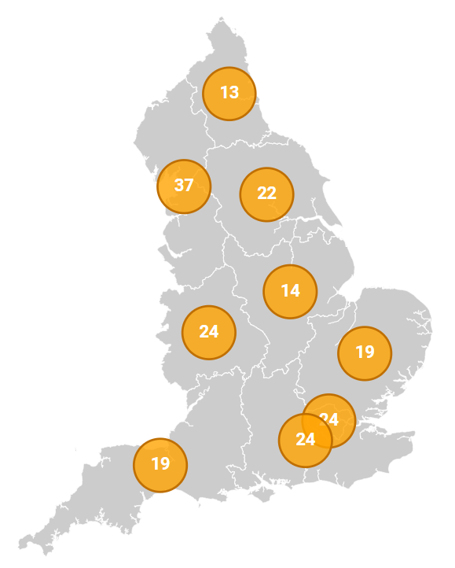
Area and Relationship Development Leads
The Education and Training Foundation (ETF) has a team of Area and Relationship Development Leads (ARDLs) working to support providers delivering or planning to deliver T Levels.
  Role of ARDLs:
  Raise awareness of T Level qualifications
  Support the planning and delivery of T Levels with providers
  Signpost providers to relevant CPD and networking opportunities
  Support providers with their CPD development plans for
  T Levels and wider workforce and leadership development
Notes:
I'm sure the majority of T Level Providers already have an established relationship with their RDL, however, if you haven’t yet made contact, I'd like to refer you to the regional map, which is located on the ETF website, where you can find the details of which RDL has been designated to each individual setting.

Slide 22

For additional support and training to develop understanding of T levels and their delivery you can contact the ETF area relationship and development leads in the North East:
Simon.Chalk@etfoundation.co.uk
Paul.Smith@etfoundation.co.uk
For further information on the T level specification and qualification please contact
customersupport@ncfe.org.uk

Slide 23
Thank you

