Slide 1

Our Region, Your Future
The world of work in the North East
Y8 Lesson
In association with VotesforSchools and The WOW Show
©VotesforSchools The WOW Show 2022

Slide 2






Learning objectives for today
Being aware of your heritage, identity and values.
Identifying common sources of information about the labour market and the education system.
Being aware that different jobs and careers bring different challenges and rewards.
Being aware that it is important to take initiative in your learning and life.
Recognising the injustices caused by prejudice, stereotypes and discrimination in learning and workplaces.
Being aware that there are trends in local and national labour markets.
©VotesforSchools The WOW Show 2022
Notes:
Images & References
https://www.thecdi.net/New-Career-Development-Framework

Slide 3
Keywords
Labour Market Information (LMI): Information about the jobs and careers available in a geographical area.
Sector: The areas into which the economic activity of a country is divided.
Employability: Having the skills and abilities needed to have a job or career.
Career: The job or series of jobs that you do during your working life.
Prejudice: An unfair and unreasonable opinion or feeling, especially when formed without enough thought or knowledge.
Stereotype: A set idea that people have about what someone or something is like, especially an idea that is wrong.
Discrimination: Treating a person or particular group of people differently, especially in a worse way from the way in which you treat other people, because of their skin colour, sex, sexuality, etc.
©VotesforSchools The WOW Show 2022
Notes:
References
https://dictionary.cambridge.org/dictionary/english/sector
https://dictionary.cambridge.org/dictionary/english/employability
https://dictionary.cambridge.org/dictionary/english/career
https://dictionary.cambridge.org/dictionary/english/labour-market

Slide 4

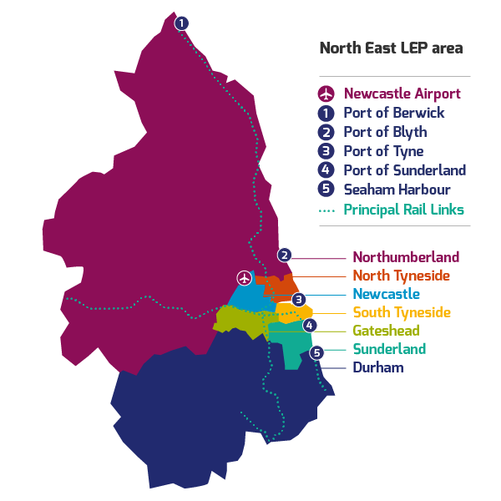
1
What is Labour Market Information?
Define: Labour Market Information (LMI)
This tells you about the current work and job opportunities in your area.
LMI is important for the future, it allows young people to understand what is on offer in their area and how to get there by making good decisions about their future career choices.
Class discussion (2-3 mins)
How do you think Labour Market Information could help you find a job in your area?
It helps us understand the world of work by breaking it down into smaller parts.
LMI highlights the fantastic career opportunities available and what existing opportunities and growth areas there are near you.
©VotesforSchools The WOW Show 2022
Notes:
References:
http://www.lmiforall.org.uk/explore_lmi/
https://www.lmiforall.org.uk/explore_lmi/learning-units/what-is-lmi/ - There is a YouTube video explaining LMI if needed on this page.

Slide 5


1
What is Labour Market Information?
LMI can help you understand which jobs are available near to you and how many jobs there are in all of the different sectors.
Define: Sector
An area of work and production that makes money for an area or country.
Individual activity (2-3 mins)
Write down three careers that interest you for the future.
LMI could help you see where job opportunities are and how much certain roles pay.
LMI is updated regularly, so you can see how job opportunities change and some sectors grow.
©VotesforSchools The WOW Show 2022
Notes:
Images
1) North East LEP
References
http://www.lmiforall.org.uk/explore_lmi/
https://www.lmiforall.org.uk/explore_lmi/learning-units/what-is-lmi/ - There is a YouTube video explaining LMI if needed on this page.

Slide 6
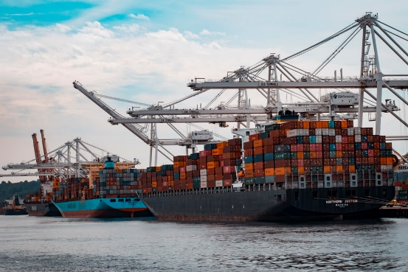






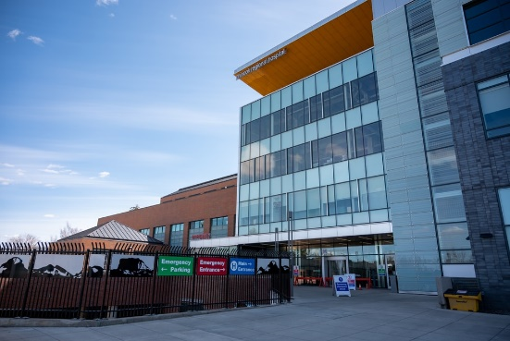
2
The North East Labour Market
Pair discussion (2-3 mins)
Talk to your partner about what opportunities you know of in your local area – click for some picture hints. Then, head to the next slide for more information on the sectors that have roles on offer in the North East.
Challenge:
Do you know what kind of work is involved in each of these sectors?
©VotesforSchools The WOW Show 2022
Notes:
Please Note: The North East Local Enterprise Partnership works with partners to develop a more competitive economy for the North East, Helping to create more and better jobs for everyone.
Images
Unsplash
References
https://www.northeastambition.co.uk/toolkits/labour-market-insights-toolkit
https://www.northeastlep.co.uk/key-sectors/
https://evidencehub.northeastlep.co.uk/report/gva-industry
https://dictionary.cambridge.org/dictionary/english/manufacturing
https://dictionary.cambridge.org/dictionary/english/administration
https://dictionary.cambridge.org/dictionary/english/retail
https://dictionary.cambridge.org/dictionary/english/social-care

Slide 7
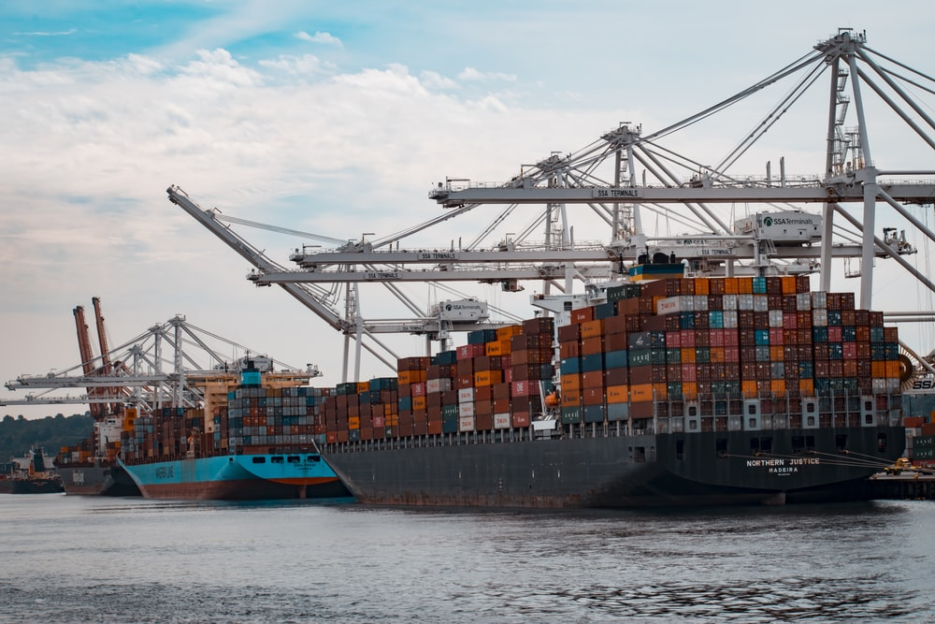



2
The North East Labour Market
Transport & Logistics:
Transport of people and movement of goods (things we buy).
Advanced Manufacturing:
This includes making parts for cars, trains, electronics and subsea engineering.
Construction:
Building and work across all parts of our built environment.
Health & Life Sciences:
Research and development into health and care (looking after people).
©VotesforSchools The WOW Show 2022
Notes:
Please Note: The North East Local Enterprise Partnership works with partners to develop a more competitive economy for the North East, Helping to create more and better jobs for everyone.
Images
Unsplash
References
https://www.northeastambition.co.uk/toolkits/labour-market-insights-toolkit
https://www.northeastlep.co.uk/key-sectors/
https://evidencehub.northeastlep.co.uk/report/gva-industry
https://dictionary.cambridge.org/dictionary/english/manufacturing
https://dictionary.cambridge.org/dictionary/english/administration
https://dictionary.cambridge.org/dictionary/english/retail
https://dictionary.cambridge.org/dictionary/english/social-care

Slide 8




2
The North East Labour Market
Digital:
Work involving Information Technology (IT) and digital data.
Education:
There are over 1,150 schools in the North East and five universities.
Financial & Business Services:
This includes financial and legal services.
Energy:
Research and development in producing energy.
©VotesforSchools The WOW Show 2022
Notes:
Please Note: The North East Local Enterprise Partnership works with partners to develop a more competitive economy for the North East, Helping to create more and better jobs for everyone.
There are four Universities in the North East LEP and one in Tees Valley
There are nine Further Education colleges and two sixth forms
There are over 240 secondaries including SEND, PRU and Alternative Provision
There are over seven hundred primaries
Images
Unsplash
References
https://www.northeastambition.co.uk/toolkits/labour-market-insights-toolkit
https://www.northeastlep.co.uk/key-sectors/
https://evidencehub.northeastlep.co.uk/report/gva-industry
https://dictionary.cambridge.org/dictionary/english/manufacturing
https://dictionary.cambridge.org/dictionary/english/administration
https://dictionary.cambridge.org/dictionary/english/retail
https://dictionary.cambridge.org/dictionary/english/social-care

Slide 9
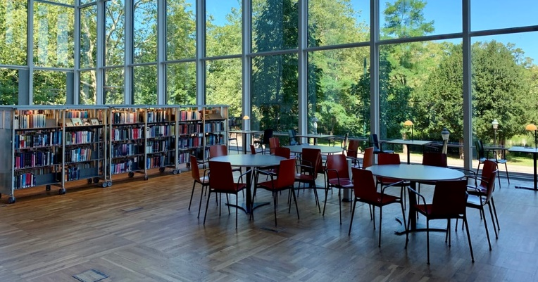




2
The North East Labour Market
Mind the gaps (3-5 mins)
Now you’ve seen the range of active sectors in the North East, it’s time to see some of the numbers behind them. On your own or in a pair, choose the right answer to fill the gap in each statement on the next few slides – you can use the images to help you. Then, click to see if you’re right!
©VotesforSchools The WOW Show 2022
Notes:
Images
Unsplash
References
https://www.northeastlep.co.uk/key-sectors/digital/
https://www.northeastlep.co.uk/key-sectors/advanced-manufacturing/
https://www.northeastlep.co.uk/key-sectors/energy/

Slide 10

2
The North East Labour Market
On your own or in a pair, choose the right answer to fill the gap!
A
26%
B
52%
_______% of all electric cars made in the UK are produced in the North East.
C
78%
©VotesforSchools The WOW Show 2022
Notes:
Images
Unsplash
References
https://www.northeastlep.co.uk/key-sectors/digital/
https://www.northeastlep.co.uk/key-sectors/advanced-manufacturing/
https://www.northeastlep.co.uk/key-sectors/energy/

Slide 11

2
The North East Labour Market
On your own or in a pair, choose the right answer to fill the gap!
A
10,000
B
29,000
C
There are _________ people employed in the North East in IT and digital industries
45,000
©VotesforSchools The WOW Show 2022
Notes:
Images
Unsplash
References
https://www.northeastlep.co.uk/key-sectors/digital/
https://www.northeastlep.co.uk/key-sectors/advanced-manufacturing/
https://www.northeastlep.co.uk/key-sectors/energy/

Slide 12
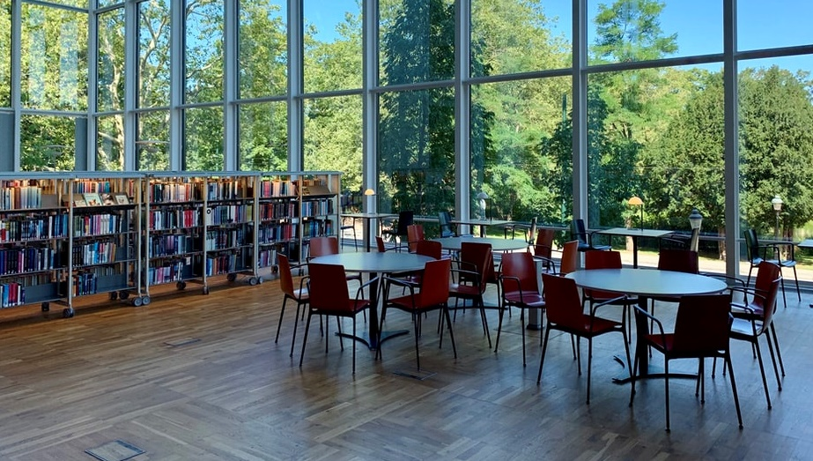
2
The North East Labour Market
On your own or in a pair, choose the right answer to fill the gap!
A
81,000
B
110,000
___________ students study in the region’s 5 universities.
C
210,000
©VotesforSchools The WOW Show 2022
Notes:
Images
Unsplash
References
https://www.northeastlep.co.uk/key-sectors/digital/
https://www.northeastlep.co.uk/key-sectors/advanced-manufacturing/
https://www.northeastlep.co.uk/key-sectors/energy/

Slide 13

2
The North East Labour Market
On your own or in a pair, choose the right answer to fill the gap!
A
7,000
B
700
C
There are currently __________ people employed in life sciences in the North East.
70
©VotesforSchools The WOW Show 2022
Notes:
Images
Unsplash
References
https://www.northeastlep.co.uk/key-sectors/digital/
https://www.northeastlep.co.uk/key-sectors/advanced-manufacturing/
https://www.northeastlep.co.uk/key-sectors/energy/

Slide 14

2
The North East Labour Market
On your own or in a pair, choose the right answer to fill the gap!
A
Electric cars
B
Offshore wind
The North East is a global leader in __________.
C
Eco-farming
©VotesforSchools The WOW Show 2022
Notes:
Images
Unsplash
References
https://www.northeastlep.co.uk/key-sectors/digital/
https://www.northeastlep.co.uk/key-sectors/advanced-manufacturing/
https://www.northeastlep.co.uk/key-sectors/energy/

Slide 15



3
Your North East opportunities in Energy
With so many advances in technology, an increasing population, and changing climates, the way we generate and use energy will constantly change.
0:00-3:32
The North East is already an important place for research and innovation in solving challenges with energy.
Class activity (4 mins)
Click the image to watch the video and discuss any of the careers featured that you would be interested in.
We have world-leading projects such as offshore energy, renewables and the development of hydrogen technologies.
Challenge:
There are many routes to careers in Energy, as you heard in the film. If you are interested, why not visit the website?
©VotesforSchools The WOW Show 2022
Notes:
YouTube Video Link: https://www.youtube.com/watch?app=desktop&v=_fu-5AYPenA&feature=youtu.be
SafeShare Video Link: https://safeshare.tv/x/_fu-5AYPenA
Images
NELEP
References
https://www.northeastlep.co.uk/key-sectors/energy/
https://www.northeastautomotivealliance.com/

Slide 16
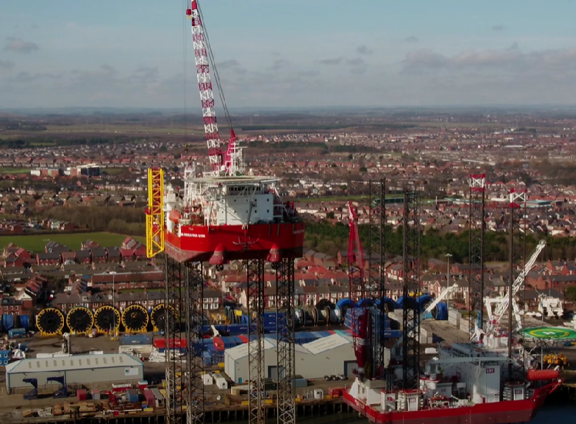
3
Your North East opportunities in Energy
0:00-2:10
Class activity (2 mins)
Watch the film about Port of Blyth, are there any facts here that surprised you?
Port of Blyth is a fascinating place at the cutting edge of off-shore renewable energy and cable handling.
Define: Subsea
Under the sea
Define: Offshore
Near to the coast
Port of Blyth regularly offers support to complex and unique offshore energy related projects for the likes of GE Renewable Energy, Subsea7, TechnipFMC, Saipem, Helix Energy Solutions and Baker Hughes.
©VotesforSchools The WOW Show 2022
Notes:
YouTube Video Link: https://www.youtube.com/watch?v=aPXZVmEDruk
SafeShare TV Video Link: https://safeshare.tv/x/aPXZVmEDruk#
Images
North East LEP
References
https://www.gov.uk/government/news/government-backs-britishvolt-plans-for-blyth-gigafactory-to-build-electric-vehicle-batteries
https://www.northeastlep.co.uk/key-sectors/energy/
https://www.news18.com/news/tech/explained-what-are-gigafactories-and-rils-big-plan-to-build-four-of-them-3887561.html
https://www.collinsdictionary.com/dictionary/english/subsea
https://www.collinsdictionary.com/dictionary/english/offshore
https://portofblyth.co.uk/offshore-energy/

Slide 17




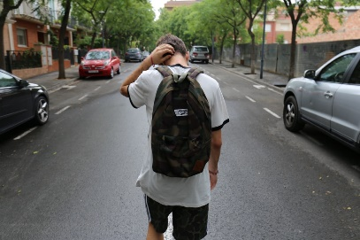

4
What are stereotypes?
Define: Stereotype
A set idea that people have about what someone or something is like, especially an idea that is wrong.
Stereotyping is a type of prejudice as it is a view often based on the appearance of a person.
Pair activity (3-5 mins)
On the next slide, you are going to see some phrases. In your pairs, choose two. Your task is to write what you think these phrases really mean and how they contribute to gender stereotypes.
Challenge:
Would you think twice about using any of these phrases again?
©VotesforSchools The WOW Show 2022
Notes:
Images
Unsplash
References
https://dictionary.cambridge.org/dictionary/english/stereotyping

Slide 18






4
What are stereotypes?
Give us a smile…
Come on, guys!
Boys don’t cry.
You’re just attention-seeking…
You’ll get over it!
You need to man up.
©VotesforSchools The WOW Show 2022
Notes:
Images
Unsplash

Slide 19
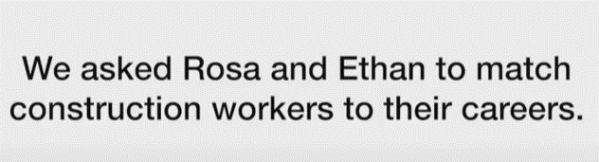
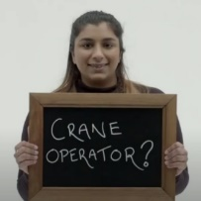
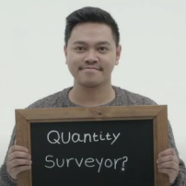
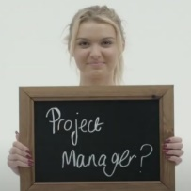
4
What are stereotypes?
You might have an image in mind of the kind of people who are likely to work in a particular sector. Now let’s take that idea a bit further…
Class discussion (4-5 mins)
Click the image to watch a short film. When you’ve finished, discuss the following question: are there any roles that you think can only be carried out by just one “type” of person? Why?
0:00-3:00
We can sometimes assume that certain sectors and roles require a particular person. However, the opposite is true! Most careers are open to everyone when they receive the right training.
Individual reflection (1-2 mins)
What is it about certain roles that make us think that only one type of person can do them? Do you think there are there any exceptions?
©VotesforSchools The WOW Show 2022
https://safeshare.tv/x/9xCn-Kwy97U
Notes:
YouTube Video Link: https://www.youtube.com/watch?v=9xCn-Kwy97U&feature=emb_logo
SafeShare Video Link: https://safeshare.tv/x/9xCn-Kwy97U
The WOW Show Link: https://www.thewowshow.org/mythbusters/
Images
1) Via video

Slide 20



5
Are you aware of heritage, identity and values?
Pair activity (4-5 mins)
Talk to a partner. What do you consider to be your heritage, identity and values?
Click to see some definitions if you aren’t sure.
Define: Heritage:
Features belonging to the culture of a particular society, such as traditions or languages, that were created in the past and still have importance.
Define: Identity:
Who a person is, or the qualities of a person or group that make them who they are and different from others.
Define: Values:
The principles that help you to decide what is right and wrong, and how you will act in various situations.
We all go through life with a sense of identity and values that we follow from our families and friends.
Our actions, and therefore our futures, can change based on how our values lead us in various situations.
©VotesforSchools The WOW Show 2022
Notes:
Images
Unsplash
References
https://dictionary.cambridge.org/dictionary/english/heritage
https://dictionary.cambridge.org/dictionary/english/identity
https://dictionary.cambridge.org/dictionary/english/values
https://www.familysearch.org/blog/en/what-is-heritage/
Images:
Icons8

Slide 21

6
What is discrimination?
Stereotyping can lead to discrimination without realising it, so it is important to always treat people equally.
Definition: Stereotype:
A set idea that people have about what someone or something is like, especially an idea that is wrong.
Equality means making sure individuals or groups are not treated differently based on a specific “protected characteristic”. These characteristics include race, gender, disability, religion or belief, sex, sexual orientation and age.
Pair discussion (2-3 mins)
Talk to a partner about the following question: have you ever felt discriminated against? When? What did you do?
Diversity aims to recognise, respect and value people’s differences. This then means they are able to reach their full potential and contribute to society because they have been encouraged through an inclusive culture.
©VotesforSchools The WOW Show 2022
Notes:
Images
iStock
References
https://dictionary.cambridge.org/dictionary/english/discrimination
https://www.oxfordshirelep.com/sites/default/files/uploads/Equality%20and%20Diversity%20Statement%20v2%20230519.pdf

Slide 22
6
What is discrimination?
As you have seen today, discrimination can affect what we choose to do as a future career. This can then lead to industries or companies missing out on having a more diverse workforce (the group of people working for them).
Final individual reflection (1-2 mins)
How has what you have explored today opened your eyes to your own career possibilities?
How will you use what you have learned to make sure you find your future right here in the North East?
©VotesforSchools The WOW Show 2022
Notes:
Images
Unsplash

Slide 23
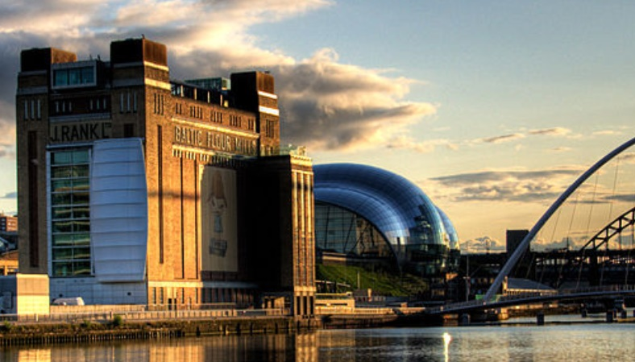

7
Take the initiative in your life
Define: Resilience
To stay positive, stay calm and go again when things go wrong.
0:00-2:13
Resilience is key to success. We all have successes and failures and it is important to learn from them.
Its important to know that different jobs and careers bring different challenges and rewards.
Class activity (4 mins)
Click the image to watch the video. Then, discuss how your own resilience is important for your future.
It is important that when things go wrong or are challenging that we stop, think and look for opportunities to improve and move forwards.
Challenge:
Can you think of a
career that would be very challenging but also very rewarding?
An example of a challenging career could be a paramedic, as it is something different every day. But, it is highly rewarding helping people.
©VotesforSchools The WOW Show 2022
Notes:
You Tube Video Link: https://www.youtube.com/watch?app=desktop&v=9biqmU4d2Ks
SafeShare TV Video Link: https://safeshare.tv/x/9biqmU4d2Ks
Staying Positive meaning Video: https://skillsbuilderpartnership.wistia.com/medias/dzwf6mz7k4
References:
https://www.skillsbuilder.org/insights

Slide 24



7
Take the initiative in your life
The internet has a whole host of information sources. For instance, The National Careers Service, Start and icould all have great support and advice. Click on the logos to visit their sites.
The National Careers Service provides careers information, advice and guidance. They can help you to make decisions on learning, training and work at all stages in your career.
Start will help you to find out which subjects and qualifications will help to prepare you for your future? Also, which pathway is right for you?
icould is a great place to get tips on GCSE options, apprenticeships, university, finding work (and much more!).
©VotesforSchools The WOW Show 2022
Notes:
Images & References
https://icould.com/
https://careers.startprofile.com/page/home-page
https://nationalcareers.service.gov.uk/

Slide 25
Thank you!
©VotesforSchools The WOW Show 2022

