Slide 1

Our Region, Your Future
The world of work in the North East
General Lesson
In association with VotesforSchools and The WOW Show
©VotesforSchools The WOW Show 2022

Slide 2



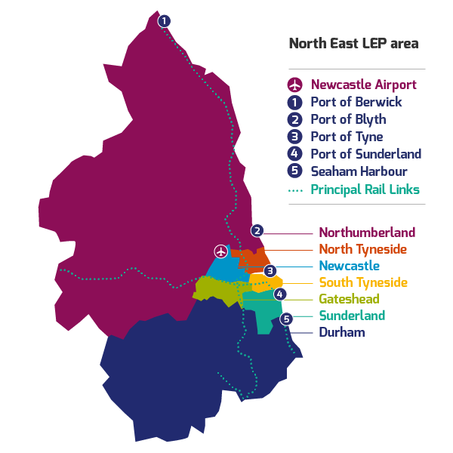
What is Labour Market Information?
Define: Labour Market Information/Intelligence (LMI)
This tells you about the current work and job opportunities in your area.
LMI is important for social mobility. It allows young people to be more equipped to understand what is on offer in their region and how to get there by making informed decisions about their future career choices.
LMI is talked about in schools so that students understand what it is and why it is important in their search for a career.
It helps decode the world of work by breaking it down into digestible chunks.
LMI highlights the fantastic career opportunities available and what opportunities and growth areas there are in your region.
©VotesforSchools The WOW Show 2022
Notes:
Images
North East LEP
References
http://www.lmiforall.org.uk/explore_lmi/
https://www.lmiforall.org.uk/explore_lmi/learning-units/what-is-lmi/ - There is a YouTube video explaining LMI if needed on this page.

Slide 3



What is Labour Market Information?
LMI can help you understand what jobs are available near to you. It can also show how many jobs there are in different sectors now, and how many there are projected to be in the future.
Define: Sector
An area of work and production that makes money for an area or country.
The North East has so many great opportunities for work and training there really is no need to leave!
LMI could help you see where job opportunities are and how much certain roles pay. This can help you think about what you want the future to look like.
LMI is updated regularly, so you can see how job opportunities change and some sectors grow.
©VotesforSchools The WOW Show 2022
Notes:
Images
North East LEP
References
http://www.lmiforall.org.uk/explore_lmi/
https://www.lmiforall.org.uk/explore_lmi/learning-units/what-is-lmi/ - There is a YouTube video explaining LMI if needed on this page.

Slide 4



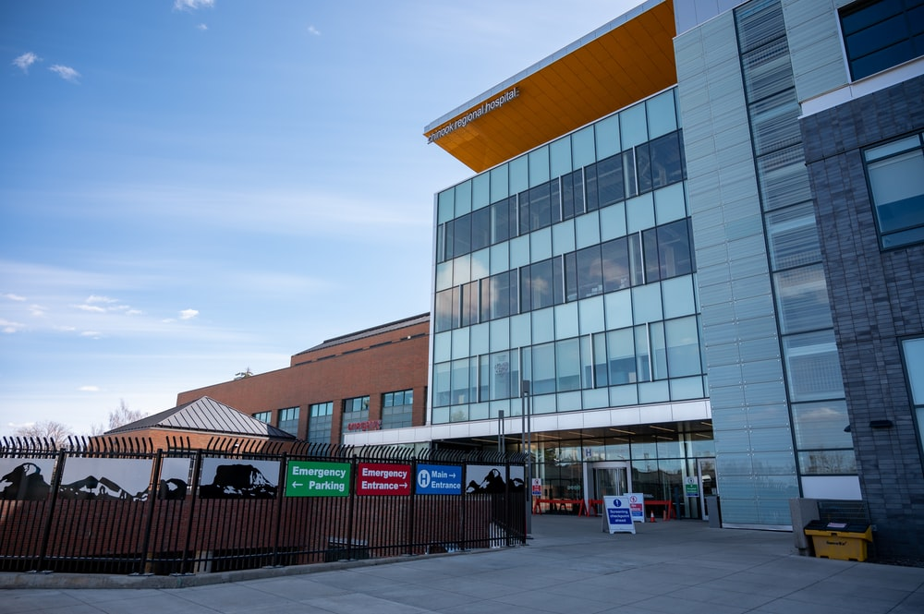
What is the LMI in the North East?
Transport & Logistics:
Transport of people and movement of goods (things we buy).
Advanced Manufacturing:
This includes making parts for cars, trains, electronics and subsea engineering.
Construction:
Building and work across all parts of our built environment.
Health & Social Care:
Research and development into health and care (looking after people).
©VotesforSchools The WOW Show 2022
Notes:
Please Note: The North East Local Enterprise Partnership works with partners to develop a more competitive economy for the North East, Helping to create more and better jobs for everyone.
Images
Unsplash
References
https://www.northeastambition.co.uk/toolkits/labour-market-insights-toolkit
https://www.northeastlep.co.uk/key-sectors/
https://evidencehub.northeastlep.co.uk/report/gva-industry
https://dictionary.cambridge.org/dictionary/english/manufacturing
https://dictionary.cambridge.org/dictionary/english/administration
https://dictionary.cambridge.org/dictionary/english/retail
https://dictionary.cambridge.org/dictionary/english/social-care

Slide 5




What is the LMI in the North East?
Digital:
Work involving Information Technology (IT) and digital data.
Education:
There are over 1,150 schools in the North East and five universities.
Financial & Business Services:
This includes financial and legal services.
Energy:
Research and development in producing energy.
©VotesforSchools The WOW Show 2022
Notes:
Please Note: The North East Local Enterprise Partnership works with partners to develop a more competitive economy for the North East, Helping to create more and better jobs for everyone.
There are four Universities in the North East LEP and one in Tees Valley
There are nine Further Education colleges and two sixth forms
There are over 240 secondaries including SEND, PRU and Alternative Provision
There are over seven hundred primaries
https://explore-education-statistics.service.gov.uk/find-statistics/school-pupils-and-their-characteristics
Images
Unsplash
References
https://www.northeastambition.co.uk/toolkits/labour-market-insights-toolkit
https://www.northeastlep.co.uk/key-sectors/
https://evidencehub.northeastlep.co.uk/report/gva-industry
https://dictionary.cambridge.org/dictionary/english/manufacturing
https://dictionary.cambridge.org/dictionary/english/administration
https://dictionary.cambridge.org/dictionary/english/retail
https://dictionary.cambridge.org/dictionary/english/social-care

Slide 6


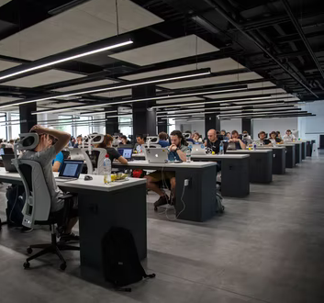

What is the LMI in the North East?
As well as the sectors featured in this lesson, there are lots of other opportunities here in the North East.
Office work:
Keeping records & computer work
Hospitality:
Hotels, restaurants, theatres and bars
Shop work:
Helping out customers
Catering:
Preparing and serving food or drink
©VotesforSchools The WOW Show 2022
Notes:
Please Note: The North East Local Enterprise Partnership works with partners to develop a more competitive economy for the North East, Helping to create more and better jobs for everyone.
Images
Unsplash
References
https://www.northeastambition.co.uk/toolkits/labour-market-insights-toolkit
https://www.northeastlep.co.uk/key-sectors/
3) https://www.business-live.co.uk/enterprise/annual-top-200-list-reveals-20887928

Slide 7
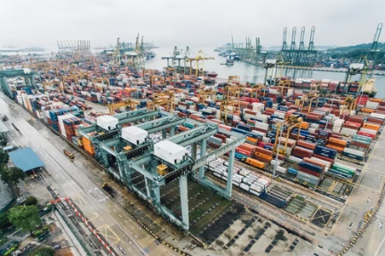



Your North East opportunities in Transport & Logistics
The North East has a whole host of careers in transport. There are buses, trains, a ferry and aircraft at Newcastle Airport.
0:00-2:22
A wide variety of roles exist across these modes of transport. These include things like driving, maintenance, planning routes, design, or administration.
Transport is how the North East connects up locally, regionally, nationally as well as globally to prosper. Click the image above to find out more.
Good transport networks help people move for jobs and leisure and distribute goods and services across the economy.
©VotesforSchools The WOW Show 2022
Notes:
YouTube Video Link: https://www.youtube.com/watch?v=pVUSJl6nCJk&t=12s
SafeShare Video Link: https://safeshare.tv/x/pVUSJl6nCJk
Image
Unsplash
References
https://evidencehub.northeastlep.co.uk/our-data/transport/
https://www.northeastlep.co.uk/the-plan/support/transport-and-logistics/

Slide 8

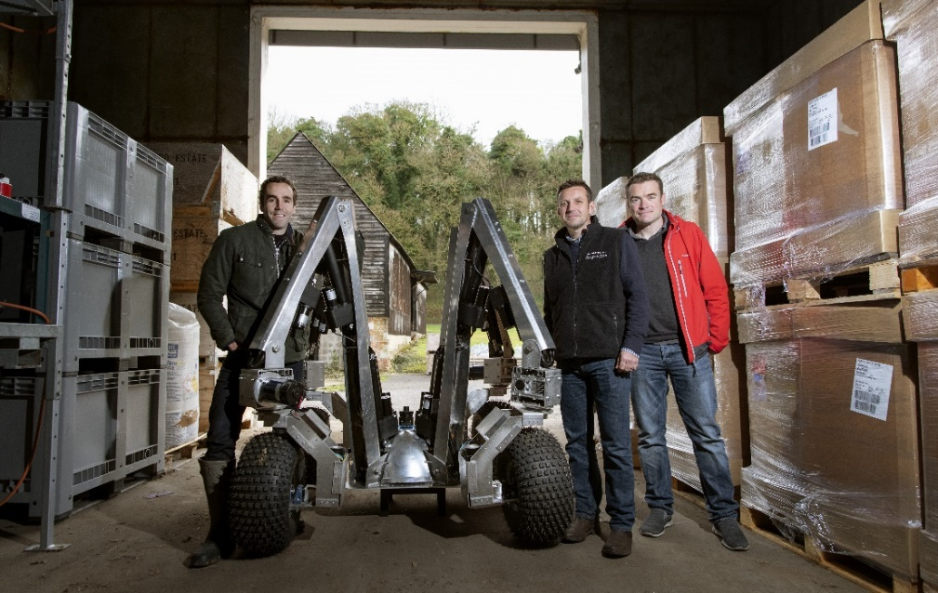
Your North East opportunities in Digital Technology
You may not think that an interest in robots or computer programming could result in a future career in agriculture, but a company here in the North East is here to prove that assumption wrong…
Small Robot Company (SRC), which focuses on sustainable farming, announced that its initial fleet of 10 robots will be manufactured by Tharsus, a Blyth-based advanced machine and robots designer and manufacturer.
0:00-2:16
The digital agenda is rapidly developing in the UK and Newcastle is one of the most popular cities in UK for high-growth digital businesses. The North East has specialisms in data analytics, virtual reality, cyber security and games design and delivery to name but a few!
Click the image above to find out more about SRC!
©VotesforSchools The WOW Show 2022
https://safeshare.tv/x/McUhua_gnpw
Notes:
YouTube Video Link: https://www.youtube.com/watch?v=McUhua_gnpw&t=147s ( - )
SafeShare Video Link: https://safeshare.tv/x/McUhua_gnpw
Images
https://drive.google.com/file/d/1aq4LJ7oXkW64Wmnoymfy84fY2TmqR3FR/view
References
https://bdaily.co.uk/articles/2020/02/07/fleet-of-farming-robots-to-produced-in-Northumberland
https://www.smallrobotcompany.com/press-releases/2020/2/7/small-robot-company-announces-robot-fleet-manufacture-with-tharsus

Slide 9
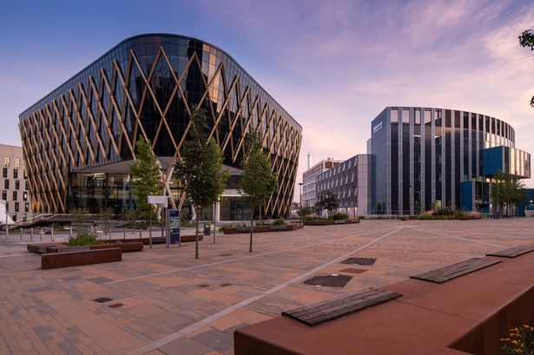
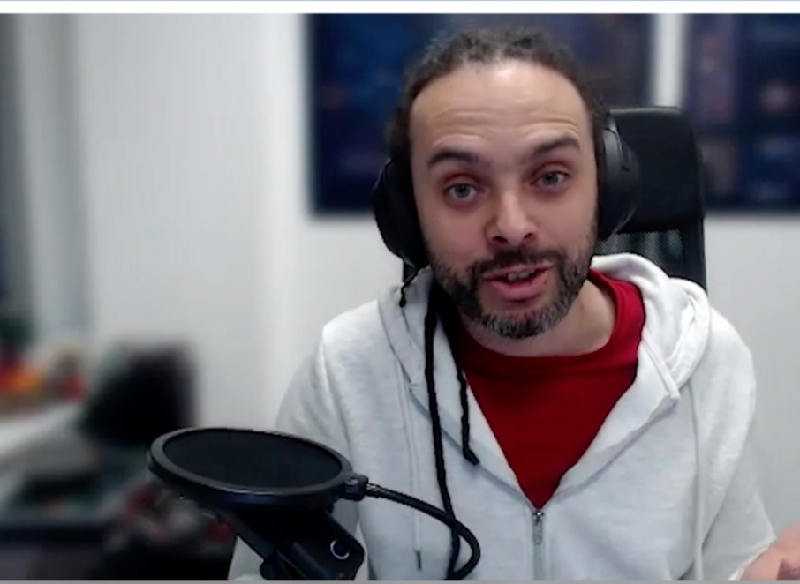
Your North East opportunities in Digital Technology
There are thousands of great opportunities across the North East, and it has one of the fastest growing digital and tech clusters in the United Kingdom.
0:00-2:17
There are over 29,000 IT & digital employees in the North East, with 15,250 creative industries employees. They contribute £2 billion to the northern ICT economy.
The North East currently has 32,000 creative employees in immersive technology, music, performing arts, libraries, museums, software development, the arts, games development and so much more.
0:00-2:46
Click the image above to find out more about the sector!
©VotesforSchools The WOW Show 2022
Notes:
YouTube Video Link: https://www.youtube.com/watch?v=BaJSciOb2nI&list=PLGVCpm23HHF_z_m8W1dRkwU1BwV2uA5fB
SafeShare Video Link: https://safeshare.tv/x/BaJSciOb2nI
YouTube Video Link:
SafeShare Video Link: https://safeshare.tv/x/ss6217eda402f39
https://www.gov.uk/government/statistics/dcms-sector-economic-estimates-2021-employment-2019-to-june-2021
Images
1) https://www.google.com/url?sa=i&url=https%3A%2F%2Fwww.business-live.co.uk%2Feconomic-development%2Fhundreds-north-east-smes-benefit-19072739&psig=AOvVaw3K0QHCT5W5icgzEsMZVPgW&ust=1643291659695000&source=images&cd=vfe&ved=0CAwQjhxqFwoTCJC05tLIz_UCFQAAAAAdAAAAABAD
References:
https://www.northeastlep.co.uk/key-sectors/digital/
https://www.ccskills.org.uk/

Slide 10
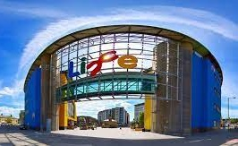

Your North East opportunities in Health and Life Sciences
Healthcare and life science technologies are innovating at a great pace, demonstrated by the need to respond to challenges such as the Covid-19 pandemic, an ageing population, and obesity. The North East has a great combination of researchers through the universities and also the ability to test and manufacture quickly.
Whether there is interest in a career in the NHS or in the development and manufacture of medicines, the North East has thousands of opportunities through many different routes.
Did you know?
The Life Centre carries out ground-breaking medical research.
0:00-2:18
NHS Jobs is an online recruitment service for the NHS and other health-related organisations. There are around 20,000 adverts every month, so for NHS or health-related career information, this site should be your first port of call.
Click the image to find out more about this.
©VotesforSchools The WOW Show 2022
Notes:
YouTube Video Link: https://www.youtube.com/watch?v=I5KyXKre9So
SafeShare Video Link: https://safeshare.tv/x/I5KyXKre9So
Images
North East LEP
References:
https://www.jobs.nhs.uk/advice/intro.html
https://www.life.org.uk/about
https://jobs.life.org.uk/

Slide 11


Your North East opportunities in Energy
With so many advances in technology, increasing population and changing climates, the way we generate and use energy will constantly evolve.
Did you know?
Renewable energy sources are key for the future and the North East is leading the way!
The North East is involved in world-leading projects such as offshore energy, renewables and the development of hydrogen technologies.
0:00-3:32
The North East is already an important place for research and innovation in solving challenges with energy.
Click the image above to find out more about the Energy opportunities in the North East.
©VotesforSchools The WOW Show 2022
Notes:
YouTube Video Link: https://www.youtube.com/watch?app=desktop&v=_fu-5AYPenA&feature=youtu.be
SafeShare Video Link: https://safeshare.tv/x/_fu-5AYPenA
Images
Unsplash
References
https://www.northeastlep.co.uk/key-sectors/energy/
https://www.northeastautomotivealliance.com/

Slide 12
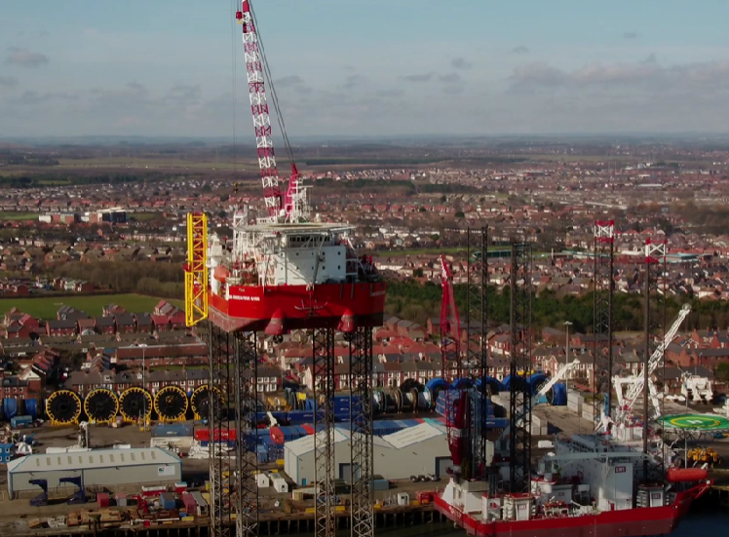
Your North East opportunities in Energy
Port of Blyth is a fascinating place at the cutting edge of off-shore renewable energy and cable handling.
0:00-2:10
Define: Subsea
Under the sea
Define: Offshore
Near to the coast
Port of Blyth regularly offers support to complex and unique offshore energy related projects for the likes of GE Renewable Energy, Subsea7, TechnipFMC, Saipem, Helix Energy Solutions and Baker Hughes.
©VotesforSchools The WOW Show 2022
Notes:
YouTube Video Link: https://www.youtube.com/watch?v=aPXZVmEDruk The WOW Show film
SafeShare TV Video Link: https://safeshare.tv/x/aPXZVmEDruk#
Images
North East LEP
References
https://www.gov.uk/government/news/government-backs-britishvolt-plans-for-blyth-gigafactory-to-build-electric-vehicle-batteries
https://www.northeastlep.co.uk/key-sectors/energy/
https://www.news18.com/news/tech/explained-what-are-gigafactories-and-rils-big-plan-to-build-four-of-them-3887561.html
https://www.collinsdictionary.com/dictionary/english/subsea
https://www.collinsdictionary.com/dictionary/english/offshore
https://portofblyth.co.uk/offshore-energy/

Slide 13
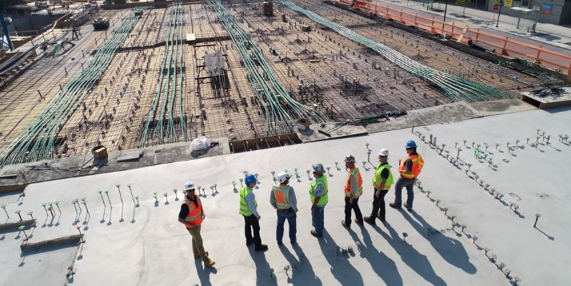
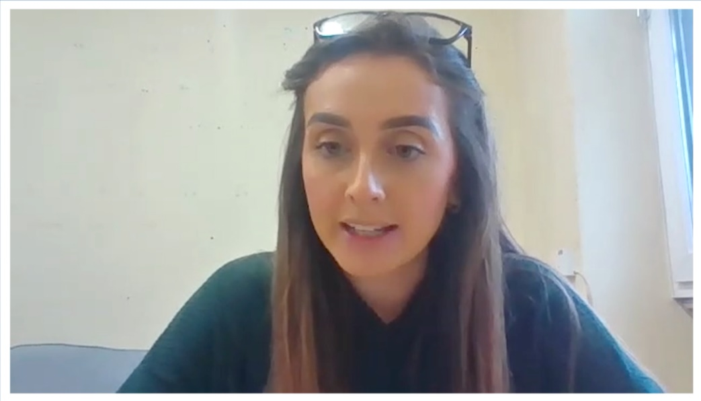

Your North East opportunities in Construction
The North East has a vast array of interesting and rewarding opportunities for everyone within the construction sector.
The challenges of a more sustainable industry include using new types of resources, reducing energy use and promoting recycled materials.
0:00-2:32
Over 6,000 enterprises employ over 50,000 people in construction in the North East.
Go Construct has great advice on the routes into construction and variety of roles. Click the logo to learn more.
©VotesforSchools The WOW Show 2022
Notes:
YouTube Video Link:
SafeShare Video Link: https://safeshare.tv/x/ss6217ee56c47db
References:
https://www.neupc.ac.uk/buildingbetterfutures
https://www.northeastlep.co.uk/the-plan/support/construction/
https://www.mckinsey.com/business-functions/sustainability/our-insights/sustainability-blog Green construction information
https://www.netzeroteesside.co.uk/
Images:
Unsplash
Icons 8

Slide 14




Your North East opportunities in Financial and Business Services
The North East is home to the headquarters of the likes of Virgin Money and Newcastle Building Society, as well as specialist teams, shared services centres, and the local offices of other well-known national brands. Click the images to visit their careers pages.
Also based here are leading regional companies in law and finance, and specialist consultancies supporting key areas of opportunity like offshore energy.
Did you know?
There are over 5,500 companies employing over 40,000 people in these sectors.
©VotesforSchools The WOW Show 2022
Notes:
Images:
North East LEP
Unsplash
References:
https://www.northeastlep.co.uk/the-plan/support/financial-professional-and-business-services/
https://careers.virginmoney.com/
https://www.newcastle.co.uk/careers

Slide 15

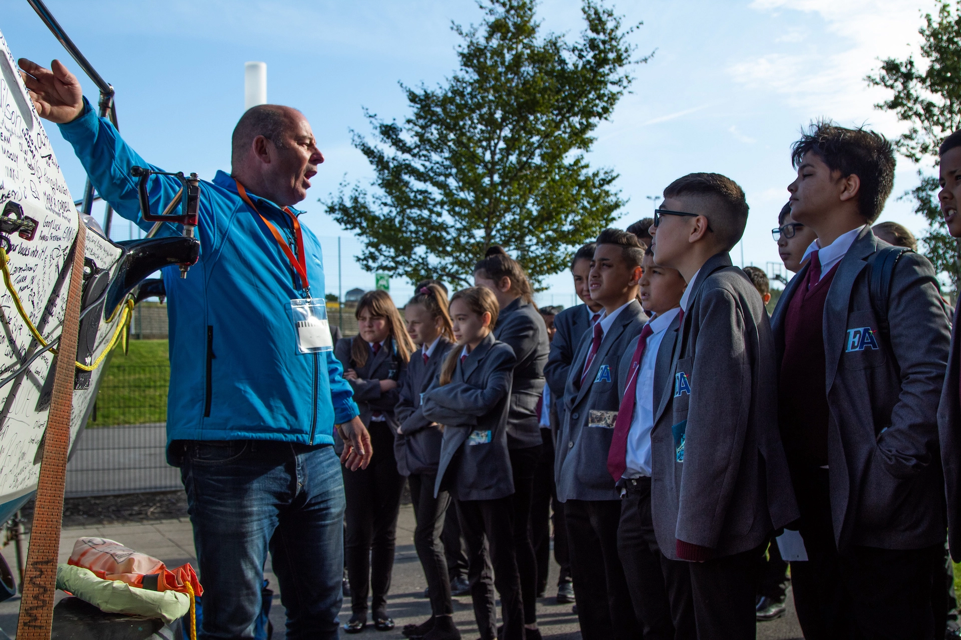
Your North East opportunities in Education
Did you know?
There are over 1,150 schools and five universities in the North East.
Over 78,000 people are employed in education in the North East across a host of different roles.
Skills are critical to the health of the regional economy and the education sector is a high-value employer providing skilled employment across the North East.
Working with young people is incredibly rewarding and there are lots of routes into these roles.
©VotesforSchools The WOW Show 2022
Notes:
References:
https://www.northeastambition.co.uk/education
27,000 employees in primary / pre-primary education (NE region 38,000)
22,000 in secondary education (NE region 31,000)
18,000 in higher education (NE region 19,000)
The remainder were in other education industry groups, with most being in “other education not elsewhere classified” (ie not the above or sport, recreation or cultural education or driving schools or support activities)
Images:
https://www.northeastambition.co.uk/education

Slide 16
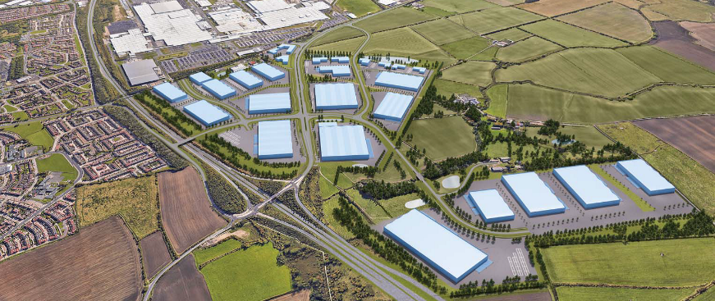
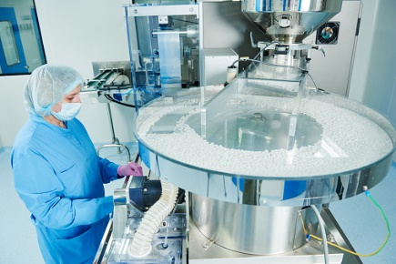
Your North East opportunities in Advanced Manufacturing
The North East has a fantastic reputation in Advanced Manufacturing, with lots of great opportunities!
0:00-2:16
Our region manufactures automotive products including passenger cars, trains and heavy off-road vehicles and a range of parts and components.
There are specialisms in automotive manufacturing, rail, electronics, pharmaceuticals and subsea engineering.
Click the image above to find out more about this sector.
Define: GDP
Gross Domestic Product is a measure of the health and size of a country’s economy.
Did you know?
The North East medicines cluster produces 33% of the UK’s GDP in pharmaceutical manufacture and packaging.
©VotesforSchools The WOW Show 2022
Notes:
YouTube Video Link: https://youtu.be/cg1cHr2lXl8
SafeShare Video Link: https://safeshare.tv/x/ss61f7c4eb81103
Images
Via video
References
https://www.northeastlep.co.uk/key-sectors/advanced-manufacturing/
https://www.northeastlep.co.uk/projects-and-funding/projects/international-advanced-manufacturing-park-iamp/
https://evidencehub.northeastlep.co.uk/report/advanced-manufacturing
https://www.bankofengland.co.uk/knowledgebank/what-is-gdp
https://www.northeastlep.co.uk/wp-content/uploads/2015/10/Lifescience-Brochure-23-10-15-amended.pdf

Slide 17









What is important at work?
These resources also look at the key skills involved in getting a keeping a job, some examples of which are listed below. You will also think about your strengths and how they relate to the world of work.
Leadership
Being a boss
Teamwork
Working together
Problem-solving
Sorting out problems
Listening
Hearing others
Aiming high
Doing your best
Speaking
Talking to others
Creativity
Thinking differently
Staying positive
Being happy
©VotesforSchools The WOW Show 2022
Notes:
Teacher’s Note: Many North East schools use https://www.skillsbuilder.org/ to support this area of the curriculum.
Images
Unsplash

Slide 18



Recognising learning pathways
The internet has a whole host of information sources. For instance, The National Careers Service, Start and icould all have great support and advice. Click on the logos to visit their sites.
The National Careers Service provides careers information, advice and guidance. They can help you to make decisions on learning, training and work at all stages in your career.
Start will help you to find out which subjects and qualifications will help to prepare you for your future? Also, which pathway is right for you?
icould is a great place to get tips on GCSE options, apprenticeships, university, finding work (and much more!).
©VotesforSchools The WOW Show 2022
Notes:
Images & References
https://icould.com/
https://careers.startprofile.com/page/home-page
https://nationalcareers.service.gov.uk/

Slide 19
Thank you!
©VotesforSchools The WOW Show 2022

Slide 20





Finding help & information
Young enterprise Company Programme provides teams of students, aged between 13-19, with an opportunity to create and run their own company, supported by a Business Volunteer.
Education Development Trust offers a range of impartial services that are underpinned by the 8 Gatsby benchmarks. Supporting schools and colleges to deliver a stable careers programme that addresses each student’s needs.
Forum Talent Potential incorporates employer input into existing study modules and seeks to help teachers bring traditional curriculum subjects alive through the context of careers.
NCS exists to engage, unite and empower young people, building their confidence to achieve their potential, regardless of background and life opportunities.
The North East Uni Connect Programme (NEUCP) is a partnership of all of the universities and colleges in the North East region who are working together to support young people in the North East think about their futures and how higher education can help them reach their goals.
©VotesforSchools The WOW Show 2022
Notes:
References
https://www.northeastambition.co.uk/directory/-ncs-skills-booster-programme
https://www.northeastambition.co.uk/directory/young-enterprise-company-programme
https://www.northeastambition.co.uk/directory/education-development-trust
https://www.northeastambition.co.uk/directory/unlocking-talent-and-potential
https://www.northeastambition.co.uk/directory/futureme

Slide 21





Finding help & information
The North East Raising Aspiration Partnership is a collaboration of the five universities in the North East of England, working together to support young people to think about their futures and how higher education can help them reach their goals.
NUSTEM works with teachers and employers to develop resources for Primary and Secondary schools and for family activities.
Outreach North East is a single point of contact for teachers and advisers in the North East of England which aims to provide impartial information about higher education to help teachers and advisers best support their students in making informed choices about their futures.
The Skills Builder Partnership brings together over 800 schools, colleges, employers and organisations around a common approach to building eight essential skills.
Speakers for Schools was founded in 2010 and is supported by ITV’s Political Editor Robert Peston and supported by the Law Family Charitable Foundation with a mission to help level the playing field for young people of all backgrounds.
©VotesforSchools The WOW Show 2022
Notes:
References
https://www.northeastambition.co.uk/directory/skills-builder-accelerator
https://www.northeastambition.co.uk/directory/educational-speakers
https://www.northeastambition.co.uk/directory/higher-education
https://www.northeastambition.co.uk/directory/-nustem-northumbria-university
https://www.northeastambition.co.uk/directory/www.outreachnortheast.ac.uk

Slide 22





Finding help & information
Start is a digital careers platform with the information, advice and tools your learners need to grow in confidence and prepare for their future.
Success at School is the place for young people to explore careers, get the lowdown on top employers, and search for the latest jobs, courses and advice.
Sunderland Engineering Training Association (Seta) is a not-for-profit Group Training Association which delivers apprenticeships and both standard and bespoke commercial training courses.
Team Programme is an enterprise journey for learners who have mild to moderate learning difficulties.
The Register is the single national directory of professionally qualified careers practitioners working across schools, colleges and universities, as well as public sector and private practitioners for adults.
©VotesforSchools The WOW Show 2022
Notes:
References
https://www.northeastambition.co.uk/directory/-sunderland-engineering-training-association
https://www.northeastambition.co.uk/directory/young-enterprise-team-programme
https://www.northeastambition.co.uk/directory/career-development-professionals
https://www.northeastambition.co.uk/directory/start-profile
https://www.northeastambition.co.uk/directory/careers-resource-success-at-school

