Slide 1
Careers in the North East health and life sciences sector
Health and social care
Notes:
Please read accompanying teacher guide before delivering these lesson resources

Slide 2
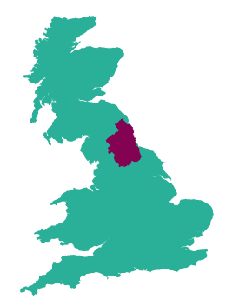
The health and life sciences sector in the North East
Health and life sciences is a sector of strategic importance to the North-East economy, due to our exceptional health and life science assets and strengths in medicines manufacturing.
There are over 5000 people employed in over 250 health and life sciences businesses in our region and this is growing
North East England
is a major centre
for medicines manufacturing with companies across our region making a vital contribution to the supply of essential medicines across the world
Our region is home to a thriving community of innovative life sciences businesses, developing new treatments and technologies to diagnose, prevent, and treat diseases such as cancer and COVID-19
Several world class research and innovation centres are based here in the North East including; the Centre for Life, the Centre for Process and Innovation and the National Innovation Centre for Ageing
Our hospital trusts
have a worldwide reputation for the quality and range of their clinical research and facilities
Notes:
Employment and enterprise figures quoted based upon ONS 20/21 data. The most up to date labour market data available can be accessed via the North East evidence hub
Health and life sciences (northeastlep.co.uk)

Slide 3
What is health and social care?
The health and social care sector consists of organisations which provide healthcare support or social care support to people.
Healthcare involves preventing, diagnosing and treating mental and physical illnesses, diseases and injuries and can be provided by a variety of people including GP’s, nurses, hospital doctors, dentists, opticians, occupational therapists and psychiatrists.
Social care services provide practical help and support such as accommodation, help at home, day centres, live-in care services, home adaptations and independent living to those who need it due to illness, disability or age.

Slide 4
Health sector employment in the North East
Health is the largest employment sector in the North East employing around 128,000 people. Around 50,000 of these work in local NHS trust hospitals and clinics. There are 350 different job roles in the NHS.
The Newcastle Upon Tyne Hospitals NHS Foundation Trust is a centre of excellence in medical research and innovation. The trust includes the Integrated Covid Hub which is the first of it's kind in the UK and the UK’s only Cardiothoracic Centre dedicated to adult and paediatric care.
Cumbria, Northumberland, Tyne and Wear NHS Foundation Trust is one of the largest mental health and disability Trusts in England.
The Northumbria Specialist Emergency Care Hospital in Cramlington was the first purpose-built hospital in England dedicated to emergency care.
Our medical training is rated as among the best in the UK, we are home to one of the UK’s top ten medical schools at Newcastle, and an innovative new medical school in Sunderland.
Notes:
Facts and figures around the health sector in the North East
Further information available at:
https://digital.nhs.uk/data-and-information/publications/statistical/nhs-workforce-statistics/october-2021
https://www.kingsfund.org.uk/audio-video/key-facts-figures-nhs

Slide 5
Adult social care employment in the NE
Employment status
Qualifications by level
94%
Entry/Level1
0%
88,000 jobs and 81,000 people working in adult social care in the North East region.
2%
4%
Permanent
Temporary
Bank/Pool
Level 2
26%
4,500 vacancies
were advertised on an average day 2020/2021.
Level 3
21%
96% jobs filled by individuals with a British nationality. 2% of the jobs are filled by individuals with an EU nationality and another 2% by non EU nationality.
.
Level 4 and above
5%
Notes:
Local area information (skillsforcare.org.uk)
This link highlights key labour market information (LMI) for social care at a local authority level so schools can bring in relevant facts depending on their location

Slide 6
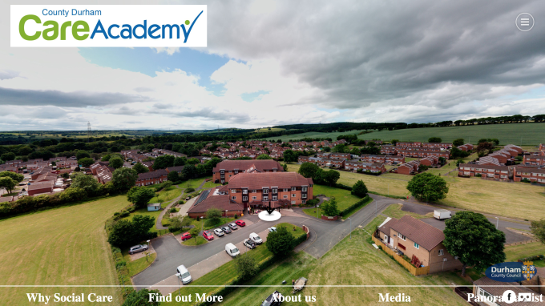
Workplace Tour: Durham Care Academy
Navigate your way around Durham Care and meet a range of employees describing their roles and career pathways open to you within the sector.
Student Activity
Explore the Workplace (northeastambition.co.uk)
Notes:
Optional activity: Students navigate their way around the virtual tour and complete the activities in the accompanying resource pack

Slide 7
Jobs in health and social care
Questions
Where does the person work?
What job does the speaker have and what types of things do they do in the role?
What qualifications do you need to get the job?
Which skills are important to the job?
How can you find out more about jobs such as these?
Watch the videos of people working in health and social care in the North East and answer the questions.
Radiographer
Genomics Practitioner
Dental Nurse Apprentice
Support Worker
Deputy Operations Director
Notes:
Students watch videos (teacher can select one which is most relevant to their students if preferred) and answer questions
See accompanying teacher guide for overview of video content
NHS Radiographer (2:02)
https://www.youtube.com/watch?v=i5v2OFXF7Lk&t=84s
Genomics practitioner (1:55)
https://www.youtube.com/watch?v=fdhQyolYUEg&list=PLnnppXZprOJe8gfYwKSygLJ3kKOSEDU9g&index=8
Dental Nurse Apprentice, Newcastle Dental Hospital (2:11)
https://www.youtube.com/watch?app=desktop&v=PxiHpercUyU&list=PLnnppXZprOJe8gfYwKSygLJ3kKOSEDU9g&index=4
Support worker Harry (2:03)
https://www.adultsocialcare.co.uk/personal-experiences/Support-Worker-Harry.aspx
Bev, Deputy Operations Director adult social care (1:16)
https://www.adultsocialcare.co.uk/personal-experiences/Bev-Deputy-Operations-Director.aspx

Slide 8
What careers are available in health and social care?
Here are some examples of jobs which are available in this sector:
Pick one of the jobs listed and research the following:
What is the job, what types of things would you do in the role?
How many hours would you work a week? Is it a typical 9-5 or varied hours? Can you work part-time or freelance?
What qualifications do you need to get the job?
What is the starting salary?
What jobs could you progress to in the future?
Paramedic
Pathologist
Radiographer
Audiologist
Healthcare science assistant
Dentist
Care worker
Biomedical scientist
Anaesthetist
Chiropractor
Genomics practitioner
Physiotherapist
Speech and language therapist
Psychologist
Nutritionist
Nursing associate
Midwife
Personal care assistant
Notes:
Slide 1 of optional extension task – only use this if you would like to turn this into a whole careers lesson rather than starter/plenary. Alternatively this activity can be set as home learning.
Activity – ask students to pick one of the jobs from the slide and then use the guiding questions on the slide to find out more about it. Websites such as the National Careers Service can be a helpful place to start but links to more detailed information on roles in the health and social care sector can be found on the next slide.

Slide 9
Useful links for research task on job roles
Routes into health and social care
Local employers
NHS Careers
Health careers | Healthcare Science
National Careers Service
Prospects | Healthcare
Amazing Apprenticeships
GOV UK | Apprenticeships
Institute for Apprenticeships | Occupational Maps
Department for Education | Post-16 options
Adult Social Care jobs: Explore roles and care settings
Take the quiz: Could you work in Adult Social Care?
Northumbria Healthcare NHS Trust
Gateshead Health NHS Foundation Trust
Newcastle upon Tyne Hospitals NHS Foundation Trust
Cumbria, Northumbria, Tyne and Wear NHS Foundation Trust
County Durham and Darlington NHS Foundation Trust
South Tyneside and Sunderland NHS Foundation Trust
Tees, Esk and Wear Valleys NHS Foundation Trust
NHS Shared Business Services
North East Ambulance Service NHS Trust
Integrated COVID Hub North East
Pioneering Care Partnership
Healthcare Careers | Exemplar Health Care (exemplarhc.com)
Home care agencies in Newcastle - Information Now
HOME - Sunderland Care and Support
County Durham Care Academy
Notes:
Slide 2 of optional extension task - research links

Slide 10
Skills for careers in health and social care
In today’s lesson we will learn about:
Text
Text
Text
We will develop skills such as:
Text
Text
Text
These are important for the health and social care sector because:
Text
Text
Text
Notes:
[Teacher to choose curriculum links most appropriate for the topic currently being studied and how this links to the health and social care sector]
See accompanying teacher briefing guide for suggested curriculum links

Slide 11
Review
How does what we have learned today link to the health and social care sector?
Want to find out more?
Here are some links to more information on careers in health and social care in the North East:
National careers service
Overview of the careers in healthcare | Prospects.ac.uk
Health careers - explore roles in healthcare science
Amazing apprenticeships
Find an apprenticeship
Institute for apprenticeships occupational maps
Dept for Education – post-16 choices
LMI For All – LMI For All
North East Local Enterprise Partnership - Health and Life Sciences
Social Care Careers - Youth Employment UK
Home care agencies in Newcastle - Information Now
Integrated Covid Hub North East
Notes:
Optional plenary task to follow subject lesson and link to starter activity.

Slide 12
Notes:
https://www.northeastlep.co.uk/

