Slide 1
LMI for the Careers Leader Part 5 What should a Careers Leader know about the labour market?
Notes:
Hello and welcome to part 5 of LMI for Careers Leaders. In this video we will look at where LMI fits into the overall duties and responsibilities of the Careers Leader in English schools and colleges. There is much more to the Careers Leader role than simply dealing with LMI – as everyone who has the role, or has had it in the past, will know – however if labour market information can be embedded successfully into the life of the institution then many other parts of the Careers Leader’s role should become much easier.

Slide 2
LMI elements of the four key Careers Leader duties
1 Leadership
- understanding the implications of a changing education landscape for career guidance eg, technical education reform
2 Management
- briefing and supporting teachers involved in career guidance
3 Coordination
- managing the provision of career and labour market information
4 Networking
- establishing and developing links with employers
Understanding the role of the Careers Leader
(Careers and Enterprise Company. 2018)
Notes:
The Careers and Enterprise Company sets out the role of Careers Leader clearly and concisely in this short publication from 2018. There are separate versions for the role in schools and colleges. Reading this guide is similar to reading a job description for the post of Careers Leader and all responsibilities are neatly packaged into four key areas, shown on the slide. A number of specific duties are grouped under each area and in the examples shown we have selected those most closely related to the labour market.

Slide 3
A guide to support Careers Leaders with LMI (amongst other things…)
“Part of the role of Careers Leader is to take responsibility for ensuring that students and parents have access to good-quality information on future study options and career opportunities…”
The Careers Leader Handbook
(Trotman. 2018)
Notes:
If your budget can stretch to it this is a highly recommended handbook to accompany the role of Careers Leader. In it are a number of hints and tips about how to carry out the role and an in-depth look at how to achieve each of the Gatsby Benchmarks. As you might expect this includes a detailed look at the collection and dissemination of labour market information, from local to global.

Slide 4
Making sense of LMI
“…but your role extends beyond making careers information available and accessible: it also involves planning activities to help students develop the important career management skills of using the careers information effectively”
The Careers Leader Handbook
(Trotman. 2018)
Notes:
The handbook makes it clear that simply providing information on careers, vacancies, education and training pathways and employment sector forecasts is not enough…the Careers Leader must ensure that there are inspiring and interactive ways of engaging with this information and using it. The development of Career Management Skills – sometimes referred to as CMS – has been a growing feature of careers programmes throughout the last ten years in response to the rapidly changing labour market through which young people will one day need to navigate.

Slide 5
6 top tips for Careers Leaders
Work with your Enterprise Adviser to devise an LMI strategy for your school or college. Perhaps you have a link governor too?
Review your website and other resources to check that they are accurate and engaging
Start early so that students and parents/carers can build up a realistic picture of the labour market
Use careers events and parents’ evenings to showcase career pathways
Work with Jobcentre Plus schools advisers to give the right messages about the labour market to both students and staff
Use a wide range of media to promote career exploration eg, posters, social media, school website and physical resources eg, in a library
The Gatsby Benchmark Toolkit for Schools
(Careers and Enterprise Company. 2018)
Notes:
The Gatsby Benchmark Toolkit, mentioned in part 2 as an important guide to devising your LMI strategy, makes six useful suggestions about how you can raise awareness and understanding of the labour market. Why do it all on your own? Use the support mechanisms around you to help share the load and take on board the views of others when implementing your LMI strategy. And don’t forget your most important stakeholders…your students! What do they think about the world of work around them? What are their hopes and fears? What do they want to learn about? We have previously talked about doing a survey amongst your students about their views on LMI before you even start this whole process. This could reveal a whole host of valuable data around their current knowledge of the labour market and the aspirations they have for their future.

Slide 6
Knowledge is power for the Careers Leader…
Globalisation
Automation
Jobs
Ageing population
Environment
These are only five of the so-called megatrends. Having a basic understanding of the wider features of the world of work could be your USP?
Notes:
Try to look on your knowledge of the labour market as something positive for the Careers Leader, something others may know little about and can look to you for guidance. Knowledge of the labour market can be your own USP and a distinctive contribution that you can make to the life of the school or college.

Slide 7
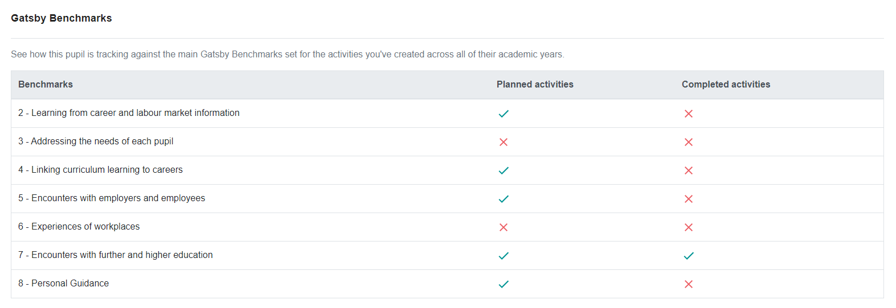
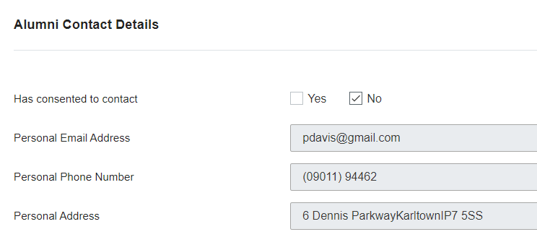
Recording LMI experiences on
Notes:
To plan, deliver and record LMI activities effectively needs a robust system. Such a system exists in the Careers and Enterprise Company’s Compass+ program. Though only available for schools and not colleges this system should provide all the functionality a Careers Leader would need to keep track of the careers programme and ensure it functions as it should. Compass+ links with a school’s MI system and means that all careers activity can be recorded at pupil level. In other words, from Year 7 to Year 13 a pupil will have an individual record of all careers lessons, employer visits, inspirational role model speakers, careers interviews, post-16 and post-18 intended destinations and any other careers activities delivered in school. So, this would include all LMI activity too. Look at the section bottom right, you could keep a database of all your alumni and ask them if they can come in to school and inspire your current students!

Slide 8
LMI permeating the whole institution
Poster displays
Bannerstands
Suspended timetable days
Careers fairs
Newsletters
Marketing leaflets
School planner
Workplace encounters and work experience including preparation and debrief
WORLD
OF
WORK
Within subjects
Local press
School plans
Assemblies
Social media
Social media
Tutor time
PSHE/careers lessons
Employer database
Destinations
Teacher CPD
Slideshows and videos on TV screens
Prospectus
School website including careerometer
Options booklets
LMI: What are we trying to achieve?
(Regional Careers Leaders Meeting. 05-07-19)
Delivery
Information
Publications
Notes:
Let’s end with a visual representation of all the different ways labour market information can permeate the institution. This slide separates the embedding of LMI into three distinct, but related, methods. Through the Delivery method, students find out about the world of work in all the activities traditionally associated with schools – lessons, tutorials, assemblies, drop-down days and so on. But this should be supplemented by two other methods – Information, meaning people can see labour market information on a regular basis through, for example, poster displays, the institution’s website and social media – and Publications, for instance prospectuses and options booklets.
Though at first glance this array of suggestions might look quite daunting take comfort in the assumption that you – and your staff don’t forget – are probably doing quite a number of these things already. And also….you don’t need to do them all!

Slide 9
If you’re eager to learn more…
LMI learning modules on the LMI for All site
Find out more about Compass+
School Careers Leader Essential Guide
Three online employer volunteer databases every Careers Leader should know about:
Inspiring the Future
Founders 4 Schools
Speakers for Schools
Notes:
For further information about what a Careers Leader should know about the labour market have a look at the links below and refer back to the references in the previous four videos.

Slide 10
Congratulations! You have made it to the end of the first 5 videos of this series!
info@nelep.co.uk
Notes:
Congratulations on reaching the end of this series of LMI for Careers Leaders. Sadly, there is no accreditation, official CPD recognition or a prize for watching all five parts but we are sure that the resulting knowledge, confidence and enthusiasm about all things LMI will be reward enough and that you will now feel inspired to take your institution to the next level when preparing your students for their future.

