Slide 1
LMI for the Careers Leader
Part 4
How can LMI be used in the curriculum?
Notes:
Hello and welcome to part 4 of LMI for Careers Leaders. In this video we will look at how LMI can be threaded throughout the curriculum in simple and practical ways. The interesting thing is that the starting point is not where you think it might be….

Slide 2
What is at the heart of good LMI delivery?
“The key to unlocking the secrets of the labour market is curiosity and asking questions about what is happening in the world around us – what might replace high street shops now that so many people shop online? Where will people choose to live if they work remotely from anywhere? What are some of the problems that will affect the world/my community in the future and how can these be solved?”
What is the role of the labour market and why does it matter?
(notgoingtouni.co.uk. 03-06-21)
Notes:
The starting point is actually in creating an interest in the labour market in the first place. Are your students passive recipients of the information you are about to give them or are they eager to learn? Do they even want to know about these things?
“The key to unlocking the secrets of the labour market is curiosity and asking questions about what is happening in the world around us – what might replace high street shops now that so many people shop online? Where will people choose to live if they work remotely from anywhere? What are some of the problems that will affect the world/my community in the future and how can these be solved?”
Perhaps there is a link here with the UN’s 17 sustainable development goals? These are the most pressing challenges the world has to face and, whichever way you look at them, they will always affect the future of work because work is a feature of life and life for everybody is inevitably tied up in these 17 key global factors. In fact, SDG8 is entitled ‘decent work and economic growth’. The Career Development Institute’s two-day annual conference in 2021 was themed entirely around the sustainable development goals, showing just how crucial and interlinked these issues are with the an individual’s career journey.

Slide 3
Remember LMI is only one piece of the jigsaw…
“When confronted with important and complex decisions, individuals have difficulties defining goals…a young person is faced with a lot of information, but struggles to make sense of it, leading to ‘choice overload’”
“Information will only be effective if timely, relevant and structured in ways that reflect the nature of young people’s decision-making process.”
The role of labour market information in guiding educational and occupational choices
(OECD. 2020)
Notes:
The secret is to start the delivery of LMI early, to do it at the right time and to do it at the right level. Don’t forget that we are talking about adolescents who have so many other things going on in their lives. Too much information delivered in the wrong amounts at the wrong time will simply overwhelm your students and be counter-productive. Start early, start positive and maintain consistency. Even primary schools are now looking closely at how they can start to raise awareness of the world of work amongst their young learners, addressing issues such as the early stereotyping of occupations in relation to gender, race and class.

Slide 4
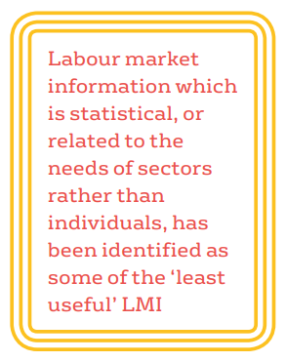
Inspiration not just information
“…personalised information in the form of ‘inspiration’ has been identified as some of the most useful.”
Careers and Labour Market Information: an international review of the evidence
(Education Development Trust. 2019)
Notes:
The word ‘inspiration’ comes up a lot in the careers space! It is likely that a role model speaker telling students about how to successfully start their own business is going to make much more impact than showing students a graph of business births and deaths over the last 12 months taken from the Business Register and Employment Survey. Instead of these ‘passive recipients’ of labour market information why not make them consumers of LMI – people who interrogate and critically discuss the data? Think about what we said in video 1, LMI can empower people and help them to make decisions that affect the rest of their lives. This is what we want to do with all our young people in the North East.

Slide 5
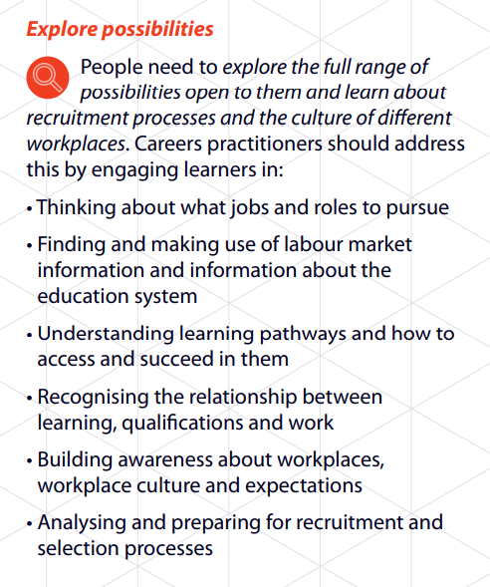
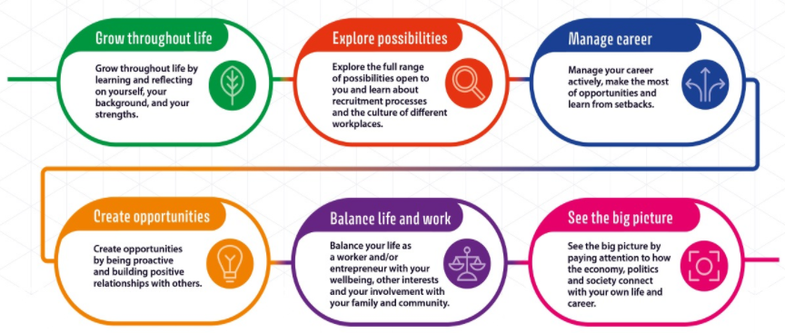
LMI as part of a progressive careers programme
Career Development Framework 2021
(The Career Development Institute. April 2021)
Notes:
So, what is suitable for each age group? What should young people learn when? We know that the LMI needs of a Year 7 student at the start of their secondary education are likely to be very different from those of a Year 11 or Year 13 student contemplating their next transition into education, employment or training. We also know that the delivery of careers education and guidance has become much more closely entwined with the personal development curriculum, a recognition that the two cannot be separated and that what a person does to earn a living would ideally reflect what they want out of life: work for many people is a part of their identity. The new CDI Framework, launched in April 2021, does just this, setting out a system for careers education and guidance within a framework of personal development and lifelong learning. Whilst Learning Area 2 focuses explicitly on the labour market, you can see implicit references to the world of work throughout all six learning areas highlighting the importance of the much-talked about ‘work/life balance’.

Slide 6
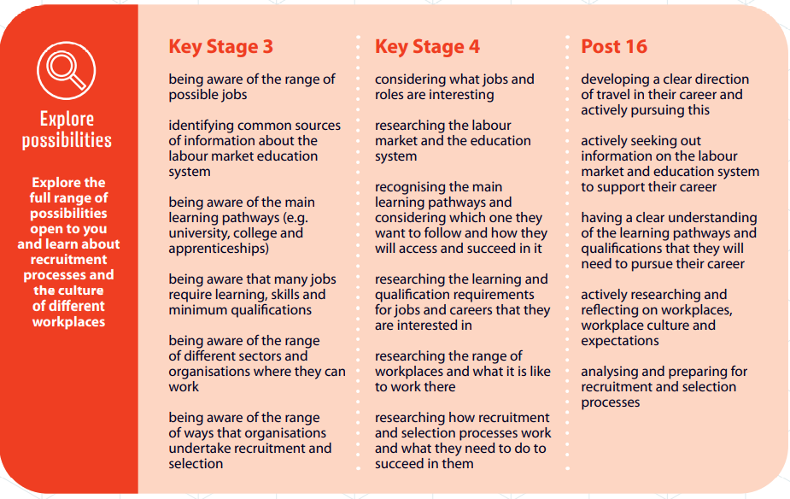
A progressive framework
Key Stage 2 launched in October 2021!
Career Development Framework 2021
(The Career Development Institute. April 2021)
Notes:
This is how each learning area breaks down into clear learning outcomes set out by key stage. There is even a primary stage that has now been published to join up all the ages. An overarching framework is essential before you start thinking about what activities to deliver – how else do you know what to deliver when and to whom? Let’s finish off this session by looking at some of the resources you can use to deliver lessons linked to the labour market.

Slide 7
My Learning,
My Future
Where can studying History take you?
Highlighting the relevance of History
to future careers and opportunities
My Learning, My Future
(Careers and Enterprise Company. 2021)
Notes:
The Careers and Enterprise Company have produced a comprehensive suite of subject powerpoint presentations to help Careers Leaders and teachers make links with careers and the curriculum. There are over 20 slide decks, all following the same format and all fully editable so you can take what you need or add your own slides to pad out the lesson.

Slide 8

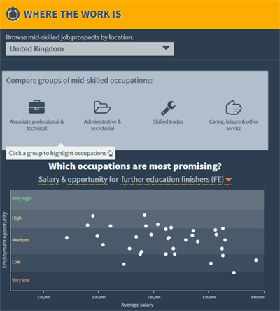


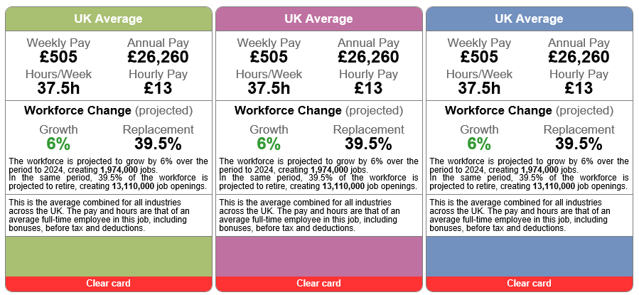



LMI resources to use with students and staff
Video 8.17
Notes:
Here is a sample of some of the main websites used in schools up and down the country to deliver LMI, whether it be a 4-minute starter video from icould.com, a piece of homework to research a job of your choice from the National Careers Service or whether it’s using LMI for All’s Careerometer which can be embedded into any school or college website. Our advice would be for Careers Leaders to check out all these sites and think about what will suit your students best. Think also about how these resources can fit into the CDI Framework and then, wider still, your whole school strategy.

Slide 9
If you’re eager to learn more…
CDI Framework 2021 – video launch (1 hour)
CDI Framework 2021 – all resources (see handbook pg 13)
UN 17 sustainable development goals
PSHE Framework 2020-21
Free careers and subject posters
CEC resource directory
Notes:
Below you will see some more links to other resources and other items of information that might be useful when embarking on the task of fully integrating labour market information into your curriculum. As ever, there is lots of information out there! But as we have highlighted this is a topic of vital importance and there is no quick way of organising the delivery of LMI for your students if you want to do it properly.

Slide 10
In Part 5 we will ask the question what should a Careers Leader know about the labour market?
info@nelep.co.uk
Notes:
In the next part we will focus on the knowledge a Careers Leader should have if you are to be the oracle of all things labour market-related.

