Slide 1
LMI for the Careers Leader
Part 2
What are schools and colleges required to deliver?
Notes:
Part 2: LMI: What are schools and colleges required to deliver?

Slide 2
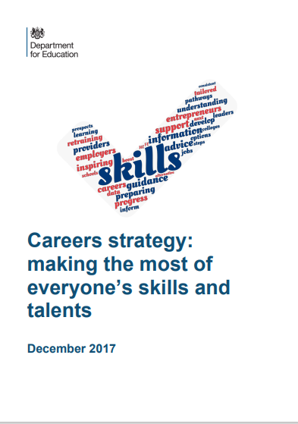
What does it say in the Careers Strategy?
“It is vital, in an environment where new industries are emerging and many of the most important jobs of the future don’t yet exist, that individuals have access to high-quality labour market information and earnings data to underpin their choices.”
Careers strategy: making the most of everyone’s skills and talents
(DfE. December 2017)
Notes:
It is useful at this stage to go back to basics: in this case December 2017 when the DfE published its national careers strategy. This has not changed and we are still following this strategy today, with all statutory guidance based on this publication. This paragraph sums up the importance of LMI:
“It is vital, in an environment where new industries are emerging and many of the most important jobs of the future don't yet exist, that individuals have access to high quality labour market information and earnings data to underpin their choices.”

Slide 3
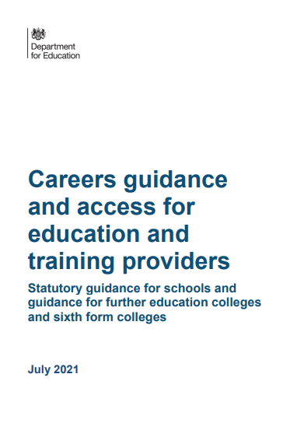
What does the Statutory Guidance say…
“With the government’s reforms to technical education and skills and the impact of COVID-19 on the labour market, there will be an increasing need for schools and colleges to work in partnership with employers, careers advisers, local authorities and other education and training providers to support students to prepare for the workplace and to make informed choices about the next step in their education or training.”
Careers guidance and access for education and training providers:
Statutory guidance for schools and guidance for further education colleges and sixth form colleges (DfE. July 2021)
Notes:
So, what does the statutory guidance say? For those of you unfamiliar with the process, a strategy document from DfE lays out the overall vision for a specific theme. Statutory guidance follows shortly afterwards and this is really the nuts and bolts of how you make the strategy happen. The statutory guidance is a careers leader’s go-to place to discover all those things that are intended to be in a careers programme. The latest guidance for careers came out in July 2021 and is a combined document for both schools and colleges. What does it say about LMI?
“With the government’s reforms to technical education and skills and the impact of COVID-19 on the labour market, there will be an increasing need for schools and colleges to work in partnership with employers, careers advisors, local authorities and other education and training providers to support students to prepare for the workplace and to make informed choices about the next step in their education or training.”
Having access to that qualified and impartial adviser is vital – it provides a high level of reassurance that your students can receive that personalised guidance, free from any bias, which can help them make the right decisions about their post-16 and post-18 pathways.
It is clear that, in actual fact, LMI should be high on the agenda for every stakeholder involved in the preparation of young people for their future.

Slide 4
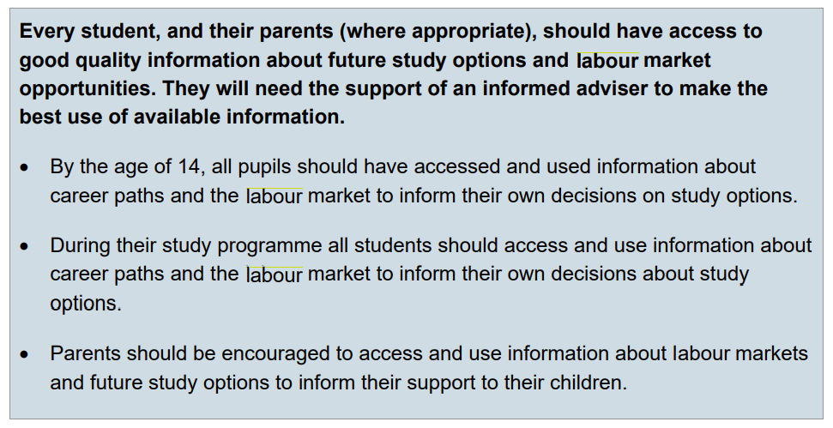
What does Benchmark 2 tell us about LMI?
Learning from career and labour market information
Careers guidance and access for education and training providers:
Statutory guidance for schools and guidance for further education colleges and sixth form colleges (DfE. July 2021)
Notes:
We all know about the eight Gatsby benchmarks, and LMI has a benchmark all of its own. Benchmark 2 is entitled ‘learning from career and labour market information’. Here is the extract that explains what schools and colleges should be focusing on when it comes to LMI. As you can see, it is not just about students it is also about their parents and carers for, as we know, parents have always been, and are likely to remain, the single biggest influence on young people’s choices.

Slide 5
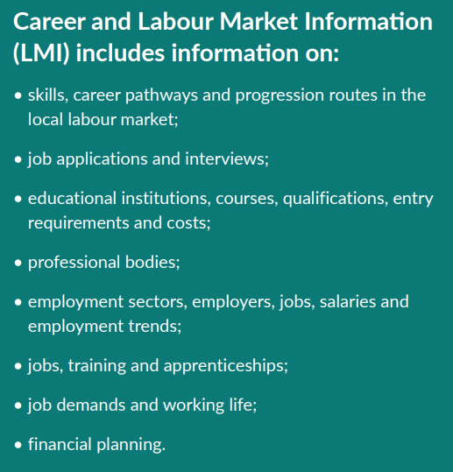
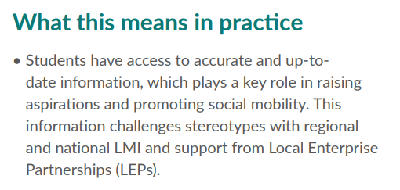
How can the Gatsby Toolkit help?
The Gatsby Benchmark Toolkit for Schools:
Practical information and guidance for schools (CEC. 2019)
Notes:
But there is lots of support on offer when addressing issues of LMI. The Gatsby toolkit is one excellent example of practical suggestions to raise awareness of key labour market issues at an appropriate age and level. Again, it is important for careers leaders, before rushing into the search for LMI resources and delivery materials, to take a moment to understand their educational and economic environment. What is the fit with your institution’s vision and values? What do you want your school or college leavers to know when they finish this part of their education with you? Such consideration will save a great deal of time in the long run as you will ensure you select only those resources that fit in with your institution’s strategy.

Slide 6
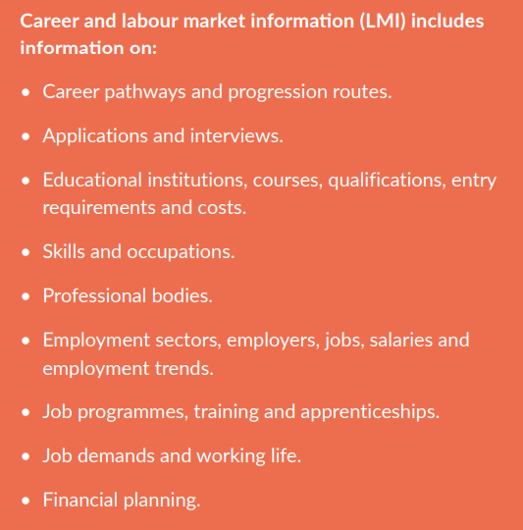
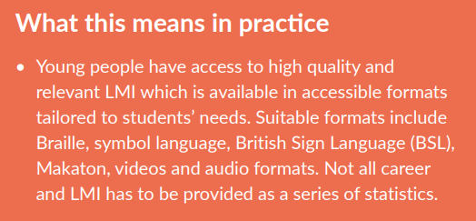
How can the Gatsby Toolkit help SEND settings?
The SEND Gatsby Benchmark Toolkit:
Practical information and guidance for schools, special schools and colleges (CEC. 2020)
Notes:
Help is also available from the Gatsby toolkit for SEND settings. You will notice that there is in fact very little difference between mainstream, college and SEND requirements as far as LMI is concerned. This is because elements of the labour market are relevant for all young people regardless of their setting, however, as we know those young people with special educational needs and/or disabilities often require a different approach, with some unlikely ever to be economically active but who nevertheless require an appropriate level of input about the world around them.

Slide 7
ASK and JCP can provide up to date messaging
“Schools and colleges may wish to enlist locally available support, for example the Apprenticeship Support and Knowledge for Schools (ASK) programme which delivers free traineeship, apprenticeship and T Level information and activities to students in years 10 to 13, or the Jobcentre Plus Support for Schools programme, which also provides this service for years 8 to 13.”
Careers guidance and access for education and training providers:
Statutory guidance for schools and guidance for further education colleges and sixth form colleges (DfE. July 2021)
Notes:
There are a number of people and organisations who can help careers leaders with their delivery of labour market information. Two established national initiatives are the ASK programme and the DWP Support for Schools programme. Both of these teams can support all schools and colleges in the North East according to need. But don't forget, there are also lots of other routes to pursue when seeking support to plan and deliver LMI, for example, local employers, local colleges, training providers, universities, and other key stakeholders. Also, don’t forget your Enterprise Advisor – a prominent individual from industry linked to your institution and something every secondary school and College in the country is entitled to.

Slide 8
But how you do it is up to you. Remember…
Learners
are different ages
have different abilities
have different interests
may have other priorities
Schools
have their own vision for development
operate in different labour markets
vary in their careers infrastructure
may have other priorities
Notes:
Remember, though, that the strategy, statutory guidance, and support organisations, really only exist to help you construct a method of LMI delivery that is right for you. It is not expected that's all young people should learn about all aspects of the labour market. Apart from the fact that this would not be possible, it is also not desirable. Both individual learners and individual schools and colleges are all different as you can see from this slide. You could always start with a baseline survey amongst all your students to see where they are in relation to the world of work. Maybe even survey your staff at the same time?

Slide 9
If you’re eager to learn more…
ASK (Apprenticeship Skills and Knowledge)
Gatsby Benchmark 2 | CEC Resource Directory
Using Labour Market Intelligence in a college context
Example strategic action plan | CEC Resource Directory
Notes:
To find out more about any of the topics raised in this video you can follow the links on each slide and use the references below.

Slide 10
In Part 3 we will ask the question what does the North East labour market look like?
info@nelep.co.uk
Notes:
We hope you have found this video useful and in part three we will begin to explore our own labour market in the North East.

