Slide 1



The North East Local Transport Plan
Schools Session 11-16 years

Slide 2

Welcome

Slide 3


In today’s session we will:
Consider why transport is important to us in our region
Identify the types of transport we use in our daily lives
Give you a chance to have your say and shape how transport works for us in our region

Slide 4
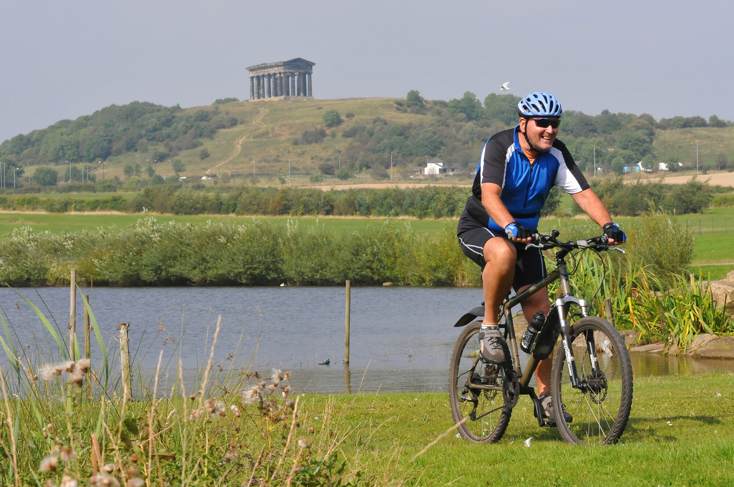
Discuss
What is transport?
How many types of transport can you name?

Slide 5
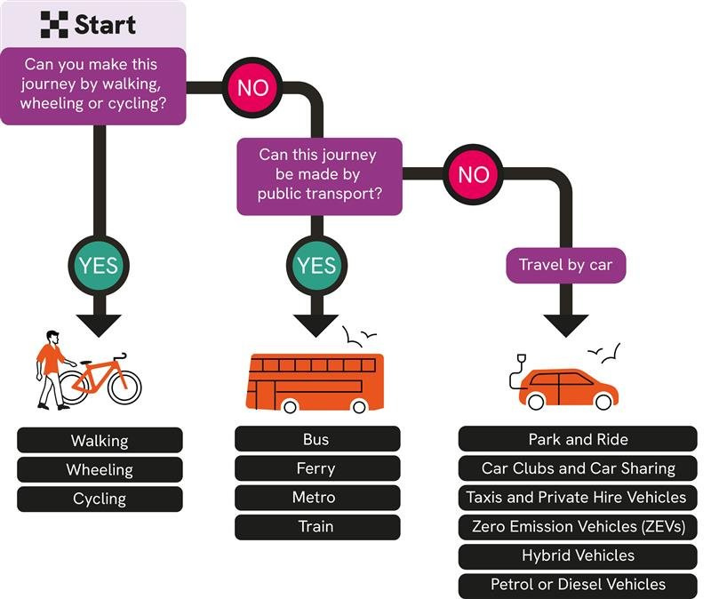
Discuss
What is ‘good’ transport?
Why do you need good transport in your life?
Why do others (people and businesses) need good transport in the North East?
Resource: Transport in the UK

Slide 6
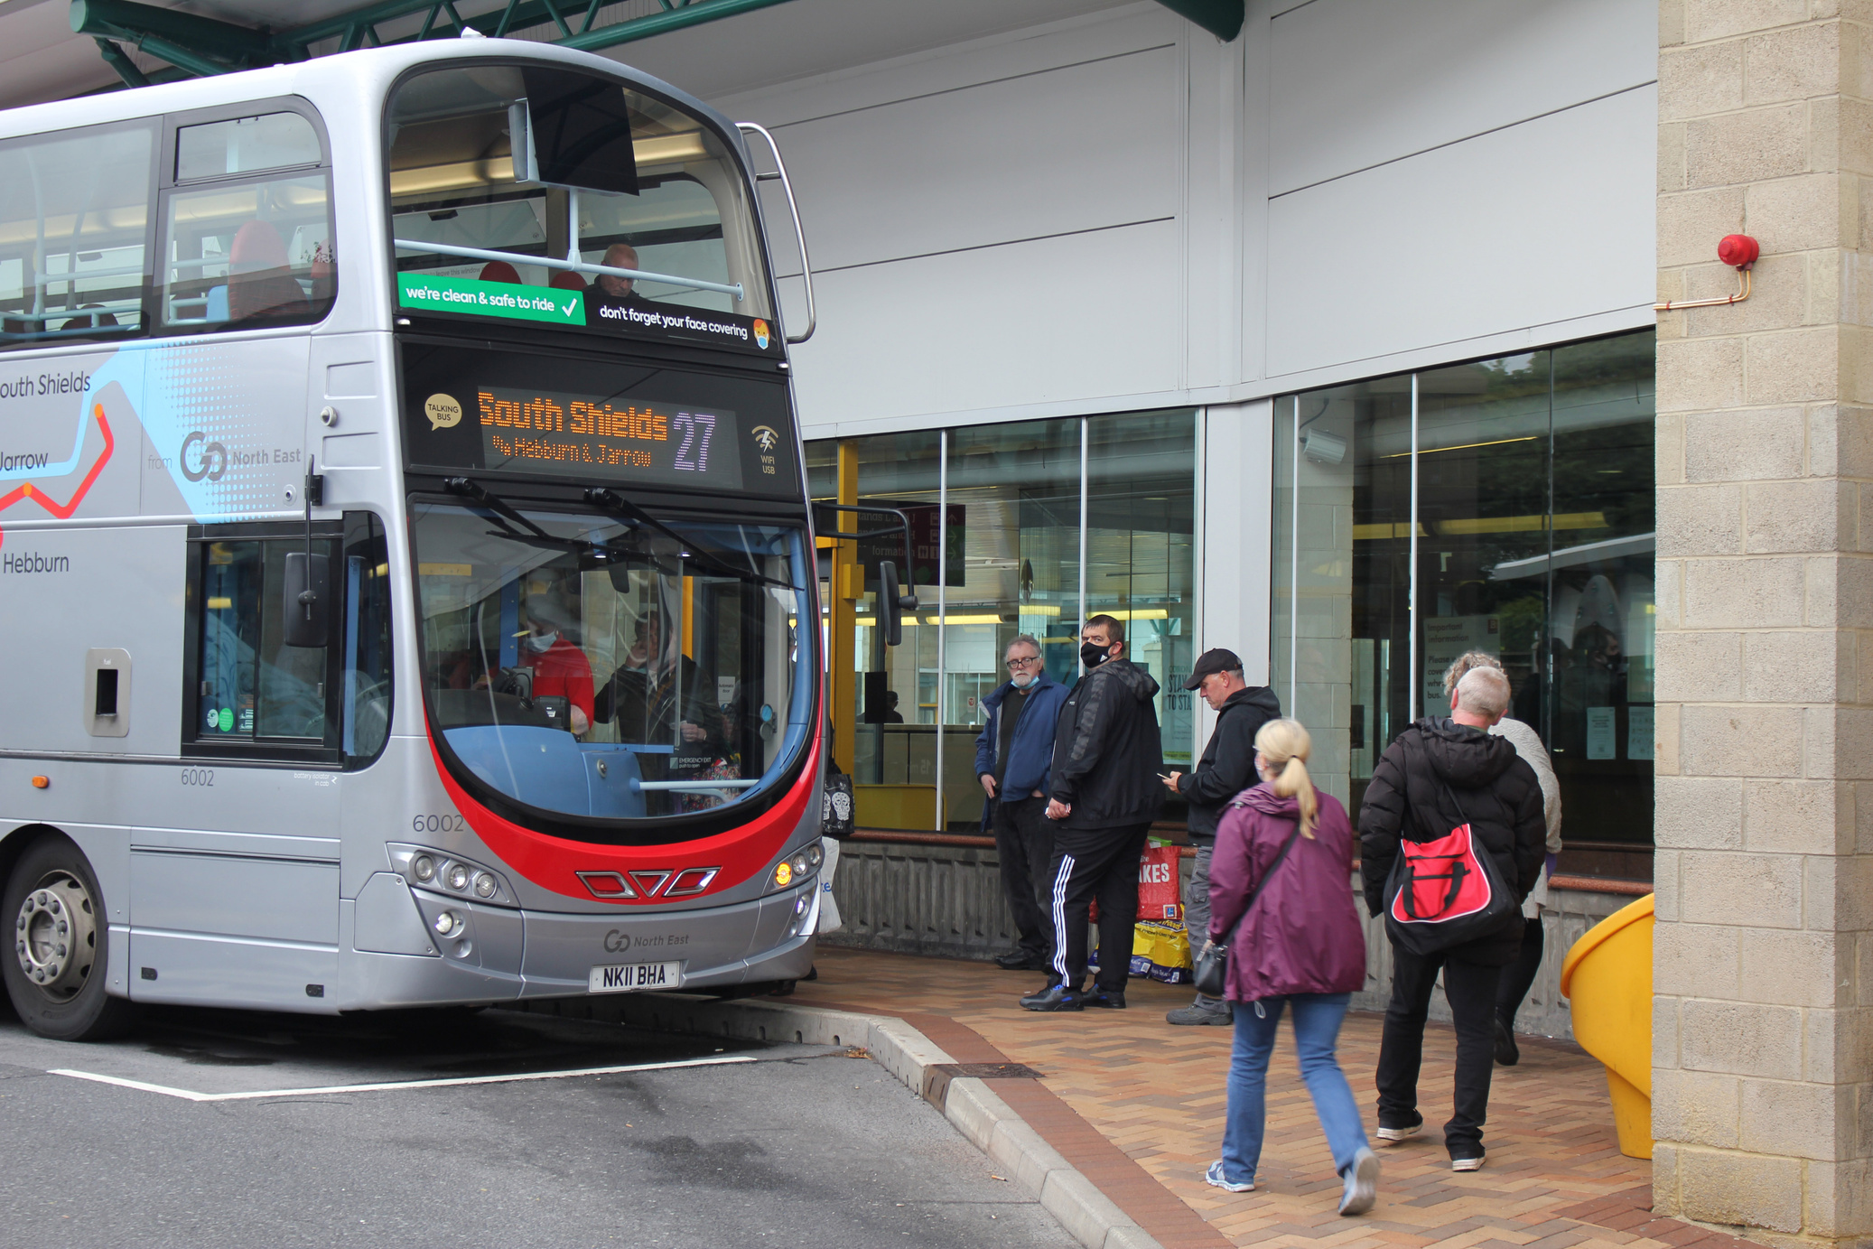
Discuss
What types of transport have you used in the last week?​
What types of transport have you used that would be classed as “Green”?​
What do you think the term “Green Integrated Transport System” means?
Can you describe an example of a journey?
Resource: What is sustainable transport?

Slide 7
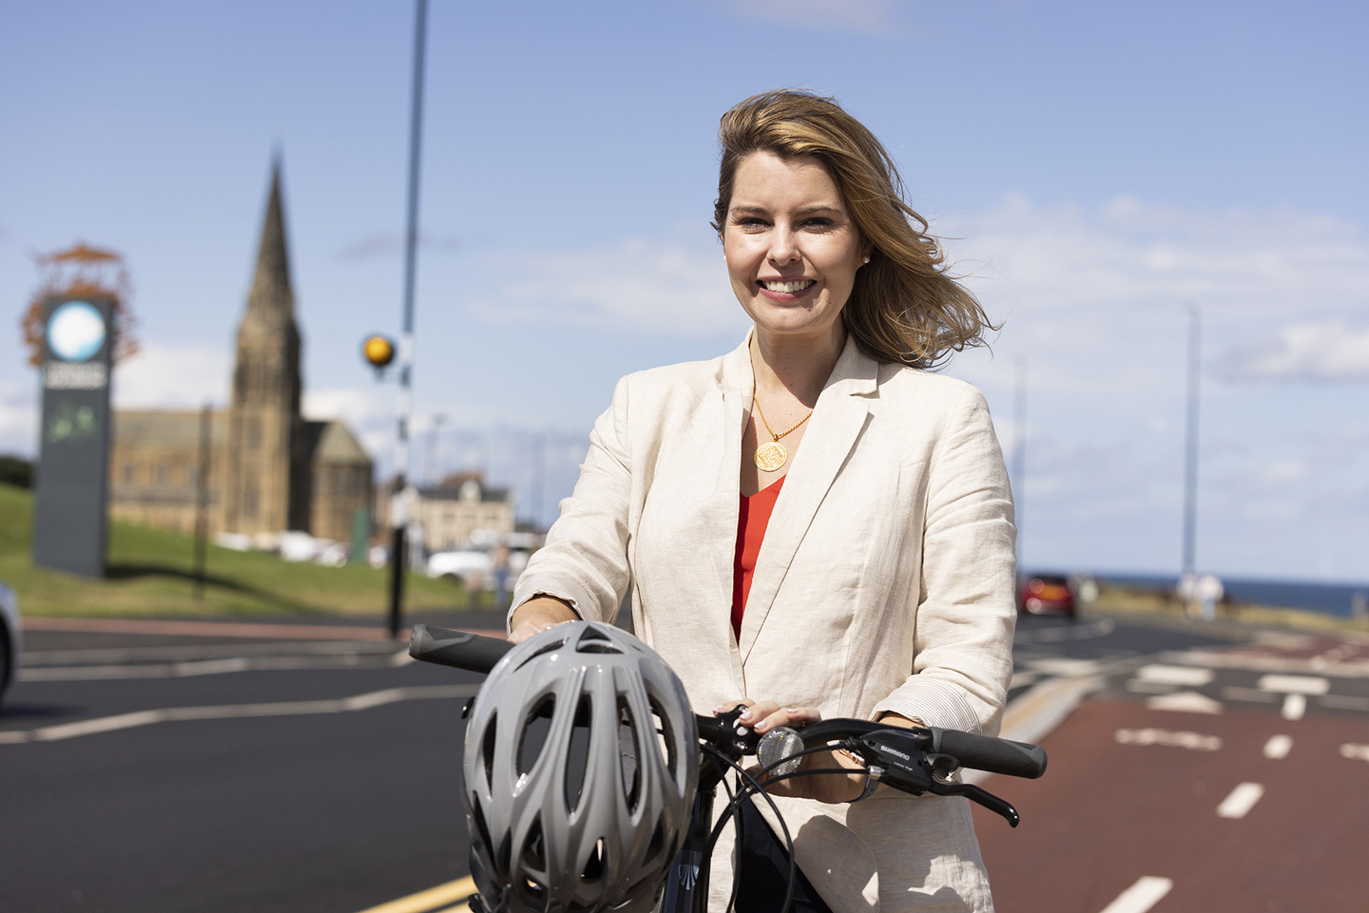
The Mayor
  Kim McGuinness elected as North East Mayor in May 2024.
  She committed to delivering “green transport that works for all”.
  Let’s hear what she has to say...

Slide 8


Slide 9

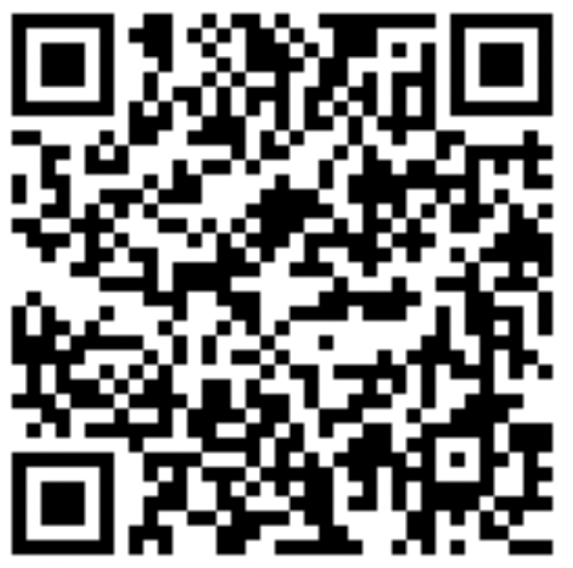
Complete our transport survey

Slide 10



Thank you for your time
northeast-ca.gov.uk/localtransportplan
haveyoursay@northeast-ca.gov.uk
0191 277 7010

