Slide 1
The North East Local Transport Plan
Schools Session 8-13 years

Slide 2
Welcome

Slide 3
In today’s session we will:
Consider why transport is important to us in our region
Identify the types of transport we use in our daily lives
Give you a chance to have your say and shape how transport works for us in our region

Slide 4
Discuss
What is transport?
How many types of transport can you name?

Slide 5
Discuss
What is ‘good’ transport?
Why do you need good transport in your life?
Why do others (people and businesses) need good transport in the North East?
Resource: Transport in the UK

Slide 6
Discuss
Think of a journey that you’ve been on recently...
What was good about it?
What could make it better?

Slide 7
The Mayor
Kim McGuinness elected as North East Mayor in May 2024.
She committed to delivering “green transport that works for all”.
Let’s hear what she has to say...

Slide 9
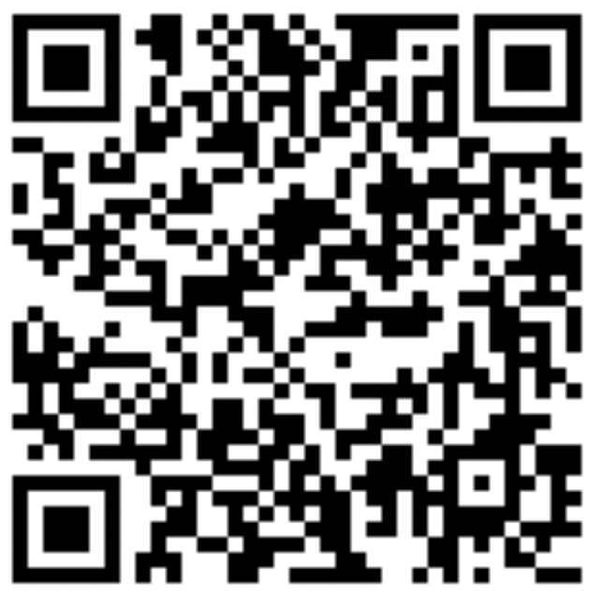
Complete our transport survey

Slide 10
Thank you for your time
northeast-ca.gov.uk/localtransportplan
haveyoursay@northeast-ca.gov.uk
0191 277 7010

