Slide 1
Apprenticeships: An introduction to Early Connect
North East Pilot

Slide 2
Contents
Part 1: Apprenticeships overview: What apprenticeships are, their benefits, and how they work.
Part 2: Early Connect: The benefits of joining the pilot, why it matters, how to get involved and the support available.
Part 3: Resources: How UCAS can help support advisers and their students.

Slide 3
Part 1: What’s an apprenticeship?
It’s a real job where you learn, gain experience, study for a qualification and get paid.
An apprentice is an employee, with a contract of employment and holiday leave.
Over 650 different apprenticeships available, from Nuclear Engineer to Architect to Digital Marketer.

Slide 4
Apprenticeships: the figures
40% of students (430,000) interested in undergraduate options are also interested in apprenticeships, but starts for young learners remains low –the number of Level 4 starts for <19 year olds less than 5,000
Negative experience of applying for apprenticeships: 50% of apprentices positive compared to 90% of placed university and college applicants
1 in 3 apprentices from a lower socioeconomic background receiving no support with their application, despite this group being most likely to hear about apprenticeships
Only 4% of 7,500 post 16 learners cited apprenticeships as an intended destination (RENEA, 2023)
63% of those from lower socioeconomic backgrounds compared with 51% from higher socioeconomic backgrounds have considered an apprenticeship. However, Sutton Trust report that twice as many degree apprentices are from the wealthiest areas

Slide 5
3 key facts about apprenticeships
An apprenticeship takes between one to six years to complete.
Apprentices typically work for a minimum of 30 hours a week (and most will work full time, between 37 – 40 hours per week). Part-time options are also available in some cases.
By the end of an apprenticeship, you’ll have the right skills and knowledge needed for your chosen career.

Slide 6
How it works
Apprenticeships are funded by the Government and/or the employer. This means that apprentices won’t have loans or tuition fees.
Apprentices have time away from their day-job protected for study this tends to equate to a about a day a week but can be delivered in different fashions like blocks of study time or in the work-place. This is called ‘off-the-job’ training and is facilitated by a college, independent training provider, or a university.
The off-the-job time is paid time and included within working hours.
What apprentices earn will depend on the industry, location and type of apprenticeship.

Slide 7
How to understand the levels
There is an apprenticeship for everyone: some are more complex than others.
It is important to note that for apprenticeships, levels are only a rough guide.
For a year 13 school leaver with little or no work experience, a level 2 or Level 3 apprenticeship is a perfect entry point into the world of work, even if you already have A levels, BTEC or T-Levels.
Some higher and degree apprenticeships give you the opportunity to combine university study and work.
LEVEL 2
LEVEL 3
LEVEL 4+
LEVEL 6-7
Intermediate
Advanced
Higher
Degree
Job roles include: Nuclear Operative, Junior Estate Agent, Rail Engineering Operative, Finance Assistant.
Job roles include: Chef De Partie, Fashion Assistant, Veterinary Nurse, IT Solutions Technician.
Job roles include: Marketing Executive, Journalist, Clinical Dental Technician.
Job roles include: Aerospace Engineer, Police Constable, Cyber Security Professional, Ecologist.
Notes:
Notes to presenter
Please note that all apprenticeships at levels 4-7 are categorised as higher, but if they are level 6-7 and contain a degree, they have become known as degree apprenticeships (e.g. a level 7 Solicitor apprenticeship contains the professional qualifications required to be a solicitor, but not a law degree).
It is important that your audience understands that the level of apprenticeship that you start on will not necessarily be determined by your prior level of qualification.
For example, it is not always the case that students completing a level 3 qualification will progress immediately to a higher or degree level apprenticeship.
Just as it is not always the case that someone who already has a degree would progress immediately to a Master’s level apprenticeship.
The starting level of any apprenticeship will be determined by the level of the role that the employer has designed.
Many intermediate and advanced apprenticeships will be the natural starting point for an individual entering that industry with no experience.
All apprentices are given a range of opportunities that will expand their personal and professional skills through the apprenticeship.
Please avoid comparing apprenticeship levels to academic attainment as this could encourage students not to consider opportunities that could be fantastic for them as they could be put off by the perception that they are not progressing to the next academic level.

Slide 8
Types of apprenticeships
There are over 650 different apprenticeship roles to consider.
Here are some examples:
Architect
Cyber Security Technician
Finance assistant
Teacher
Accounting & Taxation
Game Programmer
Boat Builder
Journalist
Assistant Puppet Maker
Event Assistant
Police Constable
Youth Worker
Civil Engineer
Chef De Partie
Digital Marketing
Personal Trainer
Physiotherapist
Nuclear Scientist
Nurse
Software Developer
Sports Coach
Auto Technician
Aerospace Engineer
Doctor – from 2024
Notes:
You can find out more on The Institute website: www.instituteforapprenticeships.org/apprenticeship-standard

Slide 9
A day in the life of an apprentice
Meet Sheona.
She’s doing a Level 4 Sales Apprenticeship.
She talks about her experience at Coca-Cola.

Slide 10
Part 2: What is Early Connect?
A pilot being delivered in partnership between the Department for Education (DfE) and UCAS.
Their aim is to support more young people onto apprenticeships and make it easier for employers to find apprentices.
To date a variety of employers have pledged over 5,000 apprenticeship vacancies in the three pilot regions.
Notes:
Notes to the presenter The Government announcement about the Early Connect pilot can be found here:
https://www.gov.uk/government/news/apprenticeships-boosted-under-plans-to-broaden-ucas
This section of the presentation explores the Early Connect pilot in more detail.

Slide 11
What do students benefit from?
Get an Apprenticeship Adviser is a way to connect directly with partners in your area who can offer tailored support by telephone or email.
Provide your details via our secure digital service which will be sent to the right people in your region who can offer the support you need.
The service is free to use.

Slide 12
Benefits for all: Why the Early Connect Project Matters
Schools / Colleges
Students
Sector
Access to fully funded support for your students
Receive exclusive resources & CPD
Support the achievement of Gatsby Benchmarks & unbiased careers provision
Increased exposure to more regional vacancies
Localised support for apprenticeship applicants in navigating application process
Access to wider pool of talent for employers
Understanding regional student interest in apprenticeships
Collaborative approach to increase starts

Slide 13
Why have we signed up?
To equip ourselves with the best possible tools, resources and knowledge to support our students when considering their next steps.
We will receive additional support from local networks and organisations.
We can help to shape the UCAS/DfE apprenticeship offer to improve outcomes for current and future students.

Slide 14
What local support will be available?
For students seeking an apprenticeship and who need some extra support, each region will offer an enhanced support package to students, which could include:
Linking with employers in the area, helping them to broaden their search to consider a wider range of vacancies.
Support with applications, interviews and employability skills.
Additional support where individuals are not initially successful.

Slide 15
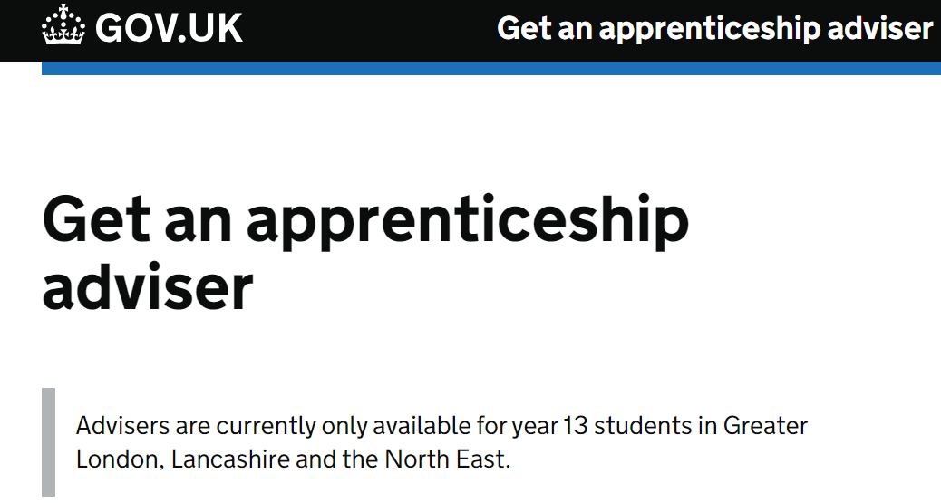
What local support will be available?
In the North East students can follow this link and access support:
Get an apprenticeship adviser (education.gov.uk)

Slide 16
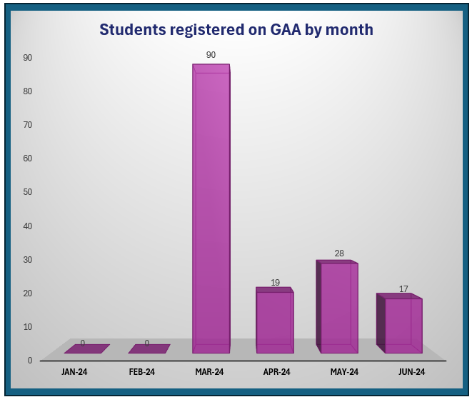
What local support will be available?
19-06-24

Slide 17
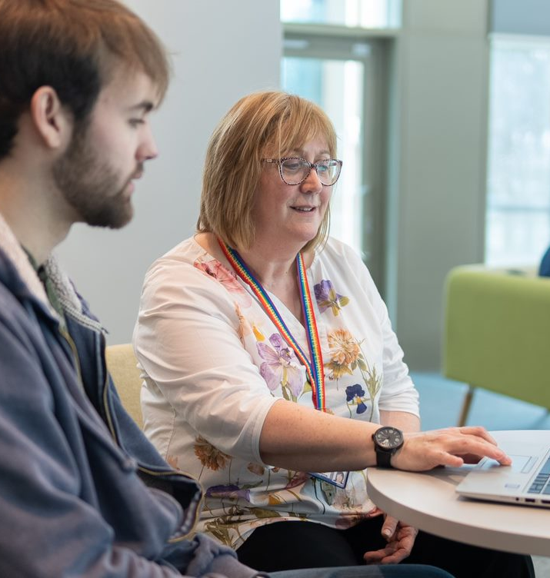
How can we support our students
Help students to see how the subjects that they are studying link to jobs.
Give students time to search for vacancies and share their findings in class time and offer support in writing and submitting applications, as we would do with other post-18 options.
Encourage applications to be made within the classroom, so they have your support and guidance.

Slide 18
How to use this service?
There are two ways to get support:
Directly via our online form: https://earlyconnect.apprenticeships.education.gov.uk/E37000025
Some students may access the service via the UCAS Hub. If you do it this way be sure to complete the short form on the Hub so that your details land with an adviser.
Complete the online form and submit your request. Our partner will contact you within three working days.
You’ll need to provide your name and contact details. We’ll also ask what you’re interested in (if you are not sure, that’s ok).

Slide 19
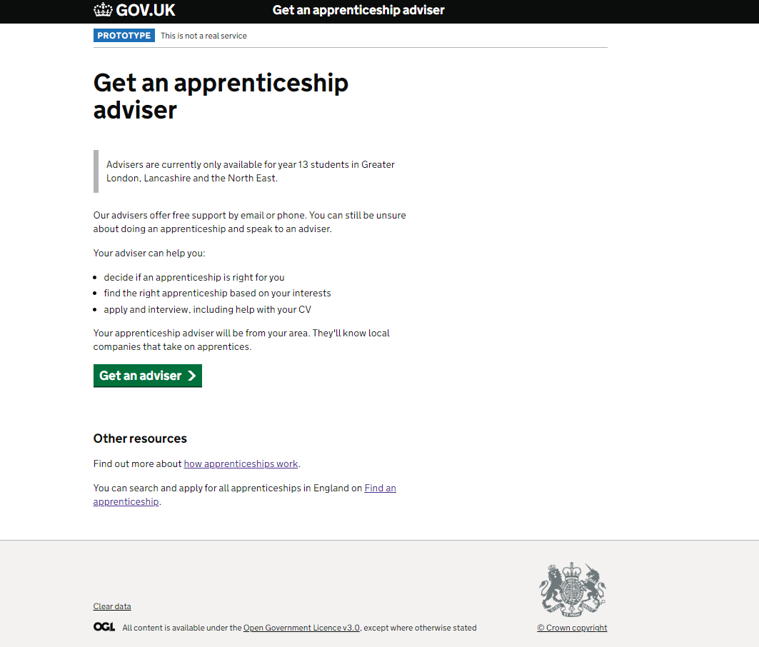

Slide 20
Notes:
Note to presenter: Optional slide to share the video as part of the presentation – you will need internet access to play the video

Slide 21
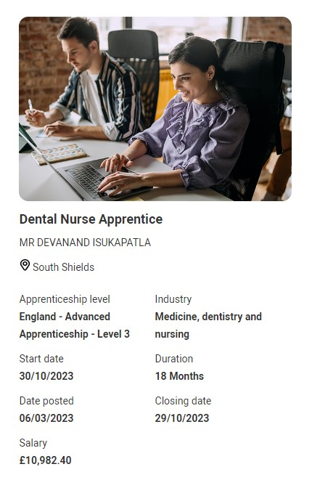
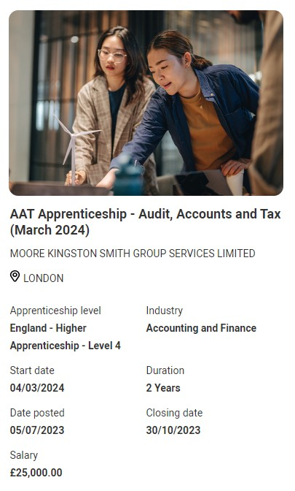
Student pathways side by side
For the first time you can now see apprenticeship opportunities alongside undergraduate courses.
The UCAS Hub enables you to explore all your options and build your profile in one place.

Slide 22
How to explore and apply for apprenticeships
You can use the UCAS Hub to
explore industries, employers, locations, careers and jobs
shortlist your favourites
find out where to start
find out how to apply
Notes:
Find out more at ucas.com/apprenticeships

Slide 23
What do you need to do?
October 2024
November 2024
Register in the
UCAS Hub to start
exploring all the
Options or via the Get an Apprenticeship Adviser
Build a profile, define interests and explore opportunities
Sign up to be matched to potential employers in the area

Slide 24
Smart Alerts
Smart alerts are a new matching service offered by UCAS.
The service enables participants to be matched to regional vacancies.
Smart Alert Sign Up
Data Entry
Matching
You register for Smart Alerts in your Hub account.
You enter information on your preferences such as location and area of interest.
If this matches an employer’s search criteria, then you are invited to apply.

Slide 25
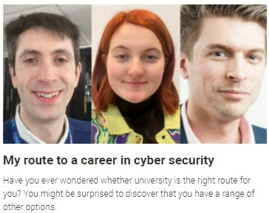
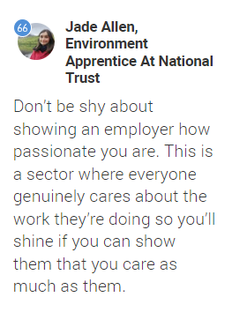
Discover Decide Apply
Notes:
The UCAS Hub is packed with research material for your students. Meet real life apprentices from lots of different sectors. Find out how different students reached the same career going down different pathways. Take the career quiz, browse industries and different learning opportunities – to make the right decision for you.

Slide 26
If they see it they can be it
Visit the Early Connect webpage to find out more: Early Connect - North East Ambition (northeast-ca.gov.uk)

