Slide 1
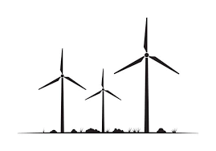
The Challenge -
Technical Specification for Dogger Bank D

Slide 2
You are involved with a business development plan for the expansion and design of Dogger Bank Wind Farm, known as Dogger Bank D.
Using :
Relevant information you have learnt from ‘Equinor’
Answers to technical (science) questions you are about to answer
Related information you have learnt / investigated in your science lessons
You should produce a short report or scientific poster to cover:
What are the benefits of increasing the size of Dogger Bank Wind Farm
What design (e.g. size, number of blades, angle of blades) the turbines should be and why
Any negative impact the development might have
What types job roles and skills will be required for the expansion of Dogger Bank Wind Farm
For information
About The Dogger Bank Wind Farm Projects - Dogger Bank Wind Farm
Dogger Bank D - Dogger Bank Wind Farm

Slide 3
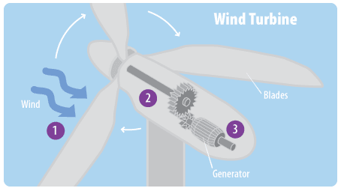
Begin this challenge by explaining the energy transfers associated with wind turbines
Complete the Energy Stores
K
E
G
M
I
N
C
E
2.
1.
3.

Slide 4
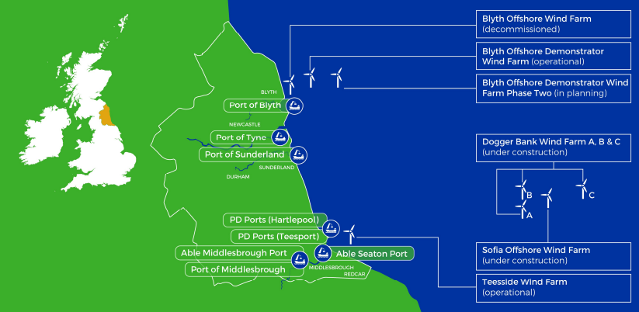
Background research:
Dogger Bank Wind Farm has announced a potential 4th phase to the wind farm.
The new
‘Dogger Bank D Wind Farm’ will occupy an area of 249km² of the 560km² agreed development area of Dogger Bank C
Power output is measured in
Watts (W)
Kilo-Watts (kW)
Mega-Watts (MW)
Giga-Watts (GW)
(Do you know how
many zeroes?)
It refers to the rate of
“work done” or rate at which energy is being transferred.

Slide 5
Research :
(Add to this box with your own research)

Slide 6
Information from science lessons or investigations :
(Add to this box with your own research)

Slide 7
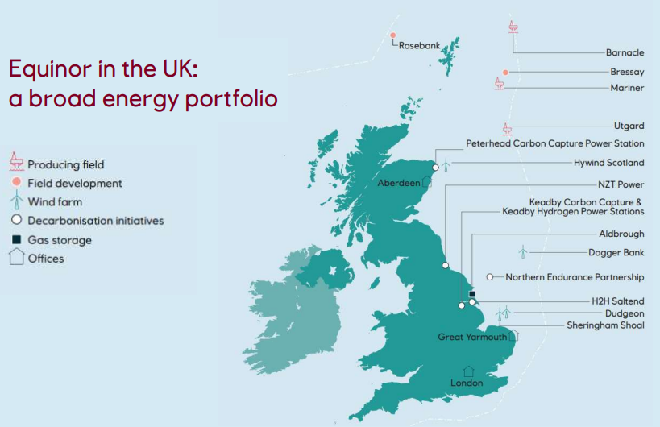
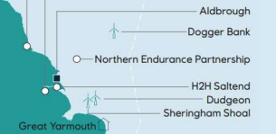
The ‘Dogger Bank wind farm’ could connect at Lincolnshire with a 1.32GW National Grid connection.
It could also be used to power electrolysis to produce
‘Green Hydrogen’
and in this case could have a maximum power generation of more than 1.32GW.
Questions
1.If the number of turbines is the same as in Dogger Bank C (87), what would the power (MW) of each turbine be for the grid connection?
2. By increasing the turbines size and therefore power (up to 20MW), calculate different numbers of turbines on the wind farm that could deliver 1.32GW to the connection.
3. What could be the benefits (economic, environmental and other) of reducing the number of turbines?
Answer 1.
Answer 2.
Answer 3.

Slide 8
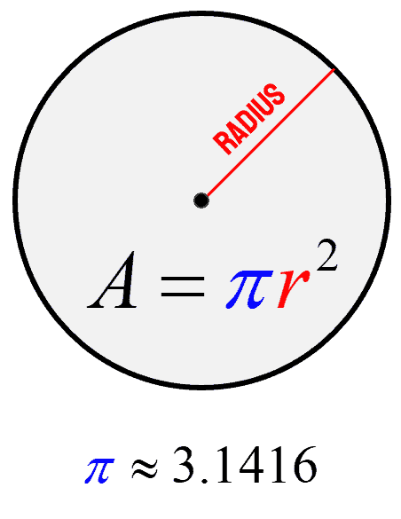
Scale:
When a farmer tells you how much land he is farming, he will usually state an area.
With a wind farm it is much the same story, though doing wind farming
we farm a vertical area instead of a horizontal one.
Calculate the swept area covered by a wind turbine with a blade 50m in length and one 100m in length.

Slide 9
Scale:
When a farmer tells you how much land he is farming, he will usually state an area.
With a wind farm it is much the same story, though doing wind farming
we farm a vertical area instead of a horizontal one.
Use your answers to explain why doubling the length more than doubles the potential power output.

Slide 10
The Challenge -
Technical Specification for Dogger Bank D
Answers

Slide 11
Begin this challenge by explaining the energy transfers associated with wind turbines
(Complete the Energy Stores)
K inetic
E lectrical
G ravitional Potential
M agnetic
I nternal (Thermal)
N uclear
C hemical
E lectrostatic
2. Shaft (Kinetic)
Wind (Kinetic)
3. Generator (Electrical)
Notes:
May also consider efficiency – heat, sound etc

Slide 12
Background research:
Dogger Bank Wind Farm has announced a potential 4th phase to the wind farm.
The new
‘Dogger Bank D Wind Farm’ will occupy an area of 249km² of the 560km² agreed development area of Dogger Bank C
Power output is measured in
Watts (W)
Kilo-Watts (kW)
(3 Zeroes)
Mega-Watts (MW)
(6 Zeroes)
Giga-Watts (GW)
(9 Zeroes)
(Do you know how
many zeroes?)
It refers to the rate of
“work done” or rate at which energy is being transferred.

Slide 13
The ‘Dogger Bank wind farm’ could connect at Lincolnshire with a 1.32GW National Grid connection.
It could also be used to power electrolysis to produce
‘Green Hydrogen’
and in this case could have a maximum power generation of more than 1.32GW.
Questions
1.If the number of turbines is the same as in Dogger Bank C (87), what would the power (MW) of each turbine be for the grid connection?
2. By increasing the turbines size and therefore power (up to 20MW), calculate different numbers of turbines on the wind farm that could deliver 1.32GW to the connection.
3. What could be the benefits (economic, environmental and other) of reducing the number of turbines?
Answer 1.
1.32 x 1000 = 1320MW
Each Turbine = Total
Number
Each Turbine = 1320MW
87
Each Turbine = 15.1724138
Answer = 15.17MW
Answer 2.
Each Turbine = Total
Number
20MW = 1320MW
Number
Number = 1320
20
Answer = 66 turbines
Answer 3.
Economic – cheaper as lower manufacture /installation costs. A larger turbine wouldn’t cost x2 of 2 smaller ones
Environmental
Less foundations, less disruption to sea bed
Other
e.g. Less to service
Notes:
For questions two. Students could consider the space and cost of building the turbines of each size compared to the potential power output to put together the best option

Slide 14
Scale:
When a farmer tells you how much land he is farming, he will usually state an area.
With a wind farm it is much the same story, though doing wind farming
we farm a vertical area instead of a horizontal one.
Calculate the swept area covered by a wind turbine with a blade 50m in length and one 100m in length.
Area = 3.1416 x r²
Area = 3.1416 x 50²
Area = 3.1416 x 2500
Area = 7853.98 m²
Area = 3.1416 x r²
Area = 3.1416 x 100²
Area = 3.1416 x 10,000
Area = 31,415.93m²

Slide 15
Scale:
When a farmer tells you how much land he is farming, he will usually state an area.
With a wind farm it is much the same story, though doing wind farming
we farm a vertical area instead of a horizontal one.
Use your answers to explain why doubling the length more than doubles the potential power output.
Comparison of length to area from calculations, may apply ratios etc

