Slide 1
Wind Turbines
Marden High School
Topic
Class
Date
Notes:
What happened last lesson?

Slide 2
5 questions…
What is the equation for kinetic energy?
What is the definition of non-renewable energy?
What is meant by carbon neutral?
Why do energy demands change?
What are the fossil fuels?

Slide 3
5 questions…
What is the equation for kinetic energy?
Kinetic energy | = | ½ | x | mass | x | velocity²
E_{k} | = | ½ | x | m | x | v²
(Joules) |  |  |  | (kg) |  | (m/s)

Slide 4
5 questions…
What is the definition of non-renewable energy?
A renewable energy resource is one that is being (or can be) replenished as it is used.

Slide 5
5 questions…
What is meant by carbon neutral?
There is no overall increase in the amount of carbon entering the atmosphere.

Slide 6
5 questions…
Why do energy demands change?
They change depending on:
Time (see previous lesson)
Electricity demands from technology and efficiency
Transport
Industry
Any two of these

Slide 7
5 questions…
What are the fossil fuels?
Fossil fuels (coal, oil, and gas) are natural resources that form underground over millions of years and are burnt to release energy.

Slide 8
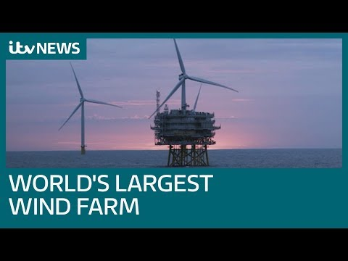
Today you will learn to...
evaluate the effectiveness of wind turbines when they have different blades.
Give this video a watch to start the lesson.
Offshore wind power generation has become an increasingly promising source of renewable energy. Much about the aerodynamic effects of larger wind farms, however, remains poorly understood. New work in this week's Journal of Renewable and Sustainable Energy, from AIP Publishing, looks to provide more insight into how the structures necessary for wind farms affect air flow.
Scientists from Cranfield University and the University of Oxford present a theoretical model for estimating the aerodynamic effects of wind turbine towers on the performance of wind farms.
Grade 8 | Evaluate the different responses of students using data to support your answers
Grade 6 | Identify errors in other students’ investigations
Grade 4 | Set up and complete an investigation into the voltage output of turbines with different numbers of blades

Slide 9
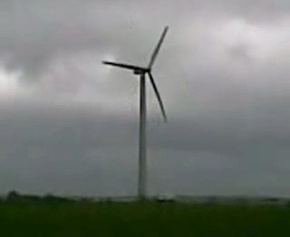
Wind Power
Renewable
No CO₂, because nothing gets burned
Turbines are quite cheap and easy to build, so they can be used even in poor countries
Turbines can be ugly and noisy
Only works if the wind speed is above 5 m/s! If the wind stops, you get no energy.
Cannot be used in high winds in case of damage!
Wind turbines, we can turn the kinetic energy of the wind into electrical energy which we can use in our homes. This is ‘wind energy’.

Slide 10
We are going to carry out an investigation. The Hypothesis for the investigation is below. The plan for the investigation is below, we will complete these bit by bit so that it isn’t too confusing.
A Planning your investigation
Identify your variables (Control, Independent, Dependent)
Write an appropriate method for your investigation.
Produce an appropriate results table.
B Carry out the investigation
C Does your results support the Hypothesis
D Other people repeating your investigation might not get exactly the same results as you did.
Suggest three reasons why this might happen.
Notes:
Investigation to be completed using 3 windmills with 3 different numbers of blades.

Slide 11
Planning your investigation
The video on the next slide talks you through the investigation. Use it to identify your variables (Control, Independent, Dependent)
Independent =
Dependent =
Control =
Notes:
Investigation to be completed using 3 windmills with 3 different numbers of blades.

Slide 12
Virtual Investigation

Slide 13
Planning your investigation
Use the video to write an appropriate method for your investigation.
Notes:
Investigation to be completed using 3 windmills with 3 different numbers of blades.

Slide 14
Case Study 1
A set of results has been provided for you. Look back at the Hypothesis. a) Does the data provided agree with the hypothesis. b) Describe the trend in the data.
Notes:
Investigation to be completed using 3 windmills with 3 different numbers of blades.

Slide 15
A set of students in a different school produced the following data. Rewatch the video and think of 3 things why their data may be different to ours?
1)
2)
3)

Slide 16
Reflection
Describe the trend shown by this data. Be specific and refer to the data provided.
Grade 8 | Evaluate the different responses of students using data to support your answers
Grade 6 | Identify errors in other students’ investigations
Grade 4 | Set up and complete an investigation into the voltage output of turbines with different numbers of blades
Notes:
Reflection to ensure that you and the students know what they have learnt: What have we learnt?, What do we know?, What can we now do?
Opportunity to discuss rewards
Homework
Quick notes

Slide 17
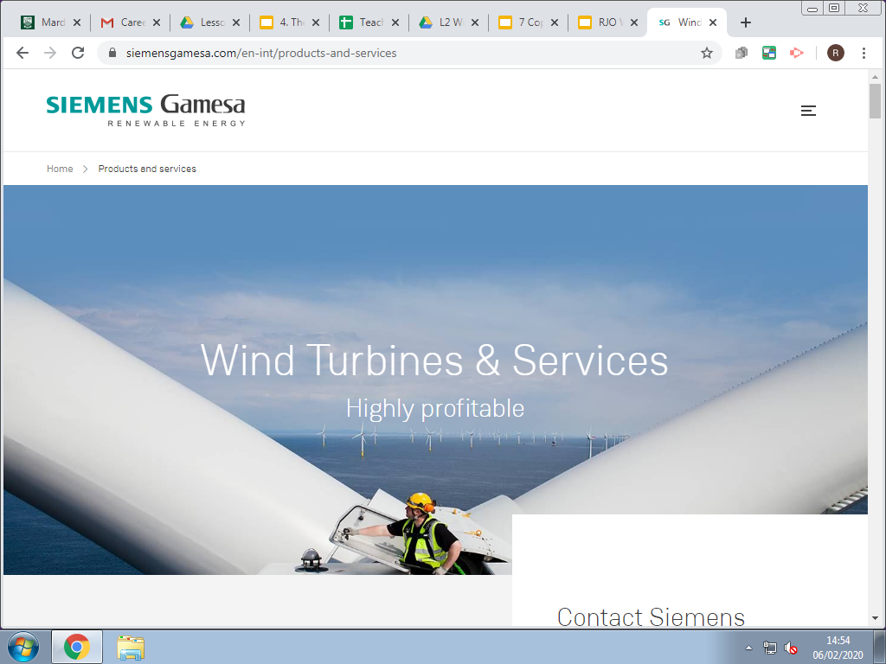
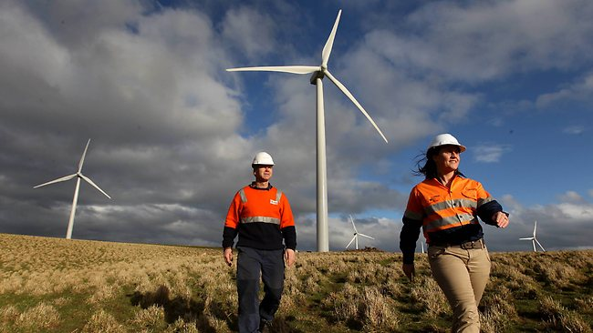
Today we will learn ...
It is relevant because... We are learning transferable skills which will benefit us in the ‘world of work’
Wind Turbine engineers
Wind Turbine Technicians
Maintenance Technicians
https://www.renewableuk.com/page/Careers
Link to great website relating to careers in renewables.
Careers related learning

