Slide 1
Wind Turbine Investigation
Marden High School
Topic:
Class:
Date:
Notes:
This could be stretched out over 3 lessons or kept to 1 depending on time available. Chose slides appropriate to class and time available

Slide 2
How can we adapt a wind turbine design to increase the energy output?
Recall
What is the definition of renewable energy?
Name the energy stores and transfers that occur when a wind turbine is in use.
What is the equation used to calculate kinetic energy?
Key Terms
Energy
Power
Kinetic
Skills
On target for 8 grade | Evaluate your results and the methodology use. Suggest improvements and further options for investigation.
On target for 6 grade | Write a clear and concise method for your investigation
On target for 4 grade | Carry out an investigation to investigate wind turbines
Notes:
What do you want your students to learn?
How will you gain buy-in?

Slide 3
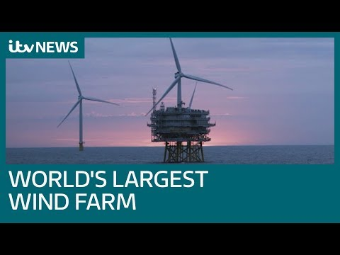
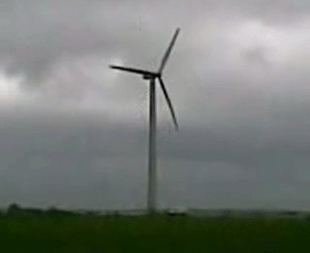
How can we adapt a wind turbine design to increase the energy output?
RECAP
Advantages
Renewable
No CO₂, because nothing gets burned
Turbines are quite cheap and easy to build, so they can be used even in poor countries
Disadvantages
Turbines can be ugly and noisy (visual pollution and noise pollution)
Only works if the wind speed is above 5 m/s! If the wind stops, you get no energy.
Cannot be used in high winds in case of damage

Slide 4
How can we adapt a wind turbine design to increase the energy output?
Planning your investigation
Develop a hypothesis for your investigation
Identify your variables (Control, Independent, Dependent)
Write an appropriate method for your investigation.
Write a risk assessment for your investigation
Produce an appropriate results table.
Notes:
The turbine kits can be used to investigate changing the number of blades as well as the pitch (angle) of the blade.

Slide 5
Power = Current x Potential difference
P= IV
Notes:
Equation slides
Strategies to allow lower targets to access
Strategies to allow higher targets to extend
Accelerated learning cycle- Connect > Activate > Demonstrate > Consolidate

Slide 6
How can we adapt a wind turbine design to increase the energy output?
Evaluating your investigation
Data analysis
What do your result show?
Discussion
Are these the results you expected? If not, why do you think the results turned out differently?
What went well in your investigation?
What could you do to improve your investigation?
Conclusion
Summarise your results and investigation in 2-3 sentences

Slide 7
Lab report checklist
Introduction
Aim of the investigation: Why are you carrying out the investigation?
Hypothesis: What is your prediction for the investigation?
Variables
Independent variable
Dependant variable
Control variable
Method and equipment
Risk assessment
Results
Data table
Graph if appropriate
Discussion
What does your data show?
Are there any unexpected results? Why?
How could you improve your experiment?
Has this lead you to want to investigate another variable?
Conclusion: summary of your data and discussion.
In your discussion, you should use and include your own knowledge and understanding of wind power when considering your results and what they might mean.
Notes:
Use if completing the lab report follow up task
Strategies to allow lower targets to access
Strategies to allow higher targets to extend
Strategies and considerations. For example SEND/PP/ students who were absent last lesson etc
Other teaching notes

Slide 8
Angle Of Blades | 0 | 10 | 20 | 30 | 40 | 50 | 60 | 70 | 80 | 90
Amps | 0.01 | 0.02 | 0.01 | 0.02 | 0.03 | 0.02 | 0.03 | 0.02 | 0.04 | 0.02
Volts | 0 | 0.05 | 0.06 | 0.07 | 0.09 | 0.12 | 0.12 | 0.19 | 0.23 | 0.2
Power | 0 | 0.001 | 0.0006 | 0.0014 | 0.0027 | 0.0024 | 0.0036 | 0.0038 | 0.0092 | 0.004
Independent Variables |  |  | Max
Wind Speed |  | Voltage | 0.23
Angle Of Blades |  | Amps | 0.04
Number Of Blades |  | Power | 0.0092
Group 1 : Results

