Slide 1
Knowing Benchmark 1
Mark Fox
Notes:
The following slideshow contains commentary to guide you through the presentation, however there are also notes available if commentary isn’t used
All documents referenced are hyperlinked to save you time seeking them out
This is applicable to both schools and colleges, but schools are referenced in examples due to my position as a schools hub lead

Slide 2
Notes:
This is the Benchmark that holds all other Benchmarks together
It is the whole-school Benchmark and keeps you on track when planning your careers programme
Use this Benchmark if you are new to Careers, or if you are experienced but require a moment of clarity
You need to consider all other Benchmarks when looking at Benchmark 1
Link Benchmark 1 with your whole school or college strategy from the start; ethos, values and mission statement

Slide 3
Three tips…
Know the guidance
Know your role
Know who can help
Access here
Access here
Notes:
There are three simple tips to feeling confident about BM1: knowing the guidance, knowing your role and knowing who can help
The first is important so that you know yourself what you are trying to achieve
The second is important so that you understand the content and boundaries of your role
The third is important because nobody expects a Careers Leader to do the whole job by themselves!
This knowledge will help you be clear about what you want from your careers programme and be able to answer any questions whether they are from students, teachers, employers or governors

Slide 4
Benchmark 1: What does it say?
”Every school and college should have an embedded programme of career education and guidance that is known and understood by pupils, teachers, governors and employers.”
Notes:
Always go back to basics: what is Gatsby Benchmark 1 telling you that you should have?
Note the three highlighted words; together they incorporate many of the Benchmarks to follow
Be mindful of having evidence for any claims you are making about your programme; what if someone asks to see it?

Slide 5
Benchmark 1: But what does it actually mean?
(School examples shown)
Notes:
If you have completed a Compass report before you will know that Benchmark 1 breaks down into a number of characteristics
Behind each characteristic is a piece of work in itself – sometimes a big piece of work – but the characteristic must only be ticked when you have belief in the evidence to show for it
Achieving Benchmark 1 and all its characteristics should mean you are well on the way to all 8 Benchmarks and may even have a timeframe in mind
This timeframe could be a year, it could be more; the detail of your progress should be documented in your North East Ambition audit
The audit gives you the opportunity to write about the characteristic in more detail and say how/when you might achieve it

Slide 6
Every ‘x’ tells a different story…
Notes:
Note the pattern of ticks and crosses on your Benchmark 1 Compass audit; for each school or college this will tell a different story
You might only have a few ticks…but they could be the vital ones to move your programme on
You might have almost all ticks…but the ones missing could be crucial characteristics that will impede your progress
By looking closely at the patterns in your audit you can determine much more clearly where your priorities lie

Slide 7
Every ‘x’ tells a different story…
Notes:
Have a look at this one; the same number of ticks and crosses but a very different story
A programme is there, strategic and operational, with resources attached. But there appears to be no backing from SLT and no involvement from governors
SLT backing is vital to moving on your programme, and a presentation can prove decisive in giving you full support and guidance to move things on
Try to get your name on the governors’ agenda, even if you have to wait some time before it happens – it’ll be a start and something you can note in your audit
There are excellent publications for governors and careers (eg, CEC, CEGNET) – why not read them first to be ready for any questions?

Slide 8
Your whole-school programme:
Notes:
Moving down the list of characteristics don’t forget your four major groups of stakeholders; each is different
Try to see your website as a marketing tool and something to help you deliver your programme, not just as a place where you are required to publish statutory information such as your careers programme, the Careers Leader’s name and contact details and your provider access policy
Within the confines of your website’s technical capabilities you can make your messages about careers as dynamic and inspirational as you like
For students and parents/carers messages can be about all the support available for both groups as students move through each year, showing a sequential programme which follows a logical and comprehensive progression until age 16/18 or beyond
For teachers you can explain their vital role in embedding careers in the curriculum
And for employers you can send out a call to action and explain how they could work with your school or college

Slide 9
Your whole-school programme:
Notes:
Evaluation is vital for all careers programmes, but again, you need different forms of evaluation from your 4 stakeholder groups
The evaluation process needs to start at the beginning of an academic year otherwise you won’t know what you are evaluating and whether what you have done has made any impact
Collating this information should provide you with a comprehensive roadmap for improvement the following year
Perhaps you could link with curriculum leads to discuss a plan of action for subject areas, and with your Enterprise Adviser to discuss how to gain and use feedback from employers: you can always contact one of the team’s Enterprise Coordinators to have a discussion about your EA relationship
Evaluation is easier and more accurate if you have a clear set of learning outcomes from your programme; the CDI framework Jan 2020 can help with this

Slide 10
(Similar guidance exists for colleges)
Notes:
It is strongly recommended to read the government’s careers strategy and its corresponding statutory guidance
Both documents are short and readable, providing the rationale for what the government is seeking to achieve with careers guidance and the tools to do it
Knowing the strategy and the guidance strengthens your confidence in your role and gives you the ‘go-to’ place when you are asked potentially challenging questions by senior leaders, governors and parents/carers

Slide 11
“We want to create a stronger, fairer society in which people from all backgrounds can realise their potential. A thriving careers system, that is accessible to everyone is at the heart of our focus on social mobility.”
Notes:
This paragraph in the introduction of the strategy document sums up what the government would like all schools and colleges to offer their students
The strategy makes frequent references to the Gatsby Benchmarks and refers to all settings and all types of student (eg, SEND, EAL)

Slide 12
“A successful careers guidance programme will be reflected in higher numbers of pupils progressing to positive destinations.”
(See previous slide for schools guidance)
Notes:
Statutory guidance often follows a strategy documents and this sets out ‘how’ schools and colleges can meet the strategy’s requirements
The guidance contains information on what ‘must’ be in place and what ‘should’ be in place. This distinction is explained
Always bear in mind the ultimate aims of any careers programme – the quantity and quality of positive destinations
Think about whether extracts from the strategy or statutory guidance could tie in nicely with your institution’s mission statement?

Slide 13
What can help me do all this?

Slide 14
There are plenty of resources to help
Access ItF
Access Barclays
Notes:
If you are looking free products to help you map ‘all’ Benchmarks across your careers programme have a look at these
Sometimes using a branded set of resources can ensure you achieve consistency across your programme
You could use more than one of these products to help you plan your programme

Slide 15
There are plenty of resources to help
Access Start
Notes:
The Start programme is an interactive, free, web-based careers software program which can be used to measure the student careers journey; add-on features can be purchased

Slide 16
There are plenty of resources to help
Access here
Notes:
Fully updated in 2020 the WorldSkillsUK Careers Advice Toolkit is available as a free download
Whilst this mapping tool is targeted at school subjects the same format could be used to map college CEIAG content

Slide 17
There are plenty of resources to help
For schools
For colleges
For SEND
Notes:
The Careers and Enterprise Company has produced a range of support materials when planning your whole careers programme
A new round of free national Careers Leader training is available from September 2020 – details are on the CEC website
CEC stresses the need for any careers programme to be linked closely to the overall school or college careers strategy; not to see it as a bolt-on but an integral part of the institution’s ethos, aims and values
Use the CEC strategy template to help you plan this, and seek help from your school or college leadership team

Slide 18
The North East Ambition Benchmark toolkits
Notes:
The idea behind the North East LEP’s Benchmark toolkits is all the key information you’ll need for each Benchmark in one place
This includes videos as well as documents and presentations
Have a look at the current Ofsted inspection handbook for references to judgments on careers guidance (pages shown refer to schools)

Slide 19
There are plenty of resources to help
Access publisher
Notes:
The Careers Leader Handbook is the one product mentioned here that has a cost attached but has been received extremely favourably by Careers Leaders who have used it and is highly recommended to guide you in your programme planning

Slide 20
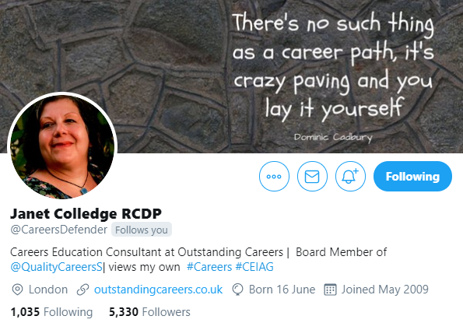
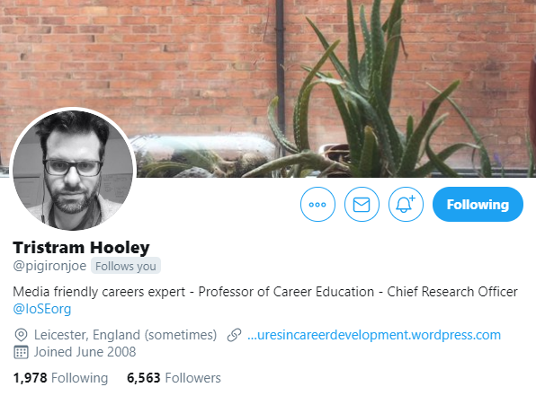
If you’re into social media…
Notes:
Following key figures in the careers world such as those highlighted in the slide can help you in a number of ways; informing you about new developments and publications, offering opinions about current hot topics and showing you what your fellow Careers Leaders are doing
It is also an opportunity for you to showcase what you are doing so you have both an evidence trail of your commitment to careers and a way of widening your reach when wanting others, such as employers and providers, to be involved in your programme

Slide 21
Don’t forget…
Careers guidance has moved on! It is not so much about occupational ‘matching’ anymore, it is about young people developing the skills to manage their own career. ‘Career management skills’ (CMS) are defined as:
“…a range of competences which provide structured ways for individuals and groups to gather, analyse, synthesise and organise self, educational and occupational information, as well as the skills to make and implement decisions and transitions”
Notes:
Remember what you are trying to help yp achieve; you are not trying to do it all for them but to help them do as much as possible for themselves with your support.

Slide 22
Don’t forget…
Building your careers programme on a clear set of learning outcomes means you can:
Construct focused careers activities
Make clearer links with curriculum areas
Measure impact after delivery
Notes:
1. You can always use a combination of frameworks to create your learning outcomes
2. Remember your evaluation process at this stage – how easy will they be to measure?
3. You don’t need lots of learning outcomes…go for quality and simplicity

Slide 23
Record, plan and evidence your progress
Access here
Notes:
Upgrading to Compass+ is currently only available for schools
This system will enable you to monitor all aspects of your careers programme and provide evidence of your students’ careers journey
Linking with your school’s MI system Compass+ will provide up to date student level data on all involvement in careers activities
This is mapped against all 8 Benchmarks, showing which students have benefitted from which Benchmarks and where the gaps are
Whilst upgrading to Compass+ is strongly recommended it is not essential if the system you use does what you need eg, in-house spreadsheets or commercial products

Slide 24
Three tips…
Know the guidance
Know your role
Know who can help
Access here
Access here
Notes:
A reminder about the three tips we started with
Who can help will vary depending on whether you are in a school or a college, and the type of institution you are in (as well as size and capacity)
But as careers is a whole-institution endeavor it will be important to find the right people
The careers strategy, national guidance and CEC publications on the role of the Careers Leader will give you a number of pointers as to who is best placed to help you
A starting place could be to gather together your line manager for careers, your link governor and your Enterprise Adviser to have an informed discussion about what is necessary and what is achievable in your institution
If you don’t have any of these people available this might throw up an even more urgent starting point about your role and your capacity to fulfil it
Perhaps also start with a September survey with students and others to see what they want/need and look at how you might be able to tap into other whole-institution surveys to gather careers intelligence

Slide 25
Thank you To see a list of all North East LEP staff visit: northeastlep.co.uk/about/executive-team

