Slide 1
North East Local Labour Market
LMI Quiz
Notes:
Welcome to this interactive resource to help bring the North East labour market to life aiming to support you to find out more about the North East economy and opportunities in the region.
You can adapt the content to deliver sessions for pupils as well as for other key stakeholders including parents/ carers and governors.

Slide 2
Key Vocabulary
Labour market: The supply of people in a particular country or area who are able and willing to work.
Labour Market Information (LMI): Information about the jobs and careers available in a geographical area.
Sector: An area of the economy made up of various jobs that are typically related in some way
Employability: Having the skills and abilities needed to have a job or career.
Career: The job or series of jobs that you do during your working life.
Notes:
What is LMI and why is it important? – LMI For All
Local labour market refers to the support of people in a particular country or area who are available for work local labour market information is then about the jobs and careers available in a geographical area.

Slide 3

Define: Labour Market Information (LMI)
Information about the jobs and careers available in a geographical area.
LMI is important for the future, it allows young people to understand what is on offer in their area and how to get there by making good decisions about their future career choices.
Discussion (2-3 mins)
How do you think Labour Market Information could help pupils shape their aspirations?
The North East
It helps us understand the world of work by breaking it down into smaller parts.
LMI highlights the fantastic career opportunities available and what existing opportunities and growth areas there are near you.
Notes:
LMI is important for the future it allows pupils to understand what is on offer in a specific area to help inform future careers choices. Discussion area how do you think labour market information could help pupils haper their aspirations? Discuss in pairs.
References:
http://www.lmiforall.org.uk/explore_lmi/
https://www.lmiforall.org.uk/explore_lmi/learning-units/what-is-lmi/ - There is a YouTube video explaining LMI if needed on this page.

Slide 4
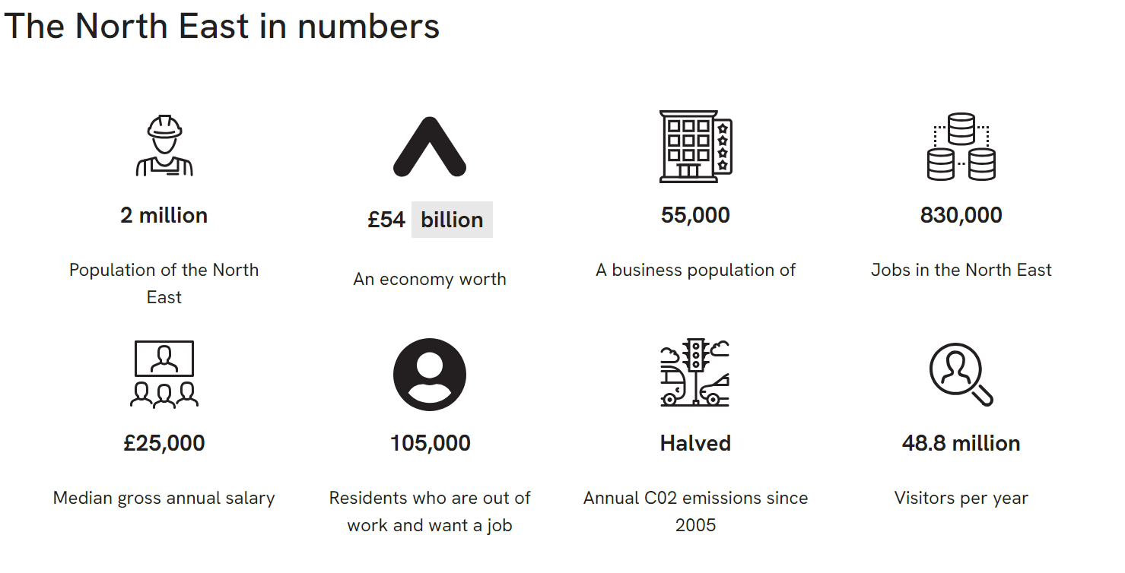
Data as of August 2024
North East Mayoral Strategic Authority Strategic Evidence base - North East Evidence Hub (northeast-ca.gov.uk) – Up to date information here
Notes:
What about the North East?
Are you aware that there are 2 million people living the North East with 105,000 who are currently unemployed and seeking work the North East also welcomes over 48 million visitors per year which contributes to our regions economy.

Slide 5
Define: Sector
An area of the economy made up of various jobs that are typically related in some way
LMI can help you understand which jobs are available near to you and how many jobs there are in all the different sectors.
Individual activity (2-3 mins)
Write down the top three careers the students in your class might aspire to. What sectors are they in?
LMI could help you see where job opportunities are and how much certain roles pay.
LMI is updated regularly, so you can see how job opportunities change and some sectors grow.
Notes:
LMI can help you understand which jobs are available near to you and how many jobs there are in different sectors in the North East.
Take 2-3 minutes to write down the top three careers the students in your class might aspire to? What sectors are they in?
Do you think that pupils aspirations align to the opportunities in our region?
References
http://www.lmiforall.org.uk/explore_lmi/
https://www.lmiforall.org.uk/explore_lmi/learning-units/what-is-lmi/ - There is a YouTube video explaining LMI if needed on this page.

Slide 6
_____________ people are employed in the North East Mayoral Strategic Authority region.
A
830,000
B
530,800
C
1,220,500
Notes:
How many people are employed in the North East Mayoral Strategic Authority region?
A) 830,000 (Correct answer)
B) 530,800
C) 1,220,500

Slide 7

Since March 2014, employment has ___________.
A
Decreased by 53,700
B
Stayed the same
C
Increased by 53,700
Notes:
Over the past 10 years has employment:
Decreased
Stayed the same
Increased by 53,700 (correct answer)
Where do you think we have seen the biggest increase?

Slide 8

___________ new workers will be required in our region from 2021 to 2027.
A
175,000
B
300,000
C
400,000
Notes:
Over the next 3 years what number of new workers will be required in the region?
a) 175,00
b) 300,00
c) 400,000 (correct)
Reference: - Strategic Evidence Base : People - North East Evidence Hub (northeast-ca.gov.uk)

Slide 9
Over 400,000 new workers needed between 2021-2027
Notes:
400,000 new workers will be needed over the next 3 years and beyond this reflects replacement demand in sectors where there is a aging workforce as well as new roles in key sectors

Slide 10
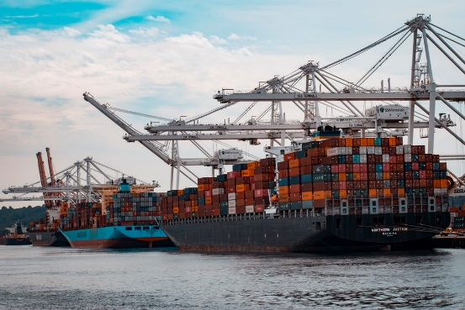






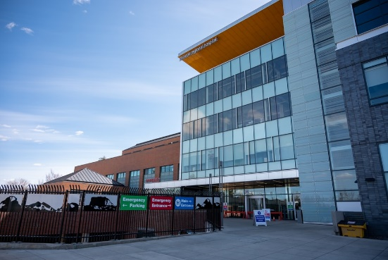
Do you know what kind of work is involved in each of these sectors?
Discussion (2-3 mins)
Discuss what you think the main areas of opportunity are in the North East.
Notes:
Discussion activity – What are the main areas of opportunity in the North East?
References
https://www.northeastambition.co.uk/toolkits/labour-market-insights-toolkit
Evidence by Theme - North East Evidence Hub (northeast-ca.gov.uk)
https://dictionary.cambridge.org/dictionary/english/manufacturing
https://dictionary.cambridge.org/dictionary/english/administration
https://dictionary.cambridge.org/dictionary/english/retail
https://dictionary.cambridge.org/dictionary/english/social-care

Slide 11
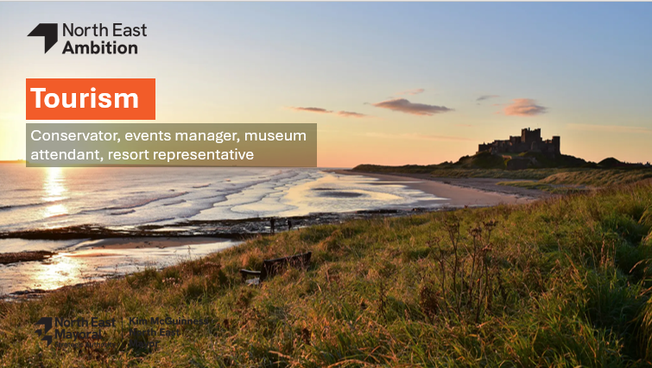
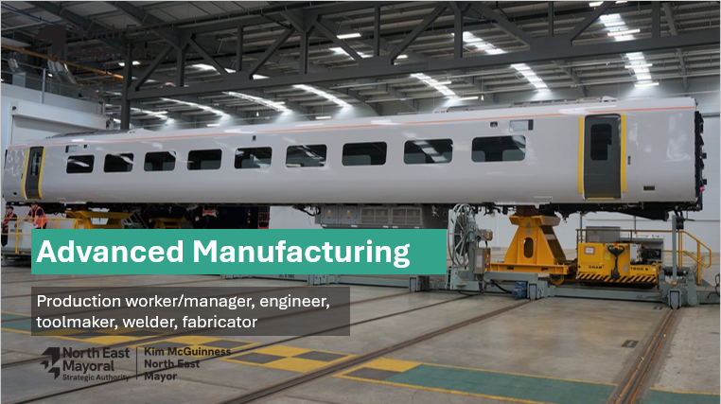





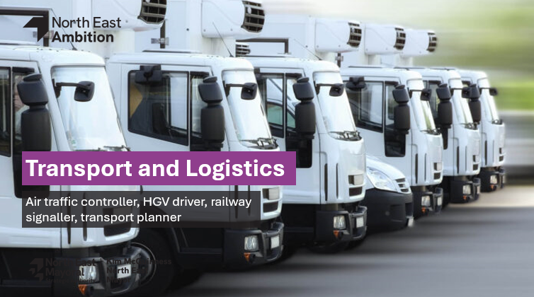

Notes:
Then North East Labour market incorporates key sectors where we are seeing significant growth and investment across the region for each key sector can you name a North East company?
Each image also includes example career roles related to the sector:
Tourism
Advanced Manufacturing
Digital
Energy
Health and life sciences
Construction
Transport and Logistics
Creative and cultural
Professional services

Slide 12
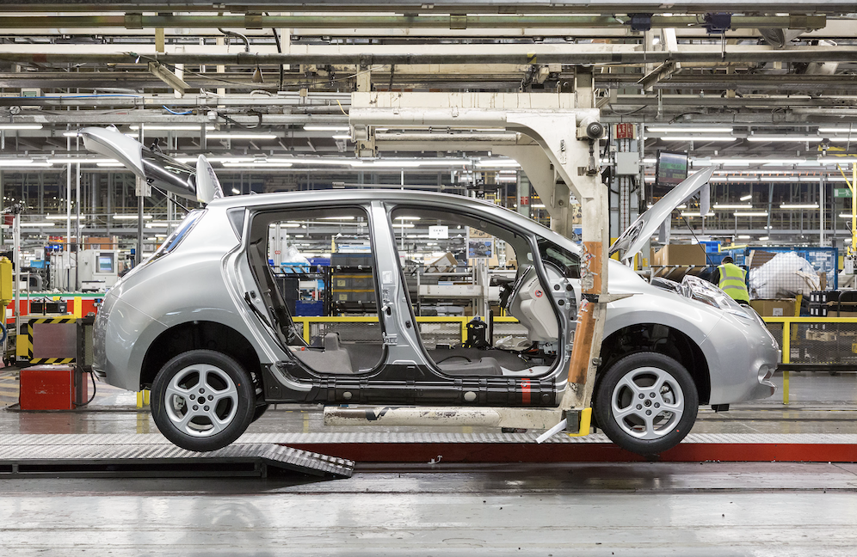
_______% of all electric cars made in the UK are produced in the North East.
A
26%
B
52%
C
78%
Notes:
What percentage of all UK made electric cars are manufactured in the North East?
a) 26% (correct)
b) 52%
c) 78%
Where do you think these cars are manufactured?
References:
Electric North East England - Invest North East England
Emergent Markets: Autonomous and Electric Vehicles - North East Evidence Hub (northeast-ca.gov.uk)

Slide 13

There are _________ people employed in the North East in IT and digital industries
A
10,000
B
29,000
C
45,000
Notes:
Digital sector in the North East is seeing significant growth how many people are employer in the IT and digital industries?
a) 10,000
b) 29,000 (correct)
c) 45,000
References
Digital and Tech | Moving My Business to North East England (investnortheastengland.co.uk)

Slide 14
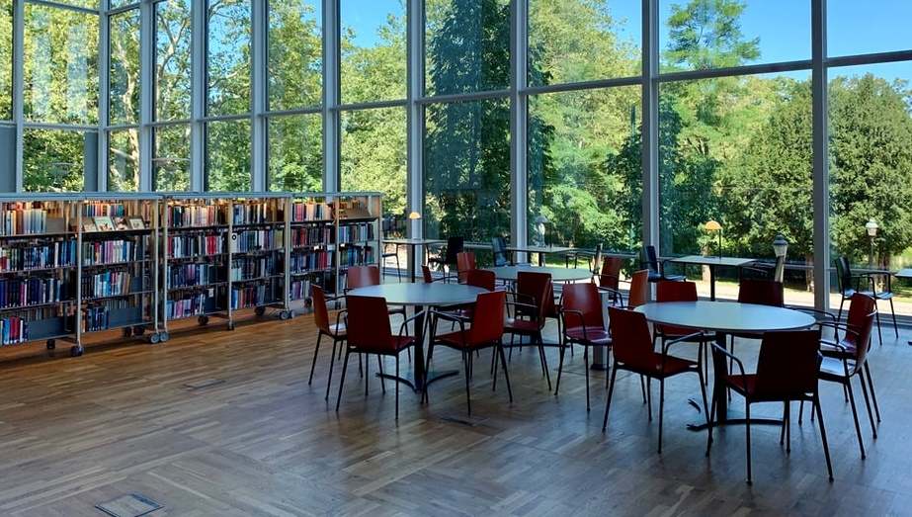
___________ students study in the region’s 5 universities.
A
81,000
B
110,000
C
210,000
Notes:
How many students are studying at the regions 5 universities? (please note this will change year on year)
81,000
110,000 (correct)
210,000
Can you name the 5 universities in the North East?
Northumbria University
Newcastle University
Sunderland University
Durham University
Teesside University
References
Report: Graduate outcomes - North East Evidence Hub (northeast-ca.gov.uk)

Slide 15

There are currently __________ people employed in life sciences in the North East.
A
7,000
B
700
C
70
Notes:
There are currently XXX people employed in the life sciences sector in the North East:
7,000 (correct)
700
70
Did you know the North East led on the regions response to Covid-19 manufacturing the Novavax vaccine here in our region at GlaxoSmithKline (GSK) facility in Barnard Castle, County Durham. The region also as manufactured PPE to support the pandemic in the Northumbria healthcare site in Seaton Deleval in Northumberland.
References
Health and Life Sciences - North East Evidence Hub (northeast-ca.gov.uk)

Slide 16

The North East is a global leader in __________.
A
Electric cars
B
Offshore wind
C
Eco-farming
Notes:
The North is a global leader in:
Electric Cars
Offshore wind (correct)
Eco-farming
Did you know that the North East is a global leader in offshore renewables and the sector continues to grow and attract new businesses the region features rhe UKS largest offshore wind farm at Dogger Bank
References
North East England - the centre of the UK’s green energy revolution (investnortheastengland.co.uk)

Slide 17
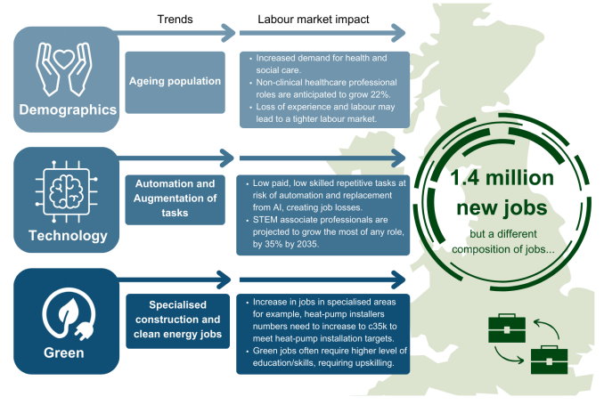
Notes:
What is happening to our labour market and sectors? Global megatrends will impact and influence our regional economy and, the type of opportunities and conversations we have with young people and parents about the labour market.
Some of these influences include globalization – the process of businesses developing international influence and operating on international scales.
The gig economy – a labour market characterised by the prevalence of short-term contracts or freelance work as opposed to permanent jobs.
Automation, ageing workforces and of course, the environment.
Consider how these trends may impact or influence jobs in the future?

Slide 18
Find out more about some of the key sectors in the North East
Notes:
The next 3 slides include optional activities you could deliver with colleagues focusing on the following three sectors:
Digital
Agriculture
Wind Power

Slide 19
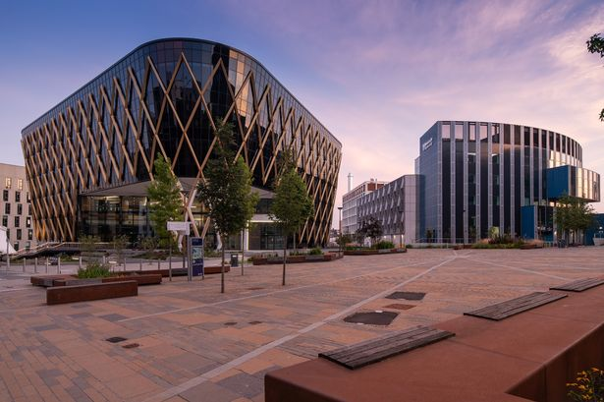

There are thousands of great opportunities across the North East, it has one of the fastest growing digital and tech clusters in the United Kingdom.
0:00-2:17
Reflection
Click the image to watch the video research which creative or digital employers are close to your school how could they link to curriculum topics?
The North East currently has 32,000 creative employees in immersive technology, software development, data management, games development and so much more.
https://safeshare.tv/x/McUhua_gnpw
Notes:
There are thousands of great opportunities in the region in the digital and tech sector the North East currently has over 30,000 creative employees this ranges from immersive technology and games development. Watch the video and research which creative or digital employers are close to your school how could they link to curriculum topics.
Video links:
YouTube Video Link: https://www.youtube.com/watch?v=BaJSciOb2nI&list=PLGVCpm23HHF_z_m8W1dRkwU1BwV2uA5fB
SafeShare Video Link: https://safeshare.tv/x/BaJSciOb2nI
Images
1) https://www.google.com/url?sa=i&url=https%3A%2F%2Fwww.business-live.co.uk%2Feconomic-development%2Fhundreds-north-east-smes-benefit-19072739&psig=AOvVaw3K0QHCT5W5icgzEsMZVPgW&ust=1643291659695000&source=images&cd=vfe&ved=0CAwQjhxqFwoTCJC05tLIz_UCFQAAAAAdAAAAABAD
References

Slide 20
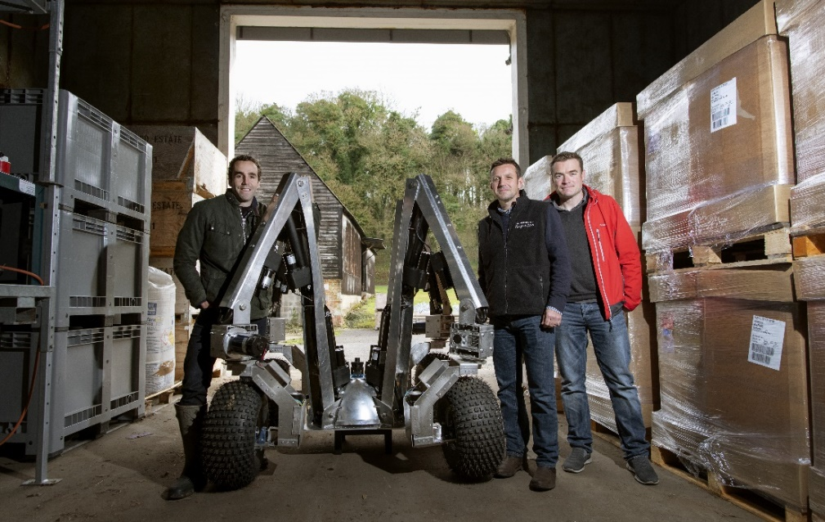

If your pupils are interested in robots and computer programming, then they could be the future of agriculture!
0:00-2:16
Reflection
Click the image to watch the video and discuss any ways this could be integrated into your curriculum.
Small Robot Company (SRC), which focuses on sustainable farming, today announced that its initial fleet of 10 robots will be manufactured by Tharsus, a Blyth-based advanced machine and robots designer and manufacturer.
https://safeshare.tv/x/McUhua_gnpw
Notes:
The small robot company focusing on sustainable farming supporting farmers to future proof crop production and diversify processes. Tharsus manufacturers who are based in Blyth in Northumberland designed and manufactured a fleet of 10 robots. Watch the video and consider how could you bring this into your curriculum.
YouTube Video Link: https://www.youtube.com/watch?v=McUhua_gnpw&t=147s ( - )
SafeShare Video Link: https://safeshare.tv/x/McUhua_gnpw
https://www.youtube.com/playlist?list=PLgdvHBuQ1d7tO10BVxg7P-BjT5gtrE_HV
Images
https://drive.google.com/file/d/1aq4LJ7oXkW64Wmnoymfy84fY2TmqR3FR/view
References
https://bdaily.co.uk/articles/2020/02/07/fleet-of-farming-robots-to-produced-in-Northumberland
https://www.smallrobotcompany.com/press-releases/2020/2/7/small-robot-company-announces-robot-fleet-manufacture-with-tharsus

Slide 21
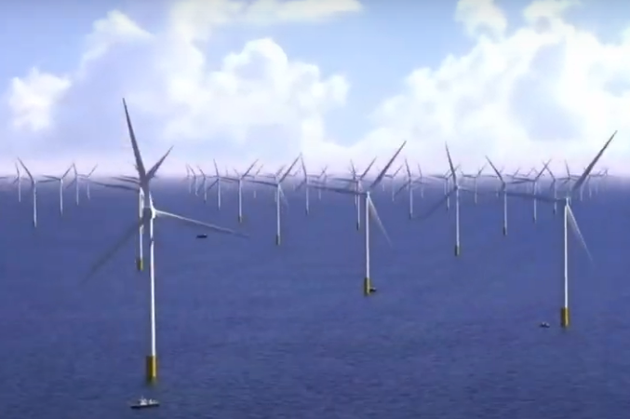
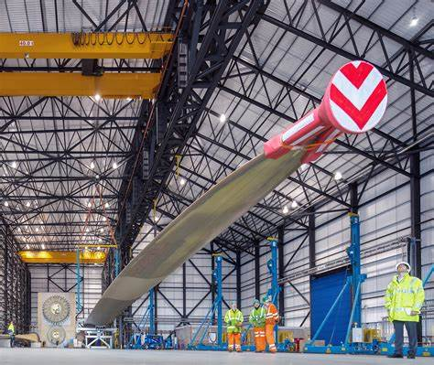
Dogger Bank Wind Farm is in the process of becoming the world’s largest offshore wind farm. It will be capable of powering 6 million British homes. The project will generate a vast source of renewable energy, harnessing the power of wind to provide sustainable energy and reducing the use of fossil fuels.
0:00-1:58
Reflection
Click the image to watch the video and discuss any ways this could be integrated into your curriculum.
The Offshore Renewable Energy (ORE) Catapult has simultaneously broken ground at its National Renewable Energy Centre in Blyth on a multimillion-pound offshore wind robotics centre and a state-of-the-art additive manufacturing cell that will be used to research next-generation wind turbine blades.
https://safeshare.tv/x/McUhua_gnpw
Notes:
Dogger Bank Wind Farm is in the process of becoming the world’s largest offshore wind farm. It will be capable of powering 6 million British homes. The project will generate a vast source of renewable energy, harnessing the power of wind to provide sustainable energy and reducing the use of fossil fuels.
Video links:
https://www.youtube.com/watch?v=ncWxe26Ljn4
References:
The World’s Largest Offshore Wind Farm - Dogger Bank Wind Farm
Equinor: Dogger Bank Wind Farm - North East Ambition (northeast-ca.gov.uk)

