Slide 1

Apprenticeships
Find out more about these
exciting qualifications and
where they can take you

Slide 3



Learning objectives
What are they?
Who are they for?
What can you study?
Where can you study?
Support available
How to search & apply
Notes:
Our aim for today is to give you an introduction to apprenticeships and make sure you have a good understanding of:
What apprenticeships are,
Which subjects you can study, and which subjects are coming in future years,
Who can study apprenticeships, what prior qualifications you need and what sort of person they are suited to,
Where you can study apprenticeships and how to find them nationally and locally,
What the application process is like,
What support and resources are available.
There will be a chance to ask questions at the end. But first….

Slide 4
2025 Research: Making Apprenticeships Affordable
The North East MSA appointed Little Lion Research (LLR) and Think to conduct research into what makes apprenticeships attractive and affordable to young people aged 16-19 in the region.
Factors affecting a robust CEIAG programme focused on technical education pathways include:
  Curriculum dominating time and resource
  Sixth Forms reluctance to share alternative pathways
  Lack of knowledge on selection and recruitment processes
  Lack of knowledge in schools on ITPs
Applying to university is much easier than applying for apprenticeships.
There is insufficient time and expertise to support students with apprenticeship applications.
There are significant perceived financial disadvantages to starting an apprenticeship. However, the average rates of pay for apprentices have increased significantly in the last four years.
Collaboration with educational institutions, training providers and employers – stakeholders have a key role to play in promoting apprenticeships.
Disadvantaged students have lower apprenticeship participation rates than non-disadvantaged students across the region.
The cost of travel, and the availability of public transport to get to and from an apprenticeship, are key factors impacting how attractive an apprenticeship is to a young person.
Notes:
We know that in many respects applying to university is much easier for Year 13s than applying for apprenticeships. They write one personal statement for multiple institutions, double and treble checked before being sent off, and they then wait for offers to come in. From February these UCAS applicants can then sit back and focus on exams, at exactly the time most apprenticeship vacancies start coming out. Learners interested in this route are then expected to embark on a full-blown job-seeking journey, going through application processes that will all be unique in their own way but demanding time and resilience to deal with setbacks/non-responses/multi-format recruitment procedures etc…whilst preparing for their final exams
Most 16-year-olds who start apprenticeships are doing so via family/friends and so have had an advantage in accessing this route, whilst many others will only want to work locally anyway so travel would not be such an issue. But for those whose families are on benefits the financial losses can be substantial if a young person embarks on an apprenticeship at 16/17, particularly if it is in one of the lower-paying sectors

Slide 5
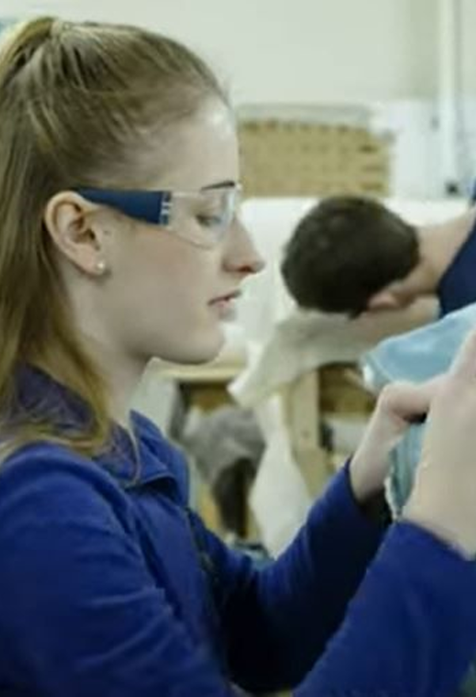
What is an apprenticeship?
An apprenticeship is a real job, with a real employer, where the apprentice will work full-time whilst also studying towards a qualification.
They will spend most of their time ‘on-the-job’ (doing the role), and a minimum of at least 6 hours per week ‘off-the-job’, which means studying or working towards their qualification in a classroom setting.
An apprentice will earn a wage – and it can be a very good salary too!
Receive the benefits of the National Union of Students (NUS), just as if going to University.
An apprenticeship typically takes 1 - 4 years to complete (sometimes up to 6 for some areas).
The employers pay the fees of the apprentice’s training - leaving ZERO debt upon completion.
Notes:
Apprenticeships are technical qualifications that employers have helped develop so you can get the right training and skills you need to succeed at work.

Slide 6
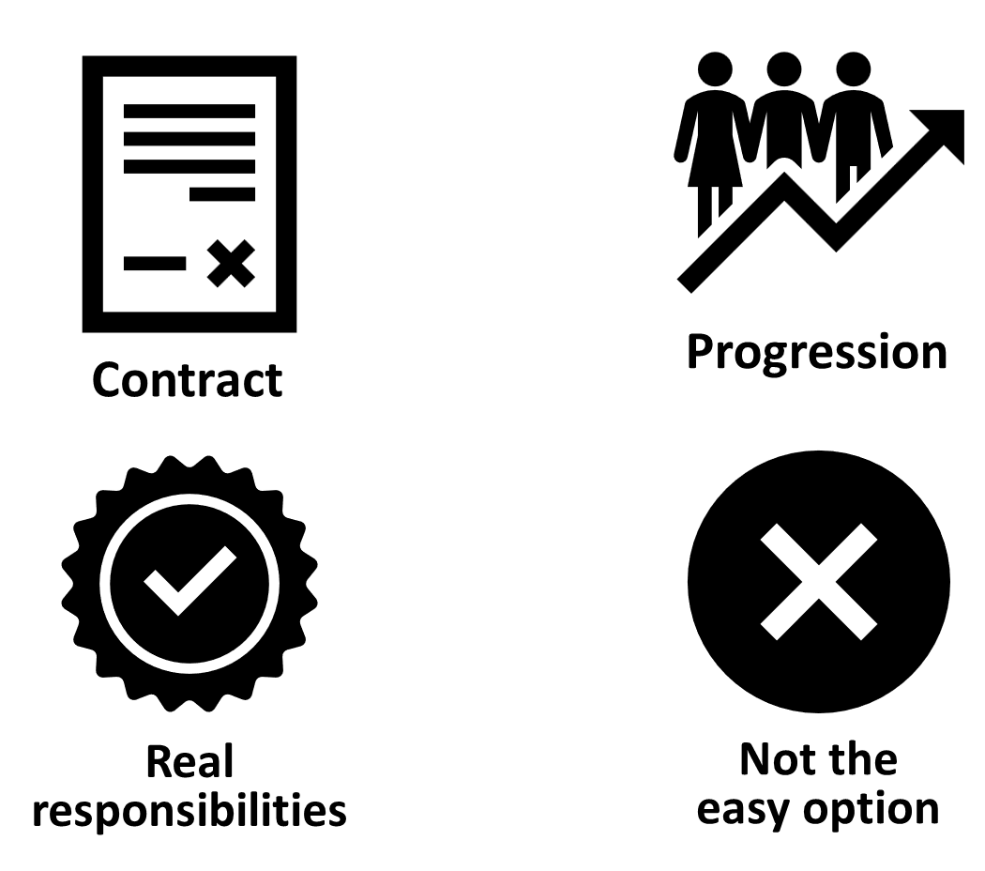
Notes:
CONTRACT
An apprentice will get a contract of employment, holiday pay, annual leave etc. – the same as any other member of staff.
REAL RESPONSIBILITIES & PROGRESSION
As I said before, it’s a real job with very real responsibilities, but with this comes clear progression pathways through the company.
NOT THE EASY OPTION
It’s important to remember that apprenticeships aren’t the ‘easy option’. It is a full-time job AND studying, which takes a certain skill and commitment, so making sure it’s the right path for that person is crucial.

Slide 7
Understanding the apprenticeship levels
The ‘fancy’ name. | Corresponding Levels | This is similar to…
Intermediate | Level 2 | 5 GCSEs at grade A* - C or 4 – 9
Advanced | Level 3 | 2 A Levels / Level 3 Diploma / International Baccalaureate
Higher | Levels 4 & 5 | Foundation degree and above
Degree | Levels 6 & 7 | Bachelor’s or Master’s Degree
Notes:
Each apprenticeship has a level which will fall into one of the four categories above: Intermediate, Advanced, Higher, and Degree apprenticeships.
The third column helps to explain what level the qualification at the end of the apprenticeship will be in comparison to more familiar qualifications, like GCSEs and A Levels.
So, you can see that if you do a level 3 (advanced) apprenticeship, once you have qualified, you’ll have gained a qualification that is equivalent to 2 A Levels, a Level 3 diploma or other equivalents, like IB’s or BTECs.
Presenter notes: Opportunity to pause to ask if there are any questions about levels and how they work.
The level of apprenticeship you start at will depend on the kind of job that you are applying for.
It’s important not to be held back by only looking for a particular level e.g. degree apprenticeships. Apprenticeships work a bit differently to school which can be confusing, as lots of students think that they should progress onto the next level For example, if you leave school after GCSEs, you don’t necessarily have to do a Level 3, and if you finish after A Levels you don’t necessarily have to go for a degree apprenticeship.
Depending on the sector and apprenticeship, it may be that you need to start at advanced or higher level and work your way up. Just because an apprenticeship is only offered at Level 2 or 3, doesn’t mean it’s not a brilliant opportunity. For example, Journalism is only offered at Level 3 because that is all the industry requires.
Equally, you may be entering a completely new sector or industry that you haven’t studied or worked in before, and so may need to do a Level 2 or 3 to enter the world of work and get that understanding.
It is very important to keep an open mind so that you can explore all the opportunities available and have multiple options available when applying.

Slide 8
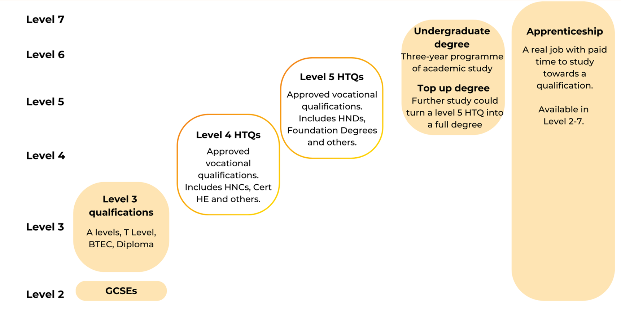
Where do apprenticeships fit alongside other qualifications?

Slide 9
BREAKING NEWS!!

Slide 10
Level 3 apprenticeships now carry UCAS Tariff points!
Applicants to higher education with a
Level 3 apprenticeship can now list their apprenticeship with the associated Tariff points in their applications for 2026 entry.

Slide 11

Post-Apprenticeship Recognition Scheme (PARS)
Apprentices can now have letters after their name, just like with a university degree!
In a nutshell, having the PARS award letters after your name shows that:
You have skills that would be an asset to any organisation
You have work experience embedded
You are part of, and contribute to, a wider apprenticeship community
You are committed to developing to a professional standard
PARS - Association of Apprentices
Notes:
PARS is a new awards scheme for those who have completed an apprenticeship in the UK. Successful applicants will be able to use letters after their name, which means people will automatically recognise your apprenticeship achievement.

Slide 12
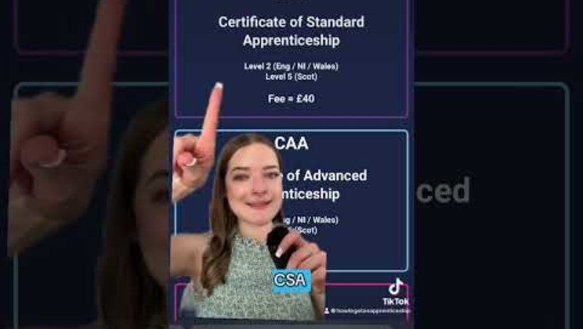
Post-Apprenticeship Recognition Scheme (PARS)

Slide 13
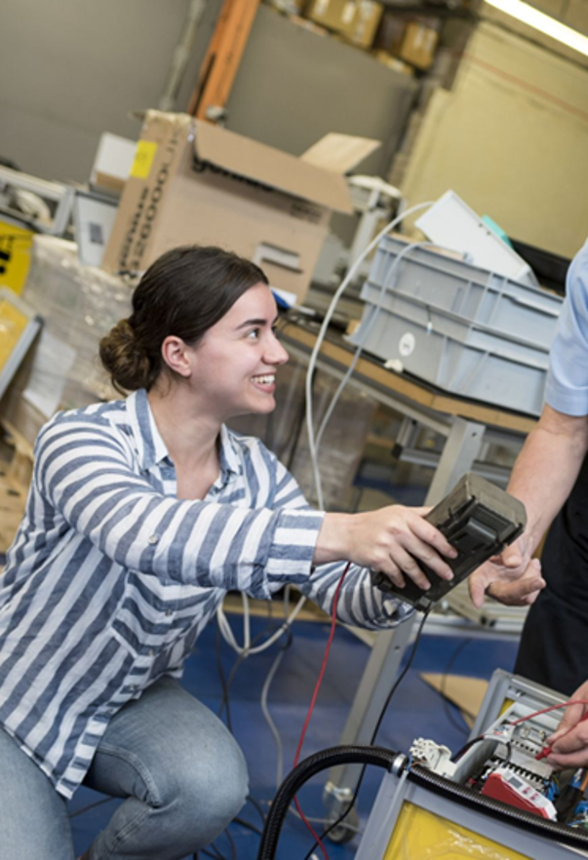
Who are they for?
You need to be at least 16 to start an apprenticeship, and there is no upper age limit.
You can apply for an apprenticeship while you’re still at school, but you’ll need to be 16 or over by the end of the summer holidays to start the apprenticeship.
You must not be in full-time education to study an apprenticeship.
An apprenticeship may suit you if you:
enjoy both hands-on and classroom-based learning
are willing to commit to work and study at the same time
are ready to start work with an employer, and be based in the workplace most of the time
are ready to be assessed through a mix of assignments and written work, including essays, reports, and practical exercises
Notes:
Who are apprenticeships for? | UCAS

Slide 14
What can you study?
These are examples of current vacancies available (as of Aug 2025).
Level 2 Apprentice Chef
Level 2 Equine Groom Apprentice
Level 2 Healthcare Science Support Worker
Level 2 Pharmacy Assistant
Level 3 Administration & Finance
Level 3 Early Years Educator
Level 3 Electronic Security Technician
Level 3 Laboratory Technician
Level 3 Events Assistant
Level 3 HR Administration
Level 3 Junior Data Analyst
Level 4 Countryside Ranger
Level 4 Police Community Support Officer
Level 4 Engineering Maintenance Technician
Level 4 RAF Intelligence Analyst
Level 6 Process Safety Engineering
Level 6 Youth Worker Apprentice
Level 6 Packaging Management
Notes:
These vacancies are/were advertised during Aug 2025 and shows just how varied apprenticeships can be across roles and sectors.

Slide 15
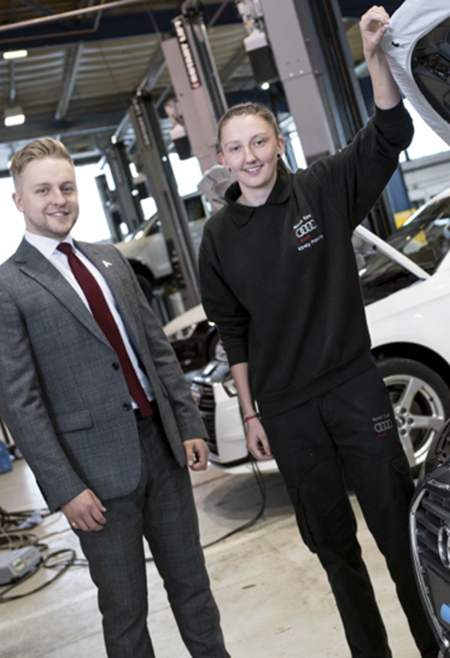
Where can you study?
Here is a flavour of training providers available in the North East offering apprenticeships.
North East FE Colleges:
Newcastle College, Education Partnership North East, Gateshead College, New College Durham, East Durham College, Derwentside College, Bishop Auckland College.
Independent Training Providers:
Access Training
Baltic Apprenticeships
Tyne North Training
B-Skill Ltd
TDR Training
Resources NE Ltd
Plus many more…
Notes:
Apprenticeships are delivered by universities, Further Education Colleges, Independent Training Providers and Institutes of Technology all over England. On the screen are some examples of training providers and institutions from within the North East MSA region.

Slide 16



How to search & apply
Visit:
https://www.gov.uk/apply-apprenticeship
Or
Search apprenticeships | UCAS
Find Apprenticeships
Research the business, training provider (if known), and job role. Find out everything you can to decide if this is the right role for you – remember, you’re applying for a job!
Research
Complete and submit applications for apprenticeship roles – each recruitment process may be different.
Apply for Roles
Notes:
It’s important that young people understand, that when they apply for an apprenticeship, they are applying for a job role, just like any other employee. Finding the right roles and conducting their own research is vital to ensure they are applying for the right type of role and at the right level.
You can find apprenticeship vacancies through the Gov.uk website, however, this is now aligned to the UCAS website – meaning a one stop shop for both degree and apprenticeship opportunities across the region.
Another way is to contact or visit the websites of specific providers and find out what apprenticeships they are offering.
Apprenticeships are becoming increasingly popular and the competition for roles can be fierce. Therefore, understanding how some organisations operate their recruitment and selection processes is important when making sure young people are suitably prepared. More information on this can be made available.

Slide 17
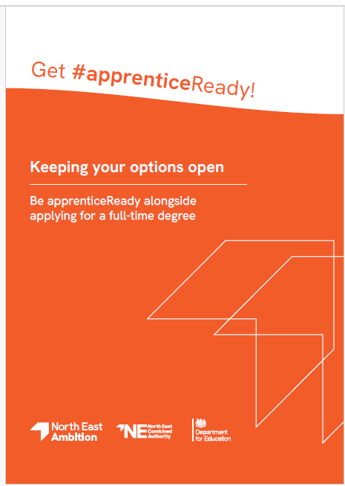
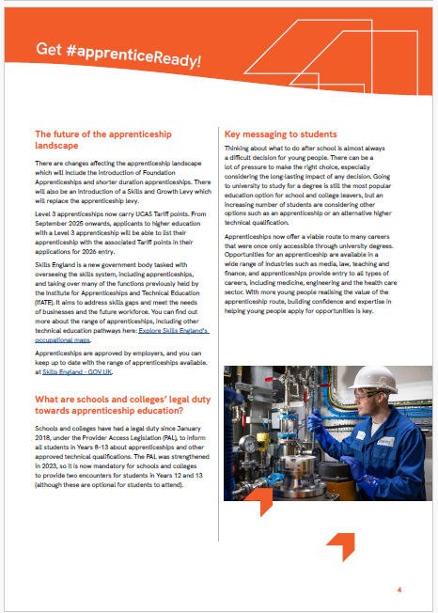
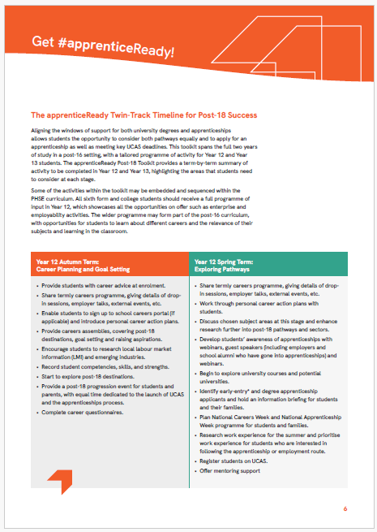
apprenticeReady Post-18 Tookit
Notes:
The apprenticeReady Post-18 Toolkit has been designed to support students interested in exploring apprenticeships alongside other options, such as undergraduate courses. This is commonly referred to as ‘twin tracking’. It provides information for schools, sixth forms and colleges to help students, teachers, parents, and carers understand, find, and apply for apprenticeships.
The toolkit aims to:
• Raise awareness of apprenticeships as an equally prestigious and viable route, a view most associated with a degree.
• Improve school culture and awareness of the organisations available to increase the promotion of and access to apprenticeships.
• Improve teacher knowledge and confidence to enable and inspire students to apply for apprenticeships via the twin tracking approach.
• Support post-18 progression and sustained destinations.
The toolkit provides are side by side comparison of the key differences between a degree and an apprenticeship, a termly outline of activity for Years 12 and 13 to ensure the right information and guidance is provided to those students who wish to explore both routes and a series of frequently asked questions submitted by students during the Early Connect pilot project.
apprenticeReady schools and colleges - North East Ambition

Slide 18
Entry requirements
Intermediate Apprenticeships (Level 2)
Typically require being 16 or over and not in full-time education, with GCSE maths and English.
Advanced Apprenticeships (Level 3)
May require prior work experience and at least five GCSEs at grades 9-4 (or equivalent).
Higher Apprenticeships (Levels 4 and 5)
Equivalent to a foundation degree or first year of a bachelor's degree, so may require five GCSEs at grades 9-4 (or equivalent) and some Level 3 qualifications.
Degree Apprenticeships (Levels 6 and 7)
May require three A-levels in specific subjects, or a higher apprenticeship qualification, along with at least five GCSEs at grades 9-4 (or equivalent).

Slide 19


Slide 20


Slide 21


Slide 22

It’s a full-time job with off-site training
Let’s review
Progression opportunities
For those 16+ with GCSE maths & English
Usually take
1-3 years to complete
Training is paid for by the employer
Level 2 - 7 qualifications
Taught in FE colleges, Universities & IoTs

Slide 23
Support available and useful resources
apprenticeReady schools and colleges - North East Ambition
Apprenticeships - North East Ambition
Find an apprenticeship - GOV.UK
Apprenticeships
Apprenticeships | Learn About Apprenticeships And Find The Right One For You
Springboard North East | Courses, Training and Apprenticeships
Northern Skills | Apprenticeships and Training in the North East
North East - The National Apprenticeship Show

Slide 24
Questions?

