Slide 1
Apprenticeships
Let’s break it down for you.

Slide 2
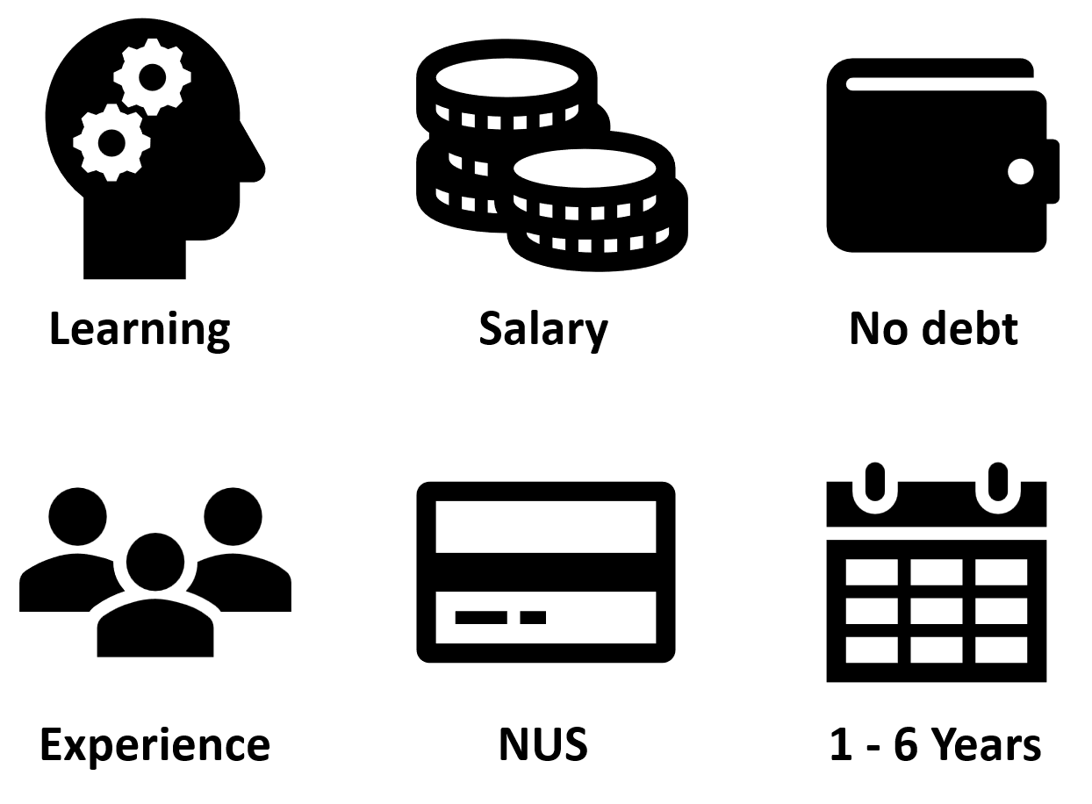
Work full time;
Study part time.
Notes:
So, what is an apprenticeship?
An apprenticeship is a real job, with a real employer, where the apprentice will work full-time whilst also studying towards a qualification.
LEARNING & EXPERIENCE
So, you could be an apprentice working for the NHS as a health care assistant, for example, whilst also studying and gaining a qualification in nursing. Meaning you are constantly learning, developing new skills and gaining new experiences to ensure you can progress in your chosen career. You will spend most of your time ‘on-the-job’ (doing your role), and a minimum of at least 6 hours per week ‘off-the-job’, which means studying or working towards your qualification. This study element (off-the-job) would take place with a training provider, who will help you to achieve the qualifications and make sure you complete your apprenticeship. Training providers could be colleges, Universities or independent training provider organisations, who deliver the training/teaching element of the course.
SALARY & NUS
As it’s a real job, you will earn a wage – and it can be a very good salary too! The salary of an apprentice can vary from employer to employer. The good news is that lots of employers pay a lot more than the National Minimum Wage for apprentices, with some employers offering starting salaries of over £15,000-£20,000. You will also continue to receive the benefits of the National Union of Students (NUS), just as you would if you had gone to University.
NO DEBT & 1 – 6 YEARS
The employers pay the fees of the apprentice’s training, showing their investment in the apprentice's development and leaving you with ZERO debt upon completion. An apprenticeship typically takes 1 to 4 years to complete (sometimes up to 6 for some areas like a Solicitor). As a minimum, all apprenticeships must last for a minimum of 12 months. The total duration will depend on the delivery model that the employer selects (how the mixture of training and working is delivered), the level (which we will come onto explain) and the subject you are studying.

Slide 3
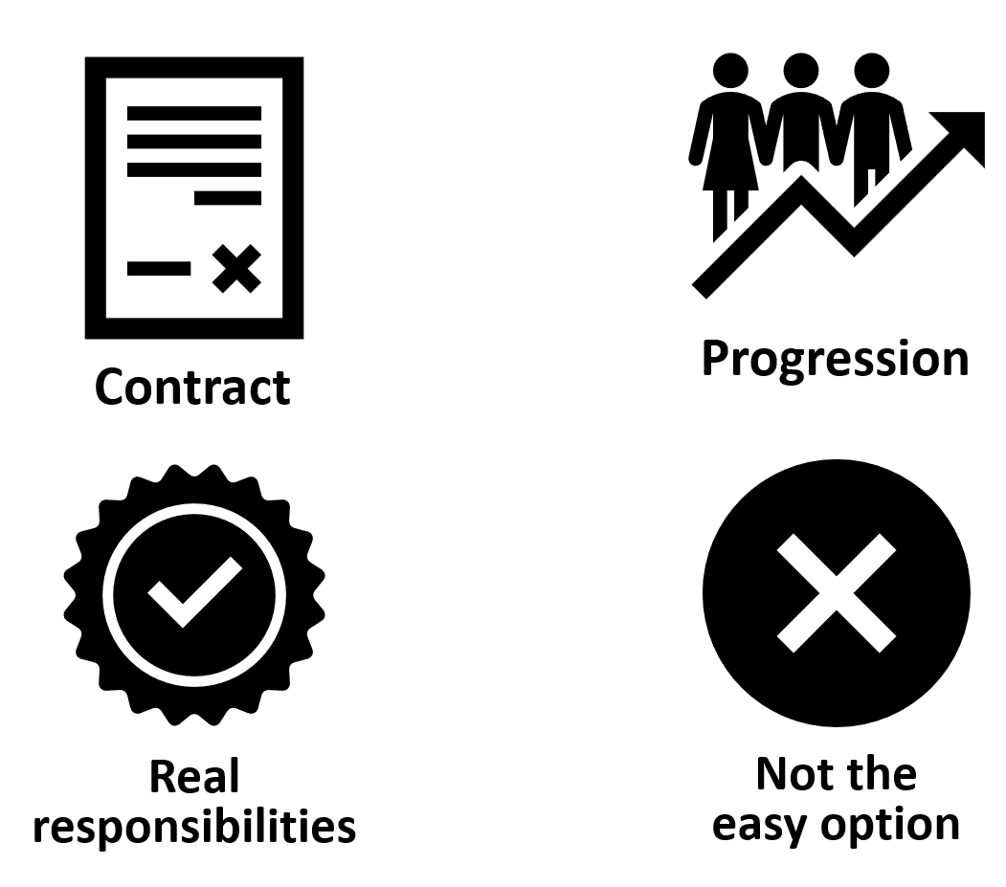
Take control of your future.
Notes:
CONTRACT
You will get a contract of employment, holiday pay, annual leave etc. – the same as any other member of staff.
REAL RESPONSIBILITIES & PROGRESSION
As I said before, it’s a real job with very real responsibilities, but with this comes clear progression pathways through the company.
NOT THE EASY OPTION
It’s important to remember that apprenticeships aren’t the ‘easy option’. You would be holding down a full-time job and studying, which takes a certain skill and commitment, so make sure it’s the right path for you.

Slide 4
Understanding the lingo
Levels | Choose the right level for you! | This is similar to…
Intermediate & Foundation | Level 2 | 5 GCSEs at grade A* - C or 4 – 9
Advanced | Level 3 | 2 A Levels / Level 3 Diploma / International Baccalaureate
Higher | Levels 4 & 5 | Foundation degree and above
Degree | Levels 6 & 7 | Bachelor’s or Master’s Degree
Notes:
Each apprenticeship has a level which will fall into one of the four categories above: Intermediate, Advanced, Higher, and Degree apprenticeships.
The third column helps to explain what level the qualification at the end of the apprenticeship will be in comparison to more familiar qualifications, like GCSEs and A Levels.
So, you can see that if you do a level 3 (advanced) apprenticeship, once you have qualified, you’ll have gained a qualification that is equivalent to 2 A Levels, a Level 3 diploma or other equivalents, like IB’s or BTECs.
Presenter notes: Opportunity to pause to ask if there are any questions about levels and how they work.
The level of apprenticeship you start at will depend on the kind of job that you are applying for.
It’s important not to be held back by only looking for a particular level e.g. degree apprenticeships. Apprenticeships work a bit differently to school which can be confusing, as lots of students think that they should progress onto the next level For example, if you leave school after GCSEs, you don’t necessarily have to do a Level 3, and if you finish after A Levels you don’t necessarily have to go for a degree apprenticeship.
Depending on the sector and apprenticeship, it may be that you need to start at advanced or higher level and work your way up. Just because an apprenticeship is only offered at Level 2 or 3, doesn’t mean it’s not a brilliant opportunity. For example, Journalism is only offered at Level 3 because that is all the industry requires.
Equally, you may be entering a completely new sector or industry that you haven’t studied or worked in before, and so may need to do a Level 2 or 3 to enter the world of work and get that understanding.
It is very important to keep an open mind so that you can explore all the opportunities available and have multiple options available when applying.

Slide 5
Did you know?
There are over 650 different roles that offer an apprenticeship.
Business
Sport
Beauty
Law
Health
Media & Art
IT
Hospitality
Construction
Social Care
Travel
Animal Care
Architect
Cyber Security Technician
Finance assistant
Teacher
Accounting & Taxation
Game Programmer
Boat Builder
Journalist
Assistant Puppet Maker
Event Assistant
Police Constable
Youth Worker
Civil Engineer
Chef De Partie
Digital Marketing
Personal Trainer
Physiotherapist
Nuclear Scientist
Nurse
Software Developer
Sports Coach
Auto Technician
Aerospace Engineer
Doctor
Notes:
We’re now going to look at the different sectors and job roles available through an apprenticeship and when we talk about apprenticeships, people often start to think of Plumbing, Electrician and some of the other construction trades. There are many brilliant apprenticeships in these areas, but there are also hundreds of new apprenticeships in exciting areas that you might not know exist.
You can do apprenticeships in….. (bring up the different sectors as examples)
And these are just some of the job roles that offer an apprenticeship route. Who would have thought you could ever do an apprenticeship to become a nuclear scientist, a game programmer, a puppet maker, and aerospace engineer, and from this year there will even be apprenticeships offering routes to become a doctor.

Slide 6
Some exciting news….

Slide 7

Post-Apprenticeship Recognition Scheme (PARS)
Have you ever fancied letters after your name, just like with a university degree?
In a nutshell, having the PARS award letters after your name shows that:
You have skills that would be an asset to any organisation
You have work experience embedded
You are part of, and contribute to, a wider apprenticeship community
You are committed to developing to a professional standard
PARS - Association of Apprentices
Notes:
PARS is a new awards scheme for those who have completed an apprenticeship in the UK. Successful applicants will be able to use letters after their name, which means people will automatically recognise your apprenticeship achievement.

Slide 8
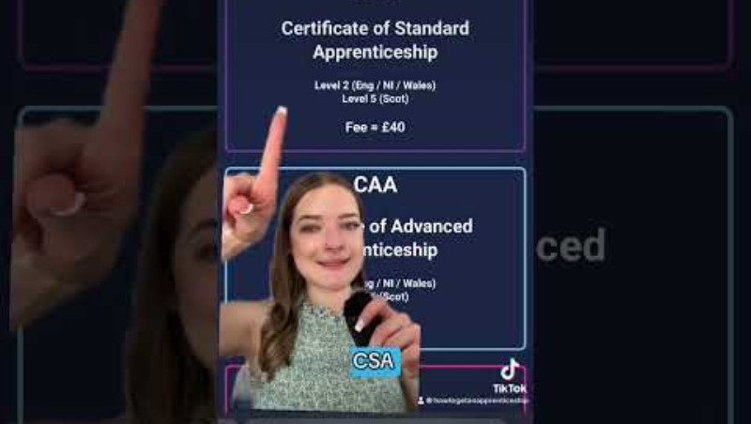

Slide 9
Have you thought about all the different departments and job roles inside just one organisation?

Slide 10
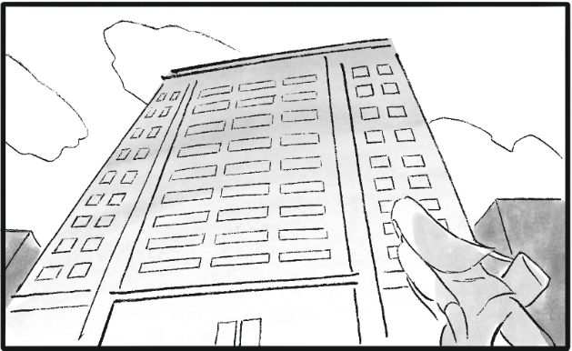
Let’s take a look inside….
Sales
IT & Cyber Security
Data Analytics
Logistics
Marketing
Facilities Management
Research & Development
Legal
Human Resources
Customer Service
Finance
Security
Notes:
Now, when considering your chosen subject area for an apprenticeship, you need to think about the different roles that a company might have. Let’s think outside the box a little bit.
Presenter notes: show the building on the slide and ask the audience to consider what this business might be: for example, hospital, construction company office, laboratories, bank, school, department store, leisure centre. Then ask students to think of all the different departments that business could entail – shout out answers.
The key message - if you want to work in finance – you shouldn’t just look at the big finance and accountancy companies. Lots of other companies will have their own in-house finance departments where you will still have access to a huge range of experiences and opportunities. You might be interested in hospitality sector but don’t want to work front of house. You could consider finance/accounting or even marketing, legal, HR, IT.
It can be a good idea to take some time to look at the different departments that a company has and see if they offer an apprenticeship in that area.
There are thousands of different opportunities!

Slide 11

Recognise any of these North East employers?
Notes:
The range of employers offering apprenticeships is incredible.
This slide shows you some familiar logos of big companies in England who all recruit apprentices in the North East.
Some of these employers may not be recruiting currently, but you will be able to track their recruitment updates on their websites or social media.
Around 50% of apprenticeships started are with large companies like this, but 50% will be with smaller local companies.
It can be tempting to think that the ‘best’ apprenticeships are just with the big, well-known companies, but many of the smaller employers have brilliant schemes that enable fast-track career progression for their apprentices, so it’s important to do your research and not to ignore smaller employers because they can be just as good.

Slide 12
APPRENTICESHIPS!
They all have one thing in common…..

Slide 13


Slide 14


Slide 15


Slide 16
So, you’re interested, right?
You want to know what to do next, right?

Slide 17
Here are some points to consider.
Taking your first steps.
Speak to your teachers and school / college careers leader / adviser for guidance.
Ask your school / college careers leader if they plan to host any events with current apprentices so you can talk to them.
Look at the UCAS resources on their website to search and compare apprenticeship vacancies.
Take on some work experience or work shadowing –
it all counts!
Be proactive in your research on local employers, sectors and job roles.
Make sure you take advantage of all the support available to you.
Notes:
It’s important to understand the process and ensure that an apprenticeship is the right path for you. So here are some first step to consider before applying for any apprenticeship.

Slide 18
Introducing… apprenticeReady
Your one stop shop for all your apprenticeship knowledge, guidance, hints & tips!

Slide 19
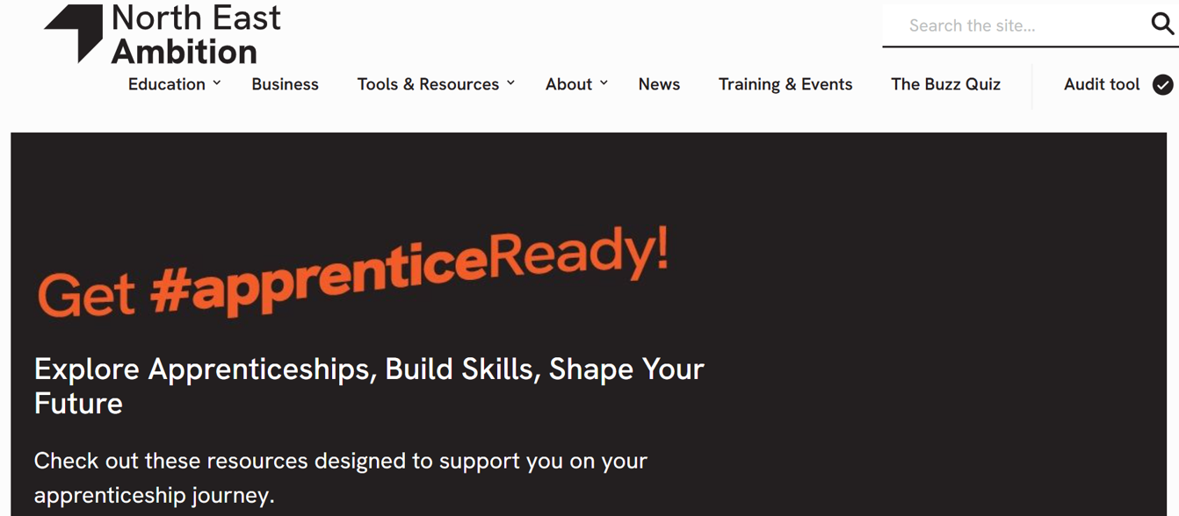
Get apprenticeReady!
The North East Ambition website is the go-to hub for North East learners to understand key information about apprenticeship pathways to support your journey and hear from others about their experiences in the workplace.
apprenticeReadylearners - North East Ambition
Hear from North East apprentices talking about the benefits of an apprenticeship.
Apprentice Callum shares five top reasons to do an apprenticeship.
Apprentice Jess shares five top reasons to do an apprenticeship.
Watch an interview with Matthew, a Quantity Surveyor Apprentice at Absolute Civil Engineering

Slide 20

Giving yourself the edge!
There are four main things you can do to help yourself on the journey to finding an apprenticeship.
Take a look at each one opposite and see if one or more appeal to you.
Perhaps you are doing them already?
Notes:
Employers will be extremely impressed if you’ve taken the initiative to enhance your skills and work experience by sourcing full/part time employment, volunteering, work experience or enrolling onto other short courses. Remember, these don’t necessarily have to be related to the industry you are seeking an apprenticeship in – all work, paid or unpaid, is valuable and teaches you vital skills. And you could be earning money while you’re looking for the right apprenticeship.

Slide 21


Why volunteer?
We all know that volunteering helps the people you volunteer for, but it can also help YOU!
You don’t need to volunteer all day, every day; what is important is making a regular commitment, for example, helping at a care home every Thursday afternoon when activities take place.

Slide 22


Why do work experience?
Miranda gives 3 reasons why work experience is so important.
Remember this can be structured in many ways: one day a week for a couple of months, one full week, or even just a day’s work shadowing.

Slide 23

How to explore and apply for apprenticeships
You can use the UCAS Hub to;
explore industries, employers, locations, careers and jobs;
shortlist your favourites;
find out where to start;
find out how to apply.

Slide 24
Register for Smart Alerts
Smart Alert Sign Up
Data Entry
Matching
You register for Smart Alerts in your Hub account.
Smart alerts are a new matching service offered by UCAS.
The service enables participants to be matched to regional vacancies.
You enter information on your preferences such as location and area of interest.
If this matches an employer’s search criteria, then you are invited to apply.

Slide 25


Slide 26
Get dressed for success!
Top Tips!
Keep an open mind
Start researching early
Use Smart Alerts
Get organised
Be ‘application ready’
Dedicate your time
Stay professional
Pay it forward
Notes:
Keep an open mind – search all levels and all pathways, remember just because one apprenticeship might be a higher level than another, doesn’t mean it’s the better choice.
Start researching early – like I said, it’s competitive out there so don’t leave it till the last minute to start looking.
Use the Smart Alerts function on the UCAS Hub – this will help organise your time and give you immediate information on newly advertised apprenticeships.
Get organised – this will stop you from getting overwhelmed.
Be ‘application ready’ – keep templates of letters to employers, personal statements and mock answers to interview questions. That way these can be tailored to suit upcoming applications you may wish to submit.
Dedicate your time – be ready to put the hours in, take control of your future.
Stay professional – don’t ignore emails and voice messages, especially from employers. They have contacted you for a reason, so stay professional – first impression are everything.
Pay it forward – if you are successful in your application, you can become an apprentice ambassador and support/encourage other young people in the region find their apprenticeship opportunity (this doesn’t have to be the same apprenticeship as you).

Slide 27
It’s competitive out there!
Don’t forget….

Slide 28
Questions?

Slide 29
Useful links
North East Ambition: Apprenticeships
https://ambition.northeast-ca.gov.uk/post16-options-apprenticeships
North East Ambition: apprenticeReady
https://ambition.northeast-ca.gov.uk/apprenticeready
UCAS Hub
https://accounts.ucas.com/account/login?returnUrl=https%3A//www.ucas.com/dashboard%23/
UCAS – search for apprenticeships
https://www.ucas.com/explore/search/apprenticeships?query=
North East Apprentice Ambassador Network
https://neaan.org.uk/
Volunteering opportunities
www.do-it.org.uk
Post-Apprenticeship Recognition Scheme (PARS)
PARS - Association of Apprentices

