Slide 1

Higher Technical Qualifications (HTQs)
How HTQs can support
employers in a changing
economic landscape.

Slide 3
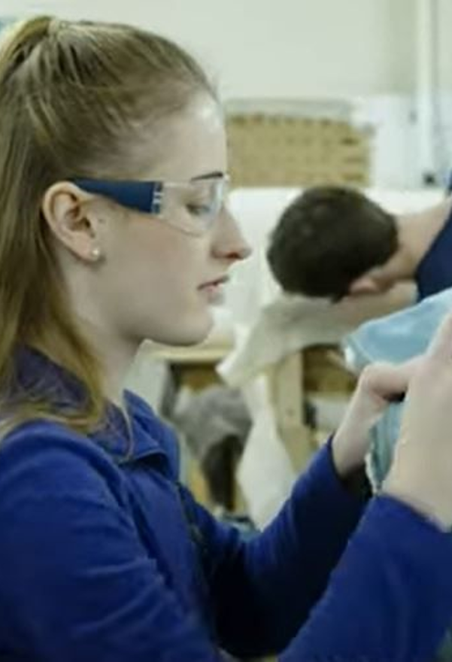
What are HTQs?
Higher Technical Qualifications (HTQs) offer a high-quality route for potential employees to develop the knowledge, skills and behaviours required for roles in demand from employers.
HTQs are a quality mark. They have been approved against employer standards.
Approved by Skills England, these qualifications are aimed at both college and school leavers or those retraining and upskilling.
HTQs are based on the same employer developed occupational standards as apprenticeships but don’t require employment as an apprentice.
Key features
A high-quality alternative to other routes, such as apprenticeships, traineeships or degrees
Skills England-approved qualifications
Notes:
HTQs are technical qualifications that employers have helped develop so you can get the right training and skills you need to fill skills gaps within your business.
Video: Introduction To Higher Technical Qualifications (HTQs) - Short Version

Slide 4

Helping business to build talent pipeline

Slide 5
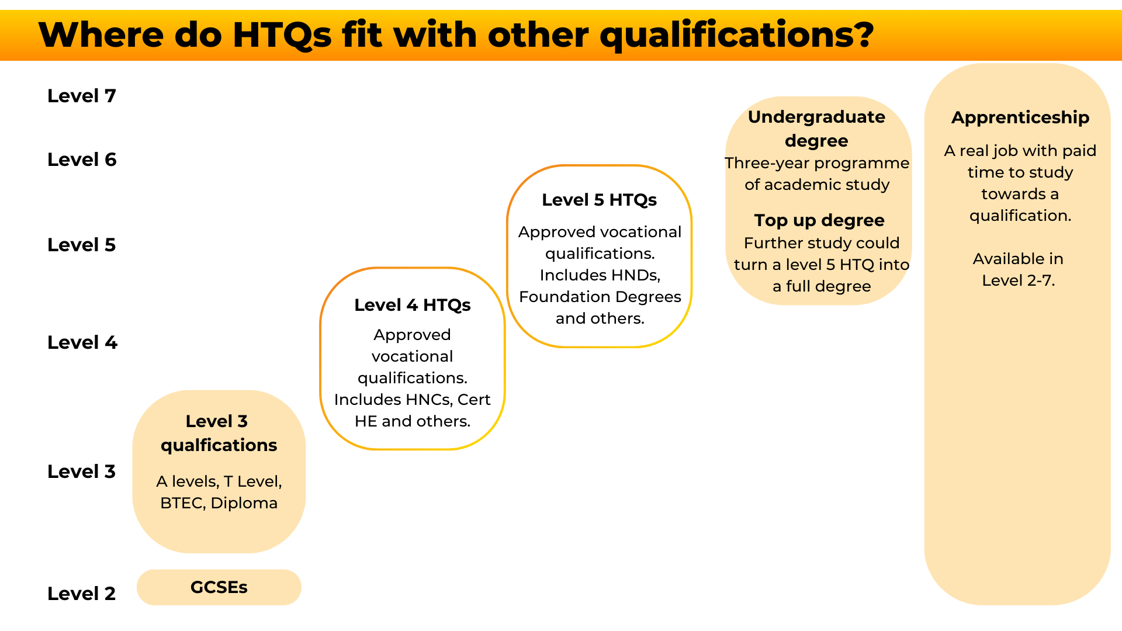
Notes:
HTQs, which are Level 4 and 5 qualifications, equip employees with practical, industry-specific skills, enabling businesses to fill skills gaps and reduce recruitment costs. They also foster innovation by providing employees with the latest knowledge and technologies.

Slide 6
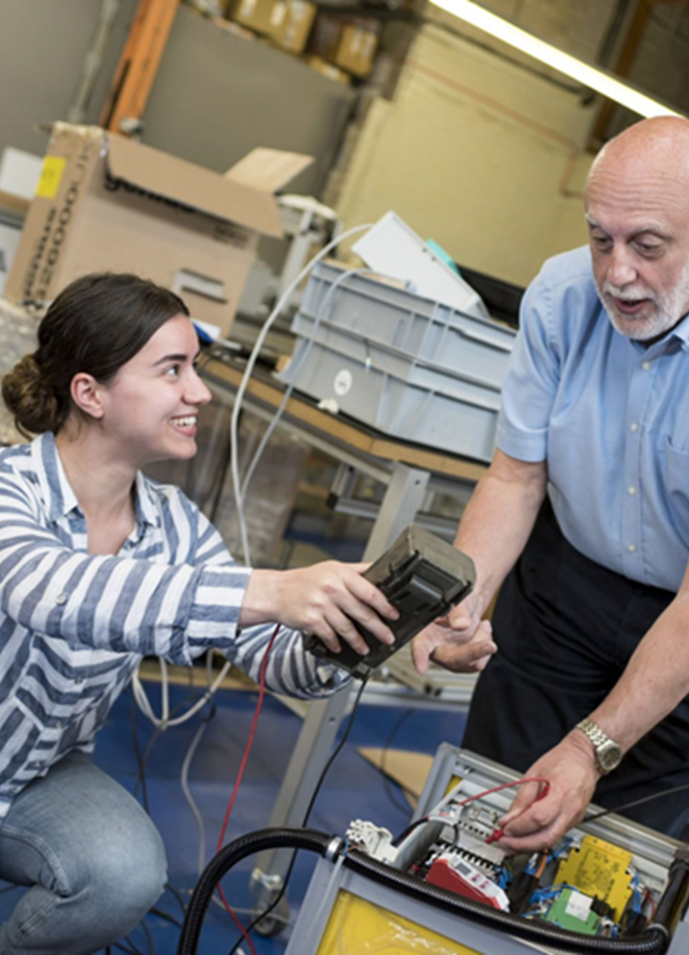
Benefits of HTQ’s
You can offer a HTQ to your existing employees or hire skilled individuals that already have HTQs.
This can:
support your employees to retrain, improve their existing skills and learn new skills
create an environment that promotes learning and development
make your business more competitive and address skills shortages

Slide 7

Benefits of HTQ’s for Employers

Slide 8

Cost and Commitment
Should you be looking to utilise HTQs to upskill your current workforce you may want to consider the cost to the business.
HTQ’s can be studied either;
part time (1 day college attendance per week over 2 years) or;
full time (2 days college attendance per week over 1 year); allowing employees to continue to work while studying.
Entry criteria varies between providers.
Fees are likely to be £6,000 - £9,500 for a one or two-year course, however learners can also qualify for the same student finance offer as standard University study (subject to eligibility criteria).

Slide 9

HTQs are available across the following sectors

Slide 10
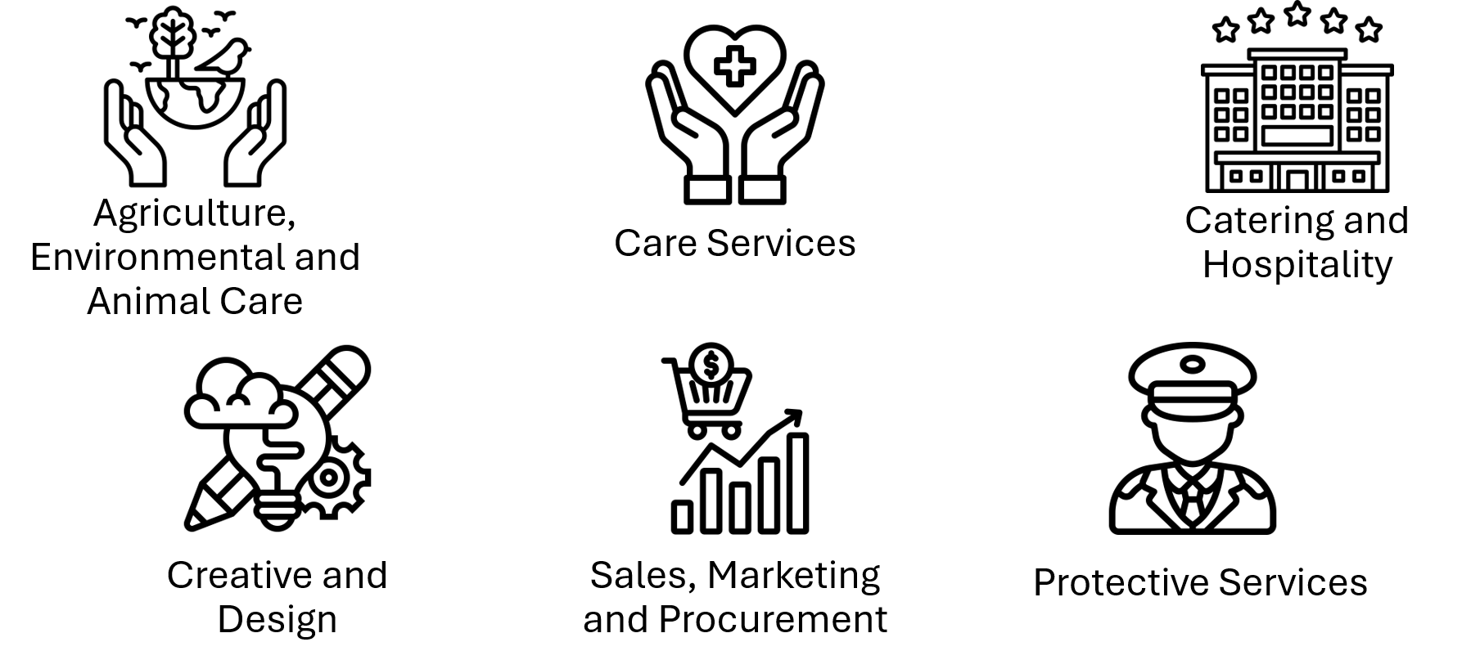
From 2025, HTQs in the following sectors will be available

Slide 11

Tech, Digital & AI
The digital sector contributes around £2.4 billion to the regional economy and employs 45,000 people in the wider region.
Established and emerging specialisms in games development including E-Sports, software development, data analytics, immersive technologies, 5G innovation, e-commerce, cybersecurity and consultancy.
Support development of skills and innovation expertise, critical to maintaining the high grow rate of the sector. This includes ensuring that there are both the higher-level and technical specialist skills required.
Current HTQ’s on offer include;
  HNC in Digital Technologies (Cyber Security and Cloud Networking) at Gateshead College
  FdSc Networking and Cyber Security at Newcastle College
  FdSc Cyber Security at New College Durham
Notes:
Skills England Occupational Map: Digital
Let’s look at some example sectors starting with Tech, Digital and AI.
Growth of the digital economy is an important part of the North East’s Digital Programme. We will create a Digital Talent Engine to grow the tech-talent pipeline - raising aspirations and skills levels and creating clear pathways into the opportunities of digital for all. HTQs can help support a clear progression of the digital economy by increasing this talent pipeline and ensuring your business has the right people with the right skills.
The North East Technical Education Advisory Group have stablished a Task & Finish group to focus solely on the Cyber-security provision available across the North East CA region to explore how this fits with current skills demand, if it’s fit for purpose, and how we might support further enhancements of the teacher training offer.

Slide 12
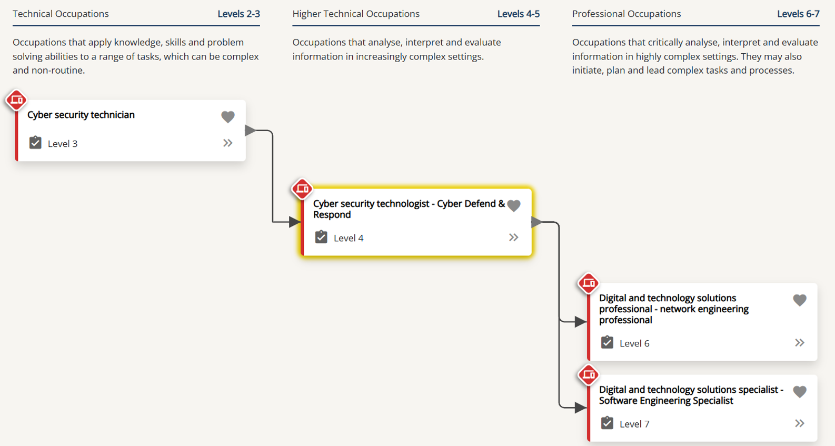
Cyber security technologist - Cyber Defend & Respond Progression Map
Notes:
This occupational progression map shows technical occupations that have transferable knowledge and skills.
In this map, the focused occupation is highlighted in yellow. The arrows indicate where transferable knowledge and skills exist between two occupations. This map shows some of the strongest progression links between the focused occupation and other occupations.
It is anticipated that individuals would be required to undertake further learning or training to progress to and from occupations. To find out more about an occupation featured in the progression map, including the learning options available, click the occupation.
Progression decisions have been reached by comparing the knowledge and skills statements between occupational standards, combined with individualised learner movement data.

Slide 13

HTQs in the Digital sector

Slide 14

Health & Science
The North East is home to one of the UK’s largest pharmaceutical clusters, along with strengths in MedTech and process industries.
Research and innovation capabilities across universities, research centres and CPI and strengthening networks between anchors.
Businesses in the sector generate around £2bn in turnover and employ 7,500 people in high value jobs, meaning investment in HTQs can significantly enhance the foundational knowledge of the future talent pool.
We expect to see continued strong growth of the life sciences and pharma sector, with opportunity for the North East to expand by more than the national average.
Current HTQs on offer include;
  FdSc Health Care Practice and Intervention at New College Durham
  FdA Children and Young People at Newcastle College
  HND in Healthcare Professions' Support for England at Tyne Coast College
Notes:
Skills England Occupational Map: Health and Science
Now let’s explore the Health & Science sector.
Building on substantial growth over the past half-decade, NECA plans to add further to the region’s economy and to create further high-value jobs through continuing investment in existing companies and in new companies through relocation to the region.
With additional plans to support a £30m NHS Medicines Manufacturing Centre in Seaton Delaval to manufacture aseptic medicines for the NHS, this provides large scope for employers to become more involved in the development of future HTQs to support with filling upcoming skills gaps and create a more diverse talent pool.

Slide 15

HTQs in the Health & Science sector

Slide 16

Engineering & Manufacturing
Established expertise with 3,900 businesses in advanced manufacturing, employing 67,000 people.
Growing specialisation in battery technologies and EVs, offshore renewables, subsea technologies, and robotics.
Implementation and expansion of MADE North East, the new facility led by Nissan, which will develop the skills pipeline and support innovation for the automotive and battery manufacturing sectors.
Opportunity for more than 2000 more jobs.
Current HTQs available are;
  HNC in Manufacturing Engineering for England at Gateshead College
  HNC Mechatronics for England at New College Durham
  HNC Architectural Technology for England at New College Durham
Notes:
Skills England Occupational Map: Engineering & Manufacturing
And finally the engineering and manufacturing sector.
The advanced manufacturing and engineering sector, including the expansion of electric vehicles, currently accounts for 67,000 individual employees across the sector and it’s supply chains, with a further 2,000 job opportunities being developed.
A sector that stems from roots in the North East industrial heritage that has seen only extensive growth over the last half a century, now contributes as a major employer in the region.

Slide 17

HTQs in Engineering & Manufacturing

Slide 18
Support available and useful resources
Find training and employment schemes for your business - Higher Technical Qualifications (HTQs)
Occupational Maps: Skills England
Higher Technical Qualifications - North East Ambition
Higher Technical Qualifications Webinars - Amazing Apprenticeships - A series of informative webinars, designed to support employers and educators.
SHINE North East
Developing an occupational standard - GOV.UK

Slide 19
Any questions?

