Slide 1

Apprenticeships
How Apprenticeships can support
employers in a changing economic
landscape.

Slide 3

What is an apprenticeship?
An apprenticeship is a real job, with a real employer, where the apprentice will work full-time whilst also studying towards a qualification.
They will spend most of their time ‘on-the-job’ (doing the role), and a minimum of at least 6 hours per week ‘off-the-job’, which means studying or working towards their qualification in a classroom setting.
An apprentice will earn a wage just like any other employee.
An apprenticeship typically takes 1 - 4 years to complete (sometimes up to 6 for some areas).
Notes:
Apprenticeships are technical qualifications that employers have helped develop so you can get the right training and skills you need for your organisation.

Slide 4
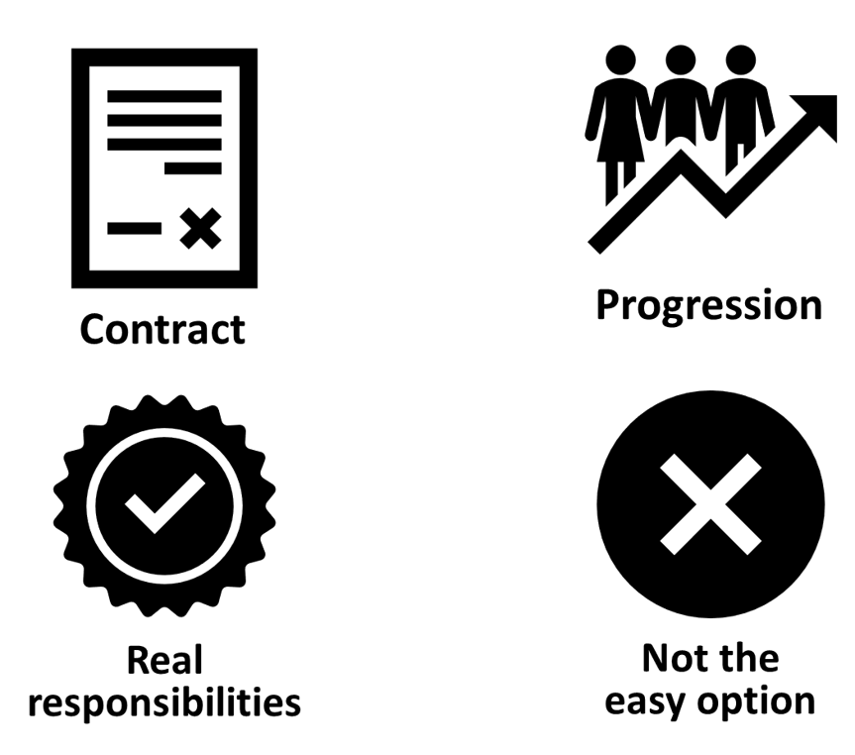

What is an apprenticeship?
Notes:
CONTRACT
An apprentice will get a contract of employment, holiday pay, annual leave etc. – the same as any other member of staff.
REAL RESPONSIBILITIES & PROGRESSION
As I said before, it’s a real job with very real responsibilities, but with this comes clear progression pathways through the company.
NOT THE EASY OPTION
It’s important to remember that apprenticeships aren’t the ‘easy option’. It is a full-time job AND studying, which takes a certain skill and commitment, so making sure it’s the right path for that person is crucial.

Slide 5
Understanding the apprenticeship levels
Apprenticeship Level | Corresponding Levels | This is similar to…
Intermediate / Foundation | Level 2 | 5 GCSEs at grade A* - C or 4 – 9
Advanced | Level 3 | 2 A Levels / Level 3 Diploma / International Baccalaureate
Higher | Levels 4 & 5 | Foundation degree and above
Degree | Levels 6 & 7 | Bachelor’s or Master’s Degree
Notes:
Each apprenticeship has a level which will fall into one of the four categories above: Intermediate, Advanced, Higher, and Degree apprenticeships.
The third column helps to explain what level the qualification at the end of the apprenticeship will be in comparison to more familiar qualifications, like GCSEs and A Levels.
So, you can see that a level 3 (advanced) apprenticeship, once qualified, you’ll have gained a qualification that is equivalent to 2 A Levels, a Level 3 diploma or other equivalents, like IB’s or BTECs.
Presenter notes: Opportunity to pause to ask if there are any questions about levels and how they work.
The level of apprenticeship you start at will depend on the kind of job that you are applying for.
It’s important not to be held back by only looking for a particular level e.g. degree apprenticeships. Apprenticeships work a bit differently to school which can be confusing, as lots of students think that they should progress onto the next level For example, if you leave school after GCSEs, you don’t necessarily have to do a Level 3, and if you finish after A Levels you don’t necessarily have to go for a degree apprenticeship.
Depending on the sector and apprenticeship, it may be that you need to start at advanced or higher level and work your way up. Just because an apprenticeship is only offered at Level 2 or 3, doesn’t mean it’s not a brilliant opportunity. For example, Journalism is only offered at Level 3 because that is all the industry requires.
Equally, you may be entering a completely new sector or industry that you haven’t studied or worked in before, and so may need to do a Level 2 or 3 to enter the world of work and get that understanding.
It is very important for young people and employers to keep an open mind so that you can explore all the opportunities available and choose the level that works best for your organisation.

Slide 6
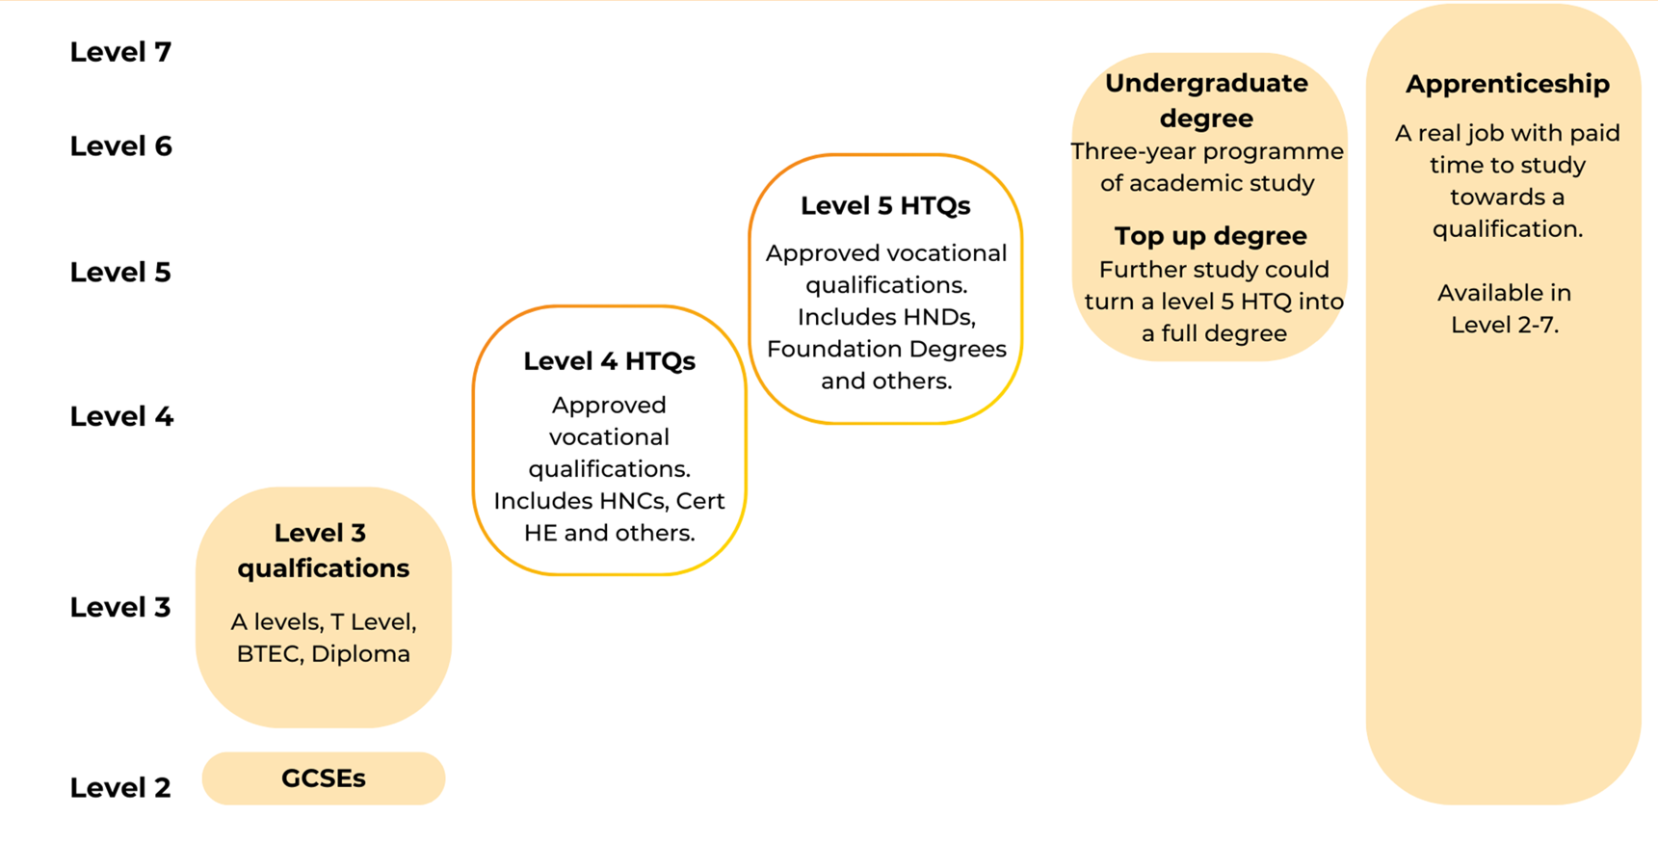
Where do apprenticeships fit alongside other qualifications?

Slide 7

Who can be an Apprentice?
Apprenticeships offer a pathway for both new and existing employees to develop valuable knowledge, skills and behaviours (KSBs) tailored to your business needs.
Designed by employers, apprenticeships ensure that your workforce is equipped with the specific KSBs required for apprentices to excel in their roles.
There are apprenticeships to support employees at every stage of their career - from foundation and intermediate apprenticeships to degree-level apprenticeships.
Notes:
Who can be an apprentice?

Slide 8
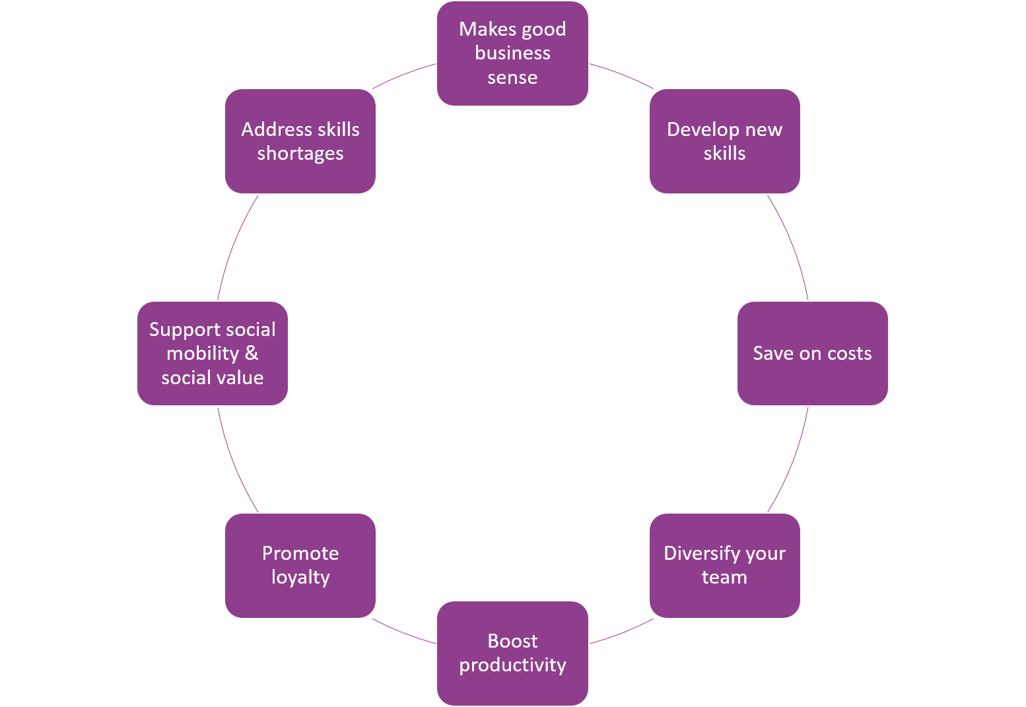
Benefits of Apprenticeships
Notes:
Hire an apprentice and invest in the future by getting talent that’s right for you. It’s easier than you think.
Makes good business sense
Develop new skills – fill skills gaps and areas of potential via 'grow your own'
Save on costs – training is funded and there are incentives available
Diversify your team – apprenticeships can bring new perspectives to your organisation and workplace culture, as well as enthusiasm and an eagerness to learn.
Boost productivity – outputs usually surpass associated costs. For example, One apprentice created ROI of 3000%, with cost savings of £69,000.
Promote loyalty- we know that apprenticeships create loyal employees who are more likely to remain with the business after completing their training.
Supporting social mobility and social value - taking on young people gives businesses a chance to inspire young adults and highlight the value of contributing to society.
Even if a business doesn't have the stability to retain someone after an apprenticeship, it does provide a pool of talent with valuable skills and experience that addresses skills shortages.

Slide 9
What makes apprenticeships affordable?
Employers don’t pay NI for 16–25-year-old apprenticeships up until they earn £50K
Government will pay 95% of the training costs, but 100% of training costs can be covered by some organisations who pledge their levy to SMEs
Government incentive grants for those aged 16-18 years (£1,000) and those leaving care (£3,000)
Apprenticeship Support Grants available via the Tees Valley Combined Authority (£3,000).
Construction Industry Training Board (CITB) Apprenticeship grants of up to £6,000.
Against a challenging labour market, with increasingly high turnover especially amongst younger recruits, 62% of apprentices stay with the employer that trained them on completion, thereby reducing churn.
Over three-quarters (77%) of apprentices in sectors including engineering and construction are in sustained employment one year after completing their apprenticeship. This compares with 63% of graduates in these sectors.
Financial incentives including grants and NI benefits and Staff retention

Slide 10
Your estimated yearly gain
Did you know on average in the UK, the estimated yearly gain for employers is between £2,500 and £18,000 per apprentice during their training period.
Apprentice outputs usually surpass their associated costs, delivering a net benefit to employers during their training.
92% of companies that have taken on apprentices believe this leads to a more motivated and satisfied workforce
86% said apprenticeships helped them develop skills relevant to their organisation
80% have seen a significant increase in employee retention
The future of your business
Notes:
By offering an apprenticeship you can ensure that the skills developed are matched to your company’s current and future needs. This will help fill any skills gaps and allow your business to source future managers and leaders from within, so you don’t have to worry.
Understanding apprenticeship benefits and funding

Slide 11


Slide 12
Foundation Apprenticeships
Who are Foundation Apprenticeships for?
Individuals aged between 16 and 21 years old (or 15 years of age if the apprentice’s birthday is between the last Friday of June and 31 August); or
Individuals aged between 22 and 24 years old who have either an Education, Health and Care (EHC) plan provided by their local authority and/or have been, or are, in the care of their local authority: or
Individuals aged between 22 and 24 years old who are either a prisoner or a prison leaver.
Foundation apprenticeships in England are entry-level, paid work-based training programs designed to provide young people with practical skills, technical knowledge, and workplace experience while still in school or shortly after.
These Level 2 apprenticeships combine classroom learning with on-the-job training, focusing on core employability skills, and are available in various sectors like construction, digital, and health and social care.
Notes:
What are Foundation Apprenticeships and who are they for? | AELP

Slide 13
Foundation Apprenticeships
What Foundation Apprenticeships are due to be available from August 2025?
• Construction Sector:
  Building service engineering
  Finishing trades
  Onsite trades
• Digital Sector:
  Hardware, network and infrastructure
  Software and data
• Other Sectors:
  Engineering and manufacturing
  Health and social care
Available to providers on the Apprenticeship Provider and Assessment Register (APAR).
The current minimum duration is 8 months.
Foundation apprentices must be employed either directly by an employer or through an approved Flexi-Job Apprenticeship Agency (FJAA).
Notes:
• Construction Sector:
Building service engineering £4,000
Finishing trades £4,000
Onsite trades £4,000
• Digital Sector:
Hardware, network and infrastructure £4,000
Software and data £4,000
• Other Sectors:
Engineering and manufacturing £4,500
Health and social care £3,000

Slide 14
Foundation Apprenticeships
Incentive Payments
Providers and Employers: 16-18 foundation apprentices are subject to an additional £1k payment. Paid in two equal instalments of £500 at 90 days and 242 days if still on the programme.
Employers: Additional employer recruit and retain incentive: £2k per foundation apprentice, paid in three instalments, 90 days (£667), 242 days (£667). The remaining instalment (£666) is payable if the individual starts a new apprenticeship within 6 months of their completion date and remains with the same employer.
Apprentices: Eligible foundation apprentices will also receive the 3k care leavers’ bursary, split as follows:
  60 days after the apprentice’s learning start date, £1k will be paid if the apprentice is still undertaking their apprenticeship.
  120 days after the apprentice’s learning start date, £1k will be paid if the apprentice is still undertaking their apprenticeship.
  Where the apprentice is on a foundation apprenticeship, this final £1k payment will be generated 242 days after the apprentice’s learning start date.

Slide 15
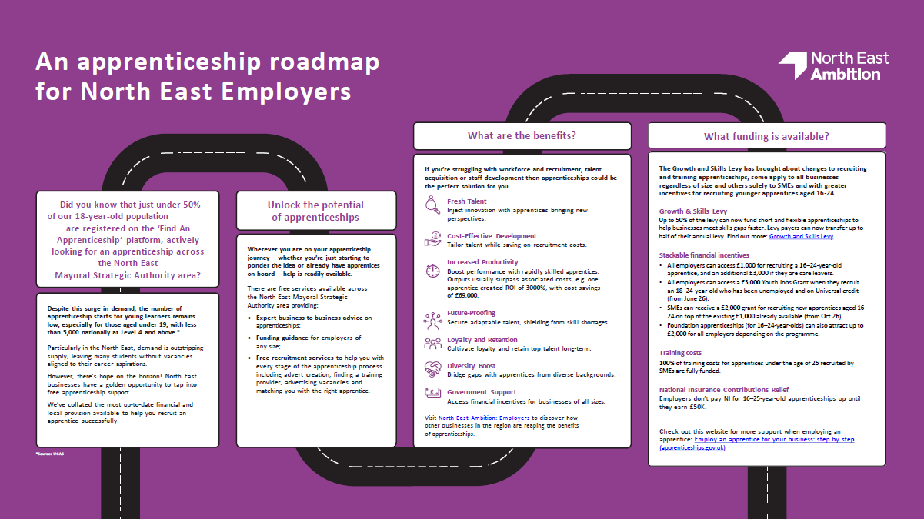
Where to next?
Notes:
North East MSA have developed an apprenticeship roadmap for employers to provide the key knowledge and guidance needed to get you started on your apprenticeship journey. The first page providing some key facts and information more generally……

Slide 16
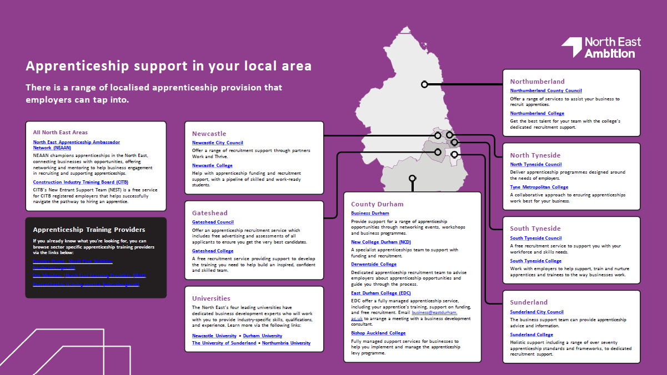
Where to next?
Notes:
….while the 2nd page provides key contacts and links in each Local Authority area.
https://ambition.northeast-ca.gov.uk/downloads/829/nel1497-nea-digital-roadmap-for-employers-v10.pdf

Slide 17
Support available and useful resources
Find training and employment schemes for your business – Apprenticeships
Foundation Apprenticeship search / Skills England
#apprenticeReady resources for employers
Apprenticeship search / Institute for Apprenticeships and Technical Education
Employing Apprentices - Amazing Apprenticeships - A series of informative webinars, designed to support employers and educators.
Occupational Maps: Skills England
Developing an occupational standard - GOV.UK
SHINE North East

Slide 18
Any questions?

