Slide 1
When I Grow Up: Planning Your Path to Success

Slide 2
Purpose of the Resource
This resource introduces KS2 pupils to the concept of career pathways and helps them understand how choices made during and after school can lead to different opportunities. It focuses on three main post-16 routes: Apprenticeships, T Levels, and A Levels, encouraging pupils to link these pathways to their interests and aspirations.
Why It Matters
Early exposure to career pathways helps pupils see the relevance of learning, motivates them to develop skills, and broadens their understanding of future options. It supports Gatsby Benchmark 2 (Learning from career and labour market information), Benchmark 4 (Linking curriculum learning to careers) and Benchmark 7 (Encounters with Further and Higher Education).
Suggestions for Delivery:
Single Session Approach (60 mins)
Starter: “When I grow up…” activity (Slide 3) – pupils share aspirations.
Main: Explore pathways (Slides 5–16), watch videos, and discuss real-life stories (Slides 17–23).
Plenary: Revisit aspirations and update pathways (Slides 24–25).
Split Across Multiple Sessions
Session 1: Introduction to careers and pathways; focus on A Levels.
Session 2: Explore T Levels and Apprenticeships with videos and discussion.
Session 3: Real-life stories and pathway mapping activity.

Slide 3
Lesson Objectives
By the end of the lesson, pupils will:
Understand what a career is and why it's important to explore different options.
Learn about different pathways including Apprenticeships, T Levels and A Levels.
Begin thinking about their own future aspirations.

Slide 4
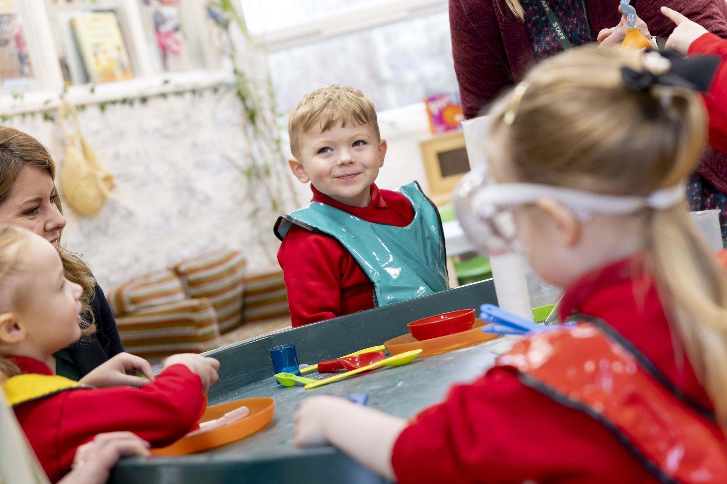
When I grow up?
When I grow up, I want to be……
Notes:
Starter activity (10 mins)
Pupils share their career aspirations
Where possible, make links to prior learning about careers and the skills needed for different jobs

Slide 5

Pathway to success
But how will I get there?
Notes:
Teacher notes:
- Mini assessment task: pupils will revisit their response at the end of the lesson
- Ask pupils to write down or draw the path they will need to take to get to their desired career
- You could use a road/path template to allow pupils to draw out their thinking
- Briefly discuss how different jobs need different skills and training

Slide 6
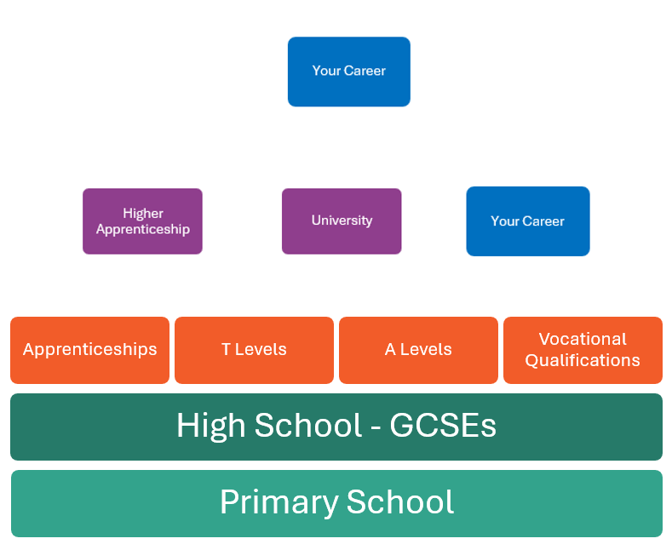
Exploring your career pathway
Notes:
Teacher notes:
Today we will be exploring career pathways and specifically looking at the following pathways: Apprenticeships, T Levels and A Levels
Not everyone will follow the same career path this may be determined by your own strengths and interests through your time at school
- Introduce the idea of pathway progression e.g. High School, T Levels, University, Career

Slide 7
Lots of way to train when you are 16
A Level: A Levels are subjects you choose to study in depth after GCSEs, usually in sixth form or college, to prepare for university, apprenticeships, or careers.
Vocational Qualifications: Courses that teach you practical skills for a specific job like building, cooking or caring for people.
T Levels: A mix of classroom and work experience, for practical careers like healthcare or digital/tech.
Apprenticeship: Learn by working with experts while also studying. You earn money and learn skills at the same time.
Notes:
Teacher notes:
There are lots of way to train when you are 16 and have finished your GCSEs. These can include:
Studying T Levels: a technical qualification linked to key industries such as healthcare or digital and tech
Studying A Levels and focusing on subjects you enjoy or that might prepare you for university or a career
Take the apprenticeship route a more hands on practical way for you to earn while you learn

Slide 8
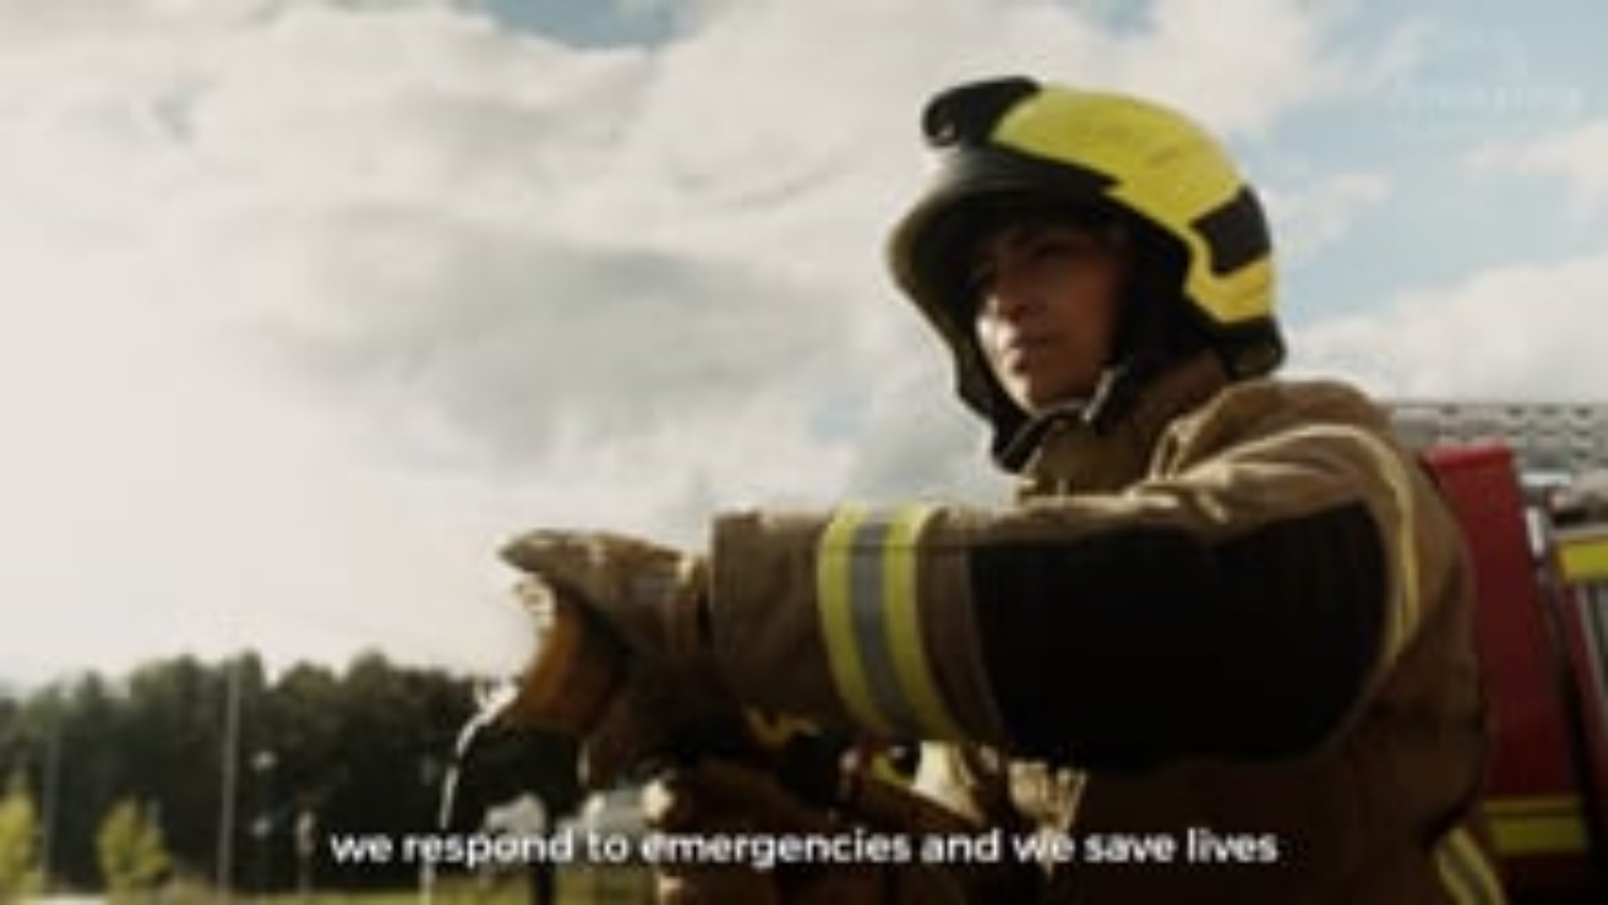
Let’s explore Apprenticeships
Notes:
Techer notes:
- Apprentices are all around us, often working in surprising roles.
- Ask pupils to watch the video and right down all the different careers or jobs that they see.

Slide 9
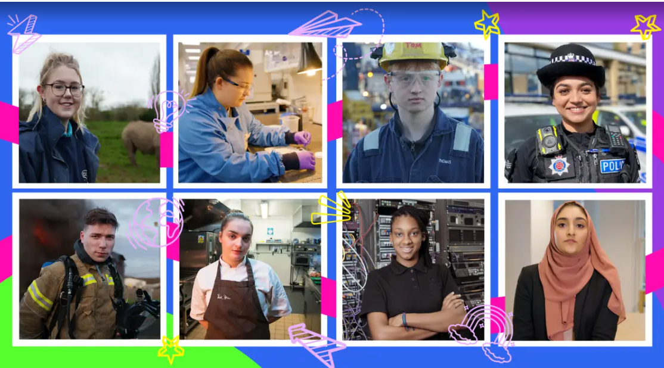
Is an apprenticeship right for you?
Notes:
Teacher notes:
- What jobs did you see in the video?
- Do you think an apprenticeship would be a good option for you?

Slide 10
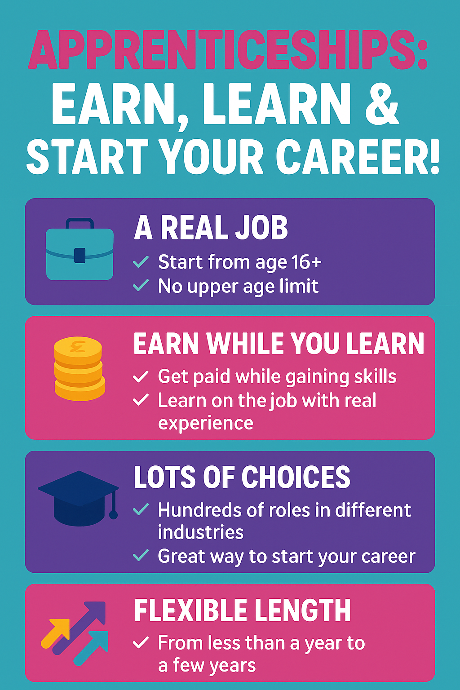
More information about apprenticeships
Notes:
Teacher notes:
- So, lets find out about more about apprenticeships what does it involve?

Slide 11
True or false?
True or False Game (Wordwall) - Amazing Apprenticeships
Notes:
Teacher notes:
- Explore the true or false game together as a class

Slide 12
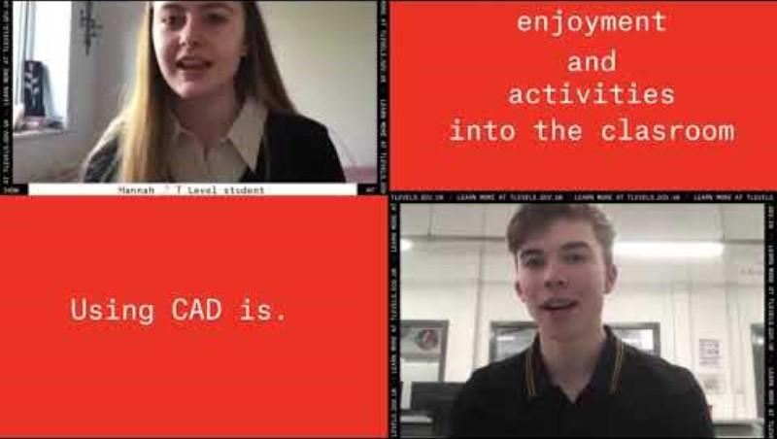
Let's explore T Levels
Notes:
Teacher notes:
- Let's watch the video and explore some more about what is a T Level.
- Link to video: https://youtu.be/7rua65bHjMw?si=erFNSBtKNrqdT7Uj

Slide 13
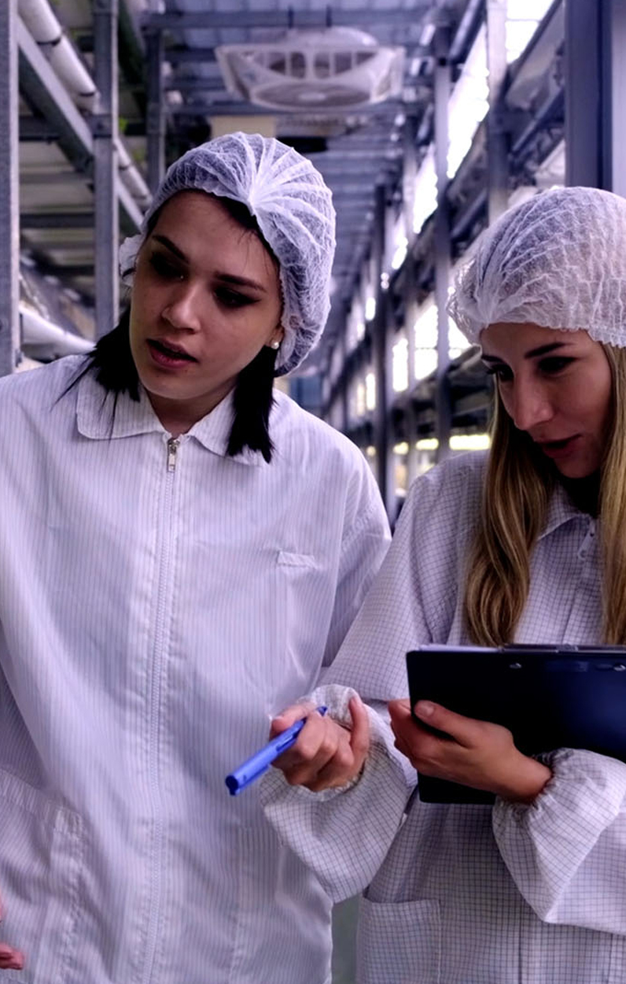

T Levels
T Levels are a 2-year qualification that you can do after GCSEs as an alternative to A Levels, other post-16 courses or an apprenticeship.
They have been designed with leading businesses and employers to give you the knowledge and skills you need.
Notes:
Teacher notes:
- What is a T Level?
- This is something you would study after you have finished your GCSE’s at secondary school this type of qualification involves studying in the classroom as well as spending time with an employer learning about a job or industry

Slide 14
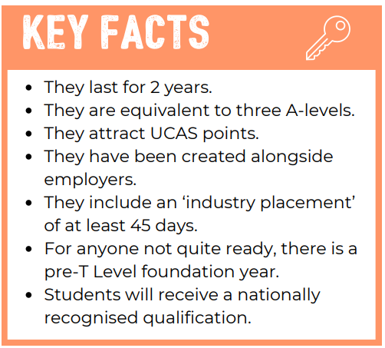
T Levels
What do I need to know?
Notes:
Teacher notes:
- The video told us lots of things about T Level’s but lets recap what do we need to know?

Slide 15
Let’s Explore A Levels
What are A Levels?
A Levels are subjects you study after GCSEs, usually in sixth form or college.
You choose a few subjects you enjoy or need for your future career.
They help you prepare for university, apprenticeships, or work.
Why are they important?
A Levels let you focus on subjects you’re most interested in.
Many university courses and jobs ask for specific A Levels (e.g., Chemistry and Biology for Pharmacy).
Notes:
Teacher notes:
- A Levels are studied after GCSEs, usually in sixth form or college.
- Students typically choose 3 subjects they enjoy or need for their future career.
- A Levels can lead to university, apprenticeships, or jobs that require specific knowledge.

Slide 16
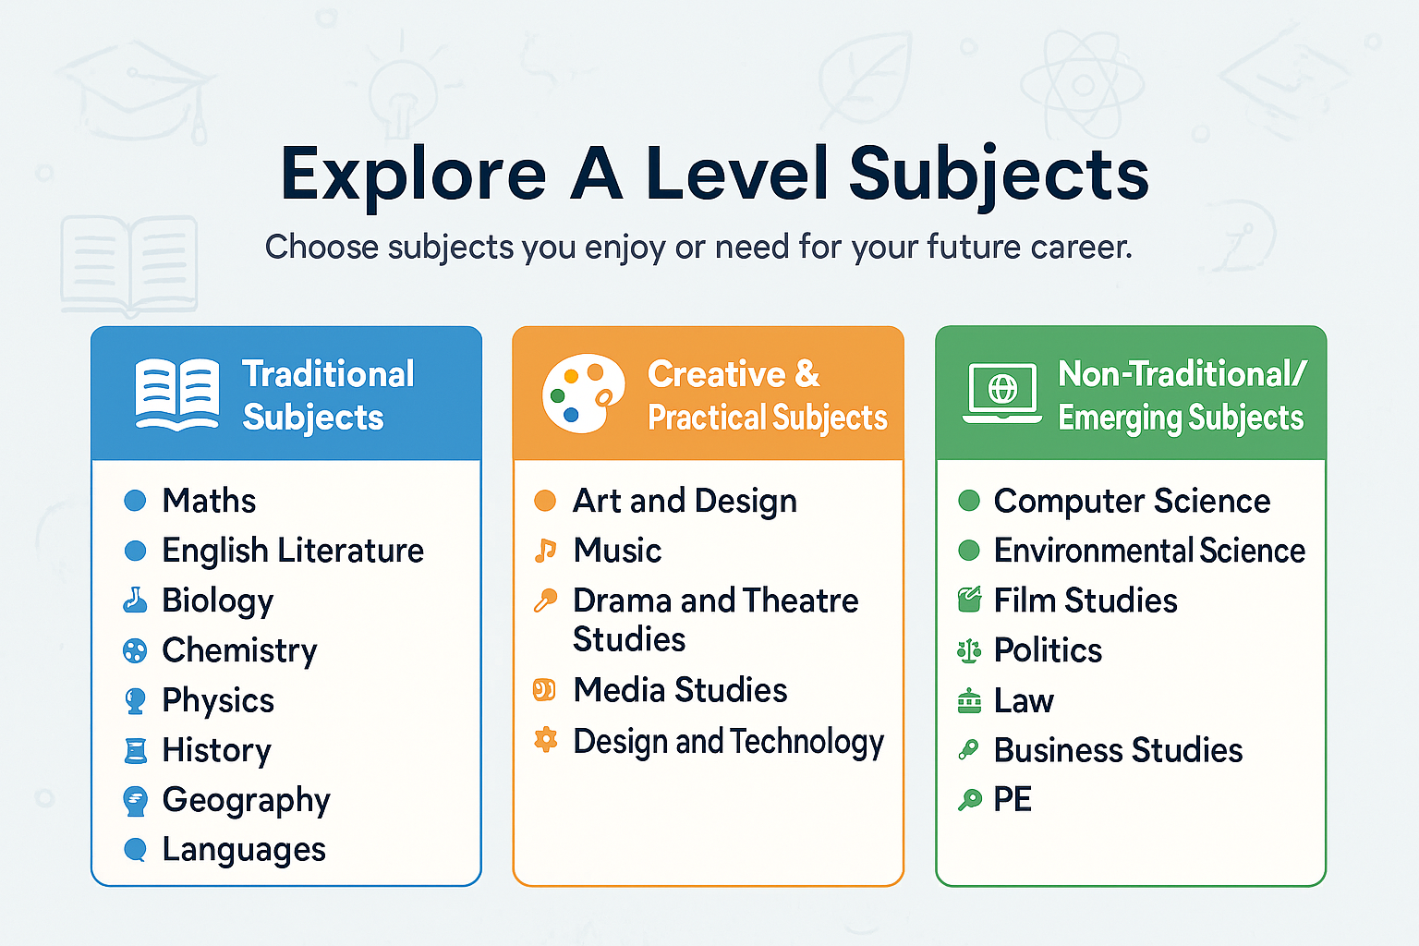
Are there any subjects you are unfamiliar with?
Which three might you choose?
Notes:
Teacher notes:
- Briefly explain any subjects that pupils don’t recognise (e.g., Sociology, Environmental Science, Media Studies).
Discussion:
- Ask pupils: “If you could pick three subjects to study more deeply, which would you choose and why?”
- Encourage them to link choices to hobbies, interests, or dream jobs.

Slide 17
Where Next?
After A Levels, Apprenticeships, or
T Levels, you could:
Go to University
Study a subject in depth and earn a degree.
Start Employment
Begin working in a job that interests you.
Work as an Apprentice
Learn on the job while earning a wage and gaining qualifications.
Further Training or Courses
Specialise in skills for a specific career.

Slide 18
How does it all fit together?
We are going to look at some real-life stories.
For each person, can you write down the pathway they have taken into their career?

Slide 19
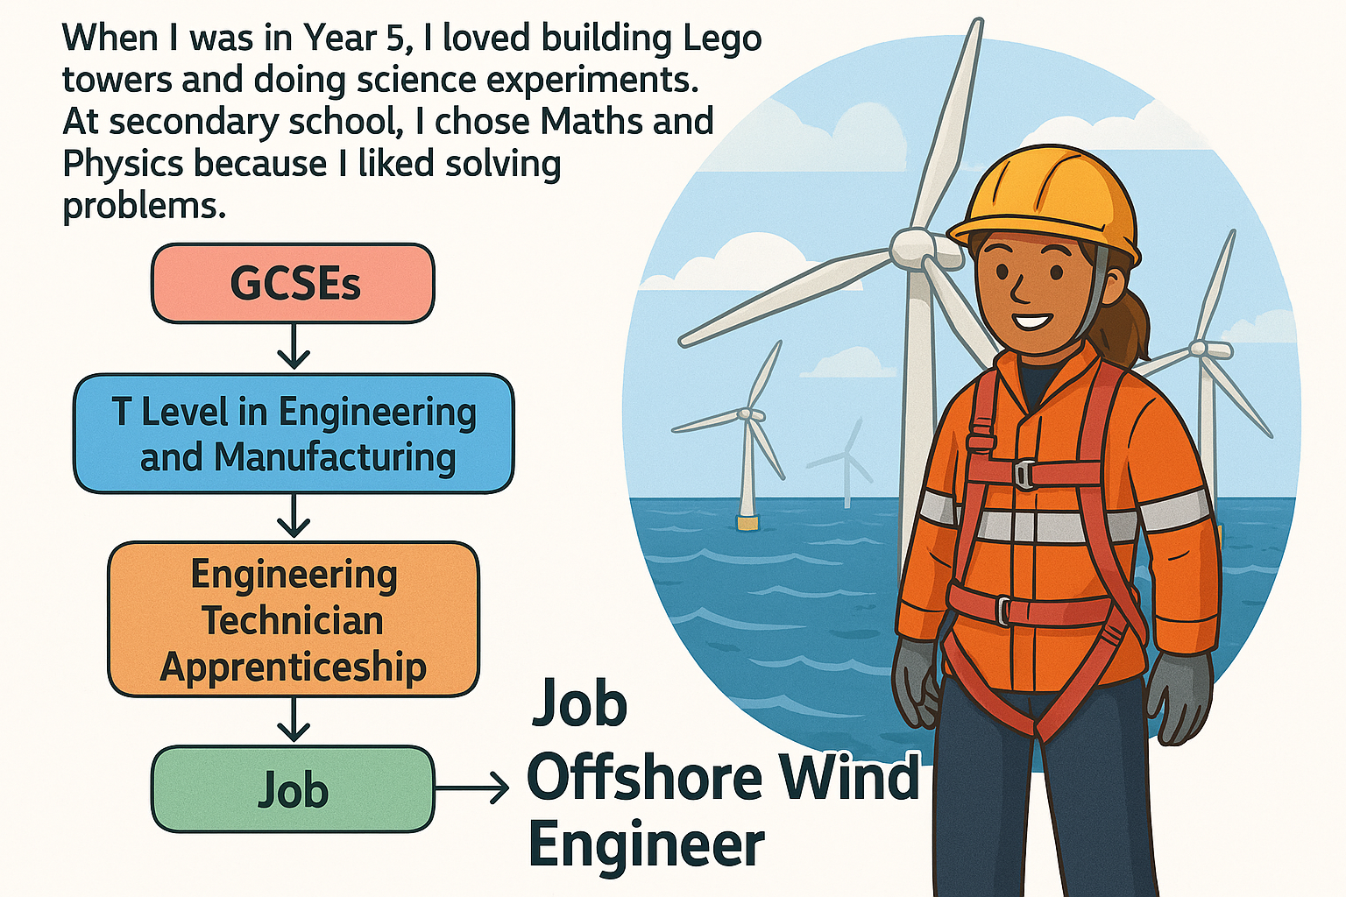
Story 1
"When I was in Year 5, I loved building Lego towers and doing science experiments. At secondary school, I enjoyed Maths and Physics because I liked solving problems. After GCSEs, I studied a T Level in Engineering and Manufacturing. Then I started an Engineering Technician Apprenticeship where I learned to fix and maintain machines. Now, I help keep huge wind turbines turning far out at sea so homes in the North East have clean energy!"
Ella – Offshore Wind Engineer
Which path did Ella take to become an Offshore Wind Engineer?

Slide 20
Ella’s career path

Slide 21

Story 2
"In primary school, I loved helping my friends and doing science experiments. At secondary school, I worked hard in Chemistry and Biology. After GCSEs, I studied A Levels in Chemistry and Biology, then went to university to study Pharmacy. Now, I work in a hospital making sure people get the right medicine to feel better."
Jack – Pharmacist
Which path did Jack take to become a Pharmacist?

Slide 22
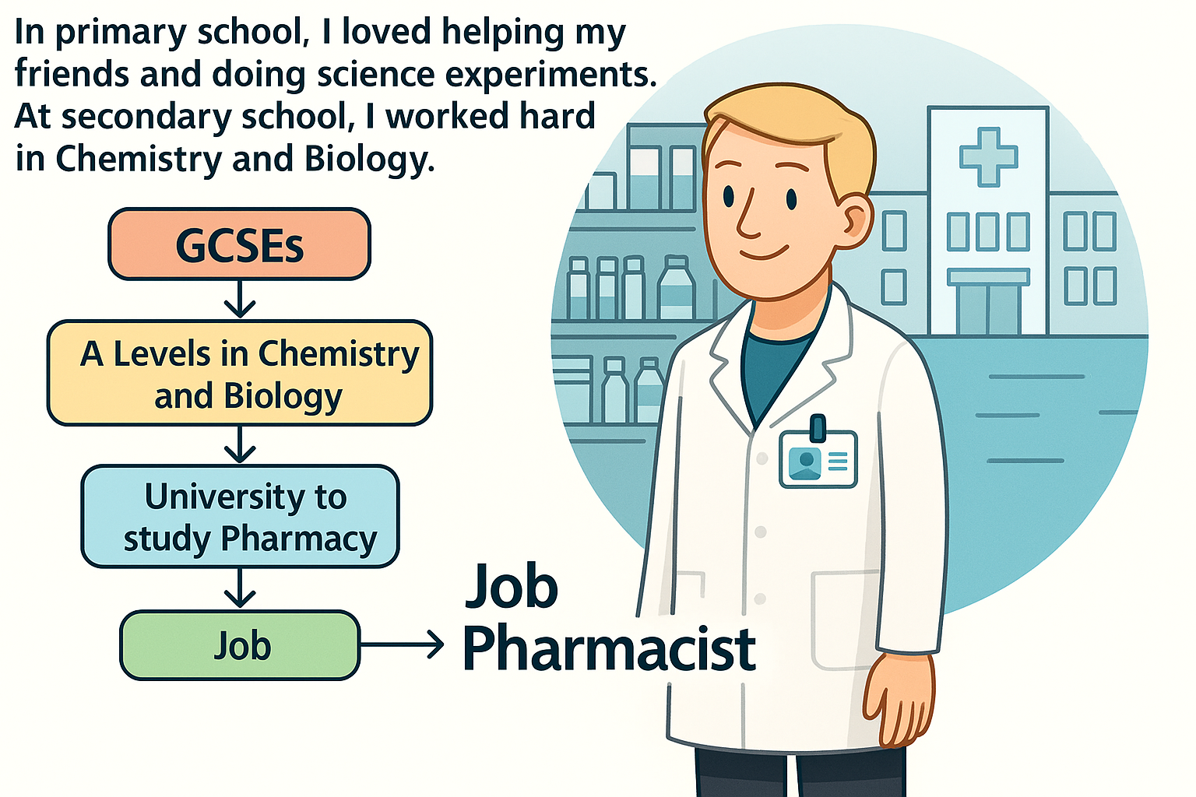
Jack’s career path

Slide 23

Story 3
"When I was little, I liked drawing buildings and playing with blocks. At secondary school, I enjoyed Design & Technology and Maths. After GCSEs, I studied a T Level in Design, Surveying and Planning for Construction. Then I joined a Construction Site Supervisor Apprenticeship. Now, I help plan big building projects in the North East, making sure everything is safe and on time."
Amina – Construction Site Supervisor
Which path did Amina take to become a construction site supervisor?

Slide 24
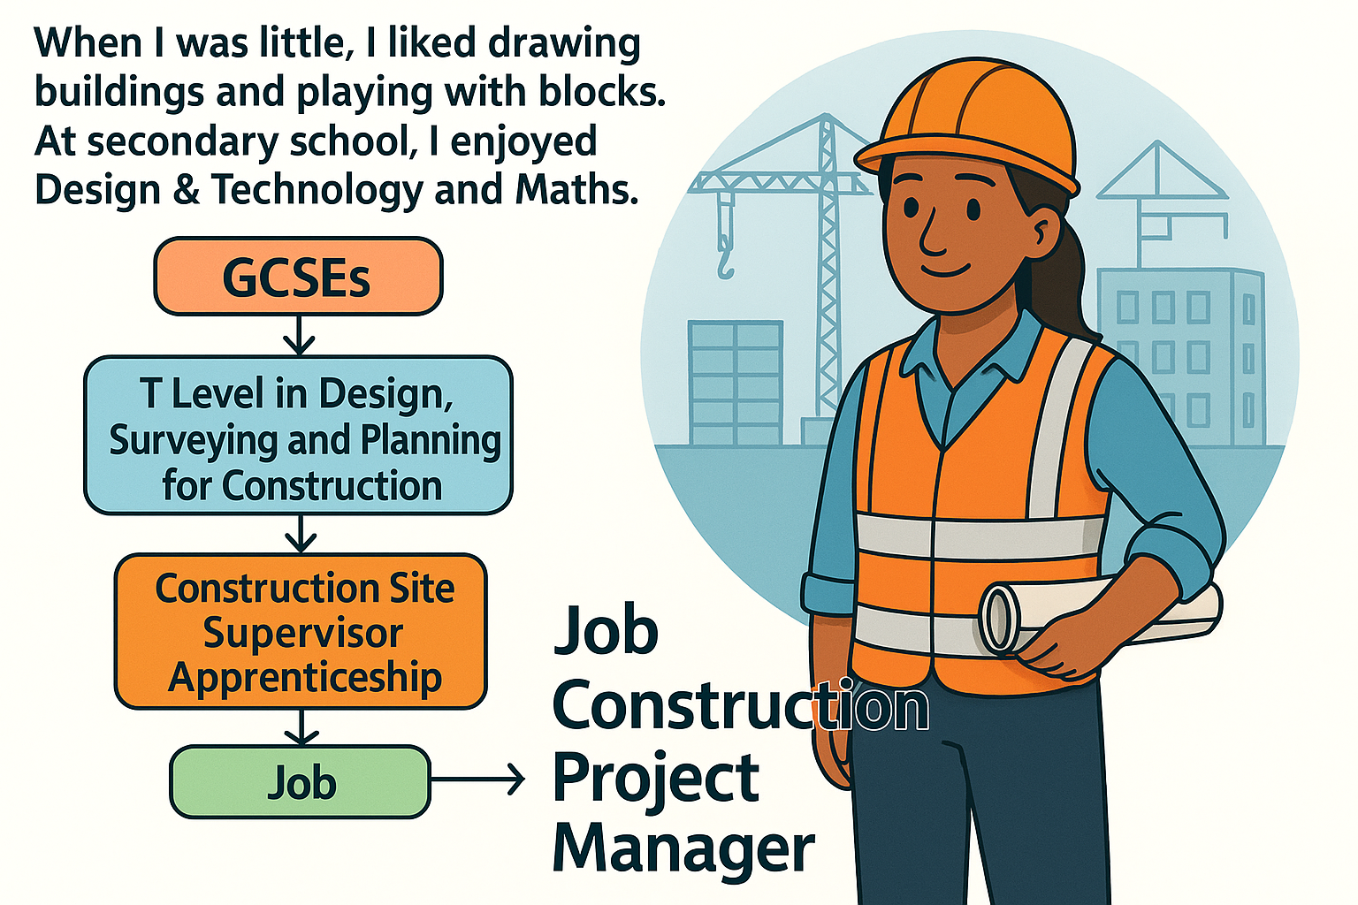
Amina’s career path

Slide 25
When I grow up?
When I grow up, I want to be……
Notes:
Plenary activity
Pupils revisit their career aspirations

Slide 26
Pathway to success
When I grow up, I want to be……
But how will I get there?
Notes:
Teacher Note:
Revisit these questions from the start of the session and update pathways with new knowledge.
The following slide includes a website where pupils can learn more about specific pathways for the career they are interested in.
Encourage pupils to think about why they have chosen certain pathways as right for them.

Slide 27
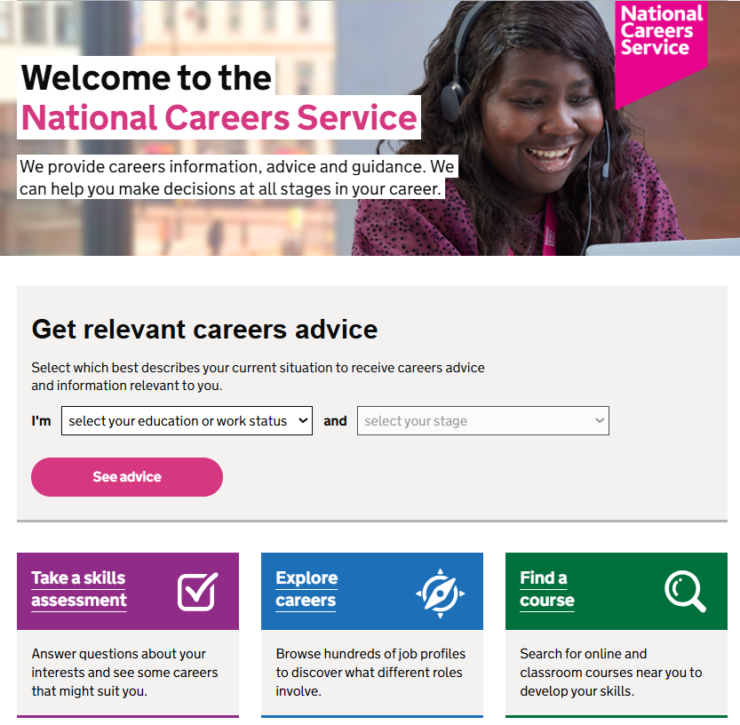
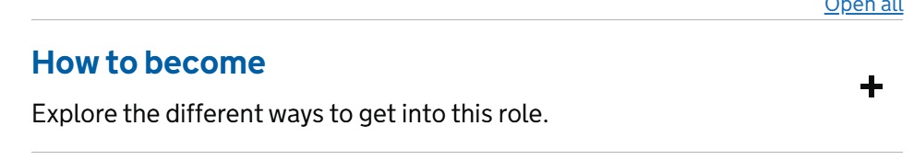
Next steps
Visit the National Careers Service to explore careers and different pathways / courses to help you get there

