Slide 1

Higher Technical Qualifications (HTQs)
Find out more about these exciting qualifications and where they can take you
Notes:
NECA delivery

Slide 2



Learning objectives
What are HTQs?
Who are they for?
What can you study?
Where can you study?
Support available
How to search & apply
Notes:
NECA delivery
Our aim for today is to give you an introduction to HTQs and make sure you have a good understanding of:
What HTQs are,
Which subjects you can study, and which subjects are coming in future years,
Who can study HTQs, what prior qualifications you need and what sort of person they are suited to,
Where you can study HTQs and how to find them nationally and locally,
What the application process is like,
What support and resources are available.
There will be a chance to ask questions at the end.

Slide 3

What are HTQs?
HTQs are qualifications approved by employer standards. This means you can get the skills employers want.
HTQs are level 4 and 5 qualifications. They focus on high quality technical skills that are sector specific.
HTQs commonly last from between 1 year through to 4 years depending on the level and full/part time study option.
HTQs are usually taught in the classroom and teach industry relevant practical skills. They provide a blend of academic and technical learning and projects.
Video: Introduction To Higher Technical Qualifications (HTQs) - Short Version
Notes:
NECA delivery
HTQs are technical qualifications that employers have helped develop so you can get the right training and skills you need to succeed at work. You can study a HTQ full time or part time.

Slide 4

HTQ Language
Course title abbreviations sitting under the
HTQ kitemark
HNC is a Higher National Diploma (Level 4)
CertHE is a Certificate of Higher Education (Level 4)
HND is a Higher National Certificate (Level 5)
FdA or FdSc are Foundation Degrees (Level 5)
A for Arts and Sc for Science
DipHE is a Diploma of Higher Education (Level 5)
Course credits
HTQs at both Level 4 and 5 earn credits:
Level 4 – typically 120 credits earned
Level 5 – typically 120 additional credits earned
Notes:
NECA delivery
Recap
HTQs are new and existing level 4 and 5 qualifications, such as HNDs, HNCs and Foundation Degrees that have been approved with the HTQ quality mark.
Not all diplomas, certificates and foundation degrees are approved HTQs. Look out for the HTQ logo or banner which always shows on approved qualifications.
The HTQ quality mark shows that a higher education course has been approved as meeting standards set by real employers in the industry.
HTQs at both level 4 or 5 earn credits: Level 4 – typically 120 credits Level 5 – typically 240 credits These credits can then be used to progress onto further study, for example a degree or an apprenticeship.
HTQs are a great way to get the skills employers want - a route to well-paid, secure and sustainable jobs. They can be studied full or part time, depending on the course.
HTQ credits can be topped up and turned into a full undergraduate degree, for example. Typically, 360 credits are needed in total to complete an undergraduate degree.

Slide 5
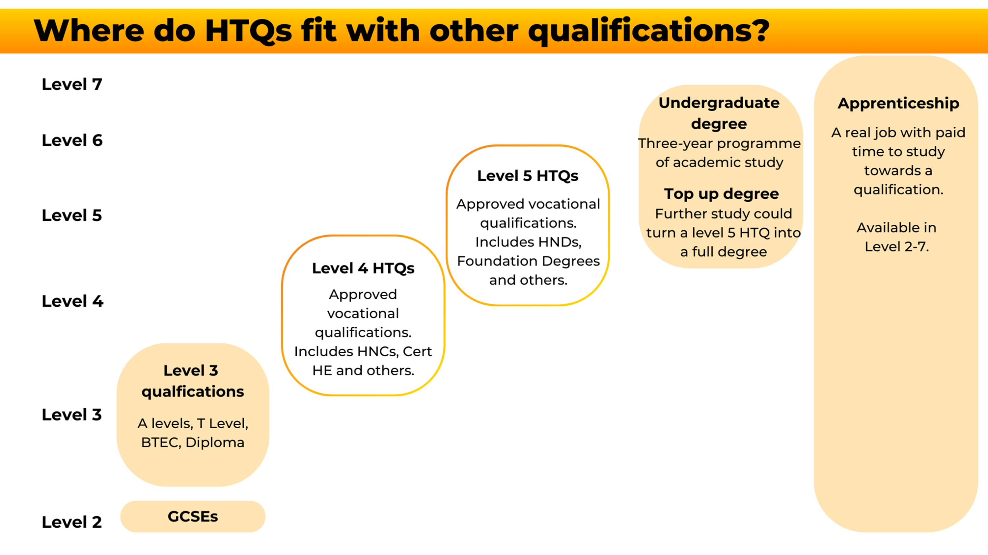
Where do HTQs fit alongside other qualifications?
Notes:
NECA delivery
After completing an HTQ, you could go straight into employment or use credits gained through your HTQ to progress onto further study, for example a degree, or an apprenticeship. You can top up your HTQ credits and turn it into a full undergraduate honours degree or use those credits to undertake an accelerated apprenticeship.
An HTQ at either level 4 or 5 would earn credits (a level 4 Certificate in Education that is an approved HTQ typically attracts 120 credits, for example). Students could make an application to a university to 'top up ' to a degree (in a similar subject area) based on these credits. Universities would consider each application on its merits. Typically, 360 credits are needed in total to complete an undergraduate degree.

Slide 6

Who are they for?
You need to be at least 18 to start a HTQ, but you can apply while you are still at school sixth form/college before you turn 18.
HTQs are also suitable for anyone looking to upskill or retrain, there is no upper age limit.
HTQs can offer a cheaper alternative to a full-time degree.
If you are undecided about a full time University pathway, HTQs offer a route into Year 2 Higher Education course or a faster route into employment.
HTQs enable you to gain UCAS credits to use for future applications, but they are also a highly sought after qualification in their own right and improve your career prospects as they are approved by employers.
You can study full time or part time, alongside a job or other responsibilities you may have.
Notes:
NECA delivery
You must have completed a level 3 qualification such as A-levels, T Levels, BTECs or some advanced apprenticeships. You can apply for HTQs while you are still at school.
HTQs are also suitable for anyone looking to upskill or retrain during their career.

Slide 7
What can you study?
Business & Administration
Construction & the Built Environment
Digital
Education & Early Years
Engineering & Manufacturing
Health & Science
Legal, Finance & Accounting
Agriculture, Environment & Animal Care
Care Services
Catering & Hospitality
Creative & Design
Protective Services
Sales, Marketing & Procurement
Notes:
College partner delivery
Level 4 and 5 qualifications are being given the HTQ mark of quality on a rolling basis. You can see on the screen where we are now, and which subject areas have been through the HTQ approval process. This means that more and more courses are becoming available each year and by 2025, there will be a wide range of HTQs across all the areas shown.

Slide 8

Where can you study?
More training offers are becoming available – but here is a flavour of what is available in the North East.
Newcastle College
HE Cert Integrated Health, Social Care and Wellbeing
FdSc Networking & Cyber Security
FdA Business Management
FdA Culinary Arts
FdSc Criminology, Policing and Criminal Law
New College Durham
HNC Construction Management for England
CMI Diploma in Operational Management
HNC Mechatronics for England
FdA Film and Media Production
HNC Architectural Technology for England
Notes:
College partner delivery (this slide can be updated/amended depending the delivery organisation if needed)
HTQs are delivered by universities, Further Education Colleges, Independent Training Providers and Institutes of Technology all over England. On the screen are some examples from within the North East CA region that are delivered by Newcastle College and New College Durham, part of the Institute of Technology. But other regional institutions may offer HTQs also, make sure to do your research.
These include, Higher Education Certificate, Foundation Degrees, Higher National Certificates, and the Chartered Management Institute – all of which are Higher Technical Qualifications (HTQs).

Slide 9



How to search & apply
Visit:
www.gov.uk/government/publications/list-of-higher-technical-qualifications
Find Providers
Contact or visit the websites of local FE colleges, Universities, Independent Training Providers and Institutes of Technology.
Contact Providers
Search on UCAS, this link will take you to a pre-filtered list of HTQs: click here.
UCAS
Notes:
College partner delivery
There are several ways you can find HTQs:
The government has a list of all the HTQs available, which you can filter and search.
Another way is to contact or visit the websites of specific providers and find out what courses they are offering.
You can also search for full-time HTQs on UCAS, just like you would for a full degree course.
You can apply for an HTQ directly through UCAS as one of your 5 course choices.
Applications should be made in the autumn term observing the January deadline to have the best chance of securing your first choice for the following September. Applications can be made after this date as some HTQ courses have a January rather than September start, allowing lots of flexibility.
You can also apply directly to the training provider and the process will vary, but is likely to include an online application form, skills test and an interview.
There is a guide to applying for HTQs that you can download, the details are on the final slide.

Slide 10
Entry requirements
Tuition fees
Each education provider sets their own grade or qualification requirements.
Typically, HTQs require completion of a Level 3 qualification e.g. A Levels, T Levels, BTECs or some advanced apprenticeships. However, for mature students, significant experience will be considered as a pre-requisite.
Most providers state their entry requirements in terms of UCAS tariff points, and requirements could range from 0 – 112.
Fees apply
If you study a HTQ, tuition fees will apply. These will vary depending on the course.
Cost
Fees are likely to be £6,000 - £9,500 for a one or two-year course
Support
You could be eligible for student support to cover tuition fees and maintenance loans.
A new Lifelong Learning Entitlement is being introduced next year making HTQs more accessible.
Find out more
Visit: www.gov.uk/student-finance
Notes:
College partner delivery
Entry requirements vary from provider to provider as each sets their own grade or qualification requirements. Most providers state their entry requirements in terms of UCAS tariff points, and requirements could range from 0 – 112. Try not to be put off by entry requirements though, and make sure you talk to the provider if you have concerns.
If a HTQ is undertaken as a standalone qualification, tuition fees will apply, which will vary depending on the course. They’re likely to cost from around £6,000 to £9,250 a year for a one-year or two-year course.
You may be eligible for funding from student finance or a scholarship, grant or bursary. This will depend on the circumstances and the type of HTQ being studied.
In the same way as full-time university study, students may wish to make arrangements for their own payment of fees, and this is also the same for HTQs.

Slide 11

Foundation Degree (FdA) Performing Arts at New College Durham
Notes:
NECA delivery

Slide 12

Higher Technical Qualification – Media New College Durham
Notes:
NECA delivery

Slide 13

Meet our FdA Culinary Arts students Newcastle College
Notes:
NECA delivery

Slide 14

Let’s review.
Flexible – full/part time study
Progression opportunities
For those 18+ with a Level 3 qualification*
Usually take
1-2 years to complete
Students can access student finance
Level 4 & 5 qualifications
Taught in FE colleges, Universities & IoTs
Typically delivered in classroom settings
Notes:
NECA delivery
*such as an A Level or T Level or significant experience may also be considered when enrolling.
Progression opportunities – HTQs could lead to an apprenticeships, full degree or employment.

Slide 15

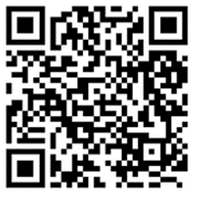
Support available and useful resources
Amazing Apprenticeships: HTQs
UCAS: HTQs
North East Institute of Technology
Study a Degree in Sport Coaching at Newcastle College University Centre (video)
Study a HTQ at Newcastle College University Centre (video)
Study a Degree in Business at Newcastle College University Centre (video)
https://qualifications.pearson.com/en/qualifications/btec-higher-nationals/higher-nationals/higher-technical-qualifications.html
https://www.htqtoolkit.co.uk/
Notes:
NECA delivery
There are resources available to support you in your HTQ journey. There is a range of resources, including the application guide I mentioned a moment ago.

Slide 16
Any questions?

