Slide 1
Automotive, Manufacturing and Sustainability
Careers Session

Slide 2
Agenda Climate Change & Sustainability North East Energy Innovation Manufacturing Electrification Skills Employers Want

Slide 3
Presenter Introduction

Slide 4
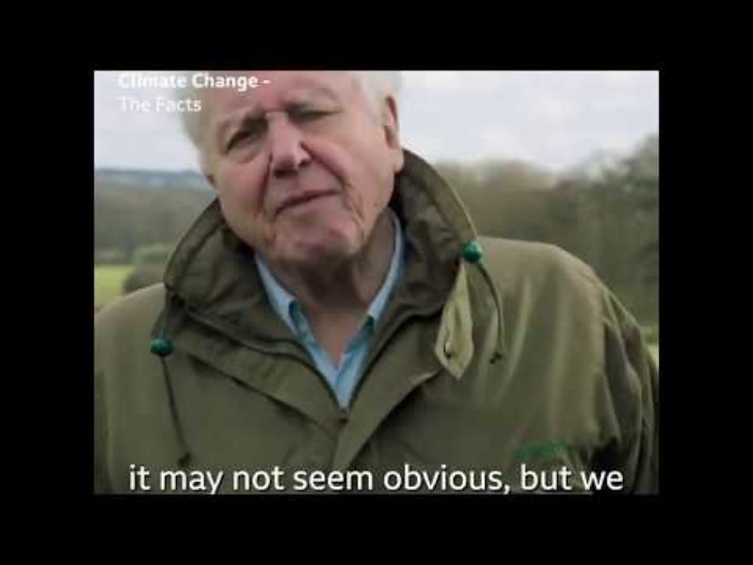
Climate Change

Slide 5

United Nations Sustainability Development Goals

Slide 6


Slide 7
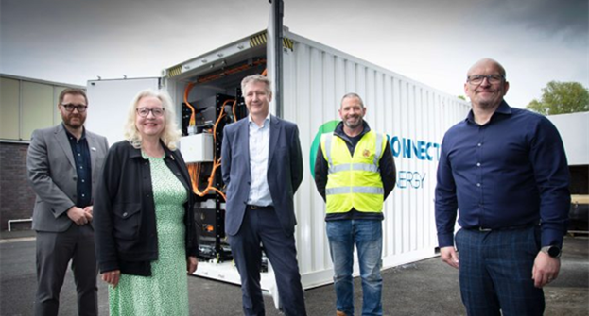

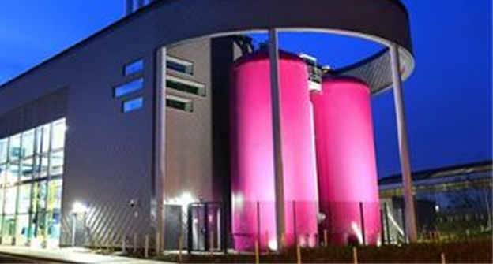


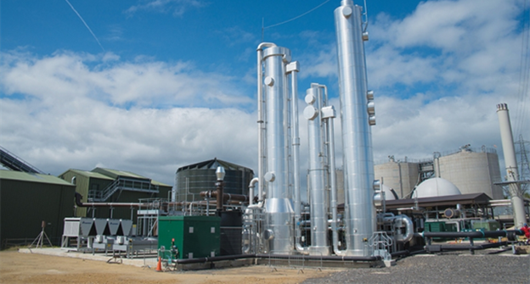
North East Energy Innovation

Slide 8


Slide 9


Slide 10
Jobs in Advanced Manufacturing
Engineering
Manufacturing Engineer
Design Engineer
Robotics Engineer
Additive Manufacturing Specialist
Automation Engineer
Electrical Engineer
Mechanical Engineer
Quality Control Engineer
Corporate Services
IT
Accounts
HR
Business Administration
Customer Services
Sales
Marketing
Site Security
Training
Procurement
Health and Safety
Risk and Compliance
Facilities Manager
Energy Manager
Manufacturing
Machine Operator/ Technician
Process Leader
Production Manager
Manufacturing Manager
Quality Control Technician
Welder
Plant Manager
Shift Supervisor
Assembly Technician
Warehousing and Logistics
Warehouse Operative
Unmanned Vehicle Operator
Logistics Coordinator
Packer

Slide 11
Electrification

Slide 12
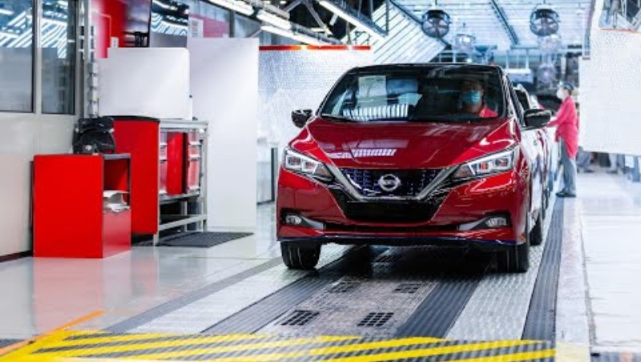
Answer the following questions whilst watching the video:
What is meant by Electrification? Why is electric vehicle production so important to the North East? What is the name of the electric car produced in Sunderland? What are the 2 different routes the young people at the end of the video have taken into working for Advanced Electric Machines? What could be the benefits of a career in Electrification?

Slide 13
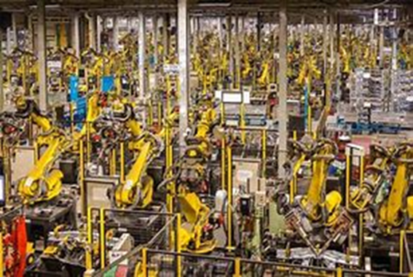

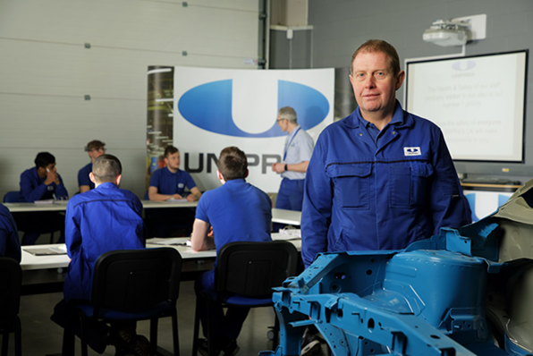
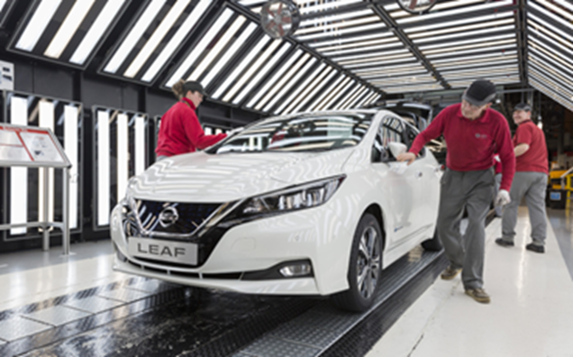
Manufacturing – Employment Forecast 2035
80,000* people in the North East currently work in Manufacturing
31,200 Vacancies between 2020 and 2035

Slide 14

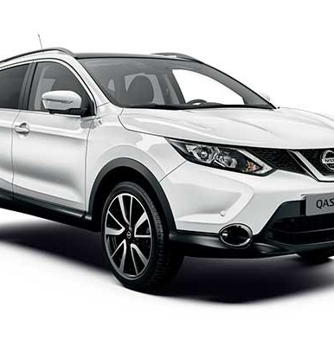
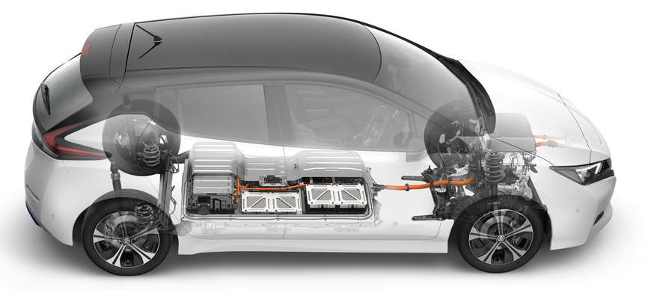
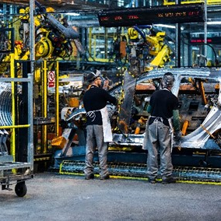
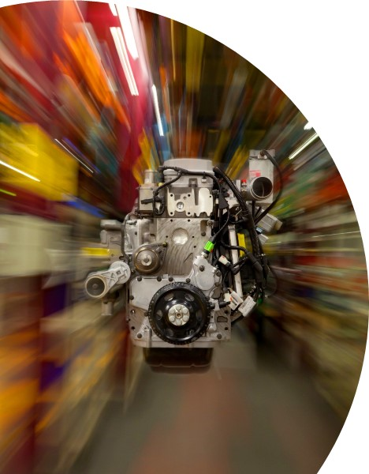
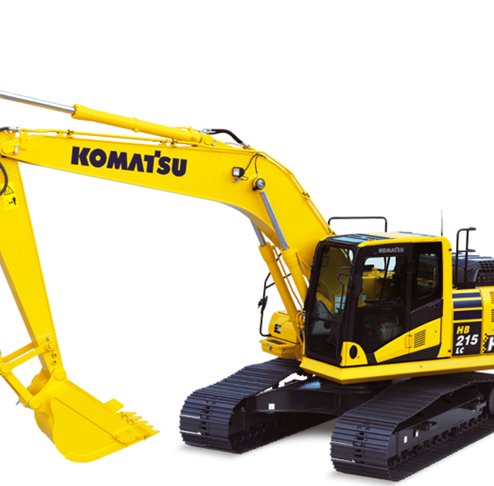


Notes:
Intro to me
W

Slide 15
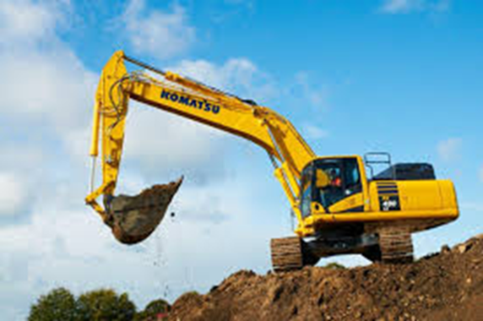
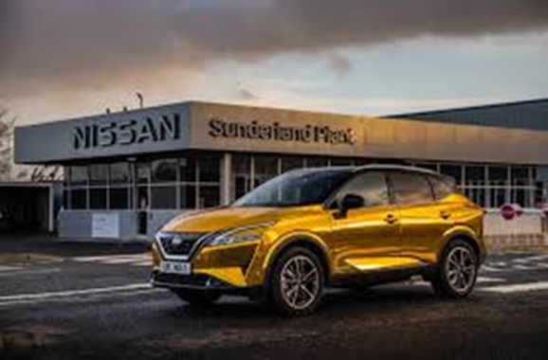
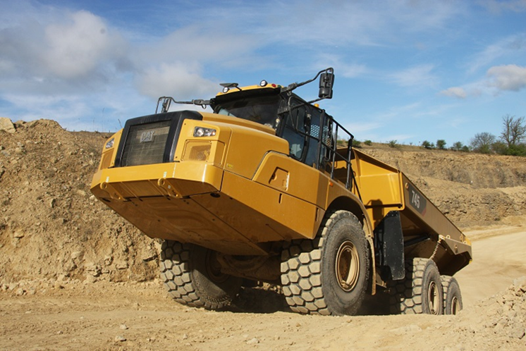
What vehicles are manufactured in the North East?

Slide 16
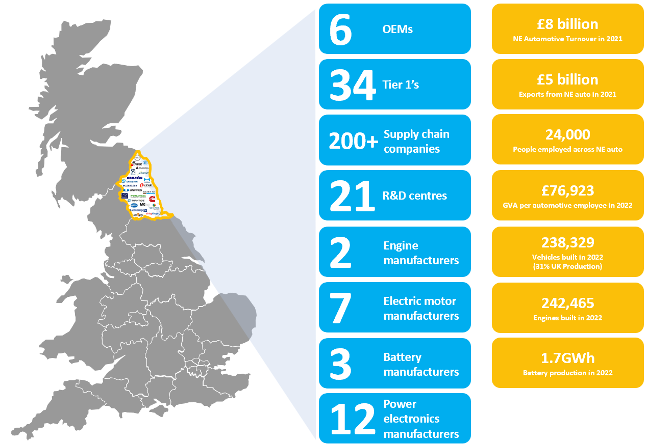
North East Automotive Sector
UK Largest car plant
1.4m cars over 5 years
Off Highway manufacturers
Over 150 supporting businesses (Supply chain)
£8BN per year
Notes:
Over past 5 years (2018-2022) NMUK produced 1,497,026 vehicles (27.5%) of all UK passenger vehicles, second to JLR with 1,550,256 vehicles (28.5%)
Average vehicle / direct employee
EU – 7.11
UK – 9.4
NE – 16.5
based on SIC29. The decision to exclude all other SIC codes than SIC29.2 and SIC29.3 has had a detrimental impact upon the North East figures and is not reflective of the true scale of the NE automotive sector, and for that matter other UK regions.
Tier 1’s excluded from NE:
Kasai UK Ltd (SIC 22290)
Nifco UK (SIC 22290)
Novares (SIC 20160)
Elring Klinger (SIC 25500)
Envision AESC (SIC 64209)
Gestamp (SIC25500)
Cummins (SIC28110)
Plus for automotive we use the BEIS definition which includes off highway which I doubt you’ve included and therefore Komatsu and CAT would be included in our figures.
The second issue is that the NE is also a branch economy where NE sites are reported out of other regions. I’d like to understand if regional sites were picked up and allocated to the correct regions or whether its based on PAYE locations, which is usually head office.
Adient UK – registered office Coventry
Cummins Ltd – registered office London
Lear Corporation – registered office London
Magna Exteriors – registered office Liverpool
Marelli UK – 2 NE sites reported out of Llanelli, Wales
Sumitomo Electric Wiring Systems (Europe) Limited - registered office Newcastle Under Lyme
ZF Automotive UK – registered office Solihull
Average robots per 10,000 automotive manufacturers - International Federation of Robotics (IFR)
UK 101 (24th Globally) , EU 114, NE +500
World average 113
EU average 114
Global leader Korea 932
EU Leader Germany (4th) 371
US (7th) 255
France (16th) 194

Slide 17
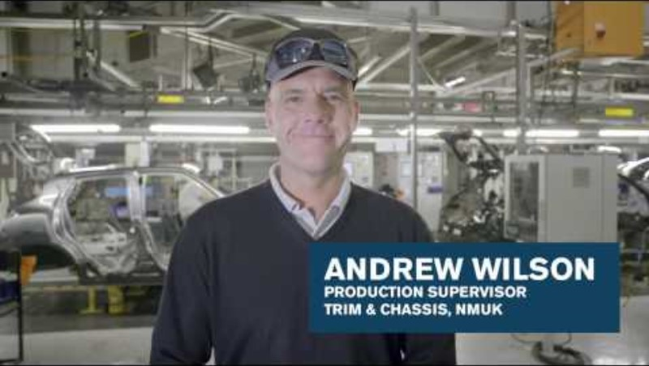
Working at Nissan

Slide 18
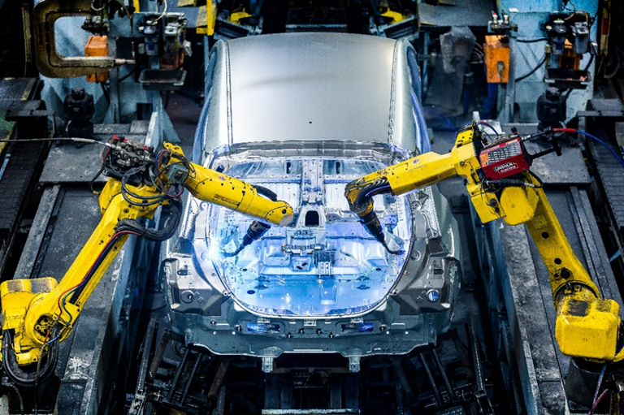
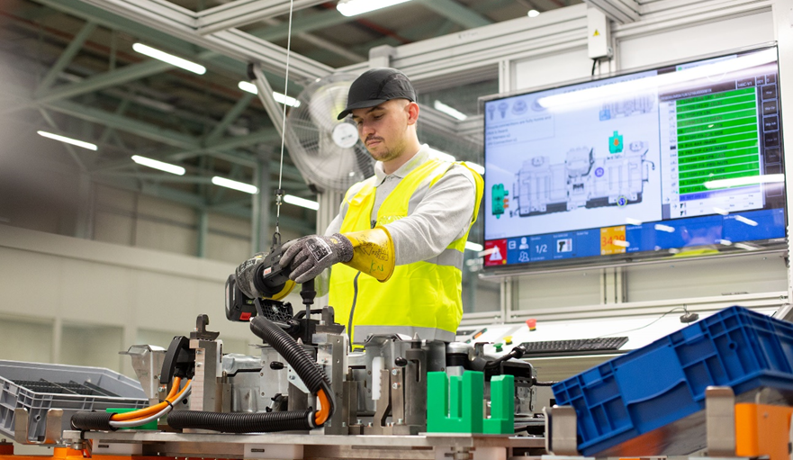


Inside the Factory

Slide 19
Careers in Advanced Manufacturing

Slide 20

Ali Coley Envision AESC
What does the company do?
What job does the speaker have and what types of things do they do in the role?
What qualifications do you need to get the job?
What skills are important to the job?
How can you find out more about jobs such as these?

Slide 21
Skills Employers Want

Slide 22
North East Future Skills
Ambition​
Innovation ​
Resilience ​
Communication ​
Integrity​
Professionalism​
Leadership​
Analytical Skills
Do you understand these terms?​
Why do you think they are important to employers?​
How do you think you could demonstrate these skills?

Slide 23
Thank You

