Slide 1
Introducing Careers-Related Learning
Name
Title
Notes:
Welcome everyone. In the next hour we’ll explore why careers belong in our primary curriculum and how to make simple, sustainable links in every subject.
Quick show of hands: “Who has already tried a careers link this year?”

Slide 2
Agenda
Welcome & Purpose
Why embed careers? Evidence & context
Tools quick-tour
Workshop: Career Mapping Canvas
Share & next steps

Slide 3
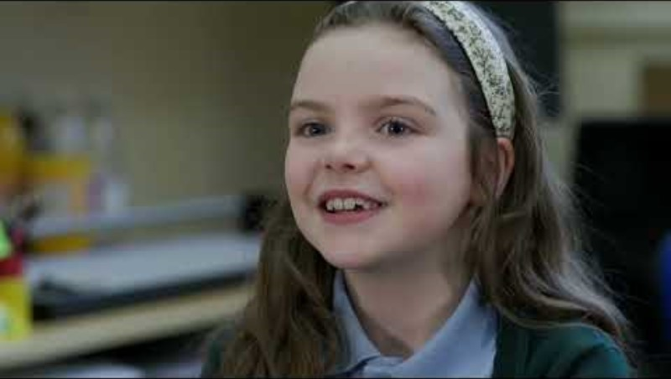
Notes:
You may wish to use this video about the North East Ambition primary network to open the session.

Slide 4
Objectives
Provide an overview of why/how to embed careers in the curriculum
Support curriculum leaders to begin mapping careers against their curriculum areas
Empower leaders to link careers-related learning to each topic
Notes:
Today’s objectives align with Benchmark 4—linking curriculum learning to careers—which expects that every year, in every subject, pupils experience how subject knowledge connects to a wide range of careers. This is not an add‑on; it’s how we demonstrate the relevance of learning.
Meeting BM4 strengthens our Personal Development offer and complements Ofsted’s expectation of a well‑sequenced, ambitious curriculum

Slide 5
Why Careers in Primary?
Children narrow aspirations early – careers learning broadens horizons.
Embedding careers improves motivation and relevance.
Primary Benchmark 4: Linking curriculum learning to careers.
“Exposing children to the world of work has a significant impact on their aspirations, motivation and confidence.” (What Works? Career‑related learning in primary schools)
Notes:
Research shows children begin to narrow aspirations early; carefully planned career‑related learning broadens horizons, challenges stereotypes and boosts motivation. This is precisely the rationale behind the primary adaptations of BM4 and why we want to link the curriculum to careers.

Slide 6
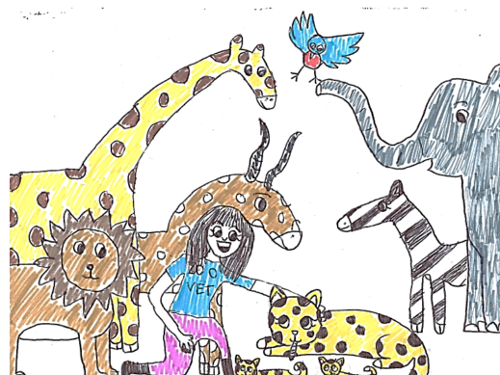
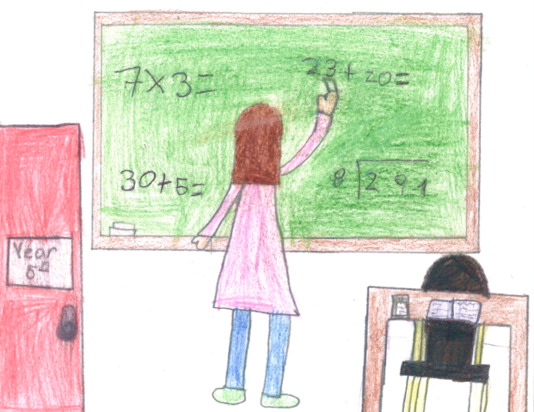
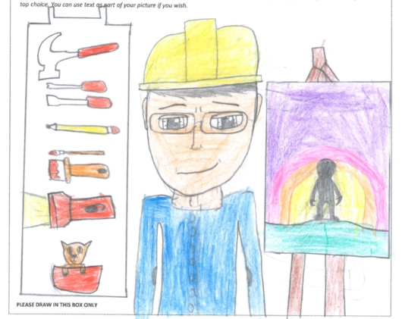
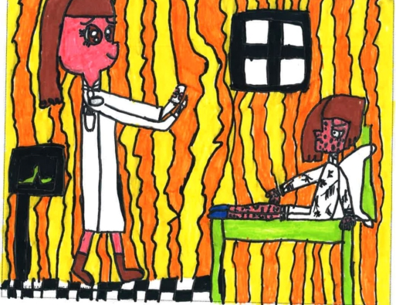
The research: Drawing the Future
Reflection
1.
What stereotypes do our pupils hold that could limit their aspirations?
2.
How do we currently challenge those stereotypes?
A survey of 20,000 primary school children with significant implications for social mobility and gender equality.
The report revealed that the difference between children’s career aspirations from age 7 to 17 are marginal, and too often based on gender stereotypes, socio-economic backgrounds and by TV, film and radio.
It also shows that some sectors vital for economic health look set to be badly resourced in the future.
Notes:
See full study here: Drawing the Future - Education and Employers
The report suggests two key reason to start early with career-related learning:
- Career-limiting decisions can be made by age 7 based on a range of factors (listed above)
- There is a disconnect between the jobs young people aspire to and the areas of opportunity for them when they grow up

Slide 7
Why?
Primary CRL helps “broaden horizons… challenge stereotypes” and connect learning with life and work.
Notes:
Benchmark 4 turns the ‘why’ into practical expectations for every subject.

Slide 8
School Context
Why are you as a school developing a careers programme?
What do you want to achieve for your pupils?
Do you have a careers strategy or intent statement that can be shared?
How does this link into wider school priorities or school development plan?
Notes:
This slide should be written by the careers lead to share your approach and intent as a school. Some prompt questions are included in the slide to guide your thinking.

Slide 9
Through NEA's Primary Network, we have access to:
Facilitator support for each school to develop a careers strategy and annual action plan
A self-assessment audit tool linked to the Primary Benchmarks
Regular network meetings, hosted by local Career Champions, to help develop effective communities of practice
Regional conferences, connecting school leaders, employers and other key stakeholders, to share best practice and knowledge of our regional economy​
CPD and training opportunities
The North East Ambition website with case studies, links to CRL providers, and resources (including the new ‘Think, Solve, Succeed: Maths and Careers in Action’ resources)
Notes:
An opportunity to share how you are engaging with the North East Ambition Primary network and the support offered.

Slide 10
North East Support
You don’t have to start from scratch!
NE Ambition Primary Toolkit
MyPath
LinkUp portal for employer encounters
Notes:
You don’t have to start from scratch. The NE Ambition Primary Toolkit curates case studies and resources for linking curriculum to careers; MyPath gives quick, teacher‑friendly career connections by topic; and the Linkup portal helps you find volunteers for encounters.
The following slides will share some specific resources that can be demonstrated in the session – you may wish to choose only the ones which you would like staff to implement.

Slide 11
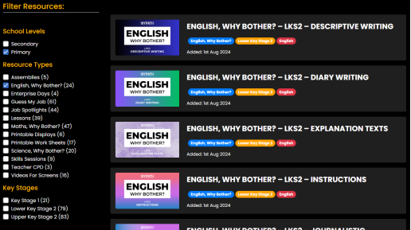
MYPATH Unlimited
Insert School Account Details
Notes:
MYPATH gives 2–3 minute videos—Job of the Week and ‘Why Bother?’ series—to connect topics to real jobs. Great for starters or assemblies.

Slide 12

Think, Solve, Succeed
Notes:
High quality maths problem solving investigations linked to real people and their careers in the North East. These resources are linked to the national curriculum and come with lesson videos and detailed teacher notes.

Slide 13
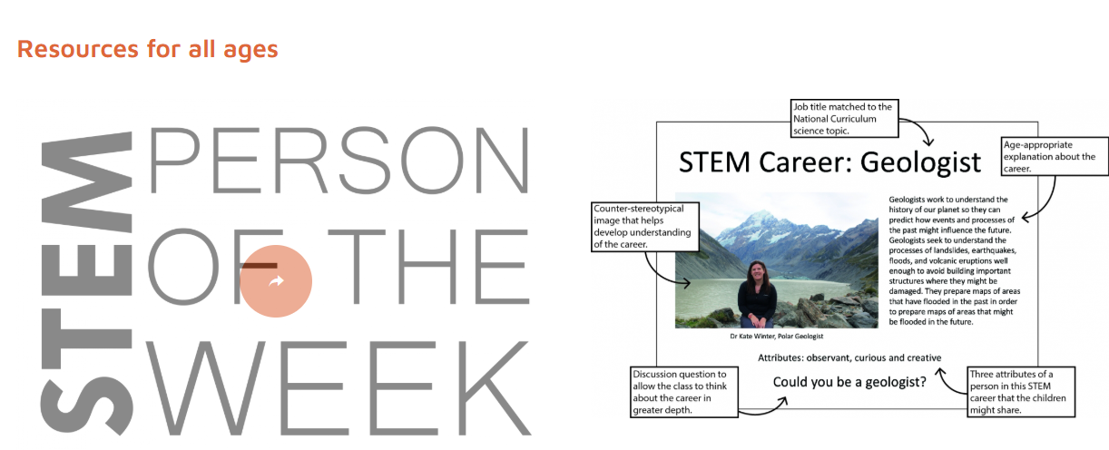
NUSTEM
Notes:
Fast career‑topic mapping + stereotype reduction.

Slide 14
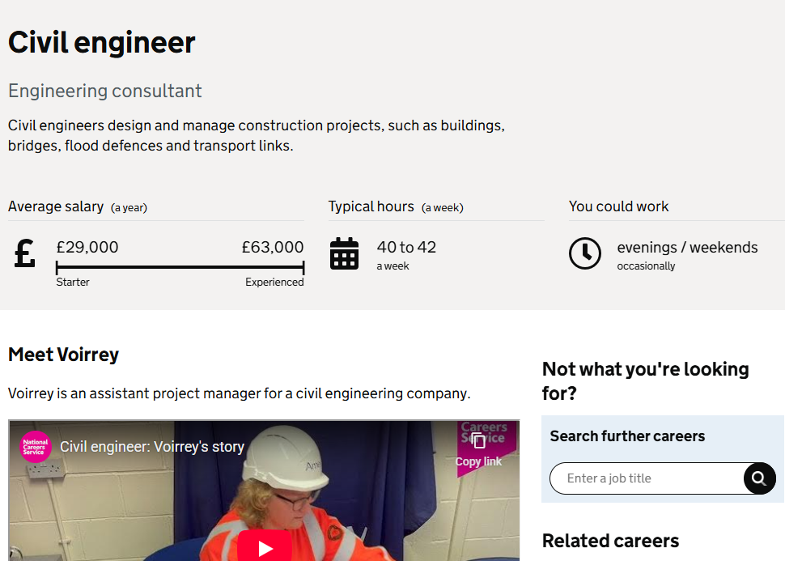
NCS Explore Careers
Notes:
NCS Explore Careers has 800+ profiles with day‑to‑day tasks, entry routes and salary bands—useful for teacher planning and upper KS2 research tasks.

Slide 15
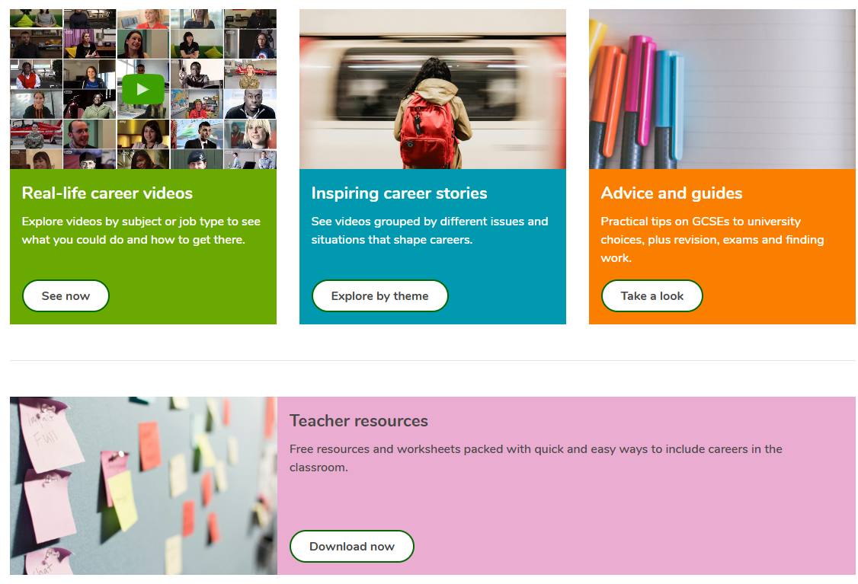
iCould
Notes:
icould provides short films of real people—use to challenge stereotypes and humanise roles in your subject

Slide 16

BBC Bitesize Careers
Notes:
A range of career profile videos to find out more and challenge stereotypes.

Slide 17
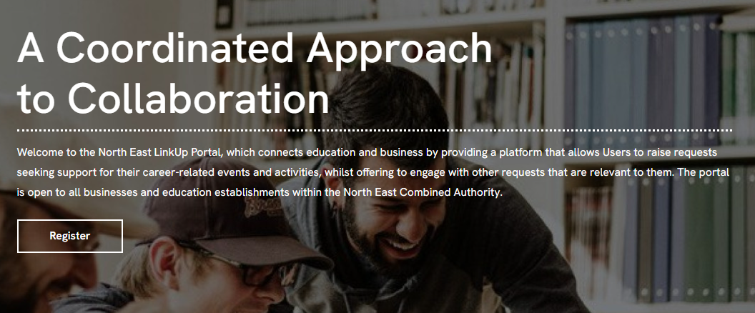
LinkUp Portal
Notes:
Use Linkup to post a simple ask: ‘Year 5 need a 20‑minute virtual talk from a civil engineer on X date linked to Y topic in the curriculum

Slide 18

Primary Futures
Notes:
Primary Futures is a free, teacher‑led national programme that connects primary schools with diverse volunteers from the world of work—either virtually or in-person—to help children understand the link between learning, skills, and future opportunities. It is part of the wider Inspiring the Future and Education and Employers charity offer.

Slide 19
Workshop
Pick one upcoming topic from your subject area
Complete Career Mapping Canvas
Use the suggested resources and the example on the following slides
Notes:
Choose one upcoming topic and use the Career Mapping Canvas to map a simple careers connection. Use the resources shown earlier to help you pick roles, encounters, and a clear ‘why this matters’.

Slide 20
Career Mapping Canvas
Geography – Investigating Rivers
Why this matters — a pupil‑friendly relevance line.
Rivers affect communities and safety
Careers & Roles — 1–3 roles (use the tools).
Flood Risk Officer, Civil Engineer
Encounter Idea — video/speaker/virtual/site visit/challenge (use Linkup).
Invite Northumbrian Water
Foundations — what prior curriculum knowledge are you building on?
KS1 map skills and water cycle basics
Stereotype Check — representation you’ll use to challenge bias.
Diverse representation
Assessment Hook — a quick exit reflection.”
Name one job where someone would use river knowledge
Notes:
Notice the concise ‘why’, the specific roles, a realistic encounter, and a clear Foundations statement. The Stereotype Check reminds us to choose images/examples that counter bias.

Slide 21
Career Mapping Canvas
Why this matters — a pupil‑friendly relevance line.
Careers & Roles — 1–3 roles (use the tools).
Encounter Idea — video/speaker/virtual/site visit/challenge (use Linkup).
Foundations — what prior curriculum knowledge are you building on?
Stereotype Check — representation you’ll use to challenge bias.
Assessment Hook — a quick exit reflection.”
Notes:
We’ll use this ‘Canvas’ to help us think about meaningful careers connections for each topic. You may wish to print this page for the activity.

Slide 22
Share and Refine
60-second share
Group feedback: one improvement + one encounter idea
Is the ‘why’ clear and pupil‑friendly?
Do we have a stereotype‑busting image or example?
Is the encounter realistic?
Notes:
60 seconds per person to share your canvas. The group gives one improvement and one encounter idea. I’ll note cross‑curricular links we spot.

Slide 23
Next Steps
Map careers against each topic by X
Arrange one employer encounter using existing connections, LinkUp or Primary Futures this year.
Share any updates to whole school careers overview
Notes:
Some suggested next steps, actions and deadlines to share. These should be tailored to your context and careers strategy.

