Slide 1
Construction and Sustainability

Slide 2
Agenda
Introductions
Stages of a construction process​
Digital Construction​
Domestic Retrofit ​
Commercial Retrofit​
Job roles & Salaries ​
Renewable Sources of Energy

Slide 3
Presenter Introduction

Slide 4

United Nations Sustainability Development Goals

Slide 5
Procurement
Client
(LA/ HA/ Private client)
Contractor
Subcontractors
Consultants

Slide 6
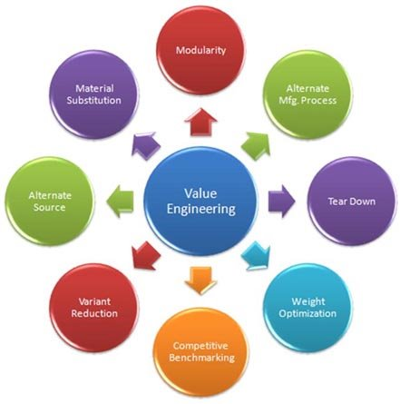
Value Engineering

Slide 7
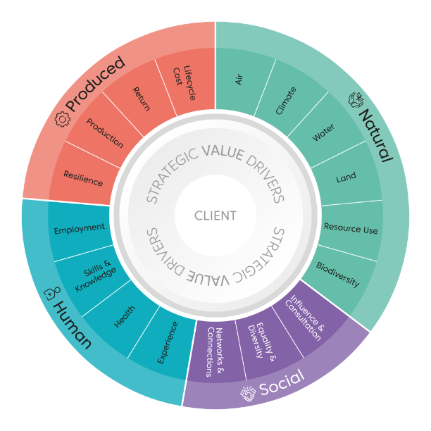
Value Toolkit
What could be the downside to construction projects being won only on Money and time they take to complete?

Slide 8
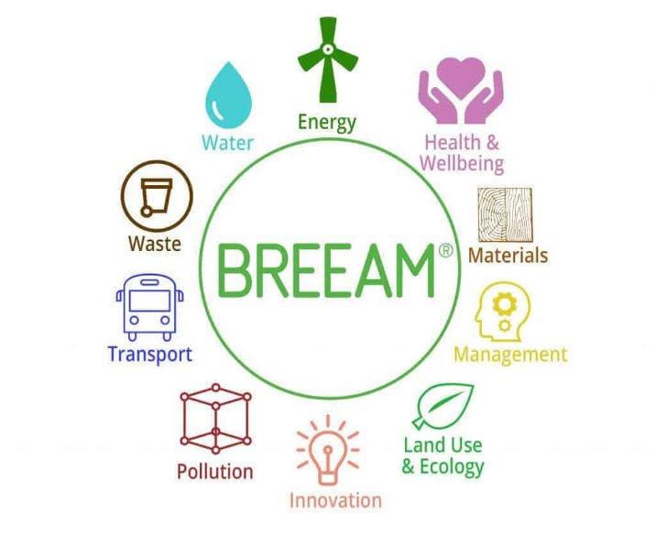
BREEAM

Slide 9
Career Map
BSc Quantity Surveying
L6 Quantity Surveyor
Quantity Surveyor - £25,500- £90,000pa
HTQ L5 Higher National Certificate in Quantity Surveying
HTQ Higher National Certificate in Quantity Surveying
L4 Construction Quantity Surveying Technician
Any Level 3 Qualification
(T level, A level, Apprenticeship, Full time course)
Any Level 2 Qualification
Any Level 1 Qualification

Slide 10
Digital Construction

Slide 11
Digital Construction
Digital Construction
Building information modelling (BIM)
Computer Aided Design (CAD)
Computer Aimed Manufacturing (CAM)
Digital Twins
Machine Learning AI and Big Data analytics
Mobile Technology
Unmanned aerial vehicles
Digital construction is defined as utilizing digital technologies and a highly data driven approach to construct more efficiently with higher quality.​
​
Why is it important to construct efficiently? ​
​
Does anyone know of any challenges associated with Digital Construction?

Slide 12

Digital Construction

Slide 13
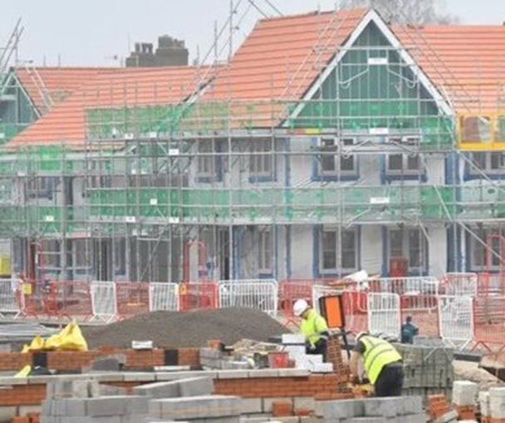
Recycling Construction Waste
100 billion tonnes of raw materials are taken from the earth every year, 40% of which are used in construction and the built environment. the construction industry is responsible for roughly 1/3 of the total global waste.

Slide 14
Modern Methods of Construction

Slide 15
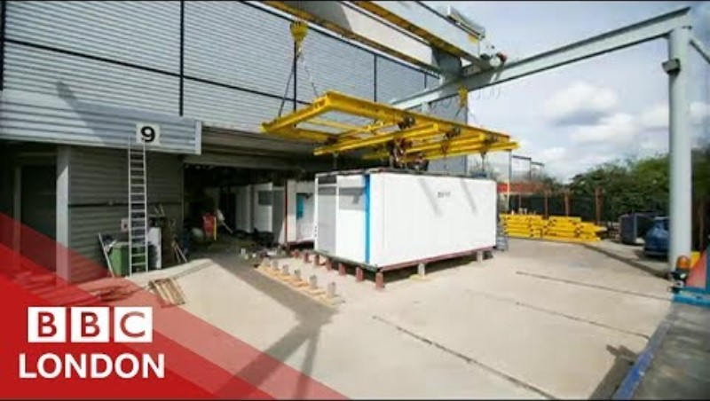
Modern Methods of Construction
Can anyone give an example of MMC?

Slide 16
Discussion
What do you think are the benefits to Modern Methods of Construction?​
What do you think are the downsides to Modern Methods of Construction? Both as a buyer and an employee?​
Would you like to work in MMC?

Slide 17
Retrofit

Slide 18
Domestic Retrofit- Discussion
What is an EPC?​
Why is retrofitting social housing domestic properties a priority to the government?​
What additional skills do you think you would need to work in this type of construction?

Slide 19
Domestic Retrofit – North East
32% of the North East emissions come from domestic sources.
The North East must retrofit our 1.2m homes so that they meet high standards of energy efficiency, and to transition home heating to zero-carbon sources.​
To meet these target new roles have been created and new skills will need to be developed amongst the existing 30,000 construction employees in the North East. ​
Many traditional construction roles will be transitioning into retrofit positions e.g. Project Manager to Retrofit Coordinator, Tenant Liaison Officer to Retrofit Advisor.​
The UK Government has set out 6 retrofit themes which they believe will ensure Retrofit works – Retrofit Planning, Building Fabric, Indoor Air quality, Services, working on site and Engaging residents.

Slide 20


Domestic Retrofit – what does it include?

Slide 21
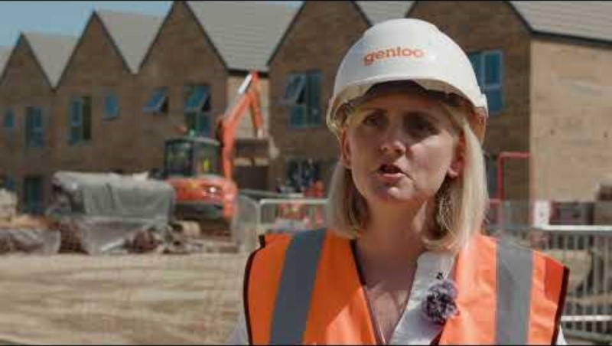
Domestic Retrofit – North East
How is the way people heat their homes changing and why?​
What does this mean for construction in the North East?​
Can you name some of the jobs involved in the RE:GEN and Gentoo developments?​
How are the skills needed in construction changing?​
What might be the benefits of a career in sustainable construction?

Slide 22

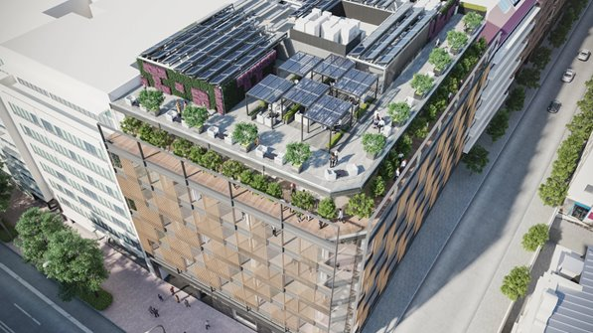
Commercial Retrofit
23% Operational carbon is from non-domestic buildings​
70% of non-domestic buildings were built before 2000 and will need some retrofit​
80% Of office building that exist today will still be used in 2050​
74% Of organisations will pay a premium for leasing a sustainable building

Slide 23


Slide 24
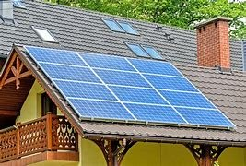
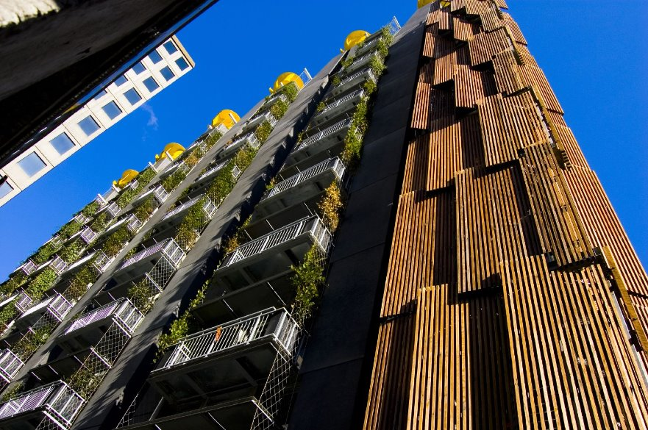

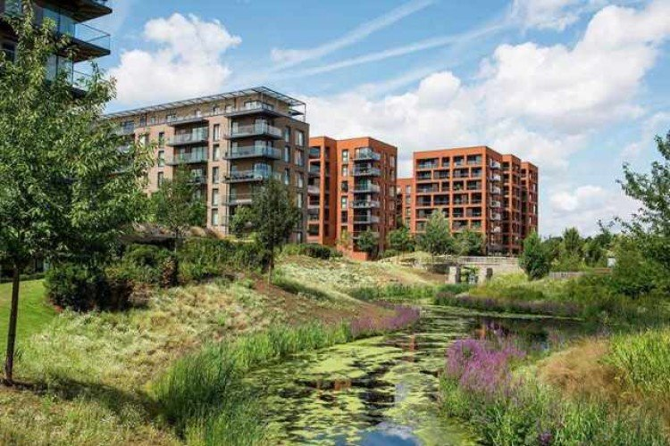
Discussion
Imagine you are an architect and have been commissioned to design a new office building, the client and end user have requested the building be as sustainable as possible.

Slide 25
Career Map
Architecture L6
BA Architecture
Architect £28,000- £60,000
Construction Design and Build Technician L4
HNC Architectural Technology L4
HNC Construction L4
Any Level 3 Course
(A Level’s, T Level, Full time study programme, BTEC Apprenticeship)
Any Level 2 Course
(GCSE’s, Apprenticeship, Full time College Course)

Slide 26
Career Map
Construction Site Management L6
Site Manager - £25,000- £80,000
Construction Site Supervisor L4
HNC Construction & the Built Environment
HNC Construction Management
Any Level 3 Qualification
(T Level, A level, Apprenticeship, Full Time Course
Any Level 2 Qualification
(GCSE’s, Full time course, apprenticeship)

Slide 27
Salary Information by Role
Role | Average Salary
Trades (Various) | £35,000 - £60,000
Corporate Social Responsibility Coordinator | £23,000 - £47,000
BIM Coordinator | £24,000 - £50,000
Domestic Energy Assessor | £24,000 - £56,000
Sustainability Manager | £28,000 - £80,000
Sustainable Drainage Engineer | £23,000 - £51,000
Plant Manager | £22,000 - £85,000
Energy Manager | £25,000 - £85,000
Site Manager/ Retrofit Coordinator | £25,000 - £80,000
Building Surveyor | £25,000 - £70,000
Civil Engineer | £30,000 - £60,000
Quantity Surveyor | £25,500 - £90,000
Project Director | £45,000- £145,000

Slide 28
Skills Employers Want

Slide 29
North East Future Skills
Ambition​
Innovation ​
Resilience ​
Communication ​
Integrity​
Professionalism​
Leadership​
Analytical Skills
Do you understand these terms?​
​
Why do you think they are important to employers?​
​
​
How do you think you could demonstrate these skills?

Slide 30
Thank you

