Slide 1
Sustainability and Careers

Slide 2
5 minute Discussion
Can anyone give an example of how climate change is impacting our region now?
What impacts might we expect to see if we don’t address climate change?
Are you concerned about climate change?
Do you think Climate change will impact on the jobs available to you?

Slide 3
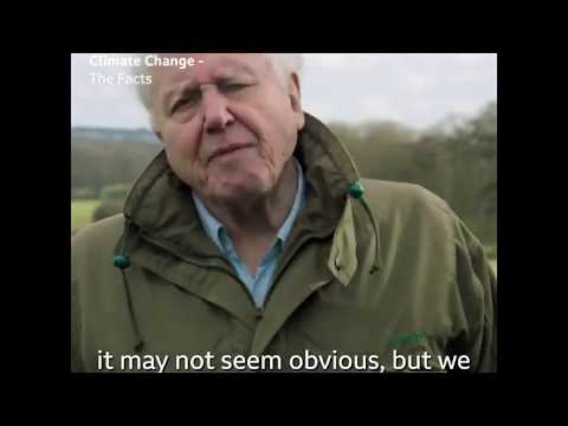
Climate Change

Slide 4
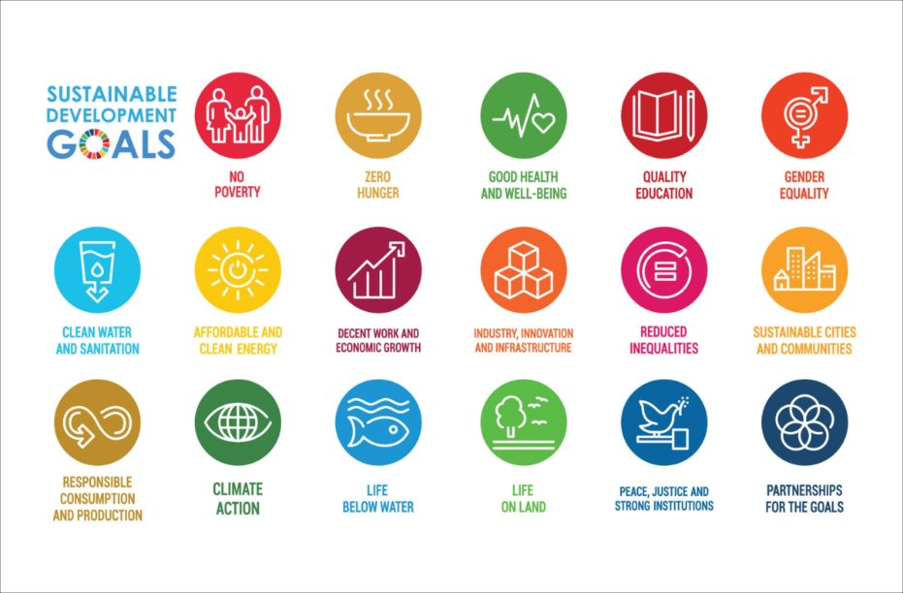
United Nations Sustainability Development Goals

Slide 5
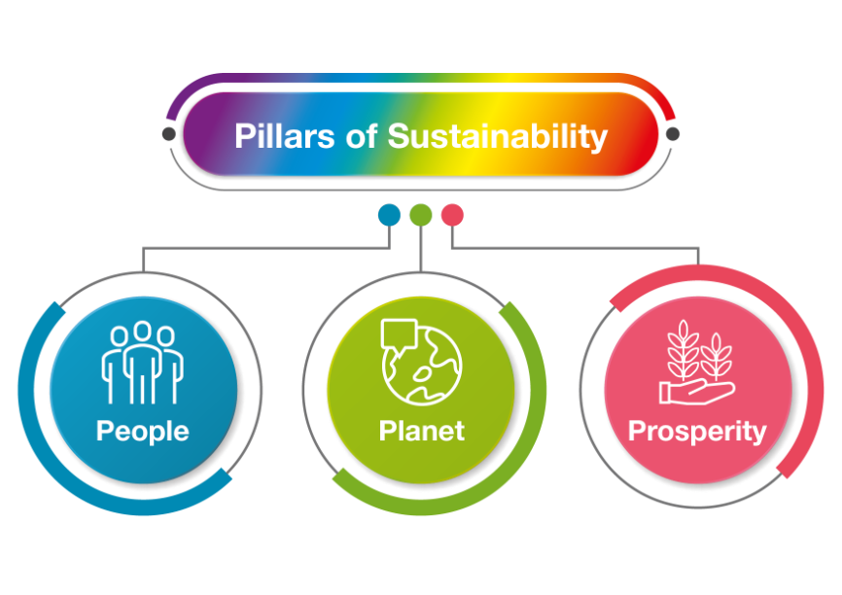
3 Pillars of sustainability

Slide 6
Construction and Sustainability

Slide 7
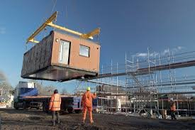
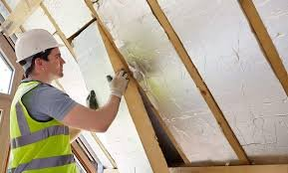
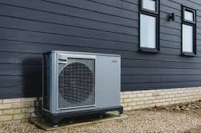
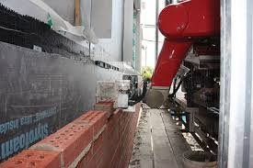

Construction and Sustainability
36,000* people working in the construction sector in the NE ​
​
20,700 Vacancies in the sector between 2020 and 2035

Slide 8
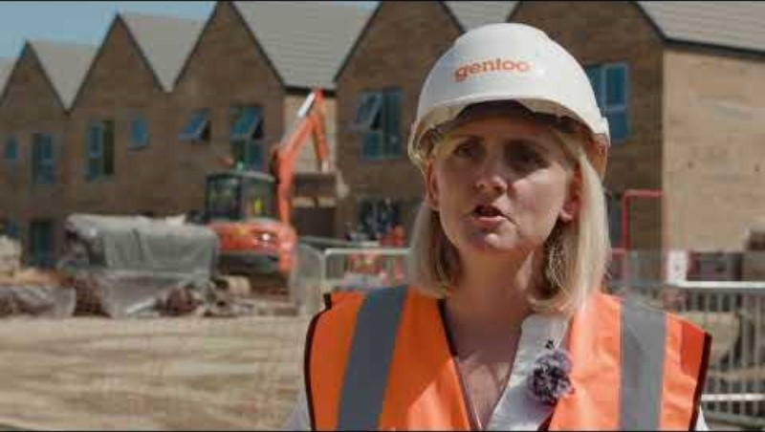
Careers in Green Construction
How is the way people heat their homes changing and why?​​
What does this mean for construction in the North East?​​
Can you name some of the jobs involved in the RE:GEN and Gentoo developments?​​
How are the skills needed in construction changing?​​
What might be the benefits of a career in sustainable construction?

Slide 9
Sustainability and Advanced Manufacturing

Slide 10
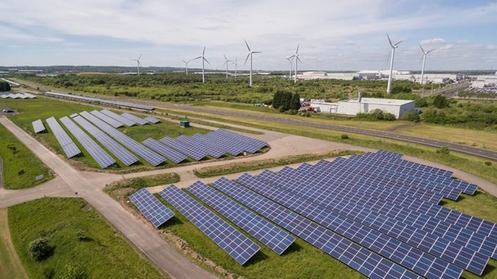
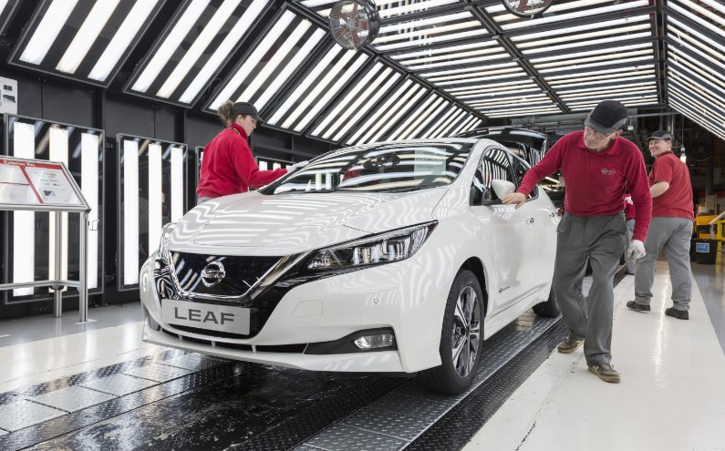
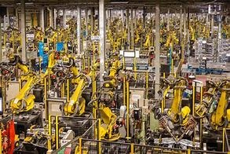
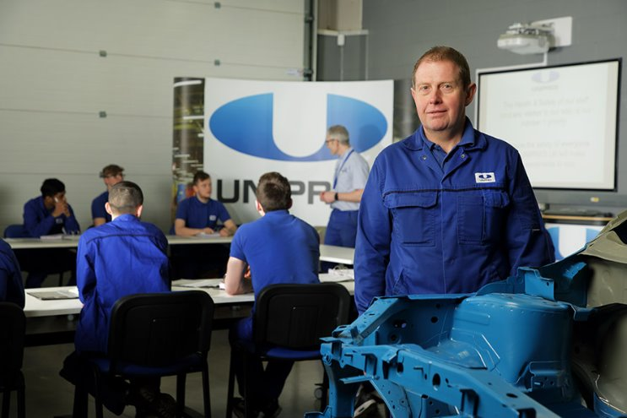
Sustainability in Advanced Manufacturing
67,000 people in the North East currently work in Advanced Manufacturing ​
​
31,200 Vacancies between 2020 and 2035

Slide 11
North East Energy Innovation

Slide 12
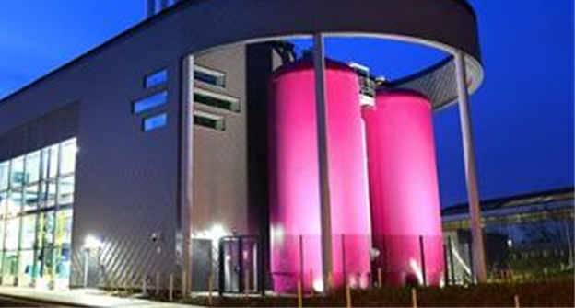
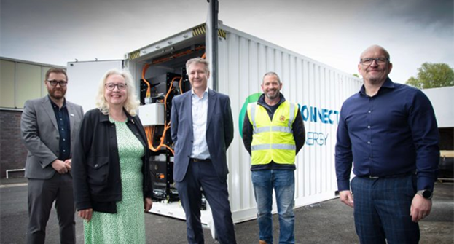
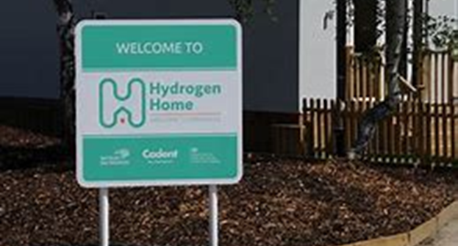
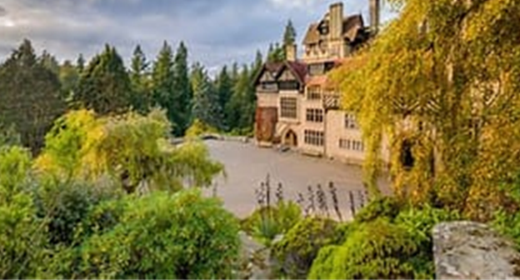

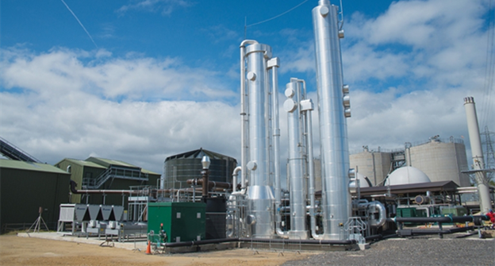
North East: Energy Innovation
North East Energy Innovation

Slide 13
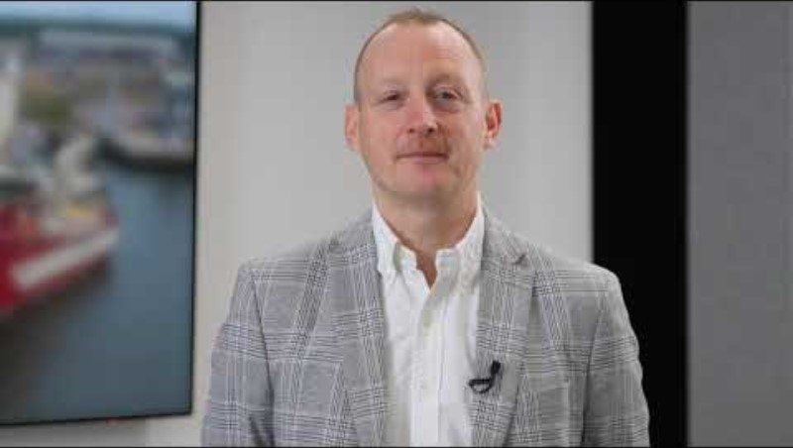
Dogger Bank Wind Farm
Home many homes will Dogger Bank power? ​
How big are the blades on the Wind Turbines? ​
How long does it take to sail to Dogger Bank?​
How do the Turbines connect to land?​
What facilities are on the vessels? ​
What is the lifetime of the Dogger Bank windfarm?

Slide 14
Skills Employers Want

Slide 15
North East Future Skills
Ambition
Innovation
Resilience
Communication
Integrity
Professionalism
Leadership
Analytical Skills
Do you understand these terms?
Why do you think they are important to employers?
How do you think you could demonstrate these skills?

Slide 16
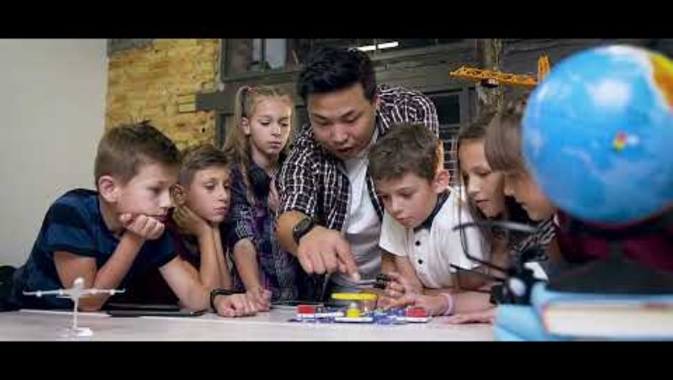
NetZero North East
Celebration Video

Slide 17
Thank You

