Slide 1
NE Energy Innovation

Slide 2
Session Agenda
Renewable Energy & Non-Renewable Energy
Offshore Wind
District Heat
The Skills Employers want

Slide 3
Presenter Introduction

Slide 4
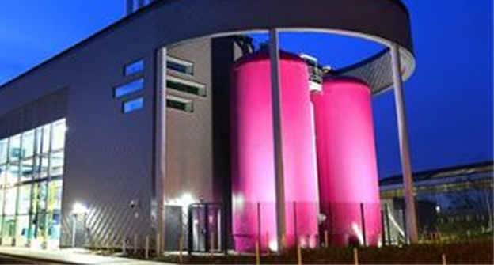
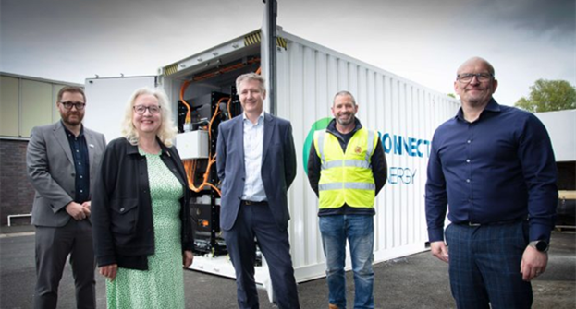

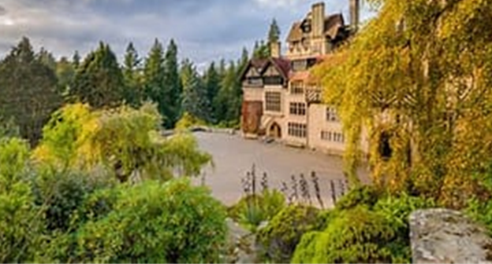

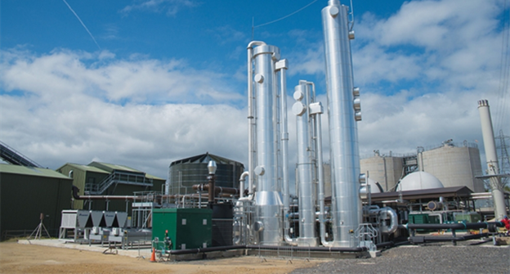
North East: Energy Innovation

Slide 5

Energy
Non- Renewable
Oil
Gas
Coal
Renewable
Wind
Geothermal
Tidal
Hydrogen
Nuclear*

Slide 6

Offshore Wind
Watch the video and answer the questions below
What is the offshore energy and subsea technology sector and why is it important to the North East?
Why does offshore wind offer a huge opportunity for the North East?
What are the strengths of the offshore energy and subsea sector in the North East
What does the future hold for the offshore energy and subsea sector in the North East?
What might be the benefits of a career in the industry?

Slide 7
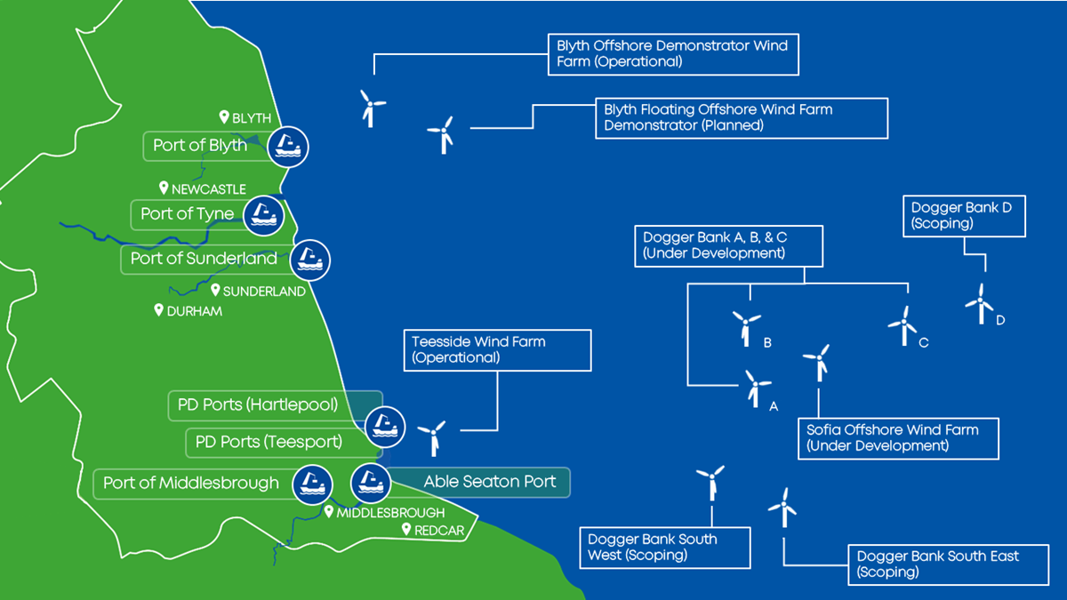

Slide 8
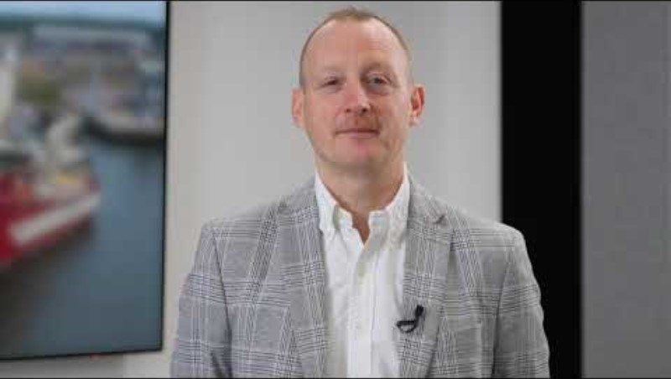
Dogger Bank
Home many homes will Dogger Bank power?
How big are the blades on the Wind Turbines?
How long does it take to sail to Dogger Bank?
How do the Turbines connect to land?
What facilities are on the vessels?
What is the lifetime of the Dogger Bank windfarm?

Slide 9
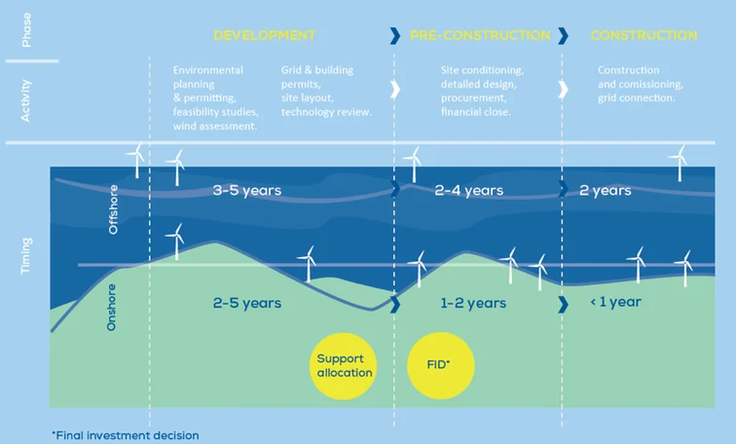

Slide 10
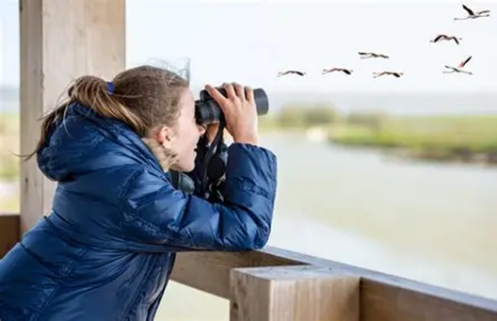
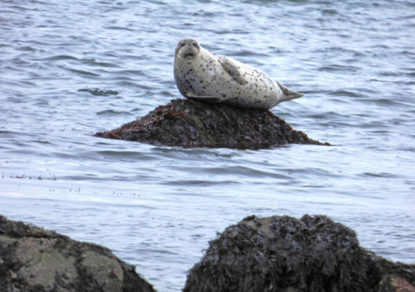
What is environmental consenting?

Slide 11
Jobs in Offshore Wind
Offshore
Wind Turbine Technician
Vessel Operative
Vessel Manager
Operations and Maintenance
Security
Business Administration
Procurement
Human Resources
Health and Safety
Accounts and Finance
Warehousing and Logistics
Development
Environmental Consenting
Construction
Project Manager
Manufacturing
Welding
Production Manager
Community Investment & Social Value

Slide 12
District Heat/ Geothermal

Slide 13

District Heat
Watch the video and answer the following questions:
What is district heat?
How many homes are above coal mines in the UK?
What are the benefits of district heat?

Slide 14
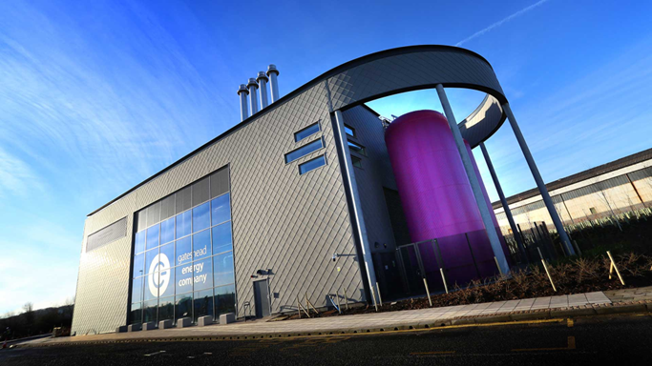
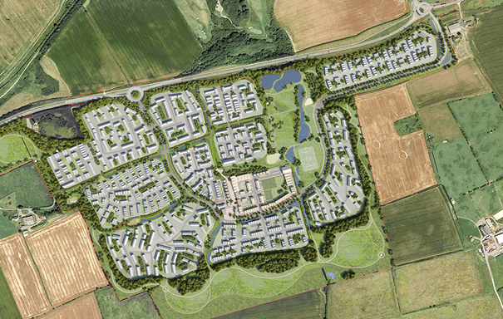
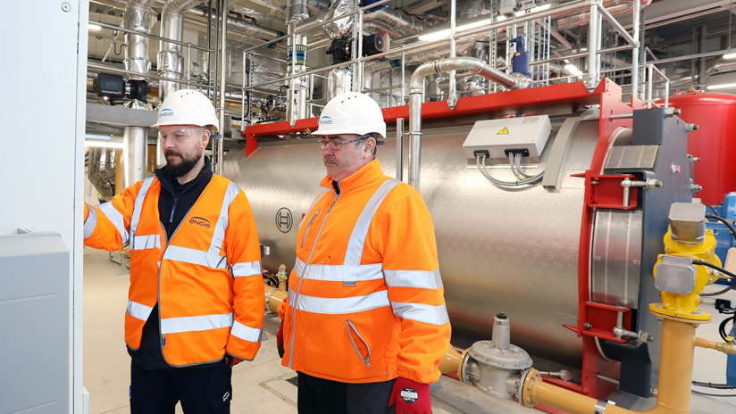
District Heat Scheme

Slide 15
Skills Employers Want

Slide 16
North East Future Skills
Ambition
Innovation
Resilience
Communication
Integrity
Professionalism
Leadership
Analytical Skills
Do you understand these terms?
Why do you think they are important to employers?
How do you think you could demonstrate these skills?

Slide 17

NetZero North East Celebration Video

Slide 18
Thank You

