Slide 1
Dogger Bank
Overview Presentation

Slide 2
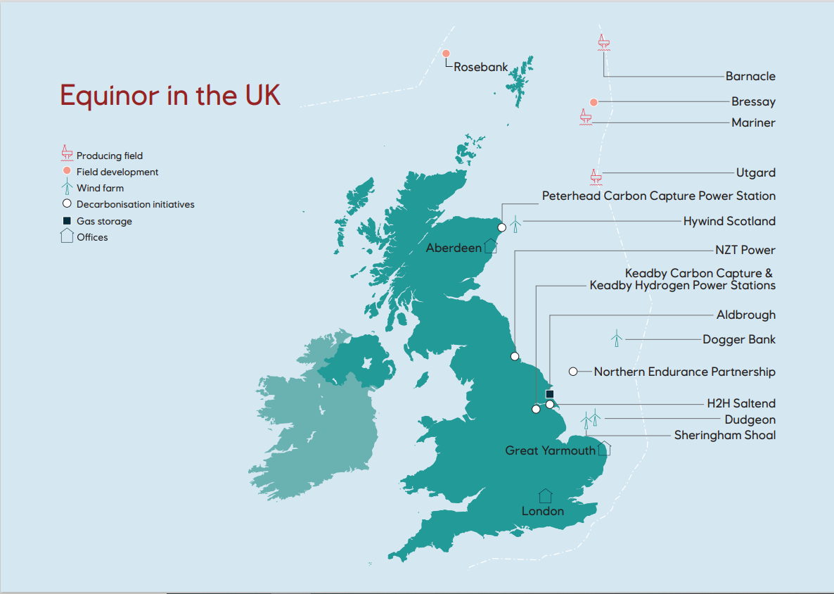

Equinor in the UK: a broad energy portfolio

Slide 3
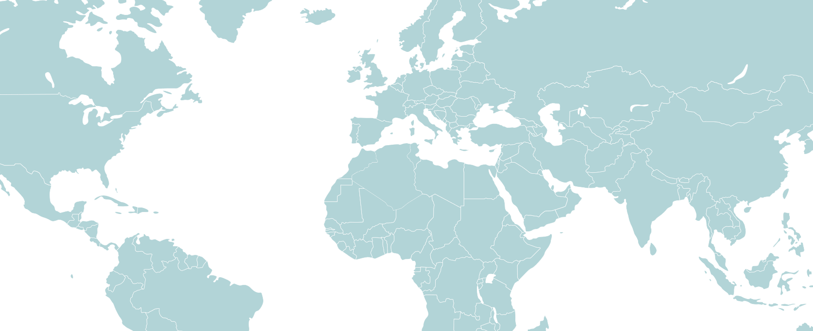
Creating value from scale in regional clusters
BALTIC SEA
Poland
(Baltyk I,II,III)
~2.5 GW
Arkona, Germany
385 MW
US EAST COAST
NORTH SEA
Dogger Bank
3.6 GW
Sheringham Shoal 317 MW
Asia: future growth
China, Japan, South Korea
Empire Wind I 816 MW
Beacon
Wind I, II
> 2 GW
Empire Wind II 1200 MW
Hywind Tampen 88 MW
Dudgeon
402 MW
UK Extensions
720 MW
Hywind Scotland
30 MW
Offshore wind clusters
based on existing assets
Pipeline
Producing

Slide 4
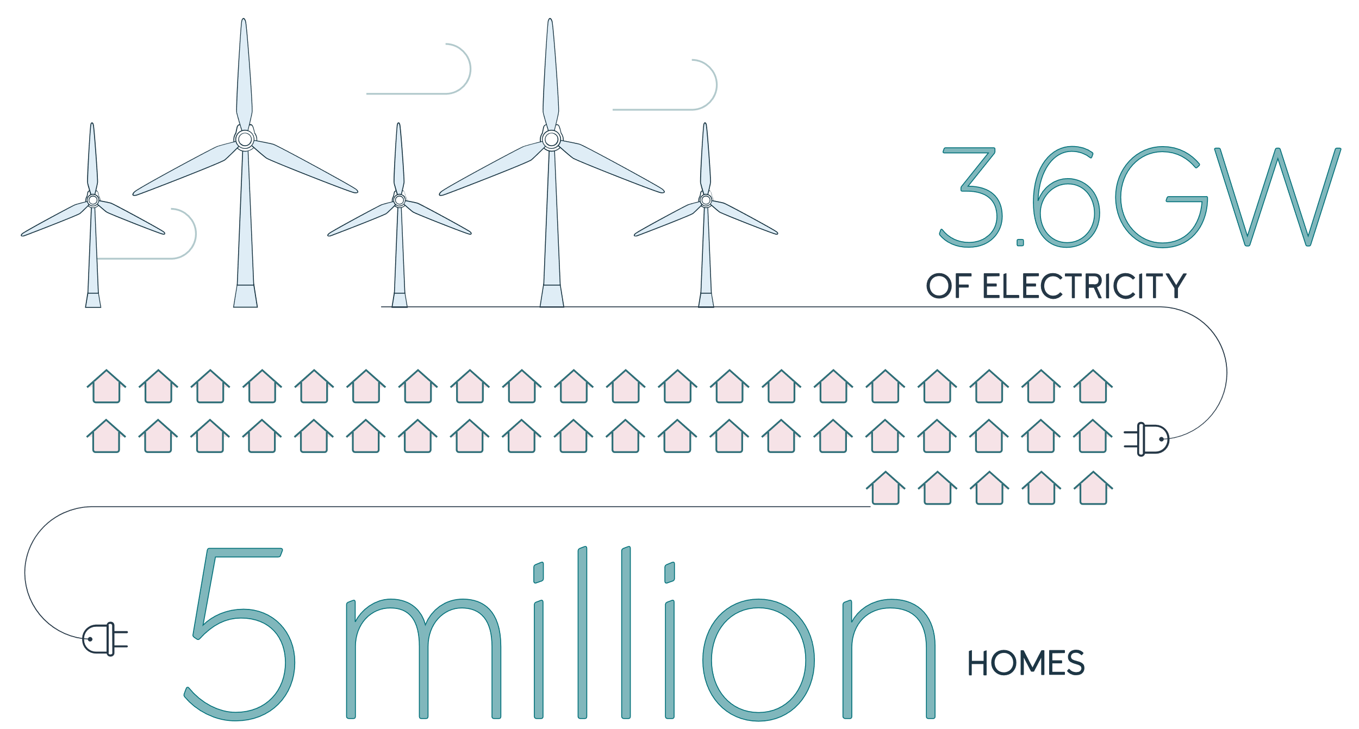


Dogger Bank
If you’ve heard of Dogger Bank, a large sandbank around 130 km off the North East coast of England, it’s quite likely to have been as part of the shipping forecast on the radio.
But soon, it will be home to the world’s largest offshore wind farm, capable of producing a whopping 3.6GW of electricity, enough to power 5 million homes, or about 5 per cent of total UK demand.
This content was paid for and produced by Equinor in collaboration with the commercial department of the Financial Times.
Notes:
Dogger Bank breaks the bounds of what size an offshore wind farm can be. The £9bn wind farm will have a lifetime of up to 35 years and is operated by Equinor.
The project is a joint venture between Equinor (40%), SSE Renewables (40%) and Eni (20%).

Slide 5

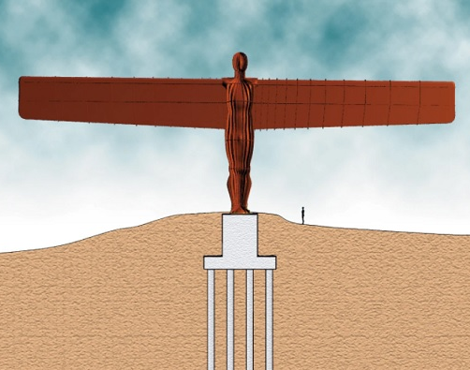
Each turbine blade is 107m long…twice the wingspan of the Angel of the North
Source: doggerbank.com

Slide 6
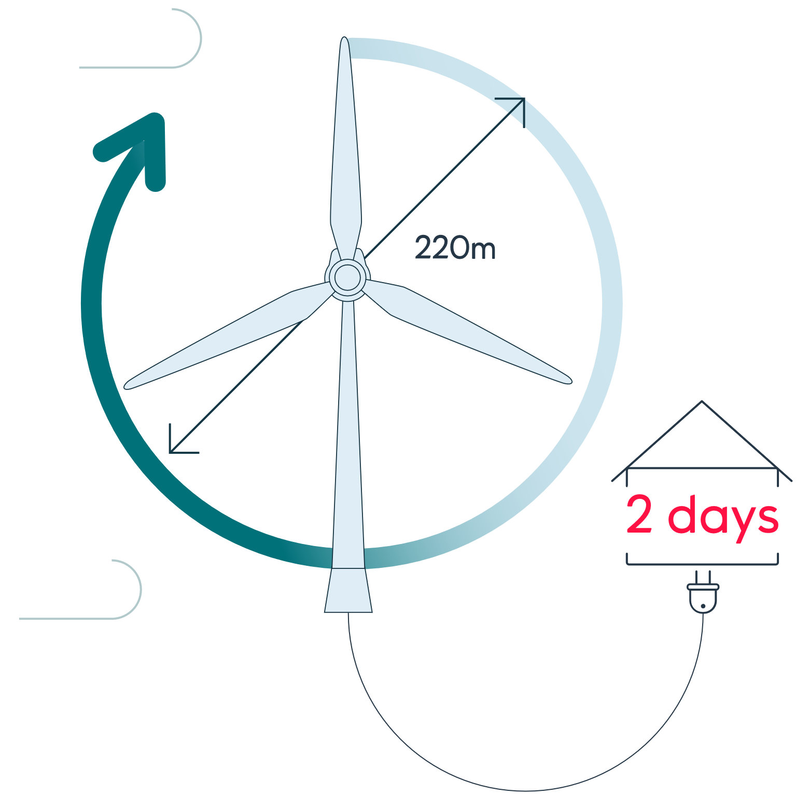
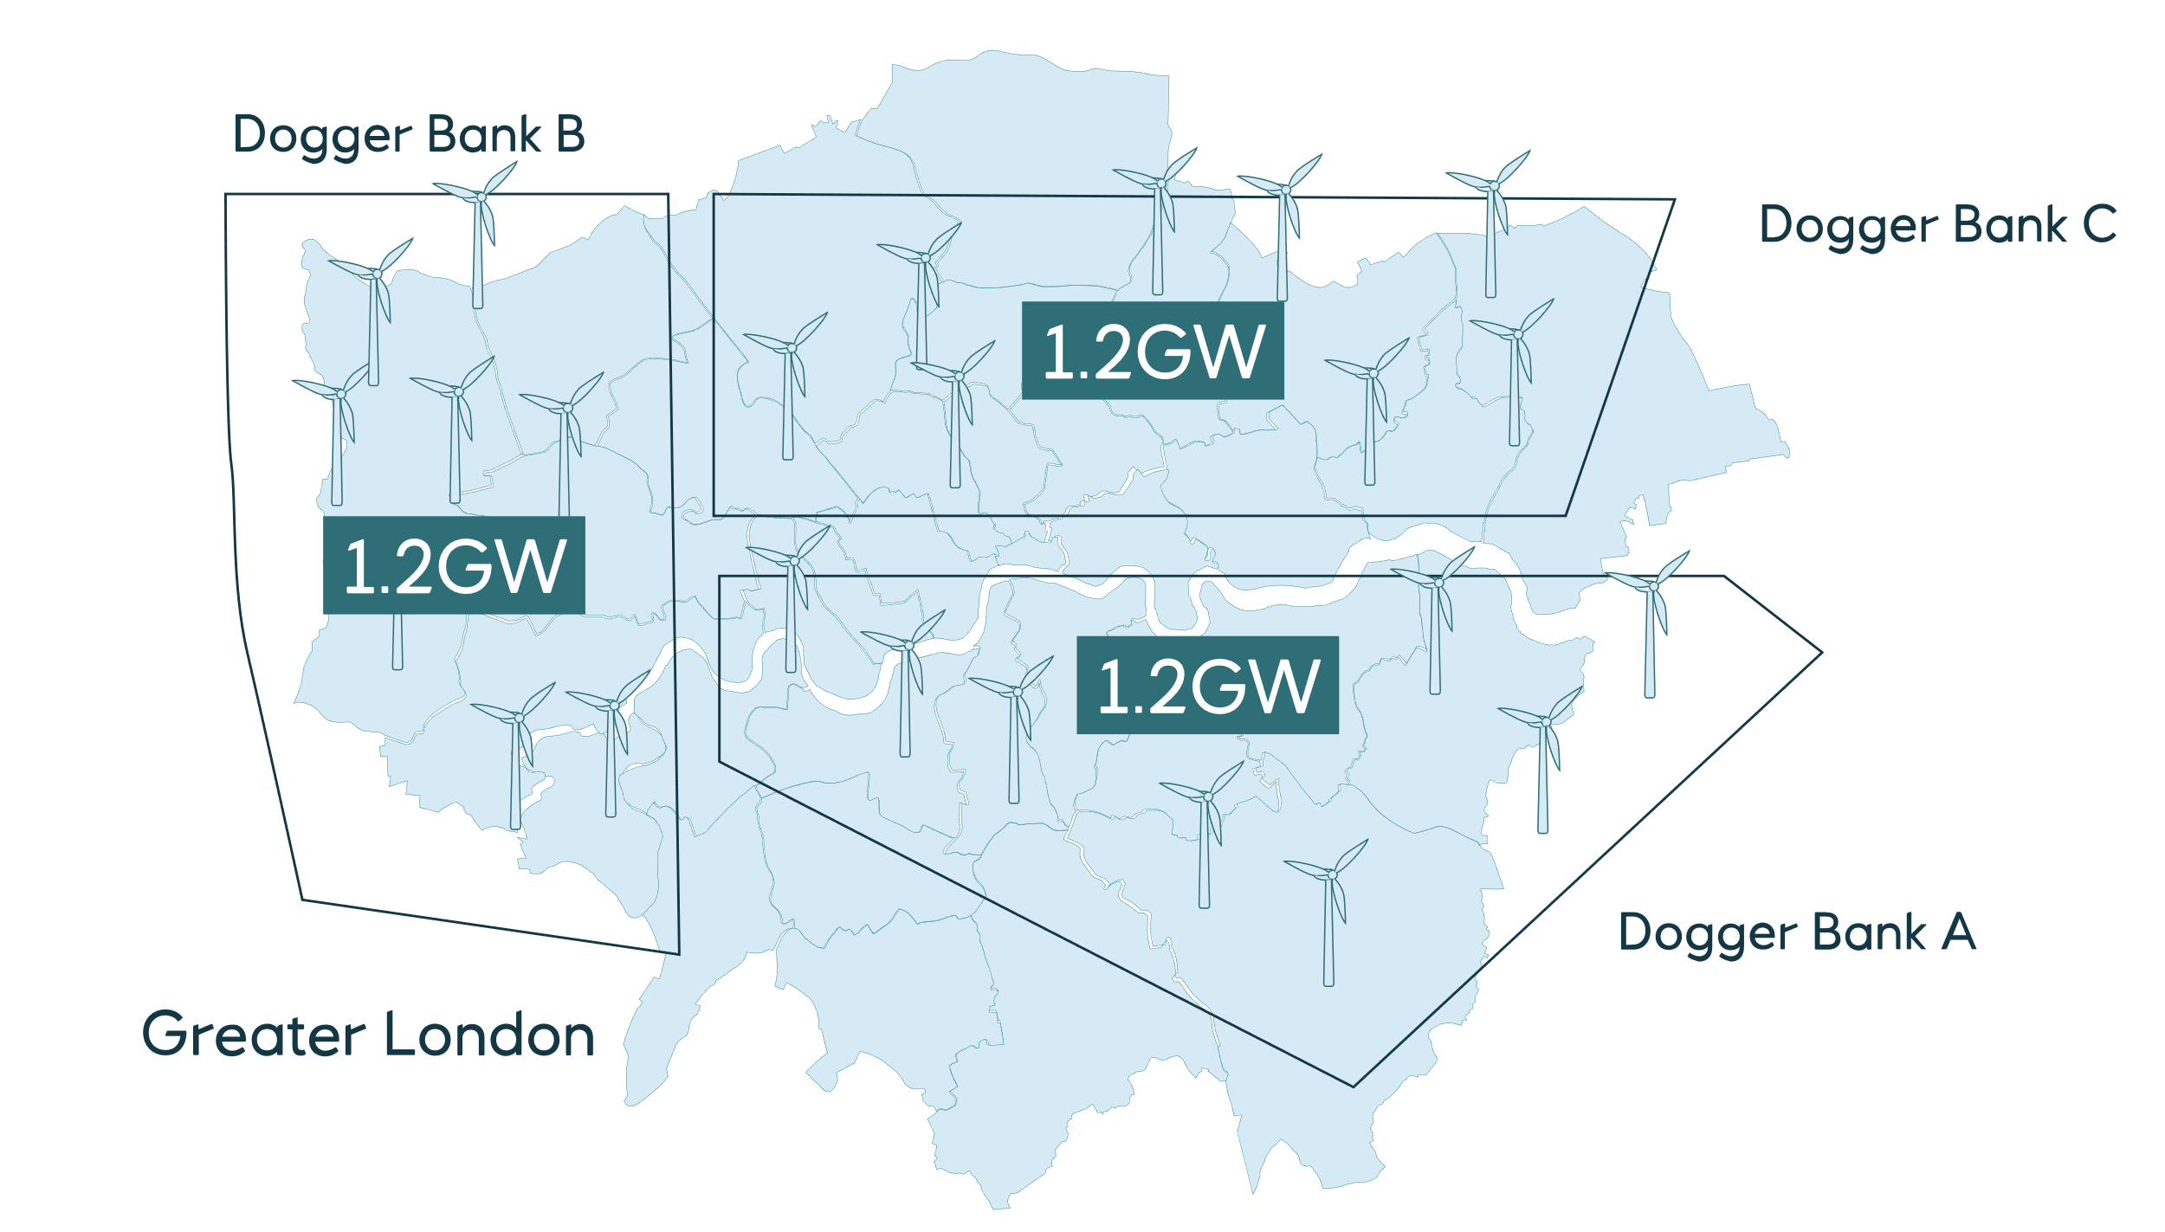
A project of scale…
The 1,700 km² project, covering an area larger than Greater London, is set to make a significant contribution to the UK economy – thousands of jobs are being created during the construction phase and more than 200 people will eventually operate the wind farm from the Port of Tyne.
13MW & 14MW turbines
A single sweep of their 220-metre rotors will produce enough electricity to power the average UK home for two days
This content was paid for and produced by Equinor in collaboration with the commercial department of the Financial Times.

Slide 7
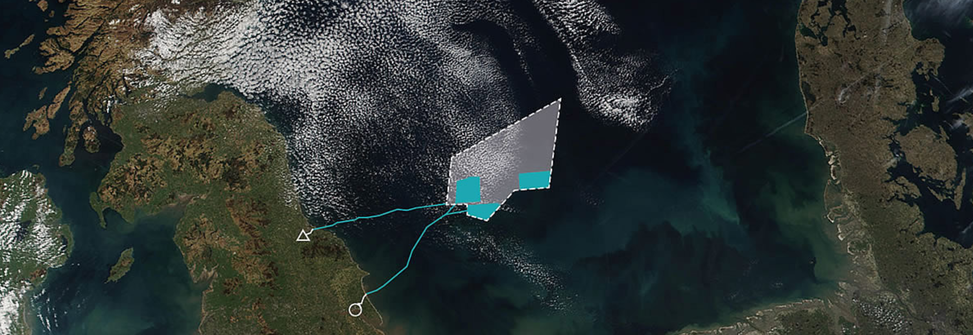
Connecting the world’s largest offshore wind farm to shore
3 phases, each comprising 1.2GW installed capacity
  DBA (previously Creyke Beck A)
  DBB (previously Creyke Beck B)
  DBC (previously Teesside A)
Awarded lowest ever CfDs averaging £40.96/MWh for these projects
DBA/DBB will connect in to the existing Creyke Beck substation near Cottingham in the East Riding of Yorkshire.
DBC will connect at the existing Lackenby Substation at Teesside
B
C
A
Teesside
East Riding of Yorkshire
Source: doggerbank.com
Notes:
First power generation 2023
Expected to cover 5% of UK’s electricity generation

Slide 8
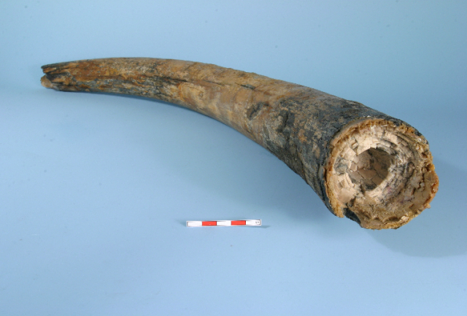
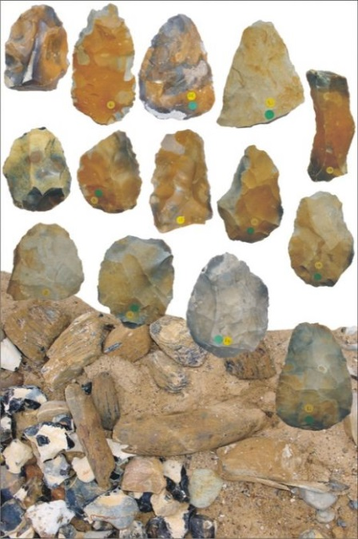
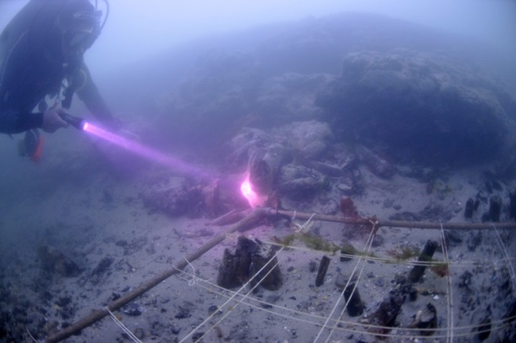
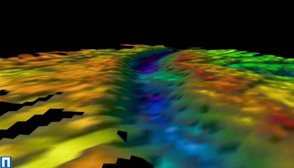
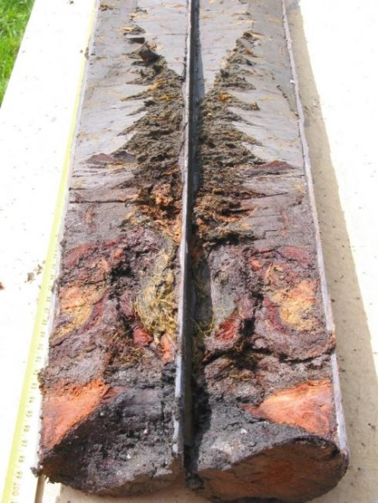
Seabed Prehistory Examples (offshore prehistory sites are very rare)
Mammouth Tusks (dredged 100km from River Humber)
Paleo-environment and paleo-landscapes, archaeological assessment of marine geophysical and geotechnical survey to try and identify where people might have lived.
88 flint tools includes hand axes, flakes and cores and was found with the remains of mammoth, rhinoceros, bison, reindeer and horse.
*Images from Wessex Archaeology
Notes:
Offshore prehistoric sites are rare
Other notes:
Bouldnor Cliff, submerged 8,000 year old Mesolithic settlement eleven metres below the surface and approximately 250 metres offshore of Bouldnor, near Yarmouth on the Isle of Wight. Worked timer, flints, oldest known piece of string,
Artefacts, e.g. fishing nets or marine aggregates
Image of Bouldnor Cliff from https://maritimearchaeologytrust.org/projects-research/bouldnor-cliff/
All other images from Wessex Archaeology

Slide 9
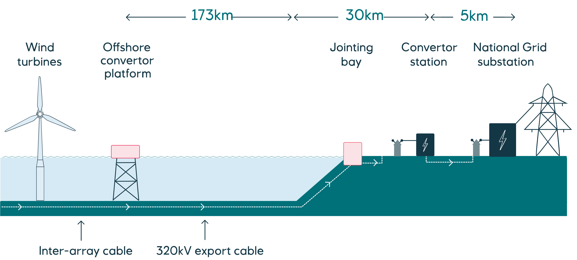
How power from Dogger Bank will be transmitted to the National Grid
This content was paid for and produced by Equinor in collaboration with the commercial department of the Financial Times.
Notes:
HVDC

Slide 10













Supply Chain
HVDC
This content was paid for and produced by Equinor in collaboration with the commercial department of the Financial Times.

Slide 11
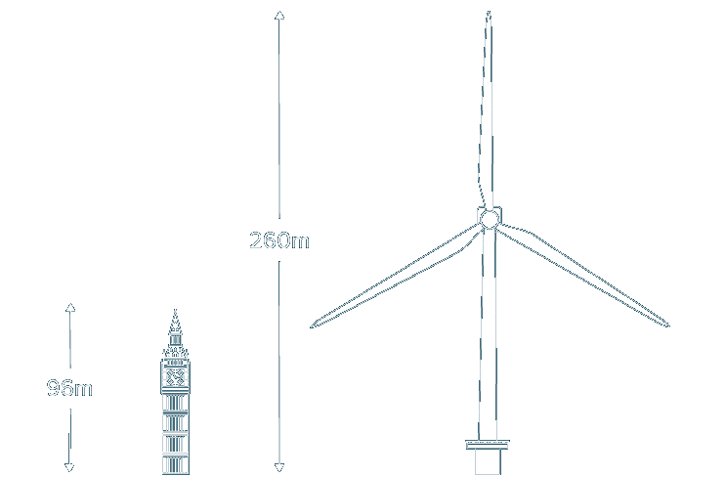
A flagship for Innovation
The world’s most powerful turbines certified to date
Innovative foundation design
World-leading installation vessels
First ever HVDC-connected wind farm in the UK
The world’s first unmanned HVDC offshore substation
Dogger Bank will be a flagship for digitalisation.
…installed by the largest turbine installation vessel of its kind, the Voltaire, currently under construction by Jan De Nul
Translating Equinor’s success in digitalisation in O&G to Offshore Wind…
C
…through process digitalisation, data science and analytics, robotics and remote control
First project in the world to use GE’s 13MW & 14MW Haliade-X
Using an HVDC system, a UK offshore wind first
At their highest point above sea level, Dogger Bank Wind Farm's turbines are more than two and a half times as tall as Big Ben
Source: doggerbank.com
Notes:
It will use the latest turbine technology, GE’s Haliade-X – the most powerful turbines certified to date, and be the first project in the world to install both the 13MW and 14MW models
Using the latest technology enabled us to reach record-low CfD prices for the project in 2019 – the lowest ever seen for a UK offshore wind farm
Whilst enabling cost reduction, bigger and heavier turbines have also meant innovative foundation design, and world-leading vessels are needed to install them
Due to the distance from shore, it will be the first ever HVDC-connected wind farm in the UK, using our decades of offshore expertise to open up new methods of transmission, and innovating to reduce costs
Revolutionary platform design, the world’s first unmanned HVDC offshore substation. This has led to a 70% reduction in topside weight per MW
Dogger Bank will be a flagship for digitalisation. With access to thousands of data points we can used advanced algorithms to ensure we are operating efficiently

Slide 12
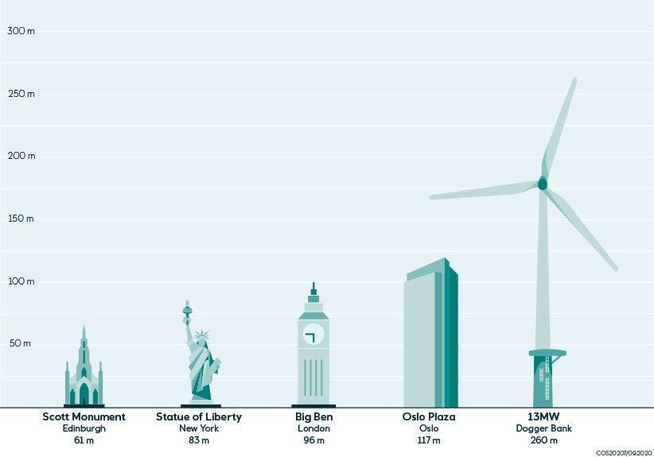
Demonstrating new technology
GE’s Haliade X turbine is so powerful it can power a UK home for over two days, with just one spin!
Increasing turbine power has played a significant role in bringing down the cost of offshore wind
With more electricity generated per turbine, fewer are needed greatly reducing installation time, maintenance needs and overall cost
Dogger Bank will be the first project in the world to use GE’s innovative Haliade X 13MW and 14MW models
With 107m blades, these are the most powerful certified turbines in the world
The swept area they cover is around the size of 4 football fields
The torque (rotational force) that the main shaft, bearings and generator needs to handle is close to 2,5 times the torque of the biggest diesel engine available
Notes:
Fun fact: initial conversations around Dogger Bank ten years ago estimated around 2000 turbines would be needed for the project. Turbine models have increased in power so much, that the project will now use around 15% of that number. This demonstrates the speed of innovation within the industry, and how developers have to bet on technology that doesn’t exist yet when compiling their bids, many years before construction.

Slide 13
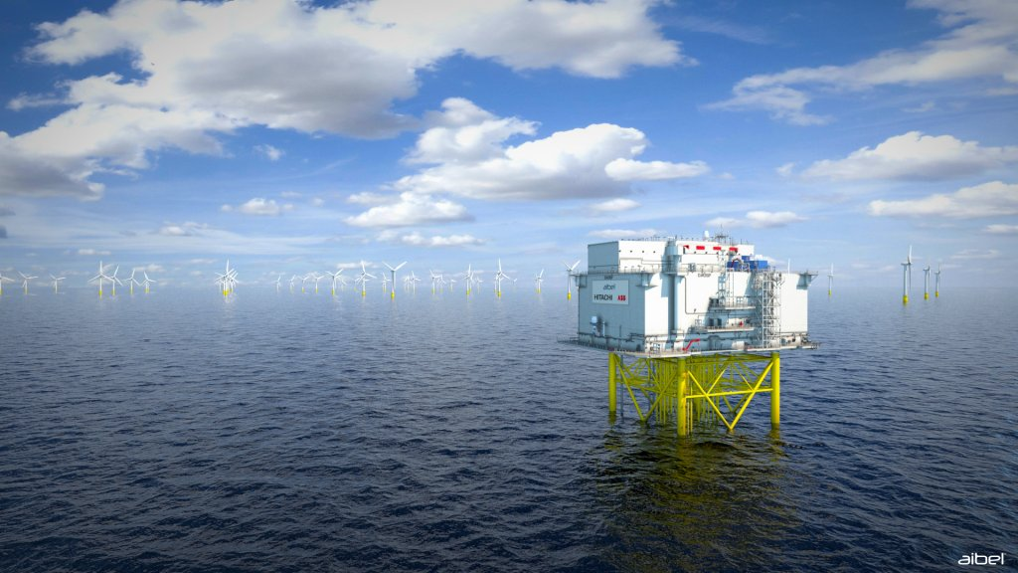
World-first offshore wind innovation
The team behind Dogger Bank are introducing new methods of transmission to the UK
  Using HVDC transmission systems instead of traditional ACDC systems reduces electrical losses.
As well as the first ever HVDC-connected wind farm in the UK, Dogger Bank has revealed a world-first in HVDC platforms
  The topside is forecast to be 70% lighter in weight per MW compared to a conventional platform
  This has saved the project significant additional costs and enabled Dogger Bank to deliver a competitive, low-cost solution
  This revolutionary design can now also be used in subsequent projects, furthering the whole industry
Project will be first UK High Voltage Direct Current (HVDC) connected offshore wind farm
Largest-ever HVDC facility at 1.2GW – major scale up from previous installations of 0.8GW
Close collaboration with supplier to design world-first unmanned HVDC offshore substation
70% reduction in topside weight per MW for offshore platforms

Slide 14


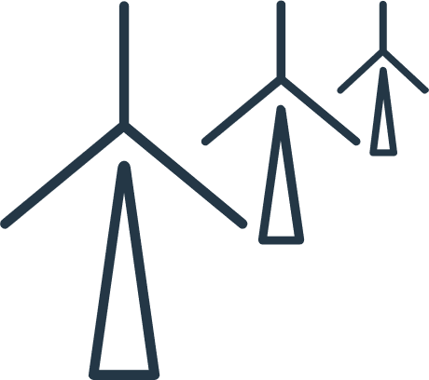

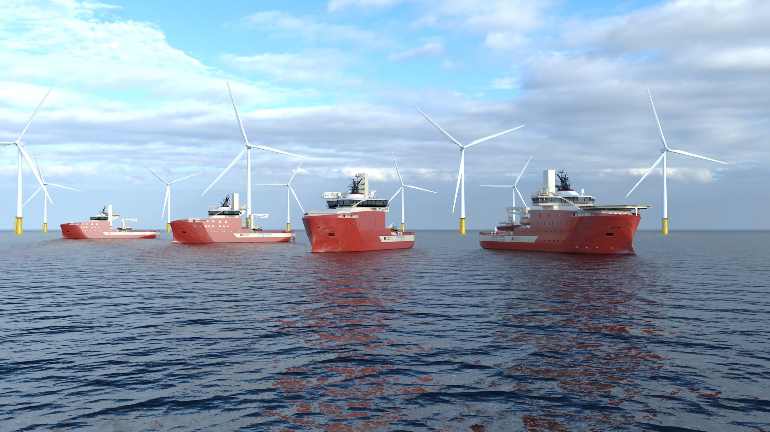


Service Operation Vessels
SOV’s are like floating hotels!
Equipped with recreational and wellbeing facilities
Motion compensated “Walk to Work” gangways
Power from shore when berthed
Batteries help to reduce overall fuel consumption and emissions
UK built Daughter crafts move technicians around the wind farm
North Star Renewables awarded SOV contracts
4 state-of-the-art vessels to be located at Port of Tyne
North Star’s designs are at the leading-edge of operability and sustainability to reduce fuel consumption and emissions.
North Star will create 170 new full-time UK-based jobs in crewing and shore-based roles for the lifetime of the contract.
Transformational contracts position Scottish firm as a major player in offshore wind, from its roots in oil and gas
Notes:
Innovations include low fuel consumption, digital decision support technology, advanced propulsion systems, hybrid power management, a waste heat recovery system, and a new daughter-craft design.
North Star will deliver one SOV to be used for scheduled maintenance at Dogger Bank A, B and C. The vessel is due to be delivered in January 2024.
A further three SOVs will be delivered by North Star to be used for corrective maintenance, at each phase of Dogger Bank.
SOV’s are like floating hotels! They are used as an in-field logistics hub where windfarm technicians will stay for 2 weeks at a time., out at the wind farm itself
SOVs are equipped with recreational and wellbeing facilities such as gyms, cinemas, games rooms and the most important room of all, the canteen!
“Walk to Work” gangways allow technicians to walk directly from the SOV to the turbine. The gangway is motion compensated which means that even in high waves, the gangway is stable.
When alongside the quay, the SOV can take power from shore, reducing idle emissions.
All three Dogger Bank SOVs will be equipped with batteries. Like a hybrid vehicle this will help to reduce overall fuel consumption and therefore emissions, as well as provide emergency power back up
Each SOV is equipped with a daughter craft which will be used to move technicians round the wind farm to more remote turbines. The daughter crafts have been designed with UK based naval architect Chartwell Marine and will also use a hybrid battery system, further reducing emissions.

Slide 15
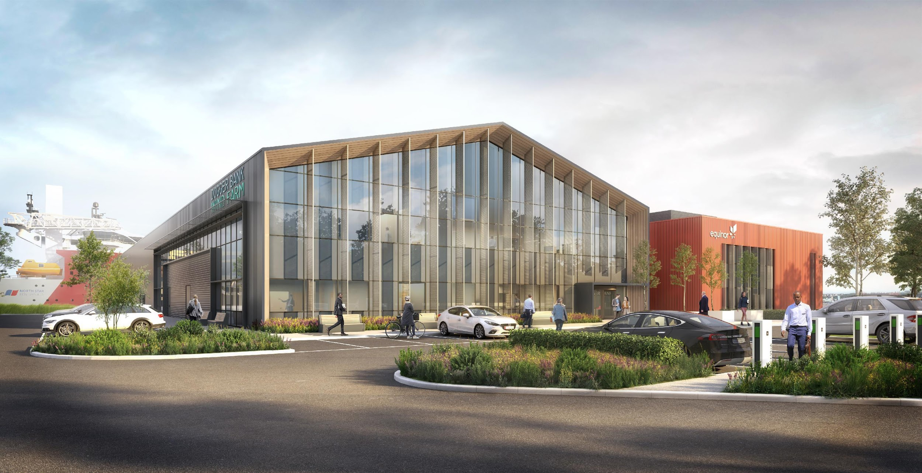
Equinor will operate Dogger Bank from 2023 to beyond 2050
Construction of new O&M facility within the Port of Tyne
  Environmentally friendly and low carbon impact
  Designed to attract talent
  Hub of operational activity throughout the life

Slide 16
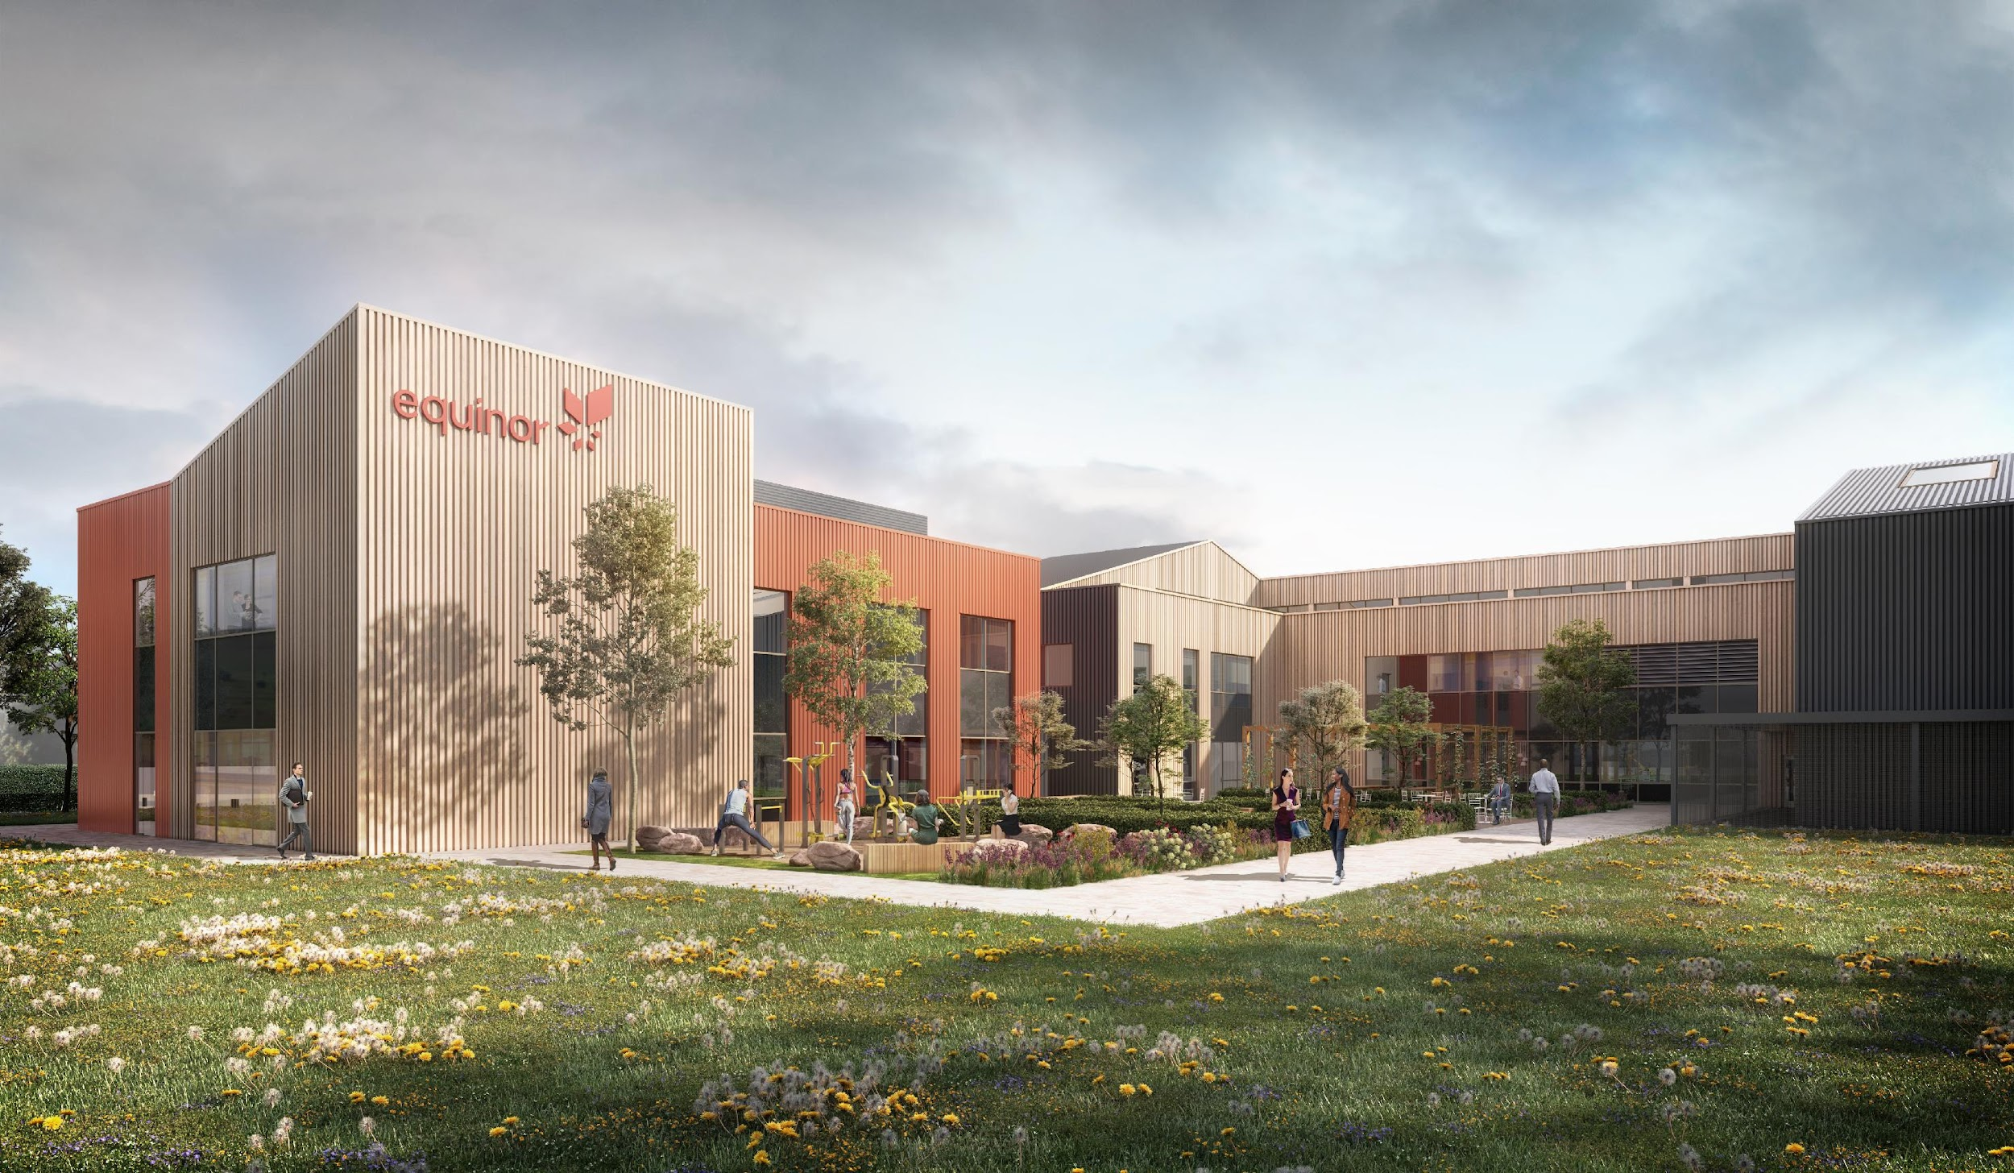




Recruitment
400 long term jobs
Existing skills pool in NE
Apprenticeships
Energy transition
Local recruitment strategy in progress – collaboration with local stakeholders

Slide 17
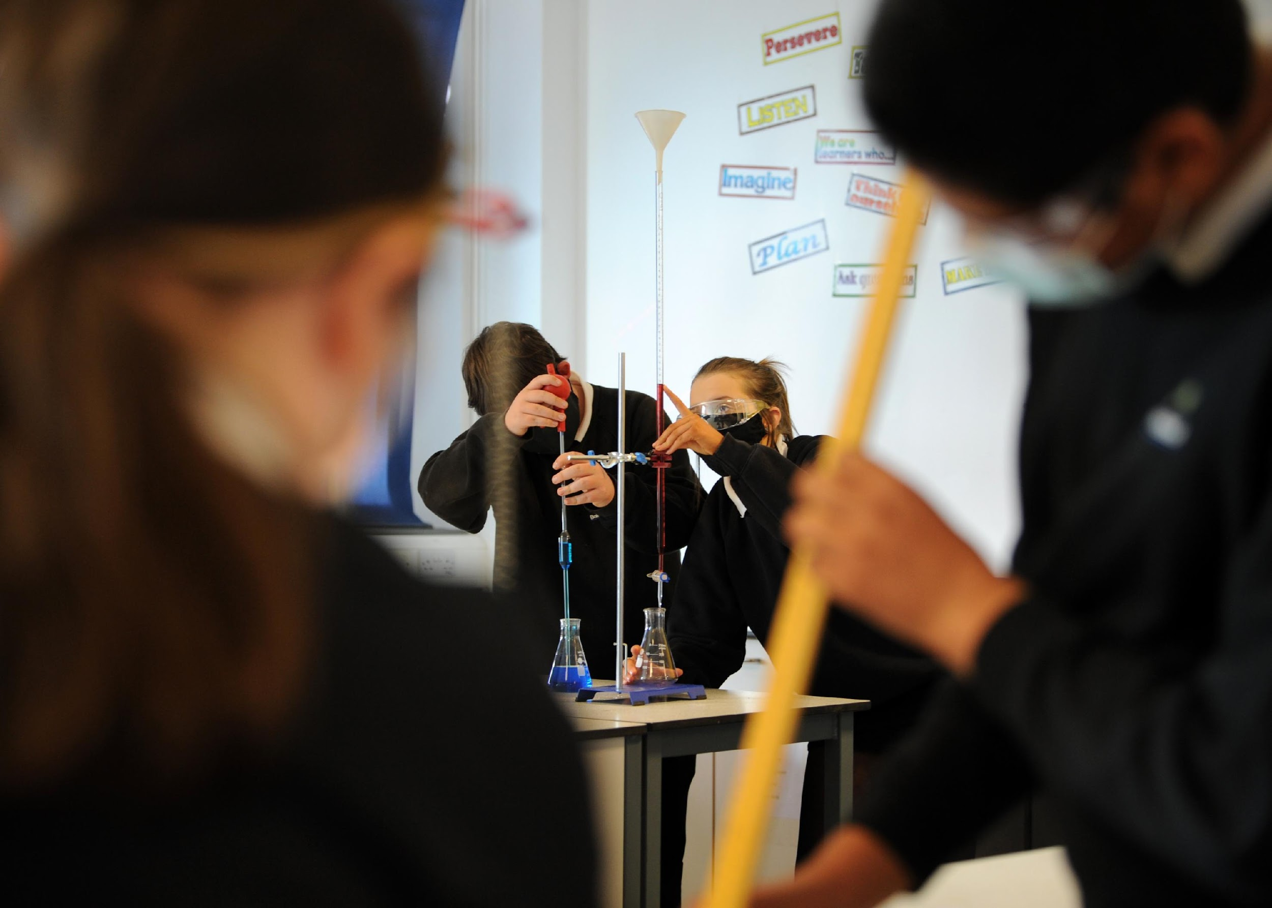

Skills & Community Fund
Community Fund – Dogger Bank
We will invest up to £1m in the construction phase
STEM education / accreditation and scholarships
Operators fund to support local projects up to £1000
Continued funding during operations of the wind farm, up to 35 years
Equinor
Community projects in South Tyneside and the wider Tyne / NE area
Volunteer to support projects in the community and education
Offshore Wind Industry
Equinor will also work with local partners
Support the next generation of workforce equipped for green growth
Notes:
Community Fund – Dogger Bank
With partners SSE & Eni, we will invest up to £1m in the construction phase in STEM education / accreditation and scholarships, with a further estimated £21m fund during operations of the wind farm, up to 35 years
STEM events in schools, O&M base and regional places of interest
South Tyneside, East Riding of Yorkshire and Redcar/Cleveland will all benefit
South Tyneside will focus on secondary school transition based on local feedback
Operator's fund to support local projects up to £500
Equinor
Community projects in South Tyneside and the wider Tyne / NE area
Volunteer to support projects in the community and education
Offshore Wind Industry Needs
Equinor will also work with local partners to help support the next generation of workforce equipped for green growth including offshore renewables

Slide 18
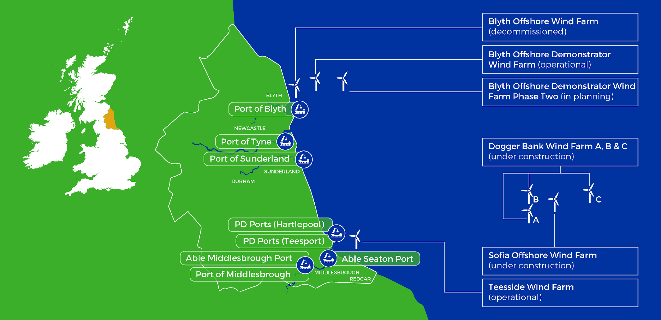

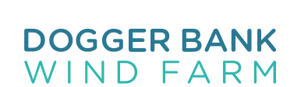


North East England Offshore Wind Cluster

Slide 19
Careers & Skills

Slide 20
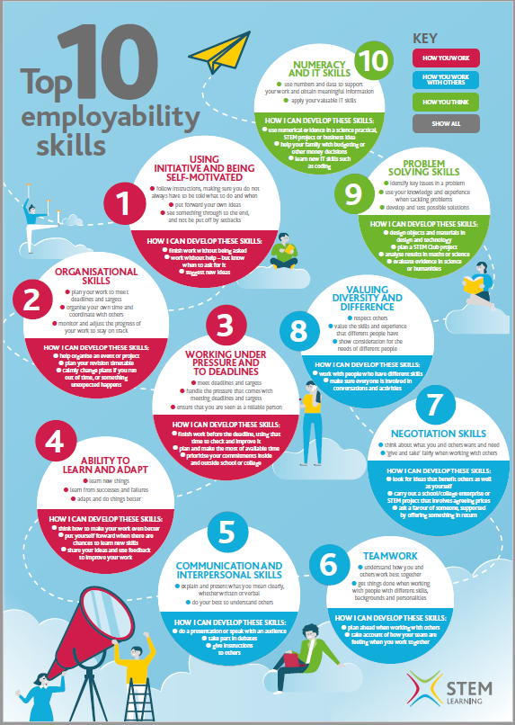
What we say to Young People
Using initiative and being self motivated
Organisational skills
Working under pressure and to deadlines
Ability to learn and adapt
Communication and interpersonal skills
Teamwork
Negotiation skills
Valuing diversity and difference
Problem solving skills
Numeracy and IT skills
Notes:
Write in the chat what top employability skill you think you need
https://www.stem.org.uk/resources/elibrary/resource/418157/top-ten-employability-skills
Where are you good and where could you develop?
Top 4 – How you work
Next 4 – How you work with others
Last 2 – How you think

Slide 21
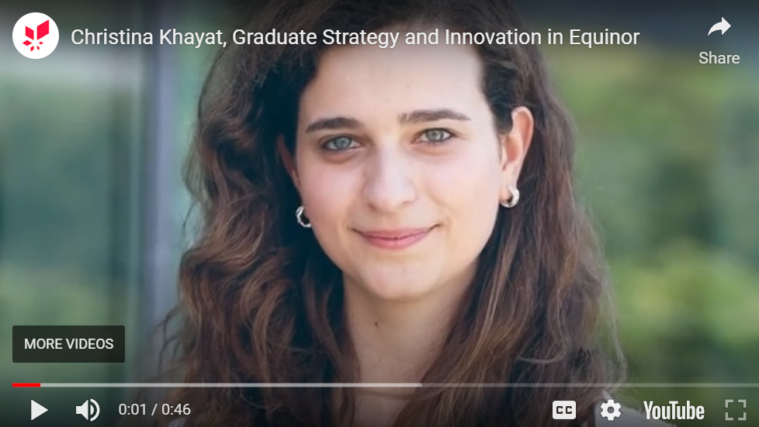
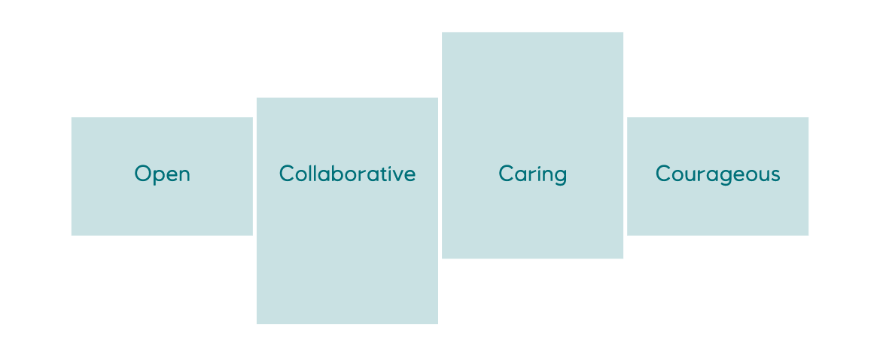

What we say to Young People – find out more about Equinor
Exciting career opportunities in Equinor
Notes:
Often Ask students what the top employability skill is…
https://www.stem.org.uk/resources/elibrary/resource/418157/top-ten-employability-skills
Where are you good and where could you develop?
Top 4 – How you work
Next 4 – How you work with others
Last 2 – How you think
Our values are very important to us and how we work is as important as what we achieve

Slide 22
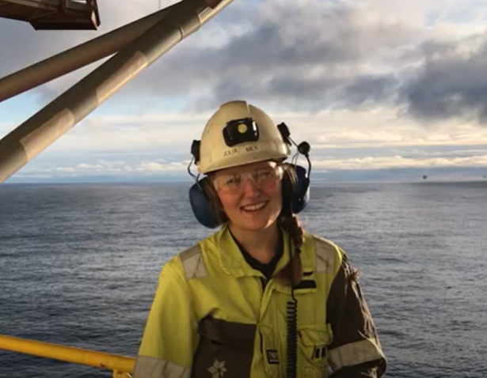
Jobs for the Future - Equinor
Career opportunities in offshore wind development, construction & operation are varied:
Project managers
Graduate project civil engineers
HSE administrators
Data and analytics specialists
Electrical package managers
Wind turbine service technicians
Electrical engineers
Contracts managers
Environmental consent managers
Media and communications officers
Commercial managers, lawyers etc.
Notes:
There are many opportunities for young people with a range of education backgrounds, interests and skills.
Various pathways: apprenticeships, university, college courses
The Offshore Wind Industry Council predicts (2021 report) 69,848 jobs in UK offshore wind, with 6656 of these in the East of England by 2026 – and there will be even more beyond that!
Roles will be within a wide range of disciplines both onshore and offshore.
See Latest OWIC report here: OWIC | Publications

Slide 23

Jobs for the future - Supply Chain
When you add in the supply chain (businesses that contribute to the development of a wind farm) the opportunities are even more diverse;
Ecologists
Archaeologists
Land owner liaison officers
Onshore civil engineers & contractors
Wind turbine designer/manufacturer
Service vessel crew and skippers
Computer graphics designer + GIS
Accommodation providers….HGV drivers
Drone operators
Software designers – AI and ML

Slide 24
Additional Information

Slide 25
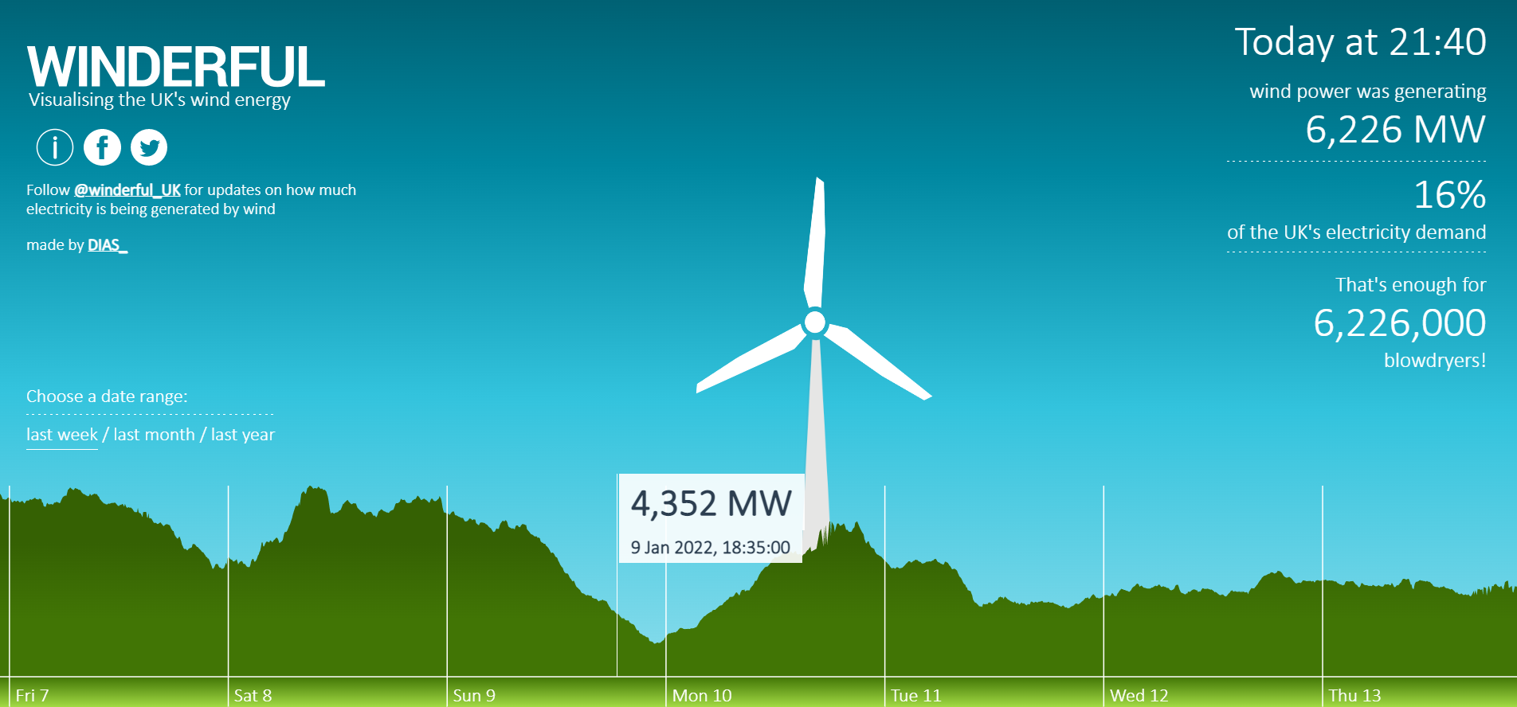
https://winderful.uk

Slide 26
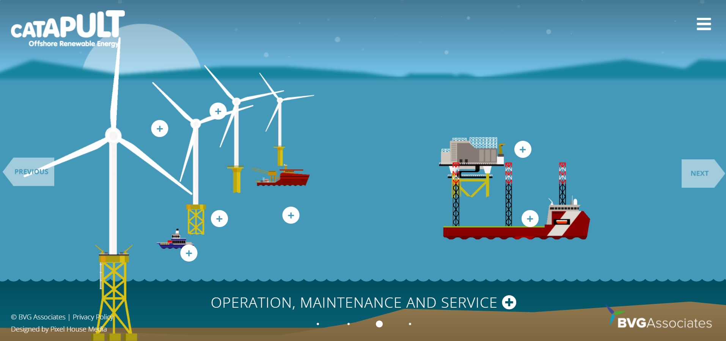
Guide to an offshore windfarm

Slide 27
Dogger Bank
Overview Presentation

