Slide 1
Careers in the North East health and life sciences sector
Pharmaceutical manufacturing
Notes:
Please read accompanying teacher guide before delivering these lesson resources

Slide 2
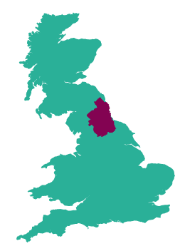




The health and life sciences sector in the North East
Health and life sciences is a sector of strategic importance to the North-East economy, due to our exceptional health and life science assets and strengths in medicines manufacturing.
There are over 5000 people employed in over 250 health and life sciences businesses in our region and this is growing
North East England
is a major centre
for medicines manufacturing with companies across our region making a vital contribution to the supply of essential medicines across the world
Our region is home to a thriving community of innovative life sciences businesses, developing new treatments and technologies to diagnose, prevent; and treat diseases such as cancer and COVID-19
Several world class research and innovation centres are based here in the North East including; the Centre for Life, the Centre for Process and Innovation and the National Innovation Centre for Ageing
Our hospital trusts
have a worldwide reputation for the quality and range of their clinical research and facilities
Notes:
Employment and enterprise figures quoted based upon ONS 20/21 data. The most up to date labour market data available can be accessed via the North East evidence hub
Health and life sciences (northeastlep.co.uk)

Slide 3
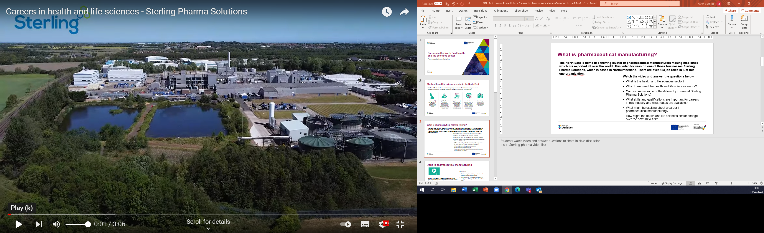
What is pharmaceutical manufacturing?
The North East is home to a thriving cluster of pharmaceutical manufacturers making medicines which are exported all over the world. This video focuses on one of those businesses Sterling Pharma Solutions, which is based in Northumberland. There are over 183 job roles in just this one organisation.
Watch the video and answer the questions below
What is the health and life sciences sector?
Why do we need the health and life sciences sector?
Can you name some of the different job roles at Sterling Pharma Solutions?
What skills and qualifications are important for careers in this industry and what routes are available?
What might be exciting about a career in pharmaceutical manufacturing?
How might the health and life sciences sector change over the next 10 years?
Notes:
Students watch video and answer questions to share in class discussion
https://www.youtube.com/watch?v=wH2O2d28a7c

Slide 4

Jobs in pharmaceutical manufacturing
Questions
Which company do they work for and what does the company do?
What job does the speaker have and what types of things do they do in their role?
What qualifications do you need to get the job?
Which skills are important for the job?
How can you find out more about jobs such as these?
Watch the videos of people working in the pharmaceutical manufacturing industry in the North East and answer the questions
Jess, Manufacturing Chemist
Libby, Chemical Engineer
Joe, Apprentice Process Operator
Connor, Maintenance Technician
Apprenticeships at GSK
Notes:
Students watch videos (teacher can select one which is most relevant to their students if preferred) and answer questions
See accompanying teacher guide for overview of video content
Video links
Jess, Manufacturing Chemist, High Force Research- link to be inserted
Libby, Chemical engineer, CPI (2:01)
https://www.youtube.com/watch?v=i_nBSkR64Z4
Joe apprentice process operator, CPI (2:08)
https://www.youtube.com/watch?v=aZ3GPD_9Iq4&t=60s
Connor Harvey maintenance technician (1:58)
https://www.youtube.com/watch?v=G0GaehIP23M
GSK, apprentices – multiple interviews (3:24)
https://vimeo.com/517149158

Slide 5
Top jobs in North East Health and Life sciences
In 2022 the North East Local Enterprise Partnership conducted research in partnership with pharmaceutical manufacturing and life sciences employers across the region. This research identified skills and job roles in most demand by North East employers in the sector.
This research found a shortage of candidates for the following jobs:
Potential career pathways into these key roles have been mapped out through this research in consultation with North East employers. Find out more here
Analytical Chemist
Process Engineer
Quality Assurance Officer
Software Engineer
Find out more about this role
Find out more about this role
Find out more about this role
Find out more about this role
Lab Technician
Life Sciences Project Manager
Find out more about this role
Find out more about this role
Notes:
Links to similar roles on national careers service website included
Analytical Chemist – this role can also be known as a manufacturing chemist or quality assurance analyst
Process Engineer – this role can also be known as a chemical engineer, bio-engineer or clinical engineer
Quality Assurance Officer – this role can also be known as regulatory affairs manager or qualified person
Software Engineer - this role can also be known as electronics and software engineer, or software developer
Lab Technician – lab technicians are required with a range of technical skills depending on the business, these range from biology based lab techniques, to chemistry, to calibrating specialist equipment (metrology technician)
Life Sciences Project Manager – In addition to general project management skills, this role also requires an understanding of the strict safety regulations which control developing and manufacturing medicines. The employers interviewed reported that the smaller R&D based business preferred candidates with a life sciences background with additional project management skills, while larger pharmaceutical manufacturers looked for qualified project managers who could learn about pharmaceuticals.

Slide 6
What careers are available in pharmaceutical manufacturing?
Here are some examples of jobs which are available in this sector:
Pick one of the jobs listed and research the following:
What is the job, what types of things would you do in the role?
How many hours would you work a week? Is it a typical 9-5 or varied hours? Can you work part-time or freelance?
What qualifications do you need to get the job?
What is the starting salary?
What jobs could you progress to in the future?
Can you find any local companies currently advertising this job role?
Analytical Chemist
Process Engineer
Quality Assurance Manager
Production and Maintenance Technician
Research and Development Chemist
Product Manager
Automation Project Engineer
Production Supervisor
Biopharmaceutical Scientist
Commercial Account Manager
Production Operator
LIMS Developer
Human Resources Manager
Quality Control Lead
Development Chemist
Lab Technician
Operations Manager
Supply Chain Apprentice
Notes:
Slide 1 of optional extension task – only use this if you would like to turn this into a whole careers lesson rather than starter/plenary. Alternatively this activity can be set as home learning.
Activity – ask students to pick one of the jobs from the slide and then use the guiding questions on the slide to find out more about it. Websites such as the National Careers Service can be a helpful place to start, but links to more detailed information on roles in the North East pharmaceutical industry can be found on the next slide.

Slide 7
Useful links for research task on job roles
Routes into the industry
National careers service
Job roles and case studies (abpi.org.uk)
Science industry partnership
Overview of the careers in science and pharmaceuticals | Prospects.ac.uk
Amazing apprenticeships
Find an apprenticeship
Institute for apprenticeships occupational maps
Dept for Education – post-16 choices
Local employers
Sterling Pharma Solutions
Quotient Sciences
GSK
Piramal
Accord healthcare
Recipharm
Leica Biosystems
Organon
Thermofisher
Fujifilm Diosynth Biotechnologies
NEPIC
High Force Research
CPI
OnyxIPCA
Notes:
Slide 2 of optional extension task - research links
https://www.abpi.org.uk/careers/job-roles-and-case-studies/
Overview of the careers in science and pharmaceuticals | Prospects.ac.uk
https://nationalcareers.service.gov.uk/
https://amazingapprenticeships.com/
https://www.gov.uk/apply-apprenticeship
https://www.instituteforapprenticeships.org/occupational-maps/
https://www.youtube.com/watch?app=desktop&v=f_xAQNNi4pA

Slide 8
Skills for careers in pharmaceutical manufacturing
In today’s lesson we will learn about:
Text
Text
Text
We will develop skills such as:
Text
Text
Text
These are important for the pharmaceutical manufacturing industry because:
Text
Text
Text
Notes:
[Teacher to choose curriculum links most appropriate for the topic currently being studied and how this links to the pharmaceutical manufacturing industry]
See accompanying teacher briefing guide for suggested curriculum links

Slide 9

Review
How does what we have learned today link to the pharmaceutical manufacturing industry?
Want to find out more?
Here are some links to more information on careers in pharmaceutical manufacturing in the North East
  National careers service
  Job roles and case studies (abpi.org.uk)
  Overview of the careers in science and pharmaceuticals | Prospects.ac.uk
  LMI For All – LMI For All
  North East Local Enterprise Partnership - Health and Life Sciences
  We Are CPI – YouTube
  Learn live careers - Where can science take you?
  Science Council
Notes:
Optional plenary task to follow subject lesson and link to starter activity.

Slide 10

Notes:
https://www.northeastlep.co.uk/

